Slide 2
³ Blessed are the poor in spirit, for theirs is the kingdom of heaven. ⁴ Blessed are those who mourn, for they will be comforted. ⁵ Blessed are the meek, for they will inherit the earth. ⁶ Blessed are those who hunger and thirst for righteousness, for they will be filled. ⁷ Blessed are the merciful, for they will be shown mercy. ⁸ Blessed are the pure in heart, for they will see God. ⁹ Blessed are the peacemakers, for they will be called children of God. ¹⁰ Blessed are those who are persecuted because of righteousness, for theirs is the kingdom of heaven. ¹¹ Blessed are you when people insult you, persecute you and falsely say all kinds of evil against you because of me. ¹² Rejoice and be glad, because great is your reward in heaven, for in the same way they persecuted the prophets who were before you.”
the beatitudes of jesus in matthew chapter 5

Slide 5
are the merciful
for they will be shown mercy

Slide 6
BIG IDEA: You’ll be happy and fulfilled when you receive and give mercy as a settled lifestyle.
are the merciful
for they will be shown mercy

Slide 7
[Jesus] explains how to get into God's kingdom right now (not in the next life), and he describes what life in God's kingdom looks like. On both counts, he speaks as a kind of spiritual revolutionary because his message runs directly contrary to the religious and ethical and philosophical teaching of his day. In a sense, Jesus was forming a counter-culture that would challenge the status quo, and this teaching was his manifesto. It doesn't take long to see that is just as revolutionary today.
gary delashmutt, “the way to true happiness”

Slide 8
In the Judeo-Christian tradition, it is a virtue to “tolerate much, forgive all, and condone nothing”. This is common moral sense. We tolerate the imperfections and sins of others, forgive them from the heart (as Christianity and other religions wisely urge), and yet never condone evil. … But… we now “condone much, tolerate little, and forgive nothing”.
dr. aaron urbanczyk, “a return to human nature”

Slide 9
³ Blessed are the poor in spirit, for theirs is the kingdom of heaven. ⁴ Blessed are those who mourn, for they will be comforted. ⁵ Blessed are the meek, for they will inherit the earth. ⁶ Blessed are those who hunger and thirst for righteousness, for they will be filled. ⁷ Blessed are the merciful, for they will be shown mercy. ⁸ Blessed are the pure in heart, for they will see God. ⁹ Blessed are the peacemakers, for they will be called children of God. ¹⁰ Blessed are those who are persecuted because of righteousness, for theirs is the kingdom of heaven. ¹¹ Blessed are you when people insult you, persecute you and falsely say all kinds of evil against you because of me. ¹² Rejoice and be glad, because great is your reward in heaven, for in the same way they persecuted the prophets who were before you.”
the beatitudes of jesus in matthew chapter 5

Slide 10
²⁵ On one occasion an expert in the law stood up to test Jesus. “Teacher,” he asked, “what must I do to inherit eternal life?”
²⁶ “What is written in the Law?” he replied. “How do you read it?”
²⁷ He answered, “‘Love the Lord your God with all your heart and with all your soul and with all your strength and with all your mind’; and, ‘Love your neighbor as yourself.’”
²⁸ “You have answered correctly,” Jesus replied. “Do this and you will live.”
²⁹ But he wanted to justify himself, so he asked Jesus, “And who is my neighbor?”
the parable of the good samaritan in luke 18

Slide 11
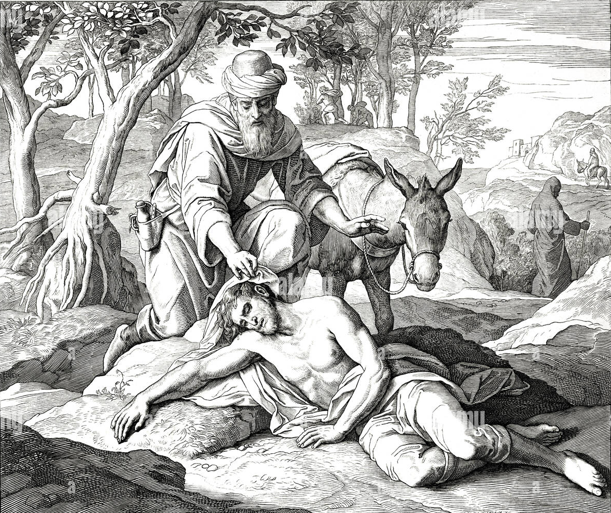
³⁰ In reply Jesus said: “A man was going down from Jerusalem to Jericho, when he was attacked by robbers. They stripped him of his clothes, beat him and went away, leaving him half dead. ³¹ A priest happened to be going down the same road, and when he saw the man, he passed by on the other side. ³² So too, a Levite, when he came to the place and saw him, passed by on the other side.
the parable of the good samaritan in luke 18

Slide 12
³³ But a Samaritan, as he traveled, came where the man was; and when he saw him, he took pity on him. ³⁴ He went to him and bandaged his wounds, pouring on oil and wine. Then he put the man on his own donkey, brought him to an inn and took care of him. ³⁵ The next day he took out two denarii and gave them to the innkeeper. ‘Look after him,’ he said, ‘and when I return, I will reimburse you for any extra expense you may have.’
the parable of the good samaritan in luke 18

Slide 13
³⁶ “Which of these three do you think was a neighbor to the man who fell into the hands of robbers?”
³⁷ The expert in the law replied, “The one who had mercy on him.”
Jesus told him, “Go and do likewise.”
the parable of the good samaritan in luke 18

Slide 14
³³ But a Samaritan, as he traveled, came where the man was; and when he saw him, he took pity on him. ³⁴ He went to him and bandaged his wounds, pouring on oil and wine. Then he put the man on his own donkey, brought him to an inn and took care of him. ³⁵ The next day he took out two denarii and gave them to the innkeeper. ‘Look after him,’ he said, ‘and when I return, I will reimburse you for any extra expense you may have.’
the parable of the good samaritan in luke 18

Slide 15
“The Lord is gracious and full of compassion, slow to anger and great in mercy. The Lord is good to all, and His tender mercies are over all His works.”
psalm 145:8-9

Slide 16
¹⁷ You say, ‘I am rich; I have acquired wealth and do not need a thing.’ But you do not realize that you are wretched, pitiful, poor, blind and naked.
revelation 3:17

Slide 17
¹ And you were dead in the trespasses and sins ² in which you once walked, following the course of this world, following the prince of the power of the air…^{3b}carrying out the desires of the body and the mind, and were by nature children of wrath, like the rest of mankind. ⁴ But God, being rich in mercy, because of the great love with which he loved us, ⁵ even when we were dead in our trespasses, made us alive together with Christ—
ephesians 2:1-7

Slide 18
by grace you have been saved—⁶and raised us up with him and seated us with him in the heavenly places in Christ Jesus, ⁷so that in the coming ages he might show the immeasurable riches of his grace in kindness toward us in Christ Jesus.”
ephesians 2:1-7

Slide 19
¹ And you were dead in the trespasses and sins ² in which you once walked, following the course of this world, following the prince of the power of the air…^{3b}carrying out the desires of the body and the mind, and were by nature children of wrath, like the rest of mankind. ⁴ But God, being rich in mercy, because of the great love with which he loved us, ⁵ even when we were dead in our trespasses, made us alive together with Christ—
ephesians 2:1-7

Slide 20
“Praise be to the God and Father of our Lord Jesus Christ! In his great mercy he has given us new birth into a living hope through the resurrection of Jesus Christ from the dead.”
1 peter 1:3

Slide 21
EXPERIENCE GOD’S MERCY TOWARD YOU.
First time
Remember
ACT MERCIFULLY.
Toward yourself
Toward others
applications

Slide 22
are the merciful
for they will be shown mercy

