Slide 2
RELATIONSHIPS OVER STUFF

Slide 3
LUKE 12:13-21, NIV
¹³ Someone in the crowd said to him, “Teacher, tell my brother to divide the inheritance with me.”

Slide 4
LUKE 12:13-21, NIV
¹³ Someone in the crowd said to him, “Teacher, tell my brother to divide the inheritance with me.”
¹⁴ Jesus replied, “Man, who appointed me a judge or an arbiter between you?” ¹⁵ Then he said to them, “Watch out! Be on your guard against all kinds of greed; life does not consist in an abundance of possessions.”

Slide 5
LUKE 12:13-21, NIV
¹³ Someone in the crowd said to him, “Teacher, tell my brother to divide the inheritance with me.”
¹⁴ Jesus replied, “Man, who appointed me a judge or an arbiter between you?” ¹⁵ Then he said to them, “Watch out! Be on your guard against all kinds of greed; life does not consist in an abundance of possessions.”
^{16a} And he told them this parable:

Slide 6
LUKE 12:13-21, NIV
^{16b} “The ground of a certain rich man yielded an abundant harvest. ¹⁷ He thought to himself, ‘What shall I do? I have no place to store my crops.’

Slide 7
LUKE 12:13-21, NIV
^{16b} “The ground of a certain rich man yielded an abundant harvest. ¹⁷ He thought to himself, ‘What shall I do? I have no place to store my crops.’
¹⁸ Then he said, “This what I’ll do. I’ll give away my excess to feed the poor. In fact, I’ll establish a work program to provide jobs for my community here on my farm. I’ll mentor these workers and leave my community better than I found it. ¹⁹ Eventually I’ll hand over my estate to a benevolent heir to carry on this tradition of generosity. I’ll breathe my last breath, satisfied with the legacy I’ve left behind and I’ll go home to my Creator!”

Slide 8
LUKE 12:13-21, NIV
^{16b} “The ground of a certain rich man yielded an abundant harvest. ¹⁷ He thought to himself, ‘What shall I do? I have no place to store my crops.’
¹⁸ Then he said, ‘This is what I’ll do. I will tear down my barns and build bigger ones, and there I will store my surplus grain. ¹⁹ And I’ll say to myself, “You have plenty of grain laid up for many years. Take life easy; eat, drink and be merry.”’

Slide 9
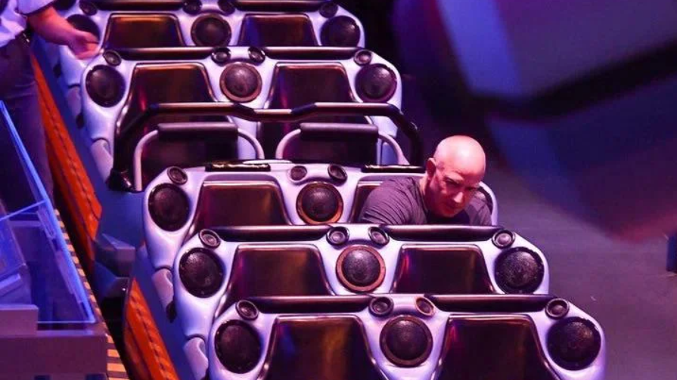

Slide 10
LUKE 12:13-21, NIV
^{16b} “The ground of a certain rich man yielded an abundant harvest. ¹⁷ He thought to himself, ‘What shall I do? I have no place to store my crops.’
¹⁸ Then he said, ‘This is what I’ll do. I will tear down my barns and build bigger ones, and there I will store my surplus grain. ¹⁹ And I’ll say to myself, “You have plenty of grain laid up for many years. Take life easy; eat, drink and be merry.”’
²⁰ But God said to him, ‘You fool! This very night your life will be demanded from you. Then who will get what you have prepared for yourself?’

Slide 11
RESPONSE & ACTION
Don’t worry

Slide 12
RESPONSE & ACTION
Don’t worry
²² Then Jesus said to his disciples: “Therefore I tell you, do not worry about your life, what you will eat; or about your body, what you will wear. ²³ For life is more than food, and the body more than clothes.” Luke 12:22-23

Slide 13
RESPONSE & ACTION
Don’t worry
Consider

Slide 14
RESPONSE & ACTION
Don’t worry
Consider
²⁴ “Consider the ravens: They do not sow or reap, they have no storeroom or barn; yet God feeds them. And how much more valuable you are than birds! ²⁵ Who of you by worrying can add a single hour to your life? ²⁶ Since you cannot do this very little thing, why do you worry about the rest?” Luke 12:24-26

Slide 15
RESPONSE & ACTION
Don’t worry
Consider
²⁷ “Consider how the wild flowers grow. They do not labor or spin. Yet I tell you, not even Solomon in all his splendor was dressed like one of these. ²⁸ If that is how God clothes the grass of the field, which is here today, and tomorrow is thrown into the fire, how much more will he clothe you—you of little faith!” Luke 12:27-28

Slide 16
RESPONSE & ACTION
Don’t worry
Consider
Check your heart, then set your heart

Slide 17
RESPONSE & ACTION
Don’t worry
Consider
Check your heart, then set your heart
²⁹ “And do not set your heart on what you will eat or drink; do not worry about it. ³⁰ For the pagan world runs after all such things, and your Father knows that you need them. ³¹ But seek his kingdom, and these things will be given to you as well. ³² Do not be afraid, little flock, for your Father has been pleased to give you the kingdom.” Luke 12:29-32

Slide 18
RESPONSE & ACTION
Don’t worry
Consider
Check your heart, then set your heart
Invest your treasure & your heart will follow

Slide 19
RESPONSE & ACTION
Don’t worry
Consider
Check your heart, then set your heart
Invest your treasure & your heart will follow
³³ “Sell your possessions and give to the poor. Provide purses for yourselves that will not wear out, a treasure in heaven that will never fail, where no thief comes near and no moth destroys. ³⁴ For where your treasure is, there your heart will be also.” Luke 12:29-31

Slide 20
The Science of Generosity, A white paper prepared for the John Templeton Foundation by the Greater Good Science Center at UC Berkeley (May 2018)
…a host of studies have uncovered evidence that humans are biologically wired for generosity. Acting generously activates the same reward pathway that is activated by sex and food, a correlation that may help to explain why giving and helping feel good…

Slide 21
The Science of Generosity, A white paper prepared for the John Templeton Foundation by the Greater Good Science Center at UC Berkeley (May 2018)
Further evidence of the deep roots of human generosity comes from studies finding consistent displays of generosity among young children— even young toddlers. Multiple studies have shown that children appear to have an innate drive to cooperate and to help others, but that this drive is tempered as children grow older and their giving behavior becomes more selective and nuanced.

Slide 22
The Science of Generosity, A white paper prepared for the John Templeton Foundation by the Greater Good Science Center at UC Berkeley (May 2018)
Further evidence of the deep roots of human generosity comes from studies finding consistent displays of generosity among young children— even young toddlers. Multiple studies have shown that children appear to have an innate drive to cooperate and to help others, but that this drive is tempered as children grow older and their giving behavior becomes more selective and nuanced.
“…remembering the words the Lord Jesus himself said: ‘It is more blessed to give than to receive.’”
Acts 20:35b

Slide 23
REFLECT & REPENT
What relationship can you prioritize over your stuff or your to do list today?
What experiment of generosity can you run this week to test Jesus’ words that it is happier to give than to receive?
What legacy will you leave behind?

Slide 24
RELATIONSHIPS OVER STUFF

