Slide 1
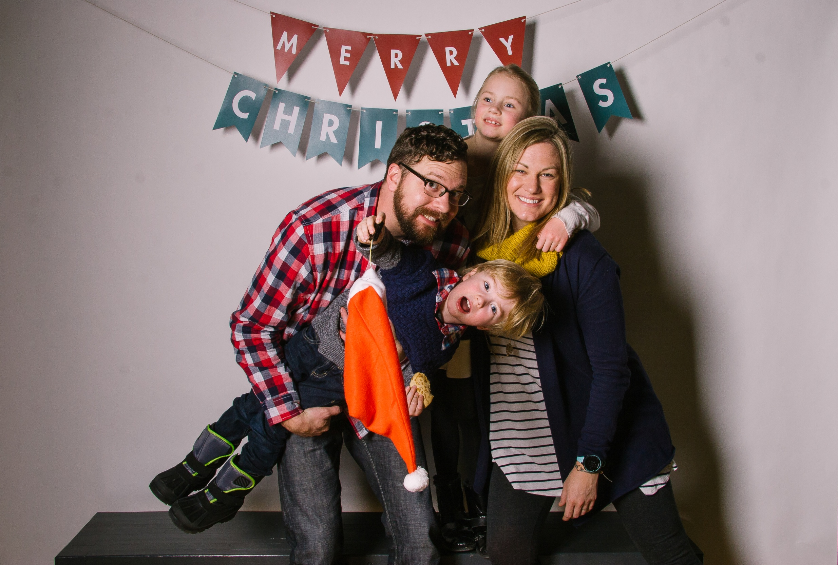

Slide 2
It’s beginning to look a lot like Christmas…

Slide 3
It’s beginning to look a lot like Christmas…storage!!!

Slide 4
America Has More Self-Storage Facilities Than McDonald’s, Because Apparently We’re All Hoarders From the Huffington Post on April 21, 2015

Slide 5
Minimalism: A Documentary About The Important Things (2015)

Slide 6
2 Corinthians 8:1-6
¹ We want you to know, brothers, about the grace of God that has been given among the churches of Macedonia, ² for in a severe test of affliction, their abundance of joy and their extreme poverty have overflowed in a wealth of generosity on their part. ³ For they gave according to their means, as I can testify, and beyond their means, of their own accord,⁴ begging us earnestly for the favor of taking part in the relief of the saints— ⁵ and this, not as we expected, but they gave themselves first to the Lord and then by the will of God to us. ⁶ Accordingly, we urged Titus that as he had started, so he should complete among you this act of grace.

Slide 7
2 Corinthians 8:7-9
⁷ But as you excel in everything—in faith, in speech, in knowledge, in all earnestness, and in our love for you—see that you excel in this act of grace also. ⁸ I say this not as a command, but to prove by the earnestness of others that your love also is genuine. ⁹ For you know the grace of our Lord Jesus Christ, that though he was rich, yet for your sake he became poor, so that you by his poverty might become rich.

Slide 8
2 Corinthians 8:1-6
¹ We want you to know, brothers, about the grace of God that has been given among the churches of Macedonia, ² for in a severe test of affliction, their abundance of joy and their extreme poverty have overflowed in a wealth of generosity on their part. ³ For they gave according to their means, as I can testify, and beyond their means, of their own accord,⁴ begging us earnestly for the favor of taking part in the relief of the saints— ⁵ and this, not as we expected, but they gave themselves first to the Lord and then by the will of God to us. ⁶ Accordingly, we urged Titus that as he had started, so he should complete among you this act of grace.

Slide 9
The Macedonian Formula
the grace of God
a severe test of affliction
their abundance of joy
+ their extreme poverty

Slide 10
The Macedonian Formula
the grace of God
a severe test of affliction
their abundance of joy
+ their extreme poverty
a wealth of generosity on their part

Slide 11
Am I rich?

Slide 12
Am I rich?
If you made $1500 last year, you’re in the top 20% of the world’s income earners.**
If you have sufficient food, decent clothes, live in a house or apartment, and have a reasonably reliable means of transportation, you are among the top 15% of the world’s wealthy. **
If you earn $25,000 or more annually, you are in the top 10% of the world’s income-earners.***
If you have any money saved, a hobby that requires some equipment or supplies, a variety of clothes in your closet, two cars (in any condition), and live in your own home, you are in the top 5% of the world’s wealthy. **
If you earn more than $50,000 annually, you are in the top 1% of the world’s income earners.***
*MSN Money
**Money Possessions & Eternity by Randy Alcorn, pg. 291
***The Hole in our Gospel by Richard Stearns, pg. 216

Slide 13
What about our poor?

Slide 14
What about our poor?
In America a couple who earns less than $14,710 per year in 2012 will be considered below the poverty line, however they will still be wealthy enough to be in the top 10% of the wealthiest on earth.
According to the World Health Organization, 1.1 billion people worldwide lack access to clean water—that’s approximately one in six people on earth. None of these people are Americans.
Today, of Americans officially designated as 'poor,' 99 percent have electricity, running water, flush toilets, and a refrigerator; 95 percent have a television, 88 percent a telephone, 71 percent a car, and 70 percent air conditioning.

Slide 15
Ok, but we’re generous, right?

Slide 16
Ok, but we’re generous, right?
More than one out of four American Protestants give away no money at all—"not even a token $5 per year,"
The median annual giving for an American Christian is actually $200, just over half a percent of after-tax income. About 5 percent of American Christians provide 60 percent of the money churches and religious groups use to operate. (It's these people who skew the average.) "A small group of truly generous Christian givers are essentially 'covering' for the vast majority of Christians who give nothing or quite little.“
"Americans who earn less than $10,000 gave 2.3 percent of their income to religious organizations whereas those who earn $70,000 or more gave only 1.2 percent.“
Passing the Plate: Why American Christians Don’t Give Away More Money by Christian Smith, Michael Emerson, and Patricia Snell (2008)

Slide 17
Ok, ok, but we at New Hope are generous, right?

Slide 18
Ok, ok, but we at New Hope are generous, right?
$50,354 (median income for MHK)
X 162 (giving units in 2017 NH Directory)
$8,157,348

Slide 19
The Gospel Circles

Slide 20
The Gospel Circles
The Gospel

Slide 21
The Gospel Circles
The Gospel
Gospel Truth

Slide 22
The Gospel Circles
The Gospel
Gospel Truth
Gospel Conduct

Slide 23
Gospel Circles
^{2 Cor 8:7} But as you excel in everything—in faith, in speech, in knowledge, in all earnestness, and in our love for you—see that you excel in this act of grace also. ⁸ I say this not as a command, but to prove by the earnestness of others that your love also is genuine. ⁹ For you know the grace of our Lord Jesus Christ, that though he was rich, yet for your sake he became poor, so that you by his poverty might become rich.

Slide 24
The Gospel
^{2 Cor 8:7} But as you excel in everything—in faith, in speech, in knowledge, in all earnestness, and in our love for you—see that you excel in this act of grace also. ⁸ I say this not as a command, but to prove by the earnestness of others that your love also is genuine. ⁹ For you know the grace of our Lord Jesus Christ, that though he was rich, yet for your sake he became poor, so that you by his poverty might become rich.

Slide 25
Gospel Truth
^{2 Cor 8:7} But as you excel in everything—in faith, in speech, in knowledge, in all earnestness, and in our love for you—see that you excel in this act of grace also. ⁸ I say this not as a command, but to prove by the earnestness of others that your love also is genuine. ⁹ For you know the grace of our Lord Jesus Christ, that though he was rich, yet for your sake he became poor, so that you by his poverty might become rich.

Slide 26
Gospel Conduct
^{2 Cor 8:7} But as you excel in everything—in faith, in speech, in knowledge, in all earnestness, and in our love for you—see that you excel in this act of grace also. ⁸ I say this not as a command, but to prove by the earnestness of others that your love also is genuine. ⁹ For you know the grace of our Lord Jesus Christ, that though he was rich, yet for your sake he became poor, so that you by his poverty might become rich.

Slide 27
Gospel Conduct
^{2 Cor 8:7} But as you excel in everything—in faith, in speech, in knowledge, in all earnestness, and in our love for you—see that you excel in this act of grace also. ⁸ I say this not as a command, but to prove by the earnestness of others that your love also is genuine. ⁹ For you know the grace of our Lord Jesus Christ, that though he was rich, yet for your sake he became poor, so that you by his poverty might become rich.
vs. 2…wealth of generosity…

Slide 28
1. Give Sacrificially!
^{2 Cor 8:1} We want you to know, brothers, about the grace of God that has been given among the churches of Macedonia, ² for in a severe test of affliction, their abundance of joy and their extreme poverty have overflowed in a wealth of generosity on their part. ³ For they gave according to their means, as I can testify, and beyond their means, of their own accord,⁴ begging us earnestly for the favor of taking part in the relief of the saints— ⁵ and this, not as we expected, but they gave themselves first to the Lord and then by the will of God to us. ⁶ Accordingly, we urged Titus that as he had started, so he should complete among you this act of grace.

Slide 29
2. Give Deliberately!
^{2 Cor 9:5} So I thought it necessary to urge the brothers to go on ahead to you and arrange in advance for the gift you have promised, so that it may be ready as a willing gift, not as an exaction. ⁶ The point is this: whoever sows sparingly will also reap sparingly, and whoever sows bountifully will also reap bountifully. ⁷ Each one must give as he has decided in his heart, not reluctantly or under compulsion, for God loves a cheerful giver.

Slide 30
2. Give Deliberately!
^{1 Cor 16:1} Now concerning the collection for the saints: as I directed the churches of Galatia, so you also are to do. ² On the first day of every week, each of you is to put something aside and store it up, as he may prosper, so that there will be no collecting when I come. ³ And when I arrive, I will send those whom you accredit by letter to carry your gift to Jerusalem.

Slide 31
Tackling our 2017 budget together!

Slide 32
Tackling our 2017 budget together!
$392,000 (2017 budget)
—$350,700 (Income NH received in 2016)
$41,000 (more needed this year compared to giving last year)

Slide 33
Tackling our 2017 budget together!
$392,000 (2017 budget)
—$350,700 (Income NH received in 2016)
$41,000 (more needed this year compared to giving last year)
$41,000/162 (giving units) = $255/year/unit

Slide 34
Tackling our 2017 budget together!
$392,000 (2017 budget)
—$350,700 (Income NH received in 2016)
$41,000 (more needed this year compared to giving last year)
$41,000/162 (giving units) = $255/year/unit
$255/12 = $21.25/month/unit

Slide 35
2. Give Cheerfully!
^{2 Cor 9:5} So I thought it necessary to urge the brothers to go on ahead to you and arrange in advance for the gift you have promised, so that it may be ready as a willing gift, not as an exaction. ⁶ The point is this: whoever sows sparingly will also reap sparingly, and whoever sows bountifully will also reap bountifully. ⁷ Each one must give as he has decided in his heart, not reluctantly or under compulsion, for God loves a cheerful giver.

Slide 36
2. Give Cheerfully!
^{2 Cor 9:5} So I thought it necessary to urge the brothers to go on ahead to you and arrange in advance for the gift you have promised, so that it may be ready as a willing gift, not as an exaction. ⁶ The point is this: whoever sows sparingly will also reap sparingly, and whoever sows bountifully will also reap bountifully. ⁷ Each one must give as he has decided in his heart, not reluctantly or under compulsion, for God loves a cheerful giver.
Not Malachi 3:8-9 motivation!

Slide 37
2. Give Cheerfully!
^{2 Cor 9:5} So I thought it necessary to urge the brothers to go on ahead to you and arrange in advance for the gift you have promised, so that it may be ready as a willing gift, not as an exaction. ⁶ The point is this: whoever sows sparingly will also reap sparingly, and whoever sows bountifully will also reap bountifully. ⁷ Each one must give as he has decided in his heart, not reluctantly or under compulsion, for God loves a cheerful giver.
^{Matt 6:21} “Where your treasure is, there your heart will be also.”

Slide 38
What we do with our money doesn’t simply indicate where our heart is. According to Jesus, it determines where our heart goes. This is an amazing and exciting truth. If I want my heart to be in one particular place and not in another, then I need to put my money in that place and not in the other. I’ve heard people say, “I want more of a heart for missions.” I always respond, “Jesus tells you exactly how to get it. Put your money in missions, and your heart will follow.”

Slide 39
What’s my scary step of faith?

Slide 40
What’s my scary step of faith?
Go from giving 0% to $25/month. Great baby step!

Slide 41
What’s my scary step of faith?
Go from giving 0% to $25/month. Great baby step!
Go from giving 10% to 15% or 20%. Perhaps a bit more scary!

Slide 42
What’s my scary step of faith?
Go from giving 0% to $25/month. Great baby step!
Go from giving 10% to 15% or 20%. Perhaps a bit more scary!
Pick up Money, Possession, and Eternity by Randy Alcorn.

Slide 43
What’s my scary step of faith?
Go from giving 0% to $25/month. Great baby step!
Go from giving 10% to 15% or 20%. Perhaps a bit more scary!
Pick up Money, Possession, and Eternity by Randy Alcorn.
Take our Kingdom Stewardship class.

Slide 44
What’s my scary step of faith?
Go from giving 0% to $25/month. Great baby step!
Go from giving 10% to 15% or 20%. Perhaps a bit more scary!
Pick up Money, Possession, and Eternity by Randy Alcorn.
Take our Kingdom Stewardship class.
How is God leading you?

Slide 45
Questions to ask Jesus.
What does my standard of giving indicate about my experience/understanding of the grace of God?
Is the fact that You’ve entrusted me with so many resources an indication that you have given me the gift of giving and want me to learn to exercise it more frequently and skillfully?
Do You want me to set a basic level of income and assets to live on, then give away whatever you provide beyond that (regardless of whether that’s 50%, 90%, or more)?

Slide 46
2 Corinthians 8:7-9
⁷ But as you excel in everything—in faith, in speech, in knowledge, in all earnestness, and in our love for you—see that you excel in this act of grace also. ⁸ I say this not as a command, but to prove by the earnestness of others that your love also is genuine. ⁹ For you know the grace of our Lord Jesus Christ, that though he was rich, yet for your sake he became poor, so that you by his poverty might become rich.

