Slide 1
RADICAL JESUS

Slide 3
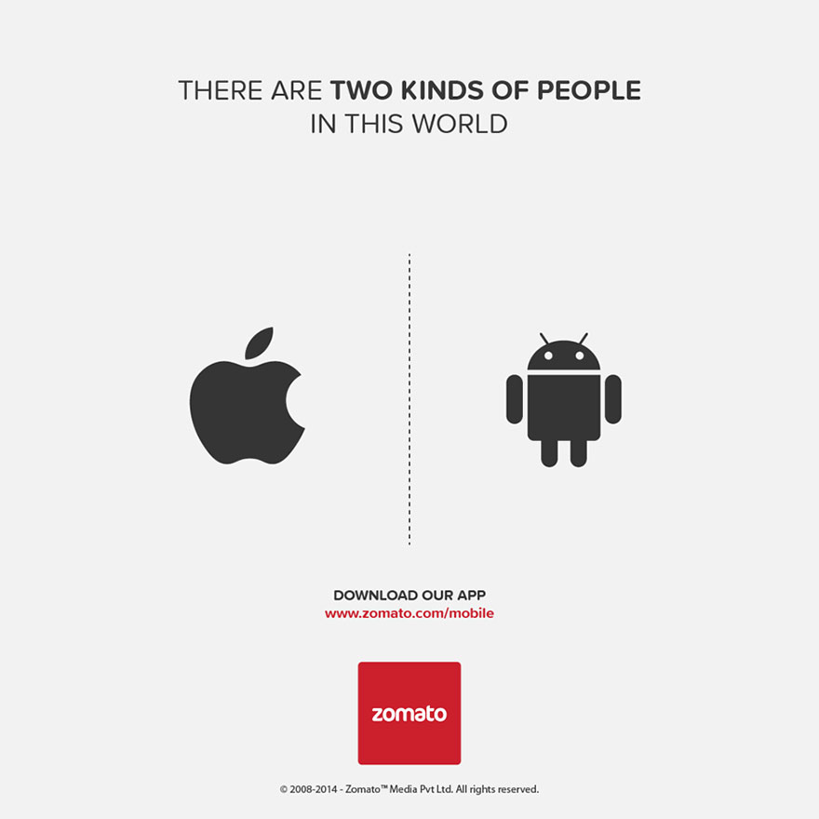

Slide 4
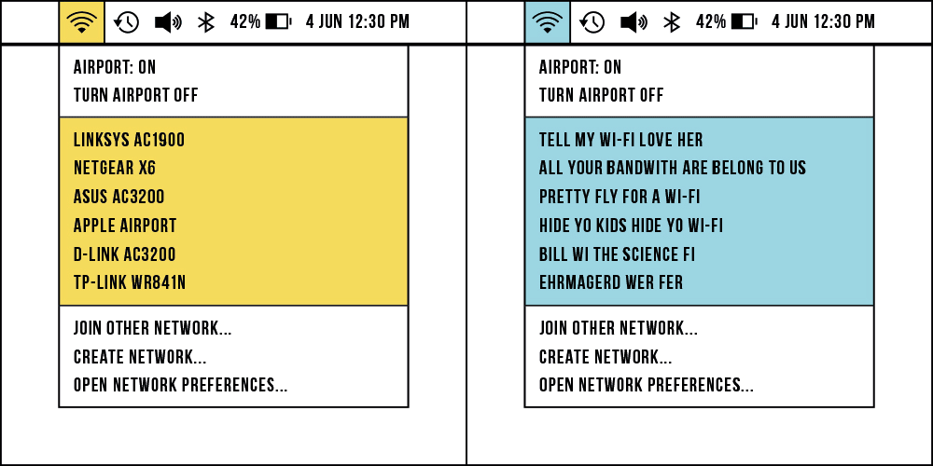

Slide 10
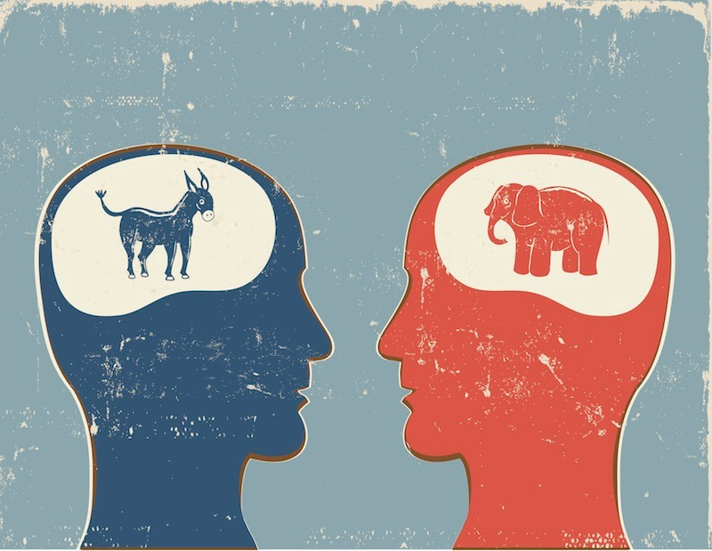

Slide 11
ALGORITHMS DIVIDE USERS
“Our algorithms exploit the human brain’s attraction to divisiveness,” one slide from the presentation read. The group found that if this core element of its recommendation engine were left unchecked, it would continue to serve Facebook users “more and more divisive content in an effort to gain user attention & increase time on the platform.”
FROM THE VERGE, 5/26/20

Slide 12
RADICAL JESUS

Slide 13
TO THE ROOT

Slide 14
TO THE ROOT
The grass withers, the flower fades, but the word of our God will stand forever.
ISAIAH 40:8

Slide 15
WORKING ACROSS FACTIONS
KANSAS LEADERSHIP CENTER

Slide 16
WORKING ACROSS FACTIONS
Focus on building trust first.
KANSAS LEADERSHIP CENTER

Slide 17
WORKING ACROSS FACTIONS
Focus on building trust first.
Identify overlapping interests and build off them, rather than focusing on disagreements.
KANSAS LEADERSHIP CENTER

Slide 18
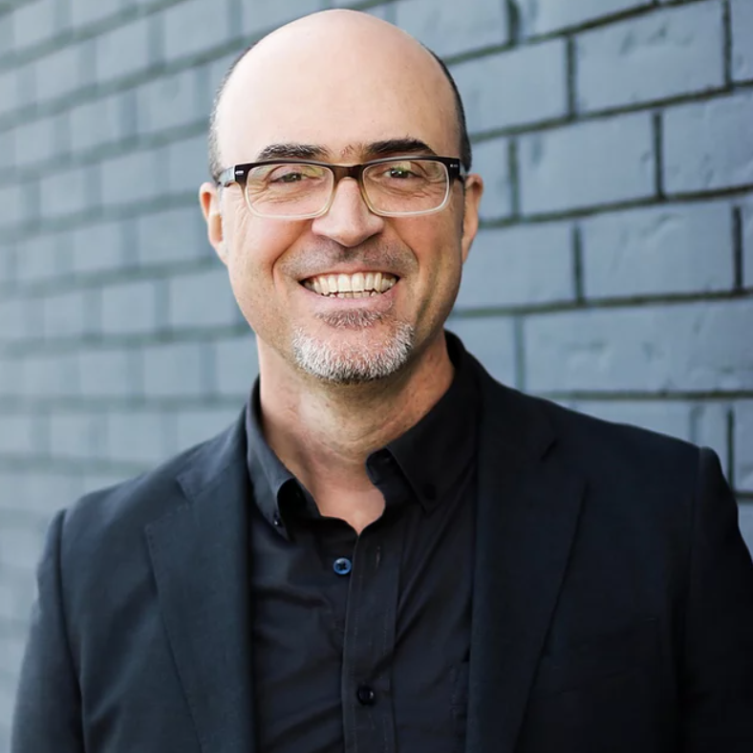
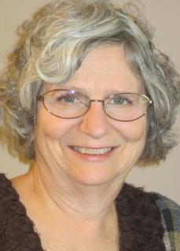
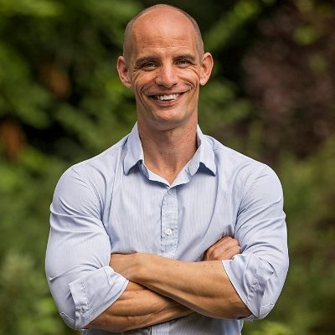
LOVE THE OTHER

Slide 19
WORKING ACROSS FACTIONS
Focus on building trust first.
Identify overlapping interests and build off them, rather than focusing on disagreements.
Have a mindset that you might not be right.
KANSAS LEADERSHIP CENTER

Slide 20
WORKING ACROSS FACTIONS
Focus on building trust first.
Identify overlapping interests and build off them, rather than focusing on disagreements.
Have a mindset that you might not be right.
Acknowledge loss the other factions might experience, rather than sugarcoating the situation.
KANSAS LEADERSHIP CENTER

Slide 21
WORKING ACROSS FACTIONS
Focus on building trust first.
Identify overlapping interests and build off them, rather than focusing on disagreements.
Have a mindset that you might not be right.
Acknowledge loss the other factions might experience, rather than sugarcoating the situation.
Ask questions.
KANSAS LEADERSHIP CENTER

Slide 22
WORKING ACROSS FACTIONS
Focus on building trust first.
Identify overlapping interests and build off them, rather than focusing on disagreements.
Have a mindset that you might not be right.
Acknowledge loss the other factions might experience, rather than sugarcoating the situation.
Ask questions.
Once you deeply understand where they are coming from, start with “Yes-Able” propositions.
KANSAS LEADERSHIP CENTER

Slide 23
WORKING ACROSS FACTIONS
Focus on building trust first.
Identify overlapping interests and build off them, rather than focusing on disagreements.
Have a mindset that you might not be right.
Acknowledge loss the other factions might experience, rather than sugarcoating the situation.
Ask questions.
Once you deeply understand where they are coming from, start with “Yes-Able” propositions.
Only after working hard to understand them, begin asking for their feedback on your opinions.
KANSAS LEADERSHIP CENTER

Slide 24
WORKING ACROSS FACTIONS
Focus on building trust first.
Identify overlapping interests and build off them, rather than focusing on disagreements.
Have a mindset that you might not be right.
Acknowledge loss the other factions might experience, rather than sugarcoating the situation.
Ask questions.
Once you deeply understand where they are coming from, start with “Yes-Able” propositions.
Only after working hard to understand them, begin asking for their feedback on your opinions.
Don’t see things as a zero sum game.
KANSAS LEADERSHIP CENTER

Slide 25
RULES OF ENGAGEMENT
Colossians 4:2, 5-6 ² Continue steadfastly in prayer, being watchful in it with thanksgiving. ⁵ Walk in wisdom toward outsiders, making the best use of the time. ⁶ Let your speech always be gracious, seasoned with salt, so that you may know how you ought to answer each person.
TO REPRESENT JESUS

Slide 26
RULES OF ENGAGEMENT
Colossians 4:2, 5-6 ² Continue steadfastly in prayer, being watchful in it with thanksgiving. ⁵ Walk in wisdom toward outsiders, making the best use of the time. ⁶ Let your speech always be gracious, seasoned with salt, so that you may know how you ought to answer each person.
1 Peter 3:15 …but in your hearts honor Christ the Lord as holy, always being prepared to make a defense to anyone who asks you for a reason for the hope that is in you; yet do it with gentleness and respect…
TO REPRESENT JESUS

Slide 27
RULES OF ENGAGEMENT
Colossians 4:2, 5-6 ² Continue steadfastly in prayer, being watchful in it with thanksgiving. ⁵ Walk in wisdom toward outsiders, making the best use of the time. ⁶ Let your speech always be gracious, seasoned with salt, so that you may know how you ought to answer each person.
1 Peter 3:15 …but in your hearts honor Christ the Lord as holy, always being prepared to make a defense to anyone who asks you for a reason for the hope that is in you; yet do it with gentleness and respect…
1 Corinthians 13:2b And if I have… all knowledge, but have not love, I am nothing.
TO REPRESENT JESUS

Slide 28
RADICAL JESUS

Slide 29
ˈræd ɪ kəl / [ rad-i-kuhl ]
adjective
of or going to the root or origin; fundamental
thoroughgoing or extreme, especially as regards change from accepted or traditional forms
favoring drastic political, economic, or social reforms: radical ideas; radical and anarchistic ideologues.
favoring, supporting, or representing extreme forms of religious fundamentalism: radical fundamentalists and their rejection of modern science.
forming a basis or foundation
radical

Slide 30
ˈræd ɪ kəl / [ rad-i-kuhl ]
adjective
existing inherently in a thing or person
Slang. excellent; wonderful; cool; rad: He's so sweet, so awesome, so radical!
Mathematics.
a) pertaining to or forming a root.
b) denoting or pertaining to the radical sign.
c) irrational.
Grammar. of or pertaining to the root of a word.
Botany. of or arising from the root or the base of the stem.
radical

Slide 31
RADICAL JESUS IS THE ROOT
There shall come forth a shoot from the stump of Jesse,
and a branch from his roots shall bear fruit.
ISAIAH 11:1

Slide 32
RADICAL JESUS IS THE ROOT
There shall come forth a shoot from the stump of Jesse,
and a branch from his roots shall bear fruit.
In that day the root of Jesse, who shall stand as a signal for the peoples—of him shall the nations inquire, and his resting place shall be glorious.
ISAIAH 11:1, 10

Slide 33
1 CORINTHIANS 15 CREED
³ For I delivered to you as of first importance what I also received: that Christ died for our sins in accordance with the Scriptures, ⁴ that he was buried, that he was raised on the third day in accordance with the Scriptures, ⁵ and that he appeared to Cephas, then to the twelve. ⁶ Then he appeared to more than five hundred brothers at one time, most of whom are still alive, though some have fallen asleep. ⁷ Then he appeared to James, then to all the apostles. ⁸ Last of all, as to one untimely born, he appeared also to me.
1 CORINTHIANS 15:3-8

Slide 34
TO THE ROOT
The grass withers, the flower fades, but the word of our God will stand forever.
ISAIAH 40:8

Slide 35
TO THE ROOT
I believe in God, the Father almighty,
creator of heaven and earth.
THE APOSTLES’ CREED

Slide 36
TO THE ROOT
I believe in Jesus Christ, his only Son, our Lord,
who was conceived by the Holy Spirit,
born of the Virgin Mary,
suffered under Pontius Pilate,
was crucified, died, and was buried;
THE APOSTLES’ CREED

Slide 37
TO THE ROOT
On the third day he rose again;
he ascended into heaven,
he is seated at the right hand of the Father,
and he will come to judge the living and the dead.
THE APOSTLES’ CREED

Slide 38
TO THE ROOT
I believe in the Holy Spirit,
the holy *catholic Church,
the communion of saints,
the forgiveness of sins,
the resurrection of the body,
and the life everlasting.
Amen.
*the whole church in all times and places
THE APOSTLES’ CREED

Slide 39
RADICAL JESUS

Slide 40
THE LORD’S SUPPER

