Slide 2
Tests of True Spirituality

Slide 3
1 JOHN 2:3a (ESV)
And by this we know that we have come to know him…

Slide 4
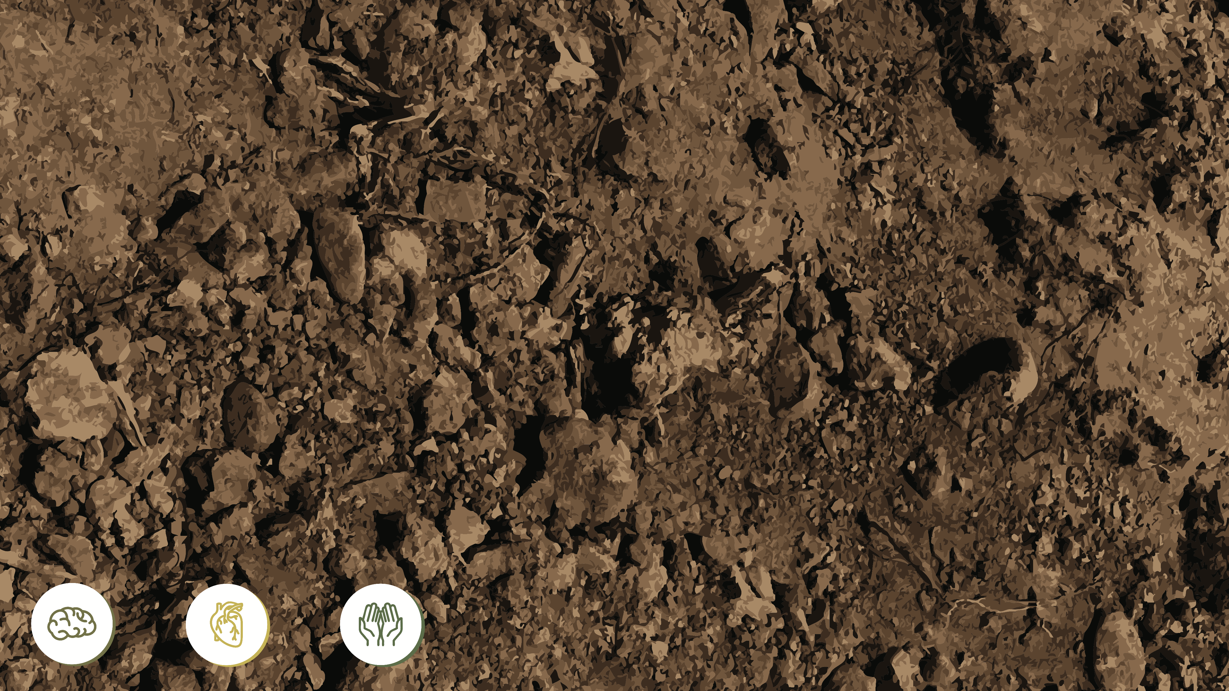
Three Tests of True Spirituality

Slide 5
Three Tests of True Spirituality
Theological Test—Do you believe Jesus is the Son of God and came in the flesh?

Slide 6
Three Tests of True Spirituality
Theological Test—Do you believe Jesus is the Son of God and came in the flesh?
Social Test—Do you love like Jesus?

Slide 7
Three Tests of True Spirituality
Theological Test—Do you believe Jesus is the Son of God and came in the flesh?
Social Test—Do you love like Jesus?
Ethical Test—Do you live like Jesus?

Slide 8
1 JOHN 2:3-6 (ESV)
³ And by this we know that we have come to know him,
if we keep his commandments. ⁴ Whoever says “I know him” but does not keep his commandments is a liar, and the truth is not in him, ⁵ but whoever keeps his word,
in him truly the love of God is perfected.
By this we may know that we are in him:
⁶ whoever says he abides in him
ought to walk in the same way in which he walked.

Slide 9
1 JOHN 2:3-6 (ESV)
³ And by this we know that we have come to know him,
if we keep his commandments. ⁴ Whoever says “I know him” but does not keep his commandments is a liar, and the truth is not in him, ⁵ but whoever keeps his word,
in him truly the love of God is perfected.
By this we may know that we are in him:
⁶ whoever says he abides in him
ought to walk in the same way in which he walked.
Jesus’ Sexual Ethics, Economic Ethics, Power Ethics

Slide 10
1 JOHN 2:7-8 (ESV)
⁷ Beloved, I am writing you no new commandment,
but an old commandment that you had from the beginning. The old commandment is the word that you have heard.
⁸ At the same time, it is a new commandment that I am writing to you, which is true in him and in you,
because the darkness is passing away
and the true light is already shining.

Slide 11
1 JOHN 2:9-11 (ESV)
⁹ Whoever says he is in the light
and hates his brother is still in darkness.
¹⁰ Whoever loves his brother abides in the light,
and in him there is no cause for stumbling.
¹¹ But whoever hates his brother
is in the darkness and walks in the darkness,
and does not know where he is going,
because the darkness has blinded his eyes.

Slide 12
The Way of Jesus

Slide 13
The Way of Jesus
Gnostics

Slide 14
The Way of Jesus
Gnostics
Judaizers

Slide 15
The Way of Jesus
Gnostics
Secret knowledge w/o obedience
Judaizers
Works-based righteousness

Slide 16
Three Tests of True Spirituality
Theological Test—Do you believe Jesus is the Son of God and came in the flesh?
Social Test—Do you love like Jesus?
Ethical Test—Do you live like Jesus?

Slide 17
1 JOHN 2:12-13a (ESV)
¹² I am writing to you, little children,
because your sins are forgiven for his name's sake.
^{13a} I am writing to you, fathers,
because you know him who is from the beginning.
I am writing to you, young men,
because you have overcome the evil one.

Slide 18
1 JOHN 2:13b-14 (ESV)
^{13b} I write to you, children,
because you know the Father.
¹⁴ I write to you, fathers,
because you know him who is from the beginning.
I write to you, young men,
because you are strong,
and the word of God abides in you,
and you have overcome the evil one.

