Slide 1
WELCOME
yall!

Slide 2
WELCOME TO SPRING! AND TALLGRASS CHURCH’S CENTRAL GATHERING IN BOYS & GIRLS CLUB!

Slide 3
A SPECIAL CHURCHWIDE SUMMER BOOK STUDY
Tuesday evenings 6:30-7:30pm starting May 18
Long’s Park, kids can play.
You’re invited!
Get the book and read along or just come and audit.

Slide 5
“I am…” in John
“I am the bread of life.” (6:35, 41, 48, 51)
“I am the light of the world.” (8:12)
“I am the door of the sheep.” (10:7,9)
“I am the resurrection and the life.” (11:25)
“I am the good shepherd.” (10:11, 14)
“I am the way, the truth, and the life.” (14:6)

Slide 6
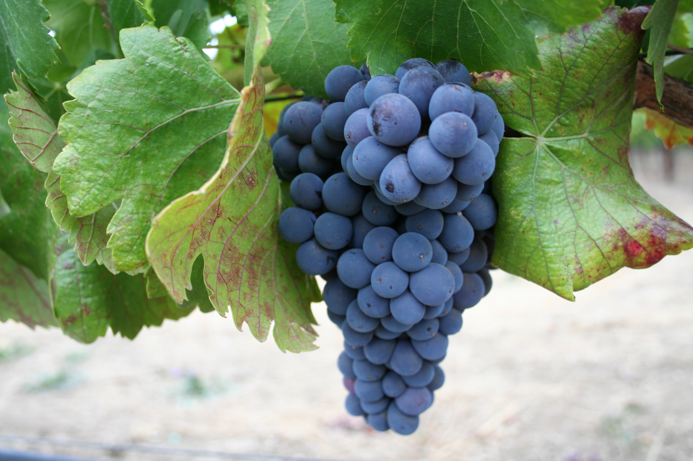
I am the true vine…
John 15:1a

Slide 7
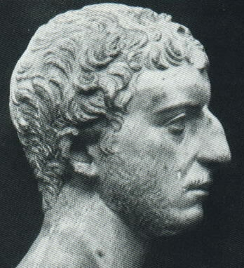
Jewish War
By Josephus
“The gate opening into the building was, as I said, completely overlaid with gold, as was the whole wall around it. It had, moreover, above it those golden vines, from which depended grape-clusters as tall as a man.” –v.210-212

Slide 8
Israel as a Vine
Thus says the LORD of hosts: “They shall glean thoroughly as a vine the remnant of Israel; like a grape gatherer pass your hand again over its branches.” How then have you turned degenerate and become a wild vine? Jeremiah 6:9
See Psalm 80; Isaiah 5:7; Jeremiah 2:21; 6:9; Ezekiel 17:6-8; 19:10-14; Hosea 10:1-4

Slide 9
Abide in The Vine
“I am the true vine, and my Father is the vinedresser. ² Every branch in me that does not bear fruit he takes away, and every branch that does bear fruit he prunes, that it may bear more fruit. ³ Already you are clean because of the word that I have spoken to you. ⁴ Abide in me, and I in you. As the branch cannot bear fruit by itself, unless it abides in the vine, neither can you, unless you abide in me. ⁵ I am the vine; you are the branches. Whoever abides in me and I in him, he it is that bears much fruit, for apart from me you can do nothing.” John 15:1-5

Slide 10
Pruning is Painful
“I am the true vine, and my Father is the vinedresser. ² Every branch in me that does not bear fruit he takes away, and every branch that does bear fruit he prunes, that it may bear more fruit. ³ Already you are clean because of the word that I have spoken to you.” John 15:1-3

Slide 11
Pruning is Painful
“I am the true vine, and my Father is the vinedresser. ² Every branch in me that does not bear fruit he takes away, and every branch that does bear fruit he prunes, that it may bear more fruit. ³ Already you are clean because of the word that I have spoken to you.” John 15:1-3

Slide 12
Pruning is Painful
“I am the true vine, and my Father is the vinedresser. ² Every branch in me that does not bear fruit he takes away, and every branch that does bear fruit he prunes, that it may bear more fruit. ³ Already you are clean because of the word that I have spoken to you.” John 15:1-3
For he knew who was to betray him; that was why he said, “Not all of you are clean.” John 13:11

Slide 13
Pruning is Painful
“I am the true vine, and my Father is the vinedresser. ² Every branch in me that does not bear fruit he takes away, and every branch that does bear fruit he prunes, that it may bear more fruit. ³ Already you are clean because of the word that I have spoken to you.” John 15:1-3
If anyone does not abide in me he is thrown away like a branch and withers; and the branches are gathered, thrown into the fire, and burned. John 15:6

Slide 14
Pruning is Painful
“I am the true vine, and my Father is the vinedresser. ² Every branch in me that does not bear fruit he lifts up, and every branch that does bear fruit he prunes, that it may bear more fruit. ³ Already you are clean because of the word that I have spoken to you.” John 15:1-3

Slide 15
Pruning is Painful
“I am the true vine, and my Father is the vinedresser. ² Every branch in me that does not bear fruit he takes up, and every branch that does bear fruit he prunes, that it may bear more fruit. ³ Already you are clean because of the word that I have spoken to you.” John 15:1-3
Take my yoke upon you… Matthew 11:29

Slide 16
Pruning is Painful
“I am the true vine, and my Father is the vinedresser. ² Every branch in me that does not bear fruit he takes away, and every branch that does bear fruit he prunes, that it may bear more fruit. ³ Already you are clean because of the word that I have spoken to you.” John 15:1-3

Slide 17
Pruning is Painful
“I am the true vine, and my Father is the vinedresser. ² Every branch in me that does not bear fruit he takes away, and every branch that does bear fruit he prunes, that it may bear more fruit. ³ Already you are clean because of the word that I have spoken to you.” John 15:1-3
For the moment all discipline seems painful rather than pleasant, but later it yields the peaceful fruit of righteousness to those who have been trained by it. Hebrews 12:11

Slide 18
Abide, Not Strive
⁴ “Abide in me, and I in you. As the branch cannot bear fruit by itself, unless it abides in the vine, neither can you, unless you abide in me. ⁵ I am the vine; you are the branches. Whoever abides in me and I in him, he it is that bears much fruit, for apart from me you can do nothing.” John 15:4-5

Slide 19
Abide, Not Strive
⁴ “Abide in me, and I in you. As the branch cannot bear fruit by itself, unless it abides in the vine, neither can you, unless you abide in me. ⁵ I am the vine; you are the branches. Whoever abides in me and I in him, he it is that bears much fruit, for apart from me you can do nothing.” John 15:4-5
As the Father has loved me, so have I loved you. Abide in my love. John 15:9

Slide 20
Abide, Not Strive
⁴ “Abide in me, and I in you. As the branch cannot bear fruit by itself, unless it abides in the vine, neither can you, unless you abide in me. ⁵ I am the vine; you are the branches. Whoever abides in me and I in him, he it is that bears much fruit, for apart from me you can do nothing.” John 15:4-5
These things I have spoken to you, that my joy may be in you, and that your joy may be full. John 15:11

Slide 21
^{The} True Vine
By Andrew Murray
“The branch is a perfect likeness of the vine; the only difference is, the one is great and strong, and the source of strength, the other little and feeble, ever needing and receiving strength. Even so the believer is, and is to be, the perfect likeness of Christ. What a life would come to us if we only consented to be branches! Dear child of God, learn the lesson.“

Slide 22
^{The} Focus is ^{the} Fruit
⁴ “Abide in me, and I in you. As the branch cannot bear fruit by itself, unless it abides in the vine, neither can you, unless you abide in me. ⁵ I am the vine; you are the branches. Whoever abides in me and I in him, he it is that bears much fruit, for apart from me you can do nothing.” John 15:1-5

Slide 23
^{The} Focus is ^{the} Fruit
⁴ “Abide in me, and I in you. As the branch cannot bear fruit by itself, unless it abides in the vine, neither can you, unless you abide in me. ⁵ I am the vine; you are the branches. Whoever abides in me and I in him, he it is that bears much fruit, for apart from me you can do nothing.” John 15:1-5
By this my Father is glorified, that you bear much fruit and so prove to be my disciples. John 15:8

Slide 24
^{The} Focus is ^{the} Fruit
⁴ “Abide in me, and I in you. As the branch cannot bear fruit by itself, unless it abides in the vine, neither can you, unless you abide in me. ⁵ I am the vine; you are the branches. Whoever abides in me and I in him, he it is that bears much fruit, for apart from me you can do nothing.” John 15:1-5
Truly, truly, I say to you, unless a grain of wheat falls into the earth and dies, it remains alone; but if it dies, it bears much fruit. John 12:24

Slide 25
I am the true vine…
John 15:1a

Slide 26
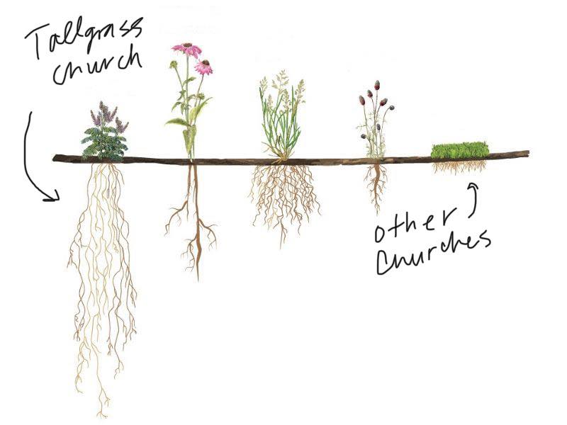

Slide 28
The vision of Tallgrass Church is to have roots in every neighborhood in MHK and the surrounding 40-mile radius by 2025 while planting Tallgrass worldwide.
—My journal entry from 4/19/2018

