Slide 2
Living Hope

Slide 3
Living Hope
How great the chasm that lay between us How high the mountain I could not climb In desperation, I turned to heaven And spoke your name into the night

Slide 4
Living Hope
Then through the darkness Your loving kindness Tore through the shadows of my soul The work is ﬁnished, the end is written Jesus Christ, my living hope

Slide 5
Living Hope
Who could imagine so great a mercy? What heart could fathom such boundless grace? The God of ages stepped down from glory To wear my sin and bear my shame

Slide 6
Living Hope
The cross has spoken, I am forgiven The king of kings calls me His own Beautiful savior, I'm yours forever Jesus Christ, my living hope

Slide 7
Living Hope
Hallelujah, praise the one who set me free Hallelujah, death has lost its grip on me You have broken every chain There's salvation in your name Jesus Christ, my living hope

Slide 8
Living Hope
Hallelujah, praise the one who set me free Hallelujah, death has lost its grip on me You have broken every chain There's salvation in your name Jesus Christ, my living hope

Slide 9
Living Hope
Then came the morning that sealed the promise Your buried body began to breathe Out of the silence, the roaring lion Declared the grave has no claim on me

Slide 10
Living Hope
Then came the morning that sealed the promise Your buried body began to breathe Out of the silence, the roaring lion Declared the grave has no claim on me

Slide 11
Living Hope
Hallelujah, praise the one who set me free Hallelujah, death has lost its grip on me You have broken every chain There's salvation in your name Jesus Christ, my living hope

Slide 12
Living Hope
Hallelujah, praise the one who set me free Hallelujah, death has lost its grip on me You have broken every chain There's salvation in your name Jesus Christ, my living hope
Jesus Christ, my living hope
Jesus Christ, my living hope

Slide 13
Jesus Paid it All

Slide 14
Jesus Paid it All
I hear the savior say Thy strength indeed is small Child of weakness, watch and pray Find in me thine all in all

Slide 15
Jesus Paid it All
Jesus paid it all, all to him I owe Sin had left a crimson stain He washed it white as snow

Slide 16
Jesus Paid it All
Lord, now indeed I find Thy power and thine alone Came and changed the lepers spots And it melt the heart of stone

Slide 17
Jesus Paid it All
Jesus paid it all All to him I owe Sin had left a crimson stain He washed it white as snow He washed away

Slide 18
Jesus Paid it All
When from my dying bed
My ransomed soul shall rise
“Jesus died my soul to save,”
Shall rend the vaulted skies

Slide 19
Jesus Paid it All
Jesus paid it all All to him I owe Sin had left a crimson stain He washed it white as snow He washed away

Slide 20
Jesus Paid it All
Oh, praise the one who paid my debt And raised this life up from the dead

Slide 21
Jesus Paid it All
Jesus paid it all All to him I owe Sin had left a crimson stain He washed it white as snow He washed away

Slide 22
Jesus Paid it All
And when before the throne I stand in him complete Jesus died my soul to save My lips shall still repeat

Slide 23
Jesus Paid it All
Jesus paid it all All to him I owe Sin had left a crimson stain He washed it white as snow He washed away

Slide 24
WELCOME TO SPRING! AND TALLGRASS CHURCH’S CENTRAL GATHERING IN BOYS & GIRLS CLUB!

Slide 25
INVITE A FRIEND TO THE CLUB NEXT SUNDAY FOR EASTER
Many are open to going to church with a friend during Easter. Who will you invite to join us next Sunday as we celebrate the Resurrection of Jesus?

Slide 26
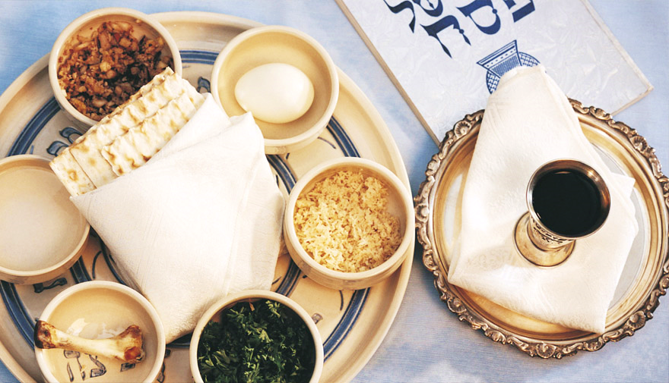
MESSIANIC PASSOVER SEDER
This Wednesday, 31st, 5:30-7:30pm at Long’s Park!
Bring your own dinner and a dessert to share.
Family friendly. Kids and visitors are welcome.
RSVP so we can plan supplies to Ben Deaver by tomorrow/Monday at: bendeaver@tallgrass.church

Slide 27
Easter Sunday, April 4, directly following Central Gathering
FILLED & TAPED EGG DONATIONS NEEDED! YOU CAN STILL BRING SOME NEXT SUNDAY MORNING BEFORE CHURCH.

Slide 29
WELCOME TO SPRING! AND TALLGRASS CHURCH’S CENTRAL GATHERING IN BOYS & GIRLS CLUB!

Slide 30
THIS TUESDAY: MARCH 30, 730-9pm
At Chris Swanson’s: 12820 Hillside Dr. Bonfire if dry enough. See yall Tuesday!

Slide 31
THERE’S STILL TIME TO GIVE!
Tallgrass is focusing on raising our full March budget, plus $5000 FOR A MUCH-NEEDED EQUIPMENT TRAILER! #Let’sMakeItFun! #Gladness #Generosity

Slide 33
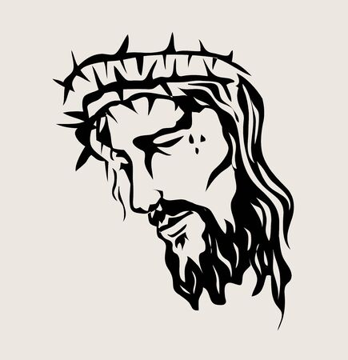
Lament birthing hope

Slide 34
Man of Sorrows

Slide 35
Isaiah 53:2
For he grew up before him like a young plant, and like a root out of dry ground; he had no form or majesty that we should look at him, and no beauty that we should desire him.
Man of Sorrows, grieve with me…

Slide 36
Isaiah 53:3
He was despised and rejected by men, a man of sorrows and acquainted with grief; and as one from whom men hide their faces he was despised, and we esteemed him not.
Man of Sorrows, grieve with me…

Slide 37
Isaiah 53:3
He was despised and rejected by men, a man of sorrows and acquainted with grief; and as one from whom men hide their faces he was despised, and we esteemed him not.
“Man of Sorrows, grieve with me, so I can grieve with others and move into unrelenting hope. Amen.”

Slide 38
John 1:1-3
¹ In the beginning was the Word, and the Word was with God, and the Word was God. ² He was in the beginning with God. ³ All things were made through him, and without him was not any thing made that was made.
Man of Sorrows, grieve with me…

Slide 39
Hebrews 5:7
In the days of his flesh, Jesus offered up prayers and supplications, with loud cries and tears, to him who was able to save him from death, and he was heard because of his reverence.
Man of Sorrows, grieve with me…

Slide 40
Isaiah 53:4-5
Surely he has borne our griefs and carried our sorrows; yet we esteemed him stricken, smitten by God, and afflicted.
But he was pierced for our transgressions; he was crushed for our iniquities; upon him was the chastisement that brought us peace, and with his wounds we are healed.
Man of Sorrows, grieve with me…

Slide 41
Hebrews 4:15-16
¹⁵ For we do not have a high priest who is unable to sympathize with our weaknesses, but one who in every respect has been tempted as we are, yet without sin. ¹⁶ Let us then with confidence draw near to the throne of grace, that we may receive mercy and find grace to help in time of need.
Man of Sorrows, grieve with me…

Slide 42
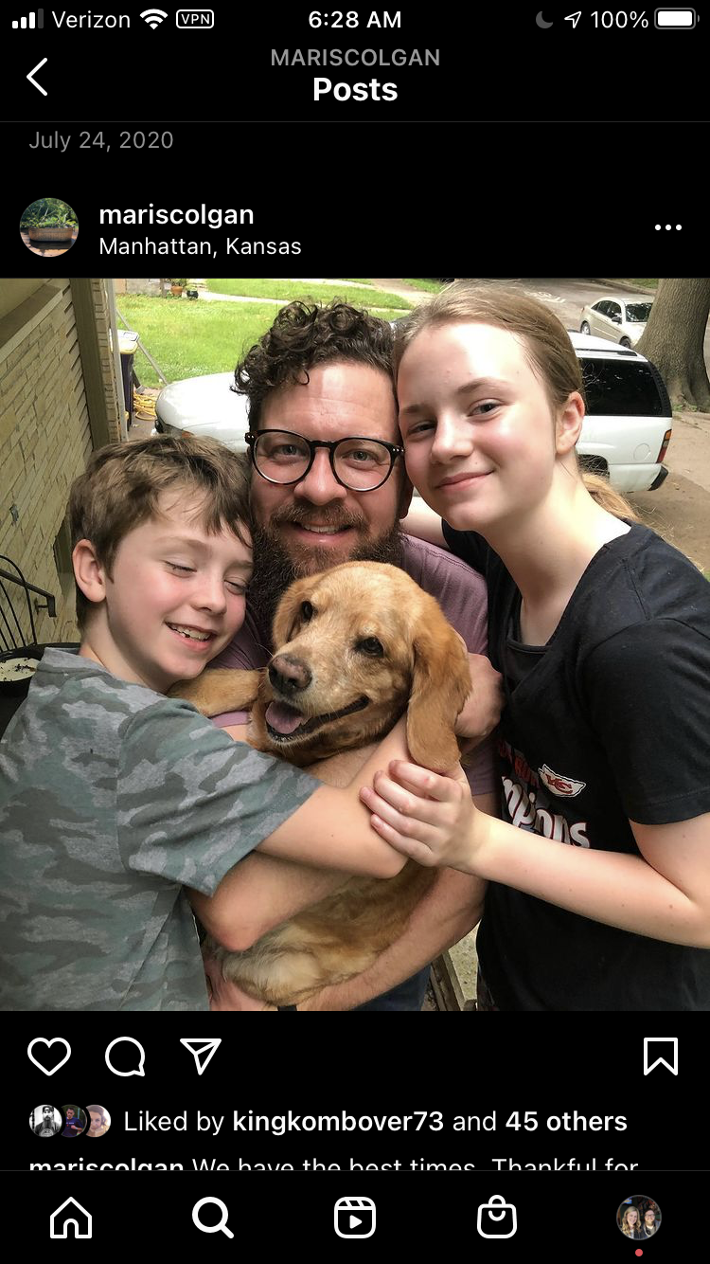
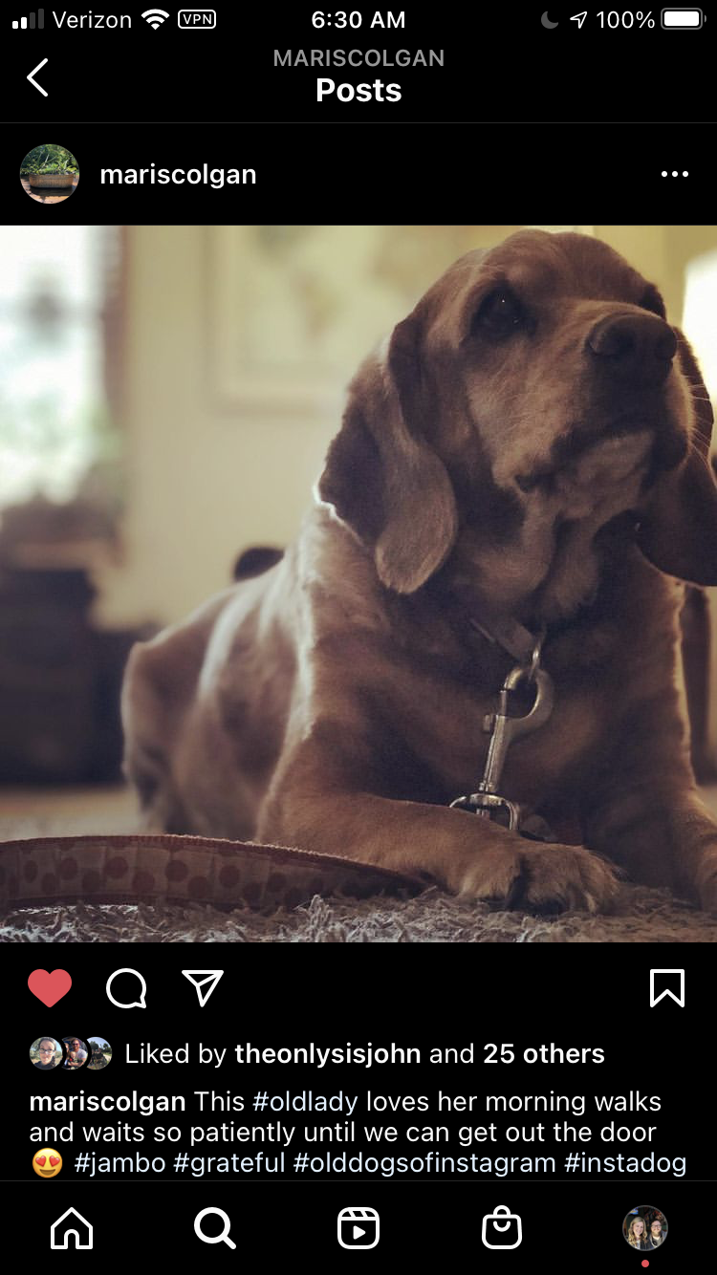

Slide 43
Psalms of Lament
Individual—3, 4, 5, 7, 9-10, 13, 14, 17, 22, 25, 26, 27*, 28, 31, 36*, 39, 40:12-17, 41, 42-43, 52*, 53, 54, 55, 56, 57, 59, 61, 64, 70, 71, 77, 86, 89*, 120, 139, 141, 142
Communal—12, 44, 58, 60, 74, 79, 80, 83, 85, 89*, 90, 94, 123, 126, 129
Penitential/Repentance—6, 32*, 38, 51, 102, 130, 143
Imprecatory/Call for Judgment— 35, 69, 83, 88, 109, 137, 140
*Difficult to classify because could fit into more than one group or are mixed types
Man of Sorrows, grieve with me…

Slide 44
Psalms of Lament
Individual—3, 4, 5, 7, 9-10, 13, 14, 17, 22, 25, 26, 27*, 28, 31, 36*, 39, 40:12-17, 41, 42-43, 52*, 53, 54, 55, 56, 57, 59, 61, 64, 70, 71, 77, 86, 89*, 120, 139, 141, 142
Communal—12, 44, 58, 60, 74, 79, 80, 83, 85, 89*, 90, 94, 123, 126, 129
Penitential/Repentance—6, 32*, 38, 51, 102, 130, 143
Imprecatory/Call for Judgment— 35, 69, 83, 88, 109, 137, 140
*Difficult to classify because could fit into more than one group or are mixed types
Structure—Protest, Petition, Praise
Man of Sorrows, grieve with me…

Slide 45
Psalms of Lament
Individual—3, 4, 5, 7, 9-10, 13, 14, 17, 22, 25, 26, 27*, 28, 31, 36*, 39, 40:12-17, 41, 42-43, 52*, 53, 54, 55, 56, 57, 59, 61, 64, 70, 71, 77, 86, 89*, 120, 139, 141, 142
Communal—12, 44, 58, 60, 74, 79, 80, 83, 85, 89*, 90, 94, 123, 126, 129
Penitential/Repentance—6, 32*, 38, 51, 102, 130, 143
Imprecatory/Call for Judgment— 35, 69, 83, 88, 109, 137, 140
*Difficult to classify because could fit into more than one group or are mixed types
Structure—Huh-uh, Haggle, Hope
Man of Sorrows, grieve with me…

Slide 46
Psalm 142:1-3—PROTEST
A Maskil of David, when he was in the cave. A Prayer.
¹ With my voice I cry out to the Lord; with my voice I plead for mercy to the Lord. ² I pour out my complaint before him; I tell my trouble before him.
³ When my spirit faints within me, you know my way! In the path where I walk they have hidden a trap for me.
Man of Sorrows, grieve with me…

Slide 47
Psalm 142:4-5—PROTEST
⁴ Look to the right and see: there is none who takes notice of me; no refuge remains to me; no one cares for my soul.
⁵ I cry to you, O Lord; I say, “You are my refuge, my portion in the land of the living.”
Man of Sorrows, grieve with me…

Slide 48
Psalm 142:6-7a—PETITION
⁶ Attend to my cry, for I am brought very low! Deliver me from my persecutors, for they are too strong for me! ^{7a} Bring me out of prison, that I may give thanks to your name!
Man of Sorrows, grieve with me…

Slide 49
Psalm 142:7b—PRAISE/HOPE
⁶ Attend to my cry, for I am brought very low! Deliver me from my persecutors, for they are too strong for me! ⁷ Bring me out of prison, that I may give thanks to your name! The righteous will surround me, for you will deal bountifully with me.
Man of Sorrows, grieve with me…

Slide 50
2 Corinthians 1:3-5
³ Blessed be the God and Father of our Lord Jesus Christ, the Father of mercies and God of all comfort, ⁴ who comforts us in all our affliction, so that we may be able to comfort those who are in any affliction, with the comfort with which we ourselves are comforted by God. ⁵ For as we share abundantly in Christ's sufferings, so through Christ we share abundantly in comfort too.
Man of Sorrows, grieve with me…

Slide 51
Isaiah 53:6-7
All we like sheep have gone astray; we have turned—every one—to his own way; and the Lord has laid on him the iniquity of us all.
He was oppressed, and he was afflicted, yet he opened not his mouth; like a lamb that is led to the slaughter, and like a sheep that before its shearers is silent, so he opened not his mouth.
Man of Sorrows, grieve with me…

Slide 52
Man of Sorrows, grieve with me…

Slide 53
Man of Sorrows

Slide 54
Man of Sorrows
Man of sorrows, Lamb of God By His own betrayed The sin of man and wrath of God Has been on Jesus laid

Slide 55
Man of Sorrows
Silent as He stood accused Beaten, mocked, and scorned Bowing to the Father's will He took a crown of thorns

Slide 56
Man of Sorrows
Oh, that rugged cross, my salvation Where Your love poured out over me Now my soul cries out, "Hallelujah" "Praise and honor unto Thee"

Slide 57
Man of Sorrows
Sent of heaven God's own Son To purchase and redeem And reconcile the very ones Who nailed Him to that tree

Slide 58
Man of Sorrows
Sent of heaven God's own Son To purchase and redeem And reconcile the very ones Who nailed Him to that tree

Slide 59
Man of Sorrows
Oh, that rugged cross, my salvation Where Your love poured out over me Now my soul cries out, "Hallelujah" "Praise and honor unto Thee"

Slide 60
Man of Sorrows
Now my debt is paid It is paid in full By the precious blood That my Jesus spilled Now the curse of sin Has no hold on me Whom the Son sets free Oh, is free indeed

Slide 61
Man of Sorrows
Now my debt is paid It is paid in full By the precious blood That my Jesus spilled Now the curse of sin Has no hold on me Whom the Son sets free Oh, is free indeed

Slide 62
Man of Sorrows
Oh, that rugged cross my salvation Where Your love poured out over me Now my soul cries out, "Hallelujah" "Praise and honor unto Thee"

Slide 63
Man of Sorrows
See the stone is rolled away Behold the empty tomb Hallelujah, God be praised He's risen from the grave

Slide 64
Man of Sorrows
h, that rugged cross my salvation Where Your love poured out over me Now my soul cries out, "Hallelujah" "Praise and honor unto Thee"

Slide 65
The Blessing

Slide 66
The Blessing
The Lord bless you And keep you Make His face shine upon you And be gracious to you The Lord turn His Face toward you And give you peace

Slide 67
The Blessing
Amen, amen, amen Amen, amen, amen

Slide 68
The Blessing
The Lord bless you And keep you Make His face shine upon you And be gracious to you The Lord turn His Face toward you And give you peace

Slide 69
The Blessing
Amen, amen, amen Amen, amen, amen

Slide 70
The Blessing
May His favor be upon you And a thousand generations And your family and your children And their children, and their children

Slide 71
The Blessing
May His presence go before you And behind you, and beside you All around you, and within you He is with you, He is with you

Slide 72
The Blessing
In the morning, in the evening In your coming, and your going In your weeping, and rejoicing He is for you, He is for you

Slide 73
The Blessing
He is for you, He is for you
He is for you, He is for you
He is for you, He is for you

Slide 74
The Blessing
Amen, amen, amen Amen, amen, amen

Slide 75
The Blessing
May His favor be upon you And a thousand generations And your family and your children And their children, and their children

Slide 76
The Blessing
May His presence go before you And behind you, and beside you All around you, and within you He is with you, He is with you

Slide 77
The Blessing
In the morning, in the evening In your coming, and your going In your weeping, and rejoicing He is for you

Slide 78
The Blessing
He is for you, He is for you
He is for you, He is for you
He is for you, He is for you

Slide 79
The Blessing
Amen, amen, amen Amen, amen, amen

