Slide 1
WELCOME!

Slide 2
WELCOME TO TALLGRASS CHURCH’S ADVENT 2020 CENTRAL GATHERINGS IN BOYS & GIRLS CLUB!

Slide 3
O Come All
Ye Faithful
“O Come All Ye Faithful” By C. Frederick Oakley David LaChance Jr. John Francis Wade

Slide 4
O come, all ye faithful,
joyful and triumphant!
O come ye, O come ye to Bethlehem!
Come and behold him,
born the King of angels;
“O Come All Ye Faithful” By C. Frederick Oakley David LaChance Jr. John Francis Wade

Slide 5
O come, let us adore Him,
O come, let us adore Him,
O come, let us adore Him,
Christ, the Lord!
“O Come All Ye Faithful” By C. Frederick Oakley David LaChance Jr. John Francis Wade

Slide 6
O come all ye faithful
O come all ye faithful
O come all ye faithful
to Bethlehem
repeat
“O Come All Ye Faithful” By C. Frederick Oakley David LaChance Jr. John Francis Wade

Slide 7
Sing, choirs of angels,
sing in exultation,
Sing, all ye citizens of heav'n above:
"Glory to God, all glory in the highest!"
“O Come All Ye Faithful” By C. Frederick Oakley David LaChance Jr. John Francis Wade

Slide 8
O come, let us adore Him,
O come, let us adore Him,
O come, let us adore Him,
Christ, the Lord!
“O Come All Ye Faithful” By C. Frederick Oakley David LaChance Jr. John Francis Wade

Slide 9
O come all ye faithful
O come all ye faithful
O come all ye faithful
to Bethlehem
repeat
“O Come All Ye Faithful” By C. Frederick Oakley David LaChance Jr. John Francis Wade

Slide 10
Yea, Lord, we greet Thee,
born this happy morning;
Jesus, to thee be all glory giv'n;
Word of the Father,
now in flesh appearing;
“O Come All Ye Faithful” By C. Frederick Oakley David LaChance Jr. John Francis Wade

Slide 11
O come, let us adore Him,
O come, let us adore Him,
O come, let us adore Him,
Christ, the Lord!
“O Come All Ye Faithful” By C. Frederick Oakley David LaChance Jr. John Francis Wade

Slide 12
O come all ye faithful
O come all ye faithful
O come all ye faithful
to Bethlehem
“O Come All Ye Faithful” By C. Frederick Oakley David LaChance Jr. John Francis Wade

Slide 13
O come all ye faithful
O come all ye faithful
O come all ye faithful
“O Come All Ye Faithful” By C. Frederick Oakley David LaChance Jr. John Francis Wade

Slide 14
O come, let us adore Him,
O come, let us adore Him,
O come, let us adore Him,
Christ, the Lord!
“O Come All Ye Faithful” By C. Frederick Oakley David LaChance Jr. John Francis Wade

Slide 15
O come all ye faithful
O come all ye faithful
O come all ye faithful
to Bethlehem
“O Come All Ye Faithful” By C. Frederick Oakley David LaChance Jr. John Francis Wade

Slide 17
2021 FAMILY BUDGET
We're pleased to announce that the 2021 budget has been approved as proposed. $600 more/mo needed for 2021 because of rent increase.
Help us meet our 2021 Family Budget by taking the 1% Challenge and step up your giving by 1% of your income!

Slide 18
HOW TO GIVE

Slide 19
TITLES GO HERE CAPS
HOPE FOR THE HOLIDAYS 2020
Type stuff in here. Make at least 35 pt Ubuntu. Pref 40+
Holiday cheer is in the air. Share yours with young adults who have aged out of foster care!
$25, $50, or $100 gift card Walmart, Target, Amazon, Dillons, Aldi, Casey’s, QuikTrip, Uber…
PLUS A HANDWRITTEN CHRISTMAS CARD
DUE TODAY DEC 6th.

Slide 20
Join us THIS Tuesday night, Dec 8, for our final Guys Group of 2020! We'll be back at Chris Swanson place (12820 Hillside Dr.) at 7:30pm. Bring your mask, chair, and a beverage or snack to share if you'd like. Extra credit if you come in a festive Xmas sweater!

Slide 21
WELCOME TO WEEK 2 OF ADVENT 2020

Slide 22
Little Drummer Boy
“Little Drummer Boy” By Katherine Kennicott Davis, 1941

Slide 23
Come they told me…
A newborn King to see…
Our finest gifts we bring…
To lay before the King…
So to honor Him… here we come!
“Little Drummer Boy” By Katherine Kennicott Davis, 1941

Slide 25
Little baby…
I am a poor boy too…
I have no gift to bring…
That’s fit to give our King…
Shall I play for You?… On my drum!
“Little Drummer Boy” By Katherine Kennicott Davis, 1941

Slide 26
Make a joyful noise to the LORD,
all the earth! Serve the LORD
with gladness! Come into
his presence with singing!
Psalm 100:1-2

Slide 27
Mary nodded…
The ox and lamb kept time…
I played my drum for Him…
I played my best for Him…
Then He smiled at me…
Me and my drum!
“Little Drummer Boy” By Katherine Kennicott Davis, 1941

Slide 28
air drumming &
chest thumping
is encouraged

Slide 31
WELCOME TO WEEK 2 OF ADVENT 2020

Slide 33
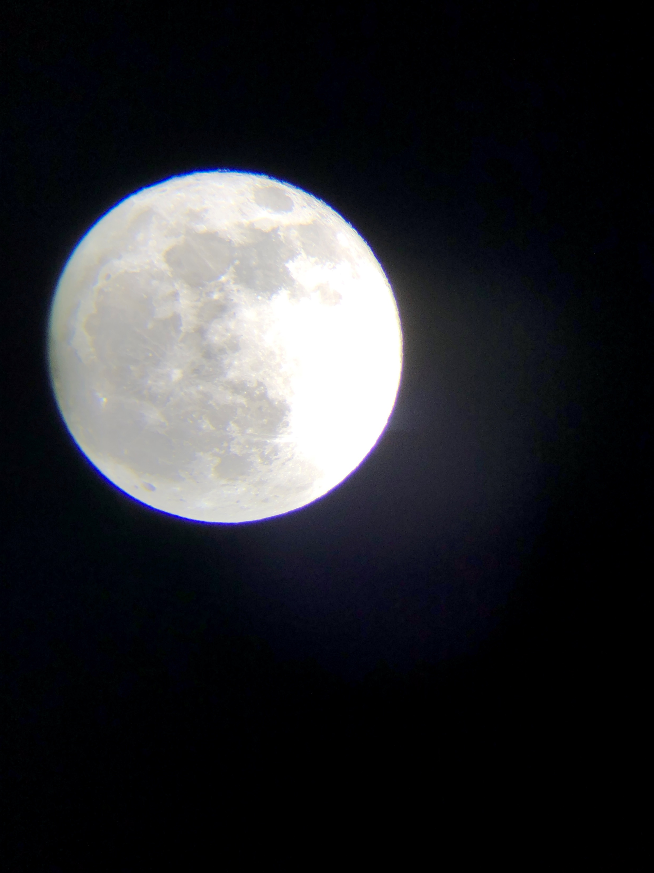

Slide 34
Serve! *advent twenty-twenty*
⁵ Have this mind among yourselves, which is yours in Christ Jesus, ⁶ who, though he was in the form of God, did not count equality with God a thing to be grasped, ⁷ but emptied himself, by taking the form of a servant, being born in the likeness of men.
Philippians 2:5-7

Slide 35
Serve! *advent twenty-twenty*
The emperor cult (of Nero) saturated Roman culture and the people at Philippi, many of whom were retired Roman soldiers who had considerable pride and devotion to the cult and to Roman law and culture which emphasized ambition, status, and wealth.
HOW THE CHRIST HYMN IN PHILIPPIANS 2:5–11 INFORMS THE PRAXIS OF LEADERSHIP IN AT-RISK COMMUNITIES: TWO SUPER-LEADERS OPERATIONALIZING KENOSIS by J. Randall Wallace in journal of biblical perspectives in leadership

Slide 36
Serve! *advent twenty-twenty*
This cultural fascination with the image of the emperor, who through pride and arrogance elevated himself to the stature of a god, coupled with the pride of the citizenry in their Roman heritage, served as a backdrop to Paul’s letter to the Philippians. In dealing with this internal conflict of the church (Phil 4:2), and the growing adoption of the values and attitudes of the culture around them, Paul composes the Christ hymn in Philippians 2:5–11.
HOW THE CHRIST HYMN IN PHILIPPIANS 2:5–11 INFORMS THE PRAXIS OF LEADERSHIP IN AT-RISK COMMUNITIES: TWO SUPER-LEADERS OPERATIONALIZING KENOSIS by J. Randall Wallace in journal of biblical perspectives in leadership

Slide 37
Serve! *advent twenty-twenty*
It presents Christ in stark contrast to Emperor Nero, without directly naming him. In doing so, Paul challenges members of the church at Philippi to imitate Christ not only in action but thought. The Christ hymn provides both a powerful insight into the character and nature of God and a counter model for how a true leader behaves.
HOW THE CHRIST HYMN IN PHILIPPIANS 2:5–11 INFORMS THE PRAXIS OF LEADERSHIP IN AT-RISK COMMUNITIES: TWO SUPER-LEADERS OPERATIONALIZING KENOSIS by J. Randall Wallace in journal of biblical perspectives in leadership

Slide 38
Serve! *advent twenty-twenty*
The hymn’s emphasis on humility and its direct reference to Christ being a servant reiterates the model Jesus provided when he washed the disciples’ feet. By that act of servanthood, he declared his perspective on leadership, and how leaders should view themselves (John 13:1–17).
HOW THE CHRIST HYMN IN PHILIPPIANS 2:5–11 INFORMS THE PRAXIS OF LEADERSHIP IN AT-RISK COMMUNITIES: TWO SUPER-LEADERS OPERATIONALIZING KENOSIS by J. Randall Wallace in journal of biblical perspectives in leadership

Slide 39
Serve! *advent twenty-twenty*
But you are a chosen race, a royal priesthood, a holy nation, a people for his own possession, that you may proclaim the excellencies of him who called you out of darkness into his marvelous light.
1 Peter 2:9

Slide 40
Serve! *advent twenty-twenty*
¹⁴ “You are the light of the world. A city set on a hill cannot be hidden. ¹⁵ Nor do people light a lamp and put it under a basket, but on a stand, and it gives light to all in the house. ¹⁶ In the same way, let your light shine before others, so that they may see your good works and give glory to your Father who is in heaven.”
Matthew 5:14-16

Slide 41
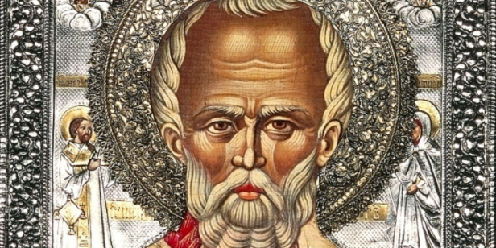

Slide 42
Serve! *advent twenty-twenty*
⁵ Have this mind among yourselves, which is yours in Christ Jesus, ⁶ who, though he was in the form of God, did not count equality with God a thing to be grasped, ⁷ but emptied himself, by taking the form of a servant, being born in the likeness of men. ⁸ And being found in human form, he humbled himself by becoming obedient to the point of death, even death on a cross.
Philippians 2:5-8

Slide 43
HOMEWORK:
Cultivate and apply Christ’s mindset this Christmas.
Memorize Philippians 2:5-8 this week.
Reflect the Light of the World by serving.
Serve one another through “Discipleship 101”.
Be inspired by servant models.

Slide 44
HOMEWORK:
Cultivate and apply Christ’s mindset this Christmas.
Memorize Philippians 2:5-8 this week.
Reflect the Light of the World by serving.
Serve one another through “Discipleship 101”.
Be inspired by servant models …like Scott Voos of Be Able!

Slide 46
Shine! *advent twenty-twenty*

Slide 47
Go Tell it on the Mountain
“Go Tell it on the Mountain” by John W. Work Jr.

Slide 48
While shepherds were out watching
Their silent flocks by night.
Behold throughout the heavens
There shone a holy light
“Go Tell it on the Mountain” by John W. Work Jr.

Slide 49
Go tell it on the mountain
Over the hills and everywhere
Go tell it on the mountain
That Jesus Christ is born.
“Go Tell it on the Mountain” by John W. Work Jr.

Slide 50
The King is here
The King is here
“Go Tell it on the Mountain” by John W. Work Jr.

Slide 51
The shepherds feared and trembled
While lo, above the earth
Rang out the angel chorus
That hailed our Savior’s birth
“Go Tell it on the Mountain” by John W. Work Jr.

Slide 52
Go tell it on the mountain
Over the hills and everywhere
Go tell it on the mountain
That Jesus Christ is born.
“Go Tell it on the Mountain” by John W. Work Jr.

Slide 53
The King is here
The King is here
“Go Tell it on the Mountain” by John W. Work Jr.

Slide 54
Down in a lowly manger
The humble Christ was born
And God sent us salvation
That blessed Christmas morn’
“Go Tell it on the Mountain” by John W. Work Jr.

Slide 55
Go tell it on the mountain
Over the hills and everywhere
Go tell it on the mountain
That Jesus Christ is born.
“Go Tell it on the Mountain” by John W. Work Jr.

Slide 56
“Go Tell it on the Mountain” by John W. Work Jr.

Slide 57
Graves into
Gardens
“Graves into Gardens” by Steven Furtick, Chris Brown, Tiffany Hammer, Brandon Lake

Slide 58
I searched the world
But it couldn’t fill me
Man’s empty praise
and treasures that fade
Are never enough
“Graves into Gardens” by Steven Furtick, Chris Brown, Tiffany Hammer, Brandon Lake

Slide 59
Then You came along
And put me back together
And every desire
is now satisfied
Here in Your love
“Graves into Gardens” by Steven Furtick, Chris Brown, Tiffany Hammer, Brandon Lake

Slide 60
Oh there’s nothing better than You
There’s nothing better than You
Lord there’s nothing;
nothing is better than You.
“Graves into Gardens” by Steven Furtick, Chris Brown, Tiffany Hammer, Brandon Lake

Slide 61
I’m not afraid
To show You my weakness
My failures and flaws
Lord You’ve seen them all
And You still call me friend
“Graves into Gardens” by Steven Furtick, Chris Brown, Tiffany Hammer, Brandon Lake

Slide 62
‘Cause the God of the mountain
is the God of the valley
There’s not a place
Your mercy and grace
Won’t find me again
“Graves into Gardens” by Steven Furtick, Chris Brown, Tiffany Hammer, Brandon Lake

Slide 63
Oh there’s nothing better than You
There’s nothing better than You
Lord there’s nothing;
nothing is better than You.
“Graves into Gardens” by Steven Furtick, Chris Brown, Tiffany Hammer, Brandon Lake

Slide 64
You turn morning to dancing
You give beauty for ashes
You turn shame into glory
You’re the only One who can
“Graves into Gardens” by Steven Furtick, Chris Brown, Tiffany Hammer, Brandon Lake

Slide 65
You turn graves into gardens
You turn bones into armies
You turn seas into highways
You’re the only One who can
“Graves into Gardens” by Steven Furtick, Chris Brown, Tiffany Hammer, Brandon Lake

Slide 66
You’re the only
One who can!
“Graves into Gardens” by Steven Furtick, Chris Brown, Tiffany Hammer, Brandon Lake

Slide 67
Oh there’s nothing better than You
There’s nothing better than You
Lord there’s nothing;
nothing is better than You.
“Graves into Gardens” by Steven Furtick, Chris Brown, Tiffany Hammer, Brandon Lake

Slide 68
You turn graves into gardens
You turn bones into armies
You turn seas into highways
You’re the only One who can
“Graves into Gardens” by Steven Furtick, Chris Brown, Tiffany Hammer, Brandon Lake

Slide 69
You’re the only
One who can!
You’re the only
One who can!
“Graves into Gardens” by Steven Furtick, Chris Brown, Tiffany Hammer, Brandon Lake

