Slide 1
WELCOME!

Slide 2
WELCOME TO TALLGRASS CHURCH’ SECOND GATHERING IN BOYS & GIRLS CLUB!

Slide 3
Joy
“Joy” by Rend Collective

Slide 4
We cast aside our shadows
Trust You with our sorrows
You're the song,
You're the song of our hearts
“Joy” by Rend Collective

Slide 5
We're choosing celebration
Breaking into freedom
You're the song,
You're the song of our hearts
“Joy” by Rend Collective

Slide 6
We're dancing to
the rhythm of Your heart
We're rising from
the ashes to the stars
“Joy” by Rend Collective

Slide 7
You're the joy, joy, joy lighting my soul.
The joy, joy, joy
making me whole.
Though I'm broken,
I am running
into Your arms of love
“Joy” by Rend Collective

Slide 8
The pain will not define us
Joy will reignite us
You're the song,
You're the song
of our hearts.
“Joy” by Rend Collective

Slide 9
The dark is just a canvas
for Your grace and brightness
You're the song,
You're the song
of our hearts.
“Joy” by Rend Collective

Slide 10
We're dancing to
the rhythm of Your heart
We're rising from
the ashes to the stars
“Joy” by Rend Collective

Slide 11
You're the joy, joy, joy lighting my soul.
The joy, joy, joy
making me whole.
Though I'm broken,
I am running
into Your arms of love
“Joy” by Rend Collective

Slide 12
The pain will not define us
Joy will reignite us
You're the song,
You're the song
of our hearts.
“Joy” by Rend Collective

Slide 13
In the shadows
In the sorrows
In the desert
When the pain hits
You are constant
Ever-present
You're the song of my heart
“Joy” by Rend Collective

Slide 14
You're the joy, joy, joy lighting my soul.
The joy, joy, joy
making me whole.
Though I'm broken,
I am running
into Your arms of love
“Joy” by Rend Collective

Slide 15
Rejoice
“Rejoice” by Dustin Kensrue and Stuart Townend

Slide 16
Come and stand
before your maker,
full of wonder full of fear.
Come behold
His power and glory, yet
with confidence draw near
“Rejoice” by Dustin Kensrue and Stuart Townend

Slide 17
For the One who
holds the heavens and
commands the stars above
is the God who
bends to bless us
with an unrelenting Love
“Rejoice” by Dustin Kensrue and Stuart Townend

Slide 18
Rejoice!
Come and lift your hands
and raise your voice;
He is worthy of all praise.
Rejoice!
Sing of mercies of your King
And with trembling, rejoice!
“Rejoice” by Dustin Kensrue and Stuart Townend

Slide 19
We are children
of the promise,
the beloved of the Lord;
Won with everlasting kindness,
bought with sacrificial blood.
“Rejoice” by Dustin Kensrue and Stuart Townend

Slide 20
Bringing reconciliation
to a world
that longs to know
the affections of a Father
who will never let them go.
“Rejoice” by Dustin Kensrue and Stuart Townend

Slide 21
Rejoice!
Come and lift your hands
and raise your voice;
He is worthy of all praise.
Rejoice!
Sing of mercies of your King
And with trembling, rejoice!
“Rejoice” by Dustin Kensrue and Stuart Townend

Slide 22
All our sickness,
all our sorrows;
Jesus carried up the hill.
He has walked
this path before us
He is walking
with us still.
“Rejoice” by Dustin Kensrue and Stuart Townend

Slide 23
Turning tragedy to triumph
Turning agony to praise
There is blessing
in the battle,
So take heart
and stand amazed!
“Rejoice” by Dustin Kensrue and Stuart Townend

Slide 24
Rejoice;
when you cry to Him
He hears your voice.
He will wipe away
your tears. Rejoice
in the midst of suffering.
He will help you sing…
“Rejoice” by Dustin Kensrue and Stuart Townend

Slide 25
Rejoice!
Come and lift your hands
and raise your voice;
He is worthy of all praise.
Rejoice!
Sing of mercies of your King
And with trembling, rejoice!
“Rejoice” by Dustin Kensrue and Stuart Townend

Slide 26
ELISHA HILLEGEIST
ELDER CANDIDATE

Slide 27
WELCOME TO TALLGRASS CHURCH’ SECOND GATHERING IN BOYS & GIRLS CLUB!

Slide 28
TRENT JONES
EXECUTIVE DIRECTOR

Slide 30
PHILIPPIANS 1
³ I thank my God in all my remembrance of you, ⁴ always in every prayer of mine for you all making my prayer with joy, ⁵ because of your partnership in the gospel from the first day until now.
⁶ And I am sure of this, that he who began a good work in you will bring it to completion at the day of Jesus Christ.

Slide 31
TOGETHER

Slide 32
JOY = chara (χαρά, 5479)
1:4 …always in every prayer of mine for you all making my prayer with joy…
1:25 …I know that I will remain and continue with you all, for your progress and joy in the faith…
2:2 …complete my joy by being of the same mind, having the same love, being in full accord and of one mind.

Slide 33
JOY = chara (χαρά, 5479)
2:29 So receive him (Epaphroditus) in the Lord with all joy, and honor such men…
4:1 Therefore, my brothers and sisters, whom I love and long for, my joy and crown, stand firm thus in the Lord, my beloved.

Slide 34
REJOICE = chairō (χαίρω, 5463)
1:18 What then? Only that in every way, whether in pretense or in truth, Christ is proclaimed, and in that I rejoice. Yes, and I will rejoice…
2:17b-18 ^{17b} …I am glad and rejoice with you all. ¹⁸ Likewise you also should be glad and rejoice with me.

Slide 35
REJOICE = chairō (χαίρω, 5463)
2:28 …that you may rejoice at seeing him again, and that I may be less anxious.
3:1a Finally, my brothers and sisters, rejoice in the Lord.
4:4 Rejoice in the Lord always; again I will say, rejoice.
4:10a I rejoiced in the Lord greatly…

Slide 36
CHOOSE TO REJOICE!
“Who’s responsible for the joy and gratitude in my life? That’s one of the most important questions we’ll ever answer. Actually, there’s only one appropriate answer: me. I must take responsibility for my response to life.”

Slide 37
CHOOSE TO REJOICE!
“I can’t leave if to my boss, my mate, my kids, neighbors or friends (or the outcome of this election or Covid-19, etc.). I’m the one who’s ultimately responsible. It’s true that the people around me can deeply affect me, but the bottom line is, I determine how it all shakes out.”
–Pure Desire by Ted Roberts, p. 232

Slide 39
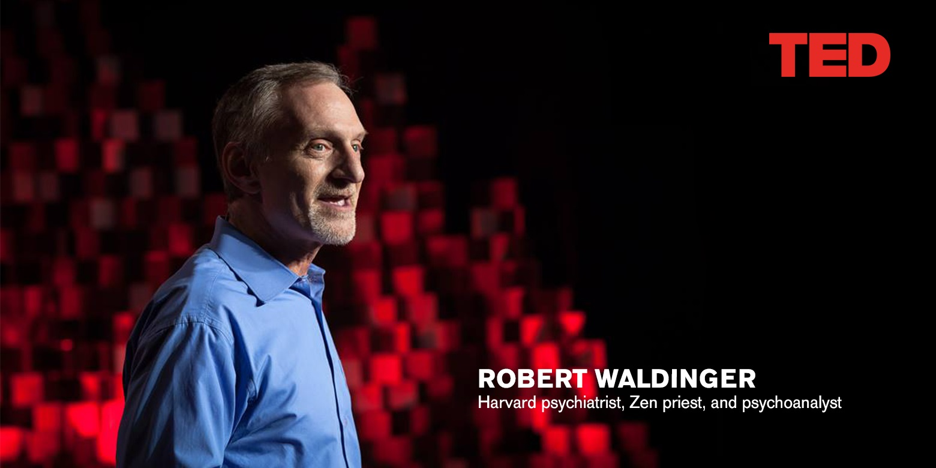
“Wealth, fame, and career success do not correlate with true happiness. Good relationships keep us
healthier and happier.
The frequency of relational contacts.
The secure attachment.”

Slide 40
FIGHTING FOR JOY
TOGETHER
1:5 …because of your partnership in the gospel from the first day until now.
1:7b …for you are all partakers with me of grace…
1:27b …with one mind striving side by side for the faith of the gospel…
2:25b …my brother and fellow worker and fellow soldier…

Slide 41
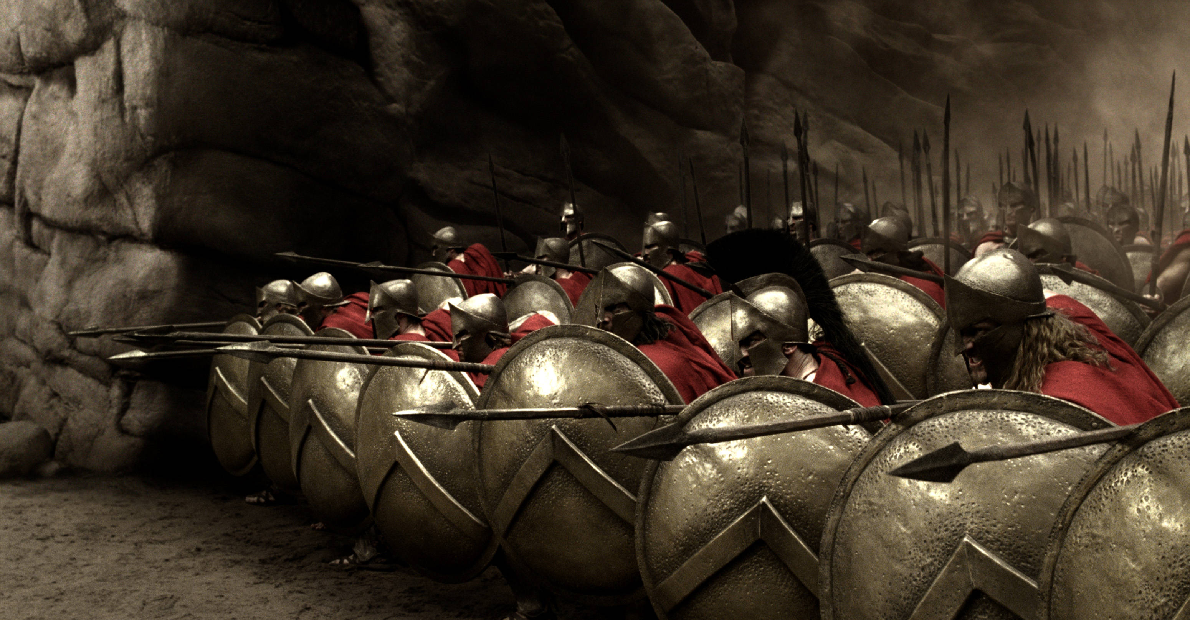
The armor of God
THE PHALANX

Slide 42
The armor of God
THE PHALANX
“In heaven we shall appear not in armour but in robes of glory; but here they (the pieces of armour specified) are to be worn night and day; we must walk, work and sleep in them, or else to stand and watch, and never relax our vigilance, for ‘the saint’s sleeping time is Satan’s tempting time.’”
--The Christian in Complete Armor by William Gurnall (1655)

Slide 43
The armor of God
FIGHTING FOR JOY
TOGETHER
4:2-3 ² I entreat Euodia and I entreat Syntyche to agree in the Lord. ³ Yes, I ask you also, true companion, help these women, who have labored side by side with me in the gospel together with Clement and the rest of my fellow workers, whose names are in the book of life.

Slide 44
The armor of God
FIGHTING FOR JOY
TOGETHER
4:2-3 ² I entreat Euodia and I entreat Syntyche to agree in the Lord. ³ Yes, I ask you also, true companion, help these women, who have labored side by side with me in the gospel together with Clement and the rest of my fellow workers, whose names are in the book of life. See 4:14-15

Slide 45
PHILIPPIANS 1
³ I thank my God in all my remembrance of you, ⁴ always in every prayer of mine for you all making my prayer with joy, ⁵ because of your partnership in the gospel from the first day until now.
⁶ And I am sure of this, that he who began a good work in you will bring it to completion at the day of Jesus Christ.

Slide 46
PHILIPPIANS 1
⁶ And I am sure of this, that he who began a good work in you will bring it to completion at the day of Jesus Christ.
JUSTIFICATION—Freed from the penalty of sin. God alone does this one-time event.
SANCTIFICATION—Growth into Christ’s character. We join God in this process.
GLORIFICATION—Freed from the power of sin. God alone does this one-time event.

Slide 48
HOMEWORK:
Take on Discipleship 101.
Memorize Philippians 1:6.
Handwrite out the upcoming passage (Philippians 1:7-11).

Slide 49
Raise a Hallelujah
“Raise a Hallelujah” Jake Stevens, Jonathan David & Melissa Helser, Molly Skaggs

Slide 50
I raise a hallelujah,
my weapon is a melody
I raise a hallelujah,
Heaven comes to fight for me
“Raise a Hallelujah” Jake Stevens, Jonathan David & Melissa Helser, Molly Skaggs

Slide 51
I raise a hallelujah,
in the presence of my enemies
I raise a hallelujah,
louder than the unbelief
“Raise a Hallelujah” Jake Stevens, Jonathan David & Melissa Helser, Molly Skaggs

Slide 52
I’m gonna sing
in the middle of the storm.
Louder and louder;
You’re gonna hear my praises roar!
“Raise a Hallelujah” Jake Stevens, Jonathan David & Melissa Helser, Molly Skaggs

Slide 53
Up from the ashes,
hope will arise.
Death is defeated,
the King is alive!
“Raise a Hallelujah” Jake Stevens, Jonathan David & Melissa Helser, Molly Skaggs

Slide 54
I raise a hallelujah,
with everything inside of me
I raise a hallelujah,
I will watch the darkness flee
“Raise a Hallelujah” Jake Stevens, Jonathan David & Melissa Helser, Molly Skaggs

Slide 55
I raise a hallelujah,
in the middle of the mystery
I raise a hallelujah,
fear, you lost your
hold on me!
“Raise a Hallelujah” Jake Stevens, Jonathan David & Melissa Helser, Molly Skaggs

Slide 56
I’m gonna sing
in the middle of the storm.
Louder and louder;
You’re gonna hear my praises roar!
“Raise a Hallelujah” Jake Stevens, Jonathan David & Melissa Helser, Molly Skaggs

Slide 57
Up from the ashes,
hope will arise.
Death is defeated,
the King is alive!
“Raise a Hallelujah” Jake Stevens, Jonathan David & Melissa Helser, Molly Skaggs

Slide 58
Sing a little louder
in the presence of my enemies.
Sing a little louder
louder than the unbelief
Sing a little louder
my weapon is a melody
Sing a little louder
heaven comes to fight for me
“Raise a Hallelujah” Jake Stevens, Jonathan David & Melissa Helser, Molly Skaggs

Slide 59
I’m gonna sing
in the middle of the storm.
Louder and louder;
You’re gonna hear my praises roar!
“Raise a Hallelujah” Jake Stevens, Jonathan David & Melissa Helser, Molly Skaggs

Slide 60
Up from the ashes,
hope will arise.
Death is defeated,
the King is alive!
“Raise a Hallelujah” Jake Stevens, Jonathan David & Melissa Helser, Molly Skaggs

Slide 61
I raise a hallelujah!
“Raise a Hallelujah” Jake Stevens, Jonathan David & Melissa Helser, Molly Skaggs

Slide 62
No Longer Slaves
“No Longer Slaves” by Jonathan David & Melissa Helser

Slide 63
You unravel me
with a melody
You surround me
with a song
of deliverance*
from my enemies
‘till all my fears are gone.
*Psalm 32:7
“No Longer Slaves” by Jonathan David & Melissa Helser

Slide 64
I’m no longer a slave to fear
I am a child of God
*Galatians 4:7, 1 John 4:8
“No Longer Slaves” by Jonathan David & Melissa Helser

Slide 65
From my mother’s womb
You have chosen me
Love has called my name
I’ve been born again,
into Your family
Your blood flows
through my veins
John 3
“No Longer Slaves” by Jonathan David & Melissa Helser

Slide 66
I’m no longer a slave to fear
I am a child of God
*Galatians 4:7, 1 John 4:8
“No Longer Slaves” by Jonathan David & Melissa Helser

Slide 67
I am surrounded
By the arms of the Father
I am surrounded
By songs of deliverance
*Psalm 32:7
“No Longer Slaves” by Jonathan David & Melissa Helser

Slide 68
We’ve been liberated
From our bondage
We’re the sons
and the daughters.
Let us sing our freedom!
*Romans 8:21
“No Longer Slaves” by Jonathan David & Melissa Helser

Slide 69
Make a joyful noise to the LORD, all the earth;
break forth into joyous song and sing praises!
Psalm 98:4
“No Longer Slaves” by Jonathan David & Melissa Helser

Slide 70
You split the sea,
so I could walk
right through it.
You drowned my fears
in perfect love.
You rescued me
so I could stand & sing
“I am a child of God”
*1 John 4:8
“No Longer Slaves” by Jonathan David & Melissa Helser

Slide 71
I’m no longer a slave to fear
I am a child of God
*Galatians 4:7, 1 John 4:8
“No Longer Slaves” by Jonathan David & Melissa Helser

Slide 72
Joy (Reprise)
“Joy” by Rend Collective

Slide 73
In the shadows
In the sorrows
In the desert
When the pain hits
You are constant
Ever-present
You're the song of my heart
“Joy” by Rend Collective

Slide 74
You're the joy, joy, joy lighting my soul.
The joy, joy, joy
making me whole.
Though I'm broken,
I am running
into Your arms of love
“Joy” by Rend Collective

