Slide 2
PANDEMIC OF
INJUSTICE

Slide 3
PANDEMIC OF
INJUSTICE
RACISM
HUMAN TRAFFICKING
ABORTION

Slide 4
HUMAN JUSTICE
REFORMATION

Slide 5
HUMAN JUSTICE
REFORMATION
REMEMBERING
RECKONING
REFORMING

Slide 6
HUMAN JUSTICE
REFORMATION
REMEMBERING
RECKONING
REFORMING
Jemar Tisby, A Racial Reformation in the 21st Century, May 31, 2020

Slide 7
1. REMEMBERING
Genesis 1:26-27 ²⁶ Then God said, “Let us make man in our image, after our likeness. And let them have dominion over the fish of the sea and over the birds of the heavens and over the livestock and over all the earth and over every creeping thing that creeps on the earth.”
²⁷ So God created man in his own image, in the image of God he created him; male and female he created them.
HUMAN JUSTICE
REFORMATION

Slide 8
1. REMEMBERING
Ephesians 2:11-12 ¹¹ Therefore remember that at one time you Gentiles in the flesh, called “the uncircumcision” by what is called the circumcision, which is made in the flesh by hands— ¹² remember that you were at that time separated from Christ, alienated from the commonwealth of Israel and strangers to the covenants of promise, having no hope and without God in the world.
HUMAN JUSTICE
REFORMATION

Slide 9
1. REMEMBERING
James 1:27 Religion that is pure and undefiled before God the Father is this: to visit orphans and widows in their affliction, and to keep oneself unstained from the world.
HUMAN JUSTICE
REFORMATION

Slide 10
1. REMEMBERING
James 1:27 Religion that is pure and undefiled before God the Father is this: to visit orphans and widows in their affliction, and to keep oneself unstained from the world.
In other words, #orphanlivesmatter #widowlivesmatter
HUMAN JUSTICE
REFORMATION

Slide 11
1. REMEMBERING
James 1:27 Religion that is pure and undefiled before God the Father is this: to visit orphans and widows in their affliction, and to keep oneself unstained from the world.
In other words, #orphanlivesmatter #widowlivesmatter
Modern paraphrase: #blacklivesmatter #traffickedlivesmatter #unbornlivesmatter
HUMAN JUSTICE
REFORMATION

Slide 12
2. RECKONING
HUMAN JUSTICE
REFORMATION

Slide 13
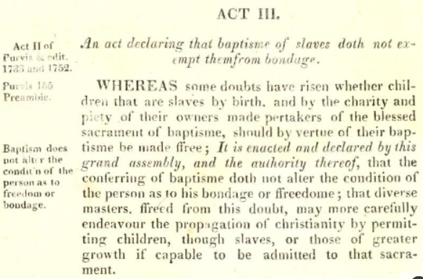
2. RECKONING
In "An act declaring that baptisme of slaves doth not exempt them from bondage," passed by the General Assembly in the session of September 1667, Virginia's colonial government, composed of White Anglican men, attempted to better define the conditions by which people were enslaved or free.
HUMAN JUSTICE
REFORMATION

Slide 14
2. RECKONING
In "An act declaring that baptisme of slaves doth not exempt them from bondage," passed by the General Assembly in the session of September 1667, Virginia's colonial government, composed of White Anglican men, attempted to better define the conditions by which people were enslaved or free.
Translation: “God can have your souls, but we keep your bodies.”
HUMAN JUSTICE
REFORMATION

Slide 15
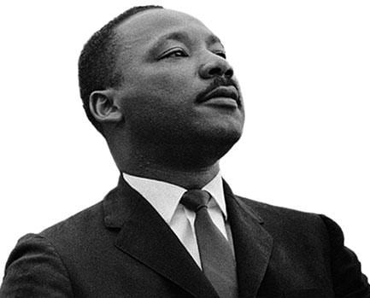
2. RECKONING
"First, I must confess that over the last few years I have been gravely disappointed with the white moderate. I have almost reached the regrettable conclusion that the Negro's great stumbling block in the stride toward freedom is not the White Citizen's Council-er or the Ku Klux Klanner, but the white moderate who is more devoted to ‘order’ than to justice; who prefers a
negative peace which is the absence of tension to
a positive peace which is the presence of justice;
who constantly says ‘I agree with you in the goal
you seek, but I can't agree with your methods of direct action;’…”
HUMAN JUSTICE
REFORMATION

Slide 16
2. RECKONING
“…who paternalistically feels he can set the timetable for another man's freedom; who lives by the myth of time and who constantly advises the Negro to wait until a ‘more convenient season.’ Shallow understanding from people of goodwill is more frustrating than absolute misunderstanding from people of ill will. Lukewarm acceptance is much more bewildering than outright rejection."
–Rev. Martin Luther King, Jr., Letter from Birmingham Jail (April 16, 1963)
HUMAN JUSTICE
REFORMATION

Slide 17
3. REFORMING
Ephesians 5:13-16 ¹³ But when anything is exposed by the light, it becomes visible, ¹⁴ for anything that becomes visible is light.
Therefore it says,
“Awake, O sleeper, and arise from the dead, and Christ will shine on you.”
¹⁵ Look carefully then how you walk, not as unwise but as wise, ¹⁶ making the best use of the time, because the days are evil.
HUMAN JUSTICE
REFORMATION

Slide 18
3. REFORMING
Proverbs 3:27-28 ²⁷ Do not withhold good from those to whom it is due, when it is in your power to do it. ²⁸ Do not say to your neighbor, “Go, and come again, tomorrow I will give it”—when you have it with you.
HUMAN JUSTICE
REFORMATION

Slide 19
3. REFORMING
Proverbs 3:27-28 ²⁷ Do not withhold good from those to whom it is due, when it is in your power to do it. ²⁸ Do not say to your neighbor, “Go, and come again, tomorrow I will give it”—when you have it with you.
James 2:14-17 ¹⁴ What good is it, my brothers, if someone says he has faith but does not have works? Can that faith save him? ¹⁵ If a brother or sister is poorly clothed and lacking in daily food, ¹⁶ and one of you says to them, “Go in peace, be warmed and filled,” without giving them the things needed for the body, what good is that? ¹⁷ So also faith by itself, if it does not have works, is dead.
HUMAN JUSTICE
REFORMATION

Slide 20
3. REFORMING
Galatians 5:13-16, 25 ¹³ For you were called to freedom, brothers and sisters. Only do not use your freedom as an opportunity for the flesh, but through love serve one another. ¹⁴ For the whole law is fulfilled in one word: “You shall love your neighbor as yourself.” ¹⁵ But if you bite and devour one another, watch out that you are not consumed by one another. ¹⁶ But I say, walk by the Spirit, and you will not gratify the desires of the flesh.
²⁵ If we live by the Spirit, let us also keep in step with the Spirit.
HUMAN JUSTICE
REFORMATION

Slide 21
3. REFORMING
Galatians 5:13-16, 25 ¹³ For you were called to freedom, brothers and sisters. Only do not use your freedom as an opportunity for the flesh, but through love serve one another. ¹⁴ For the whole law is fulfilled in one word: “You shall love your neighbor as yourself.” ¹⁵ But if you bite and devour one another, watch out that you are not consumed by one another. ¹⁶ But I say, walk by the Spirit, and you will not gratify the desires of the flesh.
²⁵ If we live by the Spirit, let us also keep in step with the Spirit.
James 4:17 So whoever knows the right thing to do and fails to do it, for him it is sin.
HUMAN JUSTICE
REFORMATION

Slide 22
3. REFORMING
HUMAN JUSTICE
REFORMATION

Slide 23
3. REFORMING
Tallgrass Anti-Racism GroupMe
HUMAN JUSTICE
REFORMATION

Slide 24
3. REFORMING
Facebook Group
Tallgrass Anti-Racism GroupMe
HUMAN JUSTICE
REFORMATION

Slide 25
HUMAN JUSTICE
REFORMATION
REMEMBERING
RECKONING
REFORMING
REDEEMER

Slide 26
4. REDEEMER
Ephesians 2:13-17 ¹³ But now in Christ Jesus you who once were far off have been brought near by the blood of Christ. ¹⁴ For he himself is our peace, who has made us both one and has broken down in his flesh the dividing wall of hostility ¹⁵ by abolishing the law of commandments expressed in ordinances, that he might create in himself one new man in place of the two, so making peace, ¹⁶ and might reconcile us both to God in one body through the cross, thereby killing the hostility. ¹⁷ And he came and preached peace to you who were far off and peace to those who were near.
HUMAN JUSTICE
REFORMATION

