Slide 1
WELCOME

Slide 2
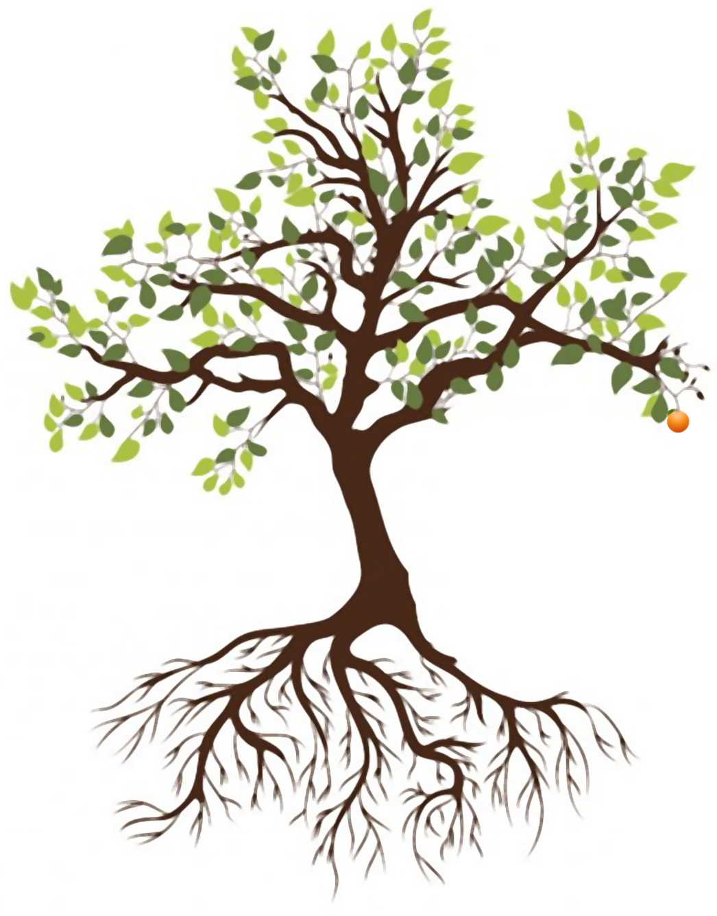
MESSIANIC SEDER
APRIL 8 DURING HOLY WEEK 2020

Slide 3
ROLES
Leader: _______________
Woman: _______________
Participant 1: _______________
Participant 2: _______________
Participant 3: _______________
Participant 4: _______________

Slide 4
SETUP
Charoset (mixture made from chopped apples, honey, nuts, and grape juice)
Four wine glasses per person (or some other type of glasses, preferably clear)
The Seder Plate (put all the things on it!)
Candles
Two song selections (Amazing Grace and the Doxology are in this document)

Slide 5
WELCOME
LEADER: Thanks for Zooming in! Before we begin our Seder, I want to take time to explain what it is. The Seder meal is part of the Jewish traditional Passover celebration. Seder means order. It is the order of service by which we recall the miraculous provisions of God as He delivered the Israelites from the bondage of slavery in Egypt, specifically by “passing over” the Israelite homes with lamb’s blood on the doorposts. The first Passover was celebrated by the Israelites, according to God’s command (Exd.12:1-2), the night before the Exodus from Egypt. Passover was and is a shadow of what is to come.

Slide 6
WELCOME
LEADER: The story we tell tonight has been retold for thousands of years. It is a timeless story of the eternal truth of God’s involvement and care of His people. It is retold through the Seder Plate that you see before us. Each item on the Seder Plate plays a part in retelling the story. During this time, we remember how God showed man’s sinfulness, His own willingness to forgive, His power to deliver his people and to make a way for them where there was no way.

Slide 7
WELCOME
LEADER: It was at Jesus’ last Passover that He instructed believers to keep the Lord's Supper, in remembrance of His sacrificial death on the Cross. The Jewish Passover of today still points to Y'shua, the Hebrew way to say Jesus, as the Messiah. Y'shua, Jesus and Joshua are all the same word, meaning Salvation, Jehovah Saves.

Slide 8
WELCOME
LEADER: The order of service we will follow tonight is a variation of the Jewish writing, called the HAGGADAH. HAGGADAH means "the Telling". In Exodus 13:8, it says “you shall tell your sons of the Exodus…” There are many versions of the Haggadah written by various Jewish Rabbis. The Seder we will be following tonight has been revised to be a “Messianic Seder” meaning that it reflects our belief in Jesus as the Messiah, the lamb of God, who has already come to save us.

Slide 9
STANDING SANCTIFICATION
ALL (STANDING): Blessed are You, O LORD our God, King of the Universe, Who has chosen us from the beginning of time, exalting us by making us holy through the blood of the Lamb of Christ. In love You have given us, O LORD our God, Sabbaths for rest, holidays for joy, festivals for gladness… and the Son for our redemption.
You give us this feast of unleavened bread, the season of our freedom, in commemoration of the Jewish Liberation from Egypt and of liberation from sin and its punishment for all peoples. Blessings to our God who saw fit to deliver us!

Slide 10
LIGHTING ^{OF THE} CANDLES
LEADER: Light is a symbol of God’s presence. Lighting candles during holidays remind us that God is our light.
(Everyone lights a candle and puts in a place where everyone can see it without burning anything down.)
WOMAN: Blessed are You, O LORD our God, King of the Universe, who has sent Your Son, Your Only Son, Jesus the Messiah, to be the light of the world and our Paschal Lamb, that through Him we might live. Blessed are You, O LORD our God, King of the Universe, Who has kept us in life and has preserved us, and has enabled us to reach this season. Amen.

Slide 11
1ST CUP ^{OF} WINE—SANCTIFICATION
LEADER: We start the Seder with the first of four cups of “wine,” a custom that goes back to ancient times. Each cup is completely drunk to symbolize the completeness of our joy. We have wine or grape juice tonight, and will fill our cups only slightly each time. There is a teaching that the four cups correspond to God’s will for us: “I will bring you out… I will free you… I will redeem you… I will take you as My own people” (Ex. 6:6-7). Each cup symbolizes a vital element of the “Seder” telling: Sanctification, Thanksgiving, Redemption, and Praise. As we lift our cup together, let us remember with joy that we are sanctified to God through Jesus and praise Him, saying:

Slide 12
1ST CUP ^{OF} WINE—SANCTIFICATION
ALL: Blessed are You, O Lord our God, King of the Universe, Creator of the Fruit of the Vine.
(Everyone fills and distributes four cups of wine or juice per person and puts them in a visible place where they won’t spill.)
LEADER: Let us drink together this first cup of Passover.
(All drink the cup.)

Slide 13
EATING ^{OF THE} GREEN VEGETABLE
LEADER: (Lifting up the parsley) We will take the parsley, called karpas, and we will dip it into the salt water. Green is a symbol of life and Spring time. It reminds us that God is a faithful provider of sustenance for His people. It also reminds us of the hyssop branches the Israelites used to paint Lamb’s blood on their doorposts.
(Lifting up the salt water) The salt water is to remind us of the tears shed by the oppressed house of Israel while in slavery in Egypt.
(Everyone dips a piece of parsley in salt water and eats it.)

Slide 14
BREAKING ^{OF THE} MIDDLE MATZAH
(Show three Matzah wrapped in a white cloth)
LEADER: Now comes the breaking of the middle matzah. Three Matzos are placed in a special white covering. The middle matzah is removed and broken. The larger piece is wrapped and hidden, it is called the afikoman meaning “that which comes later”. [in Greek]. The Afikoman is hidden, or buried, to be found and redeemed later for a reward.
(Break the middle bread.)
Now we will HIDE the Afikomen. All the children need to close their eyes....
(Hide the bread somewhere visible.)

Slide 15
FOUR QUESTIONS
CHILDREN: Why is this night different from all other nights? Why on this night do we eat only matzah for bread? Why on this night do we eat only bitter herbs? Why on this night must we dip our vegetables twice? Why, on this night do we put a pillow at the leader’s place to remind us of reclining?
LEADER: Tonight is different from all other nights because tonight we will remember what God has done for His people. “The LORD, said: “And when your children ask you, ‘What does this ceremony mean to you?’” then tell them:
ALL: “It is the Passover sacrifice to the LORD, who passed over the houses of the Israelites in Egypt and spared our homes when He struck down the Egyptians” (Ex. 12:27, 28).

Slide 16
FOUR QUESTIONS
PARTICIPANT 1: We eat matzah because when our ancestors were told by Pharaoh that they could leave Egypt, they had no time to bake bread with leaven, so they baked it without leaven.
PARTICIPANT 2: At the Seder, we eat bitter herbs to remind us of the bitterness our ancestors experienced when they were oppressed by the Egyptian taskmasters.
PARTICIPANT 3: At the Seder, we dip food twice as symbols within our story: the parsley in salt water, as we have already explained, and the matzah into bitter herbs, as we shall explain.

Slide 17
FOUR QUESTIONS
PARTICIPANT 4: In ancient times, slaves ate hurriedly, standing, while royalty and the wealthy in Egypt and other empires, dined on couches. To show that Israel was now free, they too reclined while eating. Once we were slaves, but the LORD in His goodness and mercy redeemed us with a mighty hand and outstretched arm. We recline to recognize Him for the rest He has given to us.

Slide 18
LEADER: Now we will read the telling of THE PASSOVER STORY Responsively from our Seder program.
READER: The Bible teaches that during a great famine in the land of Canaan, the sons of Israel journeyed to Egypt to purchase food. There they were reunited with their brother Joseph. Because of his influence, they were permitted to dwell in the fertile plains of Goshen. At first, the House of Israel numbered less than 80 souls. But in time, their numbers swelled, their flocks increased, and they became a mighty people.
ALL: And then there arose a new Pharaoh, one who did not know Joseph. He beheld the might of Israel, and he feared that in time of war, the sons of Jacob might join themselves with Egypt's foes.
MAGGID—TELLING ^{THE} PASSOVER STORY

Slide 19
READER: And so he subdued the Israelites, and he afflicted them with cruel labor. Task masters were placed over the Israelites, to compel them to make bricks and to build Pharaoh's great storage cities of Ramses and Pithom.
ALL: But despite their hardship, they continued to thrive, just as God had promised. This caused Pharaoh even greater alarm, and he ordered the slaughter of Israel's infant sons. By his command, every male child born to the Hebrews was to be cast into the Nile and drowned.
MAGGID—TELLING ^{THE} PASSOVER STORY

Slide 20
READER: How sober were the afflictions of the Jewish people. In anguish, we cried to the God of our Fathers. And God heard our cry. God remembered His covenant. And God raised up a deliverer, a redeemer, the man Moses. And He sent Moses to Pharaoh's court to declare the commandment of the Lord...
ALL: Let my people go.
MAGGID—TELLING ^{THE} PASSOVER STORY

Slide 21
READER: But Pharaoh would not hearken to the Lord of Hosts. And so, Moses pronounced God's judgment on Pharaoh's house and on Pharaoh's land. Plagues were poured out upon the Egyptians, upon their crops, and upon their flocks.
ALL: But Pharaoh's heart was hardened. He would not yield to the will of God. He would not let the House of Jacob depart.
MAGGID—TELLING ^{THE} PASSOVER STORY

Slide 22
MAGGID—TELLING THE PASSOVER STORY
READER: Then the tenth plague fell upon the land of Egypt: the death of Egypt's firstborn. "And all the first born in the land of Egypt shall die, from the first born of Pharaoh who sittest upon his throne, even unto the first born of the maid servant who was behind the mill; and all the first born of beasts...and against all the gods of Egypt I will execute judgment." But to protect the children of Israel, God commanded the head of each Jewish household to sacrifice a spotless lamb, without breaking any of its bones, and to apply it's blood to the doorway of our homes, first to the top of the doorway, the lintel, and then to the two sideposts.
ALL: "And the blood shall be to you for a token upon the houses where you are; and when I see the blood, I will pass over you, and the plagues shall not be upon you to destroy you when I smite the land of Egypt."

Slide 23
READER: By the blood of the lamb was Israel spared.
ALL: By the blood of the lamb was Jacob redeemed. By the blood of the lamb was death made to pass over.
READER: Passover. The night when death passed over the houses of Israel because of the blood of the Passover lamb. What a mighty act of redemption. And what a beautiful picture of redemption destined to come. For just as no bones of the first Passover lambs were broken, so none of the Messiah's bones were broken.
MAGGID—TELLING ^{THE} PASSOVER STORY

Slide 24
MAGGID—TELLING ^{THE} PASSOVER STORY
ALL: And just as the blood of those first Passover lambs was applied in faith to the doorposts of Israel's homes, so the blood of the Messiah must be applied in faith to the doorposts of our hearts.
READER: Tonight, we worship God not only because the angel of death passed over our ancestors’ homes, but because all of us whether Jewish or Gentile, may be redeemed from an even greater bondage through our faith in the Messiah of Israel, the Messiah Jesus. Through Him, we may pass over from death to life.

Slide 25
2ND CUP ^{OF} WINE—THANKSGIVING
LEADER: In every generation one must look upon himself as if he personally had come out from Egypt, as the Bible says: "And thou shalt tell thy son on that day, saying, it is because of that which the Lord did to me when I went forth from Egypt." For it was not only our forefathers whom the Holy One, blessed be He, redeemed; He redeemed us too, with them, as it is said: "He brought us out from there that He might lead us to and give us the land which He pledged to our forefathers."
ALL: Therefore, it is our duty to thank and to praise in song and prayer, to glorify and extol Him who performed all these wonders for our forefathers and for us. He brought us out from slavery to freedom, from anguish to joy, from sorrow to festivity, from darkness to great light.

Slide 26
AMAZING GRACE
Amazing grace! How sweet the sound
That saved a wretch like me!
I once was lost, but now am found;
Was blind, but now I see.

Slide 27
AMAZING GRACE
’Twas grace that taught my heart to fear,
And grace my fears relieved;
How precious did that grace appear
The hour I first believed.

Slide 28
AMAZING GRACE
Through many dangers, toils, and snares,
I have already come;
’Tis grace hath brought me safe thus far,
And grace will lead me home.

Slide 29
AMAZING GRACE
The Lord has promised good to me,
His Word my hope secures;
He will my Shield and Portion be,
As long as life endures.

Slide 30
AMAZING GRACE
Yea, when this flesh and heart shall fail,
And mortal life shall cease,
I shall possess, within the veil,
A life of joy and peace.

Slide 31
AMAZING GRACE
The earth shall soon dissolve like snow,
The sun forbear to shine;
But God, who called me here below,
Will be forever mine.

Slide 32
AMAZING GRACE
When we’ve been there ten thousand years,
Bright shining as the sun,
We’ve no less days to sing God’s praise
Than when we’d first begun.
(Distribute and fill the 2nd cup of wine.)
LEADER: Let us all drink the 2nd cup of Thanksgiving to our Lord.

Slide 33
THE BITTER HERBS
LEADER: (Lifting up the bitter herbs) These are the bitter herbs which we will eat. The youngest has asked, “What is the reason for them?”
ALL: It is because the Egyptians made the lives of our fathers in Egypt so bitter and miserable. As it is said, “And they made their lives so bitter with hard labor in mortar and bricks and all kinds of labor in the fields,” forcing them to toil long and hard (Ex. 1:14).

Slide 34
THE BITTER HERBS
LEADER: These bitter herbs are symbolic of the bitterness of slavery and the miserable existence in Egypt, and also of the bitterness of death. The Israelites’ firstborn children lived because the lambs died. To us as Christians, the eating of bitter herbs reminds us of our lives before we knew the Savior. The bitter herbs are symbolic of the bitter cup our LORD tasted on our behalf. The horseradish brings tears to our eyes as we taste it and remember. (See Rom. 6:6-8.)
ALL: We live because Christ died.
(Get Matzah to be broken into pieces and dipped into the bitter herbs. All eat.)

Slide 35
THE BITTER HERBS
LEADER: Charoset is a mixture made from chopped apples, honey, nuts and grape juice. With this mixture, we remember how the Israelites labored to make treasure cities for Pharaoh as they worked in brick and clay. (Lifting charoset) Let us once again place some bitter herbs on a small piece of matzah. But this time, before we eat, let’s put the sweet charoset on top of the bitter herbs. (Put horseradish on matzah, then cover horseradish with charoset)
ALL: (Lifting the matzah with the maror and charoset) We put the charoset with the bitter herbs to remind ourselves that even the most bitter of circumstances can be made sweet by the hope we have in Jesus.
(All eat)

Slide 36
TIME FOR THE MEAL
SIDENOTE TO BE READ BY THE LEADER: This sandwich was eaten with Lamb during temple times in Jerusalem. It is also known as “the sop”. It is still the custom today to give this dipped sop with affection to a loved one. It was with the dipped sop that Jesus spoke of his betrayal: "One of you shall betray me." Peter motioned John to ask who he was. Jesus answered: " He it is, to whom I shall give a sop" After he dipped sop and handed it to Judas, Judas left to betray Him. (John 13:21-28)

Slide 37
BAREICH—GRACE AFTER THE MEAL
LEADER: Let us continue the Seder. Let us read responsively the Grace.
LEADER: Let us give thanks to the Lord.
ALL: May the name of the Lord be blessed from this time forth and forever.
LEADER: We praise You, O God, from whose abundance we have partaken.
ALL: We praise You, O Lord our God, our Savior and our King who gives bread to all flesh, for Your lovingkindness endures forever.

Slide 38
TZAFON—EATING THE AFIKOMAN
LEADER: Our meal cannot be completed without eating the AFIKOMAN. The AFIKOMAN, the broken middle matzah that was hidden and now will be brought back, must be found. The one who finds it receives a great reward. The children must now get up and find the Afikoman.
(Children hunt for the hidden bread and hand it to their parent(s).)
LEADER: Thank you. I will give you all your reward later. Please see me after the Seder is over.
The AFIKOMAN is our substitute for the Passover Lamb, which in days of old, was the final food of the Seder feast.

Slide 39
TZAFON—EATING THE AFIKOMAN
LEADER: The roasted Passover lamb was not allowed to be eaten outside of Jerusalem, so the afikoman eventually took on much of the significance of the Passover lamb for the Jews who celebrated outside of Jerusalem. Jesus foretold of the temple destruction, and he knew that the Passover sacrifice which could be offered only by dwellers in, or travelers to, Jerusalem, would soon cease. When Jerusalem fell to the Romans, lamb was no longer eaten at the Seder. With afikoman alone we can remember the Lamb, our Messiah.

Slide 40
TZAFON—EATING THE AFIKOMAN
LEADER: It was during the blessing after the Passover meal and the during the eating of the Afikoman that the Bible tells us: Jesus, the same night in which he was betrayed, took bread: and when he had given thanks, he broke it, and said, Take, eat: this is my body, which is broken for you: this do in remembrance of me. (1 Corinthians 11:23-24)
(Each person breaks off a portion.)
LEADER: Let us eat the bread. His sacrificial death on the cross fulfilled the prophetic symbolism of the Passover Lamb.

Slide 41
3RD CUP ^{OF} WINE—REDEMPTION
LEADER: With this cup, Jews remember their deliverance from 430 years of slavery, and their redemption from the plague of death by the blood of the first Passover Lamb. It was with this cup The Word of God tells us: In the same way, after the supper he, (the Lord Jesus) took the cup, saying, "This cup is the new covenant in my blood, which is poured out for you. (Luke 22:20) This do, as often as you drink it, in remembrance of Me" (1 Corinthians 11:25b)
ALL: I will lift up the cup of salvation, and call on the name of the Lord, remembering that Jesus’ blood was poured out for the forgiveness of sins. Let us be thankful. Blessed art Thou, O Lord, Our God, King of the universe, Creator of the fruit of the Vine.

Slide 42
3RD CUP ^{OF} WINE—REDEMPTION
LEADER: Let us drink the 3rd cup symbolizing our redemption.
(All drink the third cup)
LEADER: In Egypt, had they not trusted God and applied the blood of the Lamb to their doors, they would have died. So also, God must see the blood of the Lamb, Jesus our Savior at the door of our heart, that we may Passover from death to life. It was by God's Grace and for His namesake that Israel was redeemed, not by their own righteousness. So it is also with our redemption from sin and spiritual death, for those who have put here faith in Jesus, the Lamb of God.

Slide 43
3RD CUP ^{OF} WINE—REDEMPTION
LEADER: We are witnesses to God's power to deliver us from slavery and sin. God calls us. Do not go back to bondage in Egypt nor back to the bondage of sin. There is a Redeemer, Jesus our Lord.
ALL: We have partaken of the afikoman and the Third cup of redemption, remembering the One who was to come, has already come and will come again.

Slide 44
HALLEL—PSALMS ^{OF} PRAISE
[The Passover Hallels are the Psalms of praises, Psalms 113 to 118 are the Passover Psalms. The Great Passover Hallel is Psalm 136. These were sung in the Temple by the Temple Choir during Passover.]
LEADER: Let us read Responsively a Hallel of Praise, after which we will drink our fourth and final cup of wine—that of Praise and completion.
READER: Praise the Lord!
ALL: Praise, O servants of the Lord. Praise the name of the Lord.

Slide 45
HALLEL—PSALMS ^{OF} PRAISE
READER: Blessed be the name of the Lord from this time forth and forever. When Israel went forth from Egypt, the House of Jacob from a people of strange language, Judah became His sanctuary, Israel His dominion.
ALL: The sea looked and fled. The Jordan turned back. The mountains skipped like rams, the hills like lambs.
READER: You who fear the Lord, trust in the Lord; He is their help and their shield. What shall I render to the Lord for all His benefits toward me?
ALL: I shall lift up the cup of salvation, and call upon the name of the Lord.

Slide 46
HALLEL—PSALMS ^{OF} PRAISE
READER: Give thanks to the Lord, for He is good.
ALL: For His lovingkindness is everlasting.
READER: I shall give thanks to Thee, for Thou hast answered me; and Thou hast become my salvation.
ALL: The stone which the builders rejected has become the chief cornerstone.

Slide 47
HALLEL—PSALMS ^{OF} PRAISE
LEADER: This is the Lord's doing; It is marvelous in our eyes.
ALL: This is the day which the Lord has made. Let us rejoice and be glad in it.
READER: Blessed is the One who comes in the name of the Lord.
ALL: Give thanks to the Lord for He is good. For His lovingkindness is everlasting.

Slide 48
4TH CUP ^{OF} WINE—PRAISE & COMPLETION
(Distribute cups and all drink)

Slide 49
DOXOLOGY
(Sing together.)
Praise God from whom all blessings flow
Praise Him all creatures here below
Praise Him above ye heavenly hosts
Praise Father, Son, and Holy Ghost
Amen.

Slide 50
CLOSING
ALL: In Closing we call out to our Lord and God. Have compassion, O Lord our God, upon us, upon Israel Your people, upon Jerusalem Your city, on Zion the dwelling place of Your glory, and upon Your altar and Your Temple. Rebuild Jerusalem, Your holy city, speedily in our days. Be gracious to us and give us strength. Blessed art Thou, Lord our God, Ruler of the universe. We thank Thee for sustaining us all to this day. Blessed be the Lord.
LEADER: The Seder customary ends by everyone saying: Next Year in Jerusalem!
ALL: Next Year in Jerusalem!

Slide 51
CLOSING
ALL: We hope to see one another someday in the New Jerusalem!

Slide 52
THANKS

