Slide 1
WELCOME

Slide 2
King of Kings
Brooke Ligertwood, Jason Ingram, Scott Ligertwood. #7127647

Slide 3
Praise the Father, Praise the Son
Praise the Spirit three in one
God of glory, Majesty
Praise forever to the King of kings
King of Kings

Slide 4
In the darkness we were waiting
Without hope without light
Till from heaven You came running
There was mercy in Your eyes
King of Kings

Slide 5
To fulfill the law and prophets
To a virgin came the Word
From a throne of endless glory
To a cradle in the dirt
King of Kings

Slide 6
Praise the Father, Praise the Son
Praise the Spirit three in one
God of glory, Majesty
Praise forever to the King of kings
King of Kings

Slide 7
To reveal the Kingdom coming
And to reconcile the lost
To redeem the whole creation
You did not despise the cross
King of Kings

Slide 8
For even in Your suffering
You saw to the other side
Knowing this was our salvation
Jesus for our sake You died
King of Kings

Slide 9
Praise the Father, Praise the Son
Praise the Spirit three in one
God of glory, Majesty
Praise forever to the King of kings
King of Kings

Slide 10
And the morning that You rose
All of heaven held its breath
Till that stone was moved for good
For the Lamb had conquered death
King of Kings

Slide 11
And the dead rose from their tombs
And the angels stood in awe
For the souls of all who’d come
To the Father are restored
King of Kings

Slide 12
And the Church of Christ was born
Then the Spirit lit the flame
Now this gospel truth of old
Shall not kneel shall not faint
King of Kings

Slide 13
By His blood and in His Name
In His freedom I am free
For the love of Jesus Christ
Who has resurrected me
King of Kings

Slide 14
Praise the Father, Praise the Son
Praise the Spirit three in one
God of glory, Majesty
Praise forever to the King of kings
King of Kings

Slide 15
Mingle Question
What’s your favorite restaurant & why?

Slide 16
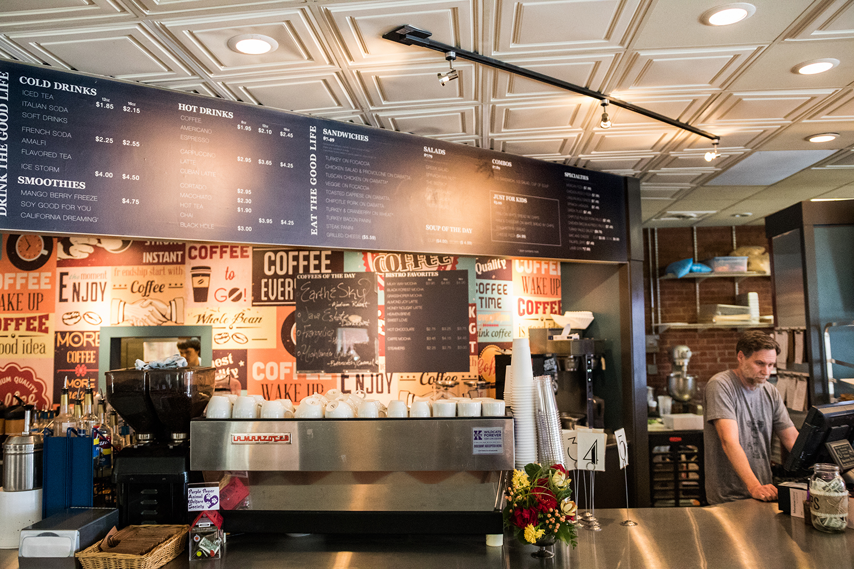

Slide 18
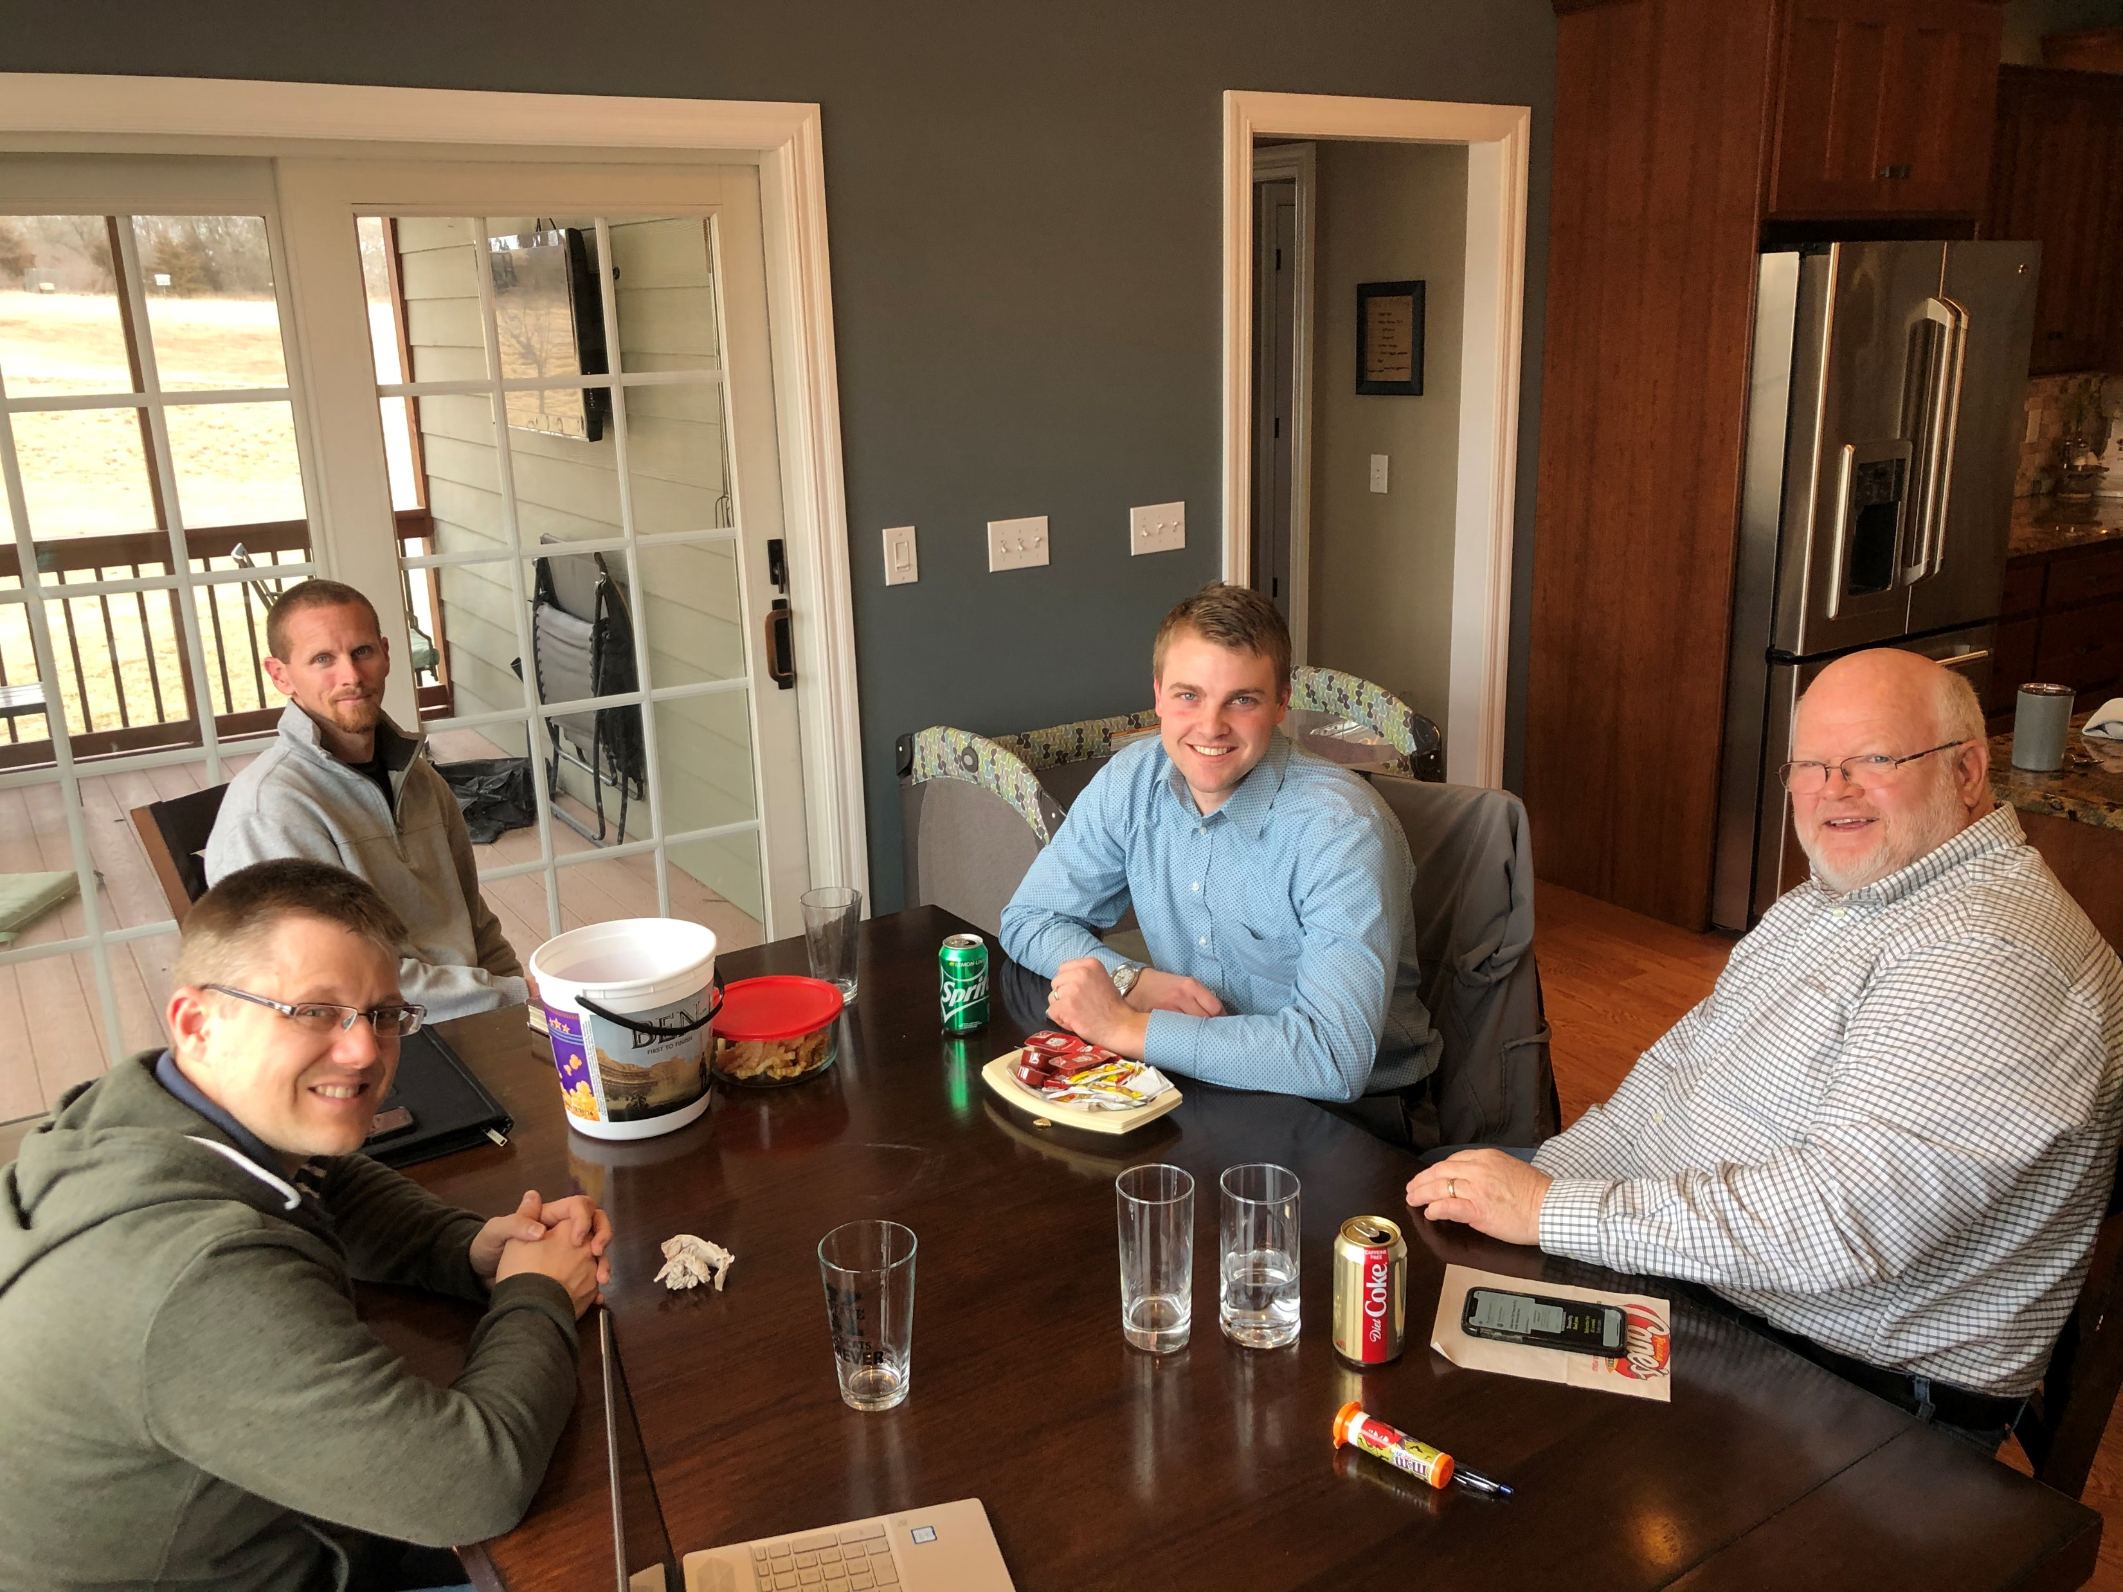
Tallgrass Church Elder Team
Dave Geldart, Ricky Greeve, David Renberg,
Ron Goodman, Ben Deaver

Slide 19
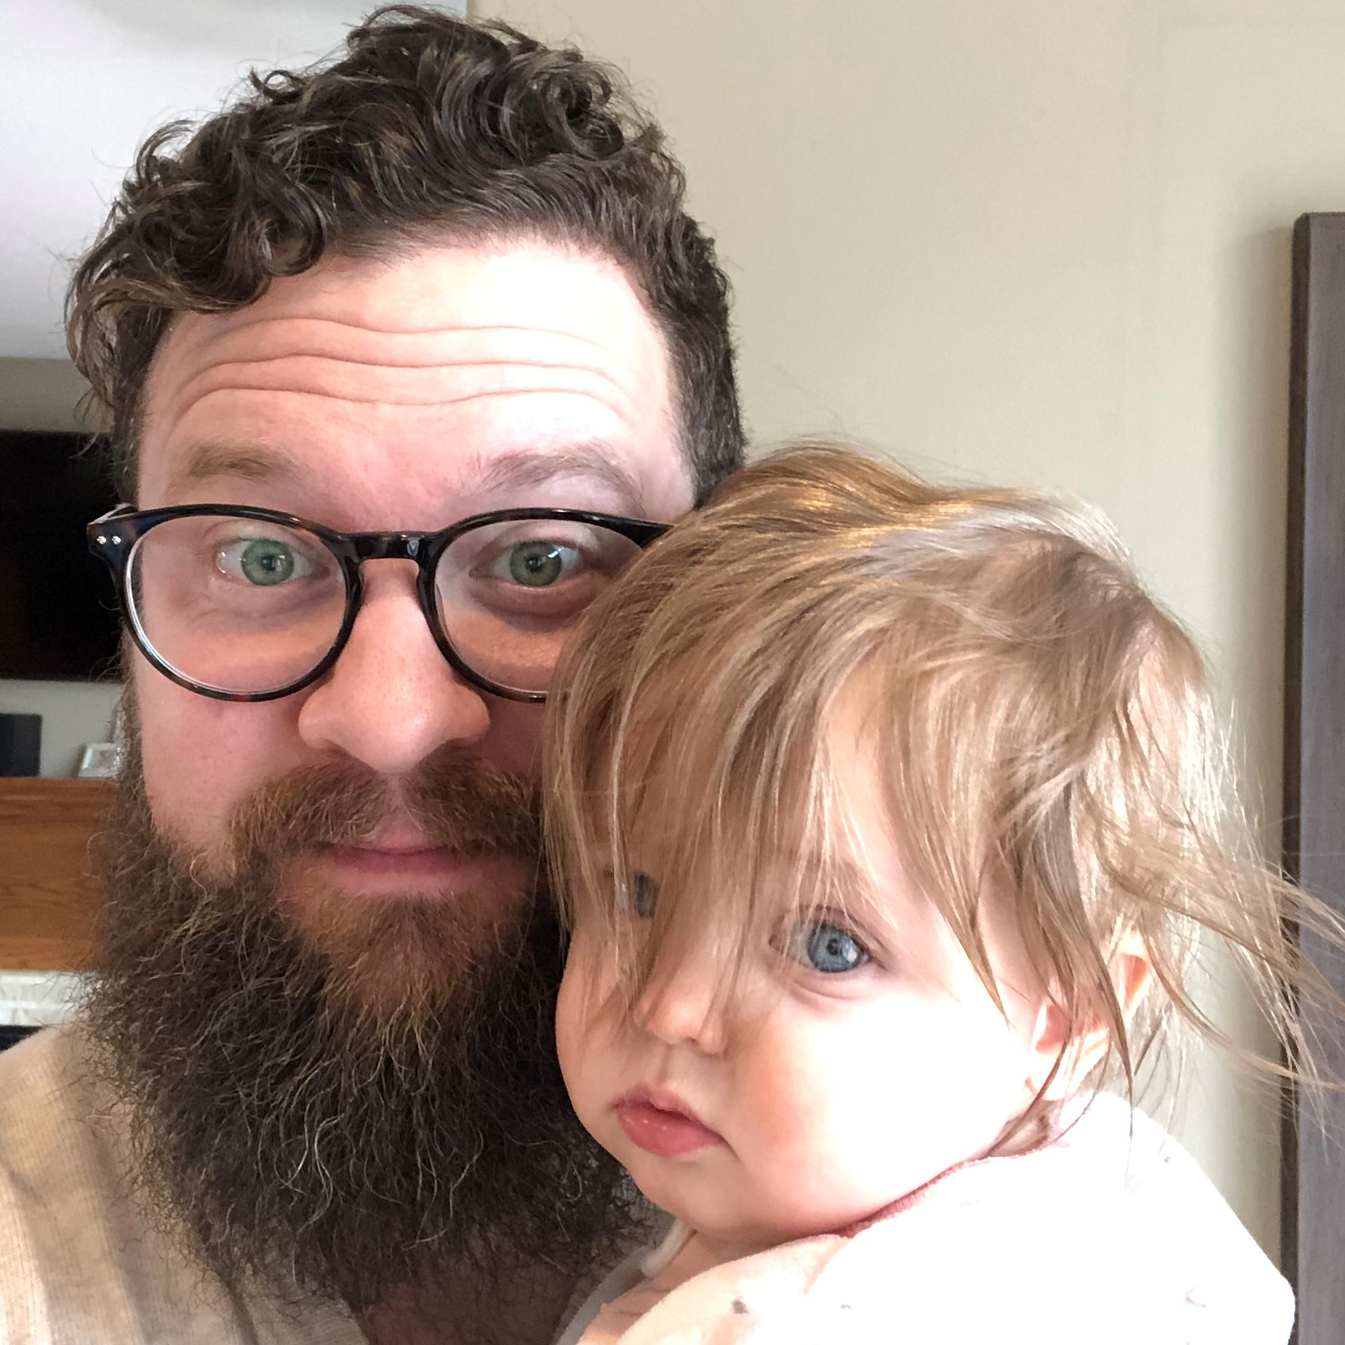
Tallgrass Church Elder Team
Dave Geldart, Ricky Greeve, David Renberg,
Ron Goodman, Ben Deaver

Slide 20
Acts 2:41
So those who received his word were baptized, and there were added that day about three thousand souls.

Slide 21
Acts 2:42-47
⁴² And they devoted themselves to the apostles' teaching and the fellowship, to the breaking of bread and the prayers. ⁴³ And awe came upon every soul, and many wonders and signs were being done through the apostles. ⁴⁴ And all who believed were together and had all things in common. ⁴⁵ And they were selling their possessions and belongings and distributing the proceeds to all, as any had need. ⁴⁶ And day by day, attending the temple together and breaking bread in their homes, they received their food with glad and generous hearts, ⁴⁷ praising God and having favor with all the people. And the Lord added to their number day by day those who were being saved.

Slide 22
Acts 2:42-47
⁴² And they devoted themselves to the apostles' teaching and the fellowship, to the breaking of bread and the prayers. ⁴³ And awe came upon every soul, and many wonders and signs were being done through the apostles. ⁴⁴ And all who believed were together and had all things in common. ⁴⁵ And they were selling their possessions and belongings and distributing the proceeds to all, as any had need. ⁴⁶ And day by day, attending the temple together and breaking bread in their homes, they received their food with glad and generous hearts, ⁴⁷ praising God and having favor with all the people. And the Lord added to their number day by day those who were being saved.

Slide 23
Acts 2:42-47
⁴² And they devoted themselves to the apostles' teaching and the fellowship, to the breaking of bread and the prayers. ⁴³ And awe came upon every soul, and many wonders and signs were being done through the apostles. ⁴⁴ And all who believed were together and had all things in common. ⁴⁵ And they were selling their possessions and belongings and distributing the proceeds to all, as any had need. ⁴⁶ And day by day, attending the temple together and breaking bread in their homes, they received their food with glad and generous hearts, ⁴⁷ praising God and having favor with all the people. And the Lord added to their number day by day those who were being saved.
Devoted to L.I.F.E.

Slide 24
Acts 2:42-47
⁴² And they devoted themselves to the apostles' teaching and the fellowship, to the breaking of bread and the prayers. ⁴³ And awe came upon every soul, and many wonders and signs were being done through the apostles. ⁴⁴ And all who believed were together and had all things in common. ⁴⁵ And they were selling their possessions and belongings and distributing the proceeds to all, as any had need. ⁴⁶ And day by day, attending the temple together and breaking bread in their homes, they received their food with glad and generous hearts, ⁴⁷ praising God and having favor with all the people. And the Lord added to their number day by day those who were being saved.
Learning Biblical Truth

Slide 25
Acts 2:42-47
⁴² And they devoted themselves to the apostles' teaching and the fellowship, to the breaking of bread and the prayers. ⁴³ And awe came upon every soul, and many wonders and signs were being done through the apostles. ⁴⁴ And all who believed were together and had all things in common. ⁴⁵ And they were selling their possessions and belongings and distributing the proceeds to all, as any had need. ⁴⁶ And day by day, attending the temple together and breaking bread in their homes, they received their food with glad and generous hearts, ⁴⁷ praising God and having favor with all the people. And the Lord added to their number day by day those who were being saved.
Intercession (Prayer)

Slide 26
Acts 2:42-47
⁴² And they devoted themselves to the apostles' teaching and the fellowship, to the breaking of bread and the prayers. ⁴³ And awe came upon every soul, and many wonders and signs were being done through the apostles. ⁴⁴ And all who believed were together and had all things in common. ⁴⁵ And they were selling their possessions and belongings and distributing the proceeds to all, as any had need. ⁴⁶ And day by day, attending the temple together and breaking bread in their homes, they received their food with glad and generous hearts, ⁴⁷ praising God and having favor with all the people. And the Lord added to their number day by day those who were being saved.
Fellowship

Slide 27
koinonia
Acts 2:42-47
⁴² And they devoted themselves to the apostles' teaching and the fellowship, to the breaking of bread and the prayers. ⁴³ And awe came upon every soul, and many wonders and signs were being done through the apostles. ⁴⁴ And all who believed were together and had all things in common. ⁴⁵ And they were selling their possessions and belongings and distributing the proceeds to all, as any had need. ⁴⁶ And day by day, attending the temple together and breaking bread in their homes, they received their food with glad and generous hearts, ⁴⁷ praising God and having favor with all the people. And the Lord added to their number day by day those who were being saved.
Fellowship

Slide 28
Acts 2:42-47
⁴² And they devoted themselves to the apostles' teaching and the fellowship, to the breaking of bread and the prayers. ⁴³ And awe came upon every soul, and many wonders and signs were being done through the apostles. ⁴⁴ And all who believed were together and had all things in common. ⁴⁵ And they were selling their possessions and belongings and distributing the proceeds to all, as any had need. ⁴⁶ And day by day, attending the temple together and breaking bread in their homes, they received their food with glad and generous hearts, ⁴⁷ praising God and having favor with all the people. And the Lord added to their number day by day those who were being saved.
Extending LIFE to Others

Slide 29
Acts 1839:42-43
⁴² We devoted ourselves to the Scriptures and to our church family, to eating meals together including the Lord’s Supper and to praying with and for one another diligently. ⁴³ We prayed for God to do amazing things in our own hearts and in the neighborhoods we were in. And guess what, He did! Every single person who was a part of the Tallgrass family was amazed by what God was doing.

Slide 30
Acts 1839:44-45
⁴⁴ Many awesome things happened through every one of the followers of Jesus who called Tallgrass Church home. We were in it together; through joys and sorrows, anxiety and depression, life and death, sickness and health, great times and difficult times. We met one another’s needs. ⁴⁵ We were meeting together in some way, whether at Central Gathering, at LIFE Group, one-on-one discipleship, serving alongside one another in the community, or just going for a run or hunting or doing yoga together, just about every day of the week.

Slide 31
Acts 1839:44-45
⁴⁶ We ate together all the time with happy and generous hearts. We knew how to give to and receive from one another in a way that built up our community with the love of Jesus. We worshiped God through singing together and then through living out the Gospel throughout each week. ⁴⁷ We had great rapport with all of Manhattan, KS and the surrounding communities. People were curious about our community. And Jesus added to the Tallgrass family every day, men and women and boys and girls of all sorts of backgrounds, to those who were in relationship with Him and who called Tallgrass their church family.

Slide 32
Acts 2:42-47
⁴² And THEY (ALL 3120ish people) devoted themselves to the apostles' teaching and the fellowship, to the breaking of bread and the prayers. ⁴³ And awe came upon EVERY soul, and many wonders and signs were being done through the apostles. ⁴⁴ And ALL who believed were together and had all things in common. ⁴⁵ And THEY (ALL 3120ish people) were selling their possessions and belongings and distributing the proceeds to ALL, as ANY had need. ⁴⁶ And day by day, attending the temple together and breaking bread in their homes, THEY (ALL 3120ish people) received their food with glad and generous hearts, ⁴⁷ praising God and having favor with ALL the people. And the Lord added to their number day by day those who were being saved.
Maturity of ALL

Slide 33
Mission Statement: Because God first loved us, we exist to love God and love our neighbors.
Acts 2:42-47
⁴² And THEY (ALL 3120ish people) devoted themselves to the apostles' teaching and the fellowship, to the breaking of bread and the prayers. ⁴³ And awe came upon EVERY soul, and many wonders and signs were being done through the apostles. ⁴⁴ And ALL who believed were together and had all things in common. ⁴⁵ And THEY (ALL 3120ish people) were selling their possessions and belongings and distributing the proceeds to ALL, as ANY had need. ⁴⁶ And day by day, attending the temple together and breaking bread in their homes, THEY (ALL 3120ish people) received their food with glad and generous hearts, ⁴⁷ praising God and having favor with ALL the people. And the Lord added to their number day by day those who were being saved.
Maturity of ALL

Slide 34
Mission Statement: God loves us. Therefore, love God. Love others.
Acts 2:42-47
⁴² And THEY (ALL 3120ish people) devoted themselves to the apostles' teaching and the fellowship, to the breaking of bread and the prayers. ⁴³ And awe came upon EVERY soul, and many wonders and signs were being done through the apostles. ⁴⁴ And ALL who believed were together and had all things in common. ⁴⁵ And THEY (ALL 3120ish people) were selling their possessions and belongings and distributing the proceeds to ALL, as ANY had need. ⁴⁶ And day by day, attending the temple together and breaking bread in their homes, THEY (ALL 3120ish people) received their food with glad and generous hearts, ⁴⁷ praising God and having favor with ALL the people. And the Lord added to their number day by day those who were being saved.
Maturity of ALL

Slide 35
Matthew 28 ¹⁹ Go therefore and make disciples of ALL NATIONS, baptizing them in the name of the Father and of the Son and of the Holy Spirit, ²⁰ teaching them to observe all that I have commanded you.
Acts 2:42-47
⁴² And THEY (ALL 3120ish people) devoted themselves to the apostles' teaching and the fellowship, to the breaking of bread and the prayers. ⁴³ And awe came upon EVERY soul, and many wonders and signs were being done through the apostles. ⁴⁴ And ALL who believed were together and had all things in common. ⁴⁵ And THEY (ALL 3120ish people) were selling their possessions and belongings and distributing the proceeds to ALL, as ANY had need. ⁴⁶ And day by day, attending the temple together and breaking bread in their homes, THEY (ALL 3120ish people) received their food with glad and generous hearts, ⁴⁷ praising God and having favor with ALL the people. And the Lord added to their number day by day those who were being saved.
Maturity of ALL

Slide 36
Colossian 1 ²⁸ Him we proclaim, warning EVERYONE and teaching EVERYONE with all wisdom, that we may present EVERYONE MATURE IN CHRIST. ²⁹ For this I toil, struggling with all his energy that he powerfully works within me.
Acts 2:42-47
⁴² And THEY (ALL 3120ish people) devoted themselves to the apostles' teaching and the fellowship, to the breaking of bread and the prayers. ⁴³ And awe came upon EVERY soul, and many wonders and signs were being done through the apostles. ⁴⁴ And ALL who believed were together and had all things in common. ⁴⁵ And THEY (ALL 3120ish people) were selling their possessions and belongings and distributing the proceeds to ALL, as ANY had need. ⁴⁶ And day by day, attending the temple together and breaking bread in their homes, THEY (ALL 3120ish people) received their food with glad and generous hearts, ⁴⁷ praising God and having favor with ALL the people. And the Lord added to their number day by day those who were being saved.
Maturity of ALL

Slide 37
Menu-browser to Regular to Co-owner

Slide 38
Acts 2:42-47
⁴² And they devoted themselves to the apostles' teaching and the fellowship, to the breaking of bread and the prayers. ⁴³ And awe came upon every soul, and many wonders and signs were being done through the apostles. ⁴⁴ And all who believed were together and had all things in common. ⁴⁵ And they were selling their possessions and belongings and distributing the proceeds to all, as any had need. ⁴⁶ And day by day, attending the temple together and breaking bread in their homes, they received their food with glad and generous hearts, ⁴⁷ praising God and having favor with all the people. And the Lord added to their number day by day those who were being saved.
Devoted to L.I.F.E.

Slide 39
Menu-browser to Regular to Co-owner

Slide 40
Menu-browser to Regular to Co-owner

Slide 41
Menu-browser to Regular to Co-owner

Slide 42
Menu-browser to Regular to Co-owner

Slide 51
Traditional Model
God
Institutional Paradigm
Clergy
Laity

Slide 52
New Testament Model
Christ (The Head)
Organic Paradigm
Leaders
(Elders)
E’erbody
(Ministers)

Slide 53
Application:
Tallgrass can be an awesome church
We need to grow in 3 key areas:
Get plugged deeply into a LIFE Group
2020 STRATEGIC PRIORITIES
Gathering Centrally
Corporate Prayer
Discipleship
Menu-brower to co-owner!

Slide 54
Reflection:
Are you a menu-browser, a regular, a regular, or co-owner of this place?

Slide 55
Reflection:
Are you a menu-browser, a regular, a regular, or co-owner of this place? What helped you get to here with Tallgrass Church?

Slide 56
Reflection:
Are you a menu-browser, a regular, a regular, or co-owner of this place? What helped you get to here with Tallgrass Church? What’s your next step into the Tallgrass Church family?

Slide 57
Reflection:
Are you a menu-browser, a regular, a regular, or co-owner of this place? What helped you get to here with Tallgrass Church? What’s your next step into the Tallgrass Church family?
How might you use $50 of the Tallgrass Neighboring Fund?

Slide 58
Reflection:
Are you a menu-browser, a regular, a regular, or co-owner of this place? What helped you get to here with Tallgrass Church? What’s your next step into the Tallgrass Church family?
How might you use $50 of the Tallgrass Neighboring Fund?
What non-profit or organization in our area are you excited about (if any)?

Slide 59
Reflection:
Are you a menu-browser, a regular, a regular, or co-owner of this place? What helped you get to here with Tallgrass Church? What’s your next step into the Tallgrass Church family?
How might you use $50 of the Tallgrass Neighboring Fund?
What non-profit or organization in our area are you excited about (if any)?
Who are three people who God may want to use you to bring to Tallgrass Church? What might be your first step with them?

Slide 62
Spirit of the Living God
Jacob Sooter, Mia Fieldes. #7035191

Slide 63
Spirit of the living God,
Spirit of the living God
We only want to hear Your voice,
We're hanging on every word
Spirit of the Living God

Slide 64
Spirit of the living God,
Spirit of the living God
We want to know You more & more
We're hanging on every word
Spirit of the Living God

Slide 65
“O God, you are my God,
and I long for you. My whole being desires you; like a dry, worn-out, and waterless land, my soul is thirsty for you.”
Spirit of the Living God
Psalm 63

Slide 66
Spirit of the living God,
Spirit of the living God
We only want to hear Your voice,
We're hanging on every word
Spirit of the Living God

Slide 67
Spirit of the living God,
Spirit of the living God
We want to know You more & more
We're hanging on every word
Spirit of the Living God

Slide 68
When You speak, when You move
When You do what only You can do
It changes us. It changes what we see
and what we seek.
Spirit of the Living God

Slide 69
When You come in the room
When You do what only You can do
It changes us. It changes what we see
and what we seek.
Spirit of the Living God

Slide 70
“I stretch out my hands to you;
my soul thirsts for you
like a parched land.”
Spirit of the Living God
Psalm 143

Slide 71
Spirit of the living God,
Spirit of the living God
We’re leaning into who You are.
Everything else can wait.
Spirit of the Living God

Slide 72
Spirit of the living God,
Spirit of the living God
Come now & breathe upon our hearts. Come now and have Your way.
Spirit of the Living God

Slide 73
When You speak, when You move
When You do what only You can do
It changes us. It changes what we see
and what we seek.
Spirit of the Living God

Slide 74
When You come in the room
When You do what only You can do
It changes us. It changes what we see
and what we seek.
Spirit of the Living God

Slide 75
“And I will give you a new heart, and a new spirit I will put within you. And I will remove the heart of stone from your flesh and give you a heart of flesh.”
Spirit of the Living God
Ezekiel 36

Slide 76
When You move,
You move all our fear.
When You move,
You move us to tears.
Spirit of the Living God

Slide 77
When You fall,
we fall on our knees.
When You fall,
we fall at Your feet.
Spirit of the Living God

Slide 78
When You speak, when You move
When You do what only You can do
It changes us. It changes what we see
and what we seek.
Spirit of the Living God

Slide 79
When You come in the room
When You do what only You can do
It changes us. It changes what we see
and what we seek.
Spirit of the Living God

Slide 80
“My sheep hear my voice,
and I know them,
and they follow me…”
Spirit of the Living God
John 10

Slide 81
Spirit of the living God,
Spirit of the living God
We only want to hear Your voice,
We're hanging on every word.
Spirit of the Living God

Slide 82
New Wine
Brooke Ligertwood. #7102397.

Slide 83
In the crushing. In the pressing.
You are making new wine.
In the soil I now surrender.
You are making new wine.
New Wine

Slide 84
So I yield to You
and to Your careful hand
When I trust You I don’t need
to understand
New Wine

Slide 85
Make me Your vessel,
Make me an offering,
Make me whatever You want me to be.
I came here with nothing,
But all You have given me.
Jesus bring new wine out of me.
New Wine

Slide 86
In the crushing. In the pressing.
You are making new wine.
In the soil I now surrender.
You are making new wine.
New Wine

Slide 87
Make me Your vessel,
Make me an offering,
Make me whatever You want me to be.
I came here with nothing,
But all You have given me.
Jesus bring new wine out of me.
New Wine

Slide 88
Jesus bring new wine out of me.
New Wine
x2

Slide 89
Where there is new wine
There is new power.
There is new freedom;
The Kingdom is here.
I lay down my old flames
To carry Your new fire today.
New Wine
x2

Slide 90
Make me Your vessel,
Make me an offering,
Make me whatever You want me to be.
I came here with nothing,
But all You have given me.
Jesus bring new wine out of me.
New Wine

Slide 91
Jesus bring new wine out of me.
New Wine
x2

Slide 92
So I yield to You
and to Your careful hand.
Yes I’ll trust You; help when I
don’t understand-in the crushing.
In the pressing You are making new wine.
New Wine

Slide 93
King of Kings
Brooke Ligertwood, Jason Ingram, Scott Ligertwood. #7127647

Slide 94
Praise the Father, Praise the Son
Praise the Spirit three in one
God of glory, Majesty
Praise forever to the King of kings
King of Kings

Slide 95
In the darkness we were waiting
Without hope without light
Till from heaven You came running
There was mercy in Your eyes
King of Kings

Slide 96
To fulfill the law and prophets
To a virgin came the Word
From a throne of endless glory
To a cradle in the dirt
King of Kings

Slide 97
Praise the Father, Praise the Son
Praise the Spirit three in one
God of glory, Majesty
Praise forever to the King of kings
King of Kings

Slide 98
To reveal the Kingdom coming
And to reconcile the lost
To redeem the whole creation
You did not despise the cross
King of Kings

Slide 99
For even in Your suffering
You saw to the other side
Knowing this was our salvation
Jesus for our sake You died
King of Kings

Slide 100
Praise the Father, Praise the Son
Praise the Spirit three in one
God of glory, Majesty
Praise forever to the King of kings
King of Kings

Slide 101
And the morning that You rose
All of heaven held its breath
Till that stone was moved for good
For the Lamb had conquered death
King of Kings

Slide 102
And the dead rose from their tombs
And the angels stood in awe
For the souls of all who’d come
To the Father are restored
King of Kings

Slide 103
And the Church of Christ was born
Then the Spirit lit the flame
Now this gospel truth of old
Shall not kneel shall not faint
King of Kings

Slide 104
By His blood and in His Name
In His freedom I am free
For the love of Jesus Christ
Who has resurrected me
King of Kings

Slide 105
Praise the Father, Praise the Son
Praise the Spirit three in one
God of glory, Majesty
Praise forever to the King of kings
King of Kings

Slide 106
Build Your Kingdom Here
Chris Llewellyn, Gareth Gilkeson. #6186078

Slide 107
Come set Your rule & reign
In our hearts again
Increase in us we pray
Unveil why we're made
Build Your Kingdom Here

Slide 108
Come set our hearts ablaze w/ hope
Like wildfire in our very souls
Holy Spirit come invade us now
We are Your Church
We need Your power, In us
Build Your Kingdom Here

Slide 109
We seek Your kingdom first
We hunger & we thirst
Refuse to waste our lives
For You're our joy & prize
Build Your Kingdom Here

Slide 110
To see the captive hearts released
The hurt; the sick; the poor at peace
We lay down our lives for Heaven's cause
We are Your church
We pray revive, this earth
Build Your Kingdom Here

Slide 111
Build Your kingdom here
Let the darkness fear
Show Your mighty hand
Heal our streets & land
Build Your Kingdom Here

Slide 112
Set Your church on fire
Win the nations back
Change the atmosphere
Build Your Kingdom here
We pray
Build Your Kingdom Here

Slide 113
Unleash Your Kingdom's power
Reaching the near & far
No force of hell can stop
Your beauty changing hearts.
Build Your Kingdom Here

Slide 114
You made us for much more than this
Awake the Kingdom seed in us
Fill us w/ the strength & love of Christ
We are Your church
We are the hope, On earth
Build Your Kingdom Here

Slide 115
Build Your kingdom here
Let the darkness fear
Show Your mighty hand
Heal our streets & land
Build Your Kingdom Here

Slide 116
Set Your church on fire
Win the nations back
Change the atmosphere
Build Your Kingdom here
We pray
Build Your Kingdom Here

Slide 117
Build Your kingdom here
Let the darkness fear
Show Your mighty hand
Heal our streets and land
Build Your Kingdom Here

Slide 118
Set Your church on fire
Win the nations back
Change the atmosphere
Build Your Kingdom here
We pray
Build Your Kingdom Here

