Slide 2
Whereas the Providence which has guided our whole existence and which has shown such care and liberality, has brought our life to the peak of perfection in giving to us Augustus Caesar, whom Providence filled with virtue for the welfare of mankind, and who, being sent to us and to our descendants as a savior, has put an end to war and has set all things in order; and whereas, having become visible… and whereas, finally that the birthday of the god, Caesar Augustus, has been for the whole world the beginning of the gospel (euangelion) concerning him, therefore, let all reckon a new era beginning from the date of his birth.

Slide 3
Paul, a servant of Christ Jesus, called to be an apostle, set apart for the gospel of God, which he promised beforehand through his prophets in the holy Scriptures, concerning his Son, who was descended from David according to the flesh and was declared to be the Son of God in power according to the Spirit of holiness by his resurrection from the dead, Jesus Christ our Lord, through whom we have received grace and apostleship to bring about the obedience of faith for the sake of his name among all the nations, including including you who are called to belong to Jesus Christ,

Slide 4
To all those in Rome who are loved by God and called to be saints:
Grace to you and peace from God our Father and the Lord Jesus Christ.

Slide 5
I am under obligation both to Greeks and to barbarians, both to the wise and to the foolish. So I am eager to preach the gospel to you also who are in Rome. For I am not ashamed of the gospel, for it is the power of God for salvation to everyone who believes, to the Jew first and also to the Greek. For in it the righteousness of God is revealed from faith for faith, as it is written, “The righteous shall live by faith.”

Slide 6
Whereas the Providence which has guided our whole existence and which has shown such care and liberality, has brought our life to the peak of perfection in giving to us Augustus Caesar, whom Providence filled with virtue for the welfare of mankind, and who, being sent to us and to our descendants as a savior, has put an end to war and has set all things in order; and whereas, having become visible… and whereas, finally that the birthday of the god, Caesar Augustus, has been for the whole world the beginning of the gospel (euangelion) concerning him, therefore, let all reckon a new era beginning from the date of his birth.
gospel = εὐαγγέλιον

Slide 7
I am under obligation both to Greeks and to barbarians, both to the wise and to the foolish. So I am eager to preach the gospel to you also who are in Rome. For I am not ashamed of the gospel, for it is the power of God for salvation to everyone who believes, to the Jew first and also to the Greek. For in it the righteousness of God is revealed from faith for faith, as it is written, “The righteous shall live by faith.”
gospel = εὐαγγέλιον

Slide 8
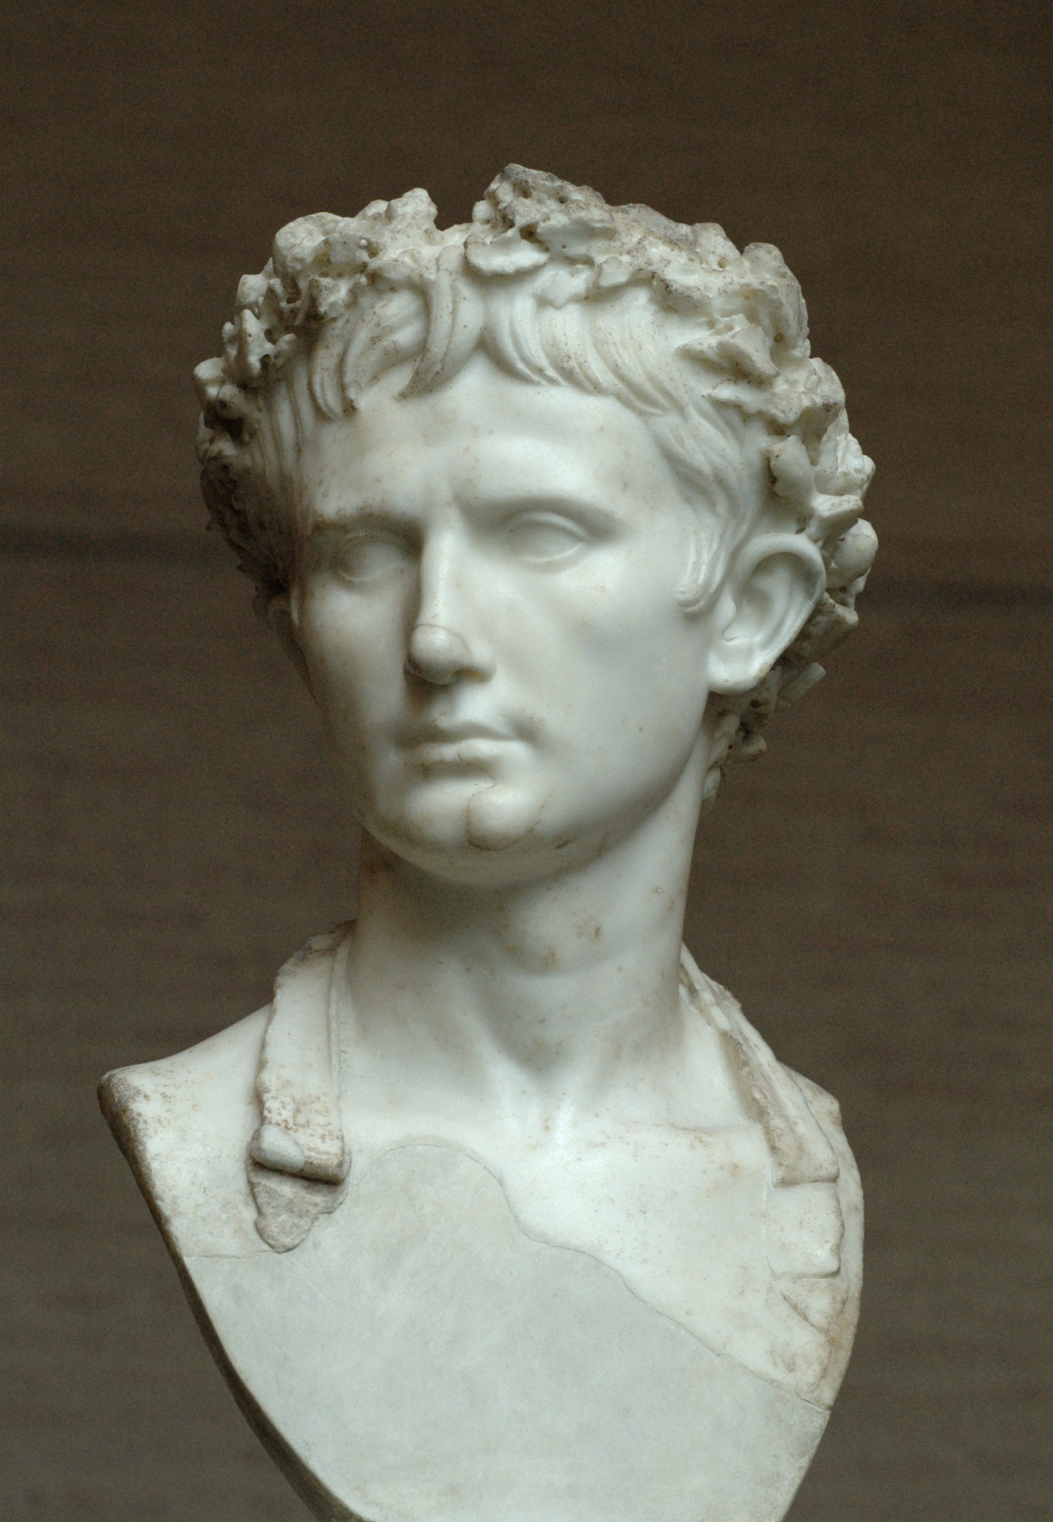
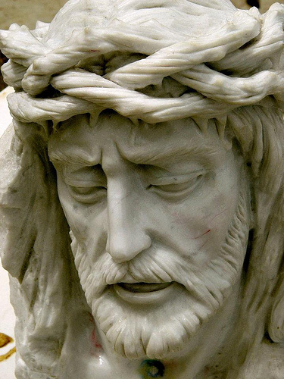
Caesar Augustus vs. Jesus Christ

Slide 9
Colossians 2:13-15^{(ESV)}
¹³ And you, who were dead in your trespasses and the uncircumcision of your flesh, God made alive together with him, having forgiven us all our trespasses, ¹⁴ by canceling the record of debt that stood against us with its legal demands. This he set aside, nailing it to the cross. ¹⁵ He disarmed the rulers and authorities and put them to open shame, by triumphing over them in him.

Slide 10
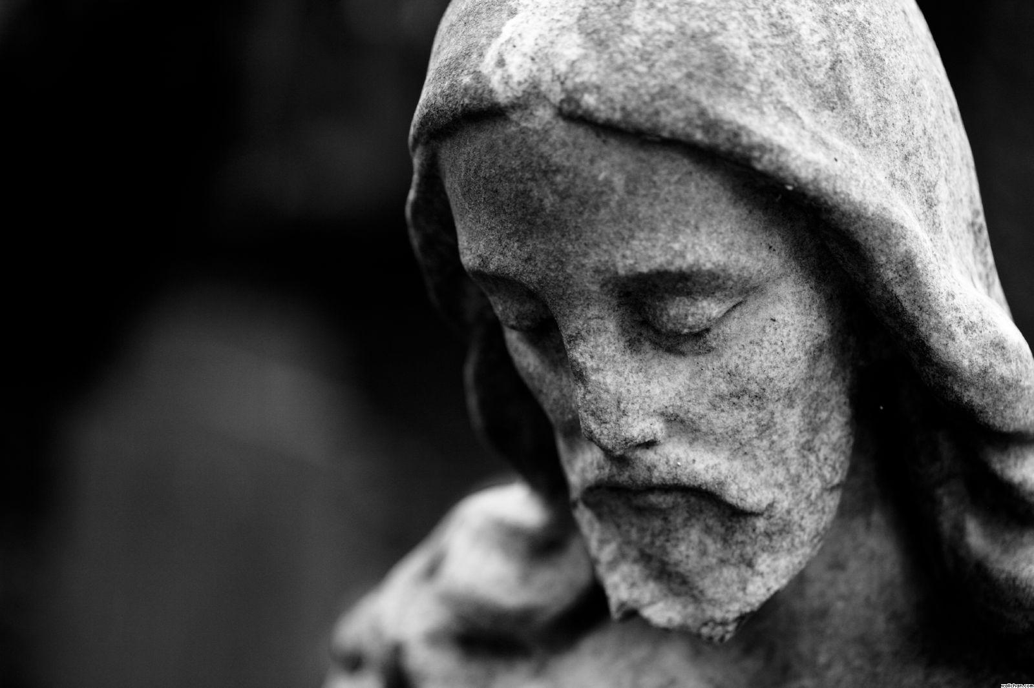
The Gospel is the rule and reign of Jesus Christ.

Slide 11
``
Preaching the
Gospel to Yourself

Slide 12
Preaching the Gospel to Yourself
When you set yourself to seriously pursue holiness, you will begin to realize what an awful sinner you are. And if you are not firmly rooted in the gospel and have not learned to preach it to yourself every day, you will soon become discouraged and will slack off in your pursuit of holiness.
To preach the gospel to yourself, then, means that you continually face up to your own sinfulness and then flee to Jesus through faith in His shed blood and righteous life. It means that you appropriate, again by faith, the fact that Jesus fully satisfied the law of God, that He is your propitiation, and that God’s holy wrath is no longer directed toward you.
--Jerry Bridges in The Discipline of Grace

Slide 13
Preaching the Gospel to Yourself
IS NOT Moralistic Therapeutic Deism.

Slide 14
Preaching the Gospel to Yourself
IS NOT Moralistic Therapeutic Deism.
Deism = A god exists who created and ordered the world and watches over human life on earth. God does not need to be particularly involved in one's life except when God is needed to resolve a problem.

Slide 15
Preaching the Gospel to Yourself
IS NOT Moralistic Therapeutic Deism.
Moralistic = God wants people to be good, nice, and fair to each other, as taught in the Bible and by most world religions. Good people go to heaven when they die.
Deism = A god exists who created and ordered the world and watches over human life on earth. God does not need to be particularly involved in one's life except when God is needed to resolve a problem.

Slide 16
Preaching the Gospel to Yourself
IS NOT Moralistic Therapeutic Deism.
Moralistic = God wants people to be good, nice, and fair to each other, as taught in the Bible and by most world religions. Good people go to heaven when they die.
Therapeutic = The central goal of life is to be happy and to feel good about oneself.
Deism = A god exists who created and ordered the world and watches over human life on earth. God does not need to be particularly involved in one's life except when God is needed to resolve a problem.

Slide 17
Why are you cast down, O my soul, and why are you in turmoil within me?
Hope in God; for I shall again praise him, my salvation and my God.
Psalm 42:5, 11; 43:5

Slide 18
Ben Deaver, called by the will of God to be an apostle of Christ Jesus, to Ben Deaver: Grace to you and peace from God your Father and the Lord Jesus Christ.
There is therefore now no condemnation for those who are in Christ Jesus (Rom 8:1).
God is in your midst, He will quiet you with His love, He will exult over you with loud singing (Zeph 3:17).

Slide 19
Preaching the Gospel to Yourself
The truest thing about us is what God says about us.
– Dennis McCallum in Walking in Victory

Slide 20
Preaching the Gospel to Yourself
The truest thing about us is what God says about us.
If you believe the Bible, you should realize that God’s view of us is the true view. If he views us a certain way, then that is, in the ultimate sense, the way we really are! Even if the majority of our peers look at things a different way, we would know they were wrong by referring to the infinite external reference point—the God and creator of all. Not only could we know that the view of our peers was wrong in some cases, we could even discover that our own view is wrong as well. If we have come to view things a certain way, but God declares they are another way, we need to change our minds.
– Dennis McCallum in Walking in Victory

Slide 21
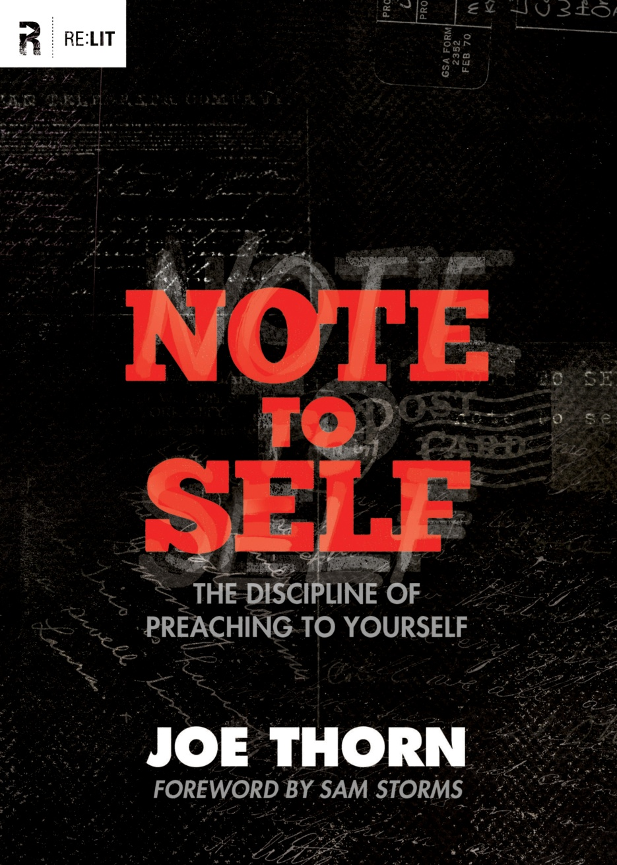

Slide 22
How do you preach the
Gospel to yourself?

Slide 23
Preaching the Gospel to Yourself
Since the gospel is only for sinners, I begin each day with the realization that despite my being a saint, I still sin every day in thought, word, deed, and motive. If I am aware of any subtle, or not so subtle, sins in my life, I acknowledge those to God. Even if my conscience is not indicting me for conscious sins, I still acknowledge to God that I have not even come close to loving Him with all my being or loving my neighbor as myself. I repent of those sins, and then I apply specific Scriptures that assure me of God’s forgiveness to those sins I have just confessed.
--Jerry Bridges in Respectable Sins

Slide 24
Preaching the Gospel to Yourself
I then generalize the Scripture’s promises of God’s forgiveness to all my life and say to God words to the effect that my only hope of a right standing with Him that day is Jesus’ bloodshed for my sins, and His righteous life lived on my behalf. This reliance on the twofold work of Christ for me is beautifully captured by Edward Mote in his hymn “The Solid Rock” with his words, “My hope is built on nothing less, than Jesus’ blood and righteousness.” Almost every day, I find myself going to those words in addition to reflecting on the promises of forgiveness in the Bible.
--Jerry Bridges in Respectable Sins

Slide 25
Preaching the Gospel to Yourself
What Scriptures do I use to preach the gospel to myself? Here are just a few I choose from each day:
As far as the east is from the west, so far does he remove our transgressions from us. (Psalm 103:12)
“I, I am he who blots out your transgressions for my own sake, and I will not remember your sins.” (Isaiah 43:25)
All we like sheep have gone astray; we have turned everyone one to his own way; and the LORD has laid on him the iniquity of us all. (Isaiah 53:6)
Blessed are those whose lawless deeds are forgiven, and whose sins are covered; blessed is the man against whom the Lord will not count his sin. (Romans 4:7-8)
There is therefore now no condemnation for those who are in Christ Jesus. (Romans 8:1)
There are many others, including Psalm 130:3-4; Isaiah 1:18; Isaiah 38:17; Micah 7:19; Ephesians 1:7; Colossians 2:13-14; Hebrews 8:12; and 10:17-18.
--Jerry Bridges in Respectable Sins

Slide 26
Preaching the Gospel to Yourself
Whatever Scriptures we use to assure us of God’s forgiveness, we must realize that whether the passage explicitly states it or not, the only basis for God’s forgiveness is the blood of Christ shed on the cross for us. As the writer of Hebrews said, “without the shedding of blood there is no forgiveness of sins” (9:22), and the context makes it clear that it is Christ’s blood that provides the objective basis on which God forgives our sins.
--Jerry Bridges in Respectable Sins

Slide 27
Preaching the Gospel to Yourself
Whatever Scriptures we use to assure us of God’s forgiveness, we must realize that whether the passage explicitly states it or not, the only basis for God’s forgiveness is the blood of Christ shed on the cross for us. As the writer of Hebrews said, “without the shedding of blood there is no forgiveness of sins” (9:22), and the context makes it clear that it is Christ’s blood that provides the objective basis on which God forgives our sins.
--Jerry Bridges in Respectable Sins

Slide 28
Now to him who is able to strengthen you according to my gospel and the preaching of Jesus Christ, according to the revelation of the mystery that was kept secret for long ages but has now been disclosed and through the prophetic writings has been made known to all nations, according to the command of the eternal God, to bring about the obedience of faith—to the only wise God be glory forevermore through Jesus Christ! Amen.

