Slide 1
WELCOME

Slide 2
To God Be the Glory
Hymn

Slide 3
To God be the glory,
Great things He has done
So loved He the world
That He gave us His Son
To God Be the Glory

Slide 4
Who yielded His life,
An atonement for sin
And opened the life gate
That all may come in
To God Be the Glory

Slide 5
Praise the Lord, praise the Lord!
Let the earth hear His voice
Praise the Lord, praise the Lord!
Let the people rejoice
To God Be the Glory

Slide 6
Oh come to the Father
Through Jesus the Son
And give Him the glory
Great things He as done
To God Be the Glory

Slide 7
Oh, perfect redemption
the purchase of blood
To every believer
the promise of God
To God Be the Glory

Slide 8
The vilest offender
who truly believes
That moment from Jesus
a pardon receives
To God Be the Glory

Slide 9
Praise the Lord, praise the Lord!
Let the earth hear His voice
Praise the Lord, praise the Lord!
Let the people rejoice
To God Be the Glory

Slide 10
Oh come to the Father
Through Jesus the Son
And give Him the glory
Great things He as done
To God Be the Glory

Slide 11
To God be the glory,
Great things He has done
So loved He the world
That He gave us His Son
To God Be the Glory

Slide 12
Who yielded His life,
An atonement for sin
And opened the life gate
That all may come in
To God Be the Glory

Slide 13
Praise the Lord, praise the Lord!
Let the earth hear His voice
Praise the Lord, praise the Lord!
Let the people rejoice
To God Be the Glory

Slide 14
Oh come to the Father
Through Jesus the Son
And give Him the glory
Great things He as done
To God Be the Glory

Slide 15
AFTER PARTY!
Join us right after Central Gathering for our After Party at Pizza Ranch (511 McCall Rd)!
There's space for the kids and plenty of pizza AND SALAD (for Terrence)!!!
TONIGHT!

Slide 17
WORD OF THE YEAR
Pick a 2020 WOTY – a spiritual growth word of the year – and share it with us online at: tallgrass.church/woty
We’ll pray for one another’s submitted WOTYs !

Slide 18
WOTY FOR LENT
Lent starts Feb 26th!
Let’s focus on our WOTYs through Lent.
Focused prayer
Focused reading
Fasting
Encouraging
Ideas?

Slide 19
Mingle Question
What would an awesome church be like?

Slide 20
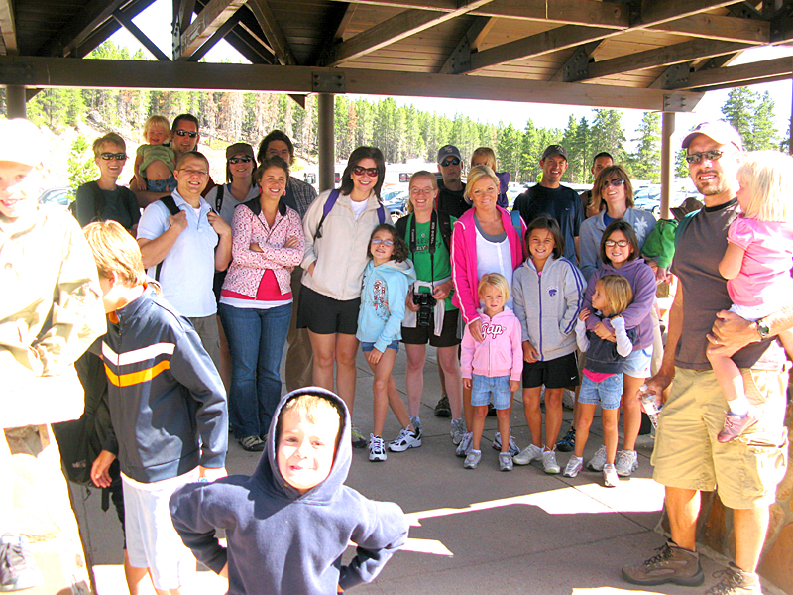
Brainstorm Question
What’s would an awesome church be like?

Slide 21
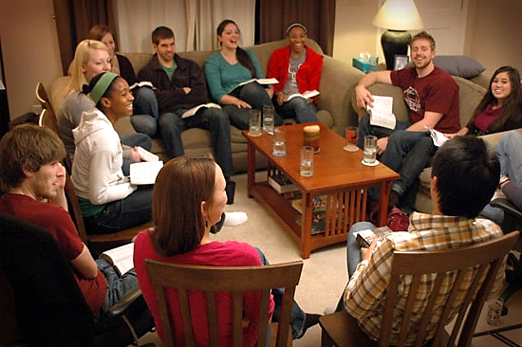

Slide 22
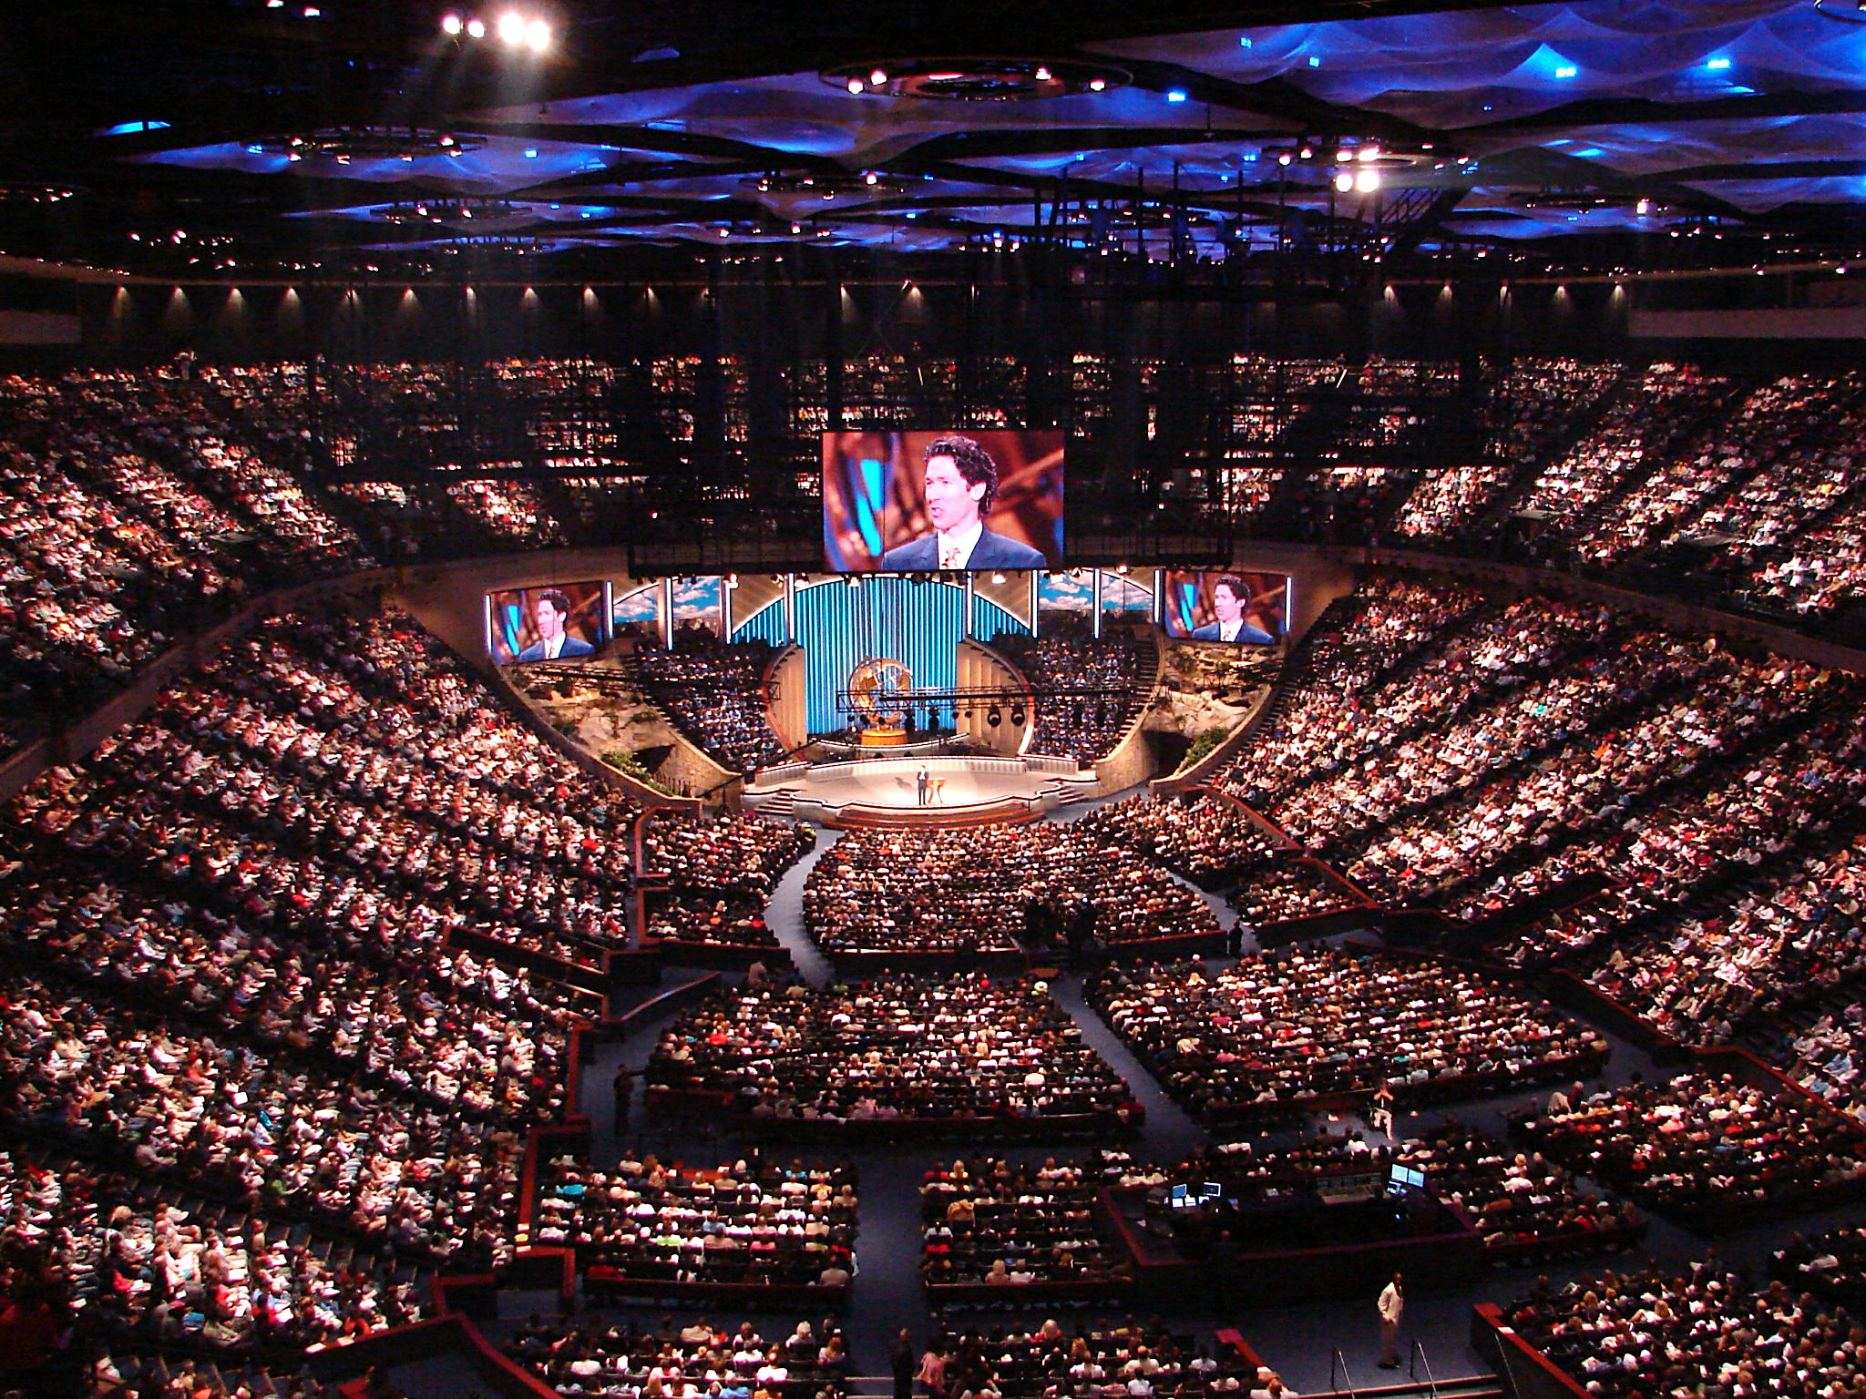

Slide 23
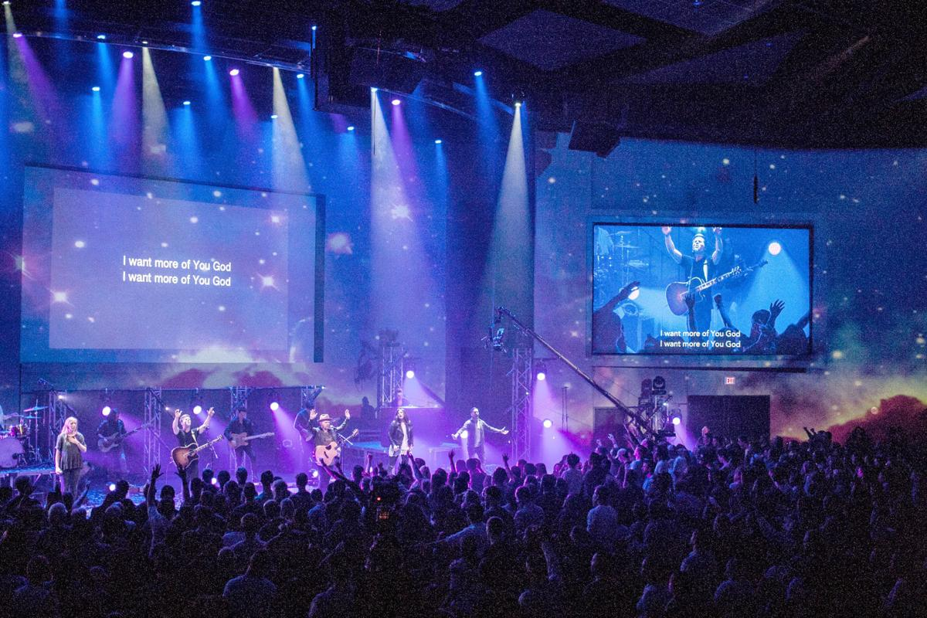

Slide 24
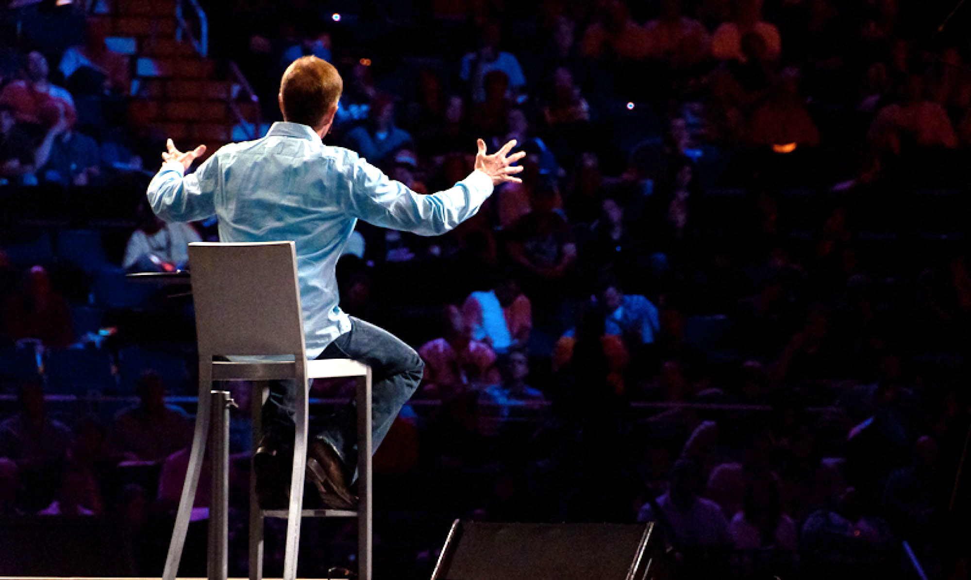

Slide 26
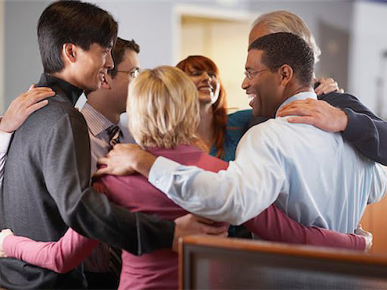

Slide 27
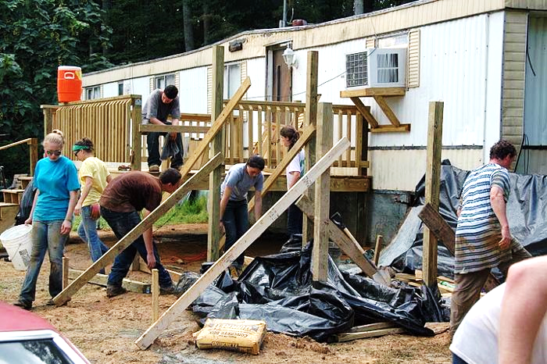

Slide 28
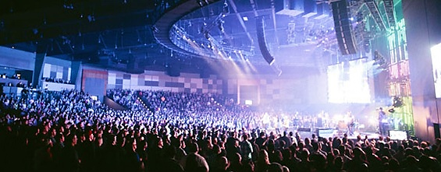

Slide 29
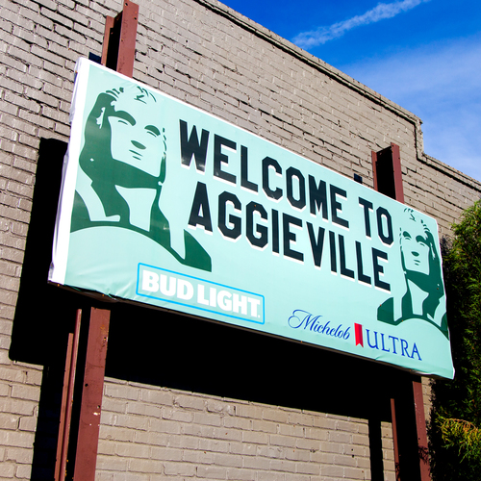

Slide 31
Acts 2:41
So those who received his word were baptized, and there were added that day about three thousand souls.

Slide 32
Acts 2:42-47
⁴² And they devoted themselves to the apostles' teaching and the fellowship, to the breaking of bread and the prayers. ⁴³ And awe came upon every soul, and many wonders and signs were being done through the apostles. ⁴⁴ And all who believed were together and had all things in common. ⁴⁵ And they were selling their possessions and belongings and distributing the proceeds to all, as any had need. ⁴⁶ And day by day, attending the temple together and breaking bread in their homes, they received their food with glad and generous hearts, ⁴⁷ praising God and having favor with all the people. And the Lord added to their number day by day those who were being saved.

Slide 33
Acts 2:42-47
⁴² And they devoted themselves to the apostles' teaching and the fellowship, to the breaking of bread and the prayers. ⁴³ And awe came upon every soul, and many wonders and signs were being done through the apostles. ⁴⁴ And all who believed were together and had all things in common. ⁴⁵ And they were selling their possessions and belongings and distributing the proceeds to all, as any had need. ⁴⁶ And day by day, attending the temple together and breaking bread in their homes, they received their food with glad and generous hearts, ⁴⁷ praising God and having favor with all the people. And the Lord added to their number day by day those who were being saved.

Slide 34
Acts 2:42-47
⁴² And they devoted themselves to the apostles' teaching and the fellowship, to the breaking of bread and the prayers. ⁴³ And awe came upon every soul, and many wonders and signs were being done through the apostles. ⁴⁴ And all who believed were together and had all things in common. ⁴⁵ And they were selling their possessions and belongings and distributing the proceeds to all, as any had need. ⁴⁶ And day by day, attending the temple together and breaking bread in their homes, they received their food with glad and generous hearts, ⁴⁷ praising God and having favor with all the people. And the Lord added to their number day by day those who were being saved.
Devoted to L.I.F.E.

Slide 35
Acts 2:42-47
⁴² And they devoted themselves to the apostles' teaching and the fellowship, to the breaking of bread and the prayers. ⁴³ And awe came upon every soul, and many wonders and signs were being done through the apostles. ⁴⁴ And all who believed were together and had all things in common. ⁴⁵ And they were selling their possessions and belongings and distributing the proceeds to all, as any had need. ⁴⁶ And day by day, attending the temple together and breaking bread in their homes, they received their food with glad and generous hearts, ⁴⁷ praising God and having favor with all the people. And the Lord added to their number day by day those who were being saved.
Learning Biblical Truth

Slide 36
Acts 2:42-47
⁴² And they devoted themselves to the apostles' teaching and the fellowship, to the breaking of bread and the prayers. ⁴³ And awe came upon every soul, and many wonders and signs were being done through the apostles. ⁴⁴ And all who believed were together and had all things in common. ⁴⁵ And they were selling their possessions and belongings and distributing the proceeds to all, as any had need. ⁴⁶ And day by day, attending the temple together and breaking bread in their homes, they received their food with glad and generous hearts, ⁴⁷ praising God and having favor with all the people. And the Lord added to their number day by day those who were being saved.
Intercession (Prayer)

Slide 37
Acts 2:42-47
⁴² And they devoted themselves to the apostles' teaching and the fellowship, to the breaking of bread and the prayers. ⁴³ And awe came upon every soul, and many wonders and signs were being done through the apostles. ⁴⁴ And all who believed were together and had all things in common. ⁴⁵ And they were selling their possessions and belongings and distributing the proceeds to all, as any had need. ⁴⁶ And day by day, attending the temple together and breaking bread in their homes, they received their food with glad and generous hearts, ⁴⁷ praising God and having favor with all the people. And the Lord added to their number day by day those who were being saved.
Fellowship

Slide 38
koinonia
Acts 2:42-47
⁴² And they devoted themselves to the apostles' teaching and the fellowship, to the breaking of bread and the prayers. ⁴³ And awe came upon every soul, and many wonders and signs were being done through the apostles. ⁴⁴ And all who believed were together and had all things in common. ⁴⁵ And they were selling their possessions and belongings and distributing the proceeds to all, as any had need. ⁴⁶ And day by day, attending the temple together and breaking bread in their homes, they received their food with glad and generous hearts, ⁴⁷ praising God and having favor with all the people. And the Lord added to their number day by day those who were being saved.
Fellowship

Slide 39
Acts 2:42-47
⁴² And they devoted themselves to the apostles' teaching and the fellowship, to the breaking of bread and the prayers. ⁴³ And awe came upon every soul, and many wonders and signs were being done through the apostles. ⁴⁴ And all who believed were together and had all things in common. ⁴⁵ And they were selling their possessions and belongings and distributing the proceeds to all, as any had need. ⁴⁶ And day by day, attending the temple together and breaking bread in their homes, they received their food with glad and generous hearts, ⁴⁷ praising God and having favor with all the people. And the Lord added to their number day by day those who were being saved.
Extending LIFE to Others

Slide 40
Matthew 28 ¹⁹ Go therefore and make disciples of all nations, baptizing them in the name of the Father and of the Son and of the Holy Spirit, ²⁰ teaching them to observe all that I have commanded you.
Acts 2:42-47
⁴² And they devoted themselves to the apostles' teaching and the fellowship, to the breaking of bread and the prayers. ⁴³ And awe came upon every soul, and many wonders and signs were being done through the apostles. ⁴⁴ And all who believed were together and had all things in common. ⁴⁵ And they were selling their possessions and belongings and distributing the proceeds to all, as any had need. ⁴⁶ And day by day, attending the temple together and breaking bread in their homes, they received their food with glad and generous hearts, ⁴⁷ praising God and having favor with all the people. And the Lord added to their number day by day those who were being saved.
Extending LIFE to Others

Slide 41
Acts 2:42-47
⁴² And they devoted themselves to the apostles' teaching and the fellowship, to the breaking of bread and the prayers. ⁴³ And awe came upon every soul, and many wonders and signs were being done through the apostles. ⁴⁴ And all who believed were together and had all things in common. ⁴⁵ And they were selling their possessions and belongings and distributing the proceeds to all, as any had need. ⁴⁶ And day by day, attending the temple together and breaking bread in their homes, they received their food with glad and generous hearts, ⁴⁷ praising God and having favor with all the people. And the Lord added to their number day by day those who were being saved.
Extending LIFE to Others

Slide 42
Hinderances?

Slide 43
Hinderances?
Consumerism

Slide 44
Hinderances?
Consumerism
Busyness

Slide 45
Hinderances?
Consumerism
Busyness
Baggage

Slide 46
Hinderances?
Consumerism
Busyness
Baggage
Inexperience

Slide 47
Applications

Slide 48
Applications
Tallgrass can be an awesome church

Slide 49
Applications
Tallgrass can be an awesome church
We need to grow in 3 key areas:

Slide 50
Applications
Tallgrass can be an awesome church
We need to grow in 3 key areas:
2020 STRATEGIC PRIORITIES
Gathering Centrally
Corporate Prayer
Discipleship

Slide 51
Applications
Tallgrass can be an awesome church
We need to grow in 3 key areas:
Take steps forward with L.I.F.E.
2020 STRATEGIC PRIORITIES
Gathering Centrally
Corporate Prayer
Discipleship

Slide 52
LIFE GROUPS OPEN TO ANYONE!

Slide 53
Applications
Tallgrass can be an awesome church
We need to grow in 3 key areas:
Take steps forward with L.I.F.E.
2020 STRATEGIC PRIORITIES
Gathering Centrally
Corporate Prayer
Discipleship

Slide 55
God of This City
Chris Tomlin

Slide 56
You’re the God of this city
You’re the King of these people
You’re the Lord of this nation
You are
God of This City

Slide 57
You’re the light in this darkness
You’re the hope to the hopeless
You’re the peace to the restless
You are
God of This City

Slide 58
For there is no one like our God
There is no one like our God
God of This City

Slide 59
Greater things have yet to come
Greater things are still to be done
In this city
God of This City

Slide 60
Greater things have yet to come
And greater things have still To be done here
God of This City

Slide 61
You’re the Lord of Creation
The Creator of all things
You’re the King above all kings
You are
God of This City

Slide 62
You’re the strength in our weakness
You’re the love to the broken
You’re the joy in the sadness
You are
God of This City

Slide 63
For there is no one like our God
There is no one like our God
God of This City

Slide 64
Greater things have yet to come
Greater things are still to be done
In this city
repeat
God of This City

Slide 65
Greater things have yet to come
And greater things have still To be done here
God of This City

Slide 66
Praying & Sending Out
Zach Breshears Jenna Park Terrence Thomas

Slide 67
Come Thou Fount
Robert Robinson

Slide 68
Come thou fount of every blessing
Tune my heart to sing thy grace
Streams of mercy, never ceasing
Call for songs of loudest praise
Come Thou Fount

Slide 69
Teach me some melodious sonnet
Sung by flaming tongues above
Praise the mount, I’m fixed upon it
Mount of Thy redeeming love
Come Thou Fount

Slide 70
Here I raise my Ebenezer
Hither by Thy help I’m come
And I hope by Thy good pleasure
Safely to arrive at home
Come Thou Fount

Slide 71
Jesus sought me when a stranger
Wandering from the fold of God
He, to rescue me from danger
Interposed His precious love
Come Thou Fount

Slide 72
O to grace how great a debtor
Daily I’m constrained to be
Let Thy goodness like a fetter
Bind my wandering heart to Thee
Come Thou Fount

Slide 73
Prone to wander, Lord I feel it
Prone to leave the God I love
Here’s my heart, O take and seal it
Seal it for Thy courts above
Come Thou Fount

Slide 74
Build Your Kingdom Here
Rend Collective

Slide 75
Come set Your rule & reign
In our hearts again
Increase in us we pray
Unveil why we're made
Build Your Kingdom Here

Slide 76
Come set our hearts ablaze w/ hope
Like wildfire in our very souls
Holy Spirit come invade us now
We are Your Church
We need Your power, In us
Build Your Kingdom Here

Slide 77
We seek Your kingdom first
We hunger & we thirst
Refuse to waste our lives
For You're our joy & prize
Build Your Kingdom Here

Slide 78
To see the captive hearts released
The hurt; the sick; the poor at peace
We lay down our lives for Heaven's cause
We are Your church
We pray revive, this earth
Build Your Kingdom Here

Slide 79
Build Your kingdom here
Let the darkness fear
Show Your mighty hand
Heal our streets & land
Build Your Kingdom Here

Slide 80
Set Your church on fire
Win the nations back
Change the atmosphere
Build Your Kingdom here
We pray
Build Your Kingdom Here

Slide 81
Unleash Your Kingdom's power
Reaching the near & far
No force of hell can stop
Your beauty changing hearts.
Build Your Kingdom Here

Slide 82
You made us for much more than this
Awake the Kingdom seed in us
Fill us w/ the strength & love of Christ
We are Your church
We are the hope, On earth
Build Your Kingdom Here

Slide 83
Build Your kingdom here
Let the darkness fear
Show Your mighty hand
Heal our streets & land
Build Your Kingdom Here

Slide 84
Set Your church on fire
Win the nations back
Change the atmosphere
Build Your Kingdom here
We pray
Build Your Kingdom Here

Slide 85
Build Your kingdom here
Let the darkness fear
Show Your mighty hand
Heal our streets and land
Build Your Kingdom Here

Slide 86
Set Your church on fire
Win the nations back
Change the atmosphere
Build Your Kingdom here
We pray
Build Your Kingdom Here

Slide 88
AFTER PARTY!
Join us right after Central Gathering for our After Party at Pizza Ranch (511 McCall Rd)!
There's space for the kids and plenty of pizza AND SALAD (for Terrence)!!!
TONIGHT!

