Slide 1
WELCOME

Slide 2
Build Your Kingdom Here
Rend Collective Chris Llewellyn Gareth Gilkeson. #6186078

Slide 3
Come set Your rule & reign
In our hearts again
Increase in us we pray
Unveil why we're made
Build Your Kingdom Here

Slide 4
Come set our hearts ablaze w/ hope
Like wildfire in our very souls
Holy Spirit come invade us now
We are Your Church
We need Your power, In us
Build Your Kingdom Here

Slide 5
We seek Your kingdom first
We hunger & we thirst
Refuse to waste our lives
For You're our joy & prize
Build Your Kingdom Here

Slide 6
To see the captive hearts released
The hurt; the sick; the poor at peace
We lay down our lives for Heaven's cause
We are Your church
We pray revive, this earth
Build Your Kingdom Here

Slide 7
Build Your kingdom here
Let the darkness fear
Show Your mighty hand
Heal our streets & land
Build Your Kingdom Here

Slide 8
Set Your church on fire
Win the nations back
Change the atmosphere
Build Your Kingdom here
We pray
Build Your Kingdom Here

Slide 9
Unleash Your Kingdom's power
Reaching the near & far
No force of hell can stop
Your beauty changing hearts.
Build Your Kingdom Here

Slide 10
You made us for much more than this
Awake the Kingdom seed in us
Fill us w/ the strength & love of Christ
We are Your church
We are the hope, On earth
Build Your Kingdom Here

Slide 11
Build Your kingdom here
Let the darkness fear
Show Your mighty hand
Heal our streets & land
Build Your Kingdom Here

Slide 12
Set Your church on fire
Win the nations back
Change the atmosphere
Build Your Kingdom here
We pray
Build Your Kingdom Here

Slide 13
Build Your kingdom here
Let the darkness fear
Show Your mighty hand
Heal our streets and land
Build Your Kingdom Here

Slide 14
Set Your church on fire
Win the nations back
Change the atmosphere
Build Your Kingdom here
We pray
Build Your Kingdom Here

Slide 16
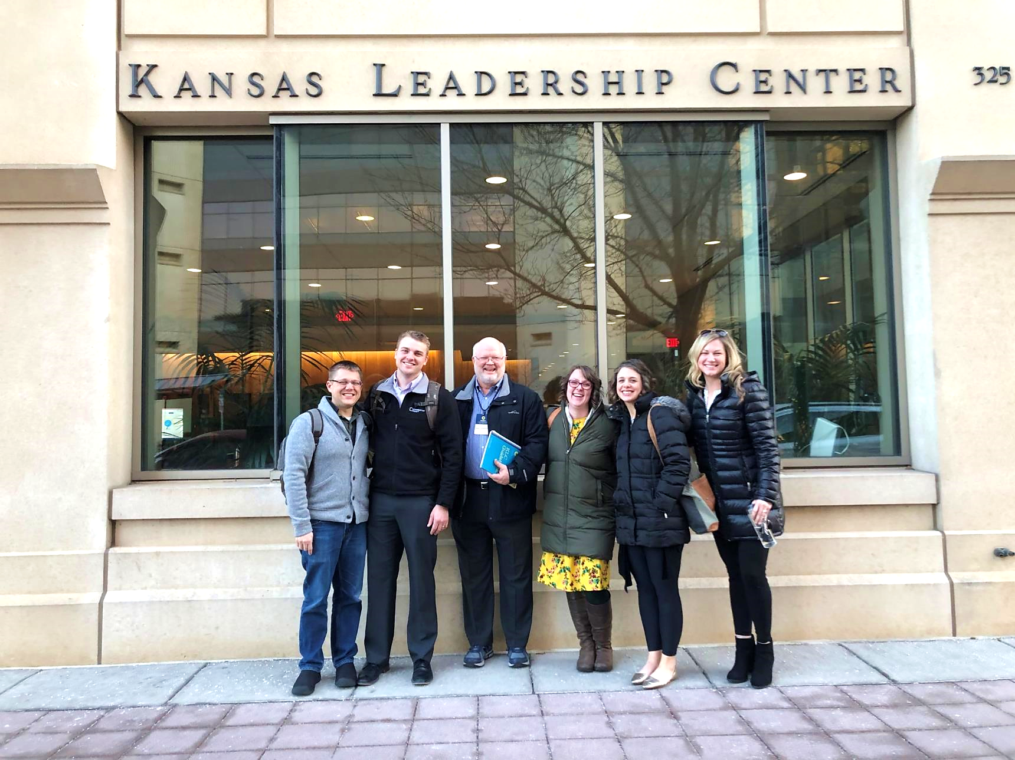
Your Leadership Edge
February 5-6, 2020

Slide 17
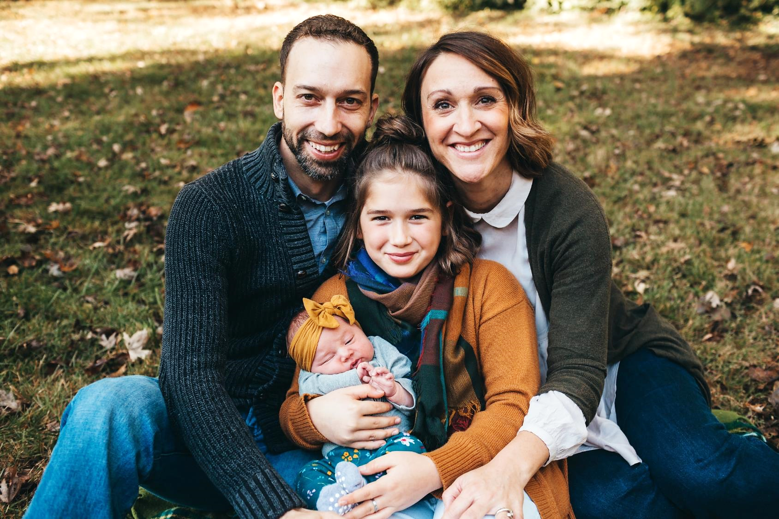
Paxton, Judy, & Jurnee LeMoine Welcome
Geddy Grace (October 3, 2019)

Slide 18
Mingle Question
What’s your best story about fire?

Slide 20
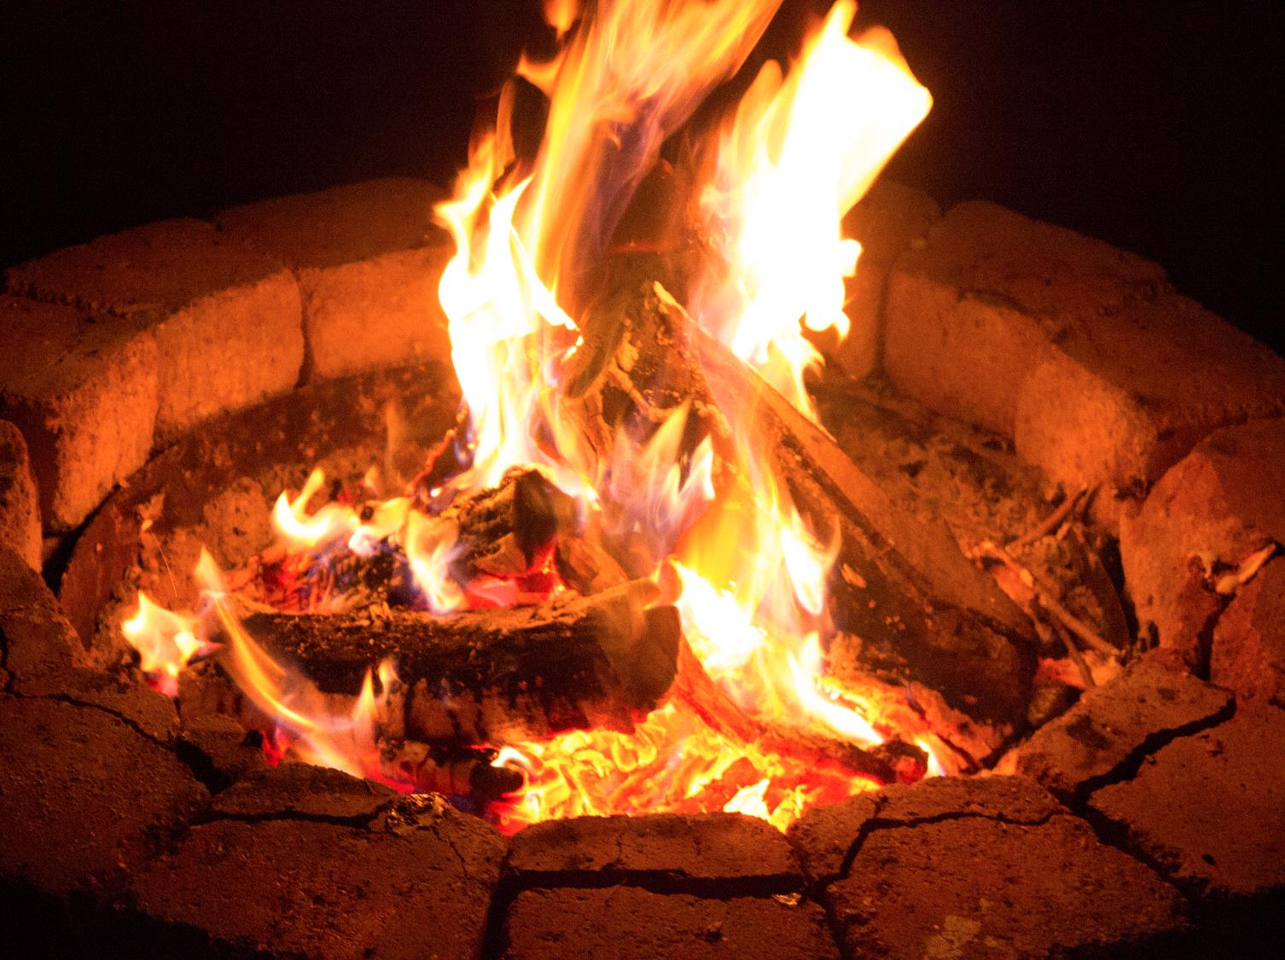

Slide 21
Acts 2:2-3
² And suddenly there came from heaven a sound like a mighty rushing wind, and it filled the entire house where they were sitting. ³ And divided tongues as of fire appeared to them and rested on each one of them.

Slide 22
Wind & Fire
The Spirit at Creation (Gen 1)
Burning Bush (Ex 3)
Pillar of Cloud & Fire (Ex 13)
Mount Sinai (Ex 19)
Tabernacle (Ex 33, 40)
Incorrect Handling Brings Death (Lev 10, 2 Sam 6)
Temple (2 Chron 7)
Some People Impermanently Filled with HS (Ex 31, Num 27, Judg 3, 16, 1 Sam 16, Ps 51)
One Day All Flesh filled with God’s Spirit (Joel 2)
Fire Leaves the Temple (Ez 10)
Jesus Comes to Earth (Luke 2, Heb 1, Jn 1, Dan 7, Rev 1, 19)
Jesus Crucified, Temple Curtain Ripped (Mat 27)
Jesus Resurrected (Luke 24, Mat 28, John 20, 1 Cor 15)
The Holy Spirit Promised (Acts 1:3-4, John 16:7)

Slide 23
Acts 2:1-21
¹ When the day of Pentecost arrived, they were all together in one place.

Slide 24
Acts 2:1-21
¹ When the day of Pentecost arrived, they were all together in one place. ² And suddenly there came from heaven a sound like a mighty rushing wind, and it filled the entire house where they were sitting. ³ And divided tongues as of fire appeared to them and rested on each one of them. ⁴ And they were all filled with the Holy Spirit

Slide 25
Acts 2:1-21
¹ When the day of Pentecost arrived, they were all together in one place. ² And suddenly there came from heaven a sound like a mighty rushing wind, and it filled the entire house where they were sitting. ³ And divided tongues as of fire appeared to them and rested on each one of them. ⁴ And they were all filled with the Holy Spirit and began to speak in other tongues as the Spirit gave them utterance. ⁵ Now there were dwelling in Jerusalem Jews, devout men from every nation under heaven. ⁶ And at this sound the multitude came together, and they were bewildered, because each one was hearing them speak in his own language.

Slide 26
Acts 2:1-21
¹⁶ This is what was uttered through the prophet Joel:
¹⁷ “‘And in the last days it shall be, God declares, that I will pour out my Spirit on all flesh, and your sons and your daughters shall prophesy, and your young men shall see visions, and your old men shall dream dreams; ¹⁸ even on my male servants and female servants in those days I will pour out my Spirit, and they shall prophesy. …²¹ And it shall come to pass that everyone who calls upon the name of the Lord shall be saved.’

Slide 27
Applications
Repent

Slide 28
Applications
Repent “Because God first loved us, we exist to

Slide 29
Applications
Repent “Because God first loved us, we exist to
love God

Slide 30
Applications
Repent “Because God first loved us, we exist to
love God
and love our neighbors.”

Slide 31
Reflections
When have I experienced the presence of God in my life through his Holy Spirit?
What did that look/feel like?
Any specific scenes?
In what way do I sense the Spirit leading me to more fully love God?
In what way do I sense the Spirit leading me to better love my neighbors?

Slide 33
Spirit of the Living God
Jacob Sooter, Mia Fieldes. #7035191

Slide 34
Spirit of the living God,
Spirit of the living God
We only want to hear Your voice,
We're hanging on every word
Spirit of the Living God

Slide 35
Spirit of the living God,
Spirit of the living God
We want to know You more & more
We're hanging on every word
Spirit of the Living God

Slide 36
“O God, you are my God,
and I long for you. My whole being desires you; like a dry, worn-out, and waterless land, my soul is thirsty for you.”
Spirit of the Living God
Psalm 63

Slide 37
Spirit of the living God,
Spirit of the living God
We only want to hear Your voice,
We're hanging on every word
Spirit of the Living God

Slide 38
Spirit of the living God,
Spirit of the living God
We want to know You more & more
We're hanging on every word
Spirit of the Living God

Slide 39
When You speak, when You move
When You do what only You can do
It changes us. It changes what we see
and what we seek.
Spirit of the Living God

Slide 40
When You come in the room
When You do what only You can do
It changes us. It changes what we see
and what we seek.
Spirit of the Living God

Slide 41
“I stretch out my hands to you;
my soul thirsts for you
like a parched land.”
Spirit of the Living God
Psalm 143

Slide 42
Spirit of the living God,
Spirit of the living God
We’re leaning into who You are.
Everything else can wait.
Spirit of the Living God

Slide 43
Spirit of the living God,
Spirit of the living God
Come now & breathe upon our hearts. Come now and have Your way.
Spirit of the Living God

Slide 44
When You speak, when You move
When You do what only You can do
It changes us. It changes what we see
and what we seek.
Spirit of the Living God

Slide 45
When You come in the room
When You do what only You can do
It changes us. It changes what we see
and what we seek.
Spirit of the Living God

Slide 46
“And I will give you a new heart, and a new spirit I will put within you. And I will remove the heart of stone from your flesh and give you a heart of flesh.”
Spirit of the Living God
Ezekiel 36

Slide 47
When You move,
You move all our fear.
When You move,
You move us to tears.
Spirit of the Living God

Slide 48
When You fall,
we fall on our knees.
When You fall,
we fall at Your feet.
Spirit of the Living God

Slide 49
When You speak, when You move
When You do what only You can do
It changes us. It changes what we see
and what we seek.
Spirit of the Living God

Slide 50
When You come in the room
When You do what only You can do
It changes us. It changes what we see
and what we seek.
Spirit of the Living God

Slide 51
“My sheep hear my voice,
and I know them,
and they follow me…”
Spirit of the Living God
John 10

Slide 52
Spirit of the living God,
Spirit of the living God
We only want to hear Your voice,
We're hanging on every word.
Spirit of the Living God

Slide 53
I Will Wait (Psalm 130)
Stuart Townend, Keith Getty, Jordan Kauflin, Matthew Merker. #7118914

Slide 54
Out of the depths I cry to You
In darkest places I will call
Incline Your ear to me anew
And hear my cry for mercy Lord
I Will Wait (Psalm 130)

Slide 55
Were You to count my sinful ways
How could I come before Your throne
Yet full forgiveness meets my gaze
I stand redeemed by grace alone
I Will Wait (Psalm 130)

Slide 56
I will wait for You,
I will wait for You
On Your word I will rely
I will wait for You,
surely wait for You
Till my soul is satisfied
I Will Wait (Psalm 130)

Slide 57
So put Your hope in God alone
Take courage in His power to save
Completely and forever won
By Christ emerging from the grave
I Will Wait (Psalm 130)

Slide 58
I will wait for You,
I will wait for You
On Your word I will rely
I will wait for You,
surely wait for You
Till my soul is satisfied
I Will Wait (Psalm 130)

Slide 59
Now He has come to make a way
And God Himself has paid the price
That all who trust in Him today
Find healing in His sacrifice
That all who trust in Him today
Find healing in His sacrifice
I Will Wait (Psalm 130)

Slide 60
I will wait for You,
I will wait for You
Through the storm & through the night
I will wait for You,
surely wait for You
For Your love is my delight
I Will Wait (Psalm 130)
x3

Slide 61
I will wait for You,
I will wait for You
On Your word I will rely
I will wait for You,
surely wait for You
Till my soul is satisfied
I Will Wait (Psalm 130)
x2

Slide 62
Come Thou Fount
Hymn, Robert Robinson

Slide 63
Come thou fount of every blessing
Tune my heart to sing thy grace
Streams of mercy, never ceasing
Call for songs of loudest praise
Come Thou Fount

Slide 64
Teach me some melodious sonnet
Sung by flaming tongues above
Praise the mount, I’m fixed upon it
Mount of Thy redeeming love
Come Thou Fount

Slide 65
Here I raise my Ebenezer
Hither by Thy help I’m come
And I hope by Thy good pleasure
Safely to arrive at home
Come Thou Fount

Slide 66
Jesus sought me when a stranger
Wandering from the fold of God
He, to rescue me from danger
Interposed His precious love
Come Thou Fount

Slide 67
O to grace how great a debtor
Daily I’m constrained to be
Let Thy goodness like a fetter
Bind my wandering heart to Thee
Come Thou Fount

Slide 68
Prone to wander, Lord I feel it
Prone to leave the God I love
Here’s my heart, O take and seal it
Seal it for Thy courts above
Come Thou Fount

Slide 69
Build Your Kingdom Here
Rend Collective

Slide 70
Build Your kingdom here
Let the darkness fear
Show Your mighty hand
Heal our streets & land
Build Your Kingdom Here

Slide 71
Set Your church on fire
Win the nations back
Change the atmosphere
Build Your Kingdom here
We pray
Build Your Kingdom Here

Slide 72
Build Your kingdom here
Let the darkness fear
Show Your mighty hand
Heal our streets and land
Build Your Kingdom Here

Slide 73
Set Your church on fire
Win the nations back
Change the atmosphere
Build Your Kingdom here
We pray
Build Your Kingdom Here

