Slide 1
WELCOME

Slide 2
Fountains
Josh Baldwin, Jonathan David Helser, Bobby Strand, Tony Brown, Joe Volk. #7083280

Slide 3
I will never forget the
moment I met You
The moment You called my name
You pulled me out of the darkness,
gave me a promise
To never thirst again
repeat
Fountains

Slide 4
All that I ever wanted
My heart has found in You
Fountains

Slide 5
I have tasted life
Nothing satisfies like You do
The fount that won’t run dry
Nothing satisfies like You do
repeat
Fountains

Slide 6
I want all that You offer;
Your living water,
Drink from the endless well.
I will sit at Your table
forever grateful
Forever where You dwell
Fountains

Slide 7
All that I ever wanted
My heart has found in You
Fountains

Slide 8
I have tasted life
Nothing satisfies like You do
The fount that won’t run dry
Nothing satisfies like You do
repeat
Fountains

Slide 9
All my fountains are in You
All my hope is built on Your love
All my fountains are in You
With every breath
I live for You, Lord
x3
Fountains

Slide 10
“Give thanks to the Lord,
for he is good…
for he satisfies the longing soul,
and the hungry soul he fills
with good things.”
Psalm 107
Fountains

Slide 11
All that I ever wanted
My heart has found in You
Fountains

Slide 12
I have tasted life
Nothing satisfies like You do
The fount that won’t run dry
Nothing satisfies like You do
Fountains

Slide 13
All my fountains are in You
All my hope is built on Your love
All my fountains are in You
With every breath
I live for You, Lord
Fountains

Slide 14
NEW TEACHING SERIES
kicks off today! #yesafootballreference

Slide 15
WELCOME
STAY AND WATCH THE GAME RIGHT HERE @2PM or head over to the Geldarts: 6101 Tumbleweed Ter.
HAPPY PERIHELION 2020!

Slide 16
NEXT SUNDAY January 26, 4pm
WELCOME
DURING OUR CENTRAL GATHERING Everyone is invited! Potluck reception to follow. Cake and fruit provided. You bring by last name: A-L main dish, M-Z side dish.
No RSVPs required, registry zola.com/wedding/williamandnaemi
HAPPY PERIHELION 2020!

Slide 17
Mingle Question
What’s your score prediction?
Write down and put in black offering box – prize for winner!

Slide 19
In the first book, O Theophilus, I have dealt with all that Jesus began to do and teach, ² until the day when he was taken up, after he had given commands through the Holy Spirit to the apostles whom he had chosen. ³ He presented himself alive to them after his suffering by many proofs, appearing to them during forty days and speaking about the kingdom of God.
Acts 1:1-3

Slide 20
In the first book, O Theophilus, I have dealt with all that Jesus began to do and teach, ² until the day when he was taken up, after he had given commands through the Holy Spirit to the apostles whom he had chosen. ³ He presented himself alive to them after his suffering by many proofs, appearing to them during forty days and speaking about the kingdom of God.
Acts 1:1-3

Slide 21
In the first book, O Theophilus, I have dealt with all that Jesus began to do and teach, ² until the day when he was taken up, after he had given commands through the Holy Spirit to the apostles whom he had chosen. ³ He presented himself alive to them after his suffering by many proofs, appearing to them during forty days and speaking about the kingdom of God.
Acts 1:1-3
Inasmuch as many have undertaken to compile a narrative of the things that have been accomplished among us, ² just as those who from the beginning were eyewitnesses and ministers of the word have delivered them to us, ³ it seemed good to me also, having followed all things closely for some time past, to write an orderly account for you, most excellent Theophilus, ⁴ that you may have certainty concerning the things you have been taught. Luke 1:1-4

Slide 24
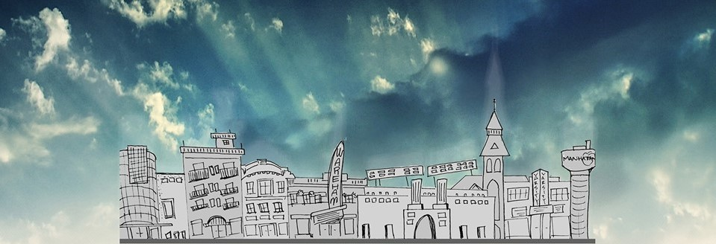

Slide 25
In the first book, O Theophilus, I have dealt with all that Jesus began to do and teach, ² until the day when he was taken up, after he had given commands through the Holy Spirit to the apostles whom he had chosen. ³ He presented himself alive to them after his suffering by many proofs, appearing to them during forty days and speaking about the kingdom of God.
Acts 1:1-3

Slide 26
In the first book, O Theophilus, I have dealt with all that Jesus began to do and teach, ² until the day when he was taken up, after he had given commands through the Holy Spirit to the apostles whom he had chosen. ³ He presented himself alive to them after his suffering by many proofs, appearing to them during forty days and speaking about the kingdom of God.
Acts 1:1-3
Luke the beloved physician…
Colossians 4:14a

Slide 27
In the first book, O Theophilus, I have dealt with all that Jesus began to do and teach, ² until the day when he was taken up, after he had given commands through the Holy Spirit to the apostles whom he had chosen. ³ He presented himself alive to them after his suffering by many proofs, appearing to them during forty days and speaking about the kingdom of God.
Acts 1:1-3
the “we” passages
Acts 16:10-17; 20:5-15; 21:1-18; 27:1-37; 28:1-16

Slide 28
In the first book, O Theophilus, I have dealt with all that Jesus began to do and teach, ² until the day when he was taken up, after he had given commands through the Holy Spirit to the apostles whom he had chosen. ³ He presented himself alive to them after his suffering by many proofs, appearing to them during forty days and speaking about the kingdom of God.
Acts 1:1-3
Luke as a premier historian
Luke 1:5; 2:1-2; 3:1-2; Acts 5; 11; 12; 18; 21-26

Slide 29
In the first book, O Theophilus, I have dealt with all that Jesus began to do and teach, ² until the day when he was taken up, after he had given commands through the Holy Spirit to the apostles whom he had chosen. ³ He presented himself alive to them after his suffering by many proofs, appearing to them during forty days and speaking about the kingdom of God.
Acts 1:1-3

Slide 30
In the first book, O Theophilus, I have dealt with all that Jesus began to do and teach, ² until the day when he was taken up, after he had given commands through the Holy Spirit to the apostles whom he had chosen. ³ He presented himself alive to them after his suffering by many proofs, appearing to them during forty days and speaking about the kingdom of God.
Acts 1:1-3
“friend of God”
…most excellent Theophilus… Luke 1:3

Slide 31
In the first book, O Theophilus, I have dealt with all that Jesus began to do and teach, ² until the day when he was taken up, after he had given commands through the Holy Spirit to the apostles whom he had chosen. ³ He presented himself alive to them after his suffering by many proofs, appearing to them during forty days and speaking about the kingdom of God.
Acts 1:1-3

Slide 32
In the first book, O Theophilus, I have dealt with all that Jesus began to do and teach, ² until the day when he was taken up, after he had given commands through the Holy Spirit to the apostles whom he had chosen. ³ He presented himself alive to them after his suffering by many proofs, appearing to them during forty days and speaking about the kingdom of God.
Acts 1:1-3
Jesus, when he began his ministry,
was about thirty years of age…
Luke 3:23a

Slide 33
In the first book, O Theophilus, I have dealt with all that Jesus began to do and teach, ² until the day when he was taken up, after he had given commands through the Holy Spirit to the apostles whom he had chosen. ³ He presented himself alive to them after his suffering by many proofs, appearing to them during forty days and speaking about the kingdom of God.
Acts 1:1-3
¹⁸ “The Spirit of the Lord is upon me, because he has anointed me to proclaim good news to the poor. He has sent me to proclaim liberty to the captives and recovering of sight to the blind, to set at liberty those who are oppressed, ¹⁹ to proclaim the year of the Lord's favor.”
Luke 4:18-19 (Isaiah 61:1-2)

Slide 34
In the first book, O Theophilus, I have dealt with all that Jesus began to do and teach, ² until the day when he was taken up, after he had given commands through the Holy Spirit to the apostles whom he had chosen. ³ He presented himself alive to them after his suffering by many proofs, appearing to them during forty days and speaking about the kingdom of God.
Acts 1:1-3

Slide 35
In the first book, O Theophilus, I have dealt with all that Jesus began to do and teach, ² until the day when he was taken up, after he had given commands through the Holy Spirit to the apostles whom he had chosen. ³ He presented himself alive to them after his suffering by many proofs, appearing to them during forty days and speaking about the kingdom of God.
Acts 1:1-3
the ACTS of the
APOSTLES

Slide 36
In the first book, O Theophilus, I have dealt with all that Jesus began to do and teach, ² until the day when he was taken up, after he had given commands through the Holy Spirit to the apostles whom he had chosen. ³ He presented himself alive to them after his suffering by many proofs, appearing to them during forty days and speaking about the kingdom of God.
Acts 1:1-3

Slide 37
In the first book, O Theophilus, I have dealt with all that Jesus began to do and teach, ² until the day when he was taken up, after he had given commands through the Holy Spirit to the apostles whom he had chosen. ³ He presented himself alive to them after his suffering by many proofs, appearing to them during forty days and speaking about the kingdom of God.
Acts 1:1-3
the ACTS of the
HOLY SPIRIT

Slide 38
In the first book, O Theophilus, I have dealt with all that Jesus began to do and teach, ² until the day when he was taken up, after he had given commands through the Holy Spirit to the apostles whom he had chosen. ³ He presented himself alive to them after his suffering by many proofs, appearing to them during forty days and speaking about the kingdom of God.
Acts 1:1-3

Slide 39
In the first book, O Theophilus, I have dealt with all that Jesus began to do and teach, ² until the day when he was taken up, after he had given commands through the Holy Spirit to the apostles whom he had chosen. ³ He presented himself alive to them after his suffering by many proofs, appearing to them during forty days and
speaking about the kingdom of God.
Acts 1:1-3

Slide 40
In the first book, O Theophilus, I have dealt with all that Jesus began to do and teach, ² until the day when he was taken up, after he had given commands through the Holy Spirit to the apostles whom he had chosen. ³ He presented himself alive to them after his suffering by many proofs, appearing to them during forty days and
speaking about the kingdom of God.
Acts 1:1-3
⁴⁴ Then he said to them, “These are my words that I spoke to you while I was still with you, that everything written about me in the Law of Moses and the Prophets and the Psalms must be fulfilled.” ⁴⁵ Then he opened their minds to understand the Scriptures...” Luke 24:44-45

Slide 41
“The manner in which Luke writes this narrative is from a theological point of view, for Luke believes that it is God, and God’s salvation plan, that is the engine that drives and connects the various facets of his account. If there is any dominant actor in the book of Acts. It is God in the person of the Holy Spirit who guides and directs the words and deeds especially of the main protagonists in the narrative (cf., e.g., Acts 15:7, 28: 16:6). In fact, the focus of both Luke and Acts is primarily theocentric and, as a subset of that fact, also Christocentric. We are talking about the mighty deeds of God performed on the stage of history by and through Jesus and his followers.”
–Witherington III, Ben. The Acts of the Apostles: A Socio-Rhetorical Commentary. Wm. B. Eerdmans Publishing Co., 1998, p. 21.

Slide 42
⁴ And while staying with them he ordered them not to depart from Jerusalem, but to wait for the promise of the Father, which, he said, “you heard from me; ⁵ for John baptized with water, but you will be baptized with the Holy Spirit not many days from now.” Acts 1:4-5

Slide 43
⁴ And while staying with them he ordered them not to depart from Jerusalem, but to wait for the promise of the Father, which, he said, “you heard from me; ⁵ for John baptized with water, but you will be baptized with the Holy Spirit not many days from now.” Acts 1:4-5
⁵⁰ And he led them out as far as Bethany,
and lifting up his hands he blessed them.
⁵¹ While he blessed them,
he parted from them and was carried up into heaven.
⁵² And they worshiped him
and returned to Jerusalem with Great JOY,
⁵³ and were continually in the temple blessing God.
Luke 24:50-53

Slide 44
⁶ So when they had come together, they asked him, “Lord, will you at this time restore the kingdom to Israel?” ⁷ He said to them, “It is not for you to know times or seasons that the Father has fixed by his own authority. ⁸ But you will receive power when the Holy Spirit has come upon you, and you will be my witnesses in Jerusalem and in all Judea and Samaria, and to the end of the earth.” Acts 1:6-8

Slide 45
⁶ So when they had come together, they asked him, “Lord, will you at this time restore the kingdom to Israel?” ⁷ He said to them, “It is not for you to know times or seasons that the Father has fixed by his own authority. ⁸ But you will receive power when the Holy Spirit has come upon you, and you will be my witnesses in Jerusalem and in all Judea and Samaria, and to the end of the earth.” Acts 1:6-8

Slide 46
⁶ So when they had come together, they asked him, “Lord, will you at this time restore the kingdom to Israel?” ⁷ He said to them, “It is not for you to know times or seasons that the Father has fixed by his own authority. ⁸ But you will receive power when the Holy Spirit has come upon you, and you will be my witnesses in Jerusalem and in all Judea and Samaria, and to the end of the earth.” Acts 1:6-8

Slide 47
⁶ So when they had come together, they asked him, “Lord, will you at this time restore the kingdom to Israel?” ⁷ He said to them, “It is not for you to know times or seasons that the Father has fixed by his own authority. ⁸ But you will receive power when the Holy Spirit has come upon you, and you will be my witnesses in Jerusalem and in all Judea and Samaria, and to the end of the earth.” Acts 1:6-8
Therefore, we are ambassadors for Christ,
God making his appeal through us.
We implore you on behalf of Christ,
be reconciled to God.
2 Corinthians 5:20

Slide 48
⁶ So when they had come together, they asked him, “Lord, will you at this time restore the kingdom to Israel?” ⁷ He said to them, “It is not for you to know times or seasons that the Father has fixed by his own authority. ⁸ But you will receive power when the Holy Spirit has come upon you, and you will be my witnesses in Jerusalem and in all Judea and Samaria, and to the end of the earth.” Acts 1:6-8
But you are a chosen race, a royal priesthood, a holy nation, a people for his own possession, that you may proclaim the excellencies of him who called you out of darkness into his marvelous light.
1 Peter 2:9

Slide 49
⁶ So when they had come together, they asked him, “Lord, will you at this time restore the kingdom to Israel?” ⁷ He said to them, “It is not for you to know times or seasons that the Father has fixed by his own authority. ⁸ But you will receive power when the Holy Spirit has come upon you, and you will be my witnesses in Jerusalem and in all Judea and Samaria, and to the end of the earth.” Acts 1:6-8
For those whom he foreknew
he also predestined to be conformed
to the image of his Son…
Romans 8:29a

Slide 50
⁶ So when they had come together, they asked him, “Lord, will you at this time restore the kingdom to Israel?” ⁷ He said to them, “It is not for you to know times or seasons that the Father has fixed by his own authority. ⁸ But you will receive power when the Holy Spirit has come upon you, and you will be my witnesses in Jerusalem and in all Judea and Samaria, and to the end of the earth.” Acts 1:6-8
^{26a} Then God said, “Let us make man in our image,
after our likeness...” ²⁷ So God created man in his own image,
in the image of God he created him;
male and female he created them. ^{28a} And God blessed them.
And God said to them,
“Be fruitful and multiply and fill the earth...”
Genesis 1:26a, 27-28a

Slide 51
⁶ So when they had come together, they asked him, “Lord, will you at this time restore the kingdom to Israel?” ⁷ He said to them, “It is not for you to know times or seasons that the Father has fixed by his own authority. ⁸ But you will receive power when the Holy Spirit has come upon you, and you will be my witnesses in Jerusalem and in all Judea and Samaria, and to the end of the earth.” Acts 1:6-8

Slide 52
⁶ So when they had come together, they asked him, “Lord, will you at this time restore the kingdom to Israel?” ⁷ He said to them, “It is not for you to know times or seasons that the Father has fixed by his own authority. ⁸ But you will receive power when the Holy Spirit has come upon you, and you will be my witnesses in Jerusalem and in all Judea and Samaria, and to the end of the earth.” Acts 1:6-8
Jerusalem (Chapters 1-7)
Judea and Samaria (Chapters 8-12)
to the end of the earth (Chapters 13-28)

Slide 53
⁹ And when he had said these things, as they were looking on, he was lifted up, and a cloud took him out of their sight. ¹⁰ And while they were gazing into heaven as he went, behold, two men stood by them in white robes, ¹¹ and said, “Men of Galilee, why do you stand looking into heaven? This Jesus, who was taken up from you into heaven, will come in the same way as you saw him go into heaven.”
Acts 1:9-11

Slide 54
⁹ And when he had said these things, as they were looking on, he was lifted up, and a cloud took him out of their sight. ¹⁰ And while they were gazing into heaven as he went, behold, two men stood by them in white robes, ¹¹ and said, “Men of Galilee, why do you stand looking into heaven? This Jesus, who was taken up from you into heaven, will come in the same way as you saw him go into heaven.”
Acts 1:9-11

Slide 55
¹² Then they returned to Jerusalem from the mount called Olivet, which is near Jerusalem, a Sabbath day's journey away. ¹³ And when they had entered, they went up to the upper room, where they were staying, Peter and John and James and Andrew, Philip and Thomas, Bartholomew and Matthew, James the son of Alphaeus and Simon the Zealot and Judas the son of James. Acts 1:12-13

Slide 56
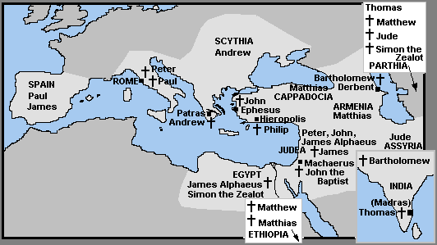

Slide 57
¹² Then they returned to Jerusalem from the mount called Olivet, which is near Jerusalem, a Sabbath day's journey away. ¹³ And when they had entered, they went up to the upper room, where they were staying, Peter and John and James and Andrew, Philip and Thomas, Bartholomew and Matthew, James the son of Alphaeus and Simon the Zealot and Judas the son of James.
¹⁴ All these with one accord were devoting themselves to prayer, together with the women and Mary the mother of Jesus, and his brothers. Acts 1:12-14

Slide 58
¹² Then they returned to Jerusalem from the mount called Olivet, which is near Jerusalem, a Sabbath day's journey away. ¹³ And when they had entered, they went up to the upper room, where they were staying, Peter and John and James and Andrew, Philip and Thomas, Bartholomew and Matthew, James the son of Alphaeus and Simon the Zealot and Judas the son of James.
¹⁴ All these with one accord were devoting themselves to prayer, together with the women and Mary the mother of Jesus, and his brothers. Acts 1:12-14
“For church leaders and for the church as a whole, prayer is not a duty – it is a joyful privilege; it is not a chore that can be taken care of by one-liners between praise songs, but a passionate desire for the presence of God.”
–Schnabel, Eckhard J. Exegetical Commentary on the New Testament. Zondervan, 2012, p. 89.

Slide 59
the ACTS of
JESUS
continue…

Slide 60
1. Neighbor—live out Acts 1:8
the ACTS of
JESUS
continue…

Slide 61
1. Neighbor—live out Acts 1:8
Because God first loved us,
we exist to love God and love our neighbors.
Tallgrass Church Mission Statement
the ACTS of
JESUS
continue…

Slide 62
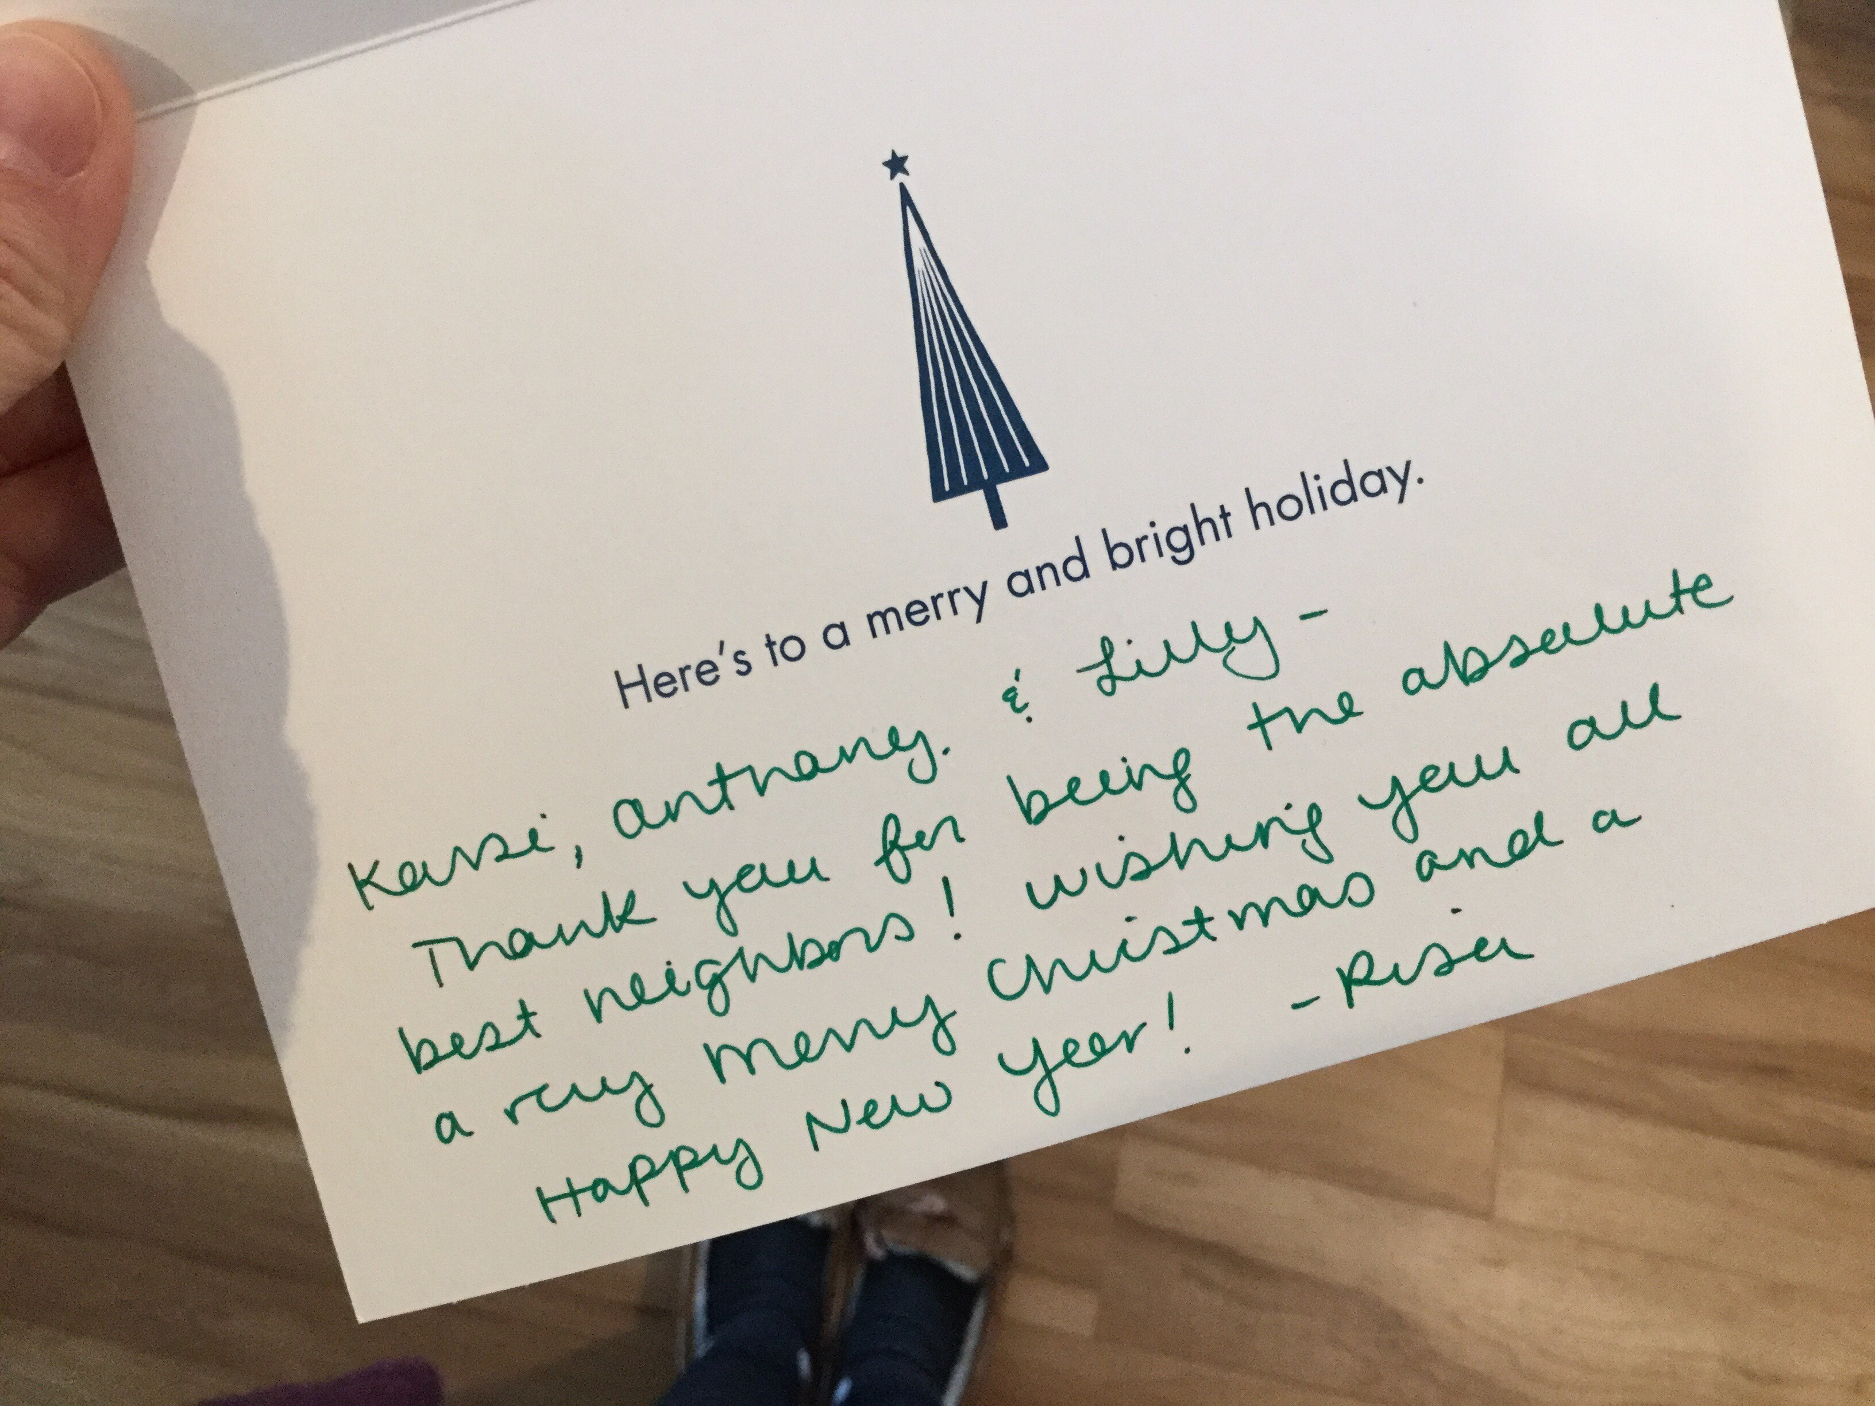
1. Neighbor—live out Acts 1:8
the ACTS of
JESUS
continue…

Slide 63
1. Neighbor—live out Acts 1:8
the ACTS of
JESUS
continue…

Slide 64
1. Neighbor—live out Acts 1:8
the ACTS of
JESUS
continue…

Slide 65
1. Neighbor—live out Acts 1:8 2. 2020 Strategic Priorities
the ACTS of
JESUS
continue…

Slide 66
1. Neighbor—live out Acts 1:8 2. 2020 Strategic Priorities
Gathering Centrally
Corporate Prayer
Discipleship
the ACTS of
JESUS
continue…

Slide 67
1. Neighbor—live out Acts 1:8 2. 2020 Strategic Priorities
3. Study Acts
the ACTS of
JESUS
continue…

Slide 68
1. Neighbor—live out Acts 1:8 2. 2020 Strategic Priorities
3. Study Acts
Read
Study
Memorize
the ACTS of
JESUS
continue…

Slide 69
Acts 1:8 “But you will receive power when the Holy Spirit has come upon you, and you will be my witnesses in Jerusalem and in all Judea and Samaria, and to the end of the earth.”
Acts 2:38 And Peter said to them, “Repent and be baptized every one of you in the name of Jesus Christ for the forgiveness of your sins, and you will receive the gift of the Holy Spirit.”
Acts 2:42 And they devoted themselves to the apostles’ teaching and the fellowship, to the breaking of bread and the prayers.
Acts 4:12 “And there is salvation in no one else, for there is no other name under heaven given among men by which we must be saved.”
Scripture Memory

Slide 70
1. Neighbor—live out Acts 1:8 2. 2020 Strategic Priorities
3. Study Acts
the ACTS of
JESUS
continue…

Slide 72
Spirit of the Living God
Jacob Sooter, Mia Fieldes. #7035191

Slide 73
Spirit of the living God,
Spirit of the living God
We only want to hear Your voice,
We're hanging on every word
Spirit of the Living God

Slide 74
Spirit of the living God,
Spirit of the living God
We want to know You more & more
We're hanging on every word
Spirit of the Living God

Slide 75
“O God, you are my God,
and I long for you. My whole being desires you; like a dry, worn-out, and waterless land, my soul is thirsty for you.”
Spirit of the Living God
Psalm 63

Slide 76
Spirit of the living God,
Spirit of the living God
We only want to hear Your voice,
We're hanging on every word
Spirit of the Living God

Slide 77
Spirit of the living God,
Spirit of the living God
We want to know You more & more
We're hanging on every word
Spirit of the Living God

Slide 78
When You speak, when You move
When You do what only You can do
It changes us. It changes what we see
and what we seek.
Spirit of the Living God

Slide 79
When You come in the room
When You do what only You can do
It changes us. It changes what we see
and what we seek.
Spirit of the Living God

Slide 80
“I stretch out my hands to you;
my soul thirsts for you
like a parched land.”
Spirit of the Living God
Psalm 143

Slide 81
Spirit of the living God,
Spirit of the living God
We’re leaning into who You are.
Everything else can wait.
Spirit of the Living God

Slide 82
Spirit of the living God,
Spirit of the living God
Come now & breathe upon our hearts. Come now and have Your way.
Spirit of the Living God

Slide 83
When You speak, when You move
When You do what only You can do
It changes us. It changes what we see
and what we seek.
Spirit of the Living God

Slide 84
When You come in the room
When You do what only You can do
It changes us. It changes what we see
and what we seek.
Spirit of the Living God

Slide 85
“And I will give you a new heart, and a new spirit I will put within you. And I will remove the heart of stone from your flesh and give you a heart of flesh.”
Spirit of the Living God
Ezekiel 36

Slide 86
When You move,
You move all our fear.
When You move,
You move us to tears.
Spirit of the Living God

Slide 87
When You fall,
we fall on our knees.
When You fall,
we fall at Your feet.
Spirit of the Living God

Slide 88
When You speak, when You move
When You do what only You can do
It changes us. It changes what we see
and what we seek.
Spirit of the Living God

Slide 89
When You come in the room
When You do what only You can do
It changes us. It changes what we see
and what we seek.
Spirit of the Living God

Slide 90
“My sheep hear my voice,
and I know them,
and they follow me…”
Spirit of the Living God
John 10

Slide 91
Spirit of the living God,
Spirit of the living God
We only want to hear Your voice,
We're hanging on every word.
Spirit of the Living God

Slide 92
All the Poor and Powerless
David Leonard, Leslie Jordan. #5881130

Slide 93
All the poor and powerless
And all the lost and lonely
All the thieves will come
And know that You are holy
Will know that You are holy
All the Poor and Powerless

Slide 94
All will sing out Hallelujah
We will sing out Hallelujah
All the Poor and Powerless

Slide 95
All the hearts who are content
And all who feel unworthy,
All who hurt with nothing left
Will know that You are holy.
All the Poor and Powerless

Slide 96
All will sing out Hallelujah
We will sing out Hallelujah
All the Poor and Powerless
repeat

Slide 97
Shout it; go on and scream it
from the mountains.
Go on and tell it to the masses
that He is God.
All the Poor and Powerless
x7

Slide 98
New Wine
Brooke Ligertwood. #7102397.

Slide 99
In the crushing. In the pressing.
You are making new wine.
In the soil I now surrender.
You are making new wine.
New Wine

Slide 100
So I yield to You
and to Your careful hand
When I trust You I don’t need
to understand
New Wine

Slide 101
Make me Your vessel,
Make me an offering,
Make me whatever You want me to be.
I came here with nothing,
But all You have given me.
Jesus bring new wine out of me.
New Wine

Slide 102
In the crushing. In the pressing.
You are making new wine.
In the soil I now surrender.
You are making new wine.
New Wine

Slide 103
Make me Your vessel,
Make me an offering,
Make me whatever You want me to be.
I came here with nothing,
But all You have given me.
Jesus bring new wine out of me.
New Wine

Slide 104
Jesus bring new wine out of me.
New Wine
x2

Slide 105
Where there is new wine
There is new power.
There is new freedom;
The Kingdom is here.
I lay down my old flames
To carry Your new fire today.
New Wine
x2

Slide 106
Make me Your vessel,
Make me an offering,
Make me whatever You want me to be.
I came here with nothing,
But all You have given me.
Jesus bring new wine out of me.
New Wine

Slide 107
Jesus bring new wine out of me.
New Wine
x2

Slide 108
So I yield to You
and to Your careful hand.
Yes I’ll trust You; help when I
don’t understand-in the crushing.
In the pressing You are making new wine.
New Wine

Slide 109
Benediction
Brooke Ligertwood. #7102397.

Slide 110
My friends may you grow in grace
And in the knowledge of our
Lord and Savior.
My friends may you grow in grace
And in the knowledge of Jesus Christ.
Benediction

Slide 111
To God be the glory
Now and forever
Now and forever amen!
Benediction
repeat

Slide 112
I pray tonight
if we learned from one another,
May we glorify Him.
And if the Lord should
bring us back together,
May we be in his arms till then.
Benediction

Slide 113
To God be the glory
Now and forever
Now and forever amen!
Benediction
repeat

Slide 115
WELCOME
STAY AND WATCH THE GAME RIGHT HERE @2PM or head over to the Geldarts: 6101 Tumbleweed Ter.
HAPPY PERIHELION 2020!

