Slide 2
WELCOME TO
Central Gathering
-- January 3, 2015 --

Slide 3
You’re invited to come pray with the elders for our church the THIS Wednesday, 6-7am at The Greenhouse. We’ll have the fire on and the coffee brewing. This opportunity comes on the first Wednesday of each month, so we hope you’ll plan to join us this week and in the future.

Slide 5
preconize ^{(v)} - To proclaim or commend publicly, often with the appointment of a Pope or Bishop
potto ^{(n)} - A type of lemur native to West Africa

Slide 6
preconize ^{(v)} - to proclaim or commend publicly, often with the appointment of a Pope or Bishop
potto ^{(n)} - a type of small lemur native to West Africa

Slide 7
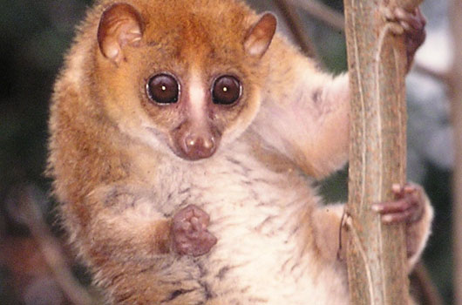
preconize ^{(v)} - to proclaim or commend publicly, often with the appointment of a Pope or Bishop
potto ^{(n)} - a type of small lemur native to West Africa

Slide 9
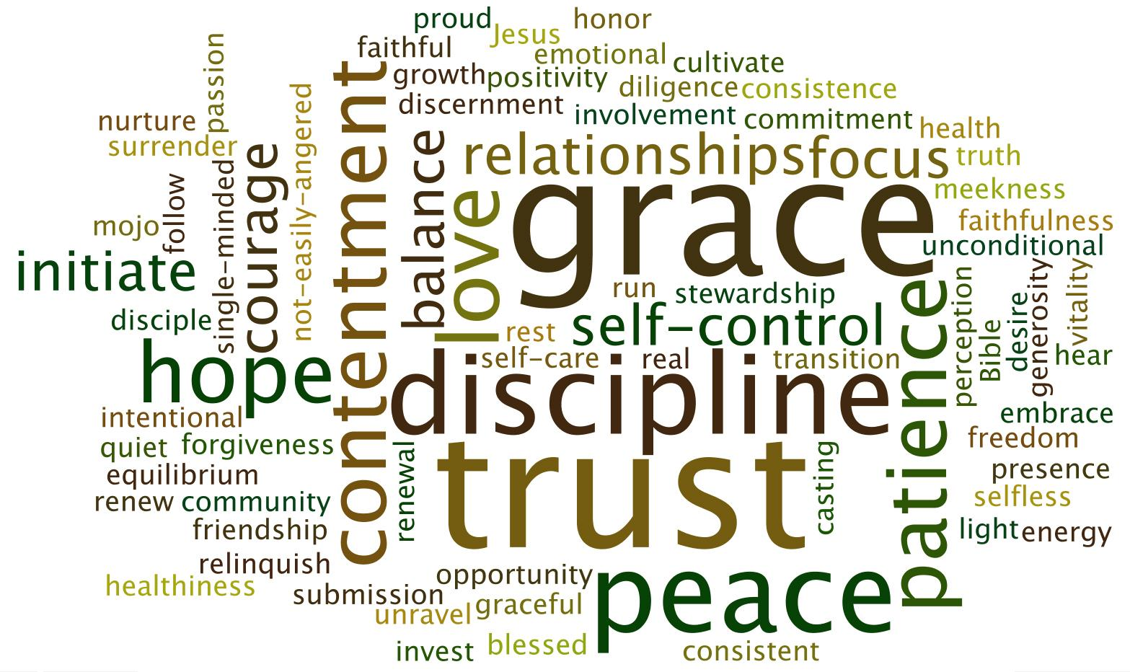

Slide 10
#nhwoty2016

Slide 12
PHILIPPIANS 3:12-17 ^{ESV}
12 Not that I have already obtained this or am already perfect, but I press on to make it my own, because Christ Jesus has made me his own. 13 Brothers, I do not consider that I have made it my own. But one thing I do: forgetting what lies behind and straining forward to what lies ahead, 14 I press on toward the goal for the prize of the upward call of God in Christ Jesus. 15 Let those of us who are mature think this way, and if in anything you think otherwise, God will reveal that also to you. 16 Only let us hold true to what we have attained. 17 Brothers, join in imitating me, and keep your eyes on those who walk according to the example you have in us.

Slide 13
PHILIPPIANS 3:12-17 ^{ESV}
12 Not that I have already obtained this or am already perfect, but I press on to make it my own, because Christ Jesus has made me his own. 13 Brothers, I do not consider that I have made it my own. But one thing I do: forgetting what lies behind and straining forward to what lies ahead, 14 I press on toward the goal for the prize of the upward call of God in Christ Jesus. 15 Let those of us who are mature think this way, and if in anything you think otherwise, God will reveal that also to you. 16 Only let us hold true to what we have attained. 17 Brothers, join in imitating me, and keep your eyes on those who walk according to the example you have in us.
To press on toward the prize we have to process the past and plan for the future while persevering in the present.

Slide 14
New Year’s Resolutions

Slide 15
New Year’s Resolutions
PERFECTIONISM

Slide 16
New Year’s Resolutions
PERFECTIONISM
Boasters and Defeaters

Slide 17
Grace-Based Goal Setting

Slide 18
Grace-Based Goal Setting
GRACE:

Slide 19
Grace-Based Goal Setting
GRACE: God’s Riches at Christ’s Expense

Slide 20
Grace-Based Goal Setting
GRACE: God’s Riches at Christ’s Expense
“Grace is not opposed to effort, it is opposed to earning. Earning is an attitude. Effort is an action.” – Dallas Willard, “The Great Omission”

Slide 21
Why Are We Still Here?

Slide 22
Why Are We Still Here?
SANCTIFICATION

Slide 23
Why Are We Still Here?
SANCTIFICATION
1 Timothy 4:7^{b}-9 “…train yourself for godliness; ⁸ for while bodily training is of some value, godliness is of value in every way, as it holds promise for the present life and also for the life to come.⁹ The saying is trustworthy and deserving of full acceptance.”

Slide 24
Why Are We Still Here?
SANCTIFICATION
GOOD WORKS

Slide 25
Why Are We Still Here?
SANCTIFICATION
GOOD WORKS
Ephesians 2:8-10 “⁸ For by grace you have been saved through faith. And this is not your own doing; it is the gift of God, ⁹ not a result of works, so that no one may boast. ¹⁰ For we are his workmanship, created in Christ Jesus for good works, which God prepared beforehand, that we should walk in them.”

Slide 26
Why Are We Still Here?
SANCTIFICATION
GOOD WORKS
Ephesians 2:8-10 “⁸ For by grace you have been saved through faith. And this is not your own doing; it is the gift of God, ⁹ not a result of works, so that no one may boast. ¹⁰ For we are his workmanship, created in Christ Jesus for good works, which God prepared beforehand, that we should walk in them.”
1st Timothy 4:15-16 “¹⁵ Practice these things, immerse yourself in them, so that all may see your progress. ¹⁶ Keep a close watch on yourself and on the teaching. Persist in this, for by so doing you will save both yourself and your hearers.”

Slide 27
Why Are We Still Here?
SANCTIFICATION
GOOD WORKS
BHAGG = Big, Hairy, Audacious, God-sized Goal

Slide 28
Why Are We Still Here?
SANCTIFICATION
GOOD WORKS
BHAGG = Big, Hairy, Audacious, God-sized Goal
SMART Goals = Specific, Measurable, Achievable, Relevant, Time-Bound

Slide 29
Why Are We Still Here?
SANCTIFICATION
GOOD WORKS
REWARDS

Slide 30
Why Are We Still Here?
SANCTIFICATION
GOOD WORKS
REWARDS
Luke 6:23 “Rejoice in that day, and leap for joy, for behold, your reward is great in heaven.”

Slide 31
Why Are We Still Here?
SANCTIFICATION
GOOD WORKS
REWARDS
Luke 6:23 “Rejoice in that day, and leap for joy, for behold, your reward is great in heaven.”
1st Corinthians 3:8 “But each will receive his own reward according to his own labor.”

Slide 32
Why Are We Still Here?
SANCTIFICATION
GOOD WORKS
REWARDS
Luke 6:23 “Rejoice in that day, and leap for joy, for behold, your reward is great in heaven.”
1st Corinthians 3:8 “But each will receive his own reward according to his own labor.”
Hebrews 11:26 “He regarded disgrace for the sake of Christ as of greater value than the treasures of Egypt, because he was looking ahead to his reward.”

Slide 33
Why Are We Still Here?
SANCTIFICATION
GOOD WORKS
REWARDS
OUR LIVES NOW MATTER!!!

Slide 34
Why Are We Still Here?
Humility
Awake
Repentance
Brokenness
Discernment
Sight
Selfless
Patience
Submission
Worship
Courage
Strength
Trust
Grace
Renew
Conviction
Confidence
Trust
Unconditional
Sensitivity
Hope
Eternity
Thanksgiving
Blessing
Kindness
Slowing
Productivity
Self-control
Fasting
Discipline
Peace
Reading
Learning
Focus
Engage
Bible
Prayer
Community
Evangelism
Kingdom
Risk
Commitment
Remember
Forgiveness
Encouragement
Relationships
Joy Fun Self-Care Identity Love
SANCTIFICATION
GOOD WORKS
REWARDS
OUR LIVES NOW MATTER!!!

Slide 35
Ephesians 4:13-16
“…we all attain to the unity of the faith and of the knowledge of the Son of God, to mature manhood, to the measure of the stature of the fullness of Christ, ¹⁴ so that we may no longer be children, tossed to and fro by the waves and carried about by every wind of doctrine, by human cunning, by craftiness in deceitful schemes. ¹⁵ Rather, speaking the truth in love, we are to grow up in every way into him who is the head, into Christ, ¹⁶ from whom the whole body, joined and held together by every joint with which it is equipped, when each part is working properly, makes the body grow so that it builds itself up in love.”

