Slide 1
Meet someone who is not in your church and ask one another, “How did you spend Christmas?”
MINGLE QUESTION

Slide 2
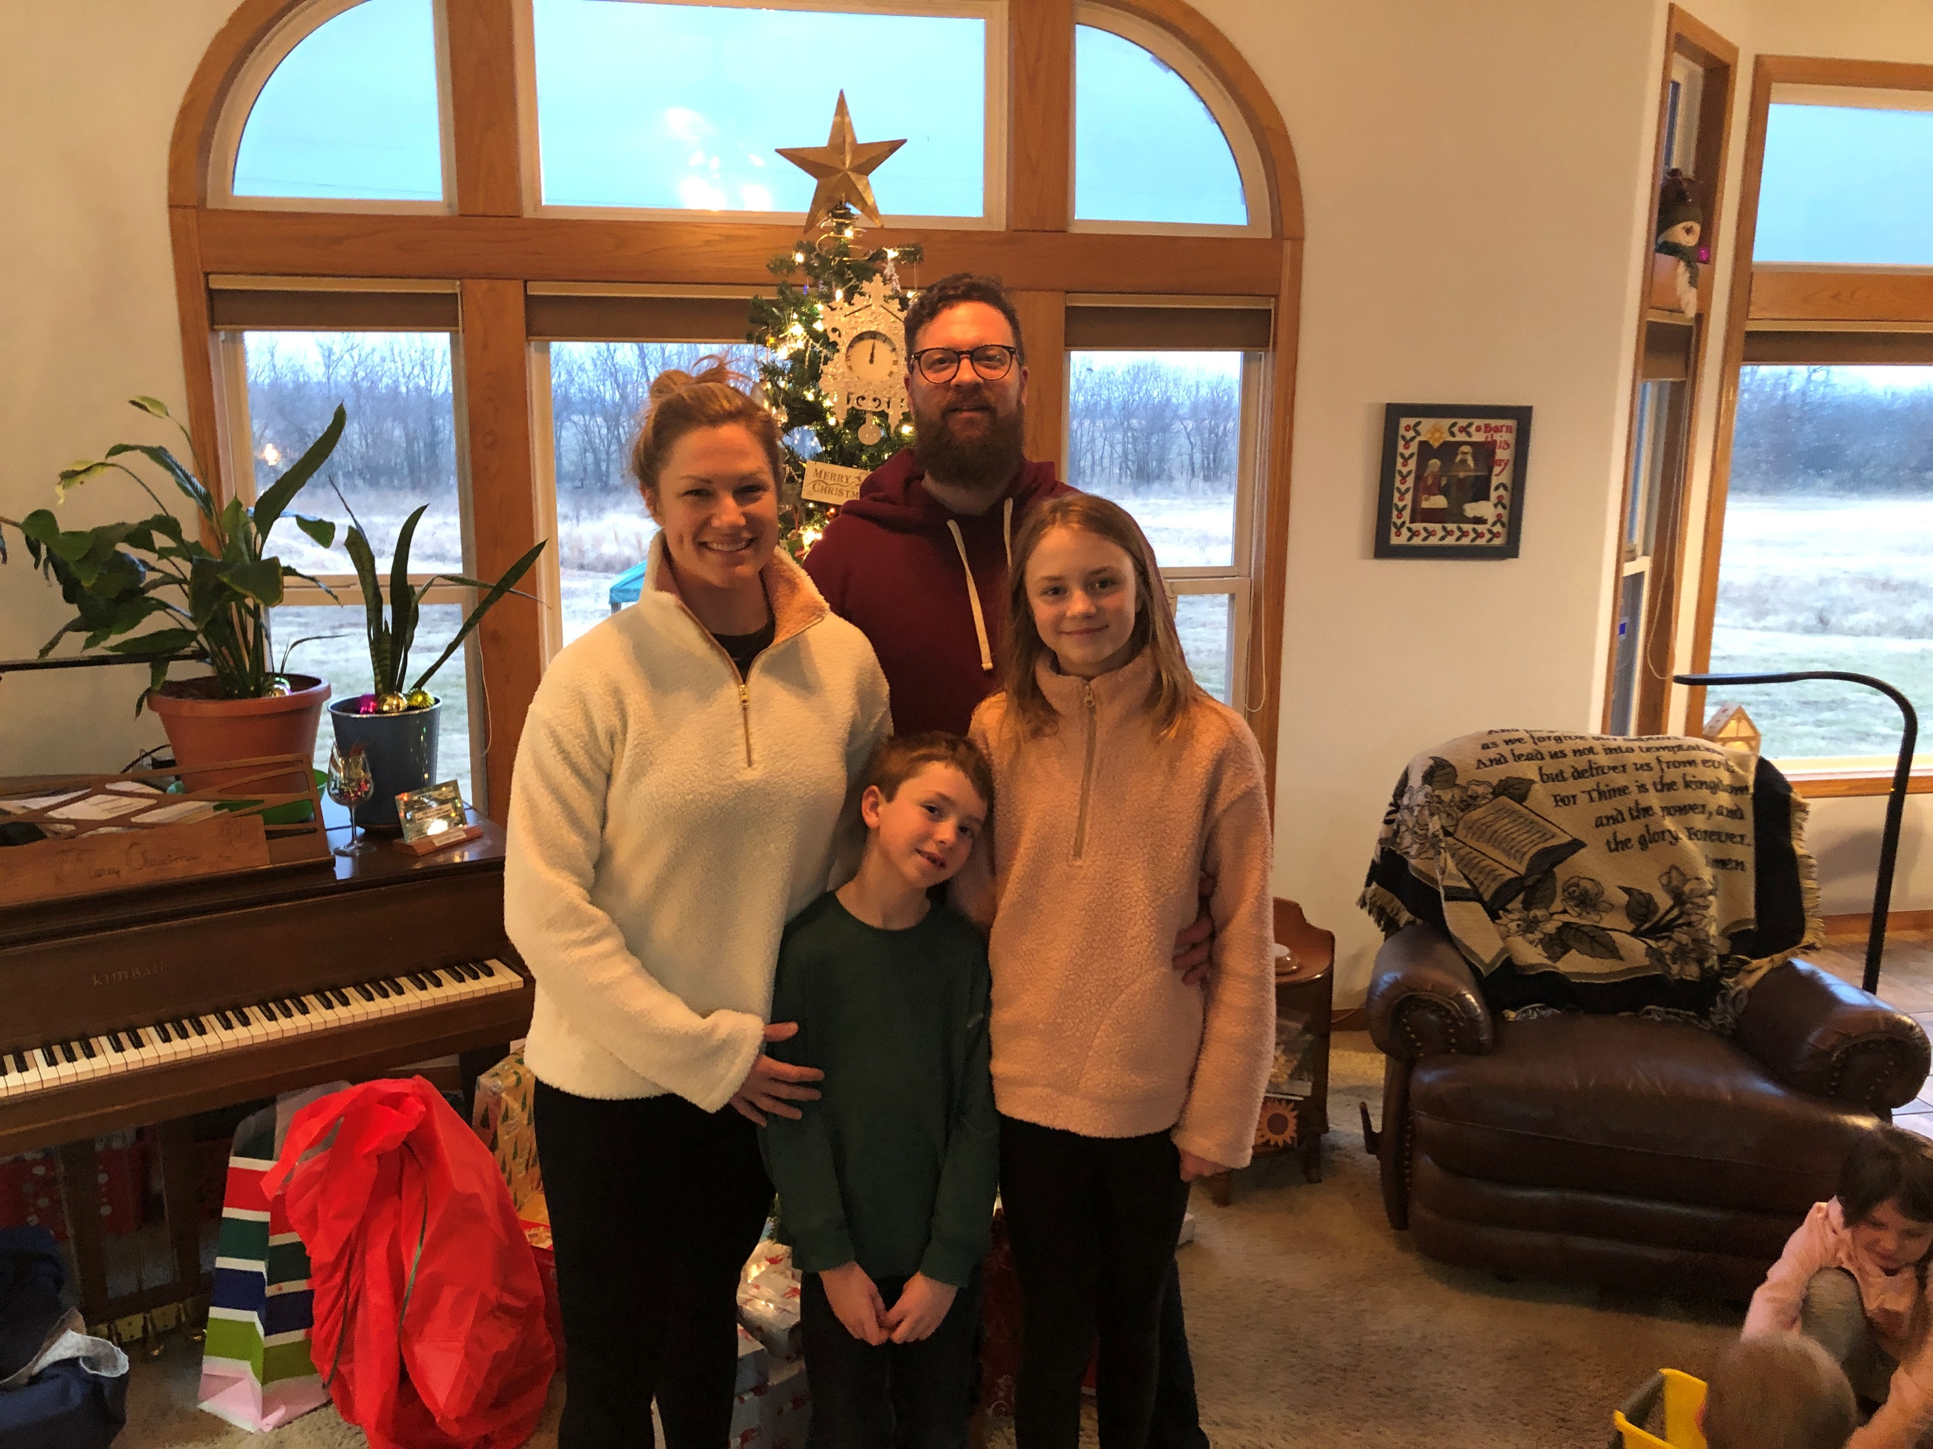

Slide 4
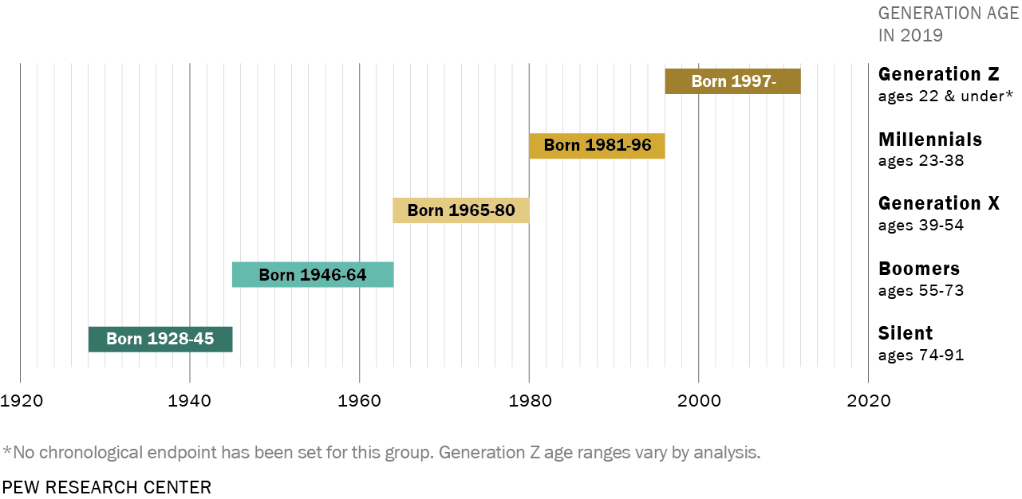

Slide 5
Ages 39-54 GENERATION X?

Slide 6
Ages 23-38 MILLENNIALS?

Slide 7
Ages 55-73 BOOMERS?

Slide 8
Ages 22 & under GENERATION Z?

Slide 9
Ages 74-91 SILENT?

Slide 10
Ages 92-118 GREATEST?

Slide 11
What generation does Forrest Gump’s son belong to?

Slide 12
What generation does Forrest Gump’s son belong to?
GEN A

Slide 13
This young generation with their computers & internet are so self absorbed.

Slide 14
This young generation with their computers & internet are so self absorbed.
It’s all meme, meme, meme…

Slide 15
We made learning so much easier for the younger generation.

Slide 16
We made learning so much easier for the younger generation.
We even reduced the planets down to eight.

Slide 17
FOR MEN & WOMEN ALIKE!

Slide 18
FOR JEW & GENTILE ALIKE!

Slide 19
FOR SLAVE & FREE ALIKE!

Slide 20
FOR YOUNG & OLD ALIKE!

Slide 21
FOR YOUNG & OLD ALIKE!

Slide 22
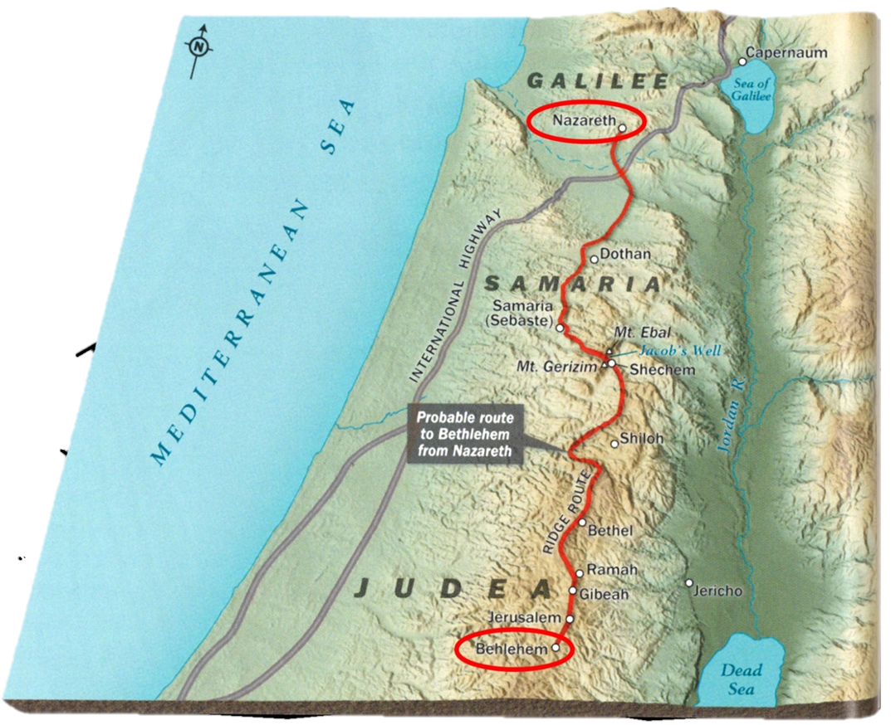
²¹ And at the end of eight days, when he was circumcised, he was called Jesus, the name given by the angel before he was conceived in the womb. ²² And when the time came for their purification according to the Law of Moses, they brought him up to Jerusalem to present him to the Lord ²³ (as it is written in the Law of the Lord, “Every male who first opens the womb shall be called holy to the Lord”) ²⁴ and to offer a sacrifice according to what is said in the Law of the Lord, “a pair of turtledoves, or two young pigeons.”
LUKE 2: FOR YOUNG & OLD ALIKE!

Slide 23
²¹ And at the end of eight days, when he was circumcised, he was called Jesus, the name given by the angel before he was conceived in the womb. ²² And when the time came for their purification according to the Law of Moses, they brought him up to Jerusalem to present him to the Lord ²³ (as it is written in the Law of the Lord, “Every male who first opens the womb shall be called holy to the Lord”) ²⁴ and to offer a sacrifice according to what is said in the Law of the Lord, “a pair of turtledoves, or two young pigeons.”
LUKE 2: FOR YOUNG & OLD ALIKE!

Slide 24
²¹ And at the end of eight days, when he was circumcised, he was called Jesus, the name given by the angel before he was conceived in the womb. ²² And when the time came for their purification according to the Law of Moses, they brought him up to Jerusalem to present him to the Lord ²³ (as it is written in the Law of the Lord, “Every male who first opens the womb shall be called holy to the Lord”) ²⁴ and to offer a sacrifice according to what is said in the Law of the Lord, “a pair of turtledoves, or two young pigeons.”
5.5 miles
LUKE 2: FOR YOUNG & OLD ALIKE!

Slide 25
³⁹ And when they had performed everything according to the Law of the Lord, they returned into Galilee, to their own town of Nazareth. ⁴⁰ And the child grew and became strong, filled with wisdom. And the favor of God was upon him.
LUKE 2: FOR YOUNG & OLD ALIKE!

Slide 26
²⁵ Now there was a man in Jerusalem, whose name was Simeon, and this man was righteous and devout, waiting for the consolation of Israel, and the Holy Spirit was upon him. ²⁶ And it had been revealed to him by the Holy Spirit that he would not see death before he had seen the Lord’s Christ. ²⁷ And he came in the Spirit into the temple, and when the parents brought in the child Jesus, to do for him according to the custom of the Law, ²⁸ he took him up in his arms and blessed God and said…
LUKE 2: FOR YOUNG & OLD ALIKE!

Slide 27
²⁹ “Lord, now you are letting your servant depart in peace, according to your word; ³⁰ for my eyes have seen your salvation ³¹ that you have prepared in the presence of all peoples, ³² a light for revelation to the Gentiles, and for glory to your people Israel.”
LUKE 2: FOR YOUNG & OLD ALIKE!

Slide 28
³³ And his father and his mother marveled at what was said about him. ³⁴ And Simeon blessed them and said to Mary his mother, “Behold, this child is appointed for the fall and rising of many in Israel, and for a sign that is opposed ³⁵ (and a sword will pierce through your own soul also), so that thoughts from many hearts may be revealed.”
LUKE 2: FOR YOUNG & OLD ALIKE!

Slide 29
³⁶ And there was a prophetess, Anna, the daughter of Phanuel, of the tribe of Asher. She was advanced in years, having lived with her husband seven years from when she was a virgin, ³⁷ and then as a widow until she was eighty-four. She did not depart from the temple, worshiping with fasting and prayer night and day. ³⁸ And coming up at that very hour she began to give thanks to God and to speak of him to all who were waiting for the redemption of Jerusalem.
LUKE 2: FOR YOUNG & OLD ALIKE!

Slide 30
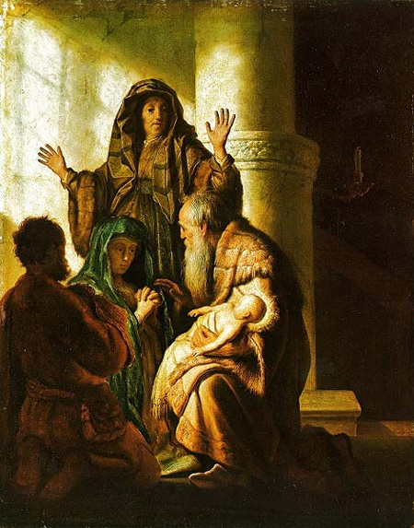
³⁶ And there was a prophetess, Anna, the daughter of Phanuel, of the tribe of Asher. She was advanced in years, having lived with her husband seven years from when she was a virgin, ³⁷ and then as a widow until she was eighty-four. She did not depart from the temple, worshiping with fasting and prayer night and day. ³⁸ And coming up at that very hour she began to give thanks to God and to speak of him to all who were waiting for the redemption of Jerusalem.
LUKE 2: FOR YOUNG & OLD ALIKE!

Slide 31
Simeon:
righteous and devout (v. 25)
waiting for the consolation of Israel (v. 25)
the Holy Spirit was upon him (v. 25)
received revelation from the Holy Spirit (v. 26)
came in the Spirit into the temple (v. 27)
He took Jesus up in his arms (v. 28)
³⁶ And there was a prophetess, Anna, the daughter of Phanuel, of the tribe of Asher. She was advanced in years, having lived with her husband seven years from when she was a virgin, ³⁷ and then as a widow until she was eighty-four. She did not depart from the temple, worshiping with fasting and prayer night and day. ³⁸ And coming up at that very hour she began to give thanks to God and to speak of him to all who were waiting for the redemption of Jerusalem.
LUKE 2: FOR YOUNG & OLD ALIKE!

Slide 32
²⁹ “Lord, now you are letting your servant depart in peace, according to your word; ³⁰ for my eyes have seen your salvation ³¹ that you have prepared in the presence of all peoples, ³² a light for revelation to the Gentiles, and for glory to your people Israel.”
Luke 2:29-32
³⁶ And there was a prophetess, Anna, the daughter of Phanuel, of the tribe of Asher. She was advanced in years, having lived with her husband seven years from when she was a virgin, ³⁷ and then as a widow until she was eighty-four. She did not depart from the temple, worshiping with fasting and prayer night and day. ³⁸ And coming up at that very hour she began to give thanks to God and to speak of him to all who were waiting for the redemption of Jerusalem.
LUKE 2: FOR YOUNG & OLD ALIKE!

Slide 33
…he (the Lord) says: “It is too light a thing that you should be my servant to raise up the tribes of Jacob and to bring back the preserved of Israel; I will make you as a light for the nations, that my salvation may reach to the end of the earth.” Isaiah 49:6
³⁶ And there was a prophetess, Anna, the daughter of Phanuel, of the tribe of Asher. She was advanced in years, having lived with her husband seven years from when she was a virgin, ³⁷ and then as a widow until she was eighty-four. She did not depart from the temple, worshiping with fasting and prayer night and day. ³⁸ And coming up at that very hour she began to give thanks to God and to speak of him to all who were waiting for the redemption of Jerusalem.
LUKE 2: FOR YOUNG & OLD ALIKE!

Slide 34
³⁴ And Simeon blessed them and said to Mary his mother, “Behold, this child is appointed for the fall and rising of many in Israel, and for a sign that is opposed ³⁵ (and a sword will pierce through your own soul also), so that thoughts from many hearts may be revealed.”
Luke 2:34-35
³⁶ And there was a prophetess, Anna, the daughter of Phanuel, of the tribe of Asher. She was advanced in years, having lived with her husband seven years from when she was a virgin, ³⁷ and then as a widow until she was eighty-four. She did not depart from the temple, worshiping with fasting and prayer night and day. ³⁸ And coming up at that very hour she began to give thanks to God and to speak of him to all who were waiting for the redemption of Jerusalem.
LUKE 2: FOR YOUNG & OLD ALIKE!

Slide 35
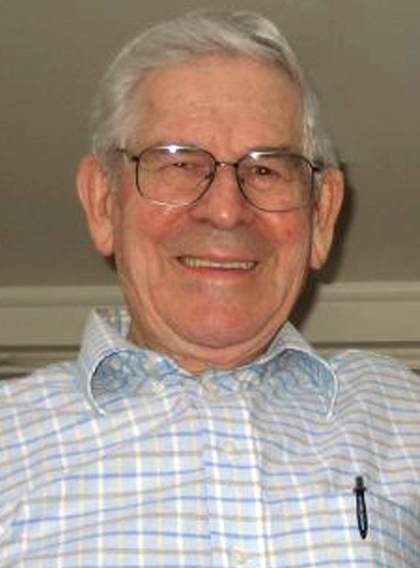
Dr. Bob Taussig
³⁶ And there was a prophetess, Anna, the daughter of Phanuel, of the tribe of Asher. She was advanced in years, having lived with her husband seven years from when she was a virgin, ³⁷ and then as a widow until she was eighty-four. She did not depart from the temple, worshiping with fasting and prayer night and day. ³⁸ And coming up at that very hour she began to give thanks to God and to speak of him to all who were waiting for the redemption of Jerusalem.
LUKE 2: FOR YOUNG & OLD ALIKE!

Slide 36
Anna:
a prophetess (v. 36)
the daughter of Phanuel, of the tribe of Asher (v. 36)
³⁶ And there was a prophetess, Anna, the daughter of Phanuel, of the tribe of Asher. She was advanced in years, having lived with her husband seven years from when she was a virgin, ³⁷ and then as a widow until she was eighty-four. She did not depart from the temple, worshiping with fasting and prayer night and day. ³⁸ And coming up at that very hour she began to give thanks to God and to speak of him to all who were waiting for the redemption of Jerusalem.
And Leah said, “Happy am I! For women have called me happy.” So she called his name Asher.
Genesis 30:13
LUKE 2: FOR YOUNG & OLD ALIKE!

Slide 37
Anna:
a prophetess (v. 36)
the daughter of Phanuel, of the tribe of Asher (v. 36)
advanced in years (v. 36)
didn’t depart from the temple (v. 37)
worshiped with fasting and prayer night and day (v. 37)
³⁶ And there was a prophetess, Anna, the daughter of Phanuel, of the tribe of Asher. She was advanced in years, having lived with her husband seven years from when she was a virgin, ³⁷ and then as a widow until she was eighty-four. She did not depart from the temple, worshiping with fasting and prayer night and day. ³⁸ And coming up at that very hour she began to give thanks to God and to speak of him to all who were waiting for the redemption of Jerusalem.
Asher's food shall be rich, and he shall yield royal delicacies.
Genesis 49:20
LUKE 2: FOR YOUNG & OLD ALIKE!

Slide 38
Anna:
a prophetess (v. 36)
the daughter of Phanuel, of the tribe of Asher (v. 36)
advanced in years (v. 36)
didn’t depart from the temple (v. 37)
worshiped with fasting and prayer night and day (v. 37)
grateful (v. 38)
spoke of Jesus to all (v. 38)
³⁶ And there was a prophetess, Anna, the daughter of Phanuel, of the tribe of Asher. She was advanced in years, having lived with her husband seven years from when she was a virgin, ³⁷ and then as a widow until she was eighty-four. She did not depart from the temple, worshiping with fasting and prayer night and day. ³⁸ And coming up at that very hour she began to give thanks to God and to speak of him to all who were waiting for the redemption of Jerusalem.
Asher's food shall be rich, and he shall yield royal delicacies.
Genesis 49:20
LUKE 2: FOR YOUNG & OLD ALIKE!

Slide 39
In 2020:
Prepare to grow old well.
Speak of Jesus.
Invest in generations.
Love the season of life you’re in.
³⁶ And there was a prophetess, Anna, the daughter of Phanuel, of the tribe of Asher. She was advanced in years, having lived with her husband seven years from when she was a virgin, ³⁷ and then as a widow until she was eighty-four. She did not depart from the temple, worshiping with fasting and prayer night and day. ³⁸ And coming up at that very hour she began to give thanks to God and to speak of him to all who were waiting for the redemption of Jerusalem.
LUKE 2: FOR YOUNG & OLD ALIKE!

Slide 41
FOR YOUNG & OLD ALIKE!

Slide 42
Therefore, since we are surrounded by so great a cloud of witnesses, let us also lay aside every weight, and sin which clings so closely, and let us run with endurance the race that is set before us, ² looking to Jesus, the founder and perfecter of our faith, who for the joy that was set before him endured the cross, despising the shame, and is seated at the right hand of the throne of God.
Hebrews 12:1-2
BENEDICTION

