Slide 1
WELCOME

Slide 2
GIVING INTENTION CARDS
Please drop yours in the black box today
Or email it to Dave by tomorrow
… text REGISTER to set it up

Slide 3
TALLGRASS PRAYER
Come join fellow Tallgrassians to pray for God’s work within and out from our church. Come and go as needed.
RESCHEDULED!
THIS SATURDAY, NOV 2, 4PM-MORNING
at Aly Gilbert’s back yard in University Park. You bring camping stuff. Tallgrass provides food.
RSVP by Oct 30 to Kassi. Deets online at tallgrass.church/events

Slide 4
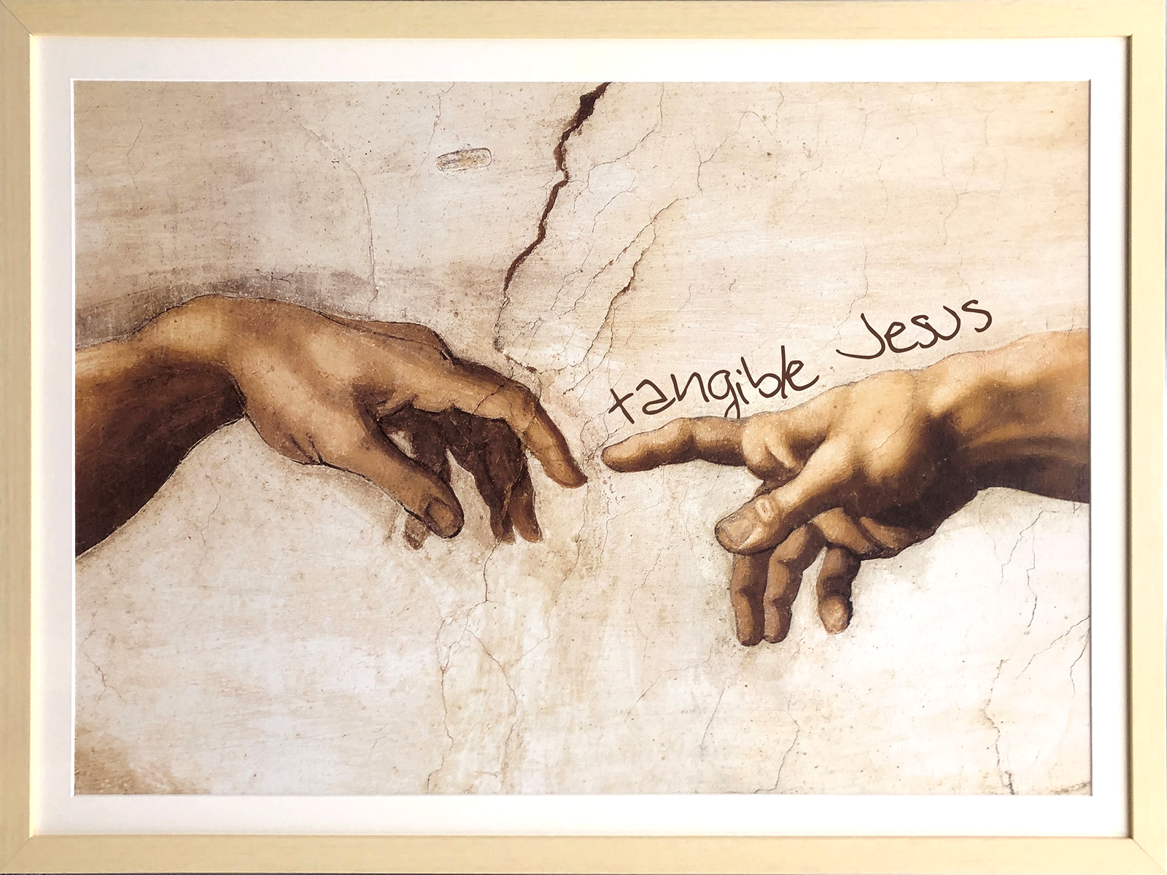
New teaching series STARTS NEXT SUNDAY!

Slide 5
MINGLE QUESTION
What’s something that comes to mind when you think about HOME?

Slide 7
teaching series concludes today!
catch up at tallgrass.church

Slide 8
GOSPEL RELATING
emotions
dads
Overlays like this
work
yourself

Slide 9
RELATING FOR LIFE

Slide 10
RELATING FOR LIFE
PSALM 90

Slide 11
RELATING FOR LIFE
PSALM 90
¹⁰ Our days may come to seventy years, or eighty, if our strength endures;

Slide 12
RELATING FOR LIFE
PSALM 90
¹⁰ Our days may come to seventy years, or eighty, if our strength endures;
¹² Teach us to number our days, that we may gain a heart of wisdom.

Slide 13
RELATING FOR LIFE
PSALM 90
¹⁰ Our days may come to seventy years, or eighty, if our strength endures;
¹² Teach us to number our days, that we may gain a heart of wisdom.
Research shows that numbering our days makes us:
Less afraid of death
Less defensive of our worldview
More generous
More kind
More loving
Higher value on human life
Higher value on relationships
The Atlantic: “What Good is Thinking About Death?” https://www.theatlantic.com/health/archive/2015/05/what-good-is-thinking-about-death/394151/

Slide 14
RELATING FOR LIFE
PSALM 90
¹⁰ Our days may come to seventy years, or eighty, if our strength endures;
¹² Teach us to number our days, that we may gain a heart of wisdom.
INTERVIEW WITH AL LYLE

Slide 15
THE LOVE OF GOD

Slide 16
THE LOVE OF GOD
The love of God is greater far
than tongue or pen can ever tell;
It goes beyond the highest star,
And reaches to the lowest hell;

Slide 17
THE LOVE OF GOD
The guilty pair, bowed down with care,
God gave His Son to win;
His erring child He reconciled,
And pardoned from his sin.

Slide 18
THE LOVE OF GOD
Oh, love of God, how rich and pure!
How measureless and strong!
It shall forevermore endure—
The saints’ and angels’ song.

Slide 19
THE LOVE OF GOD
Could we with ink the ocean fill,
and were the skies of parchment made,
were every stalk on earth a quill,
and every man a scribe by trade;

Slide 20
THE LOVE OF GOD
to write the love of God above
would drain the ocean dry;
nor could the scroll contain the whole,
though stretched from sky to sky.

Slide 21
RELATING FOR LIFE
“if we have been united with him in a death like his, we shall certainly be united with him in a resurrection like his.” - Romans 6:5 “For this perishable body must put on the imperishable, and this mortal body must put on immortality. …then shall come to pass the saying that is written: 'Death is swallowed up in victory.' 'O death, where is your victory? O death, where is your sting?’” - 1 Corinthians 15:53,55

Slide 22
RELATING FOR LIFE
“if we have been united with him in a death like his, we shall certainly be united with him in a resurrection like his.” - Romans 6:5 “For this perishable body must put on the imperishable, and this mortal body must put on immortality. …then shall come to pass the saying that is written: 'Death is swallowed up in victory.' 'O death, where is your victory? O death, where is your sting?’” - 1 Corinthians 15:53,55

Slide 23
RELATING FOR LIFE
“after my skin has been destroyed,
yet in my flesh I will see God;
I myself will see him
with my own eyes—I, and not another.
How my heart yearns within me!”
- Job 19: 26-27

Slide 24
RELATING FOR LIFE
“train yourself for godliness; for while bodily training is of some value, godliness is of value in every way, as it holds promise for the present life and also for the life to come.” - 1 Timothy 4:7-8

Slide 25
RELATING FOR LIFE
emotions
dads
Overlays like this
work
yourself

Slide 26
RELATING FOR LIFE
“And he who was seated on the throne said, “Behold, I am making all things new.” - Revelation 21:5
“Being sure of this, that he who began a good work in you will bring it to completion at the day of Jesus Christ.” - Philippians 1:6

Slide 28
How would you live differently if you knew you’d die in three months?
How could a firmer hope in resurrection empower your life now?
What next steps of faith do you sense God calling you to in response to this?
Any questions for Al?

Slide 29
OCEANS
by Hillsong

Slide 30
OCEANS
You call me out upon the waters
The great unknown where feet may fail
And there I find You in the mystery
In oceans deep my faith will stand
So I will call upon Your Name
And keep my eyes above the waves
When oceans rise
My soul will rest in Your embrace
For I am Yours, and You are mine
by Hillsong

Slide 31
OCEANS
Your grace abounds in deepest waters
Your sovereign hand will be my guide
Where feet may fail and fear surrounds me
You've never failed and You won't start now
So I will call upon Your Name
And keep my eyes above the waves
When oceans rise
My soul will rest in Your embrace
For I am Yours, and You are mine
by Hillsong

Slide 32
OCEANS
Spirit lead me where my trust is without borders
Let me walk upon the waters
Wherever You would call me
Take me deeper than my feet could ever wander
And my faith will be made stronger
In the presence of my Saviour
by Hillsong

Slide 33
OCEANS
So I will call upon Your Name
And keep my eyes above the waves
My soul will rest in Your embrace
For I am Yours, and You are mine
by Hillsong

Slide 34
HOW GREAT THOU ART
tallgrass.church

Slide 35
Oh Lord my God, when I in awesome wonder
consider all the worlds Thy hands have made
I see the stars, I hear the rolling thunder,
Thy power throughout the universe displayed
HOW GREAT THOU ART
tallgrass.church

Slide 36
Then sings my soul, my Savior God to Thee,
“How great Thou art”
“How great Thou art!”
Then sings my soul, my Savior God to Thee,
“How great Thou art”
“How great Thou art!”
HOW GREAT THOU ART
tallgrass.church

Slide 37
And when I think that God His Son not sparing
sent Him to die, I scarce can take it in,
that on the cross, my burden gladly bearing
He bled and died to take away my sin
HOW GREAT THOU ART
tallgrass.church

Slide 38
Then sings my soul, my Savior God to Thee,
“How great Thou art”
“How great Thou art!”
Then sings my soul, my Savior God to Thee,
“How great Thou art”
“How great Thou art!”
HOW GREAT THOU ART
tallgrass.church

Slide 39
When Christ shall come with shouts of acclamation
and take me home, what joy shall fill my heart!
Then I shall bow in humble adoration
and there proclaim “My God, how great Thou art!”
HOW GREAT THOU ART
tallgrass.church

Slide 40
Then sings my soul, my Savior God to Thee,
“How great Thou art”
“How great Thou art!”
Then sings my soul, my Savior God to Thee,
“How great Thou art”
“How great Thou art!”
HOW GREAT THOU ART
tallgrass.church

Slide 41
BENEDICTION
tallgrass.church

Slide 42
Father, give Your benediction
Give us Your peace before we part
Still our minds with truth’s conviction Calm with trust each anxious heart
BENEDICTION
tallgrass.church

Slide 43
Father, give Your benediction
Bid our grief and struggles end Peace which passes understanding On our waiting spirit send
BENEDICTION
tallgrass.church

Slide 44
Amen. Amen.
Amen. Amen.
Amen. Amen.
amen: let it be so
BENEDICTION
tallgrass.church

Slide 45
WELCOME

