Slide 1
WELCOME

Slide 2
Mega Mingle Questions:
What’s the scariest thing you’ve done for fun?
What food isn’t made better by chocolate or Ranch?
What’s your favorite children’s toy?
If you had an extra hour of free time a day, how would you use it?
If you were the eighth dwarf, what would your name be?
If you could instantly be good at something, what would it be?
What is your favorite movie?
What’s your deepest, darkest secret? (Jk, don’t answer this one!)
10 minutes to do 4 things: 1) Find a person or two. Exchange names, of course. 2) Pick one of the questions above. 3) Get a drink if needed.
4) Use the remaining time for each person to fully answer the question with as much detail as possible. Follow up each question with “Why?”

Slide 3
VISION GATHERING 2020
If you missed it, check out our key Vision Gathering from last Sunday online at tallgrass.church!

Slide 4
GIVING INTENTION CARDS
Please drop yours in the black box today
Or email it to Dave by this Wednesday
… text REGISTER to set it up

Slide 5
STEWARDSHIP REPORTS
How did you steward the $20?
Kate Deaver
Chris Swanson
Terrence Thomas
Dan Chitwood
Drew Fratecelli

Slide 6
INVESTMEST BASICS
TODAY, OCT. 20TH 6-7pm in the Parlor Rm. Free workshop brought to us by Thrivent Financial, a not-for-profit financial services organization that several Tallgrass families use for their financial planning. Food and child- care are provided for those who already RSVPed. Otherwise you’re welcome to join us, but food and childcare will be on your own.

Slide 8
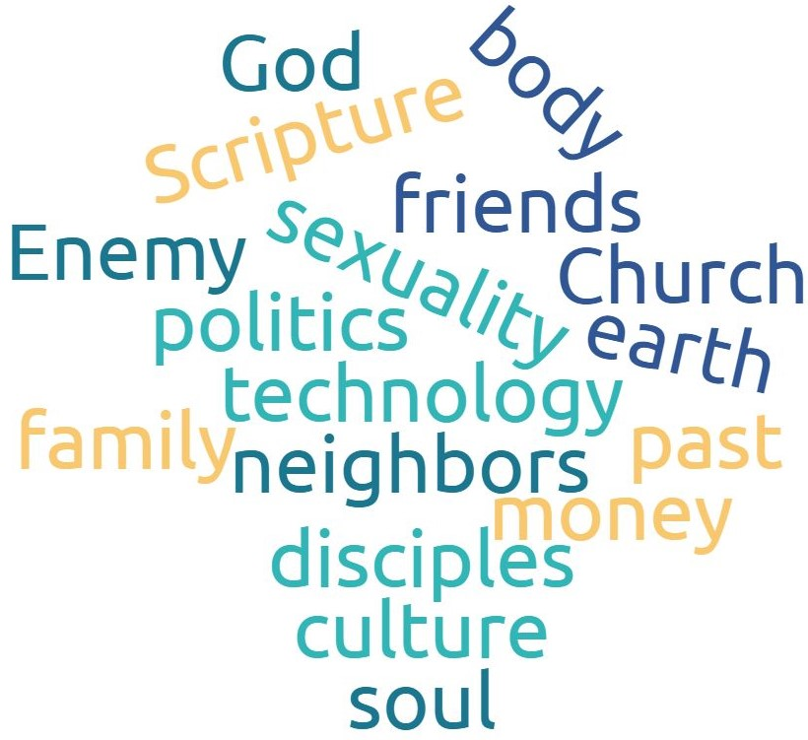
GOSPEL RELATING
Overlays like this
work

Slide 9
GOSPEL RELATING
Overlays like this
work

Slide 10
RELATING ^{TO} THIRSTY SOULS

Slide 11
My people have committed two sins: They have forsaken me, the spring of living water, and have dug their own cisterns, broken cisterns that cannot hold water.
Jeremiah 2:13

Slide 12
Drug Addict
Cool Car Guy
Workaholic
Mr. Responsibility
Social Butterfly
Alcoholic
Ministry Junkie
Funny Girl
The Expert
Sex Addict
Gym Rat
Figure-it-out Dude
Jeremiah 2:13

Slide 13
Drug Addict
Cool Car Guy
Workaholic
Mr. Responsibility
Social Butterfly
Alcoholic
Ministry Junkie
Funny Girl
The Expert
Sex Addict
Gym Rat
Figure-it-out Dude
Jeremiah 2:13

Slide 14
Drug Addict
Cool Car Guy
Workaholic
Mr. Responsibility
Social Butterfly
Alcoholic
Ministry Junkie
Funny Girl
The Expert
Sex Addict
Gym Rat
Figure-it-out Dude
Jeremiah 2:13

Slide 15
Drug Addict
Cool Car Guy
Workaholic
Mr. Responsibility
Social Butterfly
Alcoholic
Ministry Junkie
Funny Girl
The Expert
Sex Addict
Gym Rat
Figure-it-out Dude
Jeremiah 2:13

Slide 16
Drug Addict
Cool Car Guy
Workaholic
Mr. Responsibility
Social Butterfly
Alcoholic
Ministry Junkie
Funny Girl
The Expert
Sex Addict
Gym Rat
Figure-it-out Dude
Jeremiah 2:13

Slide 17
Drug Addict
Cool Car Guy
Workaholic
Mr. Responsibility
Social Butterfly
Alcoholic
Ministry Junkie
Funny Girl
The purposes
of a person’s heart are deep waters… Proverbs 20:5a
The Expert
Sex Addict
Gym Rat
Figure-it-out Dude
Jeremiah 2:13

Slide 18
Childhood scenes
Trauma
Lies
Abuse
Wounding
Shame
Fear
Victim & Victimizer
Family of origin
Drug Addict
Cool Car Guy
Workaholic
Mr. Responsibility
Social Butterfly
Alcoholic
Ministry Junkie
Funny Girl
The purposes
of a person’s heart are deep waters… Proverbs 20:5a
The Expert
Sex Addict
Gym Rat
Figure-it-out Dude
Jeremiah 2:13

Slide 19
Childhood scenes
Trauma
Lies
Abuse
Wounding
Shame
Fear
Victim & Victimizer
Family of origin
Drug Addict
Cool Car Guy
Workaholic
Mr. Responsibility
The purposes
of a person’s heart are deep waters, but one who has insight draws them out. Proverbs 20:5
Social Butterfly
Alcoholic
Ministry Junkie
Funny Girl
The Expert
Sex Addict
Gym Rat
Figure-it-out Dude
Jeremiah 2:13

Slide 20
¹³ Jesus said to her, “Everyone who drinks of this water will be thirsty again, ¹⁴ but whoever drinks of the water that I will give him will never be thirsty again. The water that I will give him will become in him a spring of water welling up to eternal life.” John 4:13-14
Childhood scenes
Trauma
Lies
Abuse
Wounding
Shame
Fear
Victim & Victimizer
Family of origin
Drug Addict
Cool Car Guy
Workaholic
Mr. Responsibility
Social Butterfly
Alcoholic
Ministry Junkie
Funny Girl
The Expert
Sex Addict
Gym Rat
Figure-it-out Dude

Slide 21
3 Agents of Change
The Word of God (Hebrews 4:12-13)
The Spirit of God (Psalm 139:23-24)
The People of God (Hebrews 3:13)

Slide 22
3 Agents of Change
The Word of God (Hebrews 4:12-13)
The Spirit of God (Psalm 139:23-24)
The People of God (Hebrews 3:13)

Slide 23
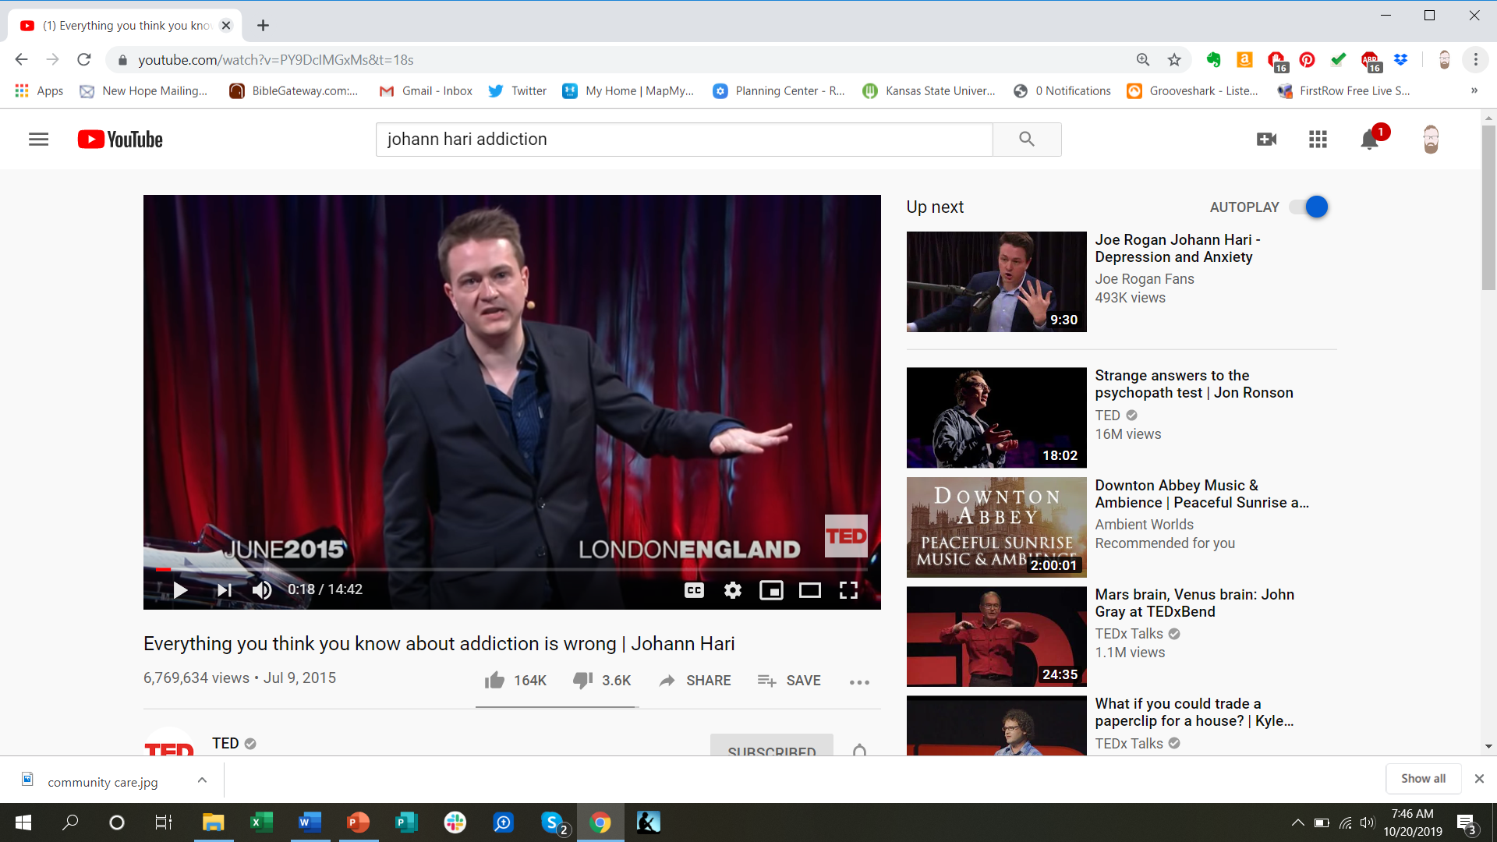

Slide 24
Drawing out deep waters
Dive into your own deep waters.

Slide 25
Drawing out deep waters
Dive into your own deep waters.
Find an intentional environment.

Slide 26
Drawing out deep waters
Dive into your own deep waters.
Find an intentional environment.
Bring curiosity. Ask questions, and then listen.

Slide 27
Drawing out deep waters
Dive into your own deep waters.
Find an intentional environment.
Bring curiosity. Ask questions, and then listen.
Don’t fix, because ultimately you can’t fix it.

Slide 28
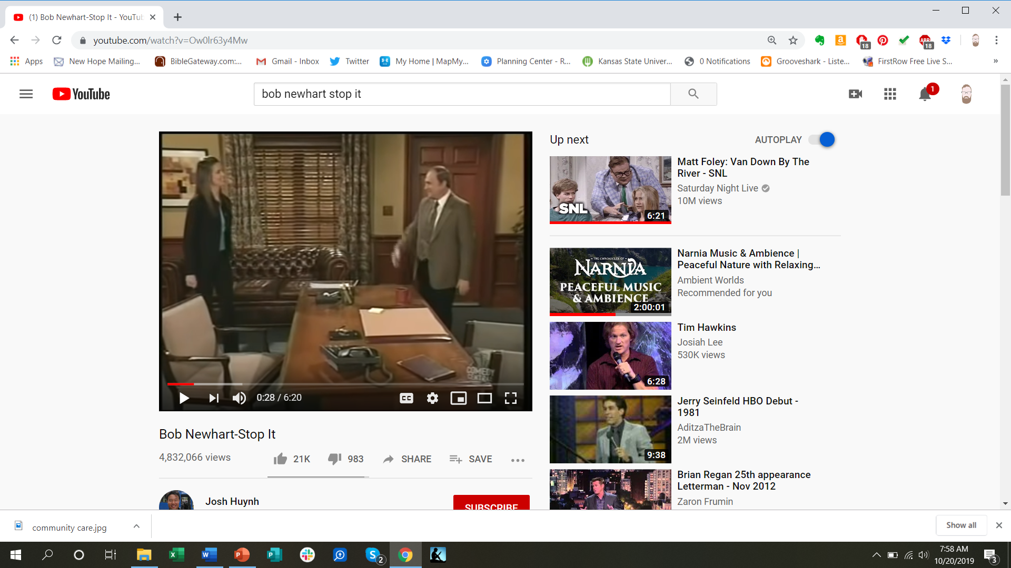
Drawing out deep waters
Dive into your own deep waters.
Find an intentional environment.
Bring curiosity. Ask questions, and then listen.
Don’t fix, because ultimately you can’t fix it.

Slide 29
Drawing out deep waters
Dive into your own deep waters.
Find an intentional environment.
Bring curiosity. Ask questions, and then listen.
Don’t fix, because ultimately you can’t fix it.
Resist the strong pull to quickly identify.

Slide 30
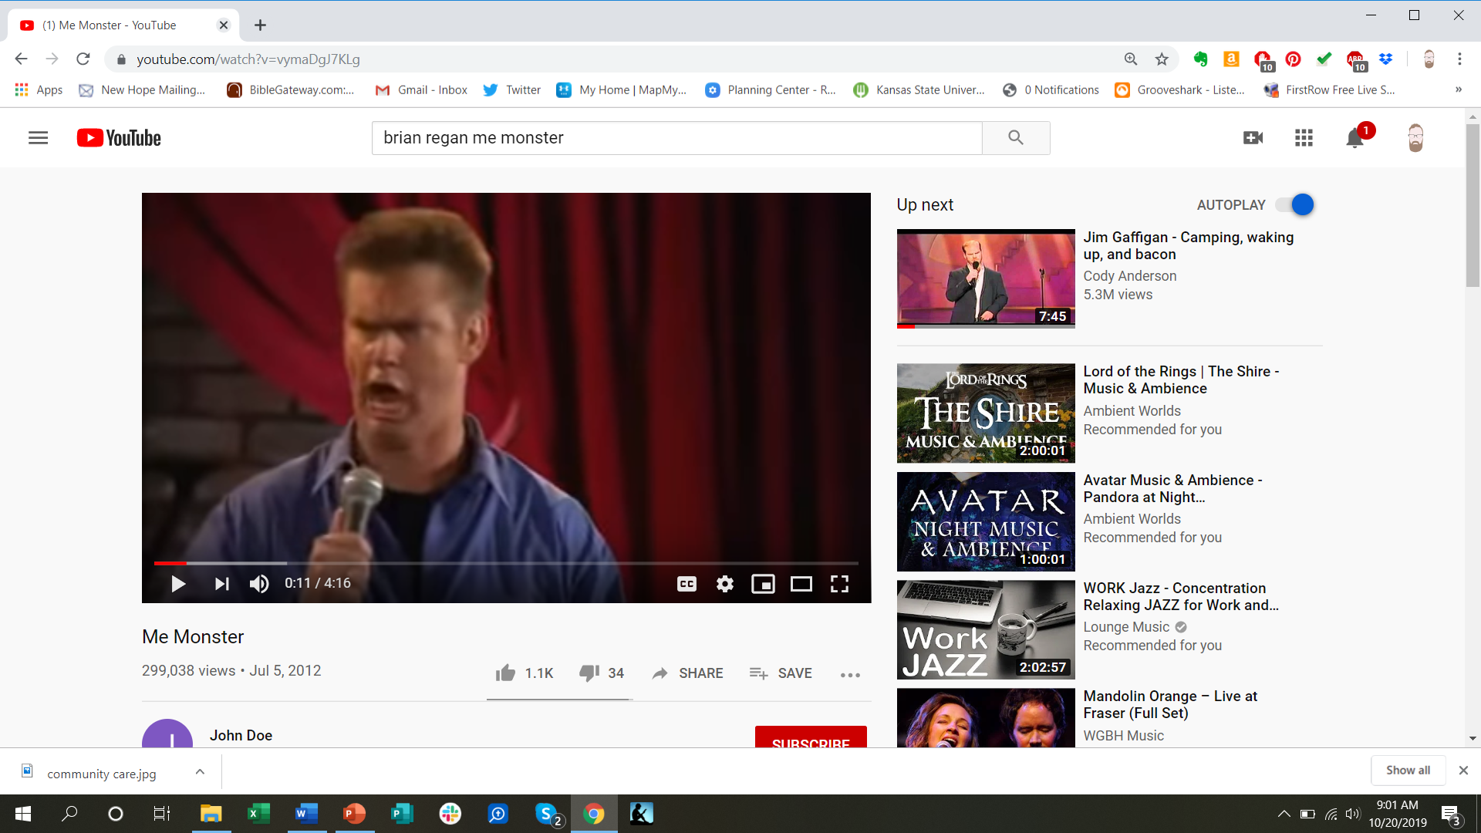

Slide 31
Drawing out deep waters
Dive into your own deep waters.
Find an intentional environment.
Bring curiosity. Ask questions, and then listen.
Don’t fix, because ultimately you can’t fix it.
Resist the strong pull to quickly identify.
Don’t act surprised when someone drops something heavy on you.

Slide 32
Drawing out deep waters
Dive into your own deep waters.
Find an intentional environment.
Bring curiosity. Ask questions, and then listen.
Don’t fix, because ultimately you can’t fix it.
Resist the strong pull to quickly identify.
Don’t act surprised when someone drops something heavy on you.
Some things are “deal breakers” meaning you’ve got to let someone else know.

Slide 33
Drawing out deep waters
Dive into your own deep waters.
Find an intentional environment.
Bring curiosity. Ask questions, and then listen.
Don’t fix, because ultimately you can’t fix it.
Resist the strong pull to quickly identify.
Don’t act surprised when someone drops something heavy on you.
Some things are “deal breakers” meaning you’ve got to let someone else know.
Pay attention to how their story is impacting you.

Slide 34
Drawing out deep waters
Dive into your own deep waters.
Find an intentional environment.
Bring curiosity. Ask questions, and then listen.
Don’t fix, because ultimately you can’t fix it.
Resist the strong pull to quickly identify.
Don’t act surprised when someone drops something heavy on you.
Some things are “deal breakers” meaning you’ve got to let someone else know.
Pay attention to how their story is impacting you.
Curiosity first, then connections.

Slide 35
Drawing out deep waters
Dive into your own deep waters.
Find an intentional environment.
Bring curiosity. Ask questions, and then listen.
Don’t fix, because ultimately you can’t fix it.
Resist the strong pull to quickly identify.
Don’t act surprised when someone drops something heavy on you.
Some things are “deal breakers” meaning you’ve got to let someone else know.
Pay attention to how their story is impacting you.
Curiosity first, then connections.
Thank them for sharing. Then, what’s the next step?

Slide 36
Childhood scenes
Trauma
Lies
Abuse
Wounding
Shame
Fear
Victim & Victimizer
Family of origin
But he was pierced for our transgressions; he was crushed for our iniquities; upon him was the chastisement that brought us peace, and with his wounds we are healed.
Isaiah 53:5
Redeemed
Healed
Co-heir with Christ
Child of God
Adopted
In Christ
Full of Joy
Abundant Life
Peacemaker
Whole
Clean
Righteous

Slide 37
Childhood scenes
Trauma
Lies
Abuse
Wounding
Shame
Fear
Victim & Victimizer
Family of origin
But he was pierced for our transgressions; he was crushed for our iniquities; upon him was the chastisement that brought us peace, and with his wounds we are healed.
Isaiah 53:5
Redeemed
Healed
Co-heir with Christ
Child of God
Adopted
In Christ
Full of Joy
Abundant Life
Peacemaker
Whole
Clean
Righteous

Slide 38
Childhood scenes
Trauma
Lies
Abuse
Wounding
Shame
Fear
Victim & Victimizer
Family of origin
But he was pierced for our transgressions; he was crushed for our iniquities; upon him was the chastisement that brought us peace, and with his wounds we are healed.
Isaiah 53:5
Redeemed
Healed
Co-heir with Christ
Child of God
Adopted
In Christ
Full of Joy
Abundant Life
Peacemaker
Whole
Clean
Righteous

Slide 39
Childhood scenes
Trauma
Lies
Abuse
Wounding
Shame
Fear
Victim & Victimizer
Family of origin
But he was pierced for our transgressions; he was crushed for our iniquities; upon him was the chastisement that brought us peace, and with his wounds we are healed.
Isaiah 53:5
Redeemed
Healed
Co-heir with Christ
Child of God
Adopted
In Christ
Full of Joy
Abundant Life
Peacemaker
Whole
Clean
Righteous

Slide 40
Childhood scenes
Trauma
Lies
Abuse
Wounding
Shame
Fear
Victim & Victimizer
Family of origin
But he was pierced for our transgressions; he was crushed for our iniquities; upon him was the chastisement that brought us peace, and with his wounds we are healed.
Isaiah 53:5
Redeemed
Healed
Co-heir with Christ
Child of God
Adopted
In Christ
Full of Joy
Abundant Life
Peacemaker
Whole
Clean
Righteous

Slide 41
Childhood scenes
Trauma
Lies
Abuse
Wounding
Shame
Fear
Victim & Victimizer
Family of origin
But he was pierced for our transgressions; he was crushed for our iniquities; upon him was the chastisement that brought us peace, and with his wounds we are healed.
Isaiah 53:5
Redeemed
Healed
Co-heir with Christ
Child of God
Adopted
In Christ
Full of Joy
Abundant Life
Peacemaker
Whole
Clean
Righteous

Slide 44
BEAUTIFUL THINGS

Slide 45
All this pain
I wonder if I'll ever find my way
I wonder if my life could really change at all
All this earth
Could all that is lost ever be found?
Could a garden come out from this ground at all?
BEAUTIFUL THINGS

Slide 46
You make beautiful things
You make beautiful things out of the dust
You make beautiful things
You make beautiful things out of us
BEAUTIFUL THINGS

Slide 47
All around,
Hope is springing up from this old ground
Out of chaos life is being found
in you
BEAUTIFUL THINGS

Slide 48
You make beautiful things
You make beautiful things out of the dust
You make beautiful things
You make beautiful things out of us
BEAUTIFUL THINGS

Slide 49
You make me new,
You are making me new
You make me new,
You are making me new
BEAUTIFUL THINGS

Slide 50
Then I saw a new heaven and a new earth, for the first heaven and the first earth had passed away, and the sea was no more. ² And I saw the holy city, new Jerusalem, coming down out of heaven from God, prepared as a bride adorned for her husband. ³ And I heard a loud voice from the throne saying, “Behold, the dwelling place of God is with man. He will dwell with them, and they will be his people, and God himself will be with them as their God. ⁴ He will wipe away every tear from their eyes, and death shall be no more, neither shall there be mourning, nor crying, nor pain anymore, for the former things have passed away.” ⁵ And he who was seated on the throne said, “Behold, I am making all things new.” Also he said, “Write this down, for these words are trust-worthy and true.” ⁶ And he said to me, “It is done! I am the Alpha and the Omega, the beginning and the end. To the thirsty I will give from the spring of the water of life without payment.
REVELATION 21:1-6

Slide 51
You make me new,
You are making me new
You make me new,
You are making me new
BEAUTIFUL THINGS

Slide 53
I SURRENDER ALL
tallgrass.church

Slide 54
All to Jesus I surrender
All to Him I freely give
I will ever love and trust Him
In His presence daily live
I SURRENDER ALL
tallgrass.church

Slide 55
I surrender all, I surrender all
All to Thee my blessed Savior
I surrender all
I SURRENDER ALL
tallgrass.church

Slide 56
All to Jesus I surrender,
Lord, I give myself to Thee
Fill me with Thy love and power
Let Thy blessing fall on me
I SURRENDER ALL
tallgrass.church

Slide 57
I surrender all, I surrender all
All to Thee my blessed Savior
I surrender all
I SURRENDER ALL
tallgrass.church

Slide 58
AMAZING GRACE
tallgrass.church

Slide 59
Amazing grace! How sweet the sound
That saved a wretch like me
I once was lost but now am found
Was blind but now I see
AMAZING GRACE
tallgrass.church

Slide 60
T’was grace that taught my heart to fear
And grace my fears relieved
How precious did that grace appear
The hour I first believed
AMAZING GRACE
tallgrass.church

Slide 61
My chains are gone I’ve been set free
My God, my Savior has ransomed me
And like a flood, His mercy reigns
Unending love Amazing grace
AMAZING GRACE
tallgrass.church

Slide 62
BENEDICTION
tallgrass.church

Slide 63
Father, give Your benediction
Give us Your peace before we part
Still our minds with truth’s conviction Calm with trust each anxious heart
BENEDICTION
tallgrass.church

Slide 64
Father, give Your benediction
Bid our grief and struggles end Peace which passes understanding On our waiting spirit send
BENEDICTION
tallgrass.church

Slide 65
Amen. Amen.
Amen. Amen.
Amen. Amen.
amen: let it be so
BENEDICTION
tallgrass.church

Slide 67
INVESTMEST BASICS
TODAY, OCT. 20TH 6-7pm in the Parlor Rm. Free workshop brought to us by Thrivent Financial, a not-for-profit financial services organization that several Tallgrass families use for their financial planning. Food and child- care are provided for those who already RSVPed. Otherwise you’re welcome to join us, but food and childcare will be on your own.

