Slide 1
WELCOME

Slide 2
FINANCIAL PLANNING 101
TODAY (22nd) 6-7pm
in the Parlor Rm. (first room on the left down the hallway)
Free workshop brought to us by Thrivent Financial, a not-for-profit financial services organization that several Tallgrass families use for their financial planning. Food and childcare are provided for those who’ve already RSVPed.
If you haven’t RSVPed and would like to join, COME! Food and childcare on your own.

Slide 3
NEXT BOOK STUDY
Join us for our next book discussion on HEAVEN by Randy Alcorn.
Tuesdays 1145a-115p here at CHBC
starting THIS TUESDAY, September 24.
Read through Chapter 4.

Slide 4
TALLGRASS PRAYER
Come join fellow Tallgrassians to pray for God’s work within and out from our church. Come and go as needed.
FRIDAY, OCTOBER 5, 4PM-MORNING
at Aly Gilbert’s back yard in University Park. You bring camping stuff. Tallgrass provides food.
RSVP by Oct 2. More deets online at tallgrass.church/events

Slide 5
MINGLE QUESTION
What’s your favorite Bible verse (if any) and why?

Slide 7
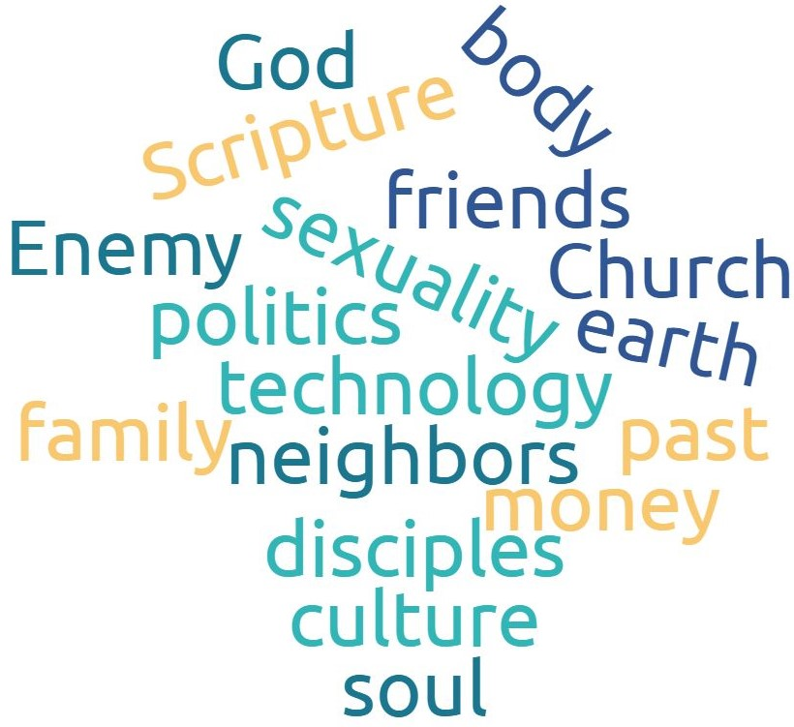
GOSPEL RELATING
Overlays like this

Slide 8
GOSPEL RELATING
Overlays like this
work

Slide 9
RELATING TO SCRIPTURE

Slide 10
RELATING TO THE BIBLE

Slide 11
BIBLES TO THE KIMYALS

Slide 12
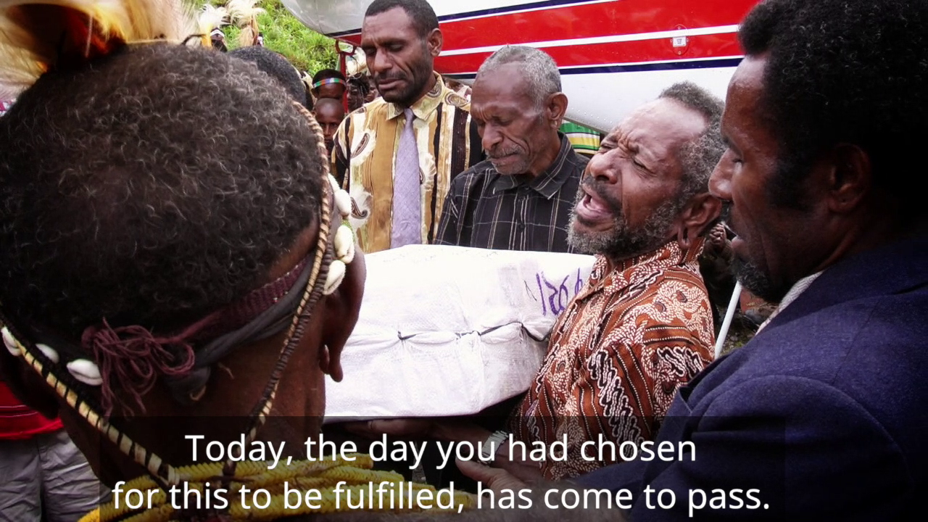
BIBLES TO THE KIMYALS
https://www.youtube.com/watch?v=ag2AzWgRKAk

Slide 13
Relating to the Bible
¹⁶ All Scripture is breathed out by God and profitable for teaching, for reproof, for correction, and for training in righteousness, ¹⁷ that the man of God may be complete, equipped for every good work. 2 Timothy 3:16-17

Slide 14
Relating to the Bible
¹⁶ All Scripture is breathed out by God and profitable for teaching, for reproof, for correction, and for training in righteousness, ¹⁷ that the man of God may be complete, equipped for every good work. 2 Timothy 3:16-17
What is the Bible?
What does the Bible do?
How will WE/YOU relate to the Bible?

Slide 15
1. What is the Bible?
¹⁶ All Scripture is breathed out by God and profitable for teaching, for reproof, for correction, and for training in righteousness, ¹⁷ that the man of God may be complete, equipped for every good work. 2 Timothy 3:16-17

Slide 16
1. What is the Bible?
¹⁶ All Scripture is breathed out by God and profitable for teaching, for reproof, for correction, and for training in righteousness, ¹⁷ that the man of God may be complete, equipped for every good work. 2 Timothy 3:16-17
39 OT books + 27 NT books = 66 books
40+ authors
1500 year span of writing
3 continents (Africa, Asia, Europe)
3 languages (Hebrew, Greek, Aramaic)
Multiple different genres (literary styles)
1 overarching story

Slide 17
1. What is the Bible?
¹⁶ All Scripture is breathed out by God and profitable for teaching, for reproof, for correction, and for training in righteousness, ¹⁷ that the man of God may be complete, equipped for every good work. 2 Timothy 3:16-17
¹⁹ And we have the prophetic word more fully confirmed, to which you will do well to pay attention as to a lamp shining in a dark place, until the day dawns and the morning star rises in your hearts, ²⁰ knowing this first of all, that no prophecy of Scripture comes from someone's own interpretation. ²¹ For no prophecy was ever produced by the will of man, but men spoke from God as they were carried along by the Holy Spirit.
1 Peter 1:19-21

Slide 18
1. What is the Bible?
¹⁶ All Scripture is breathed out by God and profitable for teaching, for reproof, for correction, and for training in righteousness, ¹⁷ that the man of God may be complete, equipped for every good work. 2 Timothy 3:16-17
1 Peter 1:19-21—Confirmation of Scripture
Luke 24:44—Jesus & the Jews confirmed the OT
2 Peter 3:16—The Apostles confirmed the OT & NT

Slide 19
Why Believe the Bible?
Dave Geldart, 6/17/18, tallgrass.church

Slide 20
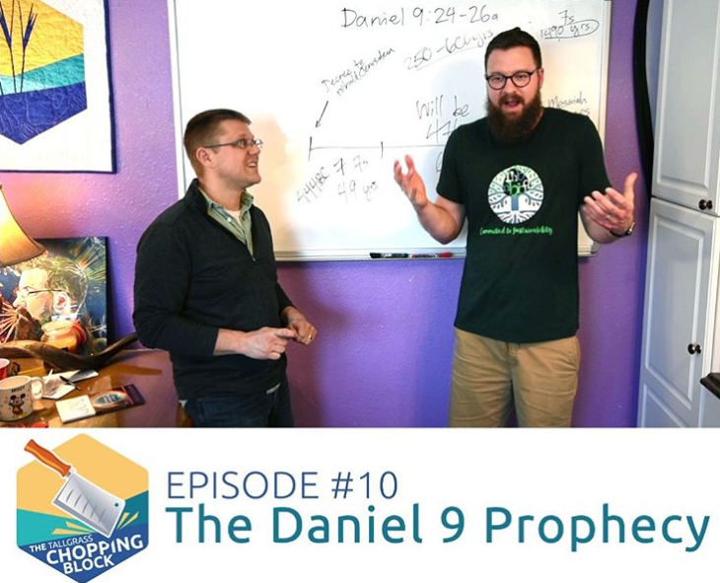

Slide 21
Translation Scale

Slide 22
FREE Book & Bible!

Slide 23
2. What does the Bible do?
¹⁶ All Scripture is breathed out by God and profitable for teaching, for reproof, for correction, and for training in righteousness, ¹⁷ that the man of God may be complete, equipped for every good work. 2 Timothy 3:16-17

Slide 24
2. What does the Bible do?
Initiate faith—Rom 10:17
Give new spiritual life—1 Pet 1:23; James 1:18
Teach, reproof, correct, train in righteousness, bring to maturity, and equip for good works—2 Tim 3:16
Help us grow—1 Pet 2:2; 1 Thess 2:13; Acts 20:32
Sanctify—John 17:17; Eph 5:26
Search and convict—Heb 4:12
Liberate—John 8:31-32
Offensive weapon in spiritual warfare—Eph 6:17
Refresh and renew (and all sorts of other things) Psalm 19:7-11; all of Psalm 119
Connect us to Jesus—John 5:39

Slide 25
2. What does the Bible do?
Initiate faith—Rom 10:17
Give new spiritual life—1 Pet 1:23; James 1:18
Teach, reproof, correct, train in righteousness, bring to maturity, and equip for good works—2 Tim 3:16
Help us grow—1 Pet 2:2; 1 Thess 2:13; Acts 20:32
Sanctify—John 17:17; Eph 5:26
Search and convict—Heb 4:12
Liberate—John 8:31-32
Offensive weapon in spiritual warfare—Eph 6:17
Refresh and renew (and all sorts of other things) Psalm 19:7-11; all of Psalm 119
Connect us to Jesus—John 5:39
3. How will YOU relate to the Bible?

Slide 26
The Word Hand

Slide 27
Pre-Bible Reading Prayers
Lord, lead me. Amen.
Lord, have mercy. Amen.
Father, as I read your Word, would you please make yourself known to me. Amen.
Father, as I read your Word, please “open my eyes, that I may see wonderful things out of your law.” (Ps 119:18)
God, my heart is not inclined to your Word this morning. Oh, God please “incline my heart to your testimonies, and not to selfish gain.” (Ps 119:36)
God, “please show me now your ways, that I may know you.” (Ex. 33:13)

Slide 28
Pre-Bible Reading Prayers
“Search me, O God, and know my heart! Try me, and know my thoughts! And see if there be any grievous way in me, and lead me in the way everlasting!” (Ps 139:23-24)
Oh Father, would you out of the riches of your glory strengthen me with power by your Spirit in my inner man so that, as I read your Word, Christ might dwell in my heart by faith and I might be rooted and grounded in his love, and, in fact, know His love for me today. (cf. Eph 3:16-19)
Oh God, “satisfy me again this morning with your steadfast love, that I may rejoice and be glad all day long.” (Ps 90:14)

Slide 30
The Word Hand
APPLY James 1:22

Slide 31
Study Resources:

Slide 32
The Word Hand
APPLY James 1:22

Slide 33
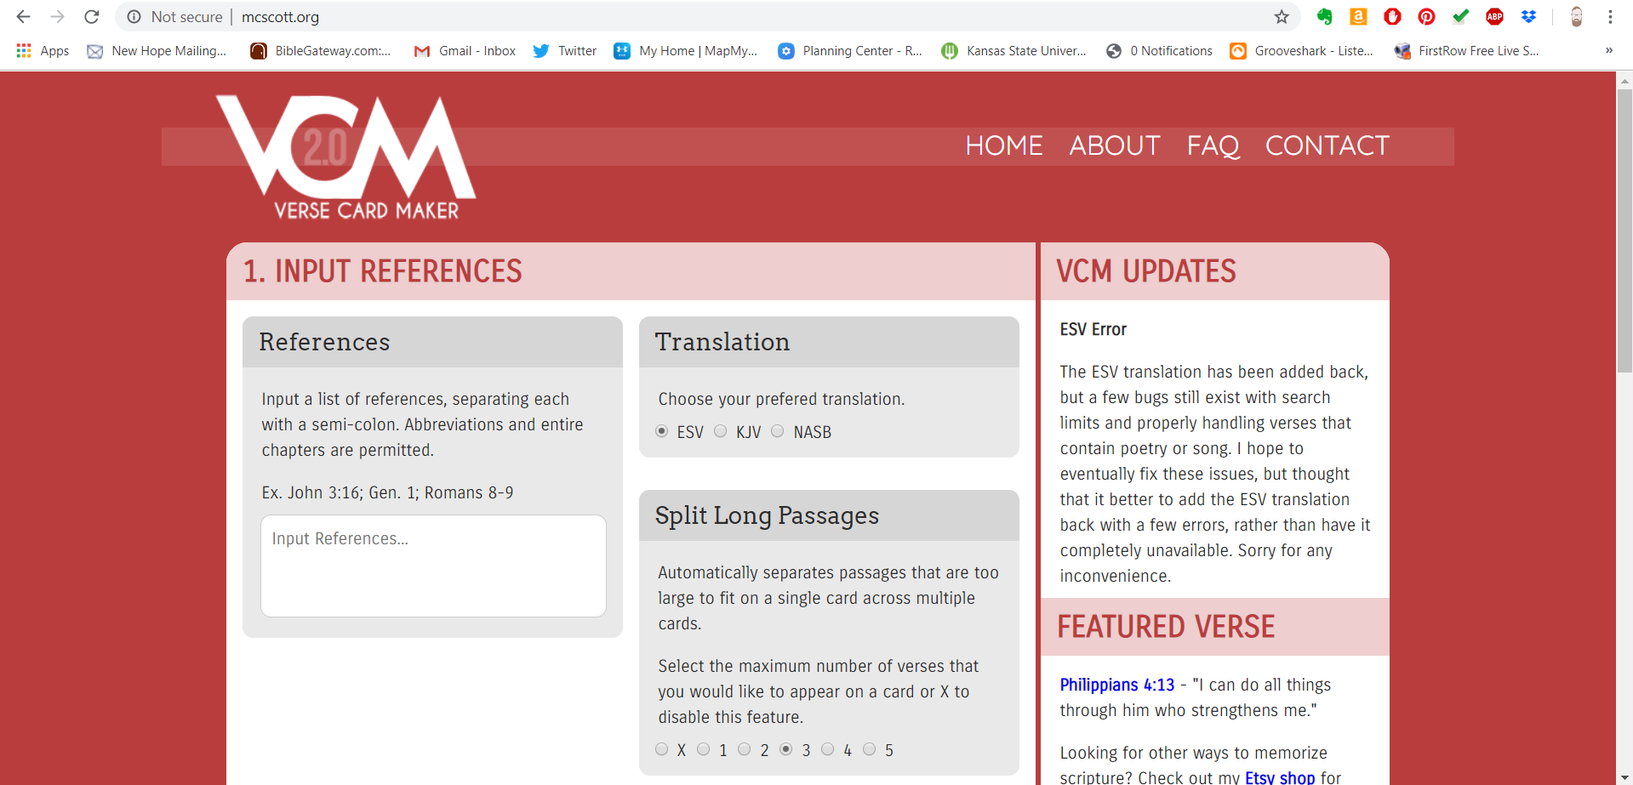
mcscott.org
APPLY James 1:22

Slide 34
The Word Hand
APPLY James 1:22

Slide 35
Firm Grasp on the Word
APPLY James 1:22
Hebrews 4:12
Ephesians 6:17

Slide 36
The Joyful Jesus-Centered Nature of the Bible
Psalm 30:5
Nehemiah 8
Luke 24:27, 44
John 5:39
APPLY James 1:22

Slide 37
Q&R&Testimonies
APPLY James 1:22

Slide 40
JESUS, WE LOVE YOU

Slide 41
JESUS, WE LOVE YOU
Old things have passed away
Your love has stayed the same
Your constant grace
Remains the cornerstone
Things that we thought were dead
Are breathing in life again
You cause Your Son to shine on darkest nights

Slide 42
JESUS, WE LOVE YOU
For all that You’ve done we will
Pour out our love
This will be our anthem song

Slide 43
JESUS, WE LOVE YOU
Jesus, we love You
Oh how we love You
You are the one our hearts adore

Slide 44
JESUS, WE LOVE YOU
The hopeless have found their hope
The orphans now have a home
All that was lost has found its place in You
You lift our weary head
You make us strong instead
You took these rags and made us beautiful

Slide 45
JESUS, WE LOVE YOU
For all that You’ve done we will
Pour out our love
This will be our anthem song

Slide 46
JESUS, WE LOVE YOU
Jesus, we love You
Oh how we love You
You are the one our hearts adore

Slide 47
JESUS, WE LOVE YOU
Our affection, our devotion
poured out on the feet of Jesus
(4x)

Slide 48
JESUS, WE LOVE YOU
Jesus we love You
Oh how we love You
You are the one our hearts adore
(3x)

Slide 50
AND STILL YOU GIVE
So lost was I,
A ghost to the world,
When you rescued me.
So lost was I,
Empty inside,
You filled the void for me.
By Drew Fratecelli

Slide 51
AND STILL YOU GIVE
I thought I was gone, but yet, I live.
You gave enough, and still, You give.
By Drew Fratecelli

Slide 52
AND STILL YOU GIVE
So lost was I,
Wanting to hide,
When You guided me.
So lost was I,
Barely alive,
You resurrected me.
By Drew Fratecelli

Slide 53
AND STILL YOU GIVE
I thought I was gone, but yet, I live.
You gave enough, and still, You give.
By Drew Fratecelli

Slide 54
AND STILL YOU GIVE
You give me strength,
Give me hope,
You are for me.
You guide me through life,
Hold the pen to my story.
I give You all of me,
You’re all I need.
God Lead me.
(4x)
By Drew Fratecelli

Slide 55
AND STILL YOU GIVE
I thought I was gone, but yet, I live.
You gave enough, and still, You give.
By Drew Fratecelli

Slide 57
THE JOY OF THE LORD

Slide 58
THE JOY OF THE LORD
Though the tears may fall
My song will rise, my song will rise to You
Though my heart may fail
My song will rise, my song will rise to You
While there's breath in my lungs
I will praise You, Lord

Slide 59
THE JOY OF THE LORD
In the dead of night,
I'll lift my eyes, I'll lift my eyes to You
Though the waters rise,
I'll lift my eyes, I'll lift my eyes to You
While there's hope in this heart
I will praise You, Lord

Slide 60
THE JOY OF THE LORD
*The joy of the Lord is my strength!
The joy of the Lord is my strength!
In the darkness I'll dance
In the shadows I'll sing
The joy of the Lord is my strength!
*Nehemiah 8:10

Slide 61
THE JOY OF THE LORD
When I cannot see You with my eyes
Let faith arise to You
When I cannot feel Your hand in mine
Let faith arise to You
God of mercy and love
I will praise You, Lord

Slide 62
THE JOY OF THE LORD
How You shine with glory, Lord of light
I feel alive with You
In Your presence now I come alive
I am alive with You
There is strength when I say:
“I will praise You, Lord”

Slide 63
THE JOY OF THE LORD
*The joy of the Lord is my strength!
The joy of the Lord is my strength!
In the darkness I'll dance
In the shadows I'll sing
The joy of the Lord is my strength!
*Nehemiah 8:10

Slide 64
THE JOY OF THE LORD
When sorrow comes my way
You’re the shield around me
Always, You remain
My courage in the fight
I hear You call my name
Jesus, I am coming
Walking on the waves
Reaching for Your light!

Slide 65
THE JOY OF THE LORD
*The joy of the Lord is my strength!
The joy of the Lord is my strength!
In the darkness I'll dance
In the shadows I'll sing
The joy of the Lord is my strength!
*Nehemiah 8:10

Slide 67
THE BENEDICTION

Slide 68
THE BENEDICTION
My friends may you grow in grace
And in the knowledge
Of our Lord and Savior.
My friends may you grow in grace
And in the knowledge
Of Jesus Christ.

Slide 69
THE BENEDICTION
To God be the glory
Now and forever,
Now and forever amen.
(repeat)

Slide 70
THE BENEDICTION
I pray tonight if we
Learned from one another,
May we glorify Him.
And if the Lord should
Bring us back together,
May we be in his arms till then.

Slide 71
THE BENEDICTION
My friends may you grow in grace
And in the knowledge
Of our Lord and Savior.
My friends may you grow in grace
And in the knowledge
Of Jesus Christ.

Slide 73
FINANCIAL PLANNING 101
TODAY (22nd) 6-7pm
in the Parlor Rm. (first room on the left down the hallway)
Free workshop brought to us by Thrivent Financial, a not-for-profit financial services organization that several Tallgrass families use for their financial planning. Food and childcare are provided for those who’ve already RSVPed.
If you haven’t RSVPed and would like to join, COME! Food and childcare on your own.

