Slide 1
WELCOME

Slide 2
AFTER PARTY @ Jimmy
TODAY
Join us for our After Party at Jimmy Johns (by Westloop) after Central Gathering!

Slide 3
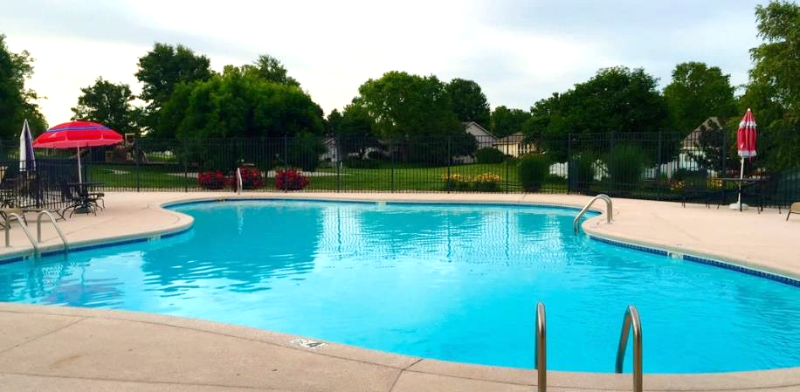
AFTER PARTY NEXT SUN
NEXT SUNDAY Sept 1st
Timbercreek 3 Neighborhood Pool.
Bring a sack dinner.
Park in the Geldarts' drive (6101 Tumbleweed Ter), in front of their house, along the road by the TC3 sign, or in the overflow parking by the Timber- creek 2 pool (just walk past to the TC3 pool!).
Deets and a map online at tallgrass.church.

Slide 4
FALL SPROUTS!!!
KICKS OFF TODAY!!!
TODAY: kids through 6th Grade check in to their Sprouts classes down the east hallway before the CG starts.
8 SPOTS LEFT TO FULLY STAFF SPROUTS
THIS FALL!, Contact Elisha at: sprouts@tallgrass.church

Slide 5
TALLGRASS *NOTEPADS

Slide 6
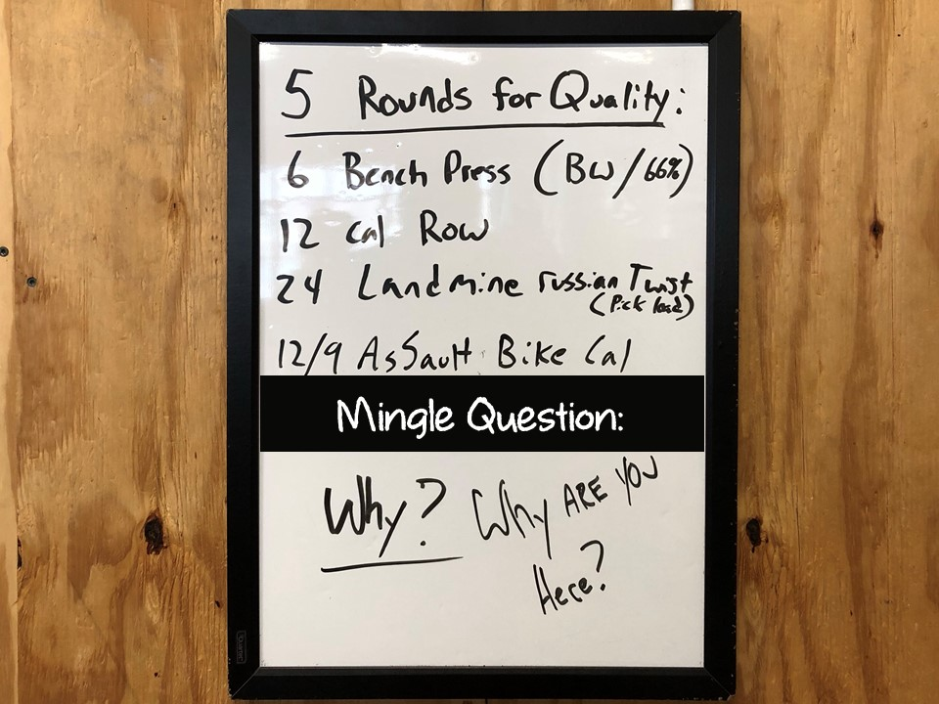

Slide 7
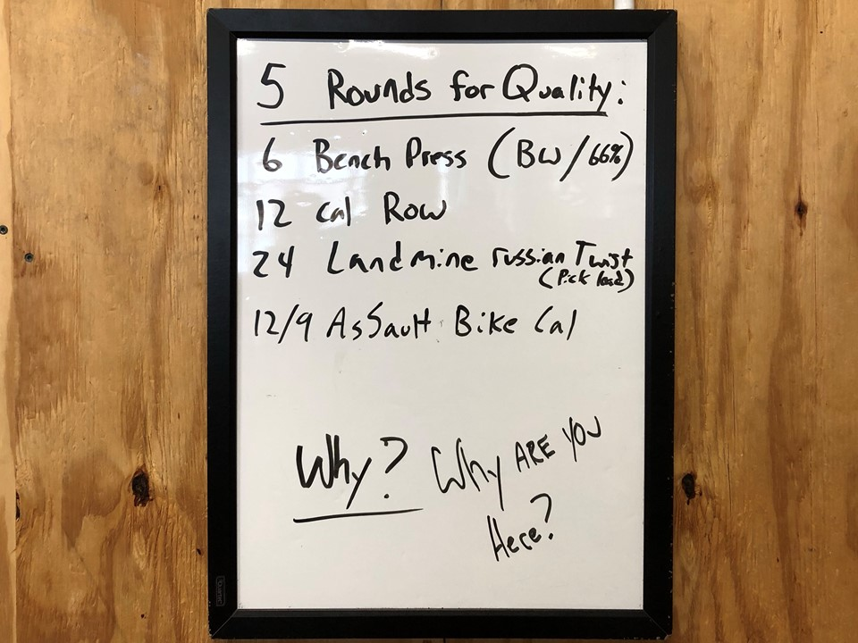

Slide 8
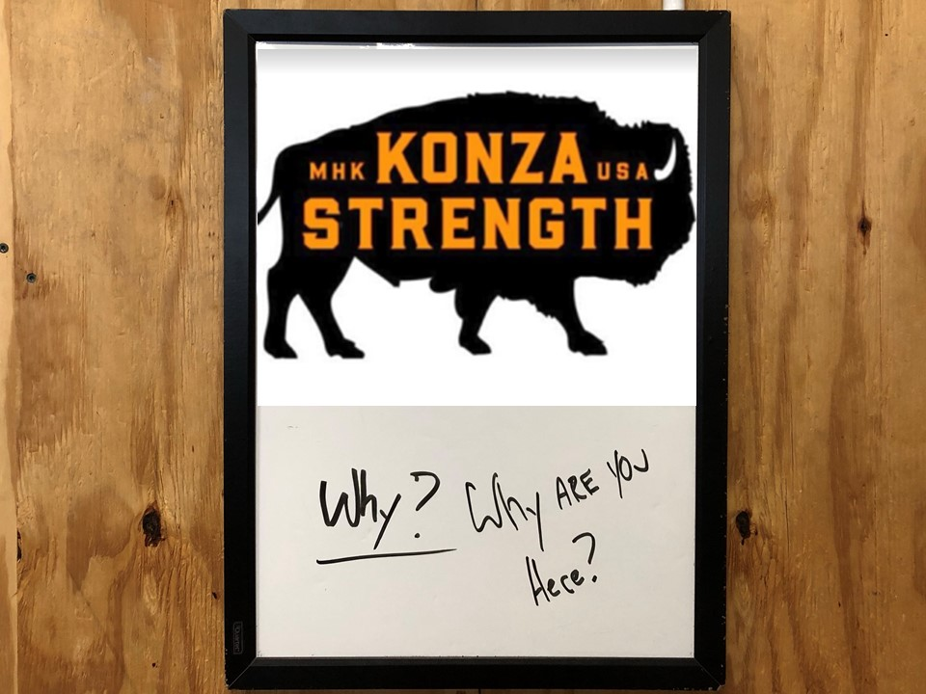

Slide 10
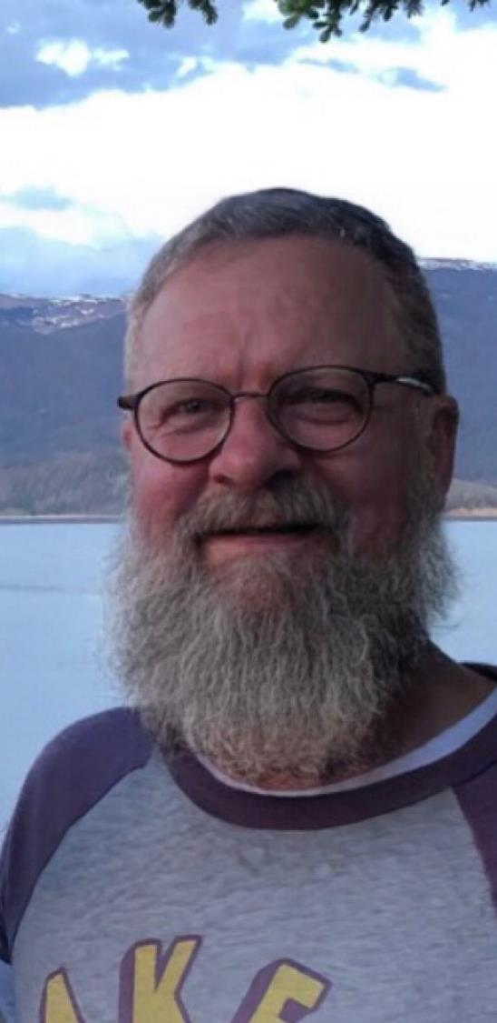

Slide 11
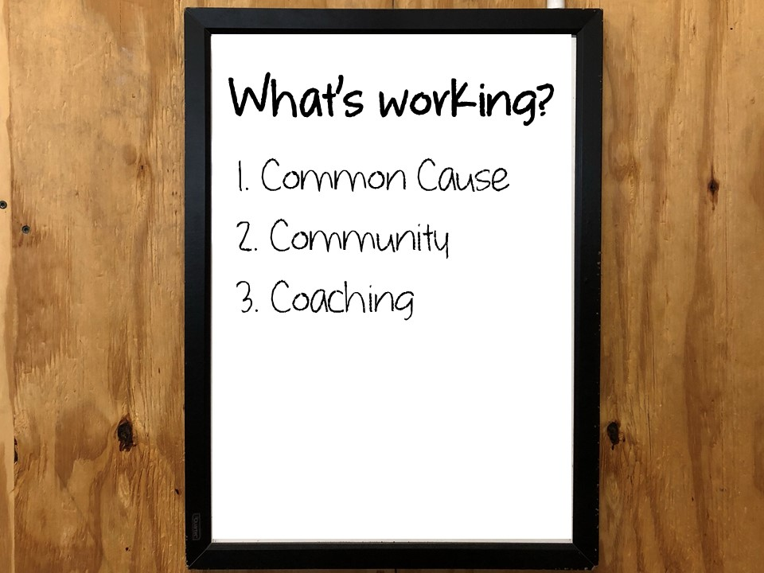

Slide 12
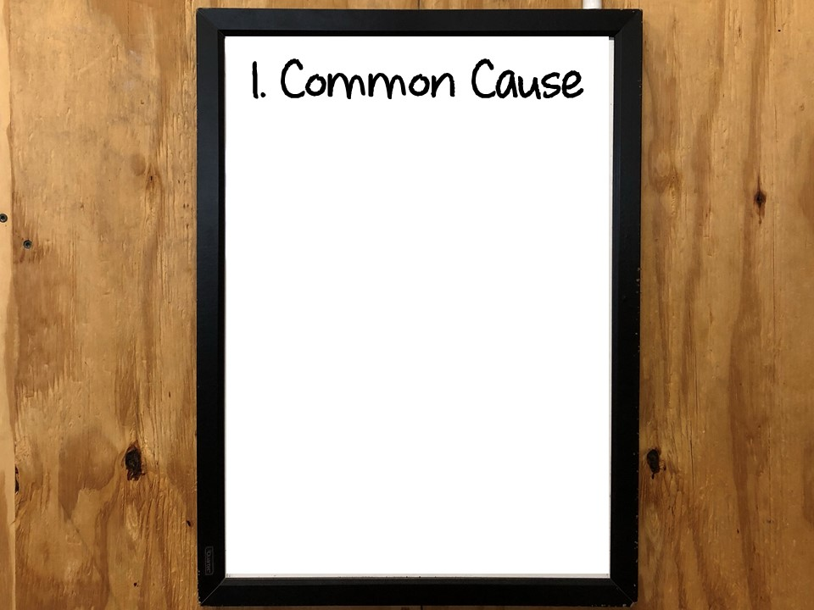

Slide 17
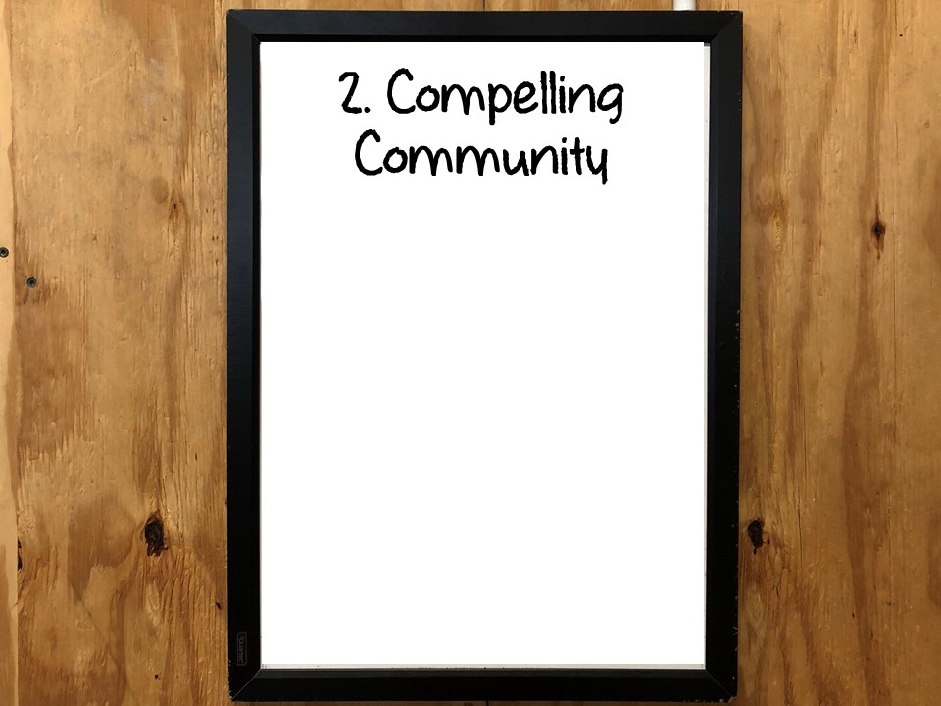

Slide 19
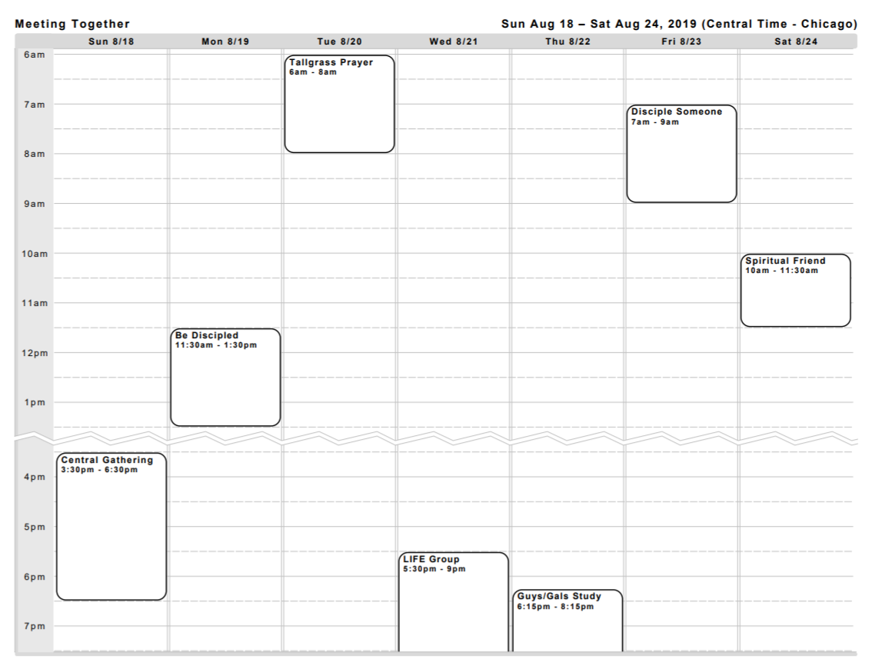

Slide 20
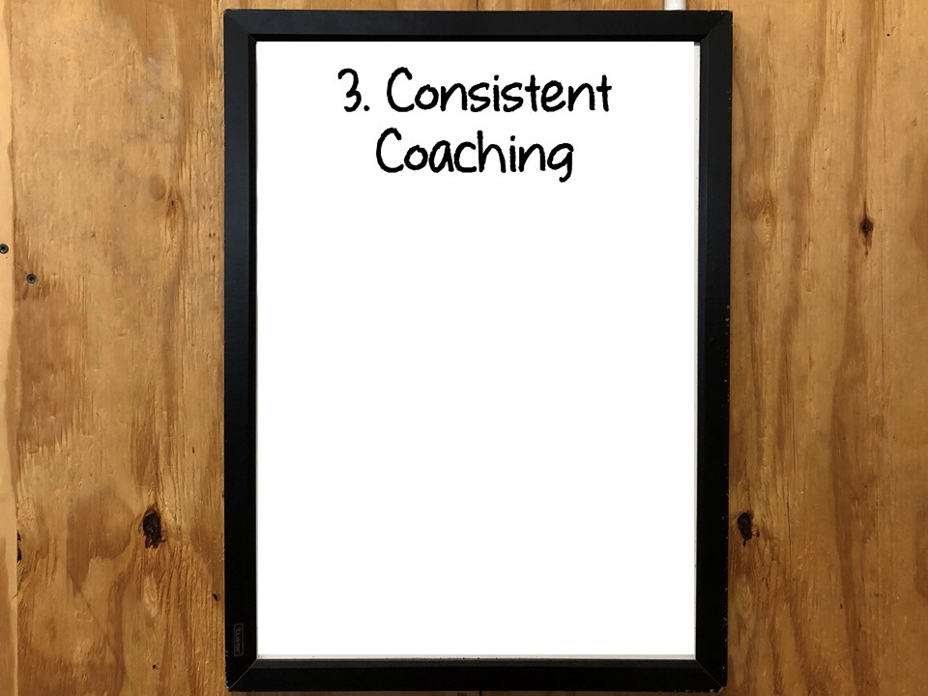

Slide 21
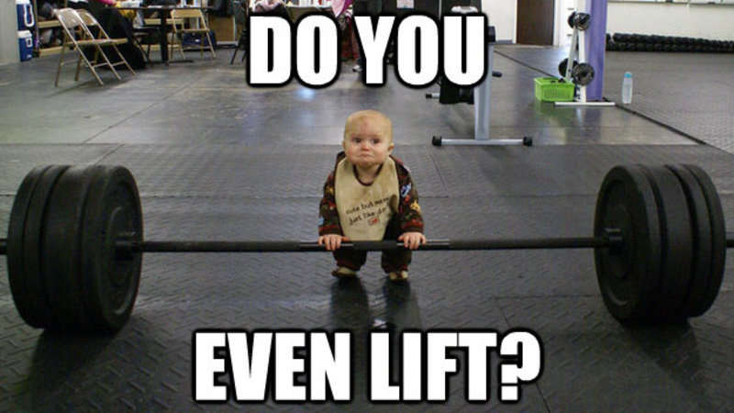

Slide 23
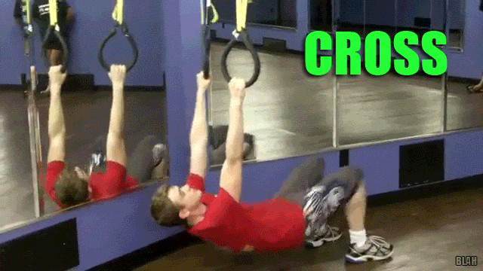

Slide 24
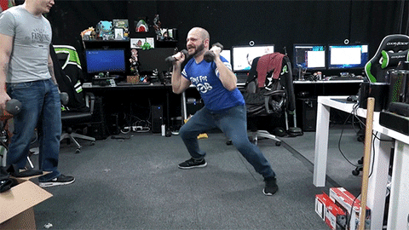

Slide 31
LIFE GROUP BOOK
Tallgrass LIFE Groups are pumped to be studying through “LOVING GOD’S WAY” this fall.
Grab a copy today for only $5!
Not required for LIFE Group engagement.

Slide 32
LIFE GROUP LEADERS
Tuesdays – Wamego | 6pm | Led by David and Nikki Renberg david.renberg@gmail.com Co-leaders Ron & Barb Goodman
Tuesdays – MHK Eastside | 6:45pm | Led by Dave Geldart davegeldart@tallgrass.church
Wednesdays – MHK Central | 6pm | Led by Ben & Maris Deaver bendeaver@tallgrass.church
Wednesdays – MHK Eastside | 6pm | Led by Ricky & Amalie Greeve rgreeve10@gmail.com Co-leaders Chris & Effie Swanson

Slide 34
tallgrass.church

Slide 35
WAY MAKER
tallgrass.church

Slide 36
WAY MAKER
You are here moving in our midst
I worship You, I worship You
You are here working in this place
I worship You, I worship You
[Repeat]
tallgrass.church

Slide 37
WAY MAKER
Way Maker, Miracle Worker
Promise Keeper, Light in the Darkness
My God
That is who You are
[Repeat]
tallgrass.church

Slide 38
WAY MAKER
You are here touching every heart
I worship You, I worship You
You are here healing every heart
I worship You, I worship You
You are here turning lives around
I worship You, I worship You
You are here mending every heart
I worship You, I worship You
tallgrass.church

Slide 39
WAY MAKER
Way Maker, Miracle Worker
Promise Keeper, Light in the Darkness
My God
That is who You are
[Repeat]
tallgrass.church

Slide 40
WAY MAKER
That is who You are
That is who You are
[Repeat]
tallgrass.church

Slide 41
WAY MAKER
Way Maker, Miracle Worker
Promise Keeper, Light in the Darkness
My God
That is who You are
[Repeat]
tallgrass.church

Slide 42
WAY MAKER
You wipe away all tears,
You mend the broken heart
You’re the answer to it all, Jesus
[Repeat]
tallgrass.church

Slide 43
WAY MAKER
Way Maker, Miracle Worker
Promise Keeper, Light in the Darkness
My God
That is who You are
[Repeat]
tallgrass.church

Slide 44
tallgrass.church

Slide 45
MYSTERY OF FAITH
tallgrass.church

Slide 46
Christ has died,
Christ is risen,
Christ will come again!
[repeat]
MYSTERY OF FAITH
tallgrass.church

Slide 47
We have died together,
We will rise together,
We will live together,
The body, O, the body
We are the body of Christ.
MYSTERY OF FAITH
tallgrass.church

Slide 48
We are brothers
and sisters
through our Savior’s blood.
[repeat]
MYSTERY OF FAITH
tallgrass.church

Slide 49
We have died together,
We will rise together,
We will live together,
The body, O, the body
We are the body of Christ.
MYSTERY OF FAITH
tallgrass.church

Slide 50
tallgrass.church

Slide 51
JOY OF THE LORD
by Rend Collective

Slide 52
JOY OF THE LORD
Though the tears may fall
My song will rise, my song will rise to You
Though my heart may fail
My song will rise, my song will rise to You
While there's breath in my lungs
I will praise You, Lord

Slide 53
JOY OF THE LORD
In the dead of night,
I'll lift my eyes, I'll lift my eyes to You
Though the waters rise,
I'll lift my eyes, I'll lift my eyes to You
While there's hope in this heart
I will praise You, Lord
by Rend Collective

Slide 54
JOY OF THE LORD
The joy of the Lord is my strength!
The joy of the Lord is my strength!
In the darkness I'll dance
In the shadows I'll sing
The joy of the Lord is my strength!
by Rend Collective

Slide 55
JOY OF THE LORD
When I cannot see You with my eyes
Let faith arise to You
When I cannot feel Your hand in mine
Let faith arise to You
God of mercy and love
I will praise You, Lord
by Rend Collective

Slide 56
JOY OF THE LORD
How You shine with glory, Lord of light
I feel alive with You
In Your presence now I come alive
I am alive with You
There is strength when I say:
“I will praise You, Lord”
by Rend Collective

Slide 57
JOY OF THE LORD
The joy of the Lord is my strength!
The joy of the Lord is my strength!
In the darkness I'll dance
In the shadows I'll sing
The joy of the Lord is my strength!
by Rend Collective

Slide 58
JOY OF THE LORD
When sorrow comes my way
You’re the shield around me
Always, You remain
My courage in the fight
I hear You call my name
Jesus, I am coming
Walking on the waves
Reaching for Your light!
by Rend Collective

Slide 59
JOY OF THE LORD
The joy of the Lord is my strength!
The joy of the Lord is my strength!
In the darkness I'll dance
In the shadows I'll sing
The joy of the Lord is my strength!
by Rend Collective

Slide 60
tallgrass.church

Slide 61
THE BENEDICTION
tallgrass.church

Slide 62
My friends may you grow in grace
And in the knowledge
Of our Lord and Savior.
My friends may you grow in grace
And in the knowledge
Of Jesus Christ.
THE BENEDICTION
tallgrass.church

Slide 63
To God be the glory
Now and forever,
Now and forever amen.
(repeat)
THE BENEDICTION
tallgrass.church

Slide 64
I pray tonight if we
Learned from one another,
May we glorify Him.
And if the Lord should
Bring us back together,
May we be in his arms till then.
THE BENEDICTION
tallgrass.church

Slide 65
My friends may you grow in grace
And in the knowledge
Of our Lord and Savior.
My friends may you grow in grace
And in the knowledge
Of Jesus Christ.
THE BENEDICTION
tallgrass.church

