Slide 1
WELCOME

Slide 2
https://www.youtube.com/watch?v=nUBtKNzoKZ4

Slide 4
RELATING TO TECHNOLOGY

Slide 5
RELATING TO TECHNOLOGY

Slide 6
RELATING TO TECHNOLOGY

Slide 7
RELATING TO TECHNOLOGY

Slide 8
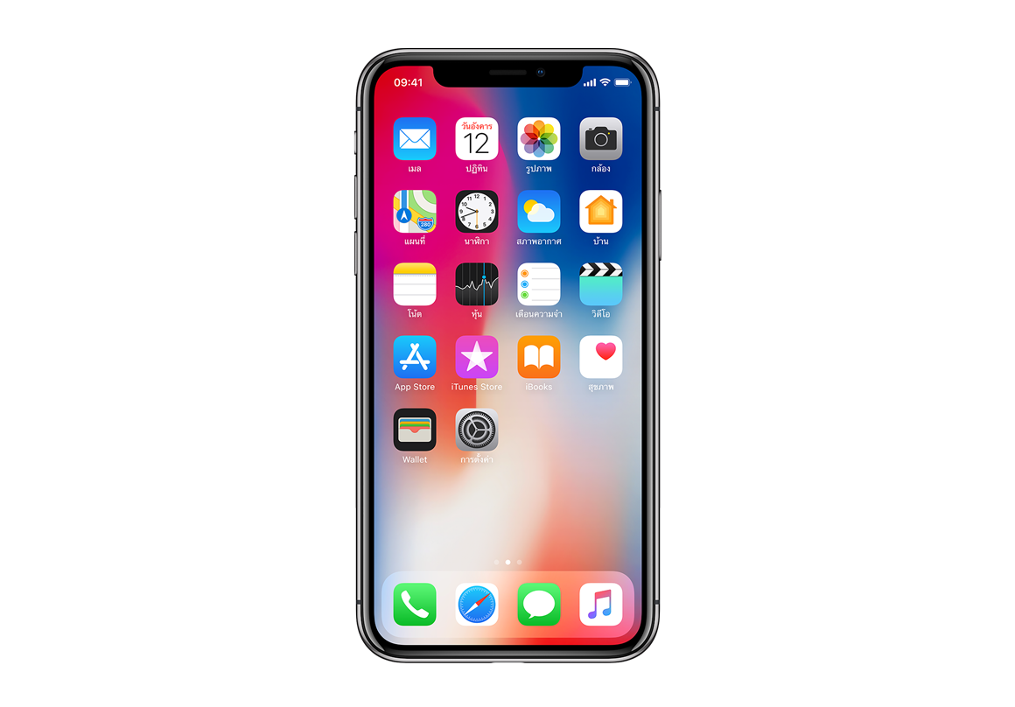
RELATING TO YOUR PHONE

Slide 9
HOW SHOULD YOU BE
RELATING TO YOUR PHONE

Slide 10
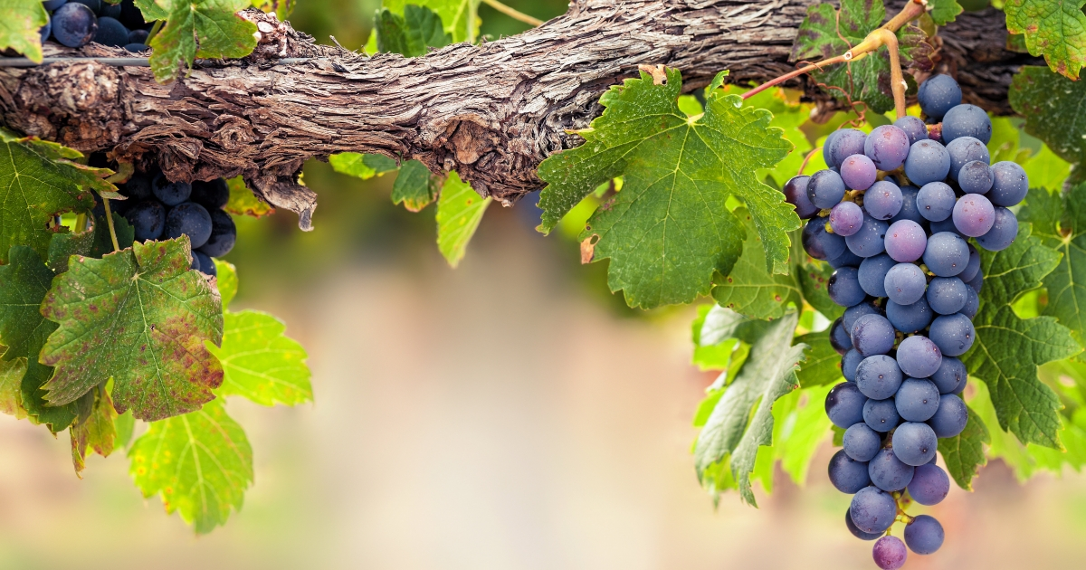
JOHN 15:5 ^{(ESV)}
I am the vine; you are the branches. Whoever abides in me and I in him, he it is that bears much fruit, for apart from me you can do nothing.

Slide 11
Galatians 5:22-23 ^{(ESV)}
…the fruit of the Spirit is love, joy, peace, patience, kindness, goodness, faithfulness, gentleness, self-control

Slide 12
Galatians 5:19-21 ^{(ESV)}
Now the works of the flesh are evident: sexual immorality, impurity, sensuality, idolatry, sor- cery, enmity, strife, jealousy, fits of anger, rivalries, dissensions, divisions, envy, drunk- enness, orgies, and things like these.

Slide 13
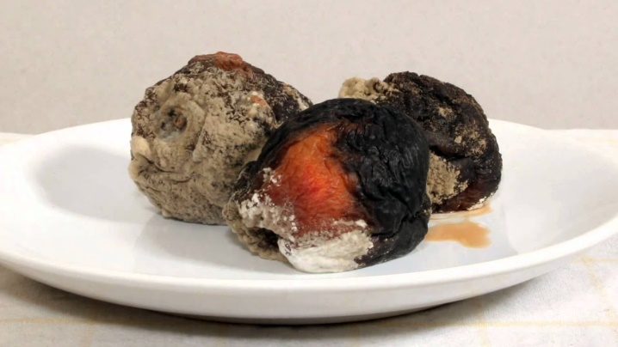
FRUIT OF THE SPIRIT
FRUIT OF THE FLESH
Love
Joy
Peace
Patience
Kindness
Goodness
Faithfulness
Gentleness
Self-Control
Sexual Immorality
Enmity
Strife
Jealousy & Envy
Rivalry
Dissensions
Idolatry & Divisions
Fits of Anger
Drunkenness

Slide 14
FRUIT OF THE SPIRIT
FRUIT OF THE FLESH
Love
Joy
Peace
Patience
Kindness
Goodness
Faithfulness
Gentleness
Self-Control
Sexual Immorality
Enmity
Strife
Jealousy & Envy
Rivalry
Dissensions
Idolatry & Divisions
Fits of Anger
Drunkenness

Slide 15
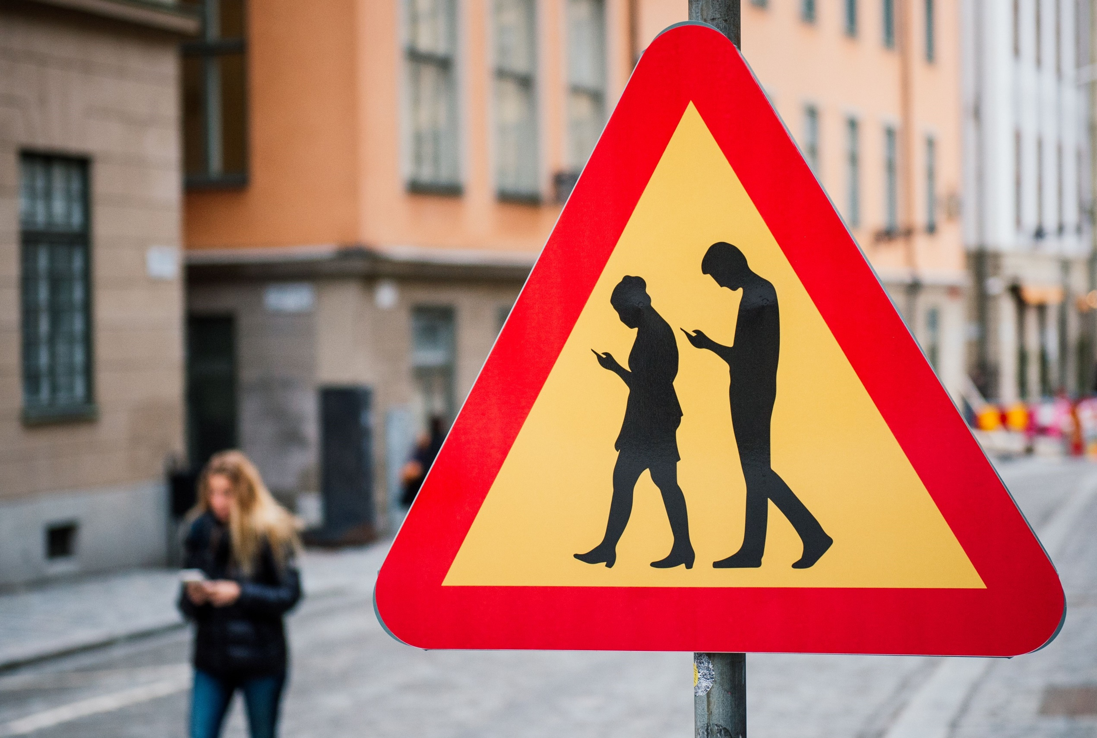
FRUIT OF THE SPIRIT
FRUIT OF THE FLESH
Love
Joy
Peace
Patience
Kindness
Goodness
Faithfulness
Gentleness
Self-Control
Sexual Immorality
Enmity
Strife
Jealousy & Envy
Rivalry
Dissensions
Idolatry & Divisions
Fits of Anger
Drunkenness

Slide 16
FRUIT OF THE SPIRIT
FRUIT OF THE FLESH
Love
Joy
Peace
Patience
Kindness
Goodness
Faithfulness
Gentleness
Self-Control
Sexual Immorality
Enmity
Strife
Jealousy & Envy
Rivalry
Dissensions
Idolatry & Divisions
Fits of Anger
Drunkenness

Slide 17
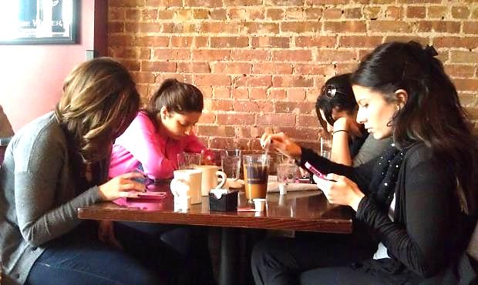
FRUIT OF THE SPIRIT
FRUIT OF THE FLESH
Love
Joy
Peace
Patience
Kindness
Goodness
Faithfulness
Gentleness
Self-Control
Sexual Immorality
Enmity
Strife
Jealousy & Envy
Rivalry
Dissensions
Idolatry & Divisions
Fits of Anger
Drunkenness

Slide 18
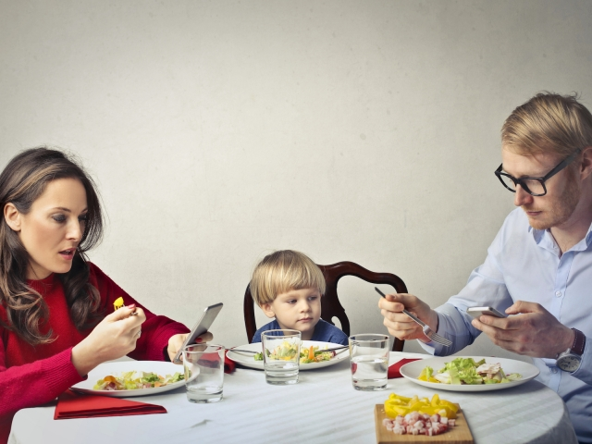
FRUIT OF THE SPIRIT
FRUIT OF THE FLESH
Love
Joy
Peace
Patience
Kindness
Goodness
Faithfulness
Gentleness
Self-Control
Sexual Immorality
Enmity
Strife
Jealousy & Envy
Rivalry
Dissensions
Idolatry & Divisions
Fits of Anger
Drunkenness

Slide 19
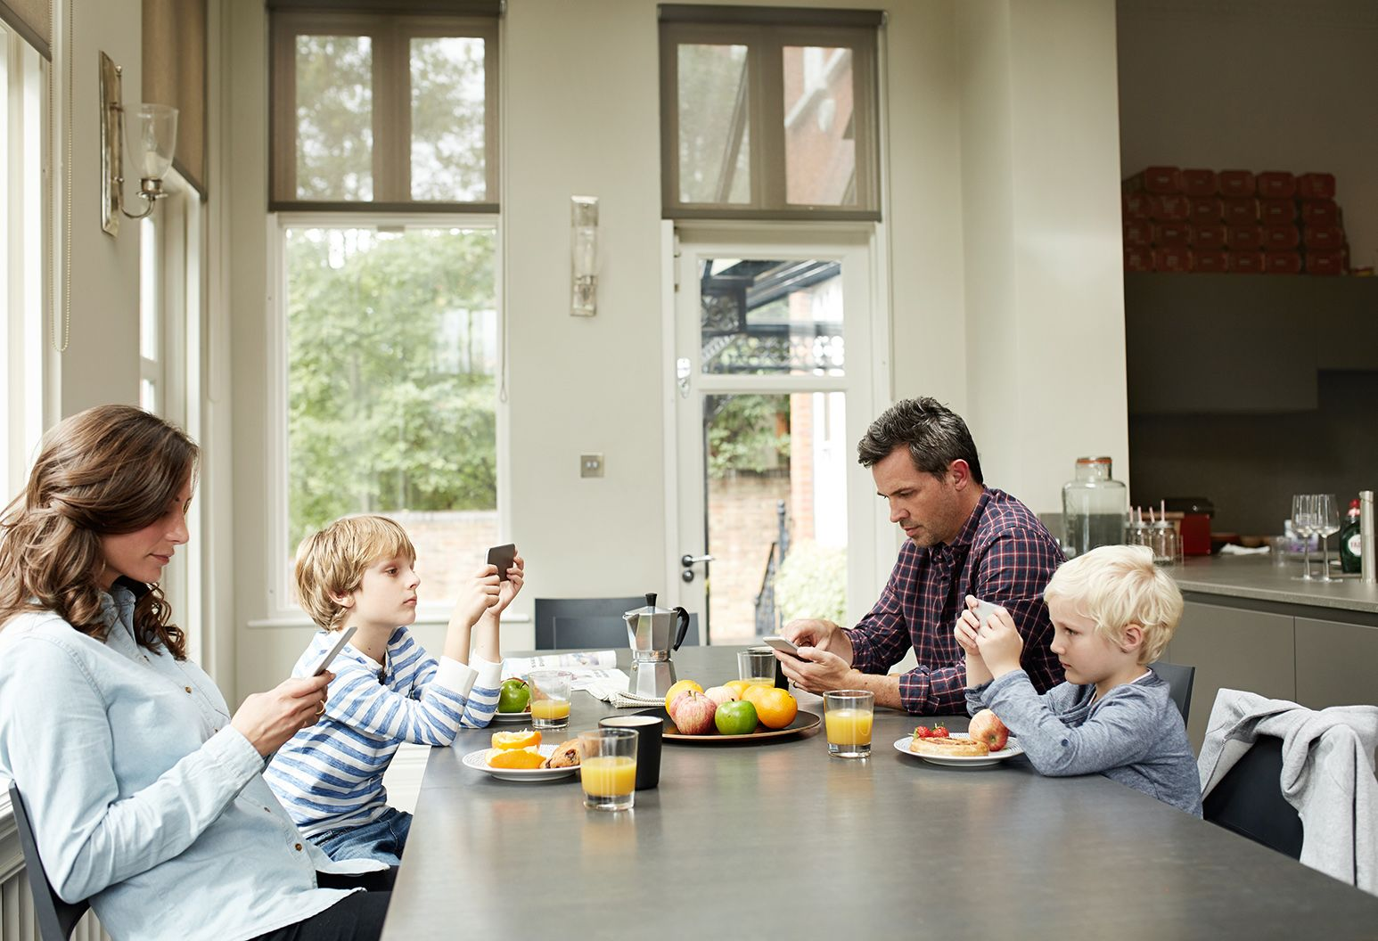
FRUIT OF THE SPIRIT
FRUIT OF THE FLESH
Love
Joy
Peace
Patience
Kindness
Goodness
Faithfulness
Gentleness
Self-Control
Sexual Immorality
Enmity
Strife
Jealousy & Envy
Rivalry
Dissensions
Idolatry & Divisions
Fits of Anger
Drunkenness

Slide 20
FRUIT OF THE SPIRIT
FRUIT OF THE FLESH
Love
Joy
Peace
Patience
Kindness
Goodness
Faithfulness
Gentleness
Self-Control
Sexual Immorality
Enmity
Strife
Jealousy & Envy
Rivalry
Dissensions
Idolatry & Divisions
Fits of Anger
Drunkenness

Slide 21
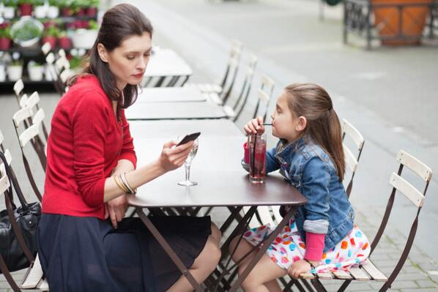
FRUIT OF THE SPIRIT
FRUIT OF THE FLESH
Love
Joy
Peace
Patience
Kindness
Goodness
Faithfulness
Gentleness
Self-Control
Sexual Immorality
Enmity
Strife
Jealousy & Envy
Rivalry
Dissensions
Idolatry & Divisions
Fits of Anger
Drunkenness

Slide 22
FRUIT OF THE SPIRIT
FRUIT OF THE FLESH
Love
Joy
Peace
Patience
Kindness
Goodness
Faithfulness
Gentleness
Self-Control
Sexual Immorality
Enmity
Strife
Jealousy & Envy
Rivalry
Dissensions
Idolatry & Divisions
Fits of Anger
Drunkenness

Slide 23
FRUIT OF THE SPIRIT
FRUIT OF THE FLESH
Love
Joy
Peace
Patience
Kindness
Goodness
Faithfulness
Gentleness
Self-Control
Sexual Immorality
Enmity
Strife
Jealousy & Envy
Rivalry
Dissensions
Idolatry & Divisions
Fits of Anger
Drunkenness

Slide 24
FRUIT OF THE SPIRIT
FRUIT OF THE FLESH
Love
Joy
Peace
Patience
Kindness
Goodness
Faithfulness
Gentleness
Self-Control
Sexual Immorality
Enmity
Strife
Jealousy & Envy
Rivalry
Dissensions
Idolatry & Divisions
Fits of Anger
Drunkenness

Slide 25
FRUIT OF THE SPIRIT
FRUIT OF THE FLESH
Love
Joy
Peace
Patience
Kindness
Goodness
Faithfulness
Gentleness
Self-Control
Sexual Immorality
Enmity
Strife
Jealousy & Envy
Rivalry
Dissensions
Idolatry & Divisions
Fits of Anger
Drunkenness

Slide 26
FRUIT OF THE SPIRIT
FRUIT OF THE FLESH
Love
Joy
Peace
Patience
Kindness
Goodness
Faithfulness
Gentleness
Self-Control
Sexual Immorality
Enmity
Strife
Jealousy & Envy
Rivalry
Dissensions
Idolatry & Divisions
Fits of Anger
Drunkenness

Slide 27
FRUIT OF THE SPIRIT
FRUIT OF THE FLESH
Love
Joy
Peace
Patience
Kindness
Goodness
Faithfulness
Gentleness
Self-Control
Sexual Immorality
Enmity
Strife
Jealousy & Envy
Rivalry
Dissensions
Idolatry & Divisions
Fits of Anger
Drunkenness

Slide 28
WHAT DO WE DO?

Slide 29
WHAT DO WE DO?
Admit you’re not exempt from the negative effects of your smartphone.

Slide 30
WHAT DO WE DO?
Admit you’re not exempt from the negative effects of your smartphone.
Honestly assess how your use of your phone affects your ability to abide in the Vine and bear good fruit.

Slide 31
WHAT DO WE DO?
Admit you’re not exempt from the negative effects of your smartphone.
Honestly assess how your use of your phone affects your ability to abide in the Vine and bear good fruit.
Remember the Gospel.

Slide 32
WHAT DO WE DO?
Admit you’re not exempt from the negative effects of your smartphone.
Honestly assess how your use of your phone affects your ability to abide in the Vine and bear good fruit.
Remember the Gospel.
Set some boundaries on your phone use.

Slide 33
WHAT DO WE DO?
Admit you’re not exempt from the negative effects of your smartphone.
Honestly assess how your use of your phone affects your ability to abide in the Vine and bear good fruit.
Remember the Gospel.
Set some boundaries on your phone use.
SUGGESTED BOUNDARIES
Detox
Minimize Notifications
Do Not Disturb
Delay Checking
No-Phone Zones
Get Accountability for Porn

Slide 34
WHAT DO WE DO?
Admit you’re not exempt from the negative effects of your smartphone.
Honestly assess how your use of your phone affects your ability to abide in the Vine and bear good fruit.
Remember the Gospel.
Set some boundaries on your phone use.
Consider how to use your phone for good!

Slide 35
RECOMMENDED RESOURCES

Slide 37
How has your phone hindered your ability to abide in the Vine and produce good fruit?
What boundaries have been helpful?
How have you used your phone for good?

