Slide 1
WELCOME

Slide 2
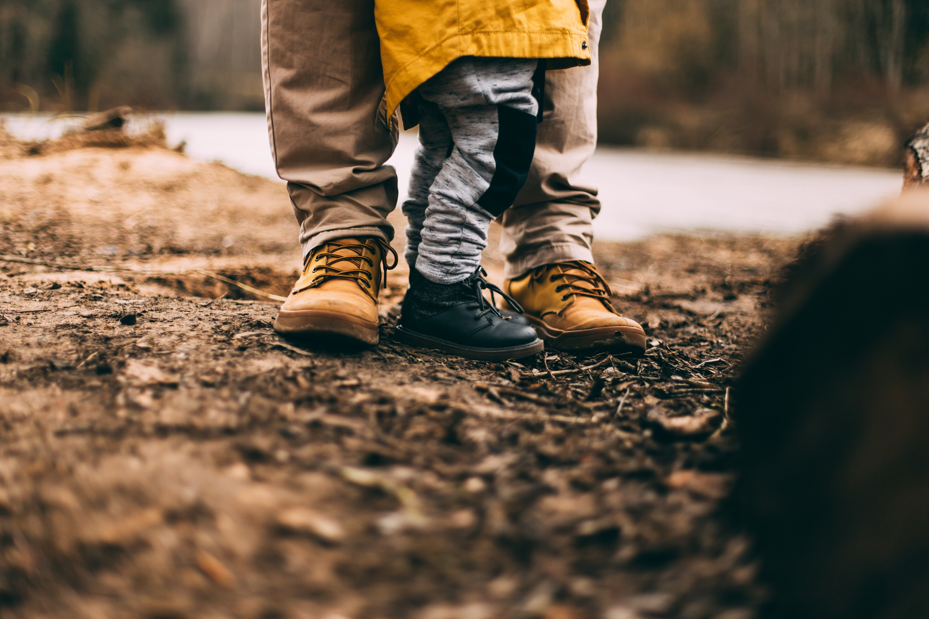
HAPPY FATHERS DAY

Slide 3
NEW DIRECTORY
Grab the brand new edition of our Tallgrass Family Directory today at the Welcome Table. Match names with faces!

Slide 4
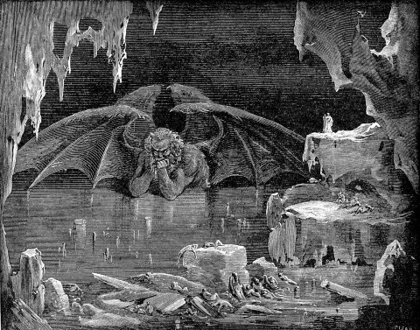
4 HELLISH VIEWS
The topic for the next Tallgrass Church book discussion is hell! We're reading "Four Views on Hell: Second Edition" and discussing over four Tuesday brown bag lunches: July 16 & 23, and August 13 & 20, from 11:45am - 1:15pm here at CHBC.
Grab your book now and get a jump on reading! A few subsidized copies are available for $10, contact Ben at bendeaver@tallgrass.church.

Slide 5
HAPPY FATHERS DAY

Slide 6
DAD JOKES BATTLE

Slide 7
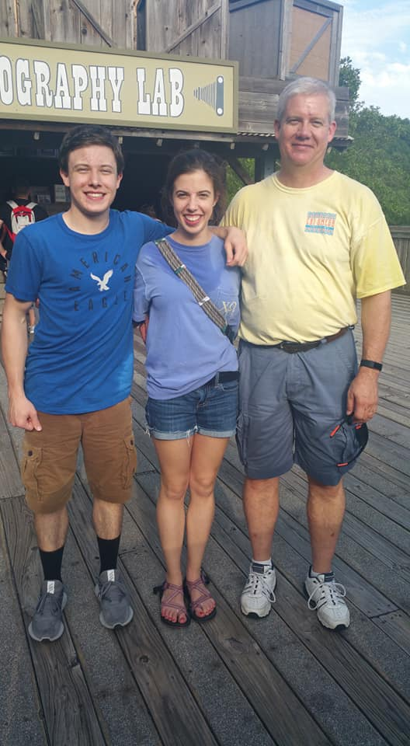
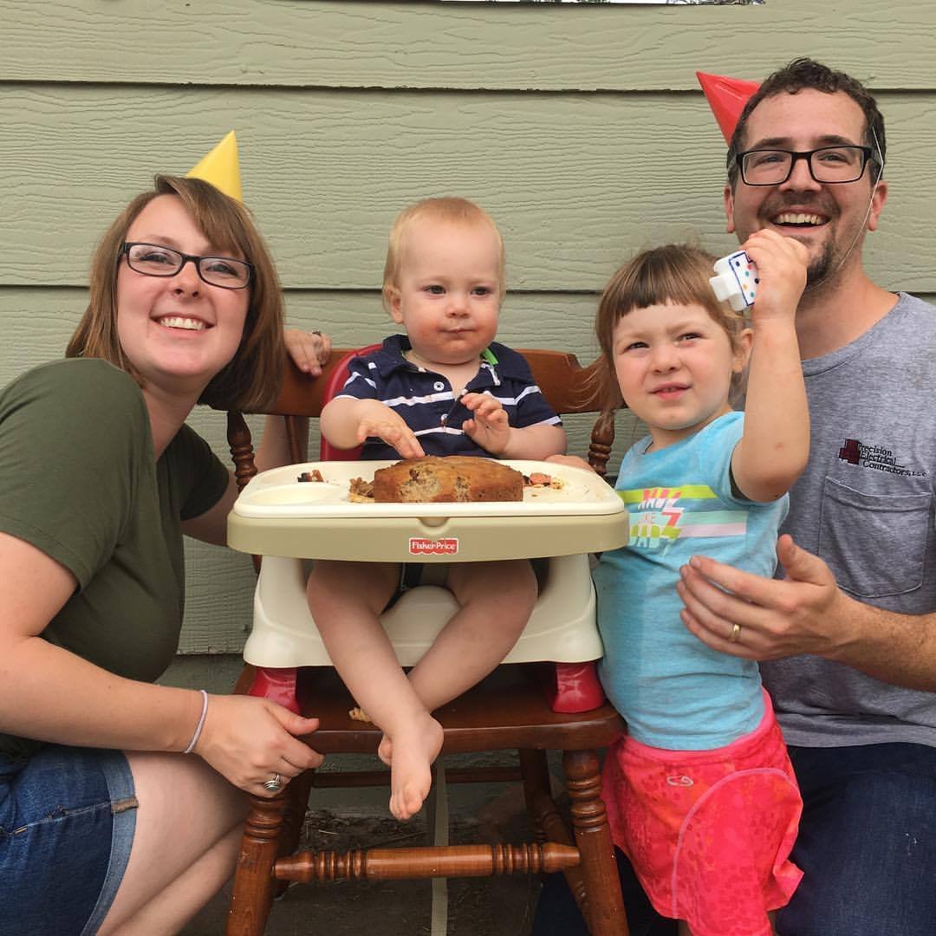
DAD JOKES BATTLE

Slide 8
Taylor Hillegeist Dan Chitwood

Slide 9
ONE LAUGHTS
opponent gets a point

Slide 10
DAD JOKES BATTLE

Slide 11
DAD JOKES BATTLE
Why did the crab
never share?

Slide 12
DAD JOKES BATTLE
Because he’s shellfish.

Slide 13
DAD JOKES BATTLE
Have you ever tried
to eat a clock?

Slide 14
DAD JOKES BATTLE
It’s very time-consuming.

Slide 15
DAD JOKES BATTLE
Did you hear the rumor about the butter?

Slide 16
DAD JOKES BATTLE
Well, I’m not going to spread it.

Slide 17
DAD JOKES BATTLE
What did the drummer call his twin daughters?

Slide 18
DAD JOKES BATTLE
Anna one, Anna two!

Slide 19
DAD JOKES BATTLE
What do you call a man who can’t stand?

Slide 20
DAD JOKES BATTLE
Neil.

Slide 21
DAD JOKES BATTLE
How do you cut the ocean in half?

Slide 22
DAD JOKES BATTLE
With a sea-saw.

Slide 23
DAD JOKES BATTLE
My wife said I don’t listen to her anymore…

Slide 24
DAD JOKES BATTLE
…or something like that.

Slide 25
DAD JOKES BATTLE
What do you call a small mother?

Slide 26
DAD JOKES BATTLE
A minimum.

Slide 27
DAD JOKES BATTLE
Who was the smartest man in the Bible?

Slide 28
DAD JOKES BATTLE
Abraham. He knew a Lot.

Slide 29
DAD JOKES BATTLE
Why didn’t they play cards on the Ark?

Slide 30
DAD JOKES BATTLE
Because Noah was standing on the deck.

Slide 31
DAD JOKES BATTLE
Where is the first tennis match mentioned in the Bible?

Slide 32
DAD JOKES BATTLE
When Joseph served in Pharaoh’s court.

Slide 33
DAD JOKES BATTLE
For years I suspected my wife of adding soil to my garden. When I asked her she just shrugged.

Slide 34
DAD JOKES BATTLE
The plot thickens…

Slide 35
DAD JOKES BATTLE
Where do cats go when they die?

Slide 36
DAD JOKES BATTLE
Purrrgatory.

Slide 37
DAD JOKES BATTLE
I used to have a job collecting leaves.

Slide 38
DAD JOKES BATTLE
I was raking it in.

Slide 39
DAD JOKES BATTLE
What kind of car did the Apostles drive?

Slide 40
DAD JOKES BATTLE
A Honda, because they were all together in one Accord.

Slide 41
DAD JOKES BATTLE
What excuse did Adam give to his children as to why he no longer lived in Eden?

Slide 42
DAD JOKES BATTLE
Your mother ate us out of house and home.

Slide 43
DAD JOKES BATTLE
Who was the greatest financier in the Bible?

Slide 44
DAD JOKES BATTLE
Noah; he was floating his stock while everyone was in liquidation.

Slide 45
DAD JOKES BATTLE
Who was the greatest comedian in the Bible?

Slide 46
DAD JOKES BATTLE
Samson. He brought the house down.

Slide 47
DAD JOKES BATTLE
Where was Solomon’s Temple located?

Slide 48
DAD JOKES BATTLE
On the side of his head.

Slide 49
DAD JOKES BATTLE
What kind of man was Boaz before he married?

Slide 50
DAD JOKES BATTLE
Ruthless.

Slide 51
DAD JOKES BATTLE
What do you call a pastor from Berlin?

Slide 52
DAD JOKES BATTLE
A German Shepherd.

Slide 53
DAD JOKES BATTLE
Where is the first baseball game in the Bible?

Slide 54
DAD JOKES BATTLE
In the big inning. Eve stole first, Adam stole second. Cain struck out Abel. The Giants and the Angels were rained out.

Slide 55
DAD JOKES BATTLE

Slide 56
MINGLE QUESTION(s)
Question 1:
What’s a good memory you have with your dad?
Question 2:
What Dad Joke did we miss?

Slide 57
RELATING AS DAD

Slide 58
FATHER’S DAY PANEL

Slide 59
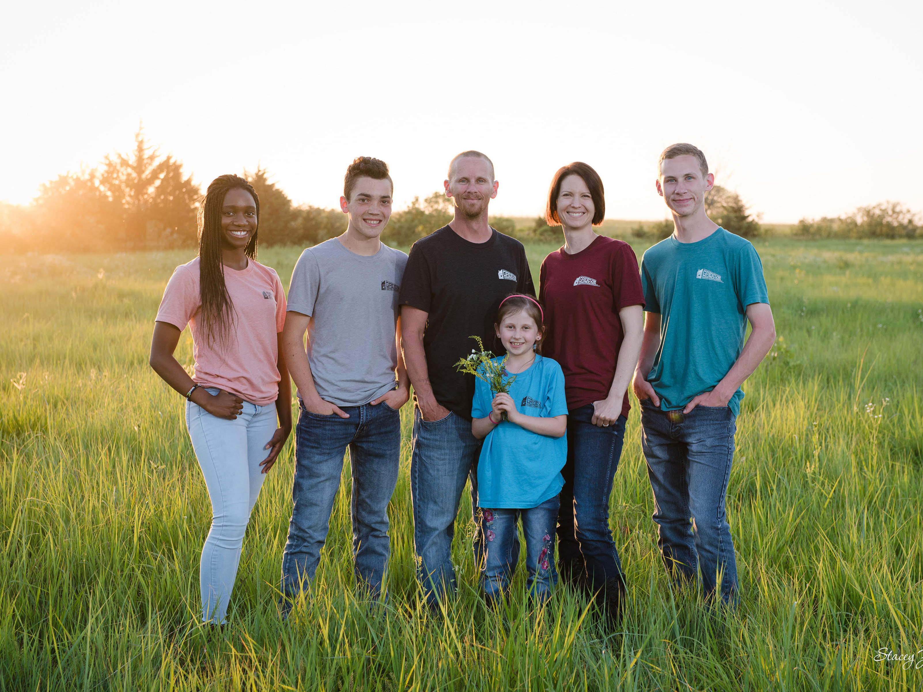
Ricky Greeve

Slide 60
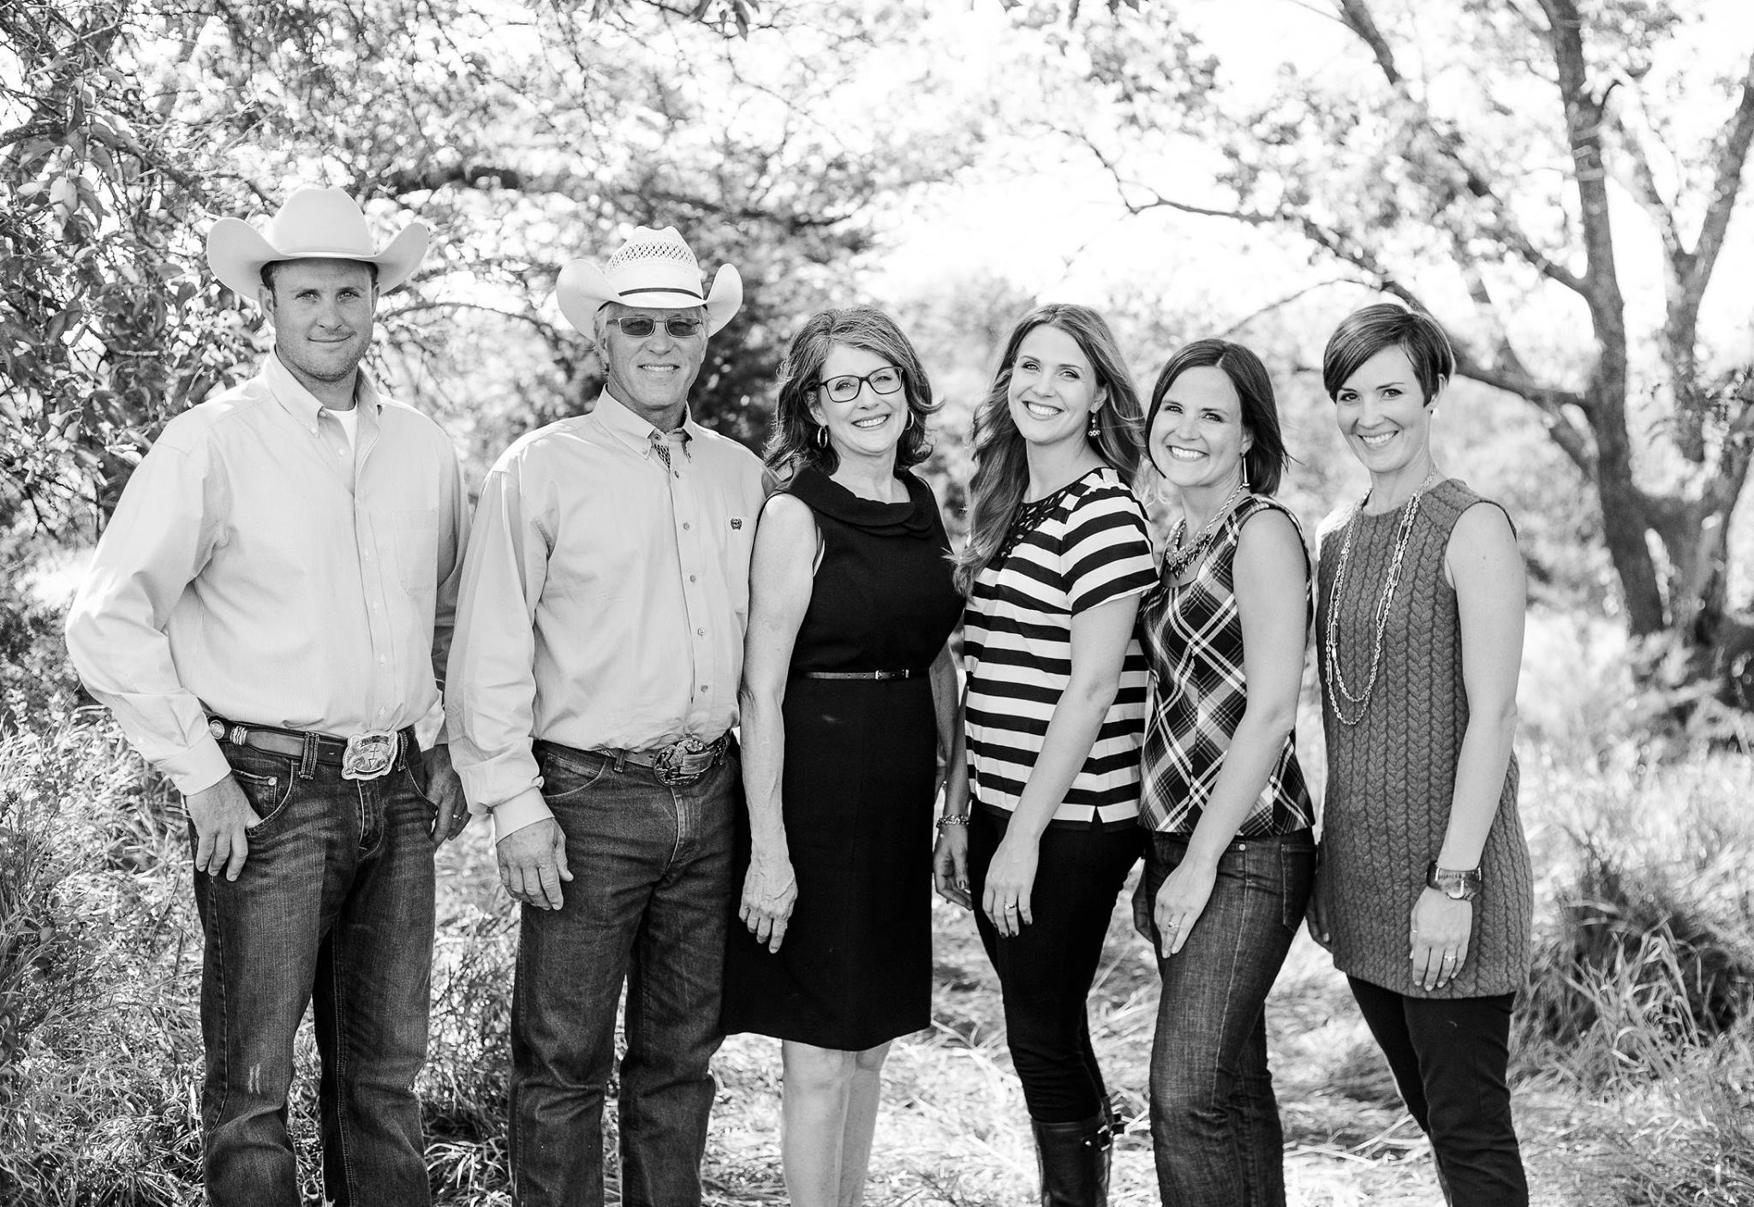
Ken Goodyear
Taylor Hillegeist Dan Chitwood

Slide 61
FATHER’S DAY PANEL
What was your relationship with your father like? How did that influence you as a father?

Slide 62
FATHER’S DAY PANEL
How did you parent as a young dad?

Slide 63
FATHER’S DAY PANEL
How have you seen God restore any years that were lost (or seemed lost)?

Slide 64
FATHER’S DAY PANEL
What would you have done differently as a dad? What would you have done the same?

Slide 65
FATHER’S DAY PANEL
What’s it been like for you to move towards your kids in their adulthood?

Slide 66
FATHER’S DAY PANEL
How has God used your journey as a father in your own life?

Slide 67
FATHER’S DAY PANEL
What have you learned about the father heart of God on your journey as a dad?

Slide 68
FATHER’S DAY PANEL
How has it been being a grandfather?

Slide 69
FATHER’S DAY PANEL
What words do you have for dads in blended families?

Slide 70
FATHER’S DAY PANEL
How would you encourage moms to spur on the dads?

Slide 71
FATHER’S DAY PANEL
What encouragement and/or wisdom would you give young dads today?

Slide 72
FATHER’S DAY PANEL
What encouragement would you give to anyone who had or has a difficult relationship with their earthly father?

Slide 73
FATHER’S DAY PANEL
How can we as fathers strengthen the voices of our daughters?

Slide 74
FATHER’S DAY PANEL
What Scripture or other resources would you encourage dads to explore?

Slide 76
Resources:

Slide 78
HOW DEEP
the Father’s love for us

Slide 79
HOW DEEP
the Father’s love for us
How deep the Father’s love for us
How vast beyond all measure
That He should give His only Son
To make a wretch His treasure
How great the pain of searing loss
The Father turns His face away
As wounds which mar the Chosen One
Bring many sons to glory

Slide 80
HOW DEEP
the Father’s love for us
Behold the man upon the cross
My sin upon His shoulders
Ashamed I hear my mocking voice
Call out among the scoffers
It was my sin that held Him there
Until it was accomplished
His dying breath has brought me life
I know that it is finished

Slide 81
HOW DEEP
the Father’s love for us
I will not boast in anything
No gifts, no power, no wisdom
But I will boast in Jesus Christ
His death and resurrection

Slide 82
HOW DEEP
the Father’s love for us
Why should I gain from His reward
I cannot give an answer
But this I know with all my heart
His wounds have paid my ransom
(repeat)
Yes this I know with all my heart
His wounds have paid my ransom

Slide 84
GOOD, GOOD FATHER

Slide 85
GOOD, GOOD FATHER
I've heard a thousand stories
Of what they think You're like
But I've heard the tender whisper
Of love in the dead of night and You
Tell me that You're pleased and that
I'm never alone

Slide 86
GOOD, GOOD FATHER
You're a good, good Father,
It's who You are, it's who You are,
It's who You are
And I'm loved by You
It's who I am, it's who I am
It's who I am

Slide 87
GOOD, GOOD FATHER
Oh and I've seen many searching for
Answers far and wide, but I know we're Searching for answers only You provide becauseYou know just what we need Before we say a word

Slide 88
GOOD, GOOD FATHER
You're a good, good Father,
It's who You are, it's who You are,
It's who You are
And I'm loved by You
It's who I am, it's who I am
It's who I am

Slide 89
GOOD, GOOD FATHER
Because You are perfect
In all of Your ways
You are perfect in all of Your ways
You are perfect in all of Your ways
To us

Slide 90
GOOD, GOOD FATHER
Oh this Love so undeniable
I, I can hardly speak
Peace so unexplainable
I, I can hardly think as You
Call me, deeper still as You
Call me deeper still as You
Me deeper still into love
Love, love

Slide 91
GOOD, GOOD FATHER
You're a good, good Father,
It's who You are, it's who You are,
It's who You are
And I'm loved by You
It's who I am, it's who I am
It's who I am

Slide 92
GOOD, GOOD FATHER
Because You are perfect
In all of Your ways
You are perfect in all of Your ways
You are perfect in all of Your ways
To us

Slide 94
NO LONGER SLAVES

Slide 95
NO LONGER SLAVES
You unravel me, with a melody
You surround me with a song
Of deliverance, from my enemies
Till all my fears are gone
I’m no longer a slave to fear
I am a child of God (2x)

Slide 96
NO LONGER SLAVES
From my mother’s womb
You have chosen me
Love has called my name
I’ve been born again, into Your family
Your blood flows through my veins
I’m no longer a slave to fear
I am a child of God (4x)

Slide 97
NO LONGER SLAVES
I am surrounded
By the arms of the Father
I am surrounded
By songs of Deliverance
We’ve been liberated
From our bondage
We’re the sons and the daughters
Let us sing our freedom!

Slide 98
NO LONGER SLAVES
You split the sea, so I could walk
right through it
You drowned my fears in perfect love
You rescued me, so I could stand & sing
I am a child of God (2x)
I am a child of God!

Slide 99
NO LONGER SLAVES
I’m no longer a slave to fear
I am a child of God (2x)

Slide 101
THE BENEDICTION

Slide 102
THE BENEDICTION
My friends may you grow in grace
And in the knowledge
Of our Lord and Savior.
My friends may you grow in grace
And in the knowledge
Of Jesus Christ.

Slide 103
THE BENEDICTION
To God be the glory
Now and forever,
Now and forever amen.
(repeat)

Slide 104
THE BENEDICTION
I pray tonight if we
Learned from one another,
May we glorify Him.
And if the Lord should
Bring us back together,
May we be in his arms till then.

Slide 105
THE BENEDICTION
My friends may you grow in grace
And in the knowledge
Of our Lord and Savior.
My friends may you grow in grace
And in the knowledge
Of Jesus Christ.

Slide 106
BENEDICTION

Slide 107
BENEDICTION
Father, give Your benediction
Give us Your peace before we part
Still our minds with truth’s conviction Calm with trust each anxious heart

Slide 108
BENEDICTION
Father, give Your benediction
Bid our grief and struggles end Peace which passes understanding On our waiting spirit send

Slide 109
BENEDICTION
Amen. Amen.
Amen. Amen.
Amen. Amen.
amen: let it be so

