Slide 1
WELCOME

Slide 3
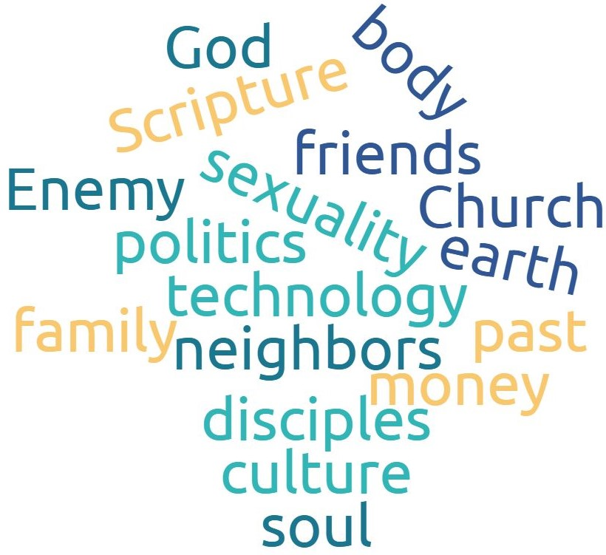
RELATING
Overlays like this

Slide 4
GOSPEL
relating

Slide 5
SCRIPTURE MEMORY
from Colossians ^{ESV}
1:19-20 ¹⁹ For in him all the fullness of God was pleased to dwell, ²⁰ and through him to reconcile to himself all things, whether on earth or in heaven, making peace by the blood of his cross.
1:28-29 ²⁸ Him we proclaim, warning everyone and teaching everyone with all wisdom, that we may present everyone mature in Christ. ²⁹ For this I toil, struggling with all his energy that he powerfully works within me.
3:12-13 ¹² Put on then, as God's chosen ones, holy and beloved, compassionate hearts, kindness, humility, meekness, and patience, ¹³ bearing with one another and, if one has a complaint against another, forgiving each other; as the Lord has forgiven you, so you also must forgive.
4:5-6 ⁵ Walk in wisdom toward outsiders, making the best use of the time.⁶ Let your speech always be gracious, seasoned with salt, so that you may know how you ought to answer each person.

Slide 6
COLOSSIANS 1:15-20
¹⁵ He is the image of the invisible God, the firstborn of all creation. ¹⁶ For by him all things were created, in heaven and on earth, visible and invisible, whether thrones or dominions or rulers or authorities —all things were created through him and for him. ¹⁷ And he is before all things, and in him all things hold together. ¹⁸ And he is the head of the body, the church. He is the beginning, the firstborn from the dead, that in everything he might be preeminent. ¹⁹ For in him all the fullness of God was pleased to dwell, ²⁰ and through him to reconcile to himself all things, whether on earth or in heaven, making peace by the blood of his cross.

Slide 7
GOSPEL
hexagons

Slide 8
GOSPEL
hexagons
GOSPEL

Slide 9
GOSPEL
hexagons
GOSPEL
TRUTHS
GOSPEL

Slide 10
GOSPEL
hexagons
GOSPEL
TRUTHS
GOSPEL
TRUTHS
GOSPEL

Slide 11
GOSPEL
hexagons
GOSPEL
TRUTHS
GOSPEL
TRUTHS
GOSPEL
TRUTHS
GOSPEL

Slide 12
GOSPEL
hexagons
GOSPEL
TRUTHS
GOSPEL
TRUTHS
GOSPEL
TRUTHS
GOSPEL
GOSPEL
TRUTHS

Slide 13
GOSPEL
hexagons
GOSPEL
TRUTHS
GOSPEL
TRUTHS
GOSPEL
TRUTHS
GOSPEL
GOSPEL
TRUTHS
GOSPEL
TRUTHS

Slide 14
GOSPEL
hexagons
GOSPEL
TRUTHS
GOSPEL
TRUTHS
GOSPEL
TRUTHS
GOSPEL
GOSPEL
TRUTHS
GOSPEL
TRUTHS
GOSPEL
TRUTHS

Slide 15
GOSPEL
hexagons
GOSPEL
TRUTHS
GOSPEL
TRUTHS
GOSPEL
TRUTHS
GOSPEL
GOSPEL
TRUTHS
GOSPEL
RELATING
GOSPEL
TRUTHS
GOSPEL
TRUTHS

Slide 16
GOSPEL
hexagons
GOSPEL
TRUTHS
GOSPEL
TRUTHS
GOSPEL
RELATING
GOSPEL
TRUTHS
GOSPEL
GOSPEL
TRUTHS
GOSPEL
RELATING
GOSPEL
TRUTHS
GOSPEL
TRUTHS

Slide 17
GOSPEL
hexagons
GOSPEL
RELATING
GOSPEL
TRUTHS
GOSPEL
TRUTHS
GOSPEL
RELATING
GOSPEL
TRUTHS
GOSPEL
GOSPEL
TRUTHS
GOSPEL
RELATING
GOSPEL
TRUTHS
GOSPEL
TRUTHS

Slide 18
GOSPEL
hexagons
GOSPEL
RELATING
GOSPEL
RELATING
GOSPEL
TRUTHS
GOSPEL
TRUTHS
GOSPEL
RELATING
GOSPEL
TRUTHS
GOSPEL
GOSPEL
TRUTHS
GOSPEL
RELATING
GOSPEL
TRUTHS
GOSPEL
TRUTHS

Slide 19
GOSPEL
hexagons
GOSPEL
RELATING
GOSPEL
RELATING
GOSPEL
RELATING
GOSPEL
TRUTHS
GOSPEL
TRUTHS
GOSPEL
RELATING
GOSPEL
TRUTHS
GOSPEL
GOSPEL
TRUTHS
GOSPEL
RELATING
GOSPEL
TRUTHS
GOSPEL
TRUTHS

Slide 20
GOSPEL
hexagons
GOSPEL
RELATING
GOSPEL
RELATING
GOSPEL
RELATING
GOSPEL
RELATING
GOSPEL
TRUTHS
GOSPEL
TRUTHS
GOSPEL
RELATING
GOSPEL
TRUTHS
GOSPEL
GOSPEL
TRUTHS
GOSPEL
RELATING
GOSPEL
TRUTHS
GOSPEL
TRUTHS

Slide 21
GOSPEL
hexagons
GOSPEL
RELATING
GOSPEL
RELATING
GOSPEL
RELATING
GOSPEL
RELATING
GOSPEL
TRUTHS
GOSPEL
TRUTHS
GOSPEL
RELATING
GOSPEL
RELATING
GOSPEL
TRUTHS
GOSPEL
GOSPEL
TRUTHS
GOSPEL
RELATING
GOSPEL
TRUTHS
GOSPEL
TRUTHS

Slide 22
GOSPEL
hexagons
GOSPEL
RELATING
GOSPEL
RELATING
GOSPEL
RELATING
GOSPEL
RELATING
GOSPEL
TRUTHS
GOSPEL
TRUTHS
GOSPEL
RELATING
GOSPEL
RELATING
GOSPEL
TRUTHS
GOSPEL
GOSPEL
TRUTHS
GOSPEL
RELATING
GOSPEL
RELATING
GOSPEL
TRUTHS
GOSPEL
TRUTHS
GOSPEL
RELATING
GOSPEL
RELATING
GOSPEL
RELATING
GOSPEL
RELATING

Slide 23
GOSPEL RELATING
Overlays like this

Slide 24
STRATEGIC PRIORITIES
2019
Overlays like this

Slide 25
STRATEGIC PRIORITIES
2019
Because God first loved us,
we exist to love God and love our neighbors.
Overlays like this

Slide 26
GOD’S RELATING
FATHER
Overlays like this
SON
SPIRIT

Slide 27
GOD’S RELATING
“’At the center of the universe is a relationship.’ That is the most fundamental truth I know. At the center of the universe is a community. It is out of that relationships that you and I were created and redeemed. And it for that relationship that you and I were created and redeemed! And it turns out that the community is a Trinity. The center of reality is Father, Son and Holy Spirit.”
—Darrell W. Johnson, Experiencing the Trinity, p. 37
Overlays like this

Slide 28
GOD’S RELATING
“’At the center of the universe is a relationship.’ That is the most fundamental truth I know. At the center of the universe is a community. It is out of that relationships that you and I were created and redeemed. And it for that relationship that you and I were created and redeemed! And it turns out that the community is a Trinity. The center of reality is Father, Son and Holy Spirit.”
—Darrell W. Johnson, Experiencing the Trinity, p. 37
Overlays like this
“Thou hast made us for Thyself, O Lord, and our heart is restless until it finds its rest in Thee.”
–Saint Augustine of Hippo, Confessions

Slide 29
ACTION STEPS #1:
consider & choose 1 or 2
Overlays like this

Slide 30
ACTION STEPS #2:
hexagonal prayer challenge
Overlays like this

Slide 31
