Slide 1
WELCOME

Slide 6
Nature of God’s Kingdom

Slide 7
Nature of God’s Kingdom
Waiting is Valued
Unlikely Responders
Upside-Down Birth of King
Greatness through Serving
Upside Down Productivity
The King is the Suffering Servant
Receive Kingdom like a Child
Upside-Down Blessings and Woes
Love Your Enemies
Unlikely Ministry Team
Spiritual Warfare
Lead by Listening and Asking Questions
Relationships Based on Giving
Hospitality to Offer Dignity
Triumph through Humility & Sacrifice
The King Dies for His Enemy
Sneaky Jesus Works Unseen
_______________________

Slide 8
Luke 24:36-53

Slide 9
Luke 24:36-43
³⁶ As they were talking about these things, Jesus himself stood among them, and said to them, “Peace to you!” ³⁷ But they were startled and frightened and thought they saw a spirit. ³⁸ And he said to them, “Why are you troubled, and why do doubts arise in your hearts? ³⁹ See my hands and my feet, that it is I myself. Touch me, and see. For a spirit does not have flesh and bones as you see that I have.” ⁴⁰ And when he had said this, he showed them his hands and his feet. ⁴¹ And while they still disbelieved for joy and were marveling, he said to them, “Have you anything here to eat?” ⁴² They gave him a piece of broiled fish, ⁴³ and he took it and ate before them.

Slide 10
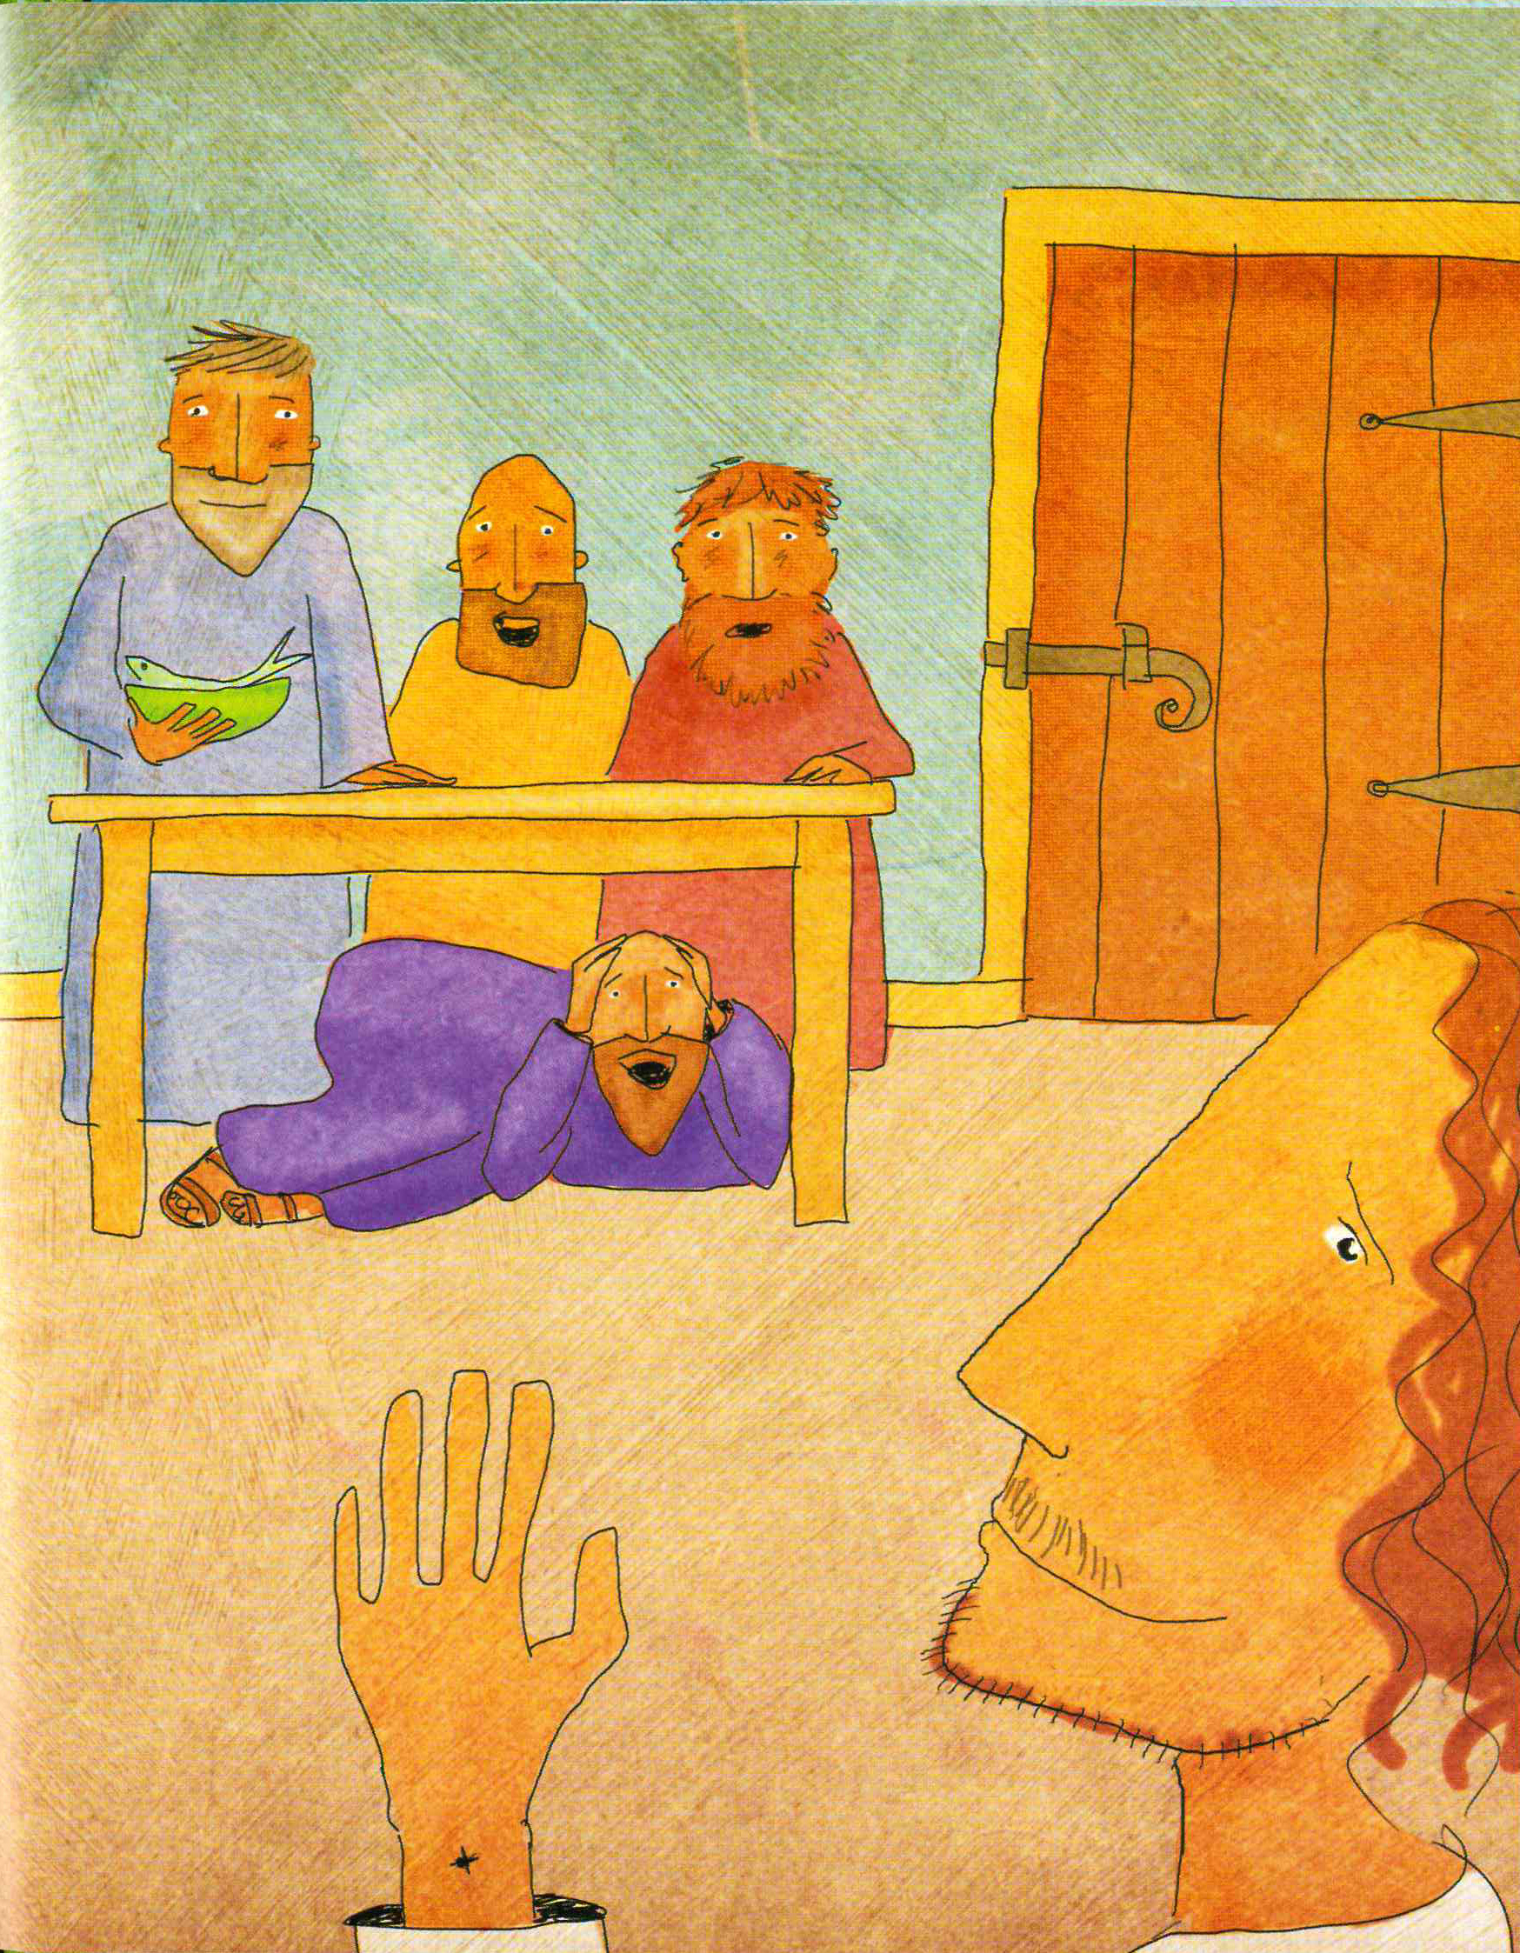
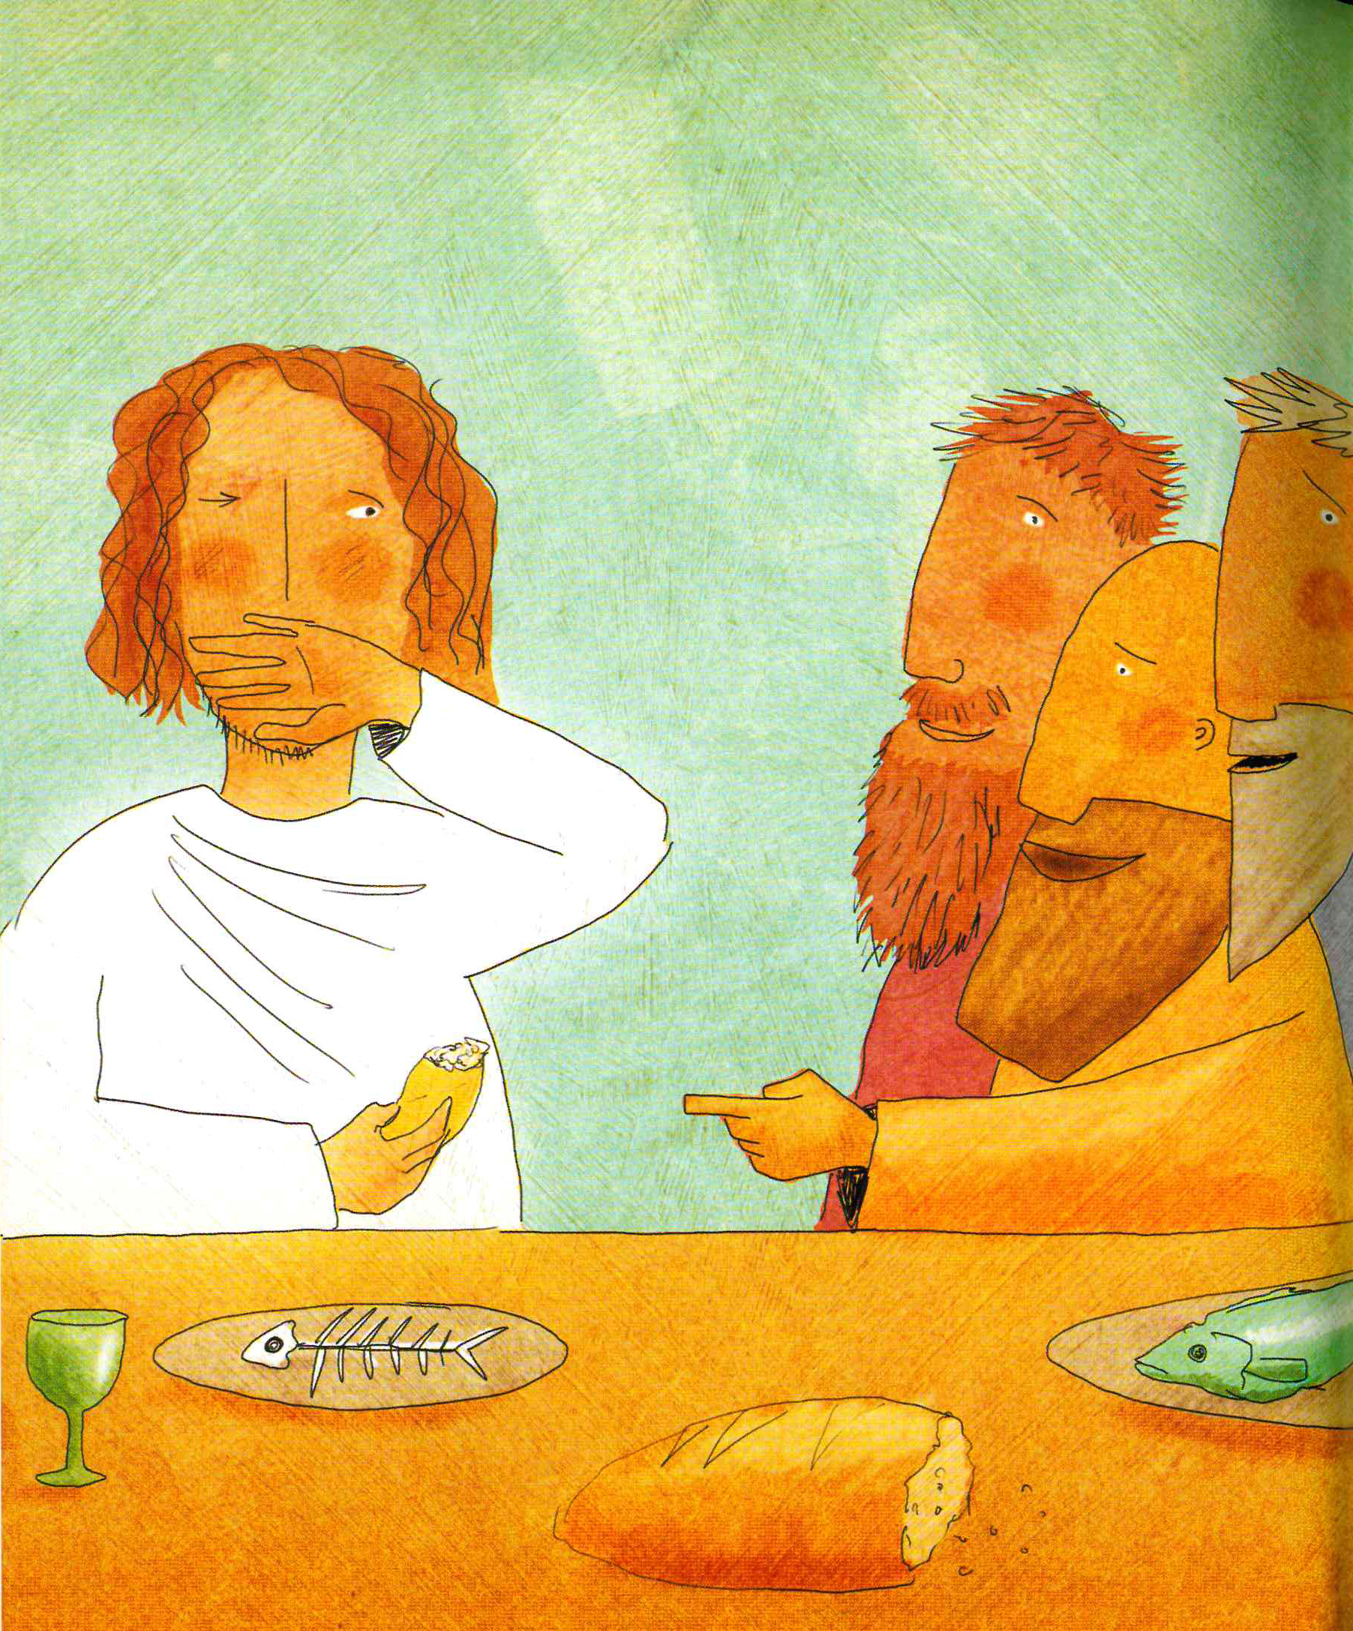
Luke 24:36-43
³⁶ As they were talking about these things, Jesus himself stood among them, and said to them, “Peace to you!” ³⁷ But they were startled and frightened and thought they saw a spirit. ³⁸ And he said to them, “Why are you troubled, and why do doubts arise in your hearts? ³⁹ See my hands and my feet, that it is I myself. Touch me, and see. For a spirit does not have flesh and bones as you see that I have.” ⁴⁰ And when he had said this, he showed them his hands and his feet. ⁴¹ And while they still disbelieved for joy and were marveling, he said to them, “Have you anything here to eat?” ⁴² They gave him a piece of broiled fish, ⁴³ and he took it and ate before them.

Slide 11
Nature of God’s Kingdom
Waiting is Valued
Unlikely Responders
Upside-Down Birth of King
Greatness through Serving
Upside Down Productivity
The King is the Suffering Servant
Receive Kingdom like a Child
Upside-Down Blessings and Woes
Love Your Enemies
Unlikely Ministry Team
Spiritual Warfare
Lead by Listening and Asking Questions
Relationships Based on Giving
Hospitality to Offer Dignity
Triumph through Humility & Sacrifice
The King Dies for His Enemy
Sneaky Jesus Works Unseen
____________________

Slide 12
Nature of God’s Kingdom
Waiting is Valued
Unlikely Responders
Upside-Down Birth of King
Greatness through Serving
Upside Down Productivity
The King is the Suffering Servant
Receive Kingdom like a Child
Upside-Down Blessings and Woes
Love Your Enemies
Unlikely Ministry Team
Spiritual Warfare
Lead by Listening and Asking Questions
Relationships Based on Giving
Hospitality to Offer Dignity
Triumph through Humility & Sacrifice
The King Dies for His Enemy
Sneaky Jesus Works Unseen
SPIRITUAL AND PHYSICAL

Slide 13
Luke 24:44-49
⁴⁴ Then he said to them, “These are my words that I spoke to you while I was still with you, that everything written about me in the Law of Moses and the Prophets and the Psalms must be fulfilled.” ⁴⁵ Then he opened their minds to understand the Scriptures, ⁴⁶ and said to them, “Thus it is written, that the Christ should suffer and on the third day rise from the dead, ⁴⁷ and that repentance for the forgiveness of sins should be proclaimed in his name to all nations, beginning from Jerusalem. ⁴⁸ You are witnesses of these things. ⁴⁹ And behold, I am sending the promise of my Father upon you. But stay in the city until you are clothed with power from on high.”

Slide 14
Luke 24:44-49
⁴⁴ Then he said to them, “These are my words that I spoke to you while I was still with you, that everything written about me in the Law of Moses and the Prophets and the Psalms must be fulfilled.” ⁴⁵ Then he opened their minds to understand the Scriptures, ⁴⁶ and said to them, “Thus it is written, that the Christ should suffer and on the third day rise from the dead, ⁴⁷ and that repentance for the forgiveness of sins should be proclaimed in his name to all nations, beginning from Jerusalem. ⁴⁸ You are witnesses of these things. ⁴⁹ And behold, I am sending the promise of my Father upon you. But stay in the city until you are clothed with power from on high.”

Slide 15
Luke 24:50-53
⁵⁰ And he led them out as far as Bethany, and lifting up his hands he blessed them. ⁵¹ While he blessed them, he parted from them and was carried up into heaven. ⁵² And they worshiped him and returned to Jerusalem with great joy, ⁵³ and were continually in the temple blessing God.

Slide 16
ACTS 1:6-11
⁶ So when they had come together, they asked him, “Lord, will you at this time restore the kingdom to Israel?” ⁷ He said to them, “It is not for you to know times or seasons that the Father has fixed by his own authority. ⁸ But you will receive power when the Holy Spirit has come upon you, and you will be my witnesses in Jerusalem and in all Judea and Samaria, and to the end of the earth.” ⁹ And when he had said these things, as they were looking on, he was lifted up, and a cloud took him out of their sight. ¹⁰ And while they were gazing into heaven as he went, behold, two men stood by them in white robes, ¹¹ and said, “Men of Galilee, why do you stand looking into heaven? This Jesus, who was taken up from you into heaven, will come in the same way as you saw him go into heaven.”

Slide 17
Applications

Slide 18
Applications
Enter the Kingdom of God

Slide 19
Applications
Enter the Kingdom of God
Live like it’s all REALLY REAL

Slide 21
What’s something that has stuck with you from this study?
What’s a next step of faith you sense God calling you to take?

Slide 22
What’s something that has stuck with you from this study?
What’s a next step of faith you sense God calling you to take?

