Slide 1
WELCOME

Slide 3
THE UPSIDE-DOWN TRIUMPH Luke 19:28-44

Slide 4
A Brief History of Israel
Luke 19
33AD

Slide 5
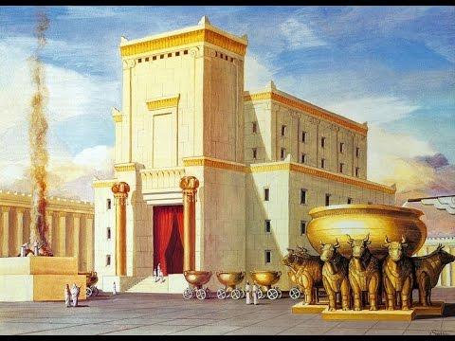
A Brief History of Israel
Luke 19
33AD
~1000BC
King David, Glory Years

Slide 6
A Brief History of Israel
Israeli Civil War, divided kingdom
930BC
Luke 19
33AD
~1000BC
King David, Glory Years

Slide 7
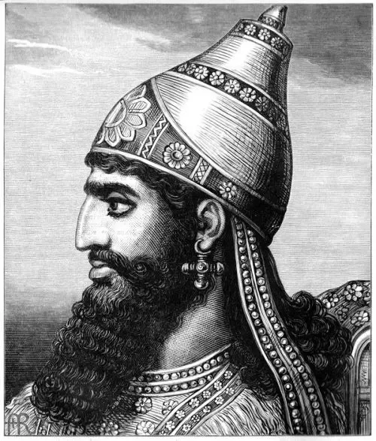
A Brief History of Israel
Israeli Civil War, divided kingdom
930BC
Luke 19
33AD
~1000BC
King David, Glory Years
~740BC
Northern Israel conquered, obliterated by Assyrians

Slide 8
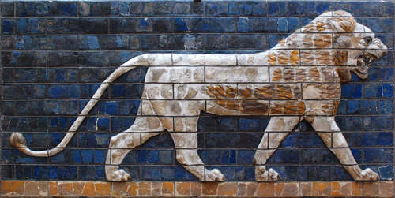
A Brief History of Israel
Israeli Civil War, divided kingdom
930BC
Conquered by Babylon
605BC
Luke 19
33AD
~1000BC
King David, Glory Years
~740BC
Northern Israel conquered, obliterated by Assyrians

Slide 9
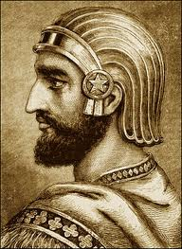
A Brief History of Israel
Israeli Civil War, divided kingdom
930BC
Conquered by Babylon
605BC
Luke 19
33AD
~1000BC
King David, Glory Years
539BC
Conquered by Medo-Persia
~740BC
Northern Israel conquered, obliterated by Assyrians

Slide 10
A Brief History of Israel
Israeli Civil War, divided kingdom
930BC
Some Israelites return and rebuild, strife
537BC
Conquered by Babylon
605BC
Luke 19
33AD
~1000BC
King David, Glory Years
539BC
Conquered by Medo-Persia
~740BC
Northern Israel conquered, obliterated by Assyrians

Slide 11
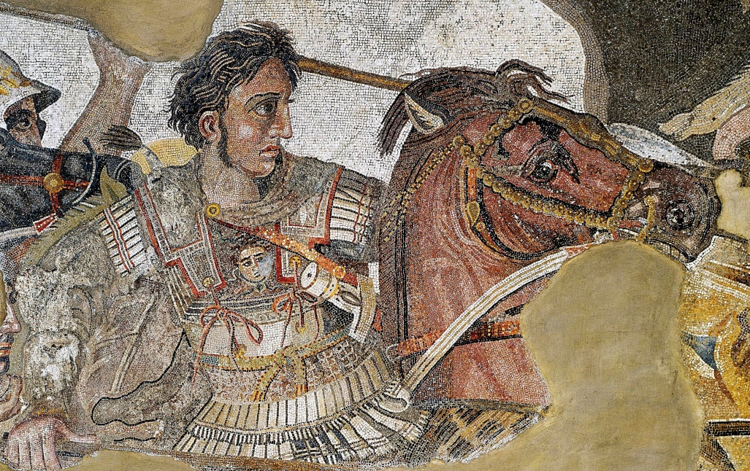
A Brief History of Israel
Israeli Civil War, divided kingdom
930BC
Some Israelites return and rebuild, strife
537BC
Conquered by Babylon
605BC
Luke 19
33AD
~1000BC
King David, Glory Years
539BC
Conquered by Medo-Persia
333BC
Conquered by Greeks (Alexander the Great)
~740BC
Northern Israel conquered, obliterated by Assyrians

Slide 12
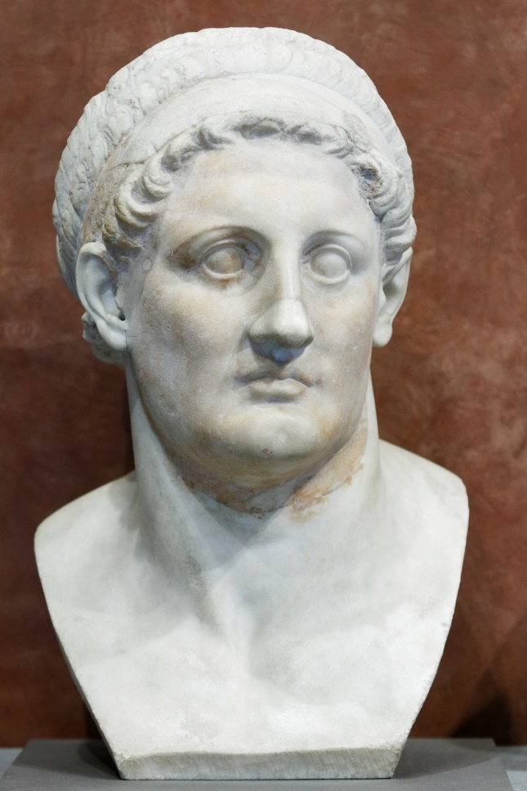
A Brief History of Israel
Repeated occupations by Greek Generals
323-305BC
Israeli Civil War, divided kingdom
930BC
Some Israelites return and rebuild, strife
537BC
Conquered by Babylon
605BC
Luke 19
33AD
~1000BC
King David, Glory Years
539BC
Conquered by Medo-Persia
333BC
Conquered by Greeks (Alexander the Great)
~740BC
Northern Israel conquered, obliterated by Assyrians

Slide 13
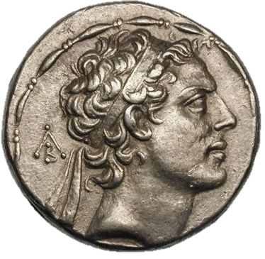
A Brief History of Israel
Repeated occupations by Greek Generals
323-305BC
Israeli Civil War, divided kingdom
930BC
Some Israelites return and rebuild, strife
537BC
Conquered by Babylon
605BC
Luke 19
33AD
~1000BC
King David, Glory Years
539BC
Conquered by Medo-Persia
167BC
Antiochus IV, attack, desecrated Temple
333BC
Conquered by Greeks (Alexander the Great)
~740BC
Northern Israel conquered, obliterated by Assyrians

Slide 14
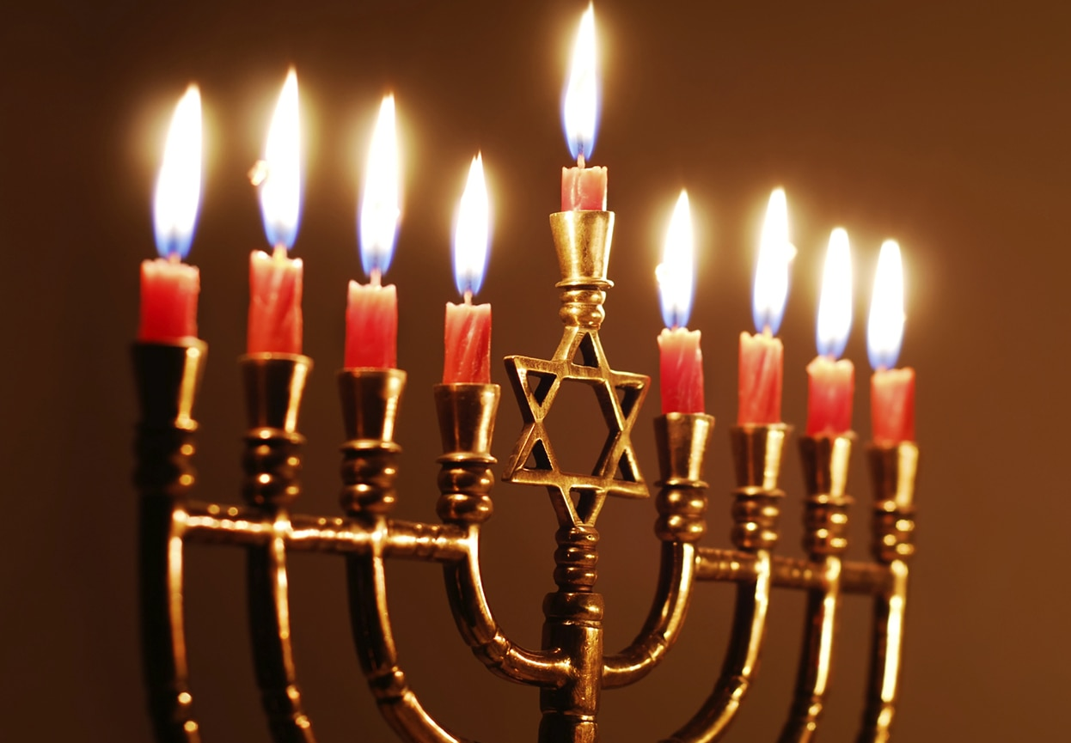
A Brief History of Israel
Repeated occupations by Greek Generals
323-305BC
Israeli Civil War, divided kingdom
930BC
Some Israelites return and rebuild, strife
537BC
Conquered by Babylon
605BC
Maccabean revolt
142BC
Luke 19
33AD
~1000BC
King David, Glory Years
539BC
Conquered by Medo-Persia
167BC
Antiochus IV, attack, desecrated Temple
333BC
Conquered by Greeks (Alexander the Great)
~740BC
Northern Israel conquered, obliterated by Assyrians

Slide 15
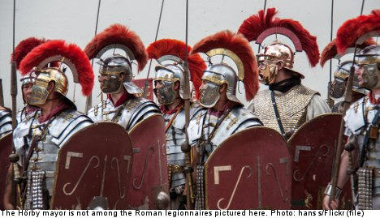
A Brief History of Israel
Repeated occupations by Greek Generals
323-305BC
Israeli Civil War, divided kingdom
930BC
Some Israelites return and rebuild, strife
537BC
Conquered by Babylon
605BC
Maccabean revolt
142BC
Luke 19
33AD
~1000BC
King David, Glory Years
63BC
Conquered by Rome
539BC
Conquered by Medo-Persia
167BC
Antiochus IV, attack, desecrated Temple
333BC
Conquered by Greeks (Alexander the Great)
~740BC
Northern Israel conquered, obliterated by Assyrians

Slide 16
A Brief History of Israel
Repeated occupations by Greek Generals
323-305BC
Israeli Civil War, divided kingdom
930BC
Some Israelites return and rebuild, strife
537BC
Conquered by Babylon
605BC
Maccabean revolt
142BC
Luke 19
33AD
~1000BC
King David, Glory Years
63BC
Conquered by Rome
539BC
Conquered by Medo-Persia
167BC
Antiochus IV, attack, desecrated Temple
333BC
Conquered by Greeks (Alexander the Great)
~740BC
Northern Israel conquered, obliterated by Assyrians

Slide 17
A Brief History of Israel
Repeated occupations by Greek Generals
323-305BC
Israeli Civil War, divided kingdom
930BC
Some Israelites return and rebuild, strife
537BC
Conquered by Babylon
605BC
Maccabean revolt
142BC
Luke 19
33AD
~1000BC
King David, Glory Years
63BC
Conquered by Rome
539BC
Conquered by Medo-Persia
167BC
Antiochus IV, attack, desecrated Temple
333BC
Conquered by Greeks (Alexander the Great)
~740BC
Northern Israel conquered, obliterated by Assyrians
~550BC: DANIEL, CH. 9
Exact date predicted for Messiah’s Triumphal Entry into Jerusalem!

Slide 18
A Brief History of Israel
Repeated occupations by Greek Generals
323-305BC
Israeli Civil War, divided kingdom
930BC
Some Israelites return and rebuild, strife
537BC
Conquered by Babylon
605BC
Maccabean revolt
142BC
Luke 19
33AD
~1000BC
King David, Glory Years
63BC
Conquered by Rome
539BC
Conquered by Medo-Persia
167BC
Antiochus IV, attack, desecrated Temple
333BC
Conquered by Greeks (Alexander the Great)
~740BC
Northern Israel conquered, obliterated by Assyrians
~550BC: DANIEL, CH. 9
Exact date predicted for Messiah’s Triumphal Entry into Jerusalem!

Slide 19
A Brief History of Israel
Repeated occupations by Greek Generals
323-305BC
Israeli Civil War, divided kingdom
930BC
Some Israelites return and rebuild, strife
537BC
Conquered by Babylon
605BC
Maccabean revolt
142BC
Luke 19
33AD
~1000BC
King David, Glory Years
63BC
Conquered by Rome
539BC
Conquered by Medo-Persia
167BC
Antiochus IV, attack, desecrated Temple
333BC
Conquered by Greeks (Alexander the Great)
~740BC
Northern Israel conquered, obliterated by Assyrians
~550BC: DANIEL, CH. 9
Exact date predicted for Messiah’s Triumphal Entry into Jerusalem!

Slide 20
Luke 19:36-40
³⁶ And as he rode along, they spread their cloaks on the road. ³⁷ As he was drawing near—already on the way down the Mount of Olives—the whole multitude of his disciples began to rejoice and praise God with a loud voice for all the mighty works that they had seen, ³⁸ saying, “Blessed is the King who comes in the name of the Lord! Peace in heaven and glory in the highest!” ³⁹ And some of the Pharisees in the crowd said to him, “Teacher, rebuke your disciples.” ⁴⁰ He answered, “I tell you, if these were silent, the very stones would cry out.”

Slide 21
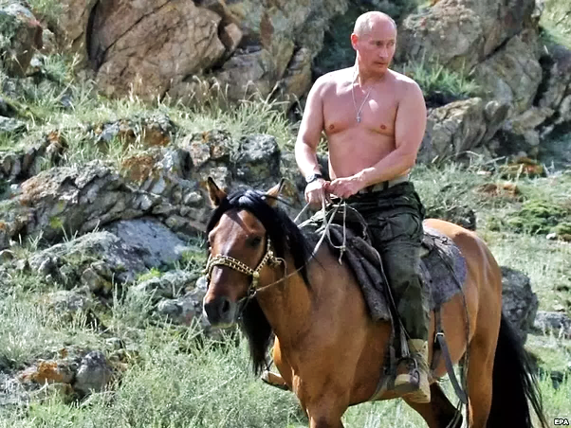

Slide 22
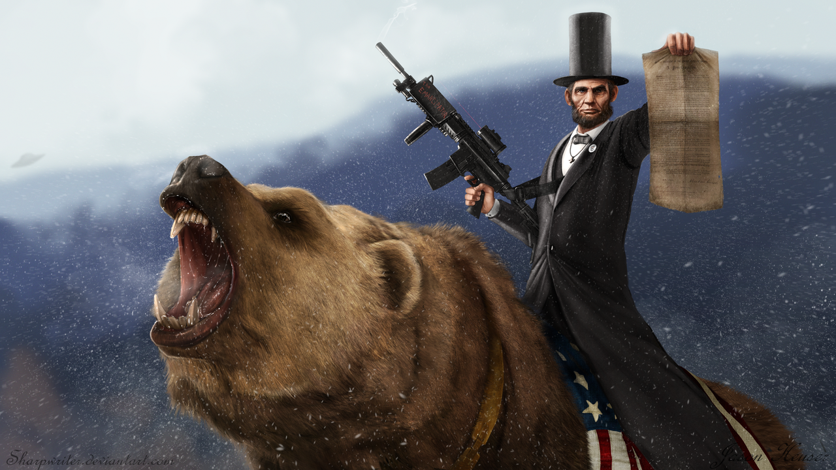

Slide 23
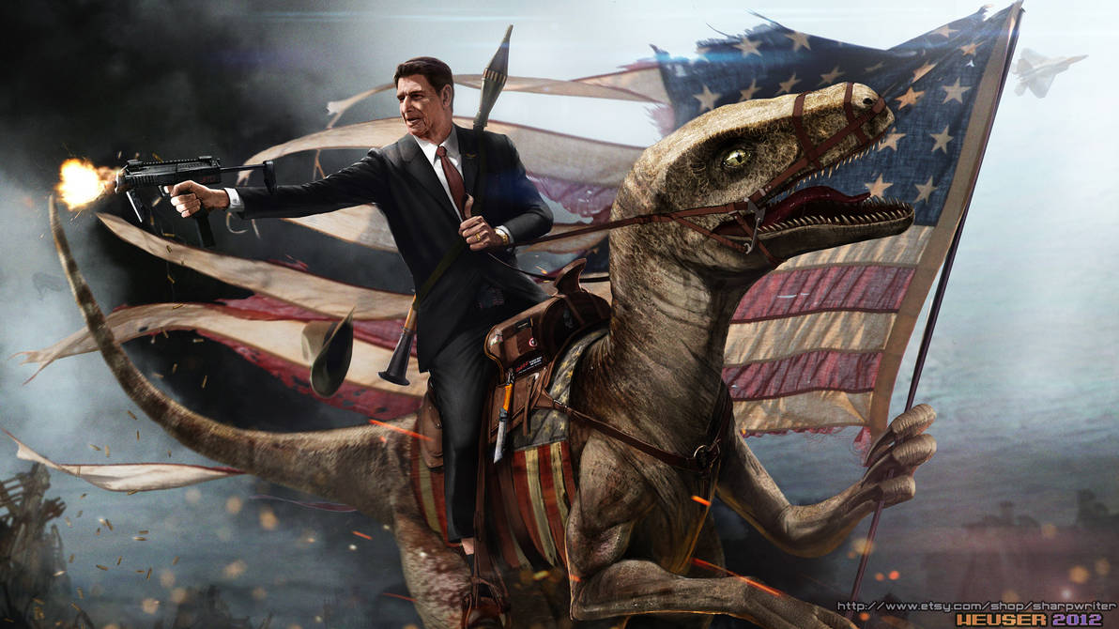

Slide 24
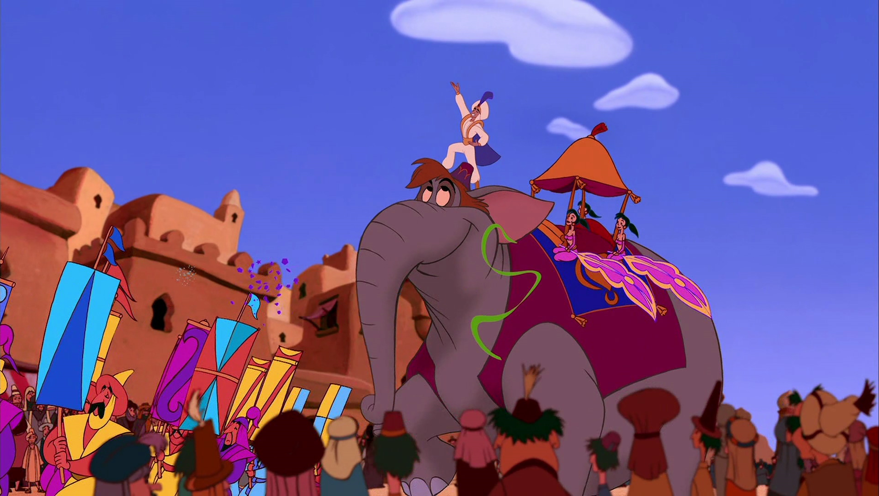

Slide 25
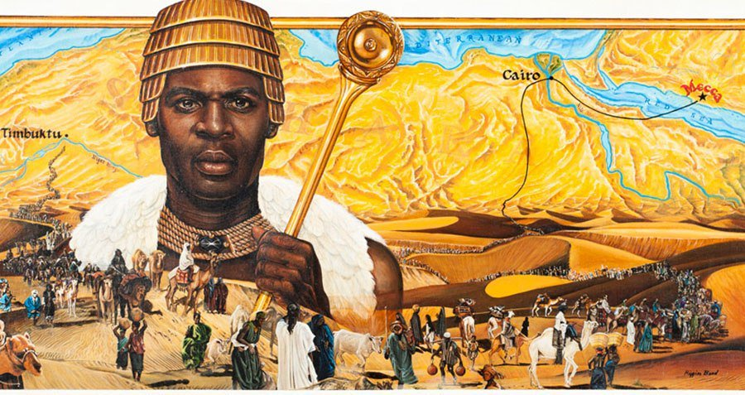
MANSA MUSA Mali, 1300AD

Slide 26
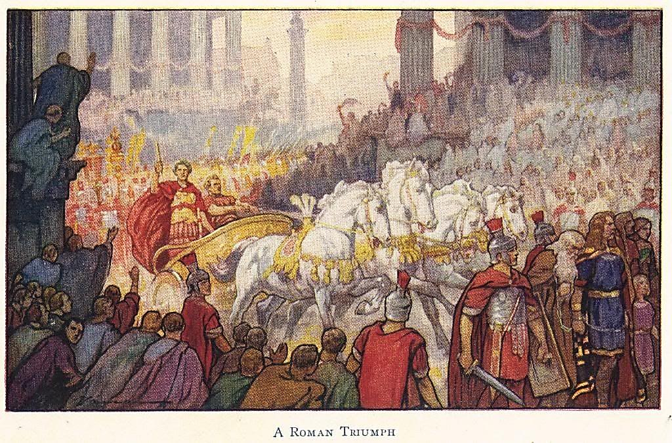
ROMAN TRIUMPHS

Slide 27
Luke 19:29-36
²⁹ When he drew near to Bethphage and Bethany, at the mount that is called Olivet, he sent two of the disciples, ³⁰ saying, “Go into the village in front of you, where on entering you will find a colt tied, on which no one has ever yet sat. Untie it and bring it here. ³¹ If anyone asks you, ‘Why are you untying it?’ you shall say this: ‘The Lord has need of it.’” ³² So those who were sent went away and found it just as he had told them. ³³ And as they were untying the colt, its owners said to them, “Why are you untying the colt?” ³⁴ And they said, “The Lord has need of it.” ³⁵ And they brought it to Jesus, and throwing their cloaks on the colt, they set Jesus on it.

Slide 28
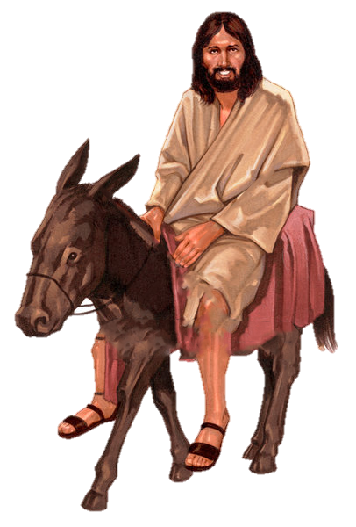
Luke 19:29-36
²⁹ When he drew near to Bethphage and Bethany, at the mount that is called Olivet, he sent two of the disciples, ³⁰ saying, “Go into the village in front of you, where on entering you will find a colt tied, on which no one has ever yet sat. Untie it and bring it here. ³¹ If anyone asks you, ‘Why are you untying it?’ you shall say this: ‘The Lord has need of it.’” ³² So those who were sent went away and found it just as he had told them. ³³ And as they were untying the colt, its owners said to them, “Why are you untying the colt?” ³⁴ And they said, “The Lord has need of it.” ³⁵ And they brought it to Jesus, and throwing their cloaks on the colt, they set Jesus on it.

Slide 29
Zechariah 9:9
Rejoice greatly, Daughter Zion! Shout, Daughter Jerusalem! See, your king comes to you, righteous and victorious, lowly and riding on a donkey, on a colt, the foal of a donkey.

Slide 30
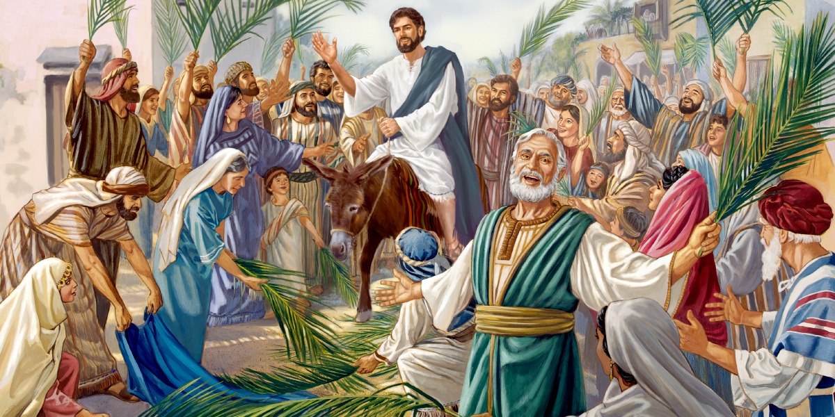
JESUS’ TRIUMPHAL ENTRY

Slide 31
Luke 19:41-44
⁴¹ And when he drew near and saw the city, he wept over it, ⁴² saying, “Would that you, even you, had known on this day the things that make for peace! But now they are hidden from your eyes. ⁴³ For the days will come upon you, when your enemies will set up a barricade around you and surround you and hem you in on every side ⁴⁴ and tear you down to the ground, you and your children within you. And they will not leave one stone upon another in you, because you did not know the time of your visitation.”

Slide 32
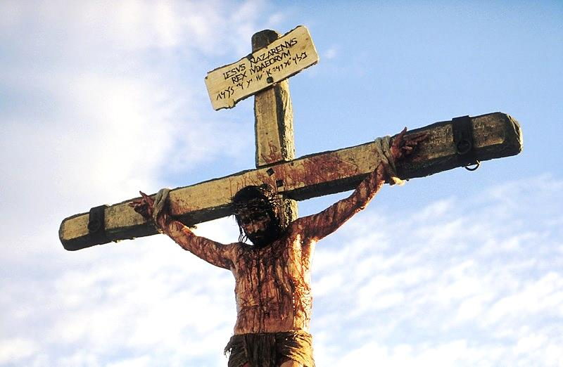

Slide 33
John 1:11-12
¹¹ He came to his own, and his own people did not receive him. ¹² But to all who did receive him, who believed in his name, he gave the right to become children of God

Slide 34
Revelation 19:11-16
¹¹ Then I saw heaven opened, and behold, a white horse! The one sitting on it is called Faithful and True, and in righteousness he judges and makes war. ¹² His eyes are like a flame of fire, and on his head are many diadems, and he has a name written that no one knows but himself. ¹³ He is clothed in a robe dipped in blood, and the name by which he is called is The Word of God. ¹⁴ And the armies of heaven, arrayed in fine linen, white and pure, were following him on white horses. … ¹⁶ On his robe and on his thigh he has a name written, King of kings and Lord of lords.

Slide 35
Applications

Slide 36
Applications
See Ourselves Afresh

Slide 37
Applications
See Ourselves Afresh
See Jesus Afresh

Slide 38
Applications
See Ourselves Afresh
See Jesus Afresh
Follow Jesus into Humble, Sacrificial Love

Slide 39
Applications
2 Corinthians 4: 16-18 ¹⁶ So we do not lose heart. Though our outer self is wasting away, our inner self is being renewed day by day. ¹⁷ For this light momentary affliction is preparing for us an eternal weight of glory beyond all comparison, ¹⁸ as we look not to the things that are seen but to the things that are unseen. For the things that are seen are transient, but the things that are unseen are eternal.
See Ourselves Afresh
See Jesus Afresh
Follow Jesus into Humble, Sacrificial Love

Slide 40
Applications
See Ourselves Afresh
See Jesus Afresh
Follow Jesus into Humble, Sacrificial Love
Lean in to Holy Week

Slide 41
THE UPSIDE-DOWN TRIUMPH Luke 19:28-44

Slide 43
What’s a next step you’re considering taking in response to this teaching?
How have you received humble, sacrificial love from Jesus or one of his followers?

