Slide 3
JESUS’ UNLIKELY FOLLOWERS (Luke 5)

Slide 4
Luke 5:1-11
¹ On one occasion, while the crowd was pressing in on him to hear the word of God, he was standing by the lake of Gennesaret

Slide 5
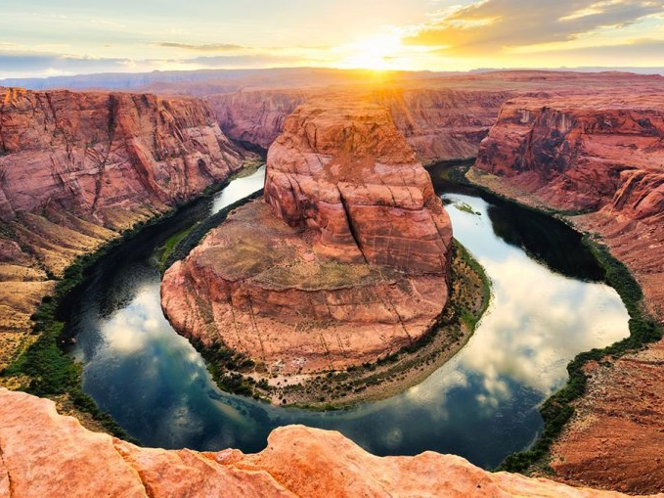
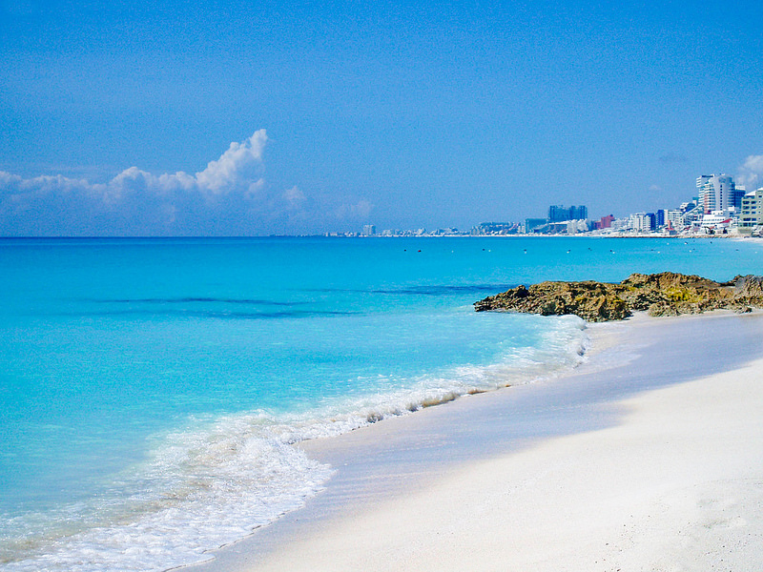
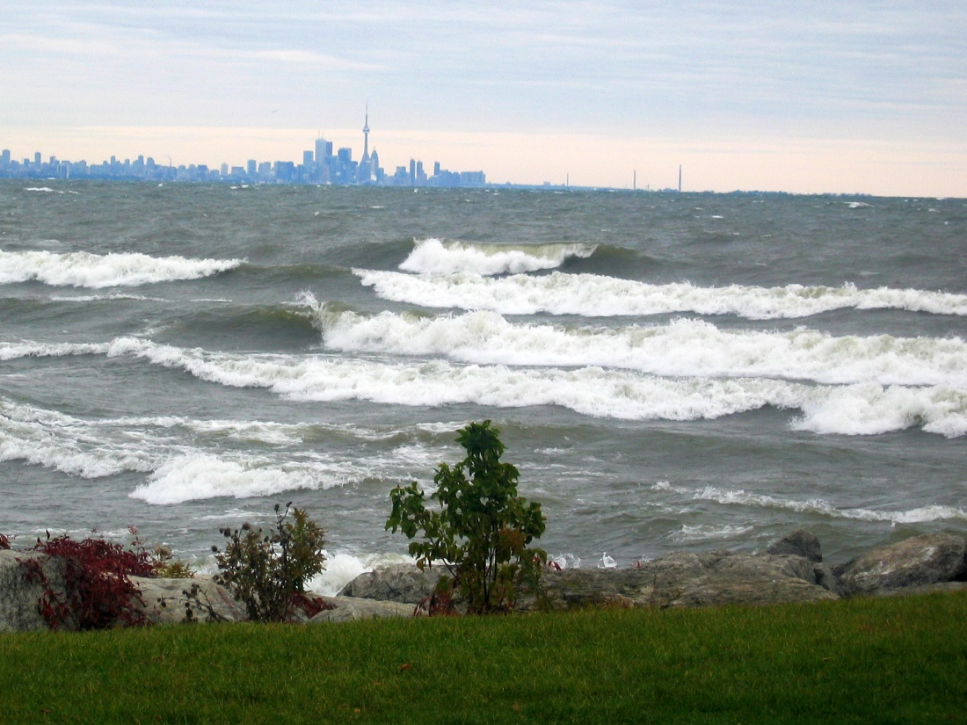
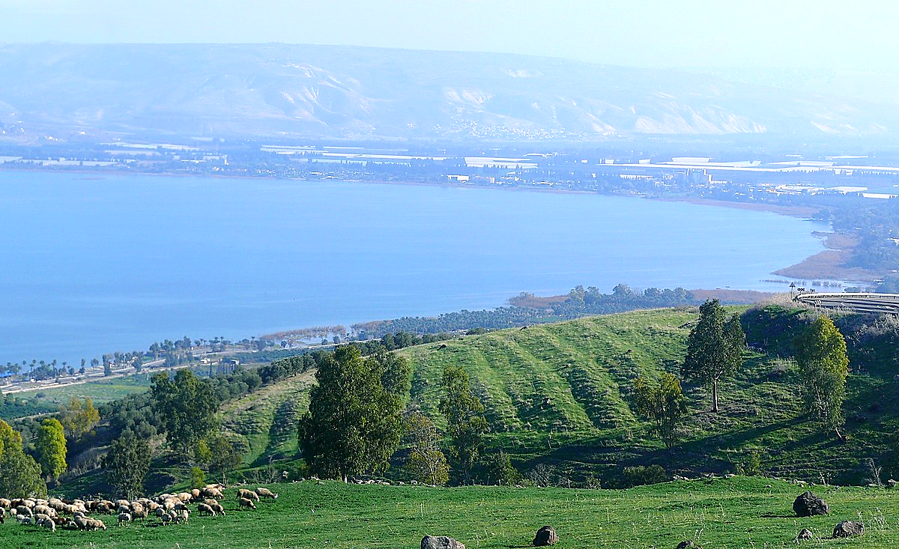
#1
#2
#3
#4

Slide 6
#4: The Sea of Galilee

Slide 7
Luke 5:1-11
¹ On one occasion, while the crowd was pressing in on him to hear the word of God, he was standing by the lake of Gennesaret, ² and he saw two boats by the lake, but the fishermen had gone out of them and were washing their nets. ³ Getting into one of the boats, which was Simon's, he asked him to put out a little from the land. And he sat down and taught the people from the boat.

Slide 8
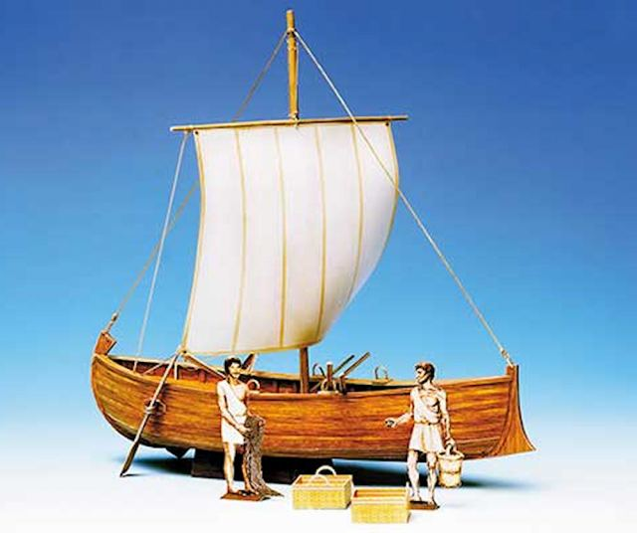
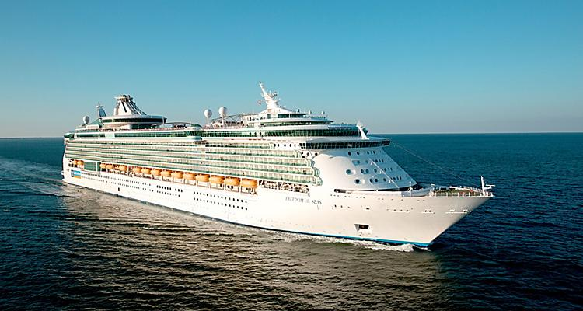
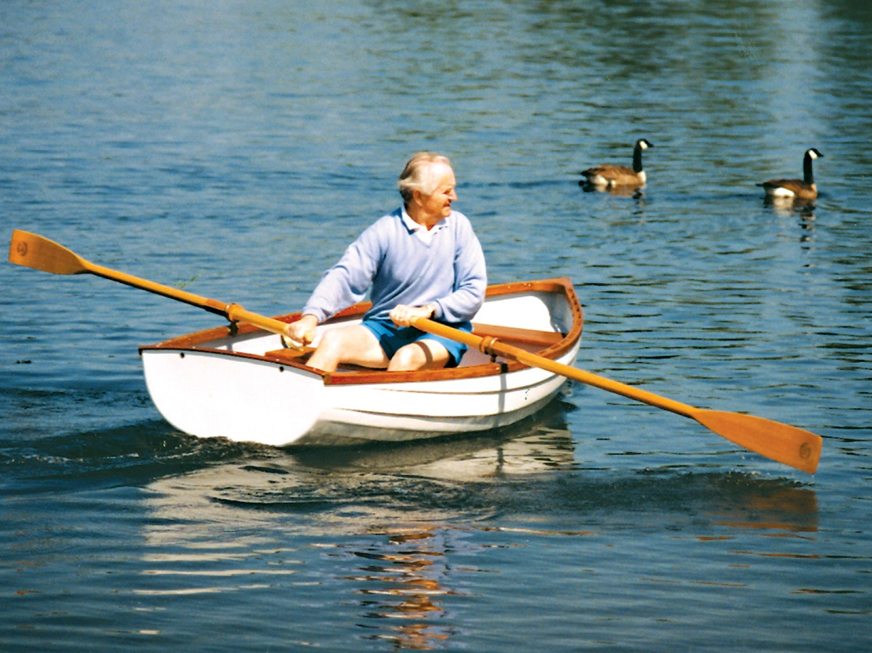
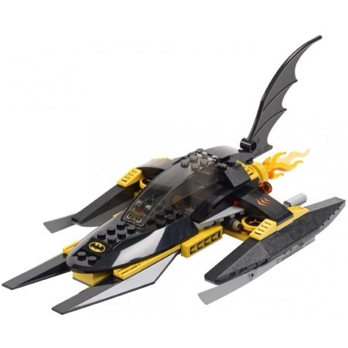
#1
#2
#3
#4

Slide 9
#2: Galilean Fishing Boat

Slide 10
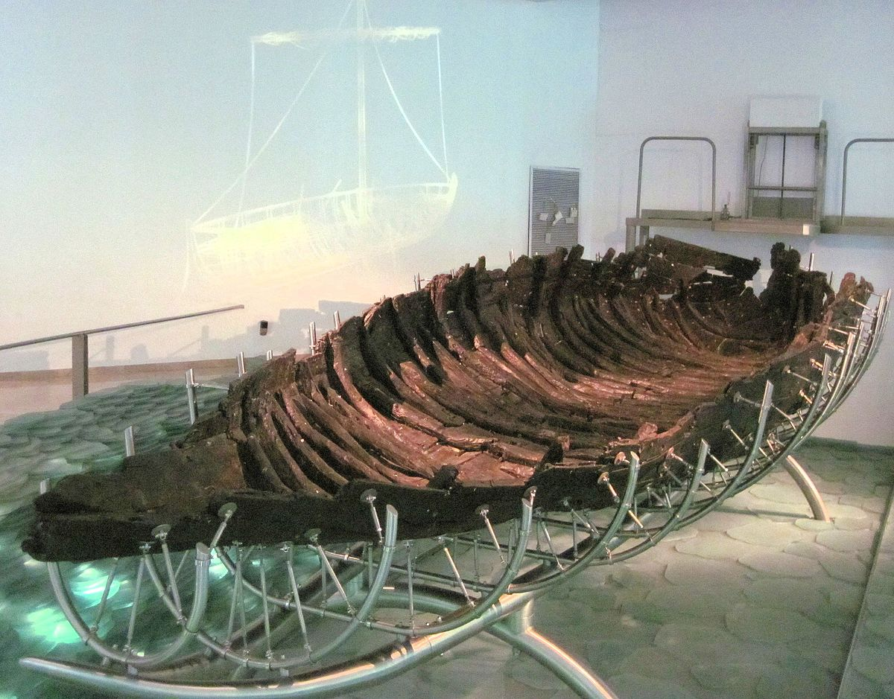
“THE JESUS BOAT”

Slide 11
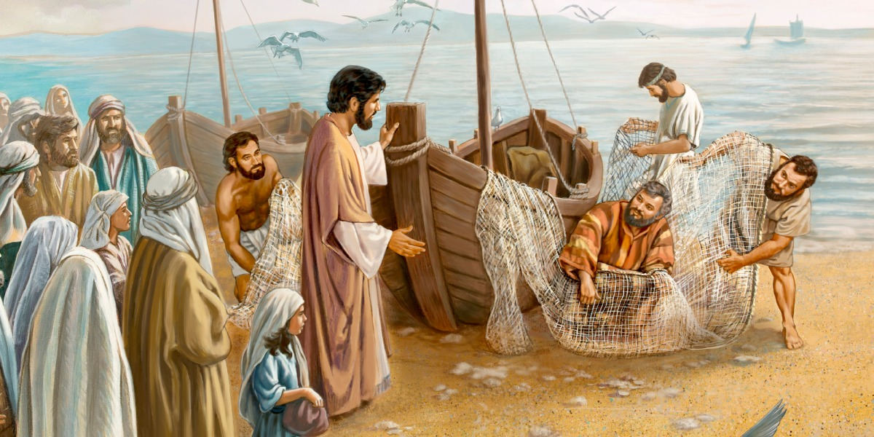
Luke 5:1-11
On one occasion, while the crowd was pressing in on him to hear the word of God, he was standing by the lake of Genne- saret, ² and he saw two boats by the lake, but the fishermen had gone out of them and were washing their nets. ³ Getting into one of the boats, which was Simon's, he asked him to put out a little from the land. And he sat down and taught the people from the boat.

Slide 12
Luke 5:1-11
On one occasion, while the crowd was pressing in on him to hear the word of God, he was standing by the lake of Genne- saret, ² and he saw two boats by the lake, but the fishermen had gone out of them and were washing their nets. ³ Getting into one of the boats, which was Simon's, he asked him to put out a little from the land. And he sat down and taught the people from the boat. ⁴ And when he had finished speaking, he said to Simon, “Put out into the deep and let down your nets for a catch.” ⁵ And Simon answered, “Master, we toiled all night and took nothing! But at your word I will let down the nets.” ⁶ And when they had done this, they enclosed a large number of fish, and their nets were breaking. ⁷ They signaled to their partners in the other boat to come and help them. And they came and filled both the boats, so that they began to sink. ⁸ But when Simon Peter saw it, he fell down at Jesus' knees, saying, “Depart from me, for I am a sinful man, O Lord.” ⁹ For he and all who were with him were astonished at the catch of fish that they had taken, ¹⁰ and so also were James and John, sons of Zebedee, who were partners with Simon. And Jesus said to Simon, “Do not be afraid; from now on you will be catching men.” ¹¹ And when they had brought their boats to land, they left everything and followed him.

Slide 13
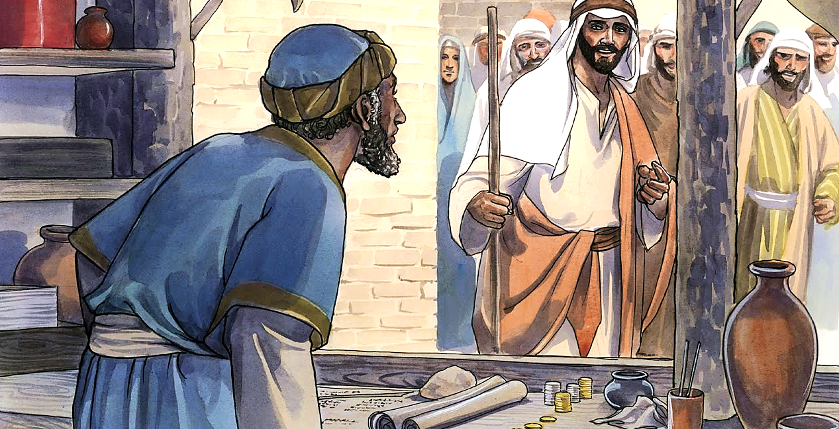
Luke 5:27-32
²⁷ After this he went out and saw a tax collector named Levi, sitting at the tax booth.

Slide 14
Luke 5:27-32
²⁷ After this he went out and saw a tax collector named Levi, sitting at the tax booth. And he said to him, “Follow me.”

Slide 15
Luke 5:27-32
²⁷ After this he went out and saw a tax collector named Levi, sitting at the tax booth. And he said to him, “Follow me.” ²⁸ And leaving everything, he rose and followed him.

Slide 16
Luke 5:27-32
²⁷ After this he went out and saw a tax collector named Levi, sitting at the tax booth. And he said to him, “Follow me.” ²⁸ And leaving everything, he rose and followed him. ²⁹ And Levi made him a great feast in his house, and there was a large company of tax collectors and others reclining at table with them. ³⁰ And the Pharisees and their scribes grumbled at his disciples, saying, “Why do you eat and drink with tax collectors and sinners?” ³¹ And Jesus answered them, “Those who are well have no need of a physician, but those who are sick. ³² I have not come to call the righteous but sinners to repentance.”

Slide 17
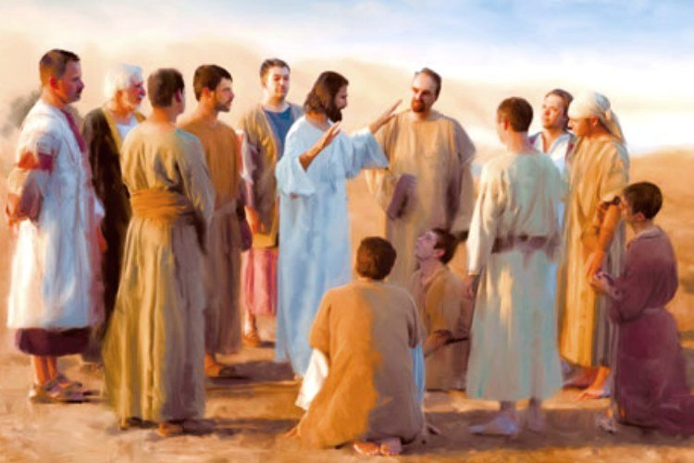
JESUS’ UNLIKELY FOLLOWERS

Slide 18
JESUS’ UNLIKELY FOLLOWERS
Luke 8:1-3 - And the twelve were with him, ² and also some women who had been healed of evil spirits and infirmities: Mary, called Magdalene, from whom seven demons had gone out, ³ and Joanna, the wife of Chuza, Herod's household manager...

Slide 19
JESUS’ UNLIKELY FOLLOWERS
JESUS LOVES TO LOVE THE UNLOVABLE!

Slide 20
JESUS’ UNLIKELY FOLLOWERS (Luke 5)

