Slide 2
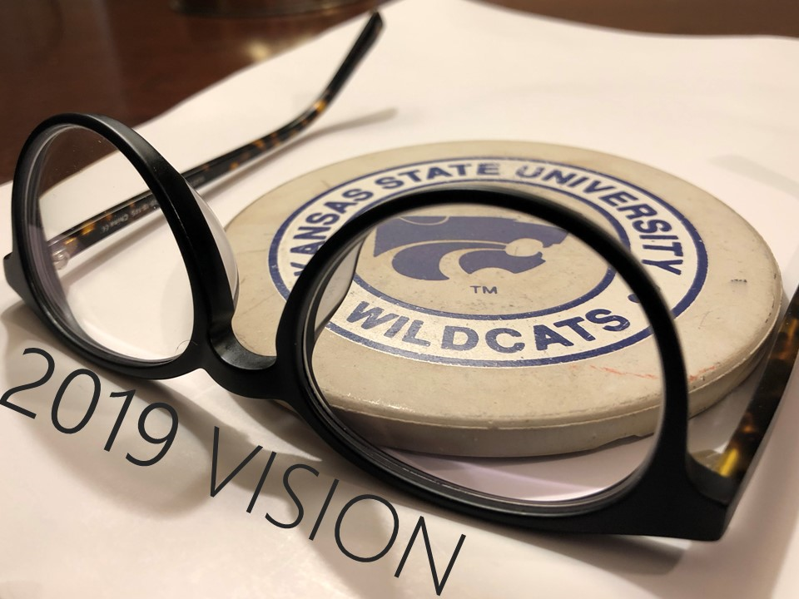
tallgrass.church

Slide 4
BEFRIEND FAITHFULNESS
³ Trust in the Lord, and do good; dwell in the land *and befriend faithfulness. ⁴ Delight yourself in the Lord, and he will give you the desires of your heart.
Psalm 37:3-4
*Or and feed on faithfulness, or and find safe pasture

Slide 5
Sprouts Coordinator
Introducing… drum roll please…
Elisha Hillegeist

Slide 6
Tallgrass Survey Report
David Renberg
Elder & LIFE Group Leader

Slide 7
Tallgrass Survey Report
David Renberg
Elder & LIFE Group Leader
QUESTIONS?
COMMENTS
TESTIMONIES

Slide 8
2018 Budget
Last year we budgeted to get $11,754/month, and actually averaged $13,423/month.
Helped us finish 2018 with extra $15,000 income.
Net General Fund (actual income—actual expenses) also a surplus: $11,600.
We have about $50,000 in our General Fund (+ another ~$5,000 in designated funds—Adoption, Neighboring).
We did AWESOME for our church planting year!!! (Now we get to build on it...and see what God does!)

Slide 9
2019 Budget
January income was lower than budgeted needed average ($12,722 vs 14,375 needed) = $-1,653 (vs budget)
This month, Geldart knows of $1,275 of canceled recurring donations that will kick in, so that will make us about $3,000 short in February (vs budget) if nothing else changes.
Last year, for reference, we budgeted to get $11,754/month, and actually averaged $13,423/month.
We’ll keep talking about money because Jesus did and it’s important to His Kingdom and our happiness.
Give online at tallgrass.church/give or in our black box.

Slide 10
2019 Budget
QUESTIONS?
COMMENTS
TESTIMONIES

Slide 11
#reclaimingneighboring
Let’s hear some *neighboring stories!
*Tallgrass Mission Statement: Because God first loved us,
we exist to love God and love our neighbors.

Slide 12
#reclaimingneighboring

Slide 13
#reclaimingneighboring

Slide 14
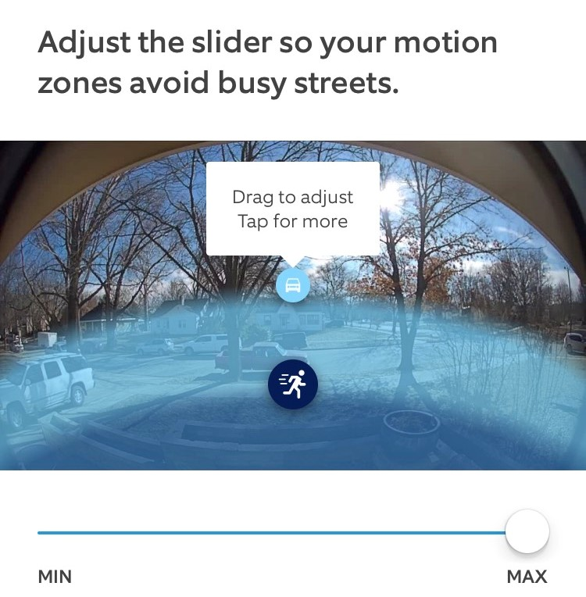
#reclaimingneighboring

Slide 15
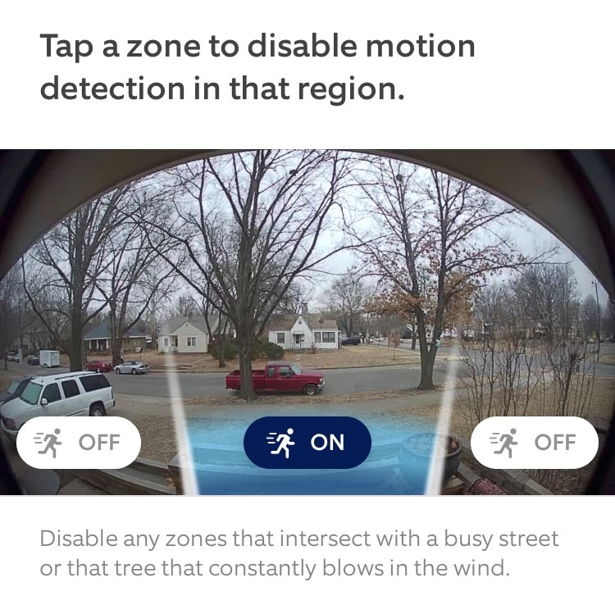
#reclaimingneighboring

Slide 16
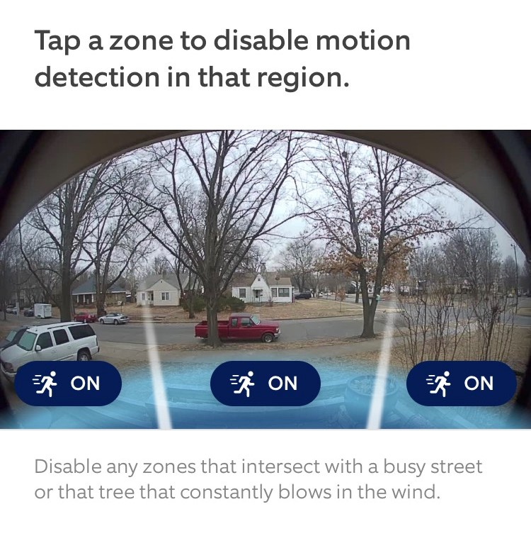
#reclaimingneighboring

Slide 17
#reclaimingneighboring
Let’s hear some *neighboring stories!
*Tallgrass Mission Statement: Because God first loved us,
we exist to love God and love our neighbors.

Slide 18
QUESTIONS?
COMMENTS
TESTIMONIES

Slide 19
tallgrass.church

Slide 20
I SURRENDER ALL
tallgrass.church

Slide 21
Verse 1:
All to Jesus I surrender
All to Him I freely give
I will ever love and trust Him
In His presence daily live
I SURRENDER ALL
tallgrass.church

Slide 22
Chorus:
I Surrender all, I surrender all
All to Thee my blessed Savior
I Surrender all
I SURRENDER ALL
tallgrass.church

Slide 23
Verse 2:
All to Jesus I surrender
Humbly at His feet I bow
Worldly pleasures all forsaken
Take me Jesus, take me now
I SURRENDER ALL
tallgrass.church

Slide 24
Chorus:
I Surrender all, I surrender all
All to Thee my blessed Savior
I Surrender all
I SURRENDER ALL
tallgrass.church

Slide 25
Verse 3:
All to Jesus I surrender
Make me Savior, wholly Thine
Let me feel the Holy Spirit
Truly know that Thou art mine
I SURRENDER ALL
tallgrass.church

Slide 26
Chorus:
I Surrender all, I surrender all
All to Thee my blessed Savior
I Surrender all
I SURRENDER ALL
tallgrass.church

Slide 27
Verse 4:
All to Jesus I surrender,
Lord, I give myself to Thee
Fill me with Thy love and power
Let Thy blessing fall on me
I SURRENDER ALL
tallgrass.church

Slide 28
Chorus:
I Surrender all, I surrender all
All to Thee my blessed Savior
I Surrender all
I SURRENDER ALL
tallgrass.church

Slide 29
I’LL FLY AWAY
tallgrass.church

Slide 30
Verse 1:
Some glad morning when this life is o'er,
I'll fly away!
To a home on God's celestial shore:
I'll fly away!
I’LL FLY AWAY
tallgrass.church

Slide 31
Chorus:
I'll fly away, oh Glory, I'll fly away.
When I die, hallelujah by and by,
I'll fly away!
I’LL FLY AWAY
tallgrass.church

Slide 32
Verse 2:
When the shadows of this life have gone,
I'll fly away.
Like a bird from prison bars have flown,
I'll fly away.
I’LL FLY AWAY
tallgrass.church

Slide 33
Chorus:
I'll fly away, oh Glory, I'll fly away.
When I die, hallelujah by and by,
I'll fly away!
I’LL FLY AWAY
tallgrass.church

Slide 34
Verse 3:
Just a few more weary days and then
I'll fly away.
To lead on where joys shall never end:
I'll fly away.
I’LL FLY AWAY
tallgrass.church

Slide 35
Chorus:
I'll fly away, oh Glory, I'll fly away.
When I die, hallelujah by and by,
I'll fly away!
I’LL FLY AWAY
tallgrass.church

Slide 36
BENEDICTION
tallgrass.church

Slide 37
Father, give Your benediction
Give us Your peace before we part
Still our minds with truth’s conviction Calm with trust each anxious heart
BENEDICTION
tallgrass.church

Slide 38
Father, give Your benediction
Bid our grief and struggles end Peace which passes understanding On our waiting spirit send
BENEDICTION
tallgrass.church

Slide 39
Amen. Amen.
Amen. Amen.
Amen. Amen.
amen: let it be so
BENEDICTION
tallgrass.church

Slide 40
COME THOU FOUNT
tallgrass.church

Slide 41
Come thou fount of every blessing
Tune my heart to sing thy grace
Streams of mercy, never ceasing
call for songs of loudest praise
Teach me some melodious sonnet
sung by flaming tongues above
Praise the mount, I’m fixed upon it
Mount of Thy redeeming love
COME THOU FOUNT
tallgrass.church

Slide 42
Here I raise my Ebenezer
Hither by Thy help I’m come
And I hope by Thy good pleasure
safely to arrive at home
Jesus sought me when a stranger
wandering from the fold of God
He, to rescue me from danger
interposed His precious love
COME THOU FOUNT
tallgrass.church

Slide 43
O to grace how great a debtor
daily I’m constrained to be
Let Thy goodness like a fetter
bind my wandering heart to Thee
Prone to wander, Lord I feel it
Prone to leave the God I love
Here’s my heart, O take and seal it
Seal it for Thy courts above
COME THOU FOUNT
tallgrass.church

Slide 45
tallgrass.church

Slide 46
#reclaimingneighboring
Neighboring is an incredibly comprehensive ministry model. In fact, it’s 100% comprehensive.
Not everyone can be a pastor, teacher, elder, singer or musician, but everyone is a neighbor. No one can opt out. Neighboring fits every demographic: young, old, single, married, adults, teenagers, apartment dwellers, soccer moms, CEOs, baristas, bachelors, grandmothers, and retired couples.
Pastoral care, divorce care, children, youth, women, men, discipleship, prayer, Bible study, sports...everything is encompassed in neighboring.

Slide 47
#reclaimingneighboring
Neighboring is an incredibly comprehensive ministry model.
In fact, it’s 100% comprehensive.

Slide 48
#reclaimingneighboring
Not everyone can be a pastor, teacher, elder, singer or musician, but everyone is a neighbor.
No one can opt out.
Neighboring fits every demographic: young, old, single, married, adults, teenagers, apartment dwellers, soccer moms, CEOs, baristas, bachelors, grandmothers, and retired couples.

Slide 49
#reclaimingneighboring
Pastoral care, divorce care, children, youth, women, men, discipleship, prayer, Bible study, sports...everything is encompassed in neighboring.

Slide 50
#reclaimingneighboring
“Your home is the number-one place for discipleship, evangelism, and fellowship.” p. 65
“Jesus came to move us out of a place of religious complexity and into a place of relational simplicity.” p. 71
“The goal is to grow. We have been programming people for comfort, not growth. We have done the opposite of what we set out to do.” p. 75
“Neighboring is quite possibly the best spiritual formation process a church can initiate.” p. 77

