Slide 3
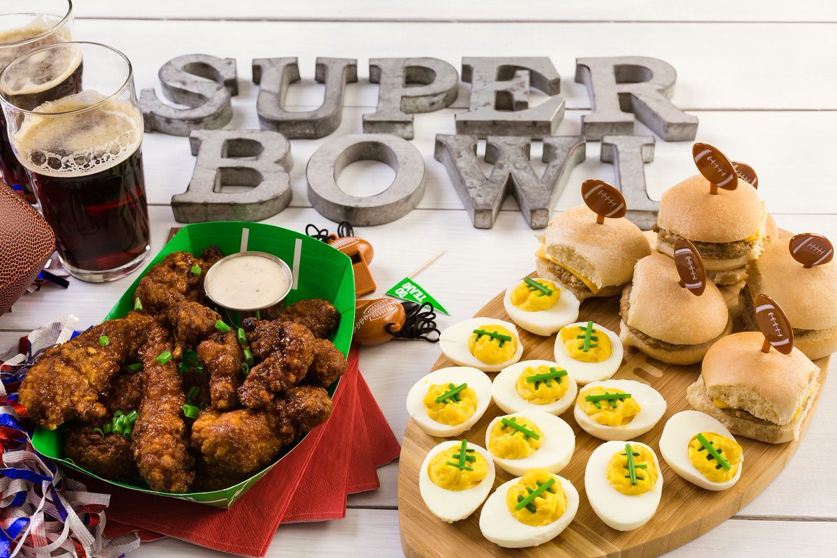
NO CG NEXT SUN, 3rd!

Slide 4
DETERMINISM LUNCHES
Tuesdays 11:45-1:15pm at College Heights
starting this Tues (Jan 22)

Slide 5
MINGLE QUESTION:
What’s one of your favorite childhood toys?

Slide 7
Luke 18:15-17
¹⁵ Now they were bringing even infants to him that he might touch them. And when the disciples saw it, they rebuked them. ¹⁶ But Jesus called them to him, saying, “Let the children come to me, and do not hinder them, for to such belongs the kingdom of God. ¹⁷ Truly, I say to you, whoever does not receive the kingdom of God like a child shall not enter it.”

Slide 8
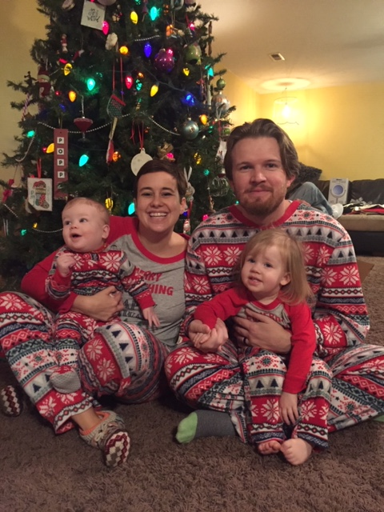
Nick & Lizy Johnson
Nora & Theo Kingston

Slide 9
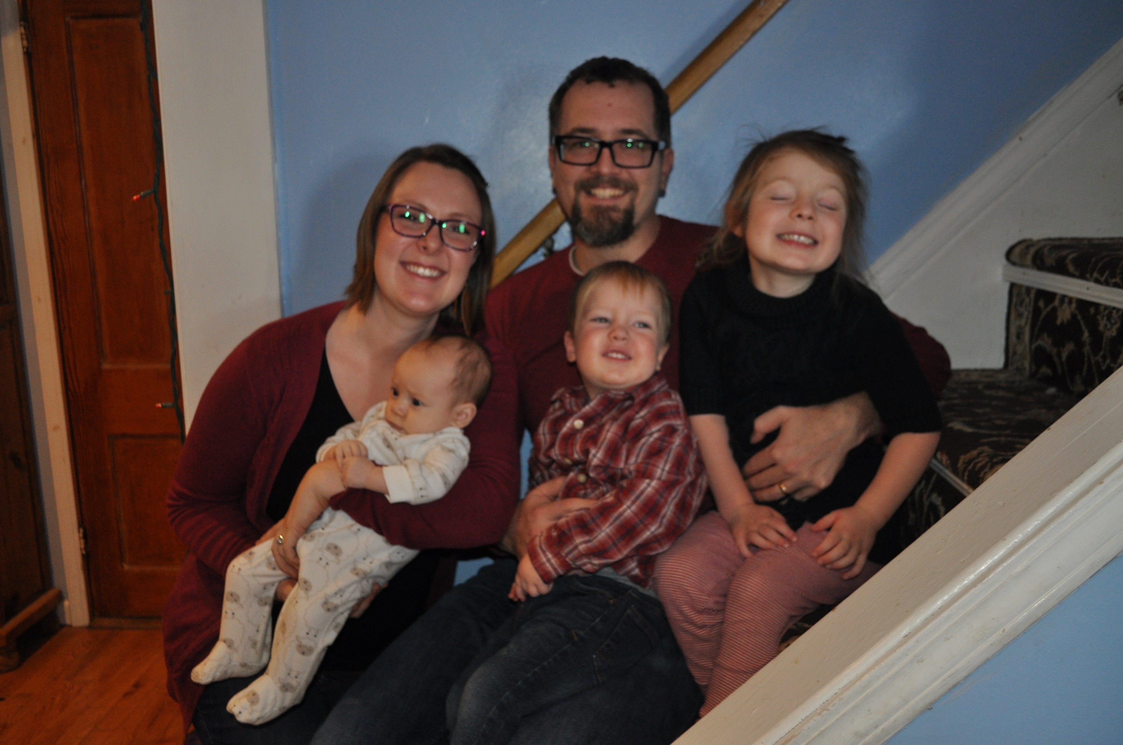
Taylor & Elisha Hillegeist
Edith, Oliver, & Elliot Don

Slide 10
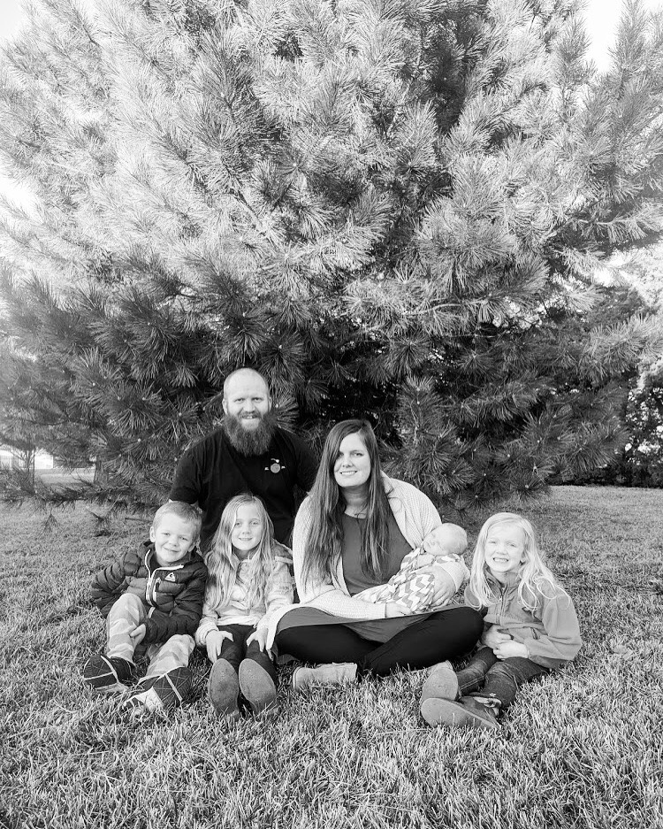
Luke & Eva Schooler
Sylvia, Abram, Klara, & Macklan Philip

Slide 11
Luke 18:15-17
¹⁵ Now they were bringing even infants to him that he might touch them. And when the disciples saw it, they rebuked them. ¹⁶ But Jesus called them to him, saying, “Let the children come to me, and do not hinder them, for to such belongs the kingdom of God. ¹⁷ Truly, I say to you, whoever does not receive the kingdom of God like a child shall not enter it.”

Slide 12
Luke 18:15-17
¹⁵ Now they were bringing even infants to him that he might touch them. And when the disciples saw it, they rebuked them. ¹⁶ But Jesus called them to him, saying, “Let the children come to me, and do not hinder them, for to such belongs the kingdom of God. ¹⁷ Truly, I say to you, whoever does not receive the kingdom of God like a child shall not enter it.”
Baby Celebration!

Slide 13
Luke 18:15-17
¹⁵ Now they were bringing even infants to him that he might touch them. And when the disciples saw it, they rebuked them. ¹⁶ But Jesus called them to him, saying, “Let the children come to me, and do not hinder them, for to such belongs the kingdom of God. ¹⁷ Truly, I say to you, whoever does not receive the kingdom of God like a child shall not enter it.”
What do you think Jesus thought of kids?

Slide 14
Luke 18:15-17
¹⁵ Now they were bringing even infants to him that he might touch them. And when the disciples saw it, they rebuked them. ¹⁶ But Jesus called them to him, saying, “Let the children come to me, and do not hinder them, for to such belongs the kingdom of God. ¹⁷ Truly, I say to you, whoever does not receive the kingdom of God like a child shall not enter it.”
Why do you think the disciples tried to stop parents from bringing kids to Jesus?

Slide 15
Luke 18:15-17
¹⁵ Now they were bringing even infants to him that he might touch them. And when the disciples saw it, they rebuked them. ¹⁶ But Jesus called them to him, saying, “Let the children come to me, and do not hinder them, for to such belongs the kingdom of God. ¹⁷ Truly, I say to you, whoever does not receive the kingdom of God like a child shall not enter it.”
How does Jesus respond to the disciples?

Slide 16
Luke 18:15-17
¹⁵ Now they were bringing even infants to him that he might touch them. And when the disciples saw it, they rebuked them. ¹⁶ But Jesus called them to him, saying, “Let the children come to me, and do not hinder them, for to such belongs the kingdom of God. ¹⁷ Truly, I say to you, whoever does not receive the kingdom of God like a child shall not enter it.”
Big Idea: Receive the Kingdom of God like a kid, not like a grown-up.
Become childish again!

Slide 17
Luke 18:15-17
¹⁵ Now they were bringing even infants to him that he might touch them. And when the disciples saw it, they rebuked them. ¹⁶ But Jesus called them to him, saying, “Let the children come to me, and do not hinder them, for to such belongs the kingdom of God. ¹⁷ Truly, I say to you, whoever does not receive the kingdom of God like a child shall not enter it.”
How are we to receive the Kingdom of God childishly?

Slide 18
Luke 18:15-17
¹⁵ Now they were bringing even infants to him that he might touch them. And when the disciples saw it, they rebuked them. ¹⁶ But Jesus called them to him, saying, “Let the children come to me, and do not hinder them, for to such belongs the kingdom of God. ¹⁷ Truly, I say to you, whoever does not receive the kingdom of God like a child shall not enter it.”
How are we to
not be childish?

Slide 19
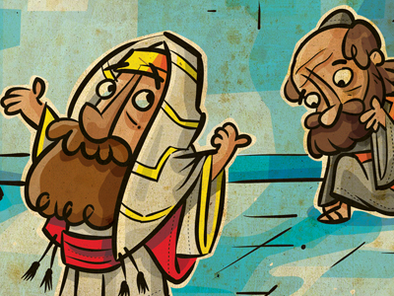
The Pharisee & the Tax Collector
¹⁰ “Two men went up into the temple to pray, one a Pharisee and the other a tax collector. ¹¹ The Pharisee, standing by himself, prayed thus: ‘God, I thank you that I am not like other men, extortioners, unjust, adulterers, or even like this tax collector. ¹² I fast twice a week; I give tithes of all that I get.’”
Luke 18:10-12

Slide 20
The Pharisee & the Tax Collector
¹³ “But the tax collector, standing far off, would not even lift up his eyes to heaven, but beat his breast, saying, ‘God, be merciful to me, a sinner!’ ¹⁴ I tell you, this man went down to his house justified, rather than the other. For everyone who exalts himself will be humbled, but the one who humbles himself will be exalted.”
Luke 18:13-14

Slide 21
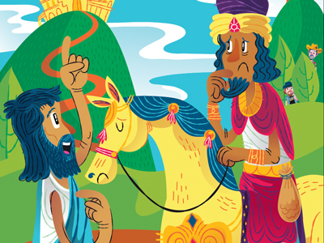
The Grown-up rich young ruler
¹⁸ And a ruler asked him, “Good Teacher, what must I do to inherit eternal life?” ¹⁹ And Jesus said to him, “Why do you call me good? No one is good except God alone. ²⁰ You know the commandments: ‘Do not commit adultery, Do not murder, Do not steal, Do not bear false witness, Honor your father and mother.’” Luke 18:18-20

Slide 22
The Grown-up rich young ruler
²¹ And he said, “All these I have kept from my youth.” ²² When Jesus heard this, he said to him, “One thing you still lack. Sell all that you have and distribute to the poor, and you will have treasure in heaven; and come, follow me.” ²³ But when he heard these things, he became very sad, for he was extremely rich.
Luke 18:21-23

Slide 23
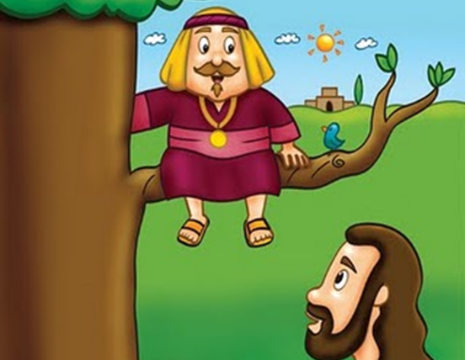
Zacchaeus climbs a tree
¹ He entered Jericho and was passing through. ² And behold, there was a man named Zacchaeus. He was a chief tax collector and was rich.³ And he was seeking to see who Jesus was, but on account of the crowd he could not, because he was small in stature. ⁴ So he ran on ahead and climbed up into a sycamore tree to see him, for he was about to pass that way.
Luke 19:1-4

Slide 24
Zacchaeus climbs a tree
⁵ And when Jesus came to the place, he looked up and said to him, “Zacchaeus, hurry and come down, for I must stay at your house today.” ⁶ So he hurried and came down and received him joyfully. ⁷ And when they saw it, they all grumbled, “He has gone in to be the guest of a man who is a sinner.”
Luke 19:5-7

Slide 25
Zacchaeus climbs a tree
⁸ And Zacchaeus stood and said to the Lord, “Behold, Lord, the half of my goods I give to the poor. And if I have defrauded anyone of anything, I restore it fourfold.” ⁹ And Jesus said to him, “Today salvation has come to this house, since he also is a son of Abraham. ¹⁰ For the Son of Man came to seek and to save the lost.”
Luke 19:8-10

Slide 26
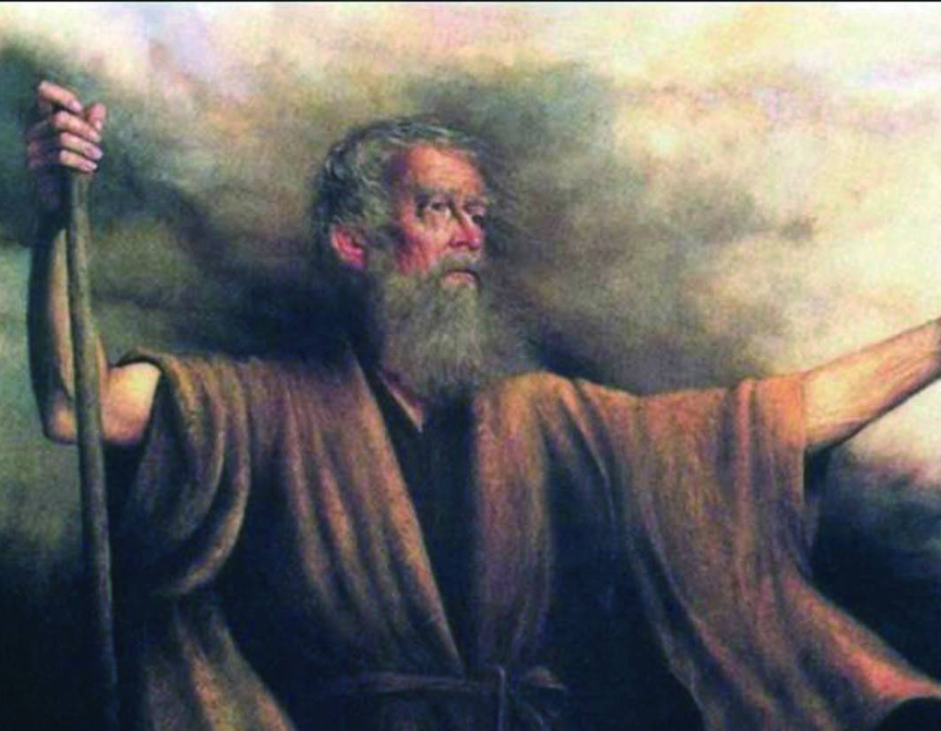
God’s Heart for healthy families
⁵ “Behold, I will send you Elijah the prophet before the great and awesome day of the Lord comes. ⁶ And he will turn the hearts of fathers to their children and the hearts of children to their fathers, lest I come and strike the land with a decree of utter destruction.”
Malachi 4:5-6

Slide 27
Psalm 131:2
But I have calmed and quieted my soul, like a weaned child with its mother; like a weaned child is my soul within me.

Slide 28
Luke 18:15-17
¹⁵ Now they were bringing even infants to him that he might touch them. And when the disciples saw it, they rebuked them. ¹⁶ But Jesus called them to him, saying, “Let the children come to me, and do not hinder them, for to such belongs the kingdom of God. ¹⁷ Truly, I say to you, whoever does not receive the kingdom of God like a child shall not enter it.”
1. Receive the Kingdom of God childishly.
2. Help children see Jesus.

Slide 33
JESUS LOVES ME
tallgrass.church

Slide 34
Jesus loves me! This I know, for the Bible tells me so. Little ones to Him belong; They are weak, but He is strong.
JESUS LOVES ME
tallgrass.church

Slide 35
Yes, Jesus loves me!
Yes, Jesus loves me!
Yes, Jesus loves me!
The Bible tells me so.
JESUS LOVES ME
tallgrass.church

Slide 36
Jesus loves me! This I know, as He loved so long ago, taking children on His knee, saying, “Let them come to Me.”
JESUS LOVES ME
tallgrass.church

Slide 37
Yes, Jesus loves me!
Yes, Jesus loves me!
Yes, Jesus loves me!
The Bible tells me so.
JESUS LOVES ME
tallgrass.church

Slide 38
Jesus loves me! He who died Heaven’s gate to open wide; He will wash away my sin, Let this little child come in.
JESUS LOVES ME
tallgrass.church

Slide 39
Yes, Jesus loves me!
Yes, Jesus loves me!
Yes, Jesus loves me!
The Bible tells me so.
JESUS LOVES ME
tallgrass.church

Slide 41
MYSTERY OF FAITH
tallgrass.church

Slide 42
Christ has died,
Christ is risen,
Christ will come again!
[repeat]
MYSTERY OF FAITH
tallgrass.church

Slide 43
We have died together,
We will rise together,
We will live together,
The body, O, the body
We are the body of Christ.
MYSTERY OF FAITH
tallgrass.church

Slide 44
We are brothers
and sisters
through our Savior’s blood.
[repeat]
MYSTERY OF FAITH
tallgrass.church

Slide 45
We have died together,
We will rise together,
We will live together,
The body, O, the body
We are the body of Christ.
MYSTERY OF FAITH
tallgrass.church

Slide 47
BENEDICTION
tallgrass.church

Slide 48
Father, give Your benediction
Give us Your peace before we part
Still our minds with truth’s conviction Calm with trust each anxious heart
BENEDICTION
tallgrass.church

Slide 49
Father, give Your benediction
Bid our grief and struggles end Peace which passes understanding On our waiting spirit send
BENEDICTION
tallgrass.church

Slide 50
Amen. Amen.
Amen. Amen.
Amen. Amen.
amen: let it be so
BENEDICTION
tallgrass.church

