Slide 3
“I must preach the good news of the kingdom of
God to the other towns
as well; for I was sent
for this purpose.”
And he was preaching
in the synagogues of
Judea.
Luke 4:43-44

Slide 4
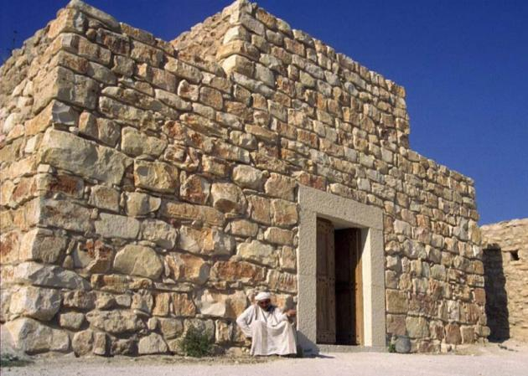

Slide 5
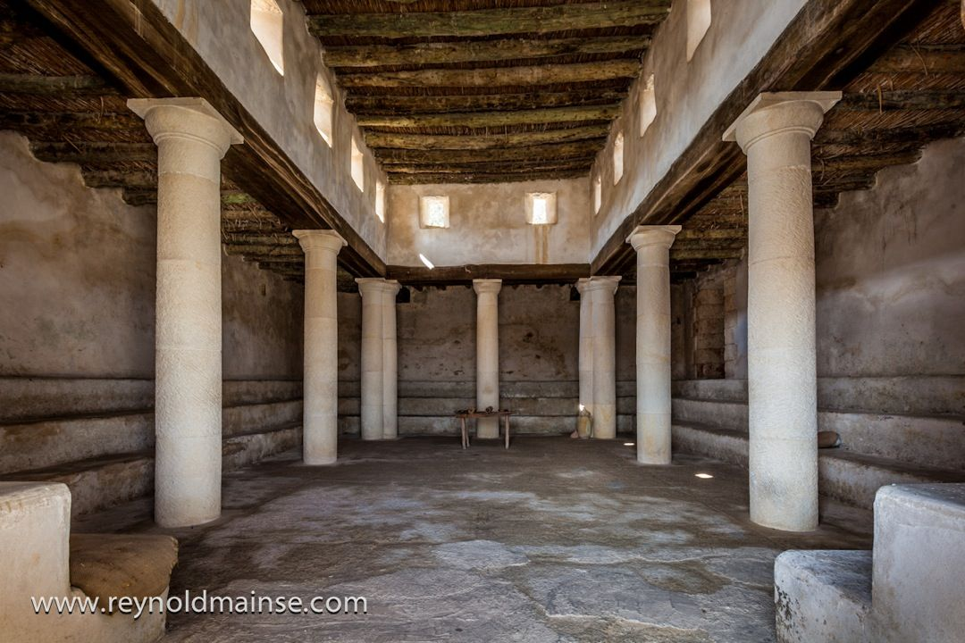

Slide 6
¹⁴ And Jesus returned in the power of the Spirit to Galilee,
and a report about him went out through all the surrounding country.
¹⁵ And he taught in their synagogues, being glorified by all.
¹⁶ And he came to Nazareth, where he had been brought up.
And as was his custom, he went to the synagogue on the Sabbath day, and he stood up to read.
Luke 4:14-16

Slide 7
And the scroll of the prophet
Isaiah was given to him.
He unrolled the scroll and found
the place where it was written,
Luke 4:17

Slide 8
The Spirit of the Lord is upon me,
because he has anointed me
to proclaim good news to the poor.
He has sent me to proclaim liberty to the captives and recovering of sight to the blind, to set at liberty those who are oppressed, to proclaim the year of the Lord's favor,
and the day of vengeance of our God;
Isaiah 61:1-2; 58:6b
Luke 4:18-19

Slide 9
The Spirit of the Lord is upon me,
because he has anointed me
to proclaim good news to the poor.
He has sent me to proclaim liberty to the captives and recovering of sight to the blind, to set at liberty those who are oppressed, to proclaim the year of the Lord's favor,
and the day of vengeance of our God;
Isaiah 61:1-2; 58:6b
#awkwardisthenewawesome

Slide 10
The Spirit of the Lord is upon me,
because he has anointed me
to proclaim good news to the poor.
He has sent me to proclaim liberty to the captives and recovering of sight to the blind, to set at liberty those who are oppressed, to proclaim the year of the Lord's favor,
and the day of vengeance of our God;
Isaiah 61:1-2; 58:6b
1. Jesus teaches the Scriptures.

Slide 11
The Spirit of the Lord is upon me,
because he has anointed me
to proclaim good news to the poor.
He has sent me to proclaim liberty to the captives and recovering of sight to the blind, to set at liberty those who are oppressed, to proclaim the year of the Lord's favor,
and the day of vengeance of our God;
Isaiah 61:1-2; 58:6b
2. Jesus teaches the human condition.

Slide 12
The Spirit of the Lord is upon me,
because he has anointed me
to proclaim good news to the poor.
He has sent me to proclaim liberty to the captives and recovering of sight to the blind, to set at liberty those who are oppressed, to proclaim the year of the Lord's favor,
and the day of vengeance of our God;
Isaiah 61:1-2; 58:6b
3. Jesus teaches grace.

Slide 13
⁸ “You shall count seven weeks of years, seven times seven years, so that the time of the seven weeks of years shall give you forty-nine years. ⁹ Then you shall sound the loud trumpet on the tenth day of the seventh month. On the Day of Atonement you shall sound the trumpet throughout all your land. ¹⁰ And you shall consecrate the fiftieth year, and proclaim liberty throughout the land to all its inhabitants. It shall be a jubilee for you, when each of you shall return to his property and each of you shall return to his clan.”
Leviticus 25:8-10
…the year of the Lord’s favor…

Slide 14
The Spirit of the Lord is upon me,
because he has anointed me
to proclaim good news to the poor.
He has sent me to proclaim liberty to the captives and recovering of sight to the blind, to set at liberty those who are oppressed, to proclaim the year of the Lord's favor,
and the day of vengeance of our God;
Isaiah 61:1-2; 58:6b
4. Jesus teaches Jesus.

Slide 15
²⁰ And when the men had come to him, they said,
“John the Baptist has sent us to you, saying,
‘Are you the one who is to come, or shall we look for another?’”
²¹ In that hour he healed many people
of diseases and plagues and evil spirits,
and on many who were blind he bestowed sight.
²² And he answered them,
“Go and tell John what you have seen and heard:
the blind receive their sight, the lame walk,
lepers are cleansed, and the deaf hear, the dead are raised up,
the poor have good news preached to them.”
Luke 7:20-22 (See Isaiah 7:13-17; 9:6-7; 11:1-10)
Jesus is King Messiah!

Slide 16
²⁵ And he said to them,
“O foolish ones,
and slow of heart to believe all that the prophets have spoken!
²⁶ Was it not necessary that the Christ
should suffer these things and enter into his glory?”
²⁷ And beginning with Moses and all the Prophets,
he interpreted to them in all the Scriptures
the things concerning himself.
Luke 24:25-27 (See Isaiah 42:1-4; 49:1-6; 50:4-7; 52:13-53:12)
Jesus is also the Suffering Servant!

Slide 17
The Spirit of the Lord is upon me,
because he has anointed me
to proclaim good news to the poor.
He has sent me to proclaim liberty to the captives and recovering of sight to the blind, to set at liberty those who are oppressed, to proclaim the year of the Lord's favor,
(crucifixion & resurrection of King Messiah
plus the Church Age)
and THEN the day of vengeance of our God;
Isaiah 61:1-2; 58:6b
No one saw this coming! (See Col. 2:15; 1 Cor. 2:8)

Slide 18
²⁰ And he rolled up the scroll and gave it
back to the attendant and sat down.
And the eyes of all in the
synagogue were fixed on him.
²¹ And he began to say to them,
“Today this Scripture has been
fulfilled in your hearing.”
Luke 4:20-21 (See Hebrews 12:2)
Eyes fixed on Jesus!

Slide 19
²² And all spoke well of him and marveled at the
gracious words that were coming from his mouth.
And they said, “Is not this Joseph's son?”
²³ And he said to them, “Doubtless you will quote to me this proverb, ‘“Physician, heal yourself.”
What we have heard you did at Capernaum,
do here in your hometown as well.’”
²⁴ And he said,
“Truly, I say to you, no prophet is acceptable in his hometown.”
Luke 4:22-24
Hometown Hero

Slide 20
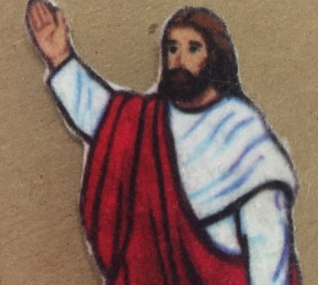
Hometown Hero
²² And all spoke well of him and marveled at the gracious words that were coming from his mouth.
And they said, “Is not this Joseph’s son?”
²³ And he said to them, “Doubtless you will quote to me this proverb, ‘“Physician, heal yourself.” What we have heard you did at Capernaum, do here in your hometown as well.’”
²⁴ And he said, “Truly, I say to you, no prophet is acceptable in his hometown.”
Luke 4:22-24

Slide 21
²⁵ “But in truth, I tell you,
there were many widows in Israel in the days of Elijah,
when the heavens were shut up three years and six months,
and a great famine came over all the land,
²⁶ and Elijah was sent to none of them but only to Zarephath,
in the land of Sidon, to a woman who was a widow.”
Luke 4:25-26 (See 1 Kings 17:9-16)
Sermon Illustration #1

Slide 22
“And there were many lepers in Israel
in the time of the prophet Elisha,
and none of them was cleansed,
but only Naaman the Syrian.”
Luke 4:27 (See 2 Kings 5:8-14)
Sermon Illustration #2

Slide 23
When they heard these things, they were like,
“Wow! Amazing grace! Good News is for everybody,
Jews AND Gentiles, poor AND wealthy, men AND women.
The reckless love of God is awesome!”
Luke 4:28
Fake News Alert!!!

Slide 24
²⁸ When they heard these things,
all in the synagogue were filled with wrath.
²⁹ And they rose up and drove him out of the town and brought
him to the brow of the hill on which their town was built,
so that they could throw him down the cliff.
³⁰ But passing through their midst, he went away.
³¹ And he went down to Capernaum, a city of Galilee.
And he was teaching them on the Sabbath,
³² and they were astonished at his teaching,
for his word possessed authority.
Luke 4:28-32 (See Luke 7:36-50; 15:11-32; Matt. 20:1-16)
Natural Response to Grace

