Slide 6
Luke 4:42-44
⁴² And when it was day, he departed and went into a desolate place. And the people sought him and came to him, and would have kept him from leaving them, ⁴³ but he said to them, “I must preach the good news of the kingdom of God to the other towns as well; for I was sent for this purpose.” ⁴⁴ And he was preaching in the synagogues of Judea.

Slide 8
Luke 4:40-41
⁴⁰ Now when the sun was setting, all those who had any who were sick with various diseases brought them to him, and he laid his hands on every one of them and healed them. ⁴¹ And demons also came out of many, crying, “You are the Son of God!” But he rebuked them and would not allow them to speak, because they knew that he was the Christ.

Slide 9
Luke 4:40-41
⁴⁰ Now when the sun was setting, all those who had any who were sick with various diseases brought them to him, and he laid his hands on every one of them and healed them. ⁴¹ And demons also came out of many, crying, “You are the Son of God!” But he rebuked them and would not allow them to speak, because they knew that he was the Christ.
What were Jesus’ pressures?

Slide 10
Luke 4:40-41
⁴⁰ Now when the sun was setting, all those who had any who were sick with various diseases brought them to him, and he laid his hands on every one of them and healed them. ⁴¹ And demons also came out of many, crying, “You are the Son of God!” But he rebuked them and would not allow them to speak, because they knew that he was the Christ.
What are your pressures?

Slide 11
Luke 4:40-42a
⁴⁰ Now when the sun was setting, all those who had any who were sick with various diseases brought them to him, and he laid his hands on every one of them and healed them. ⁴¹ And demons also came out of many, crying, “You are the Son of God!” But he rebuked them and would not allow them to speak, because they knew that he was the Christ.
^{42a} And when it was day, he departed and went into a desolate place.

Slide 12
Luke 4:40-42a
⁴⁰ Now when the sun was setting, all those who had any who were sick with various diseases brought them to him, and he laid his hands on every one of them and healed them. ⁴¹ And demons also came out of many, crying, “You are the Son of God!” But he rebuked them and would not allow them to speak, because they knew that he was the Christ.
^{42a} And when it was day, he departed and went into a desolate place.
When & where is your desolate place?

Slide 13
Desolate places
Luke 4:42a And when it was day, he departed and went into a desolate place.
Luke 5:16 But he would withdraw to desolate places and pray.

Slide 14
PRAYER in Desolate places
Luke 4:42a And when it was day, he departed and went into a desolate place.
Luke 5:16 But he would withdraw to desolate places and pray.
1. You are loved.
2. You are to love.

Slide 15
PRAYER in Desolate places
Luke 4:42a And when it was day, he departed and went into a desolate place.
Luke 5:16 But he would withdraw to desolate places and pray.
Tallgrass Mission Statement:
Because God first loved us, we exist to love God and love our neighbors.

Slide 16
PRAYER in Desolate places
Luke 4:42a And when it was day, he departed and went into a desolate place.
Luke 5:16 But he would withdraw to desolate places and pray.
Mark 1:35 And rising very early in the morning, while it was still dark, he departed and went out to a desolate place, and there he prayed.
Mornings?!?!

Slide 17
POWER in Desolate places
Luke 5:15-17 ¹⁵ But now even more the report about him went abroad, and great crowds gathered to hear him and to be healed of their infirmities. ¹⁶ But he would withdraw to desolate places and pray. ¹⁷ On one of those days, as he was teaching, Pharisees and teachers of the law were sitting there, who had come from every village of Galilee and Judea and from Jerusalem. And the power of the Lord was with him to heal.

Slide 18
POWER in Desolate places
Luke 5:15-17 ¹⁵ But now even more the report about him went abroad, and great crowds gathered to hear him and to be healed of their infirmities. ¹⁶ But he would withdraw to desolate places and pray. ¹⁷ On one of those days, as he was teaching, Pharisees and teachers of the law were sitting there, who had come from every village of Galilee and Judea and from Jerusalem. And the power of the Lord was with him to heal.
Big Idea: The upside down path to power for purposeful productivity is found in desolate places.

Slide 19
BACK to Pressures
Luke 4:42 And when it was day, he departed and went into a desolate place. And the people sought him and came to him, and would have kept him from leaving them…

Slide 20
Kingdom purpose
Luke 4:42-43 ⁴² And when it was day, he departed and went into a desolate place. And the people sought him and came to him, and would have kept him from leaving them, ⁴³ but he said to them,
“I must preach the good news of the kingdom of God to the other towns as well; for I was sent for this purpose.”

Slide 22
Big Idea: The upside down path to power for purposeful productivity is found in desolate places.

Slide 23
“I must preach the good news of the kingdom of
God to the other towns
as well; for I was sent
for this purpose.”
And he was preaching
in the synagogues of
Judea.
Luke 4:43-44

Slide 24
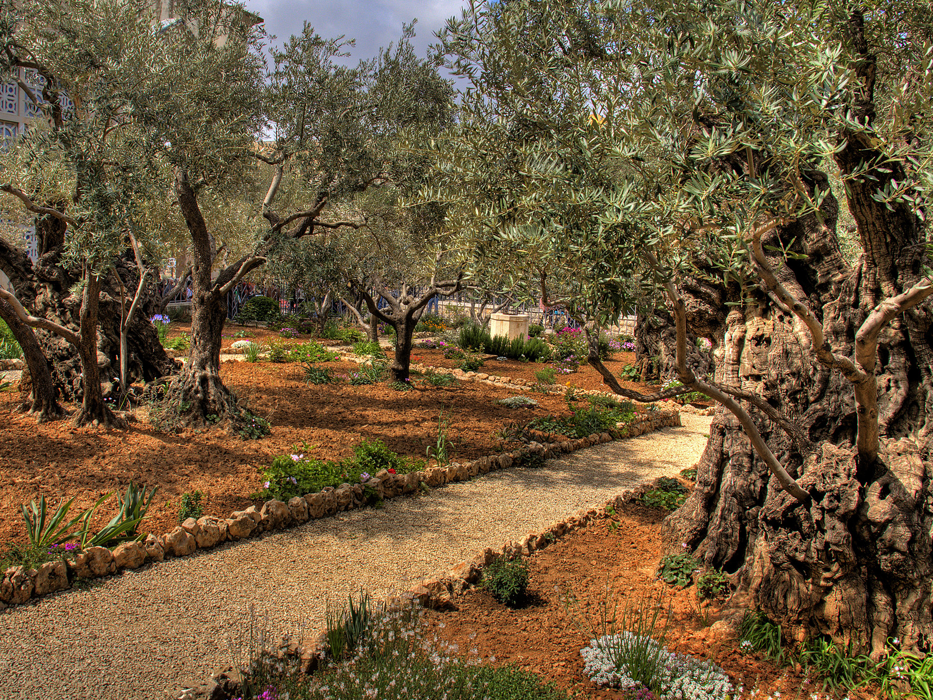
Gethsemane at the foot of
the Mount of Olives

Slide 25
Gethsemane at the foot of
the Mount of Olives
When & where are your desolate places?

Slide 27
Gethsemane at the foot of
the Mount of Olives

Slide 29
Gethsemane at the foot of
the Mount of Olives

Slide 31
³⁹ And he came out and went, as was his custom,
to the Mount of Olives, and the disciples followed him.
⁴⁰ And when he came to the place, he said to them,
“Pray that you may not enter into temptation.”
⁴¹ And he withdrew from them about a stone's throw,
and knelt down and prayed,⁴² saying,
“Father, if you are willing, remove this cup from me.
Nevertheless, not my will, but yours, be done.”
Luke 22:39-42

Slide 32
Big Idea: The upside down path to power for purposeful productivity is found in desolate places.

