Slide 3
Big Idea: The upside down birth of the King tells us what His Kingdom will be like!

Slide 4
Big Idea: The upside down birth of the King tells us what His Kingdom will be like!

Slide 6
¹ In those days a decree went
out from Caesar Augustus
that all the world should be registered. ² This was
the first registration when
Quirinius was governor of Syria. ³ And all went to
be registered, each to
his own town.
Luke 2:1-3

Slide 7
¹ In those days a decree went
out from Caesar Augustus
that all the world should be registered. ² This was
the first registration when
Quirinius was governor of Syria. ³ And all went to
be registered, each to
his own town.
Luke 2:1-3
No account of this registration in Roman records.
Registrations were done about every 14 years.
Justin Martyr and Tertullian say this was in the Roman records.
Tacitus places Quirinius in this region at this time.
Span between recorded registrations was very long.
80% of events during this period in Roman records were destroyed.
No reason to doubt this account!

Slide 8
¹ In those days a decree went
out from Caesar Augustus
that all the world should be registered. ² This was
the first registration when
Quirinius was governor of Syria. ³ And all went to
be registered, each to
his own town.
Luke 2:1-3
Caesar Augustus was ruling, but God was REALLY in charge, using Caesar’s edict to move Mary and Joseph eighty miles from Nazareth to Bethlehem to fulfill His Word.

Slide 9
⁴ And Joseph also went up from Galilee, from the town of Nazareth, to Judea, to
the city of David, which is called Bethlehem, because
he was of the house and lineage of David, ⁵ to be registered with Mary,
his betrothed, who
was with child.
Luke 2:4-5

Slide 10
⁴ And Joseph also went up from Galilee, from the town of Nazareth, to Judea, to
the city of David, which is called Bethlehem, because
he was of the house and lineage of David, ⁵ to be registered with Mary,
his betrothed, who
was with child.
Luke 2:4-5

Slide 11
2
⁴ And Joseph also went up from Galilee, from the town of Nazareth, to Judea, to
the city of David, which is called Bethlehem, because
he was of the house and lineage of David, ⁵ to be registered with Mary,
his betrothed, who
was with child.
Luke 2:4-5
The Savior would be:
A human, not an angel Genesis 3:15; Hebrews 2:16
A Jew, not a Gentile Genesis 12:2; Num. 24:17
From the tribe of Judah Genesis 49:10
From the family of David 2 Samuel 7:12-16
Born of a virgin Isaiah 7:14
In Bethlehem, the city of David—Micah 5:2

Slide 12
2
⁴ And Joseph also went up from Galilee, from the town of Nazareth, to Judea, to
the city of David, which is called Bethlehem, because
he was of the house and lineage of David, ⁵ to be registered with Mary,
his betrothed, who
was with child.
The Savior would be:
A human, not an angel Genesis 3:15; Hebrews 2:16
A Jew, not a Gentile Genesis 12:2; Num. 24:17
From the tribe of Judah Genesis 49:10
From the family of David 2 Samuel 7:12-16
Born of a virgin Isaiah 7:14
In Bethlehem, the city of David—Micah 5:2
Caesar Augustus set the stage for the upside down birth of the King!

Slide 13
⁶ And while they were there, the time came for her to give birth. ⁷ And she gave birth
to her firstborn son and wrapped him in swaddling cloths and laid him in a manger, because there
was no place for them
in the inn.
Luke 2:6-7

Slide 14
⁶ And while they were there, the time came for her to give birth. ⁷ And she gave birth
to her firstborn son and wrapped him in swaddling cloths and laid him in a manger, because there
was no place for them
in the inn.
Luke 2:6-7
guest room

Slide 15
⁶ And while they were there, the time came for her to give birth. ⁷ And she gave birth
to her firstborn son and wrapped him in swaddling cloths and laid him in a manger, because there
was no place for them
in the inn guest room.
Luke 2:6-7
…and tell the master of the house, ‘The Teacher says to you, Where is the guest room, where I may eat the Passover with my disciples?’
Luke 22:11

Slide 16
⁶ And while they were there, the time came for her to give birth. ⁷ And she gave birth
to her firstborn son and wrapped him in swaddling cloths and laid him in a manger, because there
was no place for them
in the inn guest room.
Luke 2:6-7
Then he set him on his own animal and brought him to an inn and took care of him.
Luke 10:34b

Slide 18
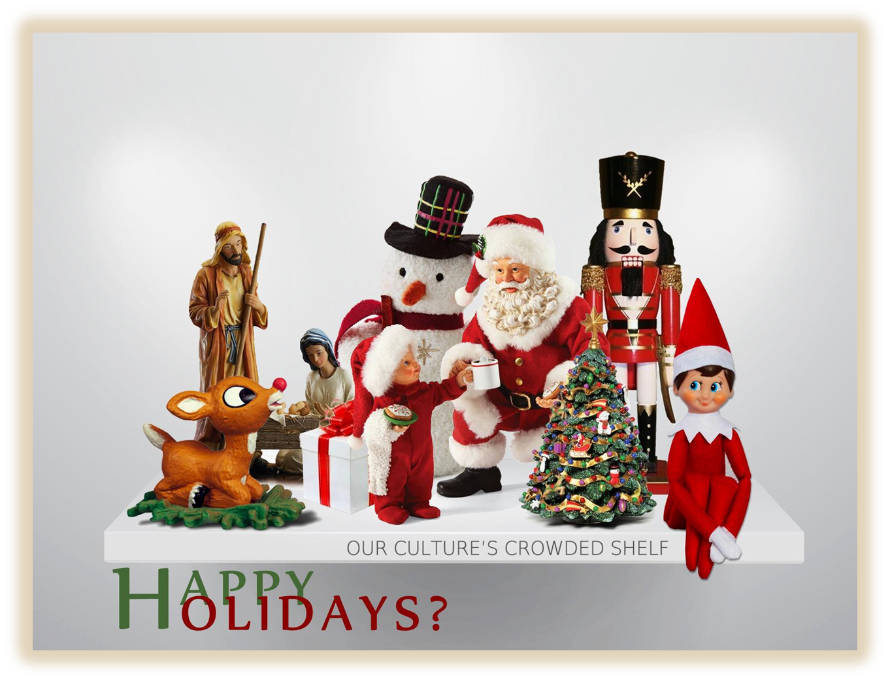

Slide 19
Away in a Manger (Verse 2)
The cattle are lowing, the baby awakes But little Lord Jesus, no crying He makes…

Slide 20
Away in a Manger (Verse 2)
The cattle are mooooing, the baby needs changed The little Lord Jesus, does cry and burp up…

Slide 21
Silent Night
Silent night, holy night
All is calm, all is bright

Slide 22
“Or consider Christmas…”

Slide 23
“Or consider Christmas—could Satan in his most malignant (vengeful) mood have devised a worse combination of graft (corruption) plus bunkum (nonsense) than the system whereby several hundred million people get a billion or so gifts
for which they have no use…”

Slide 24
“…and some thousands of shop clerks die of exhaustion while selling them, and every other child in the Western world is made ill from overeating—all in the name of the lowly Jesus?”
–Upton Sinclair, Money Writes!, p. 23

Slide 25
Hedonists
Ascetics
In the world & of the world
Irreligious
In the world but
not of the world (Jn 17)
Godly
Out of the world & not of the world
Religious

Slide 26
Hedonists
Ascetics
In the world & of the world
Irreligious
In the world but
not of the world (Jn 17)
Godly
Out of the world & not of the world
Religious
Absolutely no
Santa!
Only Jesus. No holiday songs
that aren’t
focused on Jesus!

Slide 27
Hedonists
Ascetics
In the world & of the world
Irreligious
Full blown
Santa & Elf on
the Shelf.
Absolutely no genuine Jesus!
In the world but
not of the world (Jn 17)
Godly
Out of the world & not of the world
Religious
Absolutely no
Santa!
Only Jesus. No holiday songs
that aren’t
focused on Jesus!

Slide 28
Hedonists
Ascetics
In the world & of the world
Irreligious
Full blown
Santa & Elf on
the Shelf.
Absolutely no genuine Jesus!
In the world but
not of the world (Jn 17)
Godly
What will this look like for you & your family?!?!
Out of the world & not of the world
Religious
Absolutely no
Santa!
Only Jesus. No holiday songs
that aren’t
focused on Jesus!

Slide 29
Hedonists
Ascetics
In the world & of the world
Irreligious
Full blown
Santa & Elf on
the Shelf.
Absolutely no genuine Jesus!
In the world but
not of the world (Jn 17)
Godly
What will this look like for you & your family?!?!
Kids, you can lead out here!!!
Out of the world & not of the world
Religious
Absolutely no
Santa!
Only Jesus. No holiday songs
that aren’t
focused on Jesus!

Slide 30
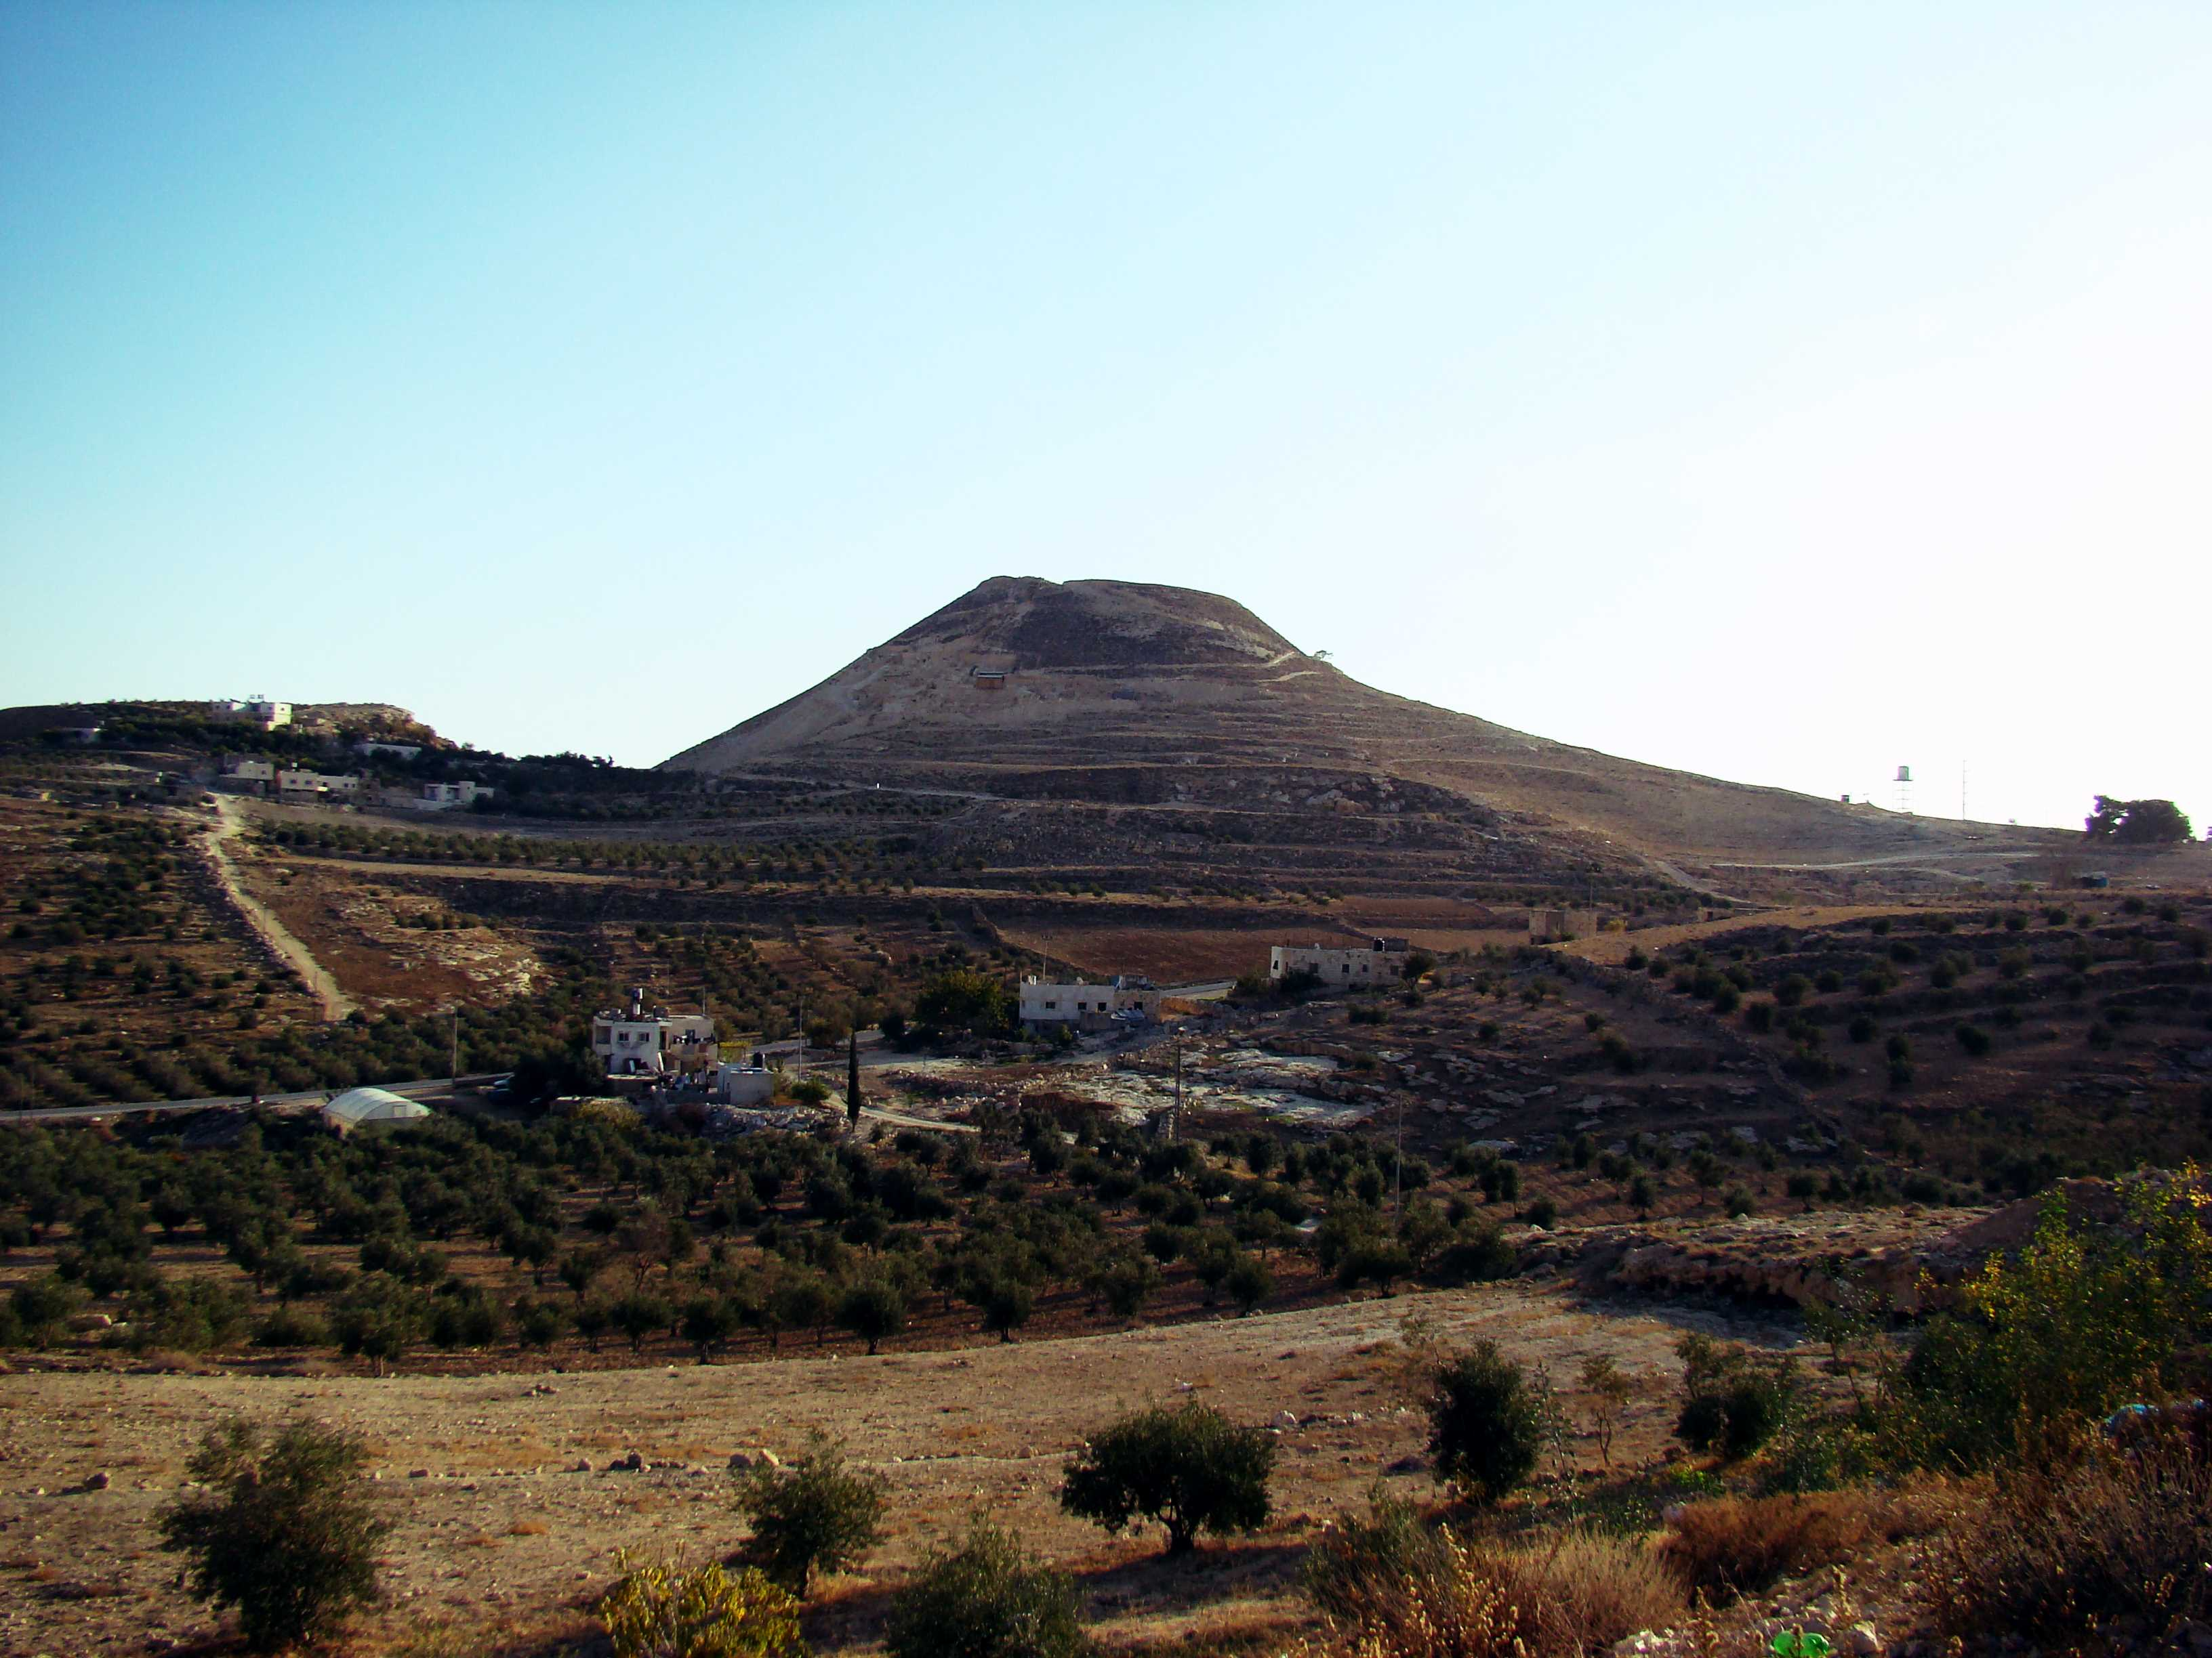

Slide 31
And in the same region there were shepherds out in the field, keeping watch over their flock by night.
Luke 2:8

Slide 32
And in the same region there were shepherds out in the field, keeping watch over their flock by night.
Luke 2:8

Slide 33
And in the same region there were shepherds out in the field, keeping watch over their flock by night.
Luke 2:8
Herodium

Slide 34
And in the same region there were shepherds out in the field, keeping watch over their flock by night.
Luke 2:8
In the days of Herod, king of Judea…
Luke 1:5a

Slide 35
Merry Christmas!
Then Herod,
when he saw that he had been tricked
by the wise men, became furious,
and he sent and killed all the
male children in Bethlehem and
in all that region who were two
years old or under, according to
the time that he had ascertained
from the wise men.
Matthew 2:16

Slide 36
⁸ And in the same region there were shepherds out in the field, keeping watch over their flock by night. ⁹ And an angel of the Lord appeared to them, and the glory of the Lord shone around them, and they were filled with great fear.
Luke 2:8-9

Slide 37
¹⁰ And the angel said to them, “Fear not, for behold, I bring you good news of great joy that will be for all the people. ¹¹ For unto you is born this day in the city of David a Savior, who is Christ the Lord. ¹² And this will be a sign for you: you will find a baby wrapped in swaddling cloths and lying in a manger.”
Luke 2:10-12

Slide 38
Merry Christmas!
⁵¹ He has shown strength with his arm;
he has scattered the proud
in the thoughts of their hearts;
⁵² he has brought down the
mighty from their thrones
and exalted those of humble estate…
Luke 1:51-52

Slide 39
¹⁰ And the angel said to them, “Fear not, for behold, I bring you good news of great joy that will be for all the people. ¹¹ For unto you is born this day in the city of David a Savior, who is Christ the Lord. ¹² And this will be a sign for you: you will find a baby wrapped in swaddling cloths and lying in a manger.”
Luke 2:10-12
¹³ And suddenly there was with the angel a multitude of the heavenly host praising God and saying, ¹⁴ “Glory to God in the highest, and on earth peace among those with whom he is pleased!”
Luke 2:13-14

Slide 40
¹⁰ And the angel said to them, “Fear not, for behold, I bring you good news of great joy that will be for all the people. ¹¹ For unto you is born this day in the city of David a Savior, who is Christ the Lord. ¹² And this will be a sign for you: you will find a baby wrapped in swaddling cloths and lying in a manger.”
Luke 2:10-12
¹³ And suddenly there was with the angel a multitude of the heavenly host praising God and saying, ¹⁴ “Glory to God in the highest, and on earth peace among those with whom he is pleased!”
Luke 2:13-14
The Gospel proclamation for the upside down King of kings!

Slide 41
¹⁰ And the angel said to them, “Fear not, for behold, I bring you good news of great joy that will be for all the people. ¹¹ For unto you is born this day in the city of David a Savior, who is Christ the Lord. ¹² And this will be a sign for you: you will find a baby wrapped in swaddling cloths and lying in a manger.”
Luke 2:10-12
¹³ And suddenly there was with the angel a multitude of the heavenly host praising God and saying, ¹⁴ “Glory to God in the highest, and on earth peace among those with whom he is pleased!”
Luke 2:13-14
Herod the Great set the stage for the birth of the Upside Down King!

Slide 42
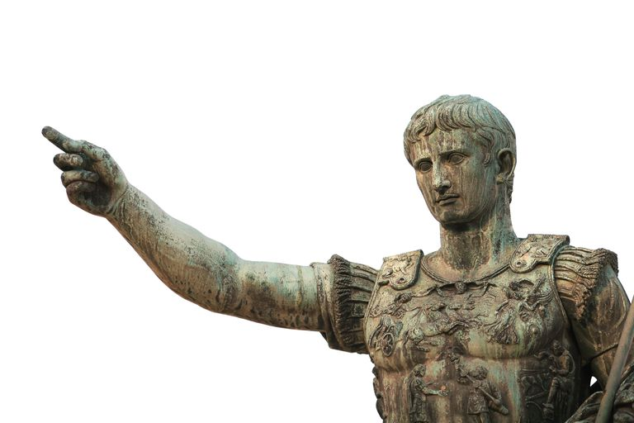

Slide 43
“Whereas the Providence which has guided our whole existence and which has shown such care and liberality, has brought our life to the peak of perfection in giving to us Augustus Caesar…”

Slide 44
“…whom Providence filled with virtue for the welfare of mankind, and who, being sent to us and to our descendants as a savior, has put an end to war and has set all things in order; and whereas, having become visible…”

Slide 45
“…and whereas, finally that the birthday of the god, Caesar Augustus, has been for the whole world the beginning of the gospel concerning him, therefore, let all reckon a new era beginning from the date of his birth.”

Slide 46
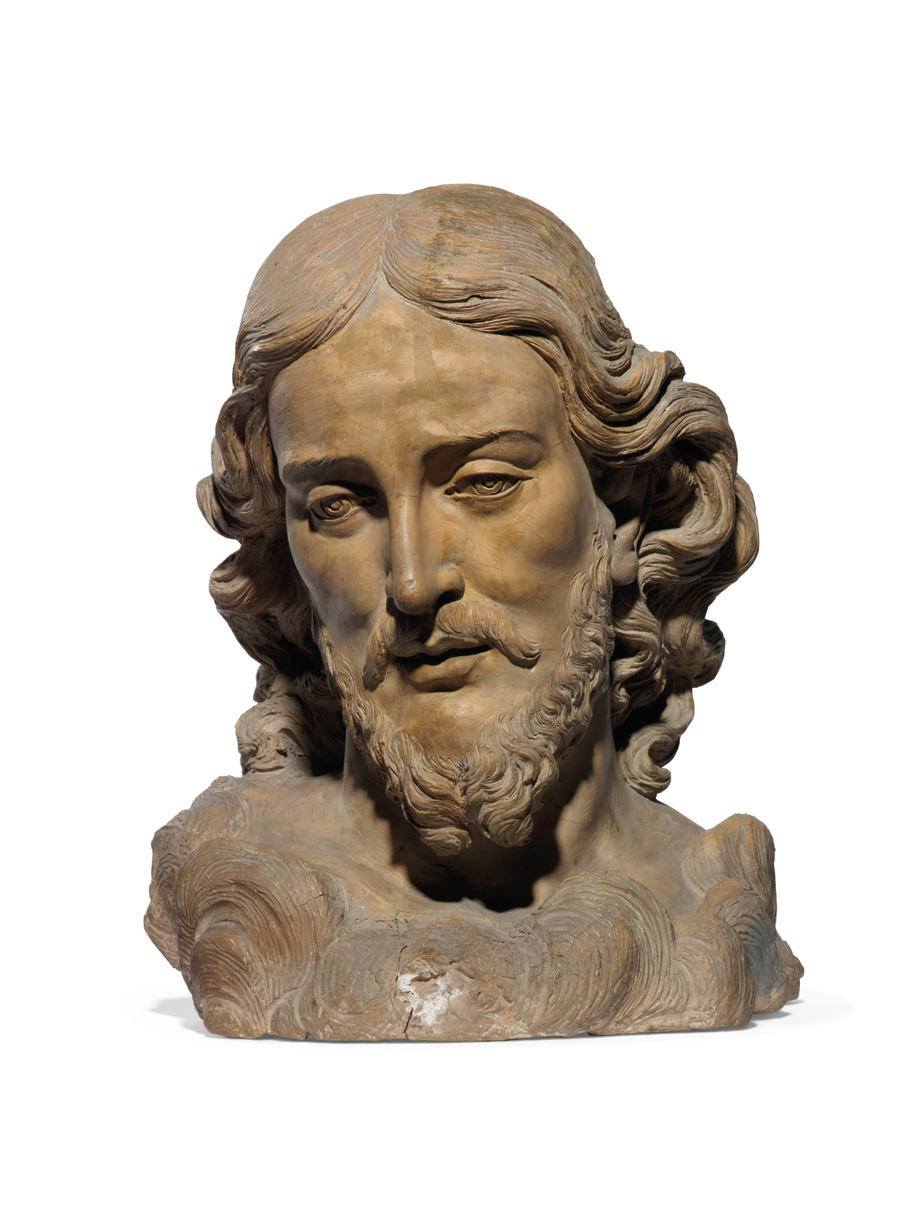
“…and whereas, finally that the birthday of the god, Caesar Augustus, has been for the whole world the beginning of the gospel concerning him, therefore, let all reckon a new era beginning from the date of his birth.”

Slide 47
Question | Christ Jesus | Caesar Augustus
Path to Throne? | Strategy & sacrifice | Strategy & war
Character? | Self-giving love | Self-seeking
Nature of Kingdom? | Godly | Worldy
Promises made? | Peace | Pseudo-peace
Duration of Reign? | Eternal | 40 years
Extent of Rule? | Earth & Heaven | Roman Empire

Slide 48
¹⁵ When the angels went away from them into heaven, the shepherds said to one another, “Let us go over to Bethlehem and see this thing that has happened, which the Lord has made known to us.” ¹⁶ And they went with haste and found Mary and Joseph, and the baby lying in a manger. ¹⁷ And when they saw it, they made known the saying that had been told them concerning this child. ¹⁸ And all who heard it wondered at what the shepherds told them.
Luke 2:15-18

Slide 49
¹⁹ But Mary treasured up all these things, pondering them in her heart. ²⁰ And the shepherds returned, glorifying and praising God for all they had heard and seen, as it had been told them.
Luke 2:19-20

Slide 50
¹⁹ But Mary treasured up all these things, pondering them in her heart. ²⁰ And the shepherds returned, glorifying and praising God for all they had heard and seen, as it had been told them.
Luke 2:19-20
1. What do you need to treasure up and ponder this Christmas?

Slide 51
¹⁹ But Mary treasured up all these things, pondering them in her heart. ²⁰ And the shepherds returned, glorifying and praising God for all they had heard and seen, as it had been told them.
Luke 2:19-20
2. Who do you need to tell the Good News of the Kingdom to?

Slide 52
¹⁹ But Mary treasured up all these things, pondering them in her heart. ²⁰ And the shepherds returned, glorifying and praising God for all they had heard and seen, as it had been told them.
Luke 2:19-20
3. How do you need to align with the Good News heading into 2019?

Slide 53
Big Idea: The upside down birth of the King tells us what His Kingdom will be like!

Slide 54
Big Idea: The upside down birth of the King tells us what His Kingdom will be like!

