Slide 2
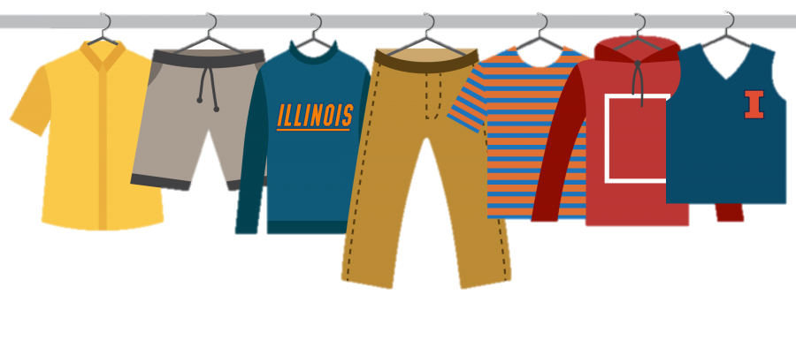
LADIES CLOTHING SWAP
SATURDAY, DEC. 1 8PM AT LIZY JOHNSON’S HOUSE
1202 3rd St., Wamego, KS 66547
No kids except nursing babies.
Invite friends & neighbors!

Slide 3
TALLGRASS.CHURCH
HD Videos (much higher quality than Facebook Live!)
Audio
PowerPoints
Teaching Notes
Events
News
Online Giving
much more!
MOBILE FRIENDLY!

Slide 5
Luke 1:1-4
¹ Inasmuch as many have undertaken to compile a narrative of the things that have been accomplished among us, ² just as those who from the beginning were eyewitnesses and ministers of the word have delivered them to us, ³ it seemed good to me also, having followed all things closely for some time past, to write an orderly account for you, most excellent Theophilus, ⁴ that you may have certainty concerning the things you have been taught.

Slide 6
Luke 1:1-4
¹ Inasmuch as many have undertaken to compile a narrative of the things that have been accomplished among us, ² just as those who from the beginning were eyewitnesses and ministers of the word have delivered them to us, ³ it seemed good to me also, having followed all things closely for some time past, to write an orderly account for you, most excellent Theophilus, ⁴ that you may have certainty concerning the things you have been taught.
Who wrote this?

Slide 7
Luke 1:1-4
¹ Inasmuch as many have undertaken to compile a narrative of the things that have been accomplished among us, ² just as those who from the beginning were eyewitnesses and ministers of the word have delivered them to us, ³ it seemed good to me also, having followed all things closely for some time past, to write an orderly account for you, most excellent Theophilus, ⁴ that you may have certainty concerning the things you have been taught.
Who is Luke?

Slide 8
Luke 1:1-4
¹ Inasmuch as many have undertaken to compile a narrative of the things that have been accomplished among us, ² just as those who from the beginning were eyewitnesses and ministers of the word have delivered them to us, ³ it seemed good to me also, having followed all things closely for some time past, to write an orderly account for you, most excellent Theophilus, ⁴ that you may have certainty concerning the things you have been taught.
Luke’s purpose

Slide 9
Luke-Acts: Books 1 & 2
Luke 1:1-4 ¹ Inasmuch as many have undertaken to compile a narrative of the things that have been accomplished among us, ² just as those who from the beginning were eyewitnesses and ministers of the word have delivered them to us, ³ it seemed good to me also, having followed all things closely for some time past, to write an orderly account for you, most excellent Theophilus, ⁴ that you may have certainty concerning the things you have been taught.
Acts 1:1-3 ¹ In the first book, O Theophilus, I have dealt with all that Jesus began to do and teach, ² until the day when he was taken up, after he had given commands through the Holy Spirit to the apostles whom he had chosen. ³ He presented himself alive to them after his suffering by many proofs, appearing to them during forty days and speaking about the kingdom of God.

Slide 10
Theophilus: Friend of God
Luke 1:1-4 ¹ Inasmuch as many have undertaken to compile a narrative of the things that have been accomplished among us, ² just as those who from the beginning were eyewitnesses and ministers of the word have delivered them to us, ³ it seemed good to me also, having followed all things closely for some time past, to write an orderly account for you, most excellent Theophilus, ⁴ that you may have certainty concerning the things you have been taught.
Acts 1:1-3 ¹ In the first book, O Theophilus, I have dealt with all that Jesus began to do and teach, ² until the day when he was taken up, after he had given commands through the Holy Spirit to the apostles whom he had chosen. ³ He presented himself alive to them after his suffering by many proofs, appearing to them during forty days and speaking about the kingdom of God.

Slide 11
Luke 1:1-4
¹ Inasmuch as many have undertaken to compile a narrative of the things that have been accomplished among us, ² just as those who from the beginning were eyewitnesses and ministers of the word have delivered them to us, ³ it seemed good to me also, having followed all things closely for some time past, to write an orderly account for you, most excellent Theophilus, ⁴ that you may have certainty concerning the things you have been taught.
1. First-Hand Reports

Slide 12
Luke 1:1-4
¹ Inasmuch as many have undertaken to compile a narrative of the things that have been accomplished among us, ² just as those who from the beginning were eyewitnesses and ministers of the word have delivered them to us, ³ it seemed good to me also, having followed all things closely for some time past, to write an orderly account for you, most excellent Theophilus, ⁴ that you may have certainty concerning the things you have been taught.
2. Multiple Sources

Slide 13
Luke 1:1-4
¹ Inasmuch as many have undertaken to compile a narrative of the things that have been accomplished among us, ² just as those who from the beginning were eyewitnesses and ministers of the word have delivered them to us, ³ it seemed good to me also, having followed all things closely for some time past, to write an orderly account for you, most excellent Theophilus, ⁴ that you may have certainty concerning the things you have been taught.
3. Methodical

Slide 16
In the days of Herod,
king of Judea,
there was a priest
named Zechariah,
of the division of Abijah.
Luke 1:5

Slide 17
¹ In those days a decree went
out from Caesar Augustus
that all the world should be registered.
² This was the first
registration when
Quirinius was
governor of Syria.
Luke 2:1-2

Slide 18
¹ In those days a decree went
out from Caesar Augustus
that all the world should be registered.
“Whereas the Providence which has guided our whole existence and which has shown such care and liberality, has brought our life to the peak of perfection in giving to us Augustus Caesar, whom Providence filled with virtue for the welfare of mankind, and who, being sent to us and to our descendants as a savior, has put an end to war and has set all things in order; and whereas, having become visible… and whereas, finally that the birthday of the god, Caesar Augustus, has been for the whole world the beginning of the gospel concerning him, therefore, let all reckon a new era beginning from the date of his birth.”
—Richard A. Horsley, Jesus and Empire
Luke 2:1-2

Slide 19
In the fifteenth year
of the reign of Tiberius Caesar,
Pontius Pilate being
governor of Judea,
Herod being tetrarch
of Galilee, his brother
Philip tetrarch of
Iturea and Trachonitis,
and Lysanias,
tetrarch of Abilene…
Luke 3:1

Slide 20
“Luke’s historicity is unsurpassed
in respect of its trustworthiness… Luke is a historian of
the first rank;
not merely are his
statements of fact
trustworthy... this author
should be placed along
with the very greatest
of historians.”
Sir William Ramsay,
The Bearing of
Recent Discovery
on the
Trustworthiness
of the New
Testament

Slide 21
Luke 1:1-4
¹ Inasmuch as many have undertaken to compile a narrative of the things that have been accomplished among us, ² just as those who from the beginning were eyewitnesses and ministers of the word have delivered them to us, ³ it seemed good to me also, having followed all things closely for some time past, to write an orderly account for you, most excellent Theophilus, ⁴ that you may have certainty concerning the things you have been taught.
What’s it about?

Slide 24
Philippians 3:20-21 ²⁰ But our citizenship is in heaven, and from it we await a Savior, the Lord Jesus Christ, ²¹ who will transform our lowly body to be like his glorious body, by the power that enables him even to subject all things to himself.

Slide 25
Bible Study Questions for Luke:
1. What’s the character of our King?
2. What’s the nature of our Kingdom?
3. How does our King feel about us?
4. How do we serve our King?

Slide 26
Scripture memory
Luke 9:1-2 ¹ And he called the twelve together and gave them power and authority over all demons and to cure diseases, ² and he sent them out to proclaim the kingdom of God and to heal.
Luke 12:31-32 ³¹ “Instead, seek his kingdom, and these things will be added to you. ³² Fear not, little flock, for it is your Father's good pleasure to give you the kingdom.”
Luke 18:16-17 ¹⁶ But Jesus called them to him, saying, “Let the children come to me, and do not hinder them, for to such belongs the kingdom of God. ¹⁷ Truly, I say to you, whoever does not receive the kingdom of God like a child shall not enter it.”

Slide 27
Kingdom of god

Slide 28
Kingdom of god
King
Nature
Constitution
Path to Citizenship
Nobility (Ruling Family)
Servants

Slide 29
Kingdom of god
Hindus
???
Muslims
Jews
King
Nature
Constitution
Path to Citizenship
Nobility (Ruling Family)
Servants
“Sinners”
Gentiles
Tax Collectors
Christians

