Slide 3
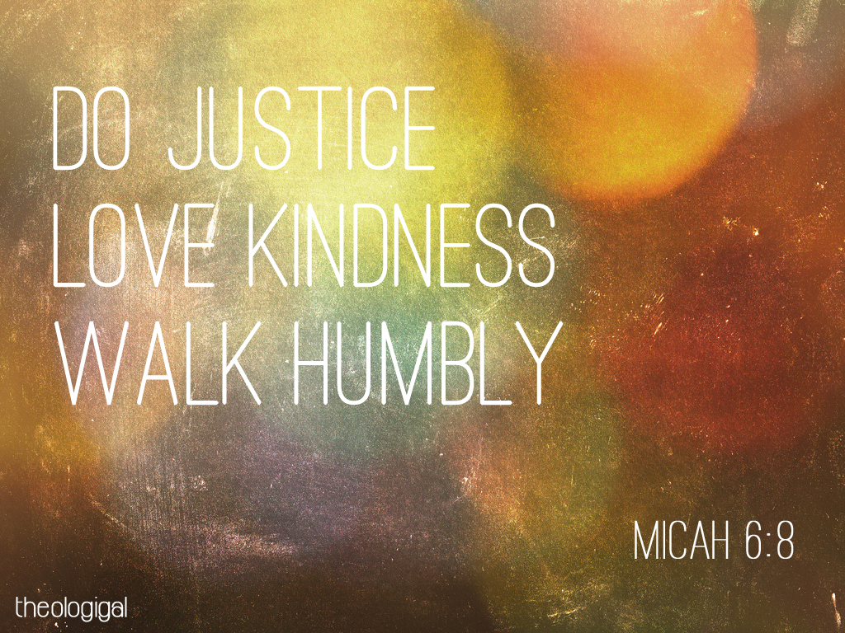
Tonight, November 11th

Slide 4
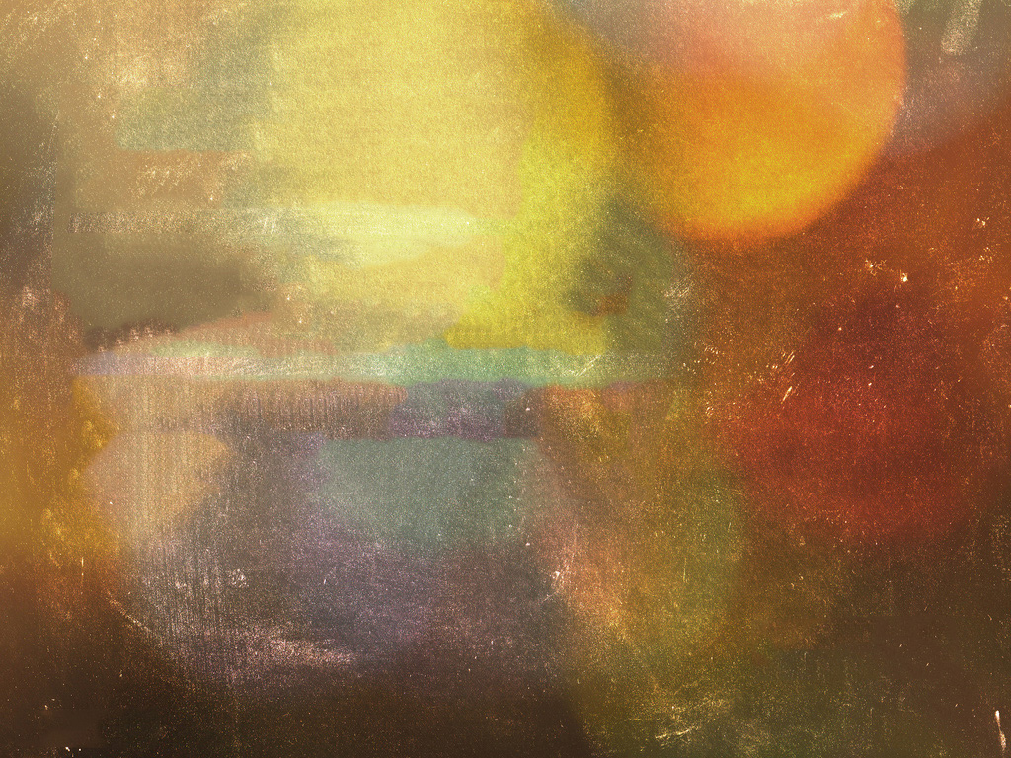
Tonight,
Kids 4 years and up
Joining us here for CG!

Slide 5
Next Sunday, November 18
4s and up joining us in CG

Slide 6
MINGLE QUESTION:
When has someone helped you out?

Slide 9
He has told you,
O man,
what is good; and what does
the Lord require of you but to do justice,
and to love kindness, and to walk humbly
with your God?
Micah 6:8

Slide 10
DO JUSTICE
LOVE KINDNESS WALK HUMBLY
Orphan Sunday 2018
Micah 6:8

Slide 11
do justice
love kindness walk humbly

Slide 12
do justice

Slide 13
do justice
love kindness walk humbly

Slide 14
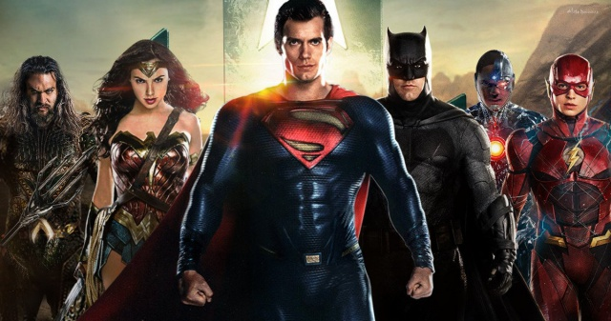

Slide 15
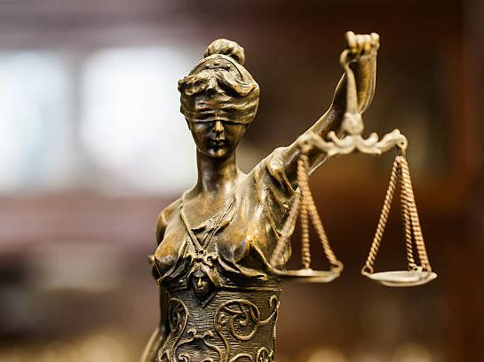

Slide 16
do justice
love kindness walk humbly

Slide 17
Respect of Individual Freedom
do justice
love kindness walk humbly

Slide 18
Maximizing Welfare
Respect of Individual Freedom
do justice
love kindness walk humbly

Slide 19
Maximizing Welfare
Promoting Virtue
Respect of Individual Freedom
do justice
love kindness walk humbly

Slide 20
Maximizing Welfare
Promoting Virtue
Respect of Individual Freedom
do justice
love kindness walk humbly
Retributive vs. Restorative Justice

Slide 21
do justice
love kindness walk humbly
The Quartet of the Vulnerable

Slide 22
Widow
Orphan
Poor
do justice
love kindness walk humbly
Immigrant
The Quartet of the Vulnerable

Slide 23
Widow
Orphan
Poor
Immigrant
¹⁷ “You shall not deprive the justice
due to the sojourner or to the fatherless,
or take a widow's garment in pledge”
Deuteronomy 24:17
The Quartet of the Vulnerable

Slide 24
Widow
Orphan
Poor
Immigrant
¹⁷ “You shall not deprive the justice
due to the sojourner or to the fatherless,
or take a widow's garment in pledge,
¹⁸ but you shall remember that you were a slave in Egypt and the Lord your God redeemed you from there”
Deuteronomy 24:17-18a
The Quartet of the Vulnerable

Slide 25
Widow
Orphan
Poor
Immigrant
¹⁷ “You shall not deprive the justice
due to the sojourner or to the fatherless,
or take a widow's garment in pledge,
¹⁸ but you shall remember that you were a slave in Egypt and the Lord your God redeemed you from there; therefore I command you to do this.”
Deuteronomy 24:17-18
The Quartet of the Vulnerable

Slide 26
Widow
Orphan
Poor
Immigrant
Because God first loved us,
we exist to love God
and to love our neighbors.
—Tallgrass Church Mission Statement
The Quartet of the Vulnerable

Slide 27
Widow
Orphan
Poor
Immigrant
When you reap your harvest in your field
and forget a sheaf in the field,
you shall not go back to get it.
It shall be for the sojourner,
the fatherless, and the widow,
that the Lord your God may bless you
in all the work of your hands.
Deuteronomy 24:19
The Quartet of the Vulnerable

Slide 28
Widow
Orphan
Poor
Immigrant
When you beat your olive trees,
you shall not go over them again.
It shall be for the sojourner,
the fatherless, and the widow.
Deuteronomy 24:20
The Quartet of the Vulnerable

Slide 29
Widow
Orphan
Poor
Immigrant
²¹ When you gather the grapes of your vineyard,
you shall not strip it afterward.
It shall be for the sojourner,
the fatherless, and the widow.
²² You shall remember
that you were a slave in the land of Egypt;
therefore I command you to do this.
Deuteronomy 24:21-22
The Quartet of the Vulnerable

Slide 30
Widow
Orphan
Poor
Immigrant
Open your mouth for the mute,
for the rights of all who are destitute.
Proverbs 31:8
The Quartet of the Vulnerable

Slide 31
Open your mouth for the mute,
for the rights of all who are destitute.
Proverbs 31:8
Who are our vulnerable?

Slide 32
Unborn
Elderly
Open your mouth for the mute,
for the rights of all who are destitute.
Proverbs 31:8
Mentally
Ill
Immigrant
Who are our vulnerable?

Slide 33
Unborn
Elderly
do justice
love kindness walk humbly
Mentally
Ill
Immigrant
Who are our vulnerable?

Slide 34
The just person will disadvantage
themselves to the advantage of their community.

Slide 35
The just person will disadvantage themselves to the advantage of their community.
The wicked person will
disadvantage the community
to advantage themselves.

Slide 36
The just person will disadvantage themselves to the advantage of their community.
The wicked person will
disadvantage the community
to advantage themselves.
“It is more blessed to give than to receive!”

Slide 37
The just person will disadvantage themselves to the advantage of their community.
The wicked person will
disadvantage the community
to advantage themselves.
“It is more HAPPY to give than to receive!”

Slide 38
do justice
love kindness walk humbly

Slide 39
do justice
love mercy walk humbly

Slide 40
do justice
love lovingkindness walk humbly

Slide 41
do justice
love steadfast love walk humbly

Slide 42
do justice
love faithfulness walk humbly

Slide 43
Hesed
do justice
love kindness walk humbly

Slide 44
Never Stopping,
Never Giving up, Unbreaking, Always and Forever Love
do justice
love kindness walk humbly

Slide 45
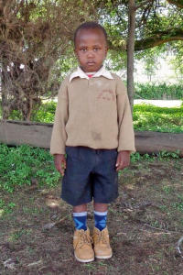
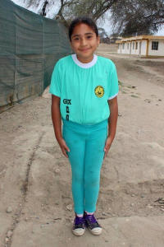
James, 5, Kenya
Minerva, 9, Peru

Slide 46
ADOPTION
FUND

Slide 47
do justice
love kindness walk humbly
How can WE do justice?

Slide 48
Pick Up Trash
Say, “Hi!”
Invite Over
Adopt
do justice
love kindness walk humbly
How can WE do justice?

Slide 49
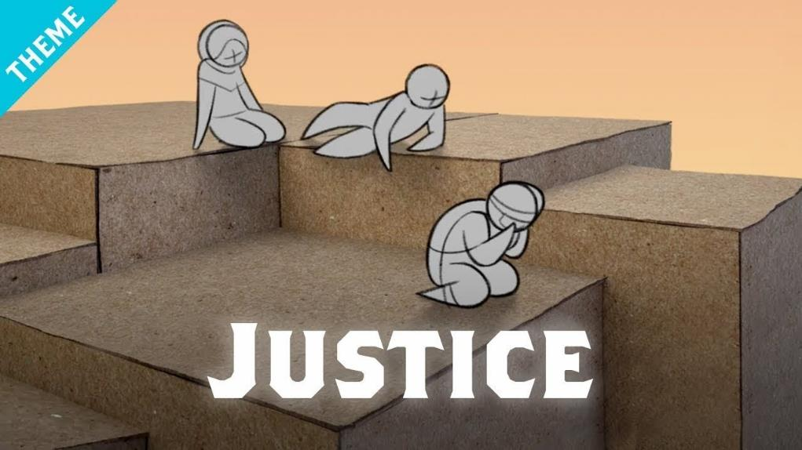
do justice
Resources

Slide 50
do justice
love kindness walk humbly

Slide 51
He has told you,
O man,
what is good; and what does
the Lord require of you but to do justice,
and to love kindness, and to walk humbly
with your God?
Micah 6:8

Slide 52
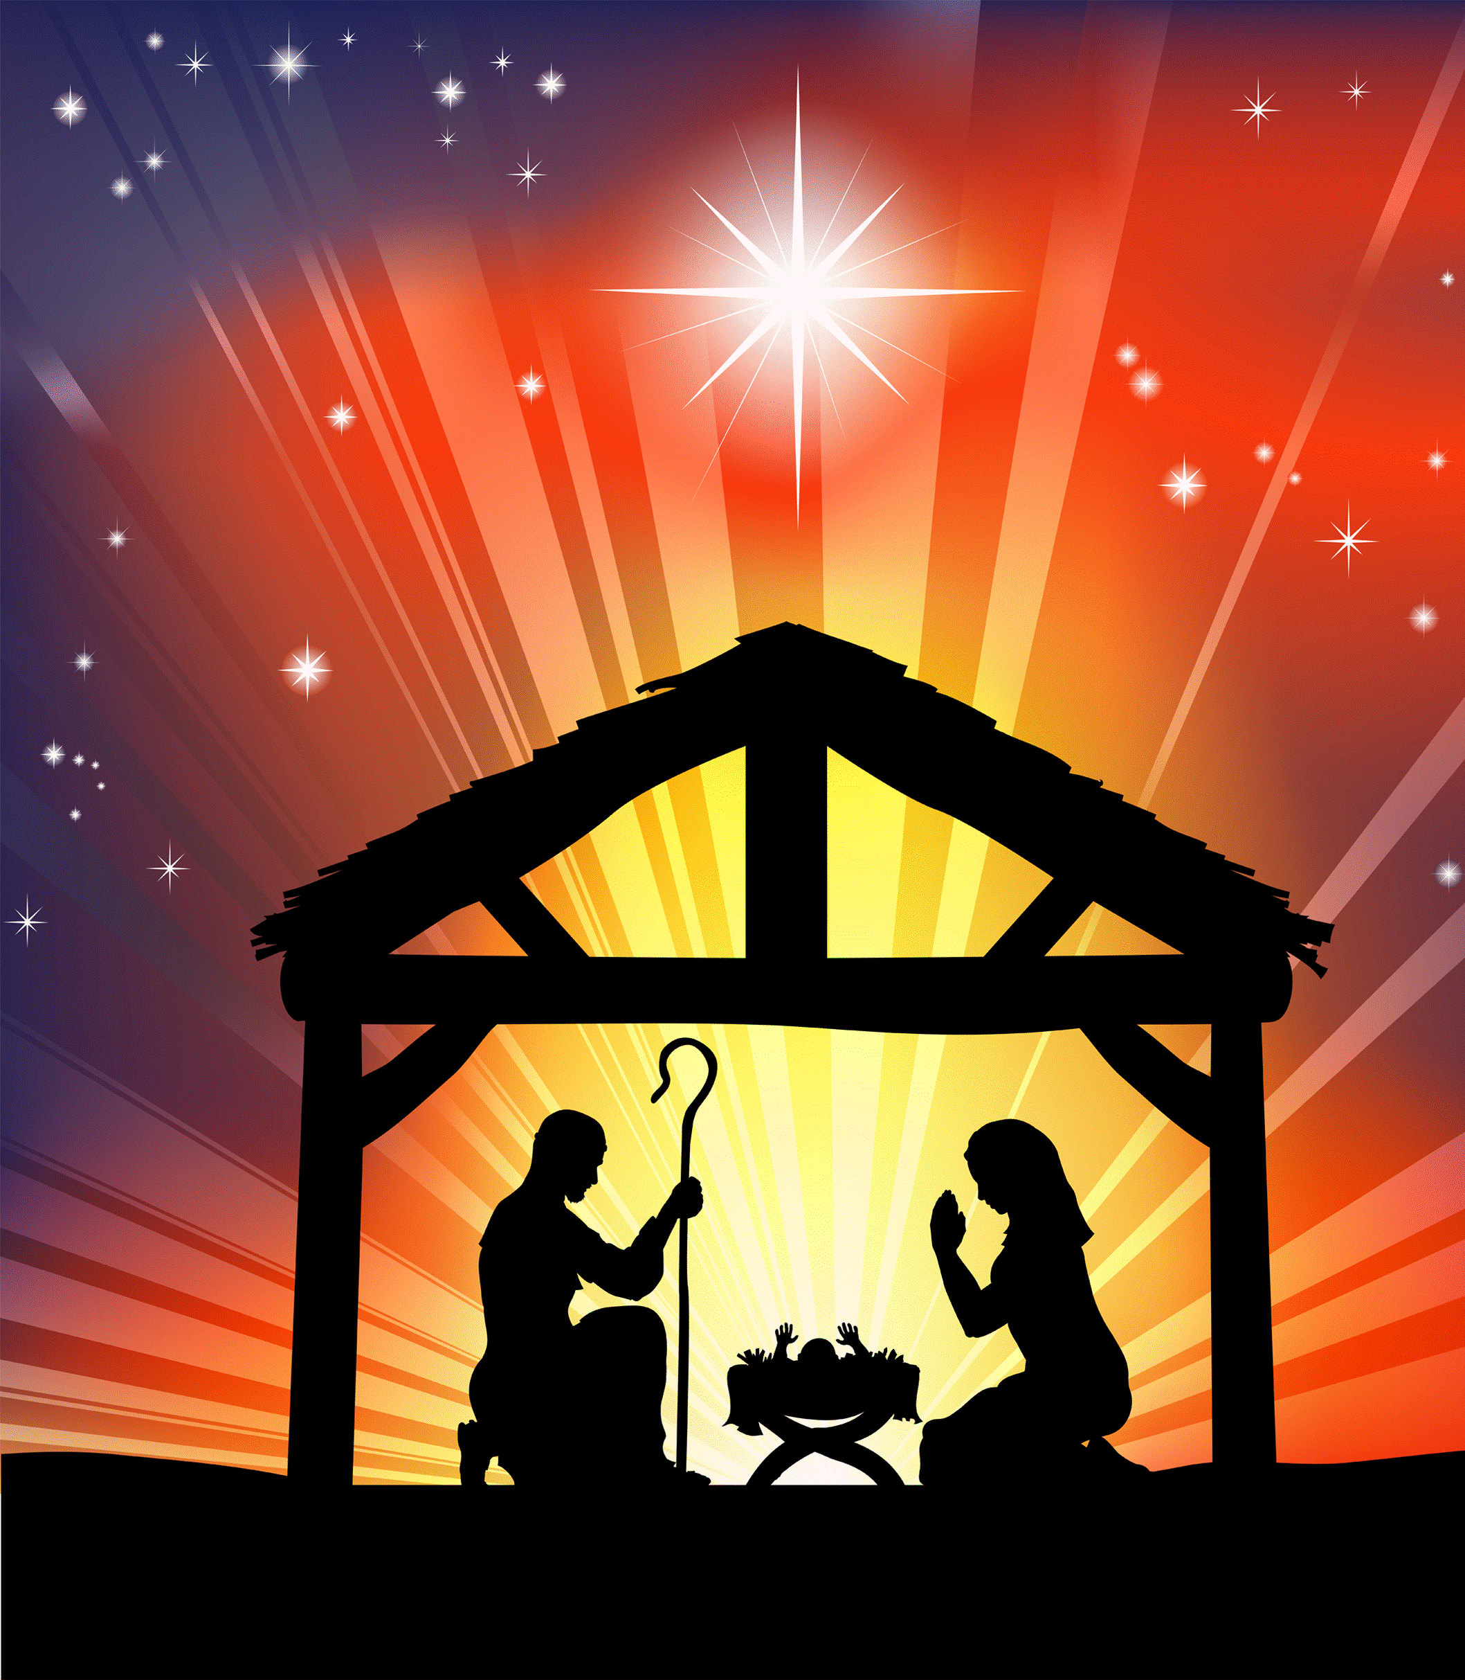
He has told you,
O man,
what is good; and what does
the Lord require of you but to do justice,
and to love kindness, and to walk humbly
with your God?
Micah 6:8

