Slide 5
Hedonists
Ascetics
In the world & of the world
Irreligious
In the world but
not of the world (Jn 17)
Godly
Out of the world & not of the world
Religious

Slide 6
Rich
Bondservants
Unhealthy focus on material riches
Godliness with contentment
Unhealthy focus on material riches
Godliness
Taking the things that matter to God, and making them matter to you. Pursuing Christ’s likeness
Investing in the Kingdom
Doing eternal good

Slide 7
1 Timothy 6:1-2a
¹Let all who are under a yoke as bondservants regard their own masters as worthy of all honor, so that the name of God and the teaching may not be reviled. ²Those who have believing masters must not be disrespectful on the ground that they are brothers; rather they must serve all the better since those who benefit from their service are believers and beloved.

Slide 8
1 Timothy 6:1-2a
¹Let all who are under a yoke as bondservants regard their own masters as worthy of all honor, so that the name of God and the teaching may not be reviled. ²Those who have believing masters must not be disrespectful on the ground that they are brothers; rather they must serve all the better since those who benefit from their service are believers and beloved.

Slide 9
1 Timothy 6:1-2a
¹Let all who are under a yoke as bondservants regard their own masters as worthy of all honor, so that the name of God and the teaching may not be reviled. ²Those who have believing masters must not be disrespectful on the ground that they are brothers; rather they must serve all the better since those who benefit from their service are believers and beloved.

Slide 10
Rich
Bondservant
Unhealthy focus on material riches
Godliness with contentment
Unhealthy focus on material riches
Respectful
Disrespectful
Reverent
Dishonest
Serve well
Disdainful

Slide 11
1 Timothy 6:17-19
¹⁷As for the rich in this present age, charge them not to be haughty, nor to set their hopes on the uncertainty of riches, but on God, who richly provides us with everything to enjoy. ¹⁸They are to do good, to be rich in good works, to be generous and ready to share, ¹⁹thus storing up treasure for themselves as a good foundation for the future, so that they may take hold of that which is truly life.

Slide 12
1 Timothy 6:17-19
¹⁷As for the rich in this present age, charge them not to be haughty, nor to set their hopes on the uncertainty of riches, but on God, who richly provides us with everything to enjoy. ¹⁸They are to do good, to be rich in good works, to be generous and ready to share, ¹⁹thus storing up treasure for themselves as a good foundation for the future, so that they may take hold of that which is truly life.

Slide 13
1 Timothy 6:17-19
¹⁷As for the rich in this present age, charge them not to be haughty, nor to set their hopes on the uncertainty of riches, but on God, who richly provides us with everything to enjoy. ¹⁸They are to do good, to be rich in good works, to be generous and ready to share, ¹⁹thus storing up treasure for themselves as a good foundation for the future, so that they may take hold of that which is truly life.
Matthew 6:19-21
¹⁹Do not lay up for yourselves treasures on earth, where moth and rust destroy and where thieves break in and steal, ²⁰but lay up for yourselves treasures in heaven, where neither moth nor rust destroys and where thieves do not break in and steal. ²¹For where your treasure is, there your heart will be also.

Slide 14
1 Timothy 6:17-19
¹⁷As for the rich in this present age, charge them not to be haughty, nor to set their hopes on the uncertainty of riches, but on God, who richly provides us with everything to enjoy. ¹⁸They are to do good, to be rich in good works, to be generous and ready to share, ¹⁹thus storing up treasure for themselves as a good foundation for the future, so that they may take hold of that which is truly life.
Steward: God has provided me with resources to manage
Owner: I have all I have on my own, and I will do what I please with it

Slide 15
1 Timothy 6:17-19
¹⁷As for the rich in this present age, charge them not to be haughty, nor to set their hopes on the uncertainty of riches, but on God, who richly provides us with everything to enjoy. ¹⁸They are to do good, to be rich in good works, to be generous and ready to share, ¹⁹thus storing up treasure for themselves as a good foundation for the future, so that they may take hold of that which is truly life.

Slide 16
Rich
Bondservant
Unhealthy focus on material riches
Godliness with contentment
Unhealthy focus on material riches
Haughty and Arrogant
Respectful
Disrespectful
Find security in riches
Reverent
Dishonest
Selfish
Serve well
Disdainful
Never experience that which is truly life
Humble
Proactively Generous
Fuller experience of life
Have an Eternal Security

Slide 17
1 Timothy 6:2b-10
Teach and urge these things. ³If anyone teaches a different doctrine and does not agree with the sound words of our Lord Jesus Christ and the teaching that accords with godliness, ⁴he is puffed up with conceit and understands nothing. He has an unhealthy craving for controversy and for quarrels about words, which produce envy, dissension, slander, evil suspicions, ⁵and constant friction among people who are depraved in mind and deprived of the truth, imagining that godliness is a means of gain. ⁶Now there is great gain in godliness with contentment, ⁷for we brought nothing into the world, and we cannot take anything out of the world. ⁸But if we have food and clothing, with these we will be content. ⁹But those who desire to be rich fall into temptation, into a snare, into many senseless and harmful desires that plunge people into ruin and destruction. ¹⁰For the love of money is a root of all kinds of evils. It is through this craving that come have wandered away from the faith and pierced themselves with many pangs.

Slide 18
1 Timothy 6:2b-10
Teach and urge these things. ³If anyone teaches a different doctrine and does not agree with the sound words of our Lord Jesus Christ and the teaching that accords with godliness, ⁴he is puffed up with conceit and understands nothing. He has an unhealthy craving for controversy and for quarrels about words, which produce envy, dissension, slander, evil suspicions, ⁵and constant friction among people who are depraved in mind and deprived of the truth, imagining that godliness is a means of gain. ⁶Now there is great gain in godliness with contentment, ⁷for we brought nothing into the world, and we cannot take anything out of the world. ⁸But if we have food and clothing, with these we will be content. ⁹But those who desire to be rich fall into temptation, into a snare, into many senseless and harmful desires that plunge people into ruin and destruction. ¹⁰For the love of money is a root of all kinds of evils. It is through this craving that come have wandered away from the faith and pierced themselves with many pangs.

Slide 19
1 Timothy 6:2b-10
Teach and urge these things. ³If anyone teaches a different doctrine and does not agree with the sound words of our Lord Jesus Christ and the teaching that accords with godliness, ⁴he is puffed up with conceit and understands nothing. He has an unhealthy craving for controversy and for quarrels about words, which produce envy, dissension, slander, evil suspicions, ⁵and constant friction among people who are depraved in mind and deprived of the truth, imagining that godliness is a means of gain. ⁶Now there is great gain in godliness with contentment, ⁷for we brought nothing into the world, and we cannot take anything out of the world. ⁸But if we have food and clothing, with these we will be content. ⁹But those who desire to be rich fall into temptation, into a snare, into many senseless and harmful desires that plunge people into ruin and destruction. ¹⁰For the love of money is a root of all kinds of evils. It is through this craving that come have wandered away from the faith and pierced themselves with many pangs.

Slide 20
1 Timothy 6:2b-10
Teach and urge these things. ³If anyone teaches a different doctrine and does not agree with the sound words of our Lord Jesus Christ and the teaching that accords with godliness, ⁴he is puffed up with conceit and understands nothing. He has an unhealthy craving for controversy and for quarrels about words, which produce envy, dissension, slander, evil suspicions, ⁵and constant friction among people who are depraved in mind and deprived of the truth, imagining that godliness is a means of gain. ⁶Now there is great gain in godliness with contentment, ⁷for we brought nothing into the world, and we cannot take anything out of the world. ⁸But if we have food and clothing, with these we will be content. ⁹But those who desire to be rich fall into temptation, into a snare, into many senseless and harmful desires that plunge people into ruin and destruction. ¹⁰For the love of money is a root of all kinds of evils. It is through this craving that come have wandered away from the faith and pierced themselves with many pangs.

Slide 21
Rich
Bondservant
Unhealthy focus on material riches
Godliness with contentment
Unhealthy focus on material riches
Haughty and Arrogant
Respectful
Disrespectful
Find security in riches
Reverent
Dishonest
Selfish
Serve well
Disdainful
Never experience that which is truly life
Humble
Proactively Generous
Relational discord
Relational discord
Fuller experience of life
Turmoil
Turmoil
Have an Eternal Security
No flourishing
No flourishing
Human flourishing
Unity within the body
GREAT GAIN

Slide 22
Our Money Use Matters!
Our use of money is tightly tied to our character

Slide 23
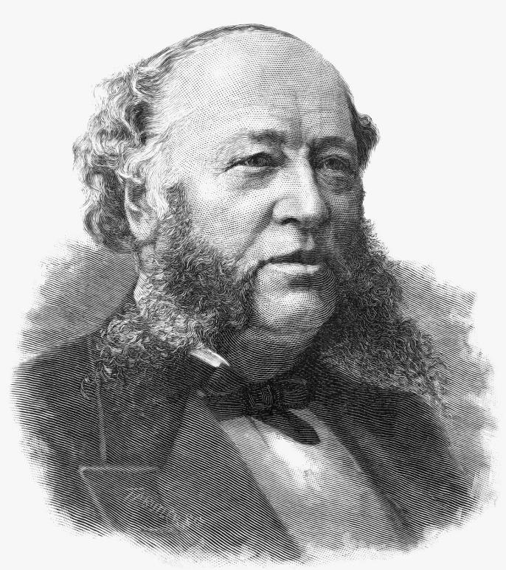
Our Money Use Matters!
Our use of money is tightly tied to our character
Pursuing earthly riches will never satisfy you
“The care of $200 million is enough to kill anyone. There is no pleasure in it.”
William Henry Vanderbilt

Slide 24
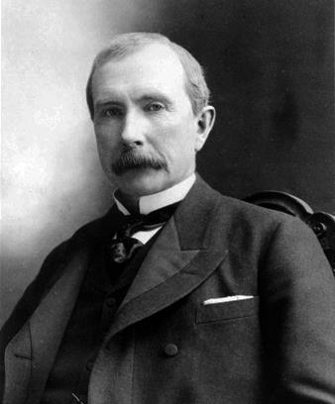
Our Money Use Matters!
Our use of money is tightly tied to our character
Pursuing earthly riches will never satisfy you
“I have made many millions, but they have brought me no happiness.”
John D Rockefeller

Slide 25
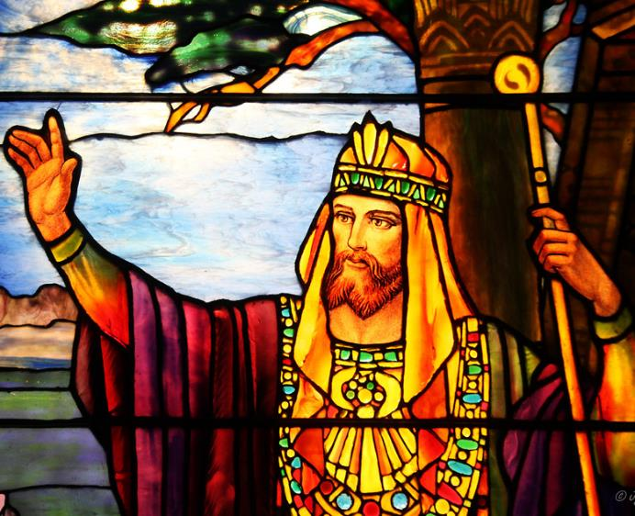
Our Money Use Matters!
Our use of money is tightly tied to our character
Pursuing earthly riches will never satisfy you
“He who loves money will not be satisfied with money, nor he who loves wealth with his income; this also is vanity.” - Ecclesiastes 5:10
King Solomon

Slide 26
Our Money Use Matters!
Our use of money is tightly tied to our character
Pursuing earthly riches will never satisfy you
Godliness with contentment is where true life is found (now and later)

Slide 27
Where to go from here?
Prayerfully consider if you are in hotter pursuit of earthly or heavenly riches

Slide 28
Where to go from here?
Prayerfully consider if you are in hotter pursuit of earthly or heavenly riches
Invest in the Kingdom!

Slide 29
Where to go from here?
Prayerfully consider if you are in hotter pursuit of earthly or heavenly riches
Invest in the Kingdom!
Invite outside input on your finances

Slide 30
Where to go from here?
Prayerfully consider if you are in hotter pursuit of earthly or heavenly riches
Invest in the Kingdom!
Invite outside input on your finances

Slide 31
Where to go from here?
Prayerfully consider if you are in hotter pursuit of earthly or heavenly riches
Invest in the Kingdom!
Invite outside input on your finances

Slide 32
Where to go from here?
Prayerfully consider if you are in hotter pursuit of earthly or heavenly riches
Invest in the Kingdom!
Invite outside input on your finances
Matthew 5:14-16
¹⁴“You are the light of the world. A city set on a hill cannot be hidden. ¹⁵Nor do people light a lamp and put it under a basket, but on a stand, and it gives light to all in the house. ¹⁶In the same way, let your light shine before others, so that they may see your good works and give glory to your Father who is in heaven.”

Slide 33
Where to go from here?
Prayerfully consider if you are in hotter pursuit of earthly or heavenly riches
Invest in the Kingdom!
Invite outside input on your finances
Put the Rightful Judge back on the throne

Slide 34
Where to go from here?
Prayerfully consider if you are in hotter pursuit of earthly or heavenly riches
Invest in the Kingdom!
Invite outside input on your finances
Put the Rightful Judge back on the throne
Live in grace

