Slide 3
Traditional Model
God
Institutional Paradigm
Clergy
Laity

Slide 4
New Testament Model
Christ (the head)
Organic Paradigm
Leaders
(elders…)
Everybody
(ministers)

Slide 5
1 Timothy 3:1-13
¹ The saying is trustworthy: If anyone aspires to the office of overseer, he desires a noble task. ² Therefore an overseer must be above reproach, the husband of one wife, sober-minded, self-controlled, respectable, hospitable, able to teach, ³ not a drunkard, not violent but gentle, not quarrelsome, not a lover of money. ⁴ He must manage his own household well, with all dignity keeping his children submissive, ⁵ for if someone does not know how to manage his own household, how will he care for God's church? ⁶ He must not be a recent convert, or he may become puffed up with conceit and fall into the condemnation of the devil. ⁷ Moreover, he must be well thought of by outsiders, so that he may not fall into disgrace, into a snare of the devil.

Slide 6
1 Timothy 3:1-13
⁸ Deacons likewise must be dignified, not double-tongued, not addicted to much wine, not greedy for dishonest gain. ⁹ They must hold the mystery of the faith with a clear conscience. ¹⁰ And let them also be tested first; then let them serve as deacons if they prove themselves blameless. ¹¹ Their wives likewise must be dignified, not slanderers, but sober-minded, faithful in all things. ¹² Let deacons each be the husband of one wife, managing their children and their own households well. ¹³ For those who serve well as deacons gain a good standing for themselves and also great confidence in the faith that is in Christ Jesus.

Slide 7
2 Types of Leaders
¹ The saying is trustworthy: If anyone aspires to the office of overseer, he desires a noble task. ² Therefore an overseer must be above reproach, the husband of one wife, sober-minded, self-controlled, respectable, hospitable, able to teach …
⁸ Deacons likewise must be dignified, not double-tongued, not addicted to much wine, not greedy for dishonest gain. ⁹ They must hold the mystery of the faith with a clear conscience …

Slide 8
2 Types of Leaders
¹ The saying is trustworthy: If anyone aspires to the office of overseer, he desires a noble task. ² Therefore an overseer must be above reproach, the husband of one wife, sober-minded, self-controlled, respectable, hospitable, able to teach …
⁸ Deacons likewise must be dignified, not double-tongued, not addicted to much wine, not greedy for dishonest gain. ⁹ They must hold the mystery of the faith with a clear conscience …

Slide 9
2 Types of Leaders
¹ The saying is trustworthy: If anyone aspires to the office of overseer, he desires a noble task. ² Therefore an overseer must be above reproach, the husband of one wife, sober-minded, self-controlled, respectable, hospitable, able to teach …
⁸ Deacons likewise must be dignified, not double-tongued, not addicted to much wine, not greedy for dishonest gain. ⁹ They must hold the mystery of the faith with a clear conscience …
“episkopos”
epi- (over) -skopos (seer)

Slide 10
2 Types of Leaders
¹ The saying is trustworthy: If anyone aspires to the office of overseer, he desires a noble task. ² Therefore an overseer must be above reproach, the husband of one wife, sober-minded, self-controlled, respectable, hospitable, able to teach …
⁸ Deacons likewise must be dignified, not double-tongued, not addicted to much wine, not greedy for dishonest gain. ⁹ They must hold the mystery of the faith with a clear conscience …
synonymous with “elder” “presbyteros” (Titus 1:6-7)

Slide 11
2 Types of Leaders
¹ The saying is trustworthy: If anyone aspires to the office of overseer, he desires a noble task. ² Therefore an overseer must be above reproach, the husband of one wife, sober-minded, self-controlled, respectable, hospitable, able to teach …
⁸ Deacons likewise must be dignified, not double-tongued, not addicted to much wine, not greedy for dishonest gain. ⁹ They must hold the mystery of the faith with a clear conscience …

Slide 12
2 Types of Leaders
¹ The saying is trustworthy: If anyone aspires to the office of overseer, he desires a noble task. ² Therefore an overseer must be above reproach, the husband of one wife, sober-minded, self-controlled, respectable, hospitable, able to teach …
⁸ Deacons likewise must be dignified, not double-tongued, not addicted to much wine, not greedy for dishonest gain. ⁹ They must hold the mystery of the faith with a clear conscience …
“diakonous”
servant, minister

Slide 13
HEALTHY CHURCHES
1) … have official leaders

Slide 14
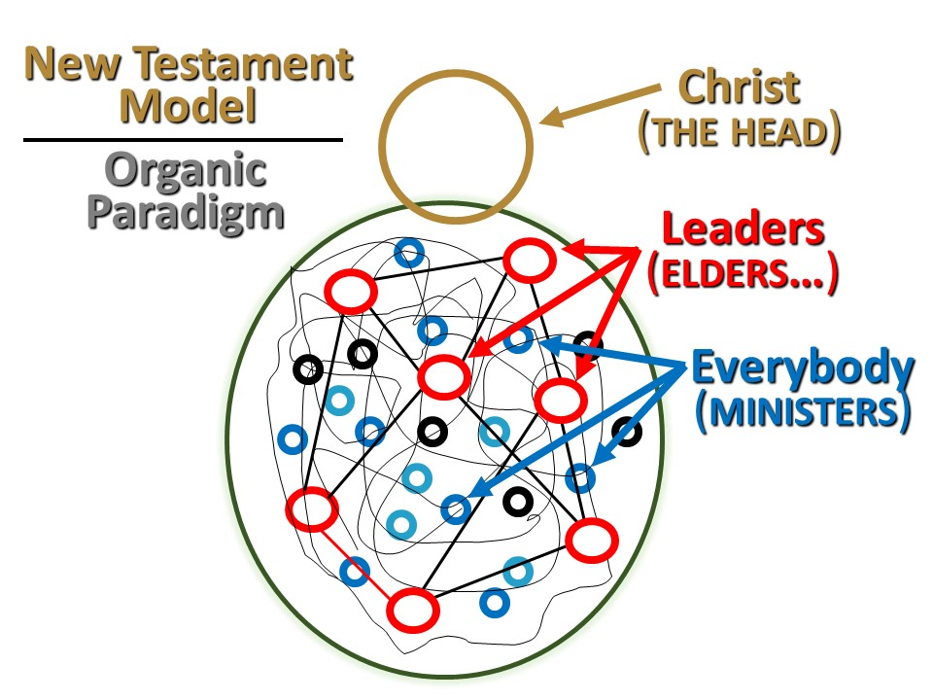
HEALTHY CHURCHES
1) … have official leaders

Slide 15
HEALTHY CHURCHES
1) … have official leaders
1 Timothy 3:1 The saying is trustworthy: If anyone aspires to the office of overseer, he desires a noble task.

Slide 16
HEALTHY CHURCHES
1) … have official leaders
1 Timothy 3:1 The saying is trustworthy: If anyone aspires to the office of overseer, he desires a noble task.
“(The house church must be) gathering under the Headship of Jesus Christ without a clergy, where the members know one another deeply and are experiencing a depth in Christ, where decisions are made by the community, and where every member functions in the meetings without any (person) controlling, directing, facilitating, or dominating . . .” -- Frank Viola, “Rethinking the Five-Fold Ministry.”

Slide 17
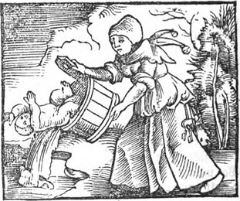
HEALTHY CHURCHES
1) … have official leaders
1 Timothy 3:1 The saying is trustworthy: If anyone aspires to the office of overseer, he desires a noble task.
“(The house church must be) gathering under the Headship of Jesus Christ without a clergy, where the members know one another deeply and are experiencing a depth in Christ, where decisions are made by the community, and where every member functions in the meetings without any (person) controlling, directing, facilitating, or dominating . . .” -- Frank Viola, “Rethinking the Five-Fold Ministry.”

Slide 18
HEALTHY CHURCHES
2) … value indigenous leadership

Slide 19
HEALTHY CHURCHES
2) … value indigenous leadership
Titus 1:5 This is why I left you in Crete, so that you might put what remained into order, and appoint elders in every town as I directed you

Slide 20
HEALTHY CHURCHES
3) … lead in teams

Slide 21
HEALTHY CHURCHES
3) … lead in teams
1 Timothy 3: ¹ The saying is trustworthy: If anyone aspires to the office of overseer, he desires a noble task. ² Therefore an overseer must be above reproach, the husband of one wife, sober-minded, self-controlled, respectable, hospitable, able to teach …

Slide 22
HEALTHY CHURCHES
3) … lead in teams
1 Timothy 3: ¹ The saying is trustworthy: If anyone aspires to the office of overseer, he desires a noble task. ² Therefore an overseer must be above reproach, the husband of one wife, sober-minded, self-controlled, respectable, hospitable, able to teach …
Titus 1:5 This is why I left you in Crete, so that you might put what remained into order, and appoint elders in every town as I directed you

Slide 23
HEALTHY CHURCHES
4) … CHOOSE GODLY LEADERS
1 Timothy 3: ² Therefore an overseer must be above reproach, the husband of one wife, sober-minded, self-controlled, respectable, hospitable, able to teach, ³ not a drunkard, not violent but gentle, not quarrelsome, not a lover of money. ⁴ He must manage his own household well…
⁸ Deacons likewise must be dignified, not double-tongued, not addicted to much wine, not greedy for dishonest gain. ⁹ They must hold the mystery of the faith with a clear conscience ¹⁰ And let them also be tested first; then let them serve as deacons if they prove themselves blameless. …^{12b} managing their children and their own households well.

Slide 24
HEALTHY CHURCHES
4) … CHOOSE GODLY LEADERS
1 Timothy 3: ² Therefore an overseer must be above reproach, the husband of one wife, sober-minded, self-controlled, respectable, hospitable, able to teach, ³ not a drunkard, not violent but gentle, not quarrelsome, not a lover of money. ⁴ He must manage his own household well…
⁸ Deacons likewise must be dignified, not double-tongued, not addicted to much wine, not greedy for dishonest gain. ⁹ They must hold the mystery of the faith with a clear conscience ¹⁰ And let them also be tested first; then let them serve as deacons if they prove themselves blameless. …^{12b} managing their children and their own households well.
A. WHO Are RELATIVELY SPIRITUALLY MATURE CURRENTLY

Slide 25
HEALTHY CHURCHES
4) … CHOOSE GODLY LEADERS
1 Timothy 3: ² Therefore an overseer must be above reproach, the husband of one wife, sober-minded, self-controlled, respectable, hospitable, able to teach, ³ not a drunkard, not violent but gentle, not quarrelsome, not a lover of money. ⁴ He must manage his own household well…
⁸ Deacons likewise must be dignified, not double-tongued, not addicted to much wine, not greedy for dishonest gain. ⁹ They must hold the mystery of the faith with a clear conscience ¹⁰ And let them also be tested first; then let them serve as deacons if they prove themselves blameless. …^{12b} managing their children and their own households well.
B. WHO KNOW, BELIEVE, and can teach God’s Word

Slide 26
HEALTHY CHURCHES
4) … CHOOSE GODLY LEADERS
1 Timothy 3: ² Therefore an overseer must be above reproach, the husband of one wife, sober-minded, self-controlled, respectable, hospitable, able to teach, ³ not a drunkard, not violent but gentle, not quarrelsome, not a lover of money. ⁴ He must manage his own household well…
⁸ Deacons likewise must be dignified, not double-tongued, not addicted to much wine, not greedy for dishonest gain. ⁹ They must hold the mystery of the faith with a clear conscience ¹⁰ And let them also be tested first; then let them serve as deacons if they prove themselves blameless. …^{12b} managing their children and their own households well.
C. WHO HAVE PROVEN EFFECTIVE SPIRITUAL LEADERSHIP

Slide 27
HEALTHY CHURCHES
have official leaders
RAISED UP FROM WITHIN (INDIGINEOUS)
who lead in teams.
CHOOSE Godly LEADERS wHO
Are relatively spiritually mature Currently
Know, believe, and can teach God’s Word
have proven effective spiritual leadership

Slide 28
LEADERSHIP AT TALLGRASS
Bylaws: Section 7.01 General
Under the authority of Jesus Christ and the Word of God, the Elder Team is the final authority within this local Church. This authority is normally exercised through the nomination and approval of Elders to shepherd and govern the Church.
Bylaws: Section 7.02 Leadership
A. The leadership of the Church shall be vested in the Elder Team who is responsible for governing the Church, teaching the Word, and tending the flock of God in this Church. …
B. The Paid Staff Team shall consist of those who are tasked to lead the charge to equip the saints for ministry as described in Ephesians 4:11-16.
C. The Servant Leadership Team shall consist of anyone who demonstrates the character qualities and leadership competency to serve Tallgrass Church in some way determined by the Elders to be beneficial to the leadership of Tallgrass Church.

Slide 29
HEALTHY CHURCHES
have official leaders
RAISED UP FROM WITHIN (INDIGINEOUS)
who lead in teams
CHOOSE Godly LEADERS wHO
Are relatively spiritually mature Currently
Know, believe, and can teach God’s Word
have proven effective spiritual leadership

Slide 30
HEALTHY CHURCHES
have official leaders
RAISED UP FROM WITHIN (INDIGINEOUS)
who lead in teams.
CHOOSE Godly LEADERS wHO
Are relatively spiritually mature Currently
Know, believe, and can teach God’s Word
have proven effective spiritual leadership
HAVE GOOD FOLLOWERS

Slide 31
HEALTHY CHURCHES
have official leaders
RAISED UP FROM WITHIN (INDIGINEOUS)
who lead in teams.
CHOOSE Godly LEADERS wHO
Have relatively spiritually mature character, Currently
Know, believe, and can teach God’s Word
have proven effective spiritual leadership
HAVE GOOD FOLLOWERS
1 Thessalonians 5:12 But we request of you, brethren, that you appreciate those who diligently labor among you, and have charge over you in the Lord and give you instruction, ¹³ and that you esteem them very highly in love because of their work.
Hebrews 13:17 Obey your leaders and submit to them, for they keep watch over your souls as those who will give an account. Let them do this with joy and not with grief, for this would be unprofitable for you.

Slide 32
APPLICATIONS

Slide 33
APPLICATIONS
Consider your next step of faith as a good follower.

Slide 34
APPLICATIONS
Consider your next step of faith as a good follower.
Consider your next step of faith as a potential leader.

Slide 35
APPLICATIONS
Consider your next step of faith as a good follower.
Consider your next step of faith as a potential leader.
Repent of your failures to follow and/or lead well.

Slide 36
APPLICATIONS
Consider your next step of faith as a good follower.
Consider your next step of faith as a potential leader.
Repent of your failures to follow and/or lead well.
Consider how you might honor and encourage those who lead among us.

Slide 38
THE LORD’S SUPPER

