Slide 2
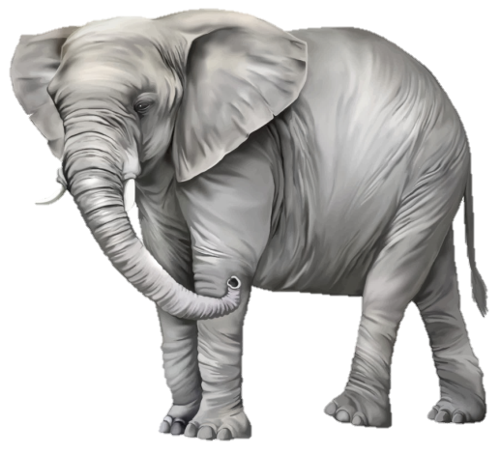

Slide 3
Four Views on Women
in the home, church, and society
Hard
Patriarchy
Soft Patriarchy
Evangelical Egalitarianism
Secular Egalitarianism
From Slaves, Women, & Homosexuals: Exploring the Hermeneutics of Cultural Analysis by William J. Webb (pp. 26-28)
Complementarian Egalitarian

Slide 4
Puzzle Pieces as Context
Section
Testament
Genre
Phrase
Canon
Culture
Word
Sentence
Paragraph
Book

Slide 5
Some Puzzles are Difficult
There are some things in them that are hard to understand, which the ignorant and unstable twist to their own destruction, as they do the other Scriptures.
2 Peter 3:16b
Convictions:
We must seek to be faithful to the intent of the Scriptures.
We must be consistent in our interpretation and application.
Women must be treated with dignity and respect.
Men must not be passive.
We all bring ourselves to the Scriptures.

Slide 6
Puzzle Pieces in 1 Timothy 2
¹¹ Let a woman learn quietly with all submissiveness. ¹² I do not permit a woman to teach or to exercise authority over a man; rather, she is to remain quiet. ¹³ For Adam was formed first, then Eve; ¹⁴ and Adam was not deceived, but the woman was deceived and became a transgressor. ¹⁵ Yet she will be saved through childbearing—if they continue in faith and love and holiness, with self-control.
1 Timothy 2:11-15

Slide 7
Not a Universal Restriction
“If there is one verse in the Bible more than any other which is used to disbar women from proclaiming the Good News of Jesus Christ and exercising their talents for his glory, it is 1 Timothy 2:12.” (pp. 11-12)
“In this book, we shall suggest that 1 Timothy 2:11-15 is not a decree of timeless and universal restriction and punishment but a corrective: a specific direction as to what women should not teach and why.” (p. 23)

Slide 8
Puzzle Pieces in 1 Timothy 2
¹² I do not permit a woman to teach or to exercise authority over a man; rather, she is to remain quiet. ¹³ For Adam was formed first, then Eve…
1 Timothy 2:12-13
Four Possible Meanings of “Authentein”
To begin something, to be primarily responsible for a condition or action (especially murder)
To rule, to dominate
To usurp power or rights from another
To claim ownership, sovereignty, or authorship

Slide 9
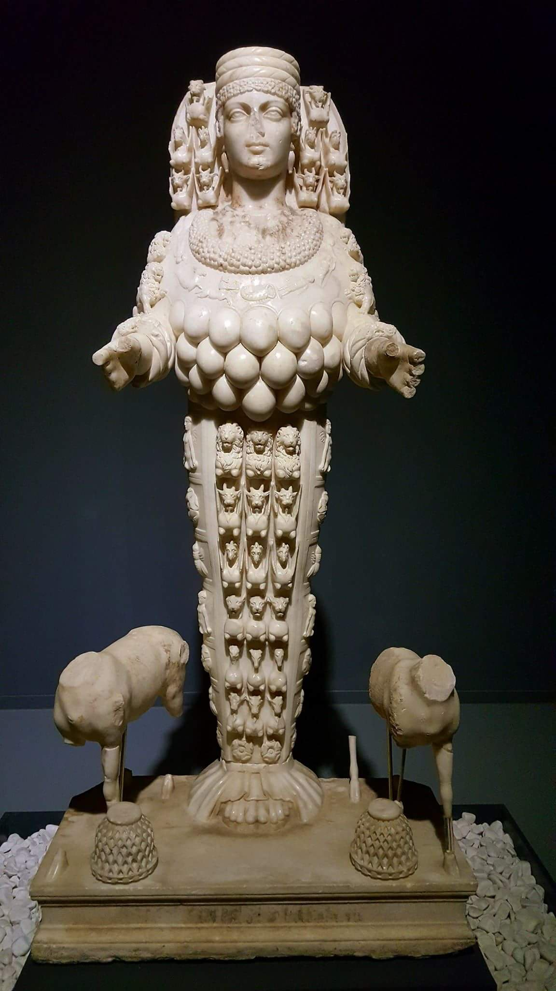
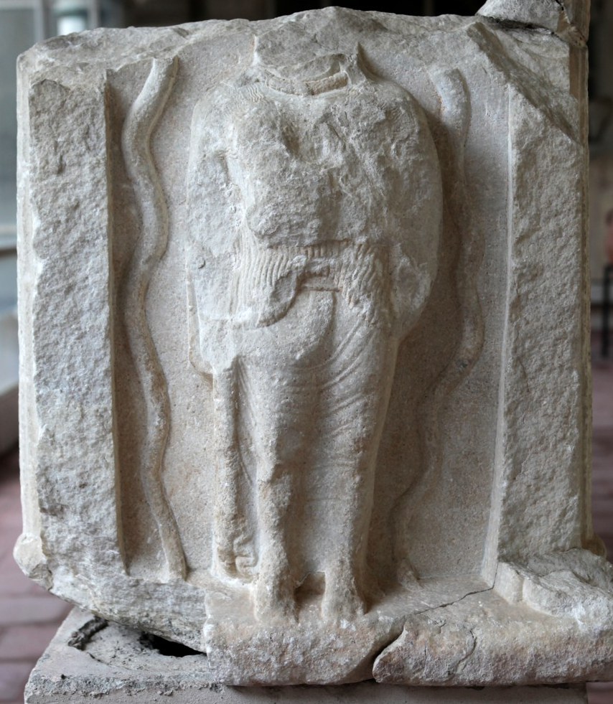
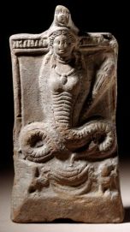
Puzzle Pieces in Archeology
Artemis of Ephesus (left)
Cybele, Mountain Mother (above)
Egyptian Isis (right)

Slide 10
Another Credible Translation
¹² I do not permit woman to teach nor to represent herself as originator of man but she is to be in conformity [with the Scriptures]. ¹³ For Adam was created first, then Eve. (p. 103)
1 Timothy 2:12-13
Four Possible Meanings of “Authentein”
To begin something, to be primarily responsible for a condition or action (especially murder)
To rule, to dominate
To usurp power or rights from another
To claim ownership, sovereignty, or authorship

Slide 11
Another Credible Translation
¹² I do not permit woman to teach nor to represent herself as originator of man but she is to be in conformity [with the Scriptures]. ¹³ For Adam was created first, then Eve. (p. 103)
1 Timothy 2:12-13
For we did not follow cleverly devised myths when we made known to you the power and coming of our Lord Jesus Christ, but we were eyewitnesses of his majesty.
2 Peter 1:16

Slide 12
Puzzle Pieces in Romans 16
¹ I commend to you our sister Phoebe, a servant of the church at Cenchreae, ² that you may welcome her in the Lord in a way worthy of the saints, and help her in whatever she may need from you, for she has been a patron of many and of myself as well. ³ Greet Prisca and Aquila, my fellow workers in Christ Jesus, ⁴ who risked their necks for my life, to whom not only I give thanks but all the churches of the Gentiles give thanks as well. ⁵ Greet also the church in their house. Greet my beloved Epaenetus, who was the first convert to Christ in Asia. ⁶ Greet Mary, who has worked hard for you. ⁷ Greet Andronicus and Junia, my kinsmen and my fellow prisoners. They are well known to the apostles, and they were in Christ before me.
Romans 16:1-7

Slide 13
Puzzle Pieces in Romans 16
⁸ Greet Ampliatus, my beloved in the Lord. ⁹ Greet Urbanus, our fellow worker in Christ, and my beloved Stachys. ¹⁰ Greet Apelles, who is approved in Christ. Greet those who belong to the family of Aristobulus. ¹¹ Greet my kinsman Herodion. Greet those in the Lord who belong to the family of Narcissus. ¹² Greet those workers in the Lord, Tryphaena and Tryphosa. Greet the beloved Persis, who has worked hard in the Lord. ¹³ Greet Rufus, chosen in the Lord; also his mother, who has been a mother to me as well. ¹⁴ Greet Asyncritus, Phlegon, Hermes, Patrobas, Hermas, and the brothers who are with them. ¹⁵ Greet Philologus, Julia, Nereus and his sister, and Olympas, and all the saints who are with them. ¹⁶ Greet one another with a holy kiss. All the churches of Christ greet you.
Romans 16:8-16

Slide 14
Puzzle Pieces in Romans 16
¹ I commend to you our sister Phoebe, a servant of the church at Cenchreae, ² that you may welcome her in the Lord in a way worthy of the saints, and help her in whatever she may need from you, for she has been a patron of many and of myself as well. ³ Greet Prisca and Aquila, my fellow workers in Christ Jesus, ⁴ who risked their necks for my life, to whom not only I give thanks but all the churches of the Gentiles give thanks as well. ⁵ Greet also the church in their house. Greet my beloved Epaenetus, who was the first convert to Christ in Asia. ⁶ Greet Mary, who has worked hard for you. ⁷ Greet Andronicus and Junia, my kinsmen and my fellow prisoners. They are well known to the apostles, and they were in Christ before me.
Romans 16:1-7
Phoebe, Deacon

Slide 15
Puzzle Pieces in Romans 16
¹ I commend to you our sister Phoebe, a servant of the church at Cenchreae, ² that you may welcome her in the Lord in a way worthy of the saints, and help her in whatever she may need from you, for she has been a patron of many and of myself as well. ³ Greet Prisca and Aquila, my fellow workers in Christ Jesus, ⁴ who risked their necks for my life, to whom not only I give thanks but all the churches of the Gentiles give thanks as well. ⁵ Greet also the church in their house. Greet my beloved Epaenetus, who was the first convert to Christ in Asia. ⁶ Greet Mary, who has worked hard for you. ⁷ Greet Andronicus and Junia, my kinsmen and my fellow prisoners. They are well known to the apostles, and they were in Christ before me.
Romans 16:1-7
Prisca, Bible Teacher

Slide 16
Puzzle Pieces in Romans 16
¹ I commend to you our sister Phoebe, a servant of the church at Cenchreae, ² that you may welcome her in the Lord in a way worthy of the saints, and help her in whatever she may need from you, for she has been a patron of many and of myself as well. ³ Greet Prisca and Aquila, my fellow workers in Christ Jesus, ⁴ who risked their necks for my life, to whom not only I give thanks but all the churches of the Gentiles give thanks as well. ⁵ Greet also the church in their house. Greet my beloved Epaenetus, who was the first convert to Christ in Asia. ⁶ Greet Mary, who has worked hard for you. ⁷ Greet Andronicus and Junia, my kinsmen and my fellow prisoners. They are well known to the apostles, and they were in Christ before me.
Romans 16:1-7
Mary, Hard Worker

Slide 17
Puzzle Pieces in Romans 16
¹ I commend to you our sister Phoebe, a servant of the church at Cenchreae, ² that you may welcome her in the Lord in a way worthy of the saints, and help her in whatever she may need from you, for she has been a patron of many and of myself as well. ³ Greet Prisca and Aquila, my fellow workers in Christ Jesus, ⁴ who risked their necks for my life, to whom not only I give thanks but all the churches of the Gentiles give thanks as well. ⁵ Greet also the church in their house. Greet my beloved Epaenetus, who was the first convert to Christ in Asia. ⁶ Greet Mary, who has worked hard for you. ⁷ Greet Andronicus and Junia, my kinsmen and my fellow prisoners. They are well known to the apostles, and they were in Christ before me.
Romans 16:1-7
Junia, Apostle

Slide 18
Puzzle Pieces in Romans 16
¹² Greet those workers in the Lord, Tryphaena and Tryphosa. Greet the beloved Persis, who has worked hard in the Lord. ¹³ Greet Rufus, chosen in the Lord; also his mother, who has been a mother to me as well. ¹⁴ Greet Asyncritus, Phlegon, Hermes, Patrobas, Hermas, and the brothers who are with them. ¹⁵ Greet Philologus, Julia, Nereus and his sister, and Olympas, and all the saints who are with them. ¹⁶ Greet one another with a holy kiss. All the churches of Christ greet you.
Romans 16:12-16

Slide 19
Puzzle Pieces in Romans 16
¹² Greet those workers in the Lord, Tryphaena and Tryphosa. Greet the beloved Persis, who has worked hard in the Lord. ¹³ Greet Rufus, chosen in the Lord; also his mother, who has been a mother to me as well. ¹⁴ Greet Asyncritus, Phlegon, Hermes, Patrobas, Hermas, and the brothers who are with them. ¹⁵ Greet Philologus, Julia, Nereus and his sister, and Olympas, and all the saints who are with them. ¹⁶ Greet one another with a holy kiss. All the churches of Christ greet you.
Romans 16:12-16
Tryphaena & Tryphosa,
Workers in the Lord

Slide 20
Puzzle Pieces in Romans 16
¹² Greet those workers in the Lord, Tryphaena and Tryphosa. Greet the beloved Persis, who has worked hard in the Lord. ¹³ Greet Rufus, chosen in the Lord; also his mother, who has been a mother to me as well. ¹⁴ Greet Asyncritus, Phlegon, Hermes, Patrobas, Hermas, and the brothers who are with them. ¹⁵ Greet Philologus, Julia, Nereus and his sister, and Olympas, and all the saints who are with them. ¹⁶ Greet one another with a holy kiss. All the churches of Christ greet you.
Romans 16:12-16
Persis, Paul’s Friend

Slide 21
Puzzle Pieces in Romans 16
¹² Greet those workers in the Lord, Tryphaena and Tryphosa. Greet the beloved Persis, who has worked hard in the Lord. ¹³ Greet Rufus, chosen in the Lord; also his mother, who has been a mother to me as well. ¹⁴ Greet Asyncritus, Phlegon, Hermes, Patrobas, Hermas, and the brothers who are with them. ¹⁵ Greet Philologus, Julia, Nereus and his sister, and Olympas, and all the saints who are with them. ¹⁶ Greet one another with a holy kiss. All the churches of Christ greet you.
Romans 16:12-16
Rufus’ Mother,
A Mother to Paul

Slide 22
Puzzle Pieces in Romans 16
¹² Greet those workers in the Lord, Tryphaena and Tryphosa. Greet the beloved Persis, who has worked hard in the Lord. ¹³ Greet Rufus, chosen in the Lord; also his mother, who has been a mother to me as well. ¹⁴ Greet Asyncritus, Phlegon, Hermes, Patrobas, Hermas, and the brothers who are with them. ¹⁵ Greet Philologus, Julia, Nereus and his sister, and Olympas, and all the saints who are with them. ¹⁶ Greet one another with a holy kiss. All the churches of Christ greet you.
Romans 16:12-16
Julia & Nereus’ Sister

Slide 23
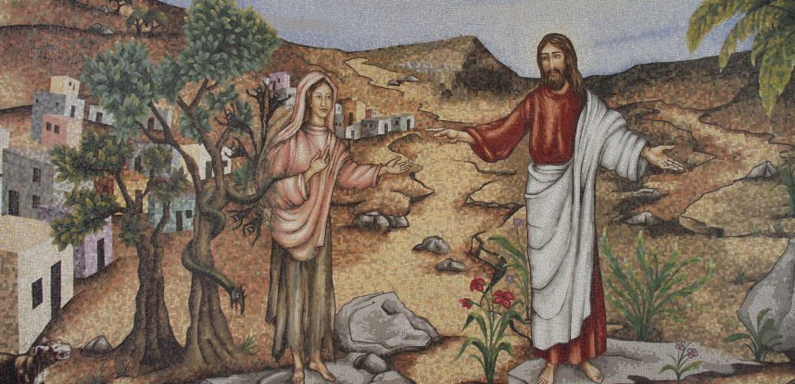
Mary Magdalene Chapel (Luke 8:2)
Apostle to the Apostles
At Duc In Altum (“launch into the deep”)

Slide 24
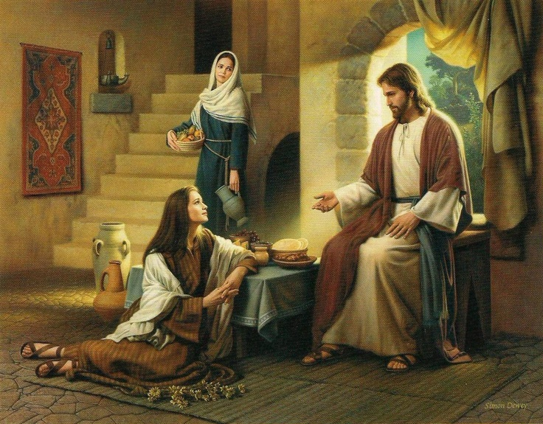
Mary of Bethany, Torah Student (Luke 10:39)

Slide 25
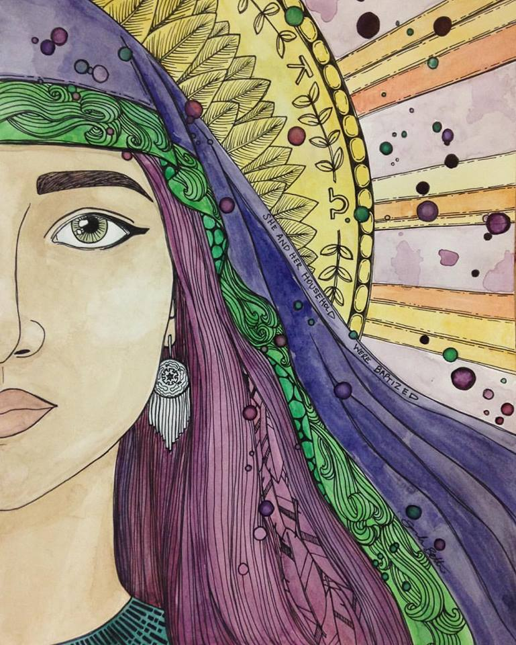
Lydia of Thyatira, Church Leader (Acts 16:11-15)
Painting by Sarah Beth Baca

Slide 26
Puzzle Pieces in New Testament
Euodia & Synteche—Phil. 4:2-3
1 Corinthians 11 Women
Mary, Mother of Jesus—Luke 1
All those who are unnamed

Slide 27
Puzzle Pieces in Old Testament
Sarah—Gen. 18:1-15; 21:1-8; Heb. 11:11
Hagar—Gen. 16:1–16; 21:8–21 (Checkout talk on God’s Heart for Ishmael at New Hope Church on 11/12/17)
Rahab—Josh. 2:1-3; 6:21-25; Matt. 1:5; Heb. 11:31
Deborah, the Judge—Judg. 4:4-10; Heb. 11:32
Hannah—1 Sam. 1-2
The Woman of Abel of Beth-maacah—2 Sam. 20:14-22
Hulda—2 Kings 22:14–20; 2 Chron. 34:22–28
Ruth—Book of Ruth; Matt. 1:5
Esther—Book of Esther
Proverbs 31 Woman
Women of Hebrews 11:35-40—See above too.

Slide 28
Application from 1 Timothy 2
False teaching must be strongly addressed.
Women can speak, teach, and lead.
Women should learn.
We should think and study deeply on this issue.
I Suffer Not a Woman: Rethinking 1 Timothy 2:11-15 in Light of Ancient Evidence by Richard Clark Kroeger and Catherine Clark Kroeger
Slaves, Women & Homosexuals: Exploring the Hermeneutics of Cultural Analysis by William J. Webb
Paul Through Mediterranean Eyes: Cultural Studies in 1 Corinthians by Kenneth E. Bailey

Slide 29
Application from 1 Timothy 2
False teaching must be strongly addressed.
Women can speak, teach, and lead.
Women should learn.
We should think and study deeply on this issue.
We need to grow in relating as brethren and sistren in Christ.

Slide 30
Application from 1 Timothy 2
False teaching must be strongly addressed.
Women can speak, teach, and lead.
Women should learn.
We should think and study deeply on this issue.
We need to grow in relating as brethren and sistren in Christ.
Q&A

Slide 31
Application from 1 Timothy 2
False teaching must be strongly addressed.
Women can speak, teach, and lead.
Women should learn.
We should think and study deeply on this issue.
We need to grow in relating as brethren and sistren in Christ.
Q&A
1 Timothy 3:14-16 NEX WEEK!

