Slide 2
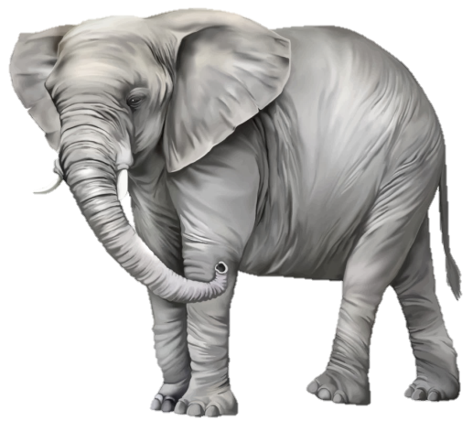
Wamego
Mon LIFE Group
Eastside
Tue LIFE Group
SoPo
Wed LIFE Group
Tallgrass Church
Central Gathering
Fall ‘18 LG Plan
1st Weeks—Party/Meal
2nd Weeks—Testimonies
3rd Weeks—Prayer Night
4th—Discovery Groups (3-5 people)
tallgrass.church

Slide 3
Back to the Schooler’s
Saturday, September 15, 5-8pm
At Luke & Eva Schooler’s
11725 Bob’s Lane, St. George
tallgrass.church

Slide 4
Guys’ Campout—Sept. 21-22
deets @ tallgrass.church

Slide 5
MINGLE QUESTION:
What’s the most recent puzzle you completed?

Slide 8
An elephant in the room
¹¹ Let a woman learn quietly with all submissiveness. ¹² I do not permit a woman to teach or to exercise authority over a man; rather, she is to remain quiet. ¹³ For Adam was formed first, then Eve; ¹⁴ and Adam was not deceived, but the woman was deceived and became a transgressor. ¹⁵ Yet she will be saved through childbearing—if they continue in faith and love and holiness, with self-control.
1st Timothy 2:11-15

Slide 9
To teach or not to teach?
¹¹ Let a woman learn quietly with all submissiveness. ¹² I do not permit a woman to teach or to exercise authority over a man; rather, she is to remain quiet. ¹³ For Adam was formed first, then Eve; ¹⁴ and Adam was not deceived, but the woman was deceived and became a transgressor. ¹⁵ Yet she will be saved through childbearing—if they continue in faith and love and holiness, with self-control.
1st Timothy 2:11-15

Slide 10
Four Views on Women
in the home, church, and society
Hard
Patriarchy
Soft Patriarchy
Evangelical Egalitarianism
Secular Egalitarianism
From Slaves, Women, & Homosexuals: Exploring the Hermeneutics of Cultural Analysis by William J. Webb (pp. 26-28)
Complementarian Egalitarian

Slide 12
Puzzle Pieces as Context
Section
Testament
Genre
Phrase
Canon
Culture
Word
Sentence
Paragraph
Book

Slide 13
Some Puzzles are Difficult
^{16b} There are some things in them that are hard to understand, which the ignorant and unstable twist to their own destruction, as they do the other Scriptures.
2nd Peter 3:16b

Slide 14
Some Puzzles are Difficult
^{16b} There are some things in them that are hard to understand, which the ignorant and unstable twist to their own destruction, as they do the other Scriptures.
2nd Peter 3:16b
Convictions:
We must seek to be faithful to the intent of the Scriptures.

Slide 15
Some Puzzles are Difficult
^{16b} There are some things in them that are hard to understand, which the ignorant and unstable twist to their own destruction, as they do the other Scriptures.
2nd Peter 3:16b
Convictions:
We must seek to be faithful to the intent of the Scriptures.
We must be consistent in our interpretation and application

Slide 16
Some Puzzles are Difficult
^{16b} There are some things in them that are hard to understand, which the ignorant and unstable twist to their own destruction, as they do the other Scriptures.
2nd Peter 3:16b
Convictions:
We must seek to be faithful to the intent of the Scriptures.
We must be consistent in our interpretation and application.
Women must be treated with dignity and respect.

Slide 17
Some Puzzles are Difficult
^{16b} There are some things in them that are hard to understand, which the ignorant and unstable twist to their own destruction, as they do the other Scriptures.
2nd Peter 3:16b
Convictions:
We must seek to be faithful to the intent of the Scriptures.
We must be consistent in our interpretation and application.
Women must be treated with dignity and respect.
Men must not be passive.

Slide 18
Some Puzzles are Difficult
^{16b} There are some things in them that are hard to understand, which the ignorant and unstable twist to their own destruction, as they do the other Scriptures.
2nd Peter 3:16b
Convictions:
We must seek to be faithful to the intent of the Scriptures.
We must be consistent in our interpretation and application.
Women must be treated with dignity and respect.
Men must not be passive.
We all bring ourselves to the Scriptures.

Slide 19
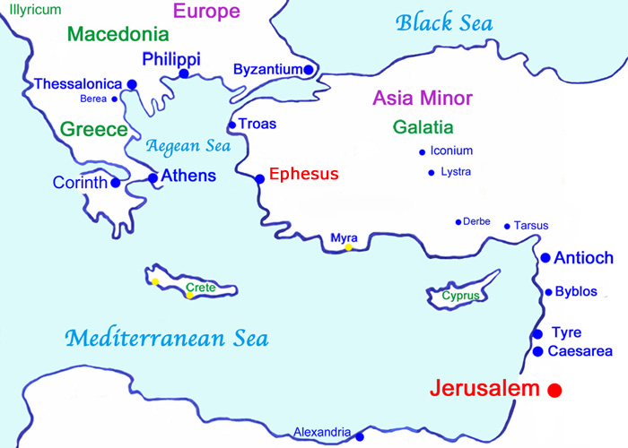
Puzzle Pieces in Acts 19

Slide 20
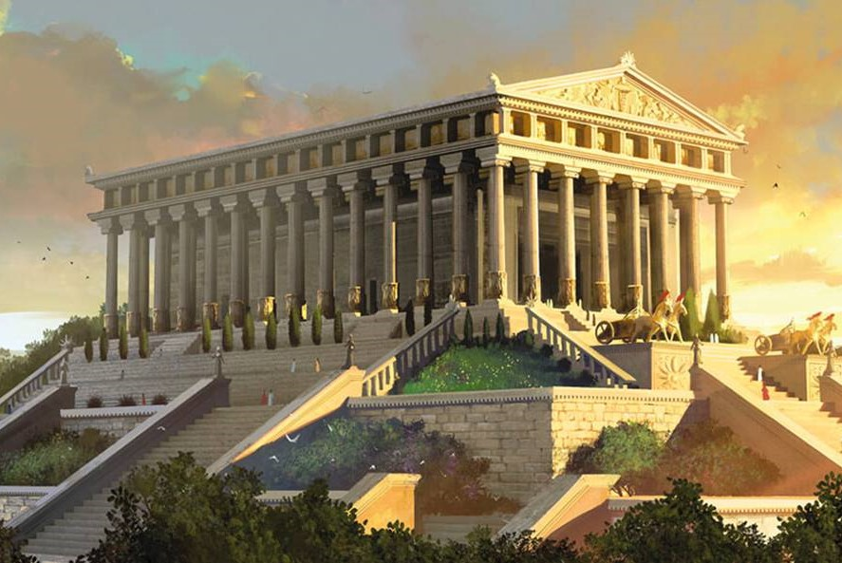
Puzzle Pieces in Acts 19

Slide 21
Puzzle Pieces in Acts 19
450’ x 225’ x 60’ with 127+ columns
“Great is Artemis of the Ephesians!”
Acts 19:28, 34

Slide 22
Puzzle Pieces in Acts 19
²⁸ Pay careful attention to yourselves and to all the flock,
in which the Holy Spirit has made you overseers,
to care for the church of God, which he obtained with his own blood.
²⁹ I know that after my departure fierce wolves will come in among you,
not sparing the flock; ³⁰ and from among your own selves will arise
men speaking twisted things, to draw away the disciples after them.
Acts 20:28-30

Slide 23
Puzzle Pieces in the Letters
Ephesians 4:7-8 ⁷ But grace was given to each one of us according to the measure of Christ's gift.⁸ Therefore it says, “When he ascended on high he led a host of captives, and he gave gifts to men.”
Ephesians 4:11 ¹¹ And he gave the apostles, the prophets, the evangelists, the shepherds and teachers…
Romans 12:6-8 ⁶ Having gifts that differ according to the grace given to us, let us use them: if prophecy, in proportion to our faith… ^{7b} …the one who teaches, in his teaching; ⁸ the one who exhorts, in his exhortation…the one who leads, with zeal…

Slide 24
Puzzle Pieces in the Letters
1 Corinthians 12:1 Now concerning spiritual gifts, brothers and sisters, I do not want you to be uninformed.
1 Corinthians 12:27-28a ²⁷ Now you are the body of Christ and individually members of it. ²⁸ And God has appointed in the church first apostles, second prophets, third teachers…
1 Peter 4:10-11a ¹⁰ As each has received a gift, use it to serve one another, as good stewards of God's varied grace: ^{11a} whoever speaks, as one who speaks oracles of God…

Slide 25
Puzzle Pieces in the Letters
Colossians 3:16 Let the word of Christ dwell in you richly, teaching and admonishing one another in all wisdom, singing psalms and hymns and spiritual songs, with thankfulness in your hearts to God.
1 Corinthians 11:1-16—Women were praying and prophesying out loud, leading in the assembly.
1 Corinthians 14:33-35 ³³ For God is not a God of confusion but of peace. As in all the churches of the saints, ³⁴ the women should keep silent in the churches. For they are not permitted to speak, but should be in submission, as the Law also says. ³⁵ If there is anything they desire to learn, let them ask their husbands at home. For it is shameful for a woman to speak in church.

Slide 26
Puzzle Pieces in Pastoral Letters
1 Timothy 1:3b-4 ^{3b} …remain at Ephesus so that you may charge certain persons not to teach any different doctrine, ⁴ nor to devote themselves to myths and endless genealogies, which promote speculations rather than the stewardship from God that is by faith.
1 Timothy 1:6 Certain persons, by swerving from these, have wandered away into vain discussion…
1 Timothy 1:19b-20 ^{19b} By rejecting this, some have made shipwreck of their faith, ²⁰ among whom are Hymenaeus and Alexander, whom I have handed over to Satan that they may learn not to blaspheme.

Slide 27
Puzzle Pieces in Pastoral Letters
1 Timothy 2:5-6 ⁵ For there is one God, and there is one mediator between God and men, the man Christ Jesus, ⁶ who gave himself as a ransom for all, which is the testimony given at the proper time.
1 Timothy 3:7 Moreover, he must be well thought of by outsiders, so that he may not fall into disgrace, into a snare of the devil.
1 Timothy 4:1-3a ¹ Now the Spirit expressly says that in later times some will depart from the faith by devoting themselves to deceitful spirits and teachings of demons, ² through the insincerity of liars whose consciences are seared, ³ who forbid marriage…
1 Timothy 4:7a Have nothing to do with irreverent, silly myths.

Slide 28
Puzzle Pieces in Pastoral Letters
1 Timothy 5:9-12—Specific instructions re: widows.
1 Timothy 5:13-15 ¹³ Besides that, they learn to be idlers, going about from house to house, and not only idlers, but also gossips and busybodies, saying what they should not. ¹⁴ So I would have younger widows marry, bear children, manage their households, and give the adversary no occasion for slander. ¹⁵ For some have already strayed after Satan.

Slide 29
Puzzle Pieces in Pastoral Letters
1 Timothy 6:3-5 ³ If anyone teaches a different doctrine and does not agree with the sound words of our Lord Jesus Christ and the teaching that accords with godliness, ⁴ he is puffed up with conceit and understands nothing. He has an unhealthy craving for controversy and for quarrels about words, which produce envy, dissension, slander, evil suspicions, ⁵ and constant friction among people who are depraved in mind and deprived of the truth, imagining that godliness is a means of gain.
1 Timothy 6:13-16—Statement about the character of Jesus.
1 Timothy 6:20b-21a ^{20b} Avoid the irreverent babble and contradictions of what is falsely called “knowledge,” ^{21a} for by professing it some have swerved from the faith.

Slide 30
Puzzle Pieces in Pastoral Letters
2 Timothy 2:16-18a ¹⁶ But avoid irreverent babble, for it will lead people into more and more ungodliness, ¹⁷ and their talk will spread like gangrene. Among them are Hymenaeus and Philetus, ¹⁸ who have swerved from the truth…
2 Timothy 2:23a, 26 ^{23a} Have nothing to do with foolish, ignorant controversies… ²⁶ …and they may come to their senses and escape from the snare of the devil, after being captured by him to do his will.
2 Timothy 3:6a, 8 ⁶ …those who creep into households and capture weak women… ^{8a} Just as Jannes and Jambres opposed Moses, so these men also oppose the truth, men corrupted in mind and disqualified regarding the faith.

Slide 31
Puzzle Pieces in Pastoral Letters
2 Timothy 4:3-4 ³ For the time is coming when people will not endure sound teaching, but having itching ears they will accumulate for themselves teachers to suit their own passions, ⁴ and will turn away from listening to the truth and wander off into myths.
2 Timothy 4:17—Paul compares himself to Daniel in Babylon.
Titus 1:14a …not devoting themselves to Jewish myths…
Titus 2:3-6—Older women and younger men
Titus 3:9a ^{9a} But avoid foolish controversies, genealogies…

Slide 32
Puzzle Pieces in 1 Timothy 2
⁸ I desire then that in every place the men should pray, lifting holy hands without anger or quarreling; ⁹ likewise also that women should adorn themselves in respectable apparel, with modesty and self-control, not with braided hair and gold or pearls or costly attire, ¹⁰ but with what is proper for women who profess godliness—with good works. ¹¹ Let a woman learn quietly with all submissiveness. ¹² I do not permit a woman to teach or to exercise authority over a man; rather, she is to remain quiet. ¹³ For Adam was formed first, then Eve; ¹⁴ and Adam was not deceived, but the woman was deceived and became a transgressor. ¹⁵ Yet she will be saved through childbearing—if they continue in faith and love and holiness, with self-control.
1 Timothy 2:8-15

Slide 33
Puzzle Pieces in 1 Timothy 2
⁸ I desire then that in every place the men should pray, lifting holy hands without anger or quarreling; ⁹ likewise also that women should adorn themselves in respectable apparel, with modesty and self-control, not with braided hair and gold or pearls or costly attire, ¹⁰ but with what is proper for women who profess godliness—with good works. ¹¹ Let a woman learn quietly with all submissiveness. ¹² I do not permit a woman to teach or to exercise authority over a man; rather, she is to remain quiet. ¹³ For Adam was formed first, then Eve; ¹⁴ and Adam was not deceived, but the woman was deceived and became a transgressor. ¹⁵ Yet she will be saved through childbearing—if they continue in faith and love and holiness, with self-control.
1 Timothy 2:8-15

Slide 34
Puzzle Pieces in 1 Timothy 2
¹¹ Let a woman learn quietly with all submissiveness. ¹² I do not permit a woman to teach or to exercise authority over a man; rather, she is to remain quiet. ¹³ For Adam was formed first, then Eve; ¹⁴ and Adam was not deceived, but the woman was deceived and became a transgressor. ¹⁵ Yet she will be saved through childbearing—if they continue in faith and love and holiness, with self-control.
1 Timothy 2:11-15

Slide 35
Puzzle Pieces in 1 Timothy 2
¹¹ Let a woman learn quietly with all submissiveness. ¹² I do not permit a woman to teach or to exercise authority over a man; rather, she is to remain quiet. ¹³ For Adam was formed first, then Eve; ¹⁴ and Adam was not deceived, but the woman was deceived and became a transgressor. ¹⁵ Yet she will be saved through childbearing—if they continue in faith and love and holiness, with self-control.
1 Timothy 2:11-15

Slide 36
Puzzle Pieces in 1 Timothy 2
¹¹ Let a woman learn quietly with all submissiveness. ¹² I do not permit a woman to teach or to exercise authority over a man; rather, she is to remain quiet. ¹³ For Adam was formed first, then Eve; ¹⁴ and Adam was not deceived, but the woman was deceived and became a transgressor. ¹⁵ Yet she will be saved through childbearing—if they continue in faith and love and holiness, with self-control.
1 Timothy 2:11-15
1 Timothy 2:1-2 ¹ First of all, then, I urge that supplications, prayers, intercessions, and thanksgivings be made for all people, ² for kings and all who are in high positions, that we may lead a peaceful and quiet life, godly and dignified in every way.

Slide 37
Puzzle Pieces in 1 Timothy 2
¹¹ Let a woman learn quietly with all submissiveness. ¹² I do not permit a woman to teach or to exercise authority over a man; rather, she is to remain quiet. ¹³ For Adam was formed first, then Eve; ¹⁴ and Adam was not deceived, but the woman was deceived and became a transgressor. ¹⁵ Yet she will be saved through childbearing—if they continue in faith and love and holiness, with self-control.
1 Timothy 2:11-15

Slide 38
Puzzle Pieces in 1 Timothy 2
¹¹ Let a woman learn quietly with all submissiveness. ¹² I do not permit a woman to teach or to exercise authority over a man; rather, she is to remain quiet. ¹³ For Adam was formed first, then Eve; ¹⁴ and Adam was not deceived, but the woman was deceived and became a transgressor. ¹⁵ Yet she will be saved through childbearing—if they continue in faith and love and holiness, with self-control.
1 Timothy 2:11-15
Genesis 3:16 To the woman he said, “I will surely multiply your pain in childbearing; in pain you shall bring forth children. Your desire shall be contrary to (against) your husband, but he shall rule over you.”

Slide 39
Puzzle Pieces in 1 Timothy 2
¹¹ Let a woman learn quietly with all submissiveness. ¹² I do not permit a woman to teach or to exercise authority over a man; rather, she is to remain quiet. ¹³ For Adam was formed first, then Eve; ¹⁴ and Adam was not deceived, but the woman was deceived and became a transgressor. ¹⁵ Yet she will be saved through childbearing—if they continue in faith and love and holiness, with self-control.
1 Timothy 2:11-15

Slide 40
Puzzle Pieces in 1 Timothy 2
¹¹ Let a woman learn quietly with all submissiveness. ¹² I do not permit a woman to teach or to exercise authority over a man; rather, she is to remain quiet. ¹³ For Adam was formed first, then Eve; ¹⁴ and Adam was not deceived, but the woman was deceived and became a transgressor. ¹⁵ Yet she will be saved through childbearing—if they continue in faith and love and holiness, with self-control.
1 Timothy 2:11-15

Slide 41
Puzzle Pieces in 1 Timothy 2
¹¹ Let a woman learn quietly with all submissiveness. ¹² I do not permit a woman to teach or to exercise authority over a man; rather, she is to remain quiet. ¹³ For Adam was formed first, then Eve; ¹⁴ and Adam was not deceived, but the woman was deceived and became a transgressor. ¹⁵ Yet she will be saved through childbearing—if they continue in faith and love and holiness, with self-control.
1 Timothy 2:11-15

Slide 42
Puzzle Pieces in 1 Timothy 2
¹¹ Let a woman learn quietly with all submissiveness. ¹² I do not permit a woman to teach or to exercise authority over a man; rather, she is to remain quiet. ¹³ For Adam was formed first, then Eve; ¹⁴ and Adam was not deceived, but the woman was deceived and became a transgressor. ¹⁵ Yet she will be saved through childbearing—if they continue in faith and love and holiness, with self-control.
1 Timothy 2:11-15
Luke 10:39 And she (Martha) had a sister called Mary, who sat at the Lord's feet and listened to his teaching.
Acts 22:3 I (Paul) am a Jew…educated at the feet of Gamaliel according to the strict manner of the law of our fathers, being zealous for God as all of you are this day.

Slide 43
Puzzle Pieces in 1 Timothy 2
¹¹ Let a woman learn quietly with all submissiveness. ¹² I do not permit a woman to teach or to exercise authority over a man; rather, she is to remain quiet. ¹³ For Adam was formed first, then Eve; ¹⁴ and Adam was not deceived, but the woman was deceived and became a transgressor. ¹⁵ Yet she will be saved through childbearing—if they continue in faith and love and holiness, with self-control.
1 Timothy 2:11-15

Slide 44
Puzzle Pieces in 1 Timothy 2
¹¹ Let a woman learn quietly with all submissiveness. ¹² I do not permit a woman to teach or to exercise authority over a man; rather, she is to remain quiet. ¹³ For Adam was formed first, then Eve; ¹⁴ and Adam was not deceived, but the woman was deceived and became a transgressor. ¹⁵ Yet she will be saved through childbearing—if they continue in faith and love and holiness, with self-control.
1 Timothy 2:11-15
1 Timothy 4:1, 3a ¹ Now the Spirit expressly says that in later times some will depart from the faith by devoting themselves to deceitful spirits and teachings of demons… ^{3a} who forbid marriage…

Slide 45
Application from 1 Timothy 2
False teaching must be strongly addressed.

Slide 46
Application from 1 Timothy 2
False teaching must be strongly addressed.
Women can speak, teach, and lead.

Slide 47
Application from 1 Timothy 2
False teaching must be strongly addressed.
Women can speak, teach, and lead.
Women should learn.

Slide 48
Application from 1 Timothy 2
False teaching must be strongly addressed.
Women can speak, teach, and lead.
Women should learn.
We should think and study deeply on this issue.

Slide 49
Application from 1 Timothy 2
False teaching must be strongly addressed.
Women can speak, teach, and lead.
Women should learn.
We should think and study deeply on this issue.
Slaves, Women & Homosexuals: Exploring the Hermeneutics of Cultural Analysis by William J. Webb
I Suffer Not a Woman: Rethinking 1 Timothy 2:11-15 in Light of Ancient Evidence by Richard Clark Kroeger and Catherine Clark Kroeger
Paul Through Mediterranean Eyes: Cultural Studies in 1 Corinthians by Kenneth E. Bailey

Slide 50
Application from 1 Timothy 2
False teaching must be strongly addressed.
Women can speak, teach, and lead.
Women should learn.
We should think and study deeply on this issue.
We need to grow in relating as brethren and sistren in Christ.

Slide 51
Application from 1 Timothy 2
False teaching must be strongly addressed.
Women can speak, teach, and lead.
Women should learn.
We should think and study deeply on this issue.
We need to grow in relating as brethren and sistren in Christ.
Q&A

Slide 52
Application from 1 Timothy 2
False teaching must be strongly addressed.
Women can speak, teach, and lead.
Women should learn.
We should think and study deeply on this issue.
We need to grow in relating as brethren and sistren in Christ.
Q&A
Next week we’ll study prominent women in the New Testament!

