Slide 1
TALLGRASS
COMMUNITY CHURCH

Slide 4
1 Timothy 2:1-10
2 ¹ First of all, then, I urge that supplications, prayers, intercessions, and thanksgivings be made for all people, ² for kings and all who are in high positions, that we may lead a peaceful and quiet life, godly and dignified in every way. ³ This is good, and it is pleasing in the sight of God our Savior, ⁴ who desires all people to be saved and to come to the knowledge of the truth. ⁵ For there is one God, and there is one mediator between God and men, the man Christ Jesus, ⁶ who gave himself as a ransom for all, which is the testimony given at the proper time. ⁷ For this I was appointed a preacher and an apostle (I am telling the truth, I am not lying), a teacher of the Gentiles in faith and truth.
⁸ I desire then that in every place the men should pray, lifting holy hands without anger or quarreling; ⁹ likewise also that women should adorn themselves in respectable apparel, with modesty and self-control, not with braided hair and gold or pearls or costly attire, ¹⁰ but with what is proper for women who profess godliness—with good works.

Slide 5
1 Timothy 2:1-10
2 ¹ First of all, then, I urge that supplications, prayers, intercessions, and thanksgivings be made for all people, ² for kings and all who are in high positions, that we may lead a peaceful and quiet life, godly and dignified in every way. ³ This is good, and it is pleasing in the sight of God our Savior, ⁴ who desires all people to be saved and to come to the knowledge of the truth. ⁵ For there is one God, and there is one mediator between God and men, the man Christ Jesus, ⁶ who gave himself as a ransom for all, which is the testimony given at the proper time. ⁷ For this I was appointed a preacher and an apostle (I am telling the truth, I am not lying), a teacher of the Gentiles in faith and truth.
⁸ I desire then that in every place the men should pray, lifting holy hands without anger or quarreling; ⁹ likewise also that women should adorn themselves in respectable apparel, with modesty and self-control, not with braided hair and gold or pearls or costly attire, ¹⁰ but with what is proper for women who profess godliness—with good works.

Slide 6
1 Timothy 2:1-10
2 ¹ First of all, then, I urge that supplications, prayers, intercessions, and thanksgivings be made for all people, ² for kings and all who are in high positions, that we may lead a peaceful and quiet life, godly and dignified in every way. ³ This is good, and it is pleasing in the sight of God our Savior, ⁴ who desires all people to be saved and to come to the knowledge of the truth. ⁵ For there is one God, and there is one mediator between God and men, the man Christ Jesus, ⁶ who gave himself as a ransom for all, which is the testimony given at the proper time. ⁷ For this I was appointed a preacher and an apostle (I am telling the truth, I am not lying), a teacher of the Gentiles in faith and truth.
⁸ I desire then that in every place the men should pray, lifting holy hands without anger or quarreling; ⁹ likewise also that women should adorn themselves in respectable apparel, with modesty and self-control, not with braided hair and gold or pearls or costly attire, ¹⁰ but with what is proper for women who profess godliness—with good works.

Slide 7
1 Timothy 2:1-10
2 ¹ First of all, then, I urge that supplications, prayers, intercessions, and thanksgivings be made for all people, ² for kings and all who are in high positions, that we may lead a peaceful and quiet life, godly and dignified in every way. ³ This is good, and it is pleasing in the sight of God our Savior, ⁴ who desires all people to be saved and to come to the knowledge of the truth. ⁵ For there is one God, and there is one mediator between God and men, the man Christ Jesus, ⁶ who gave himself as a ransom for all, which is the testimony given at the proper time. ⁷ For this I was appointed a preacher and an apostle (I am telling the truth, I am not lying), a teacher of the Gentiles in faith and truth.
⁸ I desire then that in every place the men should pray, lifting holy hands without anger or quarreling; ⁹ likewise also that women should adorn themselves in respectable apparel, with modesty and self-control, not with braided hair and gold or pearls or costly attire, ¹⁰ but with what is proper for women who profess godliness—with good works.
Functional NATURALISM

Slide 8
1 Timothy 2:1-10
2 ¹ First of all, then, I urge that supplications, prayers, intercessions, and thanksgivings be made for all people, ² for kings and all who are in high positions, that we may lead a peaceful and quiet life, godly and dignified in every way. ³ This is good, and it is pleasing in the sight of God our Savior, ⁴ who desires all people to be saved and to come to the knowledge of the truth. ⁵ For there is one God, and there is one mediator between God and men, the man Christ Jesus, ⁶ who gave himself as a ransom for all, which is the testimony given at the proper time. ⁷ For this I was appointed a preacher and an apostle (I am telling the truth, I am not lying), a teacher of the Gentiles in faith and truth.
⁸ I desire then that in every place the men should pray, lifting holy hands without anger or quarreling; ⁹ likewise also that women should adorn themselves in respectable apparel, with modesty and self-control, not with braided hair and gold or pearls or costly attire, ¹⁰ but with what is proper for women who profess godliness—with good works.
Functional DETERMINISM

Slide 9
1 Timothy 2:1-10
“What's prayer? It's shooting shafts into the dark. What mark they strike, if any, who's to say? It's reaching for a hand you cannot touch. The silence is so fathomless that prayers like plummets vanish into the sea. You beg. You whimper. You load God down with empty praise. You tell him sins that he already knows full well. You seek to change his changeless will. … And sometimes, by God's grace, a prayer is heard.”
2 ¹ First of all, then, I urge that supplications, prayers, intercessions, and thanksgivings be made for all people, ² for kings and all who are in high positions, that we may lead a peaceful and quiet life, godly and dignified in every way. ³ This is good, and it is pleasing in the sight of God our Savior, ⁴ who desires all people to be saved and to come to the knowledge of the truth. ⁵ For there is one God, and there is one mediator between God and men, the man Christ Jesus, ⁶ who gave himself as a ransom for all, which is the testimony given at the proper time. ⁷ For this I was appointed a preacher and an apostle (I am telling the truth, I am not lying), a teacher of the Gentiles in faith and truth.
⁸ I desire then that in every place the men should pray, lifting holy hands without anger or quarreling; ⁹ likewise also that women should adorn themselves in respectable apparel, with modesty and self-control, not with braided hair and gold or pearls or costly attire, ¹⁰ but with what is proper for women who profess godliness—with good works.

Slide 10
1 Timothy 2:1-10
2 ¹ First of all, then, I urge that supplications, prayers, intercessions, and thanksgivings be made for all people, ² for kings and all who are in high positions, that we may lead a peaceful and quiet life, godly and dignified in every way. ³ This is good, and it is pleasing in the sight of God our Savior, ⁴ who desires all people to be saved and to come to the knowledge of the truth. ⁵ For there is one God, and there is one mediator between God and men, the man Christ Jesus, ⁶ who gave himself as a ransom for all, which is the testimony given at the proper time. ⁷ For this I was appointed a preacher and an apostle (I am telling the truth, I am not lying), a teacher of the Gentiles in faith and truth.
⁸ I desire then that in every place the men should pray, lifting holy hands without anger or quarreling; ⁹ likewise also that women should adorn themselves in respectable apparel, with modesty and self-control, not with braided hair and gold or pearls or costly attire, ¹⁰ but with what is proper for women who profess godliness—with good works.
Ephesians 6:11-12 ¹¹ Put on the whole armor of God, that you may be able to stand against the schemes of the devil. ¹² For we do not wrestle against flesh and blood, but against the rulers, against the authorities, against the cosmic powers over this present darkness, against the spiritual forces of evil in the heavenly places.

Slide 11
1 Timothy 2:1-10
2 ¹ First of all, then, I urge that supplications, prayers, intercessions, and thanksgivings be made for all people, ² for kings and all who are in high positions, that we may lead a peaceful and quiet life, godly and dignified in every way. ³ This is good, and it is pleasing in the sight of God our Savior, ⁴ who desires all people to be saved and to come to the knowledge of the truth. ⁵ For there is one God, and there is one mediator between God and men, the man Christ Jesus, ⁶ who gave himself as a ransom for all, which is the testimony given at the proper time. ⁷ For this I was appointed a preacher and an apostle (I am telling the truth, I am not lying), a teacher of the Gentiles in faith and truth.
⁸ I desire then that in every place the men should pray, lifting holy hands without anger or quarreling; ⁹ likewise also that women should adorn themselves in respectable apparel, with modesty and self-control, not with braided hair and gold or pearls or costly attire, ¹⁰ but with what is proper for women who profess godliness—with good works.
2 Corinthians 10:3-4 ³ For though we walk in the flesh, we are not waging war according to the flesh. ⁴ For the weapons of our warfare are not of the flesh but have divine power to destroy strongholds.

Slide 12
1 Timothy 2:1-10
2 ¹ First of all, then, I urge that supplications, prayers, intercessions, and thanksgivings be made for all people, ² for kings and all who are in high positions, that we may lead a peaceful and quiet life, godly and dignified in every way. ³ This is good, and it is pleasing in the sight of God our Savior, ⁴ who desires all people to be saved and to come to the knowledge of the truth. ⁵ For there is one God, and there is one mediator between God and men, the man Christ Jesus, ⁶ who gave himself as a ransom for all, which is the testimony given at the proper time. ⁷ For this I was appointed a preacher and an apostle (I am telling the truth, I am not lying), a teacher of the Gentiles in faith and truth.
⁸ I desire then that in every place the men should pray, lifting holy hands without anger or quarreling; ⁹ likewise also that women should adorn themselves in respectable apparel, with modesty and self-control, not with braided hair and gold or pearls or costly attire, ¹⁰ but with what is proper for women who profess godliness—with good works.
“To be cynical is to be distant. While offering a false intimacy of being "in the know," cynicism actually destroys intimacy. It leads to a creeping bitterness that can deaden and even destroy the spirit... A praying life is just the opposite. It engages evil. It doesn't take no for an answer. The psalmist was in God's face, hoping, dreaming, asking. Prayer is feisty. Cynicism, on the other hand, merely critiques. It is passive, cocooning itself from the passions of the great cosmic battle we are engaged in. It is without hope.”

Slide 13
1 Timothy 2:1-10
2 ¹ First of all, then, I urge that supplications, prayers, intercessions, and thanksgivings be made for all people, ² for kings and all who are in high positions, that we may lead a peaceful and quiet life, godly and dignified in every way. ³ This is good, and it is pleasing in the sight of God our Savior, ⁴ who desires all people to be saved and to come to the knowledge of the truth. ⁵ For there is one God, and there is one mediator between God and men, the man Christ Jesus, ⁶ who gave himself as a ransom for all, which is the testimony given at the proper time. ⁷ For this I was appointed a preacher and an apostle (I am telling the truth, I am not lying), a teacher of the Gentiles in faith and truth.
⁸ I desire then that in every place the men should pray, lifting holy hands without anger or quarreling; ⁹ likewise also that women should adorn themselves in respectable apparel, with modesty and self-control, not with braided hair and gold or pearls or costly attire, ¹⁰ but with what is proper for women who profess godliness—with good works.
Ephesians 3:20-21 ²⁰ Now to him who is able to do far more abundantly than all that we ask or think, according to the power at work within us, ²¹ to him be glory in the church and in Christ Jesus throughout all generations, forever and ever. Amen.

Slide 14
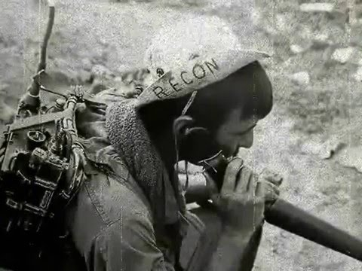
1 Timothy 2:1-10
2 ¹ First of all, then, I urge that supplications, prayers, intercessions, and thanksgivings be made for all people, ² for kings and all who are in high positions, that we may lead a peaceful and quiet life, godly and dignified in every way. ³ This is good, and it is pleasing in the sight of God our Savior, ⁴ who desires all people to be saved and to come to the knowledge of the truth. ⁵ For there is one God, and there is one mediator between God and men, the man Christ Jesus, ⁶ who gave himself as a ransom for all, which is the testimony given at the proper time. ⁷ For this I was appointed a preacher and an apostle (I am telling the truth, I am not lying), a teacher of the Gentiles in faith and truth.
⁸ I desire then that in every place the men should pray, lifting holy hands without anger or quarreling; ⁹ likewise also that women should adorn themselves in respectable apparel, with modesty and self-control, not with braided hair and gold or pearls or costly attire, ¹⁰ but with what is proper for women who profess godliness—with good works.

Slide 15
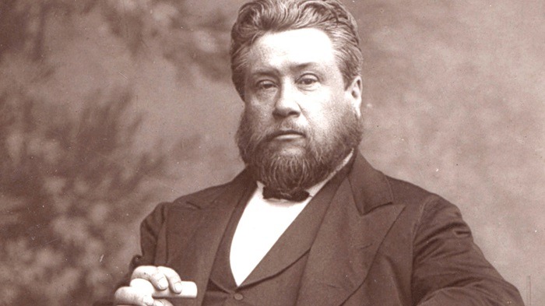
1 Timothy 2:8-11
2 ¹ First of all, then, I urge that supplications, prayers, intercessions, and thanksgivings be made for all people, ² for kings and all who are in high positions, that we may lead a peaceful and quiet life, godly and dignified in every way. ³ This is good, and it is pleasing in the sight of God our Savior, ⁴ who desires all people to be saved and to come to the knowledge of the truth. ⁵ For there is one God, and there is one mediator between God and men, the man Christ Jesus, ⁶ who gave himself as a ransom for all, which is the testimony given at the proper time. ⁷ For this I was appointed a preacher and an apostle (I am telling the truth, I am not lying), a teacher of the Gentiles in faith and truth.
⁸ I desire then that in every place the men should pray, lifting holy hands without anger or quarreling; ⁹ likewise also that women should adorn themselves in respectable apparel, with modesty and self-control, not with braided hair and gold or pearls or costly attire, ¹⁰ but with what is proper for women who profess godliness—with good works.

Slide 16
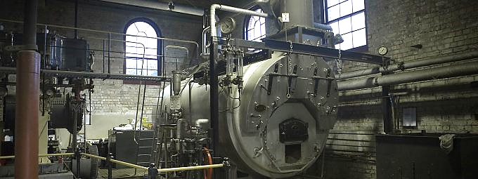
1 Timothy 2:8-11
2 ¹ First of all, then, I urge that supplications, prayers, intercessions, and thanksgivings be made for all people, ² for kings and all who are in high positions, that we may lead a peaceful and quiet life, godly and dignified in every way. ³ This is good, and it is pleasing in the sight of God our Savior, ⁴ who desires all people to be saved and to come to the knowledge of the truth. ⁵ For there is one God, and there is one mediator between God and men, the man Christ Jesus, ⁶ who gave himself as a ransom for all, which is the testimony given at the proper time. ⁷ For this I was appointed a preacher and an apostle (I am telling the truth, I am not lying), a teacher of the Gentiles in faith and truth.
⁸ I desire then that in every place the men should pray, lifting holy hands without anger or quarreling; ⁹ likewise also that women should adorn themselves in respectable apparel, with modesty and self-control, not with braided hair and gold or pearls or costly attire, ¹⁰ but with what is proper for women who profess godliness—with good works.

Slide 17
1 Timothy 2:8-11
If the engine room is out of action, then the whole mill will grind to a halt. We cannot expect blessing if we do not ask. – Charles Spurgeon
2 ¹ First of all, then, I urge that supplications, prayers, intercessions, and thanksgivings be made for all people, ² for kings and all who are in high positions, that we may lead a peaceful and quiet life, godly and dignified in every way. ³ This is good, and it is pleasing in the sight of God our Savior, ⁴ who desires all people to be saved and to come to the knowledge of the truth. ⁵ For there is one God, and there is one mediator between God and men, the man Christ Jesus, ⁶ who gave himself as a ransom for all, which is the testimony given at the proper time. ⁷ For this I was appointed a preacher and an apostle (I am telling the truth, I am not lying), a teacher of the Gentiles in faith and truth.
⁸ I desire then that in every place the men should pray, lifting holy hands without anger or quarreling; ⁹ likewise also that women should adorn themselves in respectable apparel, with modesty and self-control, not with braided hair and gold or pearls or costly attire, ¹⁰ but with what is proper for women who profess godliness—with good works.

Slide 18
1 Timothy 2:1-10 - WHAT
2 ¹ First of all, then, I urge that supplications, prayers, intercessions, and thanksgivings be made for all people, ² for kings and all who are in high positions, that we may lead a peaceful and quiet life, godly and dignified in every way. ³ This is good, and it is pleasing in the sight of God our Savior, ⁴ who desires all people to be saved and to come to the knowledge of the truth. ⁵ For there is one God, and there is one mediator between God and men, the man Christ Jesus, ⁶ who gave himself as a ransom for all, which is the testimony given at the proper time. ⁷ For this I was appointed a preacher and an apostle (I am telling the truth, I am not lying), a teacher of the Gentiles in faith and truth.
⁸ I desire then that in every place the men should pray, lifting holy hands without anger or quarreling; ⁹ likewise also that women should adorn themselves in respectable apparel, with modesty and self-control, not with braided hair and gold or pearls or costly attire, ¹⁰ but with what is proper for women who profess godliness—with good works.

Slide 19
1 Timothy 2:1-10 - WHAT
2 ¹ First of all, then, I urge that supplications, prayers, intercessions, and thanksgivings be made for all people, ² for kings and all who are in high positions, that we may lead a peaceful and quiet life, godly and dignified in every way. ³ This is good, and it is pleasing in the sight of God our Savior, ⁴ who desires all people to be saved and to come to the knowledge of the truth. ⁵ For there is one God, and there is one mediator between God and men, the man Christ Jesus, ⁶ who gave himself as a ransom for all, which is the testimony given at the proper time. ⁷ For this I was appointed a preacher and an apostle (I am telling the truth, I am not lying), a teacher of the Gentiles in faith and truth.
⁸ I desire then that in every place the men should pray, lifting holy hands without anger or quarreling; ⁹ likewise also that women should adorn themselves in respectable apparel, with modesty and self-control, not with braided hair and gold or pearls or costly attire, ¹⁰ but with what is proper for women who profess godliness—with good works.

Slide 20
1 Timothy 2:1-10 - WHAT
2 ¹ First of all, then, I urge that supplications, prayers, intercessions, and thanksgivings be made for all people, ² for kings and all who are in high positions, that we may lead a peaceful and quiet life, godly and dignified in every way. ³ This is good, and it is pleasing in the sight of God our Savior, ⁴ who desires all people to be saved and to come to the knowledge of the truth. ⁵ For there is one God, and there is one mediator between God and men, the man Christ Jesus, ⁶ who gave himself as a ransom for all, which is the testimony given at the proper time. ⁷ For this I was appointed a preacher and an apostle (I am telling the truth, I am not lying), a teacher of the Gentiles in faith and truth.
⁸ I desire then that in every place the men should pray, lifting holy hands without anger or quarreling; ⁹ likewise also that women should adorn themselves in respectable apparel, with modesty and self-control, not with braided hair and gold or pearls or costly attire, ¹⁰ but with what is proper for women who profess godliness—with good works.

Slide 21
1 Timothy 2:1-10 - WHAT
2 ¹ First of all, then, I urge that supplications, prayers, intercessions, and thanksgivings be made for all people, ² for kings and all who are in high positions, that we may lead a peaceful and quiet life, godly and dignified in every way. ³ This is good, and it is pleasing in the sight of God our Savior, ⁴ who desires all people to be saved and to come to the knowledge of the truth. ⁵ For there is one God, and there is one mediator between God and men, the man Christ Jesus, ⁶ who gave himself as a ransom for all, which is the testimony given at the proper time. ⁷ For this I was appointed a preacher and an apostle (I am telling the truth, I am not lying), a teacher of the Gentiles in faith and truth.
⁸ I desire then that in every place the men should pray, lifting holy hands without anger or quarreling; ⁹ likewise also that women should adorn themselves in respectable apparel, with modesty and self-control, not with braided hair and gold or pearls or costly attire, ¹⁰ but with what is proper for women who profess godliness—with good works.

Slide 22
1 Timothy 2:1-10
2 ¹ First of all, then, I urge that supplications, prayers, intercessions, and thanksgivings be made for all people, ² for kings and all who are in high positions, that we may lead a peaceful and quiet life, godly and dignified in every way. ³ This is good, and it is pleasing in the sight of God our Savior, ⁴ who desires all people to be saved and to come to the knowledge of the truth. ⁵ For there is one God, and there is one mediator between God and men, the man Christ Jesus, ⁶ who gave himself as a ransom for all, which is the testimony given at the proper time. ⁷ For this I was appointed a preacher and an apostle (I am telling the truth, I am not lying), a teacher of the Gentiles in faith and truth.
⁸ I desire then that in every place the men should pray, lifting holy hands without anger or quarreling; ⁹ likewise also that women should adorn themselves in respectable apparel, with modesty and self-control, not with braided hair and gold or pearls or costly attire, ¹⁰ but with what is proper for women who profess godliness—with good works.

Slide 23
1 Timothy 2:1-10 - WHAT
2 ¹ First of all, then, I urge that supplications, prayers, intercessions, and thanksgivings be made for all people, ² for kings and all who are in high positions, that we may lead a peaceful and quiet life, godly and dignified in every way. ³ This is good, and it is pleasing in the sight of God our Savior, ⁴ who desires all people to be saved and to come to the knowledge of the truth. ⁵ For there is one God, and there is one mediator between God and men, the man Christ Jesus, ⁶ who gave himself as a ransom for all, which is the testimony given at the proper time. ⁷ For this I was appointed a preacher and an apostle (I am telling the truth, I am not lying), a teacher of the Gentiles in faith and truth.
⁸ I desire then that in every place the men should pray, lifting holy hands without anger or quarreling; ⁹ likewise also that women should adorn themselves in respectable apparel, with modesty and self-control, not with braided hair and gold or pearls or costly attire, ¹⁰ but with what is proper for women who profess godliness—with good works.

Slide 24
1 Timothy 2:1-10 - WHAT
2 ¹ First of all, then, I urge that supplications, prayers, intercessions, and thanksgivings be made for all people, ² for kings and all who are in high positions, that we may lead a peaceful and quiet life, godly and dignified in every way. ³ This is good, and it is pleasing in the sight of God our Savior, ⁴ who desires all people to be saved and to come to the knowledge of the truth. ⁵ For there is one God, and there is one mediator between God and men, the man Christ Jesus, ⁶ who gave himself as a ransom for all, which is the testimony given at the proper time. ⁷ For this I was appointed a preacher and an apostle (I am telling the truth, I am not lying), a teacher of the Gentiles in faith and truth.
⁸ I desire then that in every place the men should pray, lifting holy hands without anger or quarreling; ⁹ likewise also that women should adorn themselves in respectable apparel, with modesty and self-control, not with braided hair and gold or pearls or costly attire, ¹⁰ but with what is proper for women who profess godliness—with good works.

Slide 25
1 Timothy 2:1-10 - HOW
2 ¹ First of all, then, I urge that supplications, prayers, intercessions, and thanksgivings be made for all people, ² for kings and all who are in high positions, that we may lead a peaceful and quiet life, godly and dignified in every way. ³ This is good, and it is pleasing in the sight of God our Savior, ⁴ who desires all people to be saved and to come to the knowledge of the truth. ⁵ For there is one God, and there is one mediator between God and men, the man Christ Jesus, ⁶ who gave himself as a ransom for all, which is the testimony given at the proper time. ⁷ For this I was appointed a preacher and an apostle (I am telling the truth, I am not lying), a teacher of the Gentiles in faith and truth.
⁸ I desire then that in every place the men should pray, lifting holy hands without anger or quarreling; ⁹ likewise also that women should adorn themselves in respectable apparel, with modesty and self-control, not with braided hair and gold or pearls or costly attire, ¹⁰ but with what is proper for women who profess godliness—with good works.

Slide 26
APPLICATIONS

Slide 27
APPLICATIONS
Begin Scheduling Times of Prayer

Slide 28
APPLICATIONS
Begin Scheduling Times of Prayer
Pray with your Family & Friends

Slide 29
APPLICATIONS
Begin Scheduling Times of Prayer
Pray with your Family & Friends
Prioritize Prayer Meetings
* Take a Next Step of Engagement!

Slide 30
APPLICATIONS
Begin Scheduling Times of Prayer
Pray with your Family & Friends
Prioritize Prayer Meetings
* Take a Next Step of Engagement!
Pray Boldly and BIG-LY

Slide 31
APPLICATIONS
Begin Scheduling Times of Prayer
Pray with your Family & Friends
Prioritize Prayer Meetings
* Take a Next Step of Engagement!
Pray Boldly and BIG-LY
Recommended Resources * Psalms, Ephesians, A Praying Life

Slide 32
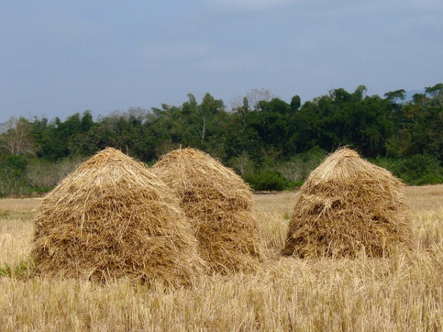
The Haystack prayer mtg

Slide 33
PRAYER PRACTICE

