Slide 1
TALLGRASS
COMMUNITY CHURCH

Slide 4
Why Believe in Jesus?

Slide 5
Why Believe in Jesus?
Evidence for the Resurrection

Slide 6
Recommended Resources

Slide 7
BASICS FOR THIS INVESTIGATION

Slide 8
BASICS FOR THIS INVESTIGATION
Use the Bible as an ancient source
Not assume inspired, inerrant, unbiased, or even especially reliable

Slide 9
BASICS FOR THIS INVESTIGATION
Use the Bible as an ancient source
Not assume inspired, inerrant, unbiased, or even especially reliable
Five things that support historical claims:
Multiple, Independent Sources
Attestation by an Enemy
Embarrassing Admissions
Eyewitness Testimony
Early Testimony

Slide 10
#1: JESUS DIED BY CRUCIFIXION

Slide 11
#1: JESUS DIED BY CRUCIFIXION
Multiply Attested in New Testament

Slide 12
#1: JESUS DIED BY CRUCIFIXION
Extrabiblical Sources

Slide 13
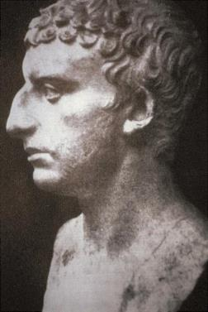
#1: JESUS DIED BY CRUCIFIXION
Extrabiblical Sources
Josephus:
“At this time there was a wise man called Jesus, and his conduct was good, and he was known to be virtuous. Many people among the Jews and the other nations became his disciples. Pilate condemned him to be crucified and to die. But those who had become his disciples did not abandon his discipleship. They reported that he had appeared to them three days after his crucifixion and that he was alive. Accordingly, he was perhaps the Messiah, concerning whom the prophets have reported wonders. And the tribe of the Christians, so named after him, has not disap- peared to this day.” - Jewish Antiquities, 18.63

Slide 14
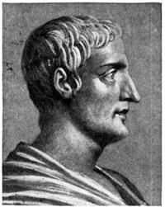
#1: JESUS DIED BY CRUCIFIXION
Extrabiblical Sources
Tacitus:
“…called Christians by the populace. Christus, from whom the name had its origin, suffered the extreme penalty during the reign of Tiberius at the hands of one of our procurators, Pontius Pilatus” - Annals, 15.44

Slide 15
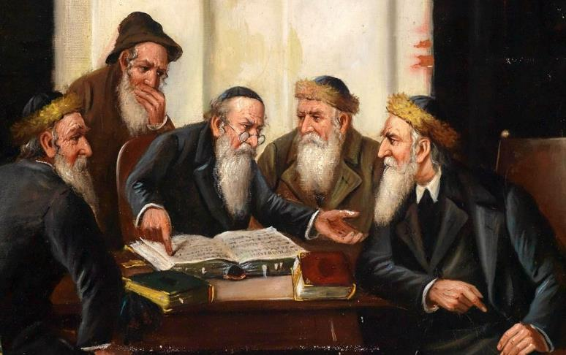
#1: JESUS DIED BY CRUCIFIXION
Extrabiblical Sources
Talmud:
"On the Eve of Passover, they hung Jesus of Nazareth for sorcery and enticing Israel [to idolatry]." - Sanhedrin 43a

Slide 16
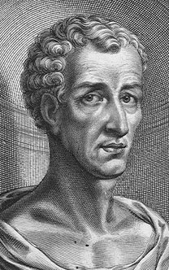
#1: JESUS DIED BY CRUCIFIXION
Extrabiblical Sources
Lucian:
“The Christians, you know, worship a man to this day – the distinguished personage who introduced their novel rites, and was crucified on that account … You see these misguided creatures … worship the crucified sage, and live after his laws.” - “The Passing of Peregrinus”

Slide 17
#1: JESUS DIED BY CRUCIFIXION
Biblical & Extrabiblical Sources
Jesus was a real 1st century man
Jesus was executed by crucifixion

Slide 18
#1: JESUS DIED BY CRUCIFIXION
Biblical & Extrabiblical Sources
Jesus was a real 1st century man
Jesus was executed by crucifixion
“That he was crucified is as sure as anything historical can ever be.” - John Dominic Crossan

Slide 19
#2: DISCIPLES BELIEVED JESUS ROSE AND APPEARED TO THEM

Slide 20
#2: DISCIPLES BELIEVED JESUS ROSE AND APPEARED TO THEM
Early Creedal Statements

Slide 21
#2: DISCIPLES BELIEVED JESUS ROSE AND APPEARED TO THEM
Early Creedal Statements
1 Corinthians 15:3-5 ^{(ESV)}
³ For I delivered to you as of first importance what I also received:
that Christ died for our sins in accordance with the Scriptures, ⁴ that he was buried, that he was raised on the third day in accordance with the Scriptures, ⁵ and that he appeared to Cephas, then to the twelve.

Slide 22
#2: DISCIPLES BELIEVED JESUS ROSE AND APPEARED TO THEM
Early Creedal Statements
1 Corinthians 15:3-5 ^{(ESV)}
³ For I delivered to you as of first importance what I also received:
that Christ died for our sins in accordance with the Scriptures, ⁴ that he was buried, that he was raised on the third day in accordance with the Scriptures, ⁵ and that he appeared to Cephas, then to the twelve.
“Even radical scholars like Gerd Lüdemann think that ‘the elements in the tradition are to be dated to the first two years after the crucifixion… no later than three years after the death of Jesus.’” - Gary Habermas

Slide 23
#2: DISCIPLES BELIEVED JESUS ROSE AND APPEARED TO THEM
Early Creedal Statements
The Gospel Accounts

Slide 24
#2: DISCIPLES BELIEVED JESUS ROSE AND APPEARED TO THEM
Early Creedal Statements
The Gospel Accounts
Early Church Fathers’ Writings

Slide 25
#2: DISCIPLES BELIEVED JESUS ROSE AND APPEARED TO THEM
Early Creedal Statements
The Gospel Accounts
Early Church Fathers’ Writings
Clement of Rome
Polycarp

Slide 26
#2: DISCIPLES BELIEVED JESUS ROSE AND APPEARED TO THEM
Early Creedal Statements
The Gospel Accounts
Early Church Fathers’ Writings
Disciples’ Willingness to Suffer and Die for their Claim

Slide 27
#2: DISCIPLES BELIEVED JESUS ROSE AND APPEARED TO THEM
Early Creedal Statements
The Gospel Accounts
Early Church Fathers’ Writings
Disciples’ Willingness to Suffer and Die for their Claim
Stephen & James the brother of John [Acts]
Peter & Paul [Clement of Rome, Tertullian, Origin]
James, brother of Jesus [Eusebius]

Slide 28
#2: DISCIPLES BELIEVED JESUS ROSE AND APPEARED TO THEM
Early Creedal Statements
The Gospel Accounts
Early Church Fathers’ Writings
Disciples’ Willingness to Suffer and Die for their Claim
"It may be taken as historically certain that Peter and the disciples had experiences after Jesus’s death in which Jesus appeared to them as the risen Christ.” - Gert Lüdemann

Slide 29
#3: PAUL SUDDENLY CHANGED

Slide 30
#3: PAUL SUDDENLY CHANGED
Luke’s account in Acts 9
Paul’s own Testimonies in Acts 22 & 26
Conversion multiply attested by Clement, Polycarp, Tertullian, Dionysius of Corinth, Origin
Died a martyr attested by Clement of Rome, Tertullian, Origin

Slide 31
#4: JAMES SUDDENLY CHANGED

Slide 32
#4: JAMES SUDDENLY CHANGED
Identity confirmed in Gospels & Josephus
Unbeliever in Jesus confirmed in Mark 3, 6, John 7
Jesus appeared to James after his death attested in Early Creedal Statement in 1 Corinthians 15
James identified as leader of Jerusalem Church afterward in Acts 15, Galatians 9
James died a martyr attested by Josephus, Hegesippus, Clement of Alexandria, Eusebius

Slide 33
#5: THE TOMB WAS EMPTY

Slide 34
#5: THE TOMB WAS EMPTY
Jerusalem Factor

Slide 35
#5: THE TOMB WAS EMPTY
Jerusalem Factor
Public execution there
Burial location known

Slide 36
#5: THE TOMB WAS EMPTY
Jerusalem Factor
Public execution there
Burial location known
The honorable burial of Jesus is one of "the earliest and best-attested facts about Jesus” - John A. T. Robinson

Slide 37
#5: THE TOMB WAS EMPTY
Jerusalem Factor
Public execution there
Burial location known
Resurrection first proclaimed there
Yet no one ever presents the body!

Slide 38
#5: THE TOMB WAS EMPTY
Jerusalem Factor
Enemy Attestation

Slide 39
#5: THE TOMB WAS EMPTY
Jerusalem Factor
Enemy Attestation
Jewish leaders claim the reason WHY the body is missing, but never that it was still in the tomb (Mt. 27:62-66; 28:4, 11-15)

Slide 40
#5: THE TOMB WAS EMPTY
Jerusalem Factor
Enemy Attestation
Criterion of Embarrassment

Slide 41
#5: THE TOMB WAS EMPTY
Jerusalem Factor
Enemy Attestation
Criterion of Embarrassment
Women reported as primary witnesses to the empty tomb and Jesus’ resurrection

Slide 42
#5: THE TOMB WAS EMPTY
Jerusalem Factor
Enemy Attestation
Criterion of Embarrassment
Women reported as primary witnesses to the empty tomb and Jesus’ resurrection
"It is extremely difficult to object to the empty tomb on historical grounds; those who deny it do so on the basis of theological or philosophical assumptions." – D. H. van Daalen

Slide 43
5 HISTORICAL FACTS
Jesus Died by Crucifixion
The Disciples’ Believed Jesus Rose and Appeared to Them
Paul was Suddenly Changed
James was Suddenly Changed
The Tomb was Empty

Slide 44
BEST EXPLANATION OF FACTS?

Slide 45
BEST EXPLANATION OF FACTS?
Fictitious Story

Slide 46
BEST EXPLANATION OF FACTS?
Fictitious Story
Legendary Embellishment

Slide 47
BEST EXPLANATION OF FACTS?
Fictitious Story
Legendary Embellishment
Myth Derived from other Religions

Slide 48
BEST EXPLANATION OF FACTS?
Fictitious Story
Legendary Embellishment
Myth Derived from other Religions
Fraud

Slide 49
BEST EXPLANATION OF FACTS?
Fictitious Story
Legendary Embellishment
Myth Derived from other Religions
Fraud
Jesus Wasn’t Really Dead

Slide 50
BEST EXPLANATION OF FACTS?
Fictitious Story
Legendary Embellishment
Myth Derived from other Religions
Fraud
Jesus Wasn’t Really Dead
Mass Hallucinations

Slide 51
BEST EXPLANATION OF FACTS?
Fictitious Story
Legendary Embellishment
Myth Derived from other Religions
Fraud
Jesus Wasn’t Really Dead
Mass Hallucinations
Jesus had an Identical Twin Brother

Slide 52
BEST EXPLANATION OF FACTS?
Fictitious Story
Legendary Embellishment
Myth Derived from other Religions
Fraud
Jesus Wasn’t Really Dead
Mass Hallucinations
Jesus had an Identical Twin Brother
God Raised Jesus from the Dead

Slide 53
IT IS REASONABLE TO BELIEVE IN JESUS!

Slide 54
1. Consider the evidence, believe in Jesus as Lord.

Slide 55
1. Consider the evidence, believe in Jesus as Lord.
“if you confess with your mouth that Jesus is Lord and believe in your heart that God raised him from the dead, you will be saved.” – Romans 10:9

Slide 56
1. Consider the evidence, believe in Jesus as Lord. 2. Gain confidence in your faith.

Slide 57
1. Consider the evidence, believe in Jesus as Lord. 2. Gain confidence in your faith. 3. Grow in your ability to talk about this with others.

Slide 58
1. Consider the evidence, believe in Jesus as Lord. 2. Gain confidence in your faith. 3. Grow in your ability to talk about this with others.
“…in your hearts honor Christ the Lord as holy, always being prepared to make a defense to anyone who asks you for a reason for the hope that is in you; yet do it with gentleness and respect” – 1 Peter 3:15

Slide 59
1. Consider the evidence, believe in Jesus as Lord. 2. Gain confidence in your faith. 3. Grow in your ability to talk about this with others. 4. Consider how you need to more fully believe in Jesus as Lord (and take steps of repentance).

