Slide 1
TALLGRASS
COMMUNITY CHURCH

Slide 2
TODAY! 7pm @ The Hi Lo
tallgrass.church | info@tallgrass.church

Slide 3
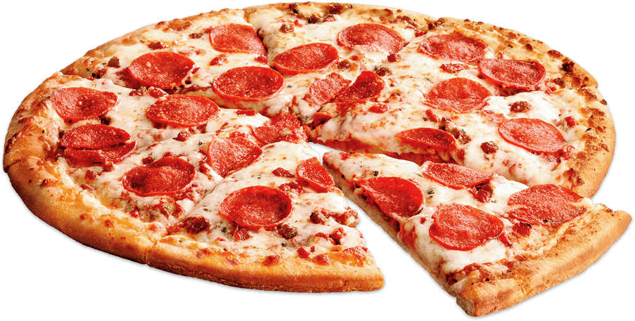
TALLGRASS YOUTH AFTER PARTY TODAY! 6:45pm @ The Oglesbys: 2132 Prairie Glen Pl.
tallgrass.church | info@tallgrass.church

Slide 4
TALLGRASS MOMS PLAYDATE
This Thursday (14th), 9-11:30am @ Long’s Park
tallgrass.church | info@tallgrass.church

Slide 5
Tallgrass KIDS
tallgrass.church | info@tallgrass.church

Slide 6
Tallgrass KIDS Summer Point: Elisha Hillegeist
tallgrass.church | info@tallgrass.church

Slide 7
Tallgrass Church Picture Directories
tallgrass.church | info@tallgrass.church

Slide 8
What’s a topic you enjoy discussing?

Slide 10
Tallgrass Church Mission Statement: Because God first loved us, we exist to love God and love our neighbors.

Slide 11
1. Why believe in God? 2. Why believe the Bible? 3. Why believe in Jesus? 4. What’s my next step?

Slide 12
Why Believe in God?

Slide 13
CLUE 1: The Origin of the Universe

Slide 14
CLUE 1: The Origin of the Universe
Second Law of Thermodynamics
Rudolf Clausius and William Thomson (Kelvin) in 1850

Slide 15
CLUE 1: The Origin of the Universe
Second Law of Thermodynamics
Rudolf Clausius and William Thomson (Kelvin) in 1850
“The Universe is like a clock slowly winding down. How did it get wound up in the first place?”
—Paul Davies (agnostic physicist)

Slide 16
CLUE 1: The Origin of the Universe
Second Law of Thermodynamics
Rudolf Clausius and William Thomson (Kelvin) in 1850
Theory of Relativity
Albert Einstein in 1917

Slide 17
CLUE 1: The Origin of the Universe
Second Law of Thermodynamics
Rudolf Clausius and William Thomson (Kelvin) in 1850
Theory of Relativity
Albert Einstein in 1917
Cosmological Redshift
Edwin Hubble in 1929

Slide 18
CLUE 1: The Origin of the Universe
Second Law of Thermodynamics
Rudolf Clausius and William Thomson (Kelvin) in 1850
Theory of Relativity
Albert Einstein in 1917
Cosmological Redshift
Edwin Hubble in 1929
Cosmic Microwave Background
Robert Wilson and Arno Penzias in 1964

Slide 19
CLUE 1: The Origin of the Universe
The Facts of the Big Bang
The discovery of the Big Bang is not a religious theory.
You could find this theory in any science textbook.
This view is a consensus in modern cosmology.

Slide 20
CLUE 1: The Origin of the Universe
The Facts of the Big Bang
The discovery of the Big Bang is not a religious theory.
You could find this theory in any science textbook.
This view is a consensus in modern cosmology.

Slide 21
CLUE 1: The Origin of the Universe
The Facts of the Big Bang
The discovery of the Big Bang is not a religious theory.
You could find this theory in any science textbook.
This view is a consensus in modern cosmology.
“In the past [the universe] was smaller. If we run the expansion in reverse for 13.7 billion years, then the ball shrinks to a single point, a single, sizeless dot. And then…? Nothing—the ball has vanished!”
—Paul Davies (agnostic physicist)

Slide 22
CLUE 1: The Origin of the Universe
The Facts of the Big Bang
The discovery of the Big Bang is not a religious theory.
You could find this theory in any science textbook.
This view is a consensus in modern cosmology.
“At this singularity, space and time came into existence; literally nothing existed before the singularity, so, if the Universe originated at such a singularity, we would truly have a creation ex nihilo [or ‘out of nothing’].”
—John Barrow (agnostic physicist)

Slide 23
CLUE 1: The Origin of the Universe
What were your choices back in the day?
God
Matter
Energy

Slide 24
CLUE 1: The Origin of the Universe
What are your choices now?
God
Nothing!

Slide 25
CLUE 1: The Origin of the Universe
What are your choices now?
God
Nothing!
“The most reasonable belief is that we came from nothing, by nothing, and for nothing.”
—Quentin Smith (atheistic philosopher)

Slide 26
CLUE 1: The Origin of the Universe
What are your choices now?
God
Nothing!
“This is an exceedingly strange development, unexpected by all but the theologians. They have always accepted the word of the Bible: In the beginning God created heaven and earth.”
—Robert Jastrow (agnostic physicist)

Slide 27
CLUE 1: The Origin of the Universe
“For the scientist who has lived by his faith in the power of reason, the story ends like a bad dream.”
—Robert Jastrow (agnostic physicist)

Slide 28
CLUE 1: The Origin of the Universe
“For the scientist who has lived by his faith in the power of reason, the story ends like a bad dream. He has scaled the mountains of ignorance; he is about to conquer the highest peak…”
—Robert Jastrow (agnostic physicist)

Slide 29
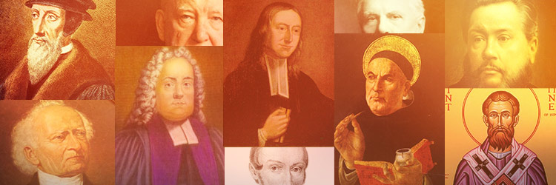
CLUE 1: The Origin of the Universe
“For the scientist who has lived by his faith in the power of reason, the story ends like a bad dream. He has scaled the mountains of ignorance; he is about to conquer the highest peak; as he pulls himself over the final rock, he is greeted by a band of theologians who have been sitting there for centuries.”
—Robert Jastrow (agnostic physicist)

Slide 30
CLUE 1: The Origin of the Universe
“I have no axe to grind in this discussion [but] the notion of a beginning is repugnant to me… I simply do not believe that the present order of things started off with a bang… the expanding Universe is preposterous… incredible… it leaves me cold.”
—Arthur Eddington (astrophysicist) in 1931

Slide 31
CLUE 1: The Origin of the Universe
“I have no axe to grind in this discussion [but] the notion of a beginning is repugnant to me… I simply do not believe that the present order of things started off with a bang… the expanding Universe is preposterous… incredible… it leaves me cold.”
—Arthur Eddington (astrophysicist) in 1931
“To deny the infinite duration of time would be to betray the very foundations of science.”—Walter Nernst (chemist and physicist)

Slide 32
CLUE 1: The Origin of the Universe
“I have no axe to grind in this discussion [but] the notion of a beginning is repugnant to me… I simply do not believe that the present order of things started off with a bang… the expanding Universe is preposterous… incredible… it leaves me cold.”
—Arthur Eddington (astrophysicist) in 1931
“To deny the infinite duration of time would be to betray the very foundations of science.”—Walter Nernst (chemist and physicist)
“I find it hard to accept the Big Bang theory; I would like to reject it.” —Philip Morrison (MIT)

Slide 33
CLUE 1: The Origin of the Universe
“I have no axe to grind in this discussion [but] the notion of a beginning is repugnant to me… I simply do not believe that the present order of things started off with a bang… the expanding Universe is preposterous… incredible… it leaves me cold.”
—Arthur Eddington (astrophysicist) in 1931
“To deny the infinite duration of time would be to betray the very foundations of science.”—Walter Nernst (chemist and physicist)
“I find it hard to accept the Big Bang theory; I would like to reject it.” —Philip Morrison (MIT)
“It is a strange conclusion…it cannot really be true.”
—Allan Sandage (Carnegie Observatories)

Slide 34
CLUE 1: The Origin of the Universe
"Because there is a law such as gravity, the universe can and will create itself from nothing. Spontaneous creation is the reason there is something rather than nothing, why the universe exists, why we exist. It is not necessary to invoke God to light the blue touch paper and set the universe going.“
—Stephen Hawking (agnostic physicist)

Slide 35
CLUE 1: The Origin of the Universe
"Because there is a law such as gravity, the universe can and will create itself from nothing. Spontaneous creation is the reason there is something rather than nothing, why the universe exists, why we exist. It is not necessary to invoke God to light the blue touch paper and set the universe going.“
—Stephen Hawking (agnostic physicist)
“Nonsense remains nonsense, even when spoken by famous scientists, even though the general public assumes, they are statements of science.”
—John Lennox (theistic mathematician)

Slide 36
CLUE 2: Fine-Tuning of the Universe

Slide 37
CLUE 2: Fine-Tuning of the Universe
4 Examples:
gravitational force constant
if larger: stars would be too hot and would burn too rapidly and too unevenly for life chemistry
if smaller: stars would be too cool to ignite nuclear fusion; thus, many of the elements needed for life
expansion rate of the universe
if larger: no galaxies would form
if smaller: universe would collapse, even before stars formed
mass density of the universe
if larger: overabundance of deuterium from big bang would cause stars to burn rapidly, too rapidly for life to form
if smaller: insufficient helium from big bang would result in a shortage of heavy elements
velocity of light
if faster: stars would be too luminous for life support
if slower: stars would be insufficiently luminous for life support
Taken from Big Bang Refined by Fire by Dr. Hugh Ross

Slide 38
CLUE 2: Fine-Tuning of the Universe
Possible Explanations:
Multiverse Theory

Slide 39
CLUE 2: Fine-Tuning of the Universe
Possible Explanations:
Multiverse Theory
Oscillating Universe Theory

Slide 40
CLUE 2: Fine-Tuning of the Universe
Possible Explanations:
Multiverse Theory
Oscillating Universe Theory
Simulation Hypothesis

Slide 41
CLUE 2: Fine-Tuning of the Universe
Possible Explanations:
Multiverse Theory
Oscillating Universe Theory
Simulation Hypothesis
Alien Design

Slide 42
CLUE 2: Fine-Tuning of the Universe
Possible Explanations:
Multiverse Theory
Oscillating Universe Theory
Alien Design
Simulation Hypothesis
Creator God (See Psalm 19:1-6 & Romans 1:18-21)

Slide 43
CLUE 2: Fine-Tuning of the Universe
“In the end it boils down to a question of belief. Is it easier to believe in a cosmic designer than the multiplicity of universes necessary? …If we cannot visit the other universes or experience them directly, their possible existence must remain just as much a matter of faith as belief in God… The seemingly miraculous concurrence of numerical values that nature has assigned to her fundamental constants must remain the most compelling evidence for an element of cosmic design.”
—Paul Davies (agnostic physicist)

Slide 44
CLUE 3: Morality

Slide 45
CLUE 3: Morality
Possible Explanations:
Morality from evolution

Slide 46
CLUE 3: Morality
Possible Explanations:
Morality from evolution
Morality from culture

Slide 47
CLUE 3: Morality
Possible Explanations:
Morality from evolution
Morality from culture
Morality from maximal happiness

Slide 48
CLUE 3: Morality
Possible Explanations:
Morality from evolution
Morality from culture
Morality from maximal happiness
“The greatest happiness of the greatest number is the foundation of morals and legislation.”
—Richard Dawkins (atheistic biologist)

Slide 49
CLUE 3: Morality
Possible Explanations:
Morality from evolution
Morality from culture
Morality from maximal happiness
Morality from God (See Romans 2:12-16)

Slide 50
Clue 1: Origin of the Universe
Are you gonna put your faith in NOTHING or GOD?
Clue 2: Fine-Tuning of the Universe
Are you gonna put your faith in the MULTIVERSE or GOD?
Clue 3: Morality
Are you gonna put your faith in HUMANITY or GOD?

Slide 51
CLUE 4: Beauty & Love

Slide 52
“If we find ourselves with a desire that nothing in this world can satisfy, the most probable explanation is that we were made for another world.”
—C.S. Lewis (theistic scholar)

Slide 53
REASONABLE FAITH
Hebrews 11:1-3 ^{ESV} ¹ Now faith is the assurance of things hoped for, the conviction of things not seen. ² For by it the people of old received their commendation. ³ By faith we understand that the universe was created by the word of God, so that what is seen was not made out of things that are visible.

Slide 54
REASONABLE FAITH
Hebrews 11:1-3 ^{ESV} ¹ Now faith is the assurance of things hoped for, the conviction of things not seen. ² For by it the people of old received their commendation. ³ By faith we understand that the universe was created by the word of God, so that what is seen was not made out of things that are visible.
Hebrews 11:6 ^{ESV} And without faith it is impossible to please him, for whoever would draw near to God must believe that he exists and that he rewards those who seek him.

Slide 55
RESOURCES:
The Reason for God: Belief in an Age of Skepticism, Tim Keller ($10 on our Resource Table)
Discovering God: Exploring the Possibilities of Faith, Dennis McCallum ($Free.99 on our Welcome Table)
Evidence Unseen: Exposing the Myth of Blind Faith, James Rochford (www.evidenceunseen.com)
Mere Christianity, C.S. Lewis
Jesus Among Secular Gods: The Countercultural Claims of Christ, Ravi Zacharias and Vince Vitale

