Slide 1
TALLGRASS
COMMUNITY CHURCH

Slide 2
Birth thru 6th grade
tallgrass.church | info@tallgrass.church

Slide 3
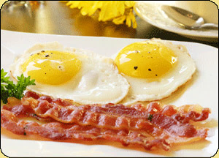
Tallgrass Potluck: BREAKFAST 4 DINNER TODAY @ after the CG
tallgrass.church | info@tallgrass.church

Slide 4
Next Sunday (10th), 7pm @ The Hi Lo
tallgrass.church | info@tallgrass.church

Slide 5
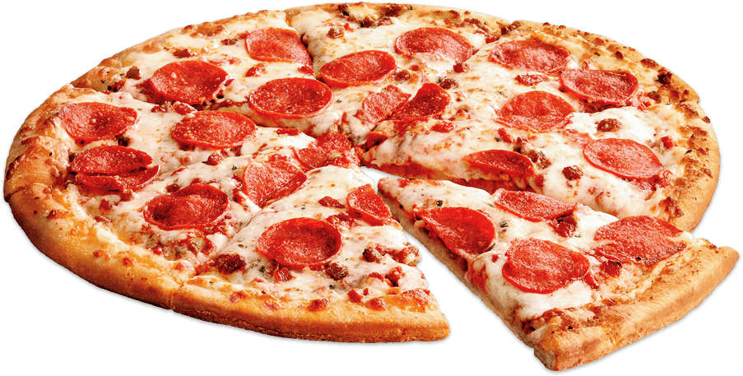
TALLGRASS YOUTH AFTER PARTY Next Sunday (10th), 6:45pm @ The Oglesbys
tallgrass.church | info@tallgrass.church

Slide 6
TALLGRASS GIVING PERCENTAGES
tallgrass.church | info@tallgrass.church

Slide 7
TALLGRASS
COMMUNITY CHURCH
What’s the best meal you’ve had recently?
tallgrass.church | info@tallgrass.church

Slide 8
TALLGRASS
COMMUNITY CHURCH

Slide 10
LORD’S
supper

Slide 11
LORD’S SUPPER
¹⁷ But in the following instructions I do not commend you, because when you come together it is not for the better but for the worse. ¹⁸ For, in the first place, when you come together as a church, I hear that there are divisions among you. And I believe it in part, ¹⁹ for there must be factions among you in order that those who are genuine among you may be recognized. ²⁰ When you come together, it is not the Lord's supper that you eat. ²¹ For in eating, each one goes ahead with his own meal. One goes hungry, another gets drunk. ²² What! Do you not have houses to eat and drink in? Or do you despise the church of God and humiliate those who have nothing? What shall I say to you? Shall I commend you in this? No, I will not.
1 Corinthians 11:17-22

Slide 12
LORD’S SUPPER
²³ For I received from the Lord what I also delivered to you, that the Lord Jesus on the night when he was betrayed took bread, ²⁴ and when he had given thanks, he broke it, and said, “This is my body, which is for you. Do this in remembrance of me.” ²⁵ In the same way also he took the cup, after supper, saying, “This cup is the new covenant in my blood. Do this, as often as you drink it, in remembrance of me.” ²⁶ For as often as you eat this bread and drink the cup, you proclaim the Lord's death until he comes.
1 Corinthians 11:23-26

Slide 13
LORD’S SUPPER
²⁷ Whoever, therefore, eats the bread or drinks the cup of the Lord in an unworthy manner will be guilty concerning the body and blood of the Lord. ²⁸ Let a person examine himself, then, and so eat of the bread and drink of the cup. ²⁹ For anyone who eats and drinks without discerning the body eats and drinks judgment on himself. ³⁰ That is why many of you are weak and ill, and some have died. ³¹ But if we judged ourselves truly, we would not be judged. ³² But when we are judged by the Lord, we are disciplined so that we may not be condemned along with the world.
1 Corinthians 11:27-32

Slide 14
LORD’S SUPPER
³³ So then, my brothers and sisters, when you come together to eat, wait for one another— ³⁴ if anyone is hungry, let him eat at home—so that when you come together it will not be for judgment. About the other things I will give directions when I come.
1 Corinthians 11:33-34

Slide 15
LORD’S
supper

Slide 16
LORD’S SUPPER
¹⁷ But in the following instructions I do not commend you, because when you come together it is not for the better but for the worse. ¹⁸ For, in the first place, when you come together as a church, I hear that there are divisions among you. And I believe it in part, ¹⁹ for there must be factions among you in order that those who are genuine among you may be recognized. ²⁰ When you come together, it is not the Lord's supper that you eat. ²¹ For in eating, each one goes ahead with his own meal. One goes hungry, another gets drunk. ²² What! Do you not have houses to eat and drink in? Or do you despise the church of God and humiliate those who have nothing? What shall I say to you? Shall I commend you in this? No, I will not.
1 Corinthians 11:17-22

Slide 17
CLIQUISHNESS
¹⁷ But in the following instructions I do not commend you, because when you come together it is not for the better but for the worse. ¹⁸ For, in the first place, when you come together as a church, I hear that there are divisions among you. And I believe it in part, ¹⁹ for there must be factions among you in order that those who are genuine among you may be recognized. ²⁰ When you come together, it is not the Lord's supper that you eat. ²¹ For in eating, each one goes ahead with his own meal. One goes hungry, another gets drunk. ²² What! Do you not have houses to eat and drink in? Or do you despise the church of God and humiliate those who have nothing? What shall I say to you? Shall I commend you in this? No, I will not.
1 Corinthians 11:17-22

Slide 18
SELF-INDULGENCE
¹⁷ But in the following instructions I do not commend you, because when you come together it is not for the better but for the worse. ¹⁸ For, in the first place, when you come together as a church, I hear that there are divisions among you. And I believe it in part, ¹⁹ for there must be factions among you in order that those who are genuine among you may be recognized. ²⁰ When you come together, it is not the Lord's supper that you eat. ²¹ For in eating, each one goes ahead with his own meal. One goes hungry, another gets drunk. ²² What! Do you not have houses to eat and drink in? Or do you despise the church of God and humiliate those who have nothing? What shall I say to you? Shall I commend you in this? No, I will not.
1 Corinthians 11:17-22

Slide 19
LORD’S SUPPER
²³ For I received from the Lord what I also delivered to you, that the Lord Jesus on the night when he was betrayed took bread, ²⁴ and when he had given thanks, he broke it, and said, “This is my body, which is for you. Do this in remembrance of me.” ²⁵ In the same way also he took the cup, after supper, saying, “This cup is the new covenant in my blood. Do this, as often as you drink it, in remembrance of me.” ²⁶ For as often as you eat this bread and drink the cup, you proclaim the Lord's death until he comes.
1 Corinthians 11:23-26

Slide 20
LORD’S SUPPER
²³ For I received from the Lord what I also delivered to you, that the Lord Jesus on the night when he was betrayed took bread, ²⁴ and when he had given thanks, he broke it, and said, “This is my body, which is for you. Do this in remembrance of me.” ²⁵ In the same way also he took the cup, after supper, saying, “This cup is the new covenant in my blood. Do this, as often as you drink it, in remembrance of me.” ²⁶ For as often as you eat this bread and drink the cup, you proclaim the Lord's death until he comes.
1 Corinthians 11:23-26
GOSPEL

Slide 21
NEW COVENANT
(Hebrew author quoting Jeremiah 31:31-34)
¹⁰ “For this is the covenant that I will make with the house of Israel after those days, declares the Lord: I will put my laws into their minds, and write them on their hearts, and I will be their God, and they shall be my people. ¹¹ And they shall not teach, each one his neighbor and each one his brother, saying, ‘Know the Lord,’ for they shall all know me, from the least of them to the greatest. ¹² For I will be merciful toward their iniquities, and I will remember their sins no more.”
¹³ In speaking of a new covenant, he makes the first one obsolete. And what is becoming obsolete and growing old is ready to vanish away.
Hebrews 8:10-13

Slide 22
LORD’S SUPPER
²⁷ Whoever, therefore, eats the bread or drinks the cup of the Lord in an unworthy manner will be guilty concerning the body and blood of the Lord. ²⁸ Let a person examine himself, then, and so eat of the bread and drink of the cup. ²⁹ For anyone who eats and drinks without discerning the body eats and drinks judgment on himself. ³⁰ That is why many of you are weak and ill, and some have died. ³¹ But if we judged ourselves truly, we would not be judged. ³² But when we are judged by the Lord, we are disciplined so that we may not be condemned along with the world.
1 Corinthians 11:27-32

Slide 23
LORD’S SUPPER
“It (the Lord’s Supper) is not merely a social occasion to pass the time with select friends. There is no audience watching a performance. Leaders and led are all participants. They have come together as the body of Christ to remember the saving events that created them as a body and to proclaim that salvation to the world.”
– Kenneth Bailey, Paul Through Mediterranean Eyes, p. 324

Slide 24
LORD’S SUPPER
“In the light of the broken nature of the fellowship that Paul is addressing, ‘examine yourself’ is related to ‘discerning the body.’ This surely means: ‘Remember that you enter into this gathering as a part of the body of Christ that has come together for healing, restoration, proclamation and empowerment.’”
– Kenneth Bailey, Paul Through Mediterranean Eyes, p. 324

Slide 25
LORD’S SUPPER
“Each worshiper is intimately connected with the other worshipers, and the struggles, joys, fears and failures of all are known and shared. All come as sinners in need of grace, and in that shared awareness there is openness to receive needed healing. The only believer who is unworthy to receive the Holy Communion is the person who thinks that he/she is worthy to receive it.”
– Kenneth Bailey, Paul Through Mediterranean Eyes, p. 324

Slide 26
LORD’S SUPPER
²⁷ Whoever, therefore, eats the bread or drinks the cup of the Lord in an unworthy manner will be guilty concerning the body and blood of the Lord. ²⁸ Let a person examine himself, then, and so eat of the bread and drink of the cup. ²⁹ For anyone who eats and drinks without discerning the body eats and drinks judgment on himself. ³⁰ That is why many of you are weak and ill, and some have died. ³¹ But if we judged ourselves truly, we would not be judged. ³² But when we are judged by the Lord, we are disciplined so that we may not be condemned along with the world.
1 Corinthians 11:27-32

Slide 27
LORD’S SUPPER
³³ So then, my brothers and sisters, when you come together to eat, wait for one another— ³⁴ if anyone is hungry, let him eat at home—so that when you come together it will not be for judgment. About the other things I will give directions when I come.
1 Corinthians 11:33-34

Slide 28
LORD’S SUPPER
³³ So then, my brothers and sisters, when you come together to eat, wait for one another— ³⁴ if anyone is hungry, let him eat at home—so that when you come together it will not be for judgment. About the other things I will give directions when I come.
1 Corinthians 11:33-34
GOSPEL BEHAVIOR

Slide 29
In light of Jesus’ broken body…
What is Jesus trying to say to you this evening?
How is your loving Father disciplining you? How will you respond?
How can you build the body by showing up to serve? At a Central Gathering? At a LIFE Group gathering? At a one-on-one meeting? Within your family?
Look…
back—to Christ’s death
in—self-examination
up—fellowship with God
around—fellowship with one another
forward—to Christ’s return
outward—to proclaim God’s word to others

Slide 30
LORD’S
supper

Slide 31
TALLGRASS
COMMUNITY CHURCH

