Slide 1
TALLGRASS
COMMUNITY CHURCH

Slide 2
Today: Ladies’ After Party (@ Blue Earth Plaza)
Today: TG Youth Kickoff (6:45pm)
Today: Tallgrass Church Directories
Next Sunday (27th): TG KIDS Summer Program begins!
Next Sunday (27th): Guys’ After Party
Monday, May 28: TG Memorial Day Picnics
TALLGRASS
COMMUNITY CHURCH
tallgrass.church | info@tallgrass.church

Slide 3
Today: Ladies’ After Party (@ Blue Earth Plaza)
Today: TG Youth Kickoff (6:45pm)
Today: Tallgrass Church Directories
Next Sunday (27th): TG KIDS Summer Program begins!
Next Sunday (27th): Guys’ After Party
Monday, May 28: TG Memorial Day Picnics
TALLGRASS
COMMUNITY CHURCH
Mingle Question:
What are you looking forward to this summer?
tallgrass.church | info@tallgrass.church

Slide 4
TALLGRASS
COMMUNITY CHURCH

Slide 5
JOSH MILLARD
LIFE GROUP ALUMN

Slide 7
EPHESIANS 4:11-16^{ESV}
¹¹ And he gave the apostles, the prophets, the evangelists, the shepherds¹ and teachers, ¹² to equip the saints for the work of ministry, for building up the body of Christ, ¹³ until we all attain to the unity of the faith and of the knowledge of the Son of God, to mature manhood, to the measure of the stature of the fullness of Christ, ¹⁴ so that we may no longer be children, tossed to and fro by the waves and carried about by every wind of doctrine, by human cunning, by craftiness in deceitful schemes.
¹⁵ Rather, speaking the truth in love, we are to grow up in every way into him who is the head, into Christ, ¹⁶ from whom the whole body, joined and held together by every joint with which it is equipped, when each part is working properly, makes the body grow so that it builds itself up in love.
¹ Or pastors

Slide 8
EPHESIANS 4:11-12^{KJV}
¹¹ And he gave some, apostles; and some, prophets; and some, evangelists; and some, pastors and teachers; ¹² For the perfecting of the saints, for the work of the ministry, for the edifying of the body of Christ…

Slide 9
EPHESIANS 4:11-12^{KJV}
¹¹ And he gave some, apostles; and some, prophets; and some, evangelists; and some, pastors and teachers; ¹² For the perfecting of the saints, for the work of the ministry, for the edifying of the body of Christ…
The Fatal Comma

Slide 10
EPHESIANS 4:11-12^{KJV}
¹¹ And he gave some, apostles; and some, prophets; and some, evangelists; and some, pastors and teachers; ¹² 1. For the perfecting of the saints, 2. for the work of the ministry, 3. for the edifying of the body of Christ…
The Fatal Comma

Slide 11
Traditional Model
God
Institutional Paradigm
Clergy
Laity

Slide 13
God is King

Slide 14
God is King
The Fall

Slide 15
“With the Fall came an implicit desire in people to have a physical leader to bring them to God. For this reason, human societies throughout history have consistently created a special caste of revered religious leaders. The medicine man, the shaman, the rhapsodist, the miracle worker, the witch doctor, the soothsayer, the wise man, and the priest have all been with us since Adam’s blunder. And this person is always marked by special training, special garb, a special vocabulary, and a special way of life.”
—Pagan Christianity (p. 108)
The Fall

Slide 16
God is King
Israel Demands a King
1064 BC (1 Kings 8)
The Fall

Slide 17
Jesus is King
King Jesus
0-33 AD
Israel Demands a King
1064 BC (1 Kings 8)
The Fall

Slide 18
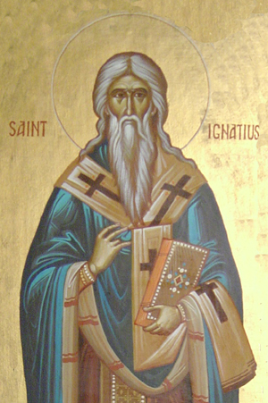
Combat Heresy
King Jesus
0-33 AD
Israel Demands a King
1064 BC (1 Kings 8)
Ignatius of Antioch
35-107 AD
The Fall

Slide 19
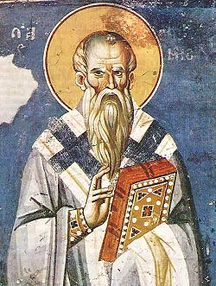
“Laity”
Clement of Rome
35-99 AD
King Jesus
0-33 AD
Israel Demands a King
1064 BC (1 Kings 8)
Ignatius of Antioch
35-107 AD
The Fall

Slide 20
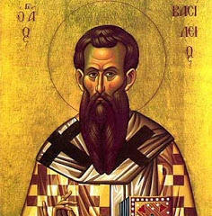
“Laity” & “Clergy”
Tertullian of Carthage
155-240 AD
Clement of Rome
35-99 AD
Jesus of Nazareth
0-33 AD
Israel Demands a King
1064 BC (1 Kings 8)
Ignatius of Antioch
35-107 AD
The Fall

Slide 21
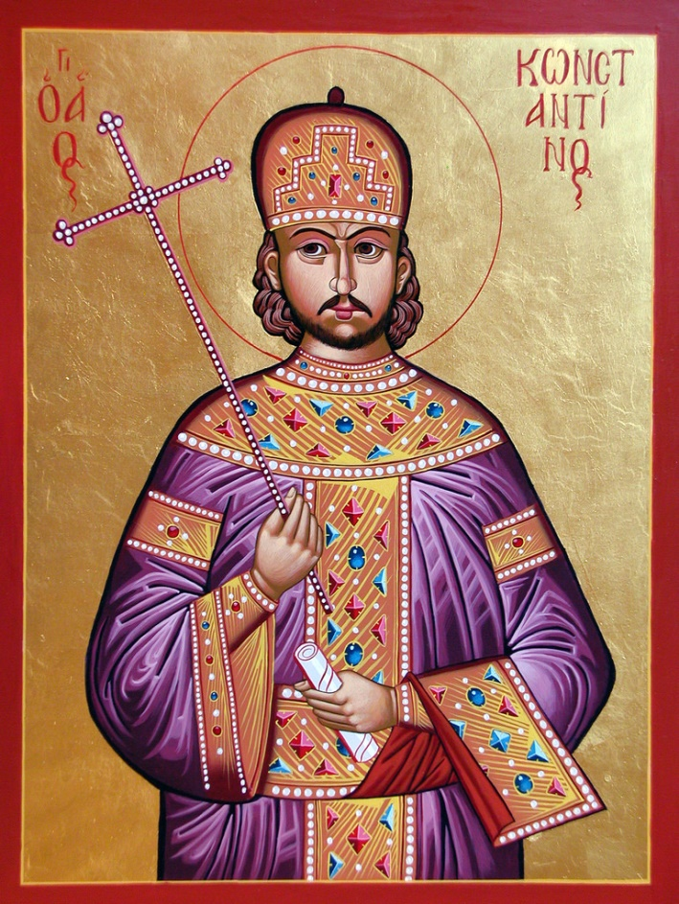
Tertullian of Carthage
155-240 AD
Clement of Rome
35-99 AD
Jesus of Nazareth
0-33 AD
Constantine the Great
272-337 AD
Israel Demands a King
1064 BC (1 Kings 8)
Ignatius of Antioch
35-107 AD
The Fall

Slide 22
“All of this (ecclesiastical structure of the pagan church, the title and vestments of the pontifex maximus, etc.) was at gross odds with God’s way for His church. Thus when Jesus entered the drama of human history, He obliterated both the religious professional icon as well as the hierarchical form of leadership. As an extension of Christ’s nature and mission, the early church was the first ‘lay-led’ movement in history. But with the death of the apostles and the men they trained, things began to change.”
—Pagan Christianity (p. 119-120)
Tertullian of Carthage
155-240 AD
Clement of Rome
35-99 AD
Jesus of Nazareth
0-33 AD
Constantine the Great
272-337 AD
Israel Demands a King
1064 BC (1 Kings 8)
Ignatius of Antioch
35-107 AD
The Fall

Slide 23
Tertullian of Carthage
155-240 AD
Martin Luther
1483-1546 AD
Clement of Rome
35-99 AD
Jesus of Nazareth
0-33 AD
Constantine the Great
272-337 AD
Israel Demands a King
1064 BC (1 Kings 8)
Ignatius of Antioch
35-107 AD
The Fall

Slide 24
Keep reforming!
Tertullian of Carthage
155-240 AD
Martin Luther
1483-1546 AD
Clement of Rome
35-99 AD
Jesus of Nazareth
0-33 AD
Constantine the Great
272-337 AD
Israel Demands a King
1064 BC (1 Kings 8)
Ignatius of Antioch
35-107 AD
The Fall

Slide 25
Tertullian of Carthage
155-240 AD
Martin Luther
1483-1546 AD
Today
May 20, 2018 AD
Clement of Rome
35-99 AD
Jesus of Nazareth
0-33 AD
Constantine the Great
272-337 AD
Israel Demands a King
1064 BC (1 Kings 8)
Ignatius of Antioch
35-107 AD
The Fall

Slide 26
Specialists & Experts
Tertullian of Carthage
155-240 AD
Martin Luther
1483-1546 AD
Today
May 20, 2018 AD
Clement of Rome
35-99 AD
Jesus of Nazareth
0-33 AD
Constantine the Great
272-337 AD
Israel Demands a King
1064 BC (1 Kings 8)
Ignatius of Antioch
35-107 AD
The Fall

Slide 27
“We believe the pastoral office has stolen your right to function as a full member of Christ’s body. It has distorted the reality of the body, making the pastor a giant mouth and transforming you into a tiny ear. It has rendered you a mute spectator who is proficient at taking sermon notes [or maybe not even that!] and passing an offering plate [which we’re not even doing].”
—Pagan Christianity (p. 136)
Tertullian of Carthage
155-240 AD
Martin Luther
1483-1546 AD
Today
May 20, 2018 AD
Clement of Rome
35-99 AD
Jesus of Nazareth
0-33 AD
Constantine the Great
272-337 AD
Israel Demands a King
1064 BC (1 Kings 8)
Ignatius of Antioch
35-107 AD
The Fall

Slide 28
Traditional Model
God
Institutional Paradigm
Clergy
casting vision
identifying & training leaders
preaching and teaching
raising money
serving the needy
providing strategy and planning
organizing church activities & programs
overseeing all administration
managing staff and volunteers
resolving conflicts
representing the congregation in the community
providing congregation care
counseling
evangelizing the unsaved
administering the sacraments
discipling individuals
Laity

Slide 29
Traditional Model
God
Institutional Paradigm
Clergy
94% feel pressured to have an ideal family.
90% work more than forty-six hours a week.
81% say they have insufficient time with their spouses.
80% believe that pastoral ministry affects their family negatively.
70% do not have someone they consider a close friend.
70% have lower self-esteem than when they entered the ministry.
50% feel unable to meet the demands of the job.
80% are discouraged or deal with depression.
More than 40% report that they are suffering from burnout, frantic schedules, and unrealistic expectations.
33% consider pastoral ministry an outright hazard to the family.
33% have seriously considered leaving their position in the past year.
40% of pastoral resignations are due to burnout.
Laity

Slide 30
Traditional Model
God
Institutional Paradigm
Clergy
“The church began as a fellowship of men and women centered on Jesus Christ. It went to Greece and became a philosophy. It went to Rome and became an institution. It went to Europe and became a culture. It came to America and became an enterprise.”
—The Neighboring Church (p. xviii)
Laity

Slide 31
New Testament Model
Christ (The Head)
Organic Paradigm
Leaders
(Elders)
E’erbody
(Ministers)

Slide 32
New Testament Model
Christ (The Head)
Organic Paradigm
Leaders
(Elders)
E’erbody
(Ministers)
“In him you also, when you heard the word of truth, the gospel of your salvation, and believed in him, were sealed with the promised Holy Spirit…”Ephesians 1:13

Slide 33
New Testament Model
Christ (The Head)
Organic Paradigm
Leaders
(Elders)
⁵ …you yourselves like living stones are being built up as a spiritual house, to be a holy priesthood, to offer spiritual sacrifices acceptable to God through Jesus Christ. ⁹ But you are a chosen race, a royal priesthood, a holy nation, a people for his own possession, that you may proclaim the excellencies of him who called you out of darkness into his marvelous light.
1 Peter 2:5, 9
E’erbody
(Ministers)

Slide 34
New Testament Model
Christ (The Head)
Organic Paradigm
Leaders
(Elders)
E’erbody
(Ministers)
²⁴ He himself bore our sins in his body on the tree, that we might die to sin and live to righteousness. By his wounds you have been healed. ²⁵ For you were straying like sheep, but have now returned to the Shepherd and Overseer of your souls.
1 Peter 2:24-25

Slide 35
New Testament Model
Christ (The Head)
Organic Paradigm
Leaders
(Elders)
E’erbody
(Ministers)
¹¹ And he gave the apostles, the prophets, the evangelists, the shepherds and teachers, ¹² to equip the saints for the work of ministry, for building up the body of Christ…
Ephesians 4:11-12

Slide 36
New Testament Model
Christ (The Head)
Organic Paradigm
Leaders
(Elders)
“The New Testament concept of the pastor is not a person who jealously guards all ministry in his own hands, and successfully squashes all lay initiatives, but of one who helps and encourages all God’s people to discover, develop and exercise their gifts. His teaching and training are directed to this end, to enable the people of God to be a servant people, ministering actively but humbly according to their gifts in a world of alienation and pain. Thus, instead of monopolizing all ministry himself, he actually multiplies ministries.”
—John Stott in The Message of Ephesians
E’erbody
(Ministers)

Slide 37
New Testament Model
Christ (The Head)
Organic Paradigm
Leaders
(Elders)
¹³ until we all attain to the unity of the faith and of the knowledge of the Son of God, to mature manhood, to the measure of the stature of the fullness of Christ, ¹⁴ so that we may no longer be children, tossed to and fro by the waves and carried about by every wind of doctrine, by human cunning, by craftiness in deceitful schemes.
Ephesians 4:13-14
E’erbody
(Ministers)

Slide 38
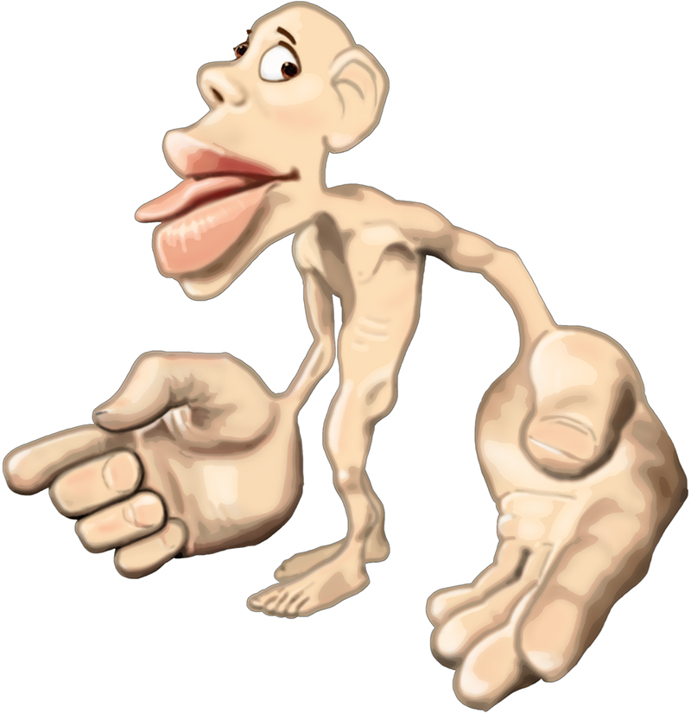

Slide 39
New Testament Model
Christ (The Head)
Organic Paradigm
Leaders
(Elders)
⁵ Rather, speaking the truth in love, we are to grow up in every way into him who is the head, into Christ, ¹⁶ from whom the whole body, joined and held together by every joint with which it is equipped, when each part is working properly, makes the body grow so that it builds itself up in love.
Ephesians 4:15-16
E’erbody
(Ministers)

Slide 41
Traditional Model
God
Institutional Paradigm
Clergy
Laity

Slide 42
New Testament Model
Christ (The Head)
Organic Paradigm
Leaders
(Elders)
E’erbody
(Ministers)

Slide 44
Songs for Response
Confident
No Longer Slaves
Joy of the Lord
Reckless Love
Jesus We Love You
Tis So Sweet to Trust in Jesus

Slide 45
YES AND AMEN
by Housefires

Slide 46
YES AND AMEN
Father of kindness
You have poured out grace
You brought me out of darkness
You have filled me with peace
Giver of mercy You're my
help in time of need
Lord I can't help but sing:
by Housefires

Slide 47
YES AND AMEN
Faithful You are
Faithful forever You will be
Faithful You are
All Your promises are yes and Amen
All Your promises are yes and Amen
[See 2 Corinthians 1:20]
by Housefires

Slide 48
YES AND AMEN
Beautiful Savior
You have brought me near
You pulled me from the ashes
You have broken every curse
Blessed redeemer
You have set this captive free
Lord I can't help but sing:
by Housefires

Slide 49
YES AND AMEN
Faithful You are
Faithful forever You will be
Faithful You are
All Your promises are yes and Amen
All Your promises are yes and Amen
[See 2 Corinthians 1:20]
by Housefires

Slide 50
YES AND AMEN
I will rest in Your promises
My confidence is Your faithfulness
by Housefires

Slide 51
YES AND AMEN
Faithful You are
Faithful forever You will be
Faithful You are
All Your promises are yes and Amen
All Your promises are yes and Amen
[See 2 Corinthians 1:20]
by Housefires

Slide 52
NO LONGER SLAVES
by Bethel

Slide 53
NO LONGER SLAVES
You unravel me, with a melody
You surround me with a song
Of deliverance, from my enemies
Till all my fears are gone
I’m no longer a slave to fear
I am a child of God (2x)
by Bethel

Slide 54
NO LONGER SLAVES
From my mother’s womb
You have chosen me
Love has called my name
I’ve been born again, into Your family
Your blood flows through my veins
I’m no longer a slave to fear
I am a child of God (4x)
by Bethel

Slide 55
NO LONGER SLAVES
I am surrounded
By the arms of the Father
I am surrounded
By songs of Deliverance
We’ve been liberated
From our bondage
We’re the sons and the daughters
Let us sing our freedom!
by Bethel

Slide 56
NO LONGER SLAVES
You split the sea, so I could walk
right through it
You drowned my fears in perfect love
You rescued me, so I could stand & sing
I am a child of God (2x)
I am a child of God!
by Bethel

Slide 57
NO LONGER SLAVES
I’m no longer a slave to fear
I am a child of God (2x)
by Bethel

Slide 58
TAKE COURAGE
by Bethel

Slide 59
TAKE COURAGE
Slow down, take time
"Breathe in," He said
He'd reveal what's to come
The thoughts in His mind
Always higher than mine
He'll reveal all to come
[See Isaiah 55:8-9]
by Bethel

Slide 60
TAKE COURAGE
So take courage my heart
Stay steadfast my soul
He's in the waiting
He's in the waiting
And hold onto your hope
As your triumph unfolds
He's never failing
He's never failing
by Bethel

Slide 61
TAKE COURAGE
Sing praise my soul
Find strength in joy
Let His words lead you on
Do not forget
His great faithfulness
He'll finish all He's begun
[See Nehemiah 8:10]
by Bethel

Slide 62
TAKE COURAGE
So take courage my heart
Stay steadfast my soul
He's in the waiting
He's in the waiting
And hold onto your hope
As your triumph unfolds
He's never failing
He's never failing
by Bethel

Slide 63
TAKE COURAGE
And You who hold the stars
Who call them each by name
Will surely keep Your promise to me
That I will rise in Your victory!
by Bethel

Slide 64
TAKE COURAGE
So take courage my heart
Stay steadfast my soul
He's in the waiting
He's in the waiting
And hold onto your hope
As your triumph unfolds
He's never failing
He's never failing
by Bethel

Slide 65
CONFIDENT
by Steffany Gretzinger & Bobby Strand

Slide 66
CONFIDENT
You’re always moving in the unseen
The breath You exhale sustaining me
Before I call, You know my need
You’re always going before me
by Steffany Gretzinger & Bobby Strand

Slide 67
CONFIDENT
I’m confident Your faithfulness
will see me through
My soul can rest, my righteousness
is found in You
With every moment left,
in every borrowed breath
Let this be true
That all my heart, for all my life
belongs to You
by Steffany Gretzinger & Bobby Strand

Slide 68
CONFIDENT
Your laughter scatters my enemies
You give me joy for my mourning
You lift my head, so I can see
All of Heaven surrounding me
by Steffany Gretzinger & Bobby Strand

Slide 69
CONFIDENT
I’m confident Your faithfulness
will see me through
My soul can rest, my righteousness
is found in You
With every moment left,
in every borrowed breath
Let this be true
That all my heart, for all my life
belongs to You
by Steffany Gretzinger & Bobby Strand

Slide 70
CONFIDENT
I won’t win this battle with the strength of
my own hands;
You’re the Mountain Mover,
and only You can
I won’t build my life on sinking sand
You’re my hope forever,
the Rock where I stand
(repeat)
by Steffany Gretzinger & Bobby Strand

Slide 71
CONFIDENT
I’m confident Your faithfulness
will see me through
My soul can rest, my righteousness
is found in You
With every moment left,
in every borrowed breath
Let this be true
That all my heart, for all my life
belongs to You
by Steffany Gretzinger & Bobby Strand

Slide 72
JESUS PAID IT ALL
by Kristian Stanfill

Slide 73
JESUS PAID IT ALL
I hear the Savior say, “Thy strength indeed is small
Child of weakness, watch and pray
Find in me thine all in all”
by Kristian Stanfill

Slide 74
JESUS PAID IT ALL
Jesus paid it all
All to him I owe
Sin had left a crimson stain
He washed it white as snow
by Kristian Stanfill

Slide 75
JESUS PAID IT ALL
Lord, now indeed I find
Thy power and thine alone
can change the leper's spots
and melt the heart of stone
by Kristian Stanfill

Slide 76
JESUS PAID IT ALL
Jesus paid it all
All to him I owe
Sin had left a crimson stain
He washed it white as snow
by Kristian Stanfill

Slide 77
JESUS PAID IT ALL
When from my dying bed my ransomed soul shall rise
“Jesus died my soul to save”
shall rend the vaulted skies
by Kristian Stanfill

Slide 78
JESUS PAID IT ALL
Jesus paid it all
All to him I owe
Sin had left a crimson stain
He washed it white as snow
by Kristian Stanfill

Slide 79
JESUS PAID IT ALL
Oh praise the one who paid my debt
and raised this life up from the dead
by Kristian Stanfill

Slide 80
JESUS PAID IT ALL
And when before the throne
I stand in Him complete I’ll lay my trophies down
All down at Jesus’ feet
by Kristian Stanfill

Slide 81
JESUS PAID IT ALL
Jesus paid it all
All to him I owe
Sin had left a crimson stain
He washed it white as snow
by Kristian Stanfill

Slide 82
JOY OF THE LORD
by Rend Collective

Slide 83
JOY OF THE LORD
Though the tears may fall
My song will rise, my song will rise to You
Though my heart may fail
My song will rise, my song will rise to You
While there's breath in my lungs
I will praise You, Lord

Slide 84
JOY OF THE LORD
In the dead of night,
I'll lift my eyes, I'll lift my eyes to You
Though the waters rise,
I'll lift my eyes, I'll lift my eyes to You
While there's hope in this heart
I will praise You, Lord
by Rend Collective

Slide 85
JOY OF THE LORD
The joy of the Lord is my strength!
The joy of the Lord is my strength!
In the darkness I'll dance
In the shadows I'll sing
The joy of the Lord is my strength!
by Rend Collective

Slide 86
JOY OF THE LORD
When I cannot see You with my eyes
Let faith arise to You
When I cannot feel Your hand in mine
Let faith arise to You
God of mercy and love
I will praise You, Lord
by Rend Collective

Slide 87
JOY OF THE LORD
How You shine with glory, Lord of light
I feel alive with You
In Your presence now I come alive
I am alive with You
There is strength when I say:
“I will praise You, Lord”
by Rend Collective

Slide 88
JOY OF THE LORD
The joy of the Lord is my strength!
The joy of the Lord is my strength!
In the darkness I'll dance
In the shadows I'll sing
The joy of the Lord is my strength!
by Rend Collective

Slide 89
JOY OF THE LORD
When sorrow comes my way
You’re the shield around me
Always, You remain
My courage in the fight
I hear You call my name
Jesus, I am coming
Walking on the waves
Reaching for Your light!
by Rend Collective

Slide 90
JOY OF THE LORD
The joy of the Lord is my strength!
The joy of the Lord is my strength!
In the darkness I'll dance
In the shadows I'll sing
The joy of the Lord is my strength!
by Rend Collective

Slide 91
JOY
by Rend Collective

Slide 92
JOY
We're choosing celebration
Breaking into freedom
You're the song,
You're the song of our hearts
We cast aside our shadows
Trust You with our sorrows
You're the song,
You're the song of our hearts
by Rend Collective

Slide 93
JOY
We're dancing to the rhythm of Your heart
We're rising from the ashes to the stars
by Rend Collective

Slide 94
JOY
You're the joy, joy, joy lighting my soul
The joy, joy, joy making me whole
Though I'm broken, I am running
into Your arms of love
by Rend Collective

Slide 95
JOY
The pain will not define us
Joy will reignite us
You're the song,
You're the song of our hearts.
The dark is just a canvas
for Your grace and brightness
You're the song,
You're the song of our hearts
by Rend Collective

Slide 96
JOY
We're dancing to the rhythm of Your heart
We're rising from the ashes to the stars
by Rend Collective

Slide 97
JOY
You're the joy, joy, joy lighting my soul
The joy, joy, joy making me whole
Though I'm broken, I am running
into Your arms of love
by Rend Collective

Slide 98
JOY
In the shadows
In the sorrows
In the desert
When the pain hits
You are constant
Ever-present
You're the song of my heart
by Rend Collective

Slide 99
JOY
You're the joy, joy, joy lighting my soul
The joy, joy, joy making me whole
Though I'm broken, I am running
into Your arms of love
by Rend Collective

Slide 100
RECKLESS LOVE
by Cory Asbury

Slide 101
RECKLESS LOVE
Before I spoke a word,
You were singing over me
You have been so, so good to me
Before I took a breath,
You breathed Your life in me
You have been so, so kind to me
by Cory Asbury

Slide 102
RECKLESS LOVE
O, the overwhelming, never-ending,
reckless love of God
O it chases me down, fights ‘til I’m found
leaves the ninety-nine
I couldn’t earn it, I don’t deserve it,
still You give Yourself away
Oh, the overwhelming, never-ending,
reckless love of God
by Cory Asbury

Slide 103
RECKLESS LOVE
When I was Your foe,
still Your love fought for me
You have been so, so good to me
When I felt no worth, You paid it all for me
You have been so, so kind to me
by Cory Asbury

Slide 104
RECKLESS LOVE
O, the overwhelming, never-ending,
reckless love of God
O it chases me down, fights ‘til I’m found
leaves the ninety-nine
I couldn’t earn it, I don’t deserve it,
still You give Yourself away
Oh, the overwhelming, never-ending,
reckless love of God
by Cory Asbury

Slide 105
RECKLESS LOVE
There’s no shadow You won’t light up
Mountain You won’t climb up
Coming after me
There’s no wall You won’t kick down
Lie You won’t tear down
Coming after me
(repeat)
by Cory Asbury

Slide 106
RECKLESS LOVE
O, the overwhelming, never-ending,
reckless love of God
O it chases me down, fights ‘til I’m found
leaves the ninety-nine
I couldn’t earn it, I don’t deserve it,
still You give Yourself away
Oh, the overwhelming, never-ending,
reckless love of God
(repeat)
by Cory Asbury

Slide 107
HOW DEEP THE FATHER’S LOVE
by Austin Stone Worship

Slide 108
HOW DEEP THE FATHER’S LOVE
How deep the Father’s love for us
How vast beyond all measure
That He should give His only Son
To make a wretch His treasure
How great the pain of searing loss
The Father turns His face away
As wounds which mar the Chosen One
Bring many sons to glory
by Austin Stone Worship

Slide 109
HOW DEEP THE FATHER’S LOVE
Behold the man upon the cross
My sin upon His shoulders
Ashamed I hear my mocking voice
Call out among the scoffers
It was my sin that held Him there
Until it was accomplished
His dying breath has brought me life
I know that it is finished
by Austin Stone Worship

Slide 110
HOW DEEP THE FATHER’S LOVE
I will not boast in anything
No gifts, no power, no wisdom
But I will boast in Jesus Christ
His death and resurrection
by Austin Stone Worship

Slide 111
HOW DEEP THE FATHER’S LOVE
Why should I gain from His reward
I cannot give an answer
But this I know with all my heart
His wounds have paid my ransom
(repeat)
Yes this I know with all my heart
His wounds have paid my ransom
by Austin Stone Worship

Slide 112
JESUS WE LOVE YOU
by Bethel

Slide 113
JESUS WE LOVE YOU
Old things have passed away
Your love has stayed the same
Your constant grace remains the cornerstone
Things that we thought were dead
Are breathing in life again
You cause Your Son to shine on darkest nights
For all that You’ve done we will
pour out our love
This will be our anthem song
by Bethel

Slide 114
JESUS WE LOVE YOU
Jesus we love You
Oh how we love You
You are the one our hearts adore
by Bethel

Slide 115
JESUS WE LOVE YOU
The hopeless have found their hope
The orphans now have a home
All that was lost has found its place in You
You lift our weary head
You make us strong instead
You took these rags and made us beautiful
For all that you’ve done we will
pour out our love
This will be our anthem song
by Bethel

Slide 116
JESUS WE LOVE YOU
Jesus we love You
Oh how we love You
You are the one our hearts adore
by Bethel

Slide 117
JESUS WE LOVE YOU
Our affection, our devotion
poured out on the feet of Jesus
(4x)
by Bethel

Slide 118
JESUS WE LOVE YOU
Jesus we love You
Oh how we love You
You are the one our hearts adore
(3x)
by Bethel

Slide 119
FOREVER
by Kari Jobe

Slide 120
FOREVER
The moon and stars they wept The morning sun was dead The Savior of the world was fallen His body on the cross His blood poured out for us The weight of every curse upon Him
by Kari Jobe

Slide 121
FOREVER
One final breath He gave As heaven looked away The son of God was laid in darkness A battle in the grave The war on death was waged The power of hell forever broken
by Kari Jobe

Slide 122
FOREVER
The ground began to shake The stone was rolled away His perfect love could not be overcome Now death where is your sting? Our resurrected King Has rendered you defeated
by Kari Jobe

Slide 123
FOREVER
Forever He is glorified Forever He is lifted high Forever He is risen He is alive, He is alive!
by Kari Jobe

Slide 124
FOREVER
The ground began to shake The stone was rolled away His perfect love could not be overcome Now death where is your sting? Our resurrected King Has rendered you defeated
by Kari Jobe

Slide 125
FOREVER
Forever He is glorified Forever He is lifted high Forever He is risen He is alive, He is alive!
by Kari Jobe

Slide 126
FOREVER
We sing hallelujah We sing hallelujah We sing hallelujah The Lamb has overcome
by Kari Jobe

Slide 127
FOREVER
Forever He is glorified Forever He is lifted high Forever He is risen He is alive, He is alive!
by Kari Jobe

Slide 128
FOREVER
You have overcome
You have overcome
You have overcome
You have overcome
by Kari Jobe

Slide 129
TIS SO SWEET TO TRUST IN JESUS
hymn

Slide 130
TIS SO SWEET TO TRUST IN JESUS
‘Tis so sweet to trust in Jesus,
Just to take Him at His word;
Just to rest upon His promise;
Just to know, “Thus saith the Lord.”
hymn

Slide 131
TIS SO SWEET TO TRUST IN JESUS
Jesus, Jesus, how I trust Him,
How I’ve proved Him o’er and o’er,
Jesus, Jesus, Precious Jesus!
O for grace to trust Him more.
hymn

Slide 132
TIS SO SWEET TO TRUST IN JESUS
O how sweet to trust in Jesus,
Just to trust His cleansing blood;
Just in simple faith to plunge me,
’Neath the healing, cleansing flood.
hymn

Slide 133
TIS SO SWEET TO TRUST IN JESUS
Jesus, Jesus, how I trust Him,
How I’ve proved Him o’er and o’er,
Jesus, Jesus, Precious Jesus!
O for grace to trust Him more.
hymn

Slide 134
TIS SO SWEET TO TRUST IN JESUS
Yes, ’tis sweet to trust in Jesus,
Just from sin and self to cease;
Just from Jesus simply taking
life, and rest, and joy, and peace.
hymn

Slide 135
TIS SO SWEET TO TRUST IN JESUS
Jesus, Jesus, how I trust Him,
How I’ve proved Him o’er and o’er,
Jesus, Jesus, Precious Jesus!
O for grace to trust Him more.
hymn

Slide 136
TIS SO SWEET TO TRUST IN JESUS
I’m so glad I learned to trust Thee,
Precious Jesus, Savior, Friend;
And I know that Thou art with me,
Wilt be with me to the end.
hymn

Slide 137
TIS SO SWEET TO TRUST IN JESUS
Jesus, Jesus, how I trust Him,
How I’ve proved Him o’er and o’er,
Jesus, Jesus, Precious Jesus!
O for grace to trust Him more.
hymn

Slide 138
TALLGRASS
COMMUNITY CHURCH

