Slide 1
TALLGRASS
COMMUNITY CHURCH

Slide 2
Today: No After Parties (Mother’s Day)
Today: Staggered Kids Pickup (:20, :25, :30)
Today: Tallgrass Church Directories
This Sat-Sun, (19-20th): ManCamp 1.0 (@ University Park)
Next Sunday (20th) TG Youth Kickoff (6:45pm)
Monday, May 28: TG Memorial Day Picnics
TALLGRASS
COMMUNITY CHURCH
tallgrass.church | info@tallgrass.church

Slide 3
Today: No After Parties (Mother’s Day)
Today: Staggered Kids Pickup (:20, :25, :30)
Today: Tallgrass Church Directories
This Sat-Sun, (19-20th): ManCamp 1.0 (@ University Park)
Next Sunday (20th) TG Youth Kickoff (6:45pm)
Monday, May 28: TG Memorial Day Picnics
TALLGRASS
COMMUNITY CHURCH
Mingle Question:
What’s a great gift you’ve received recently?
tallgrass.church | info@tallgrass.church

Slide 4
TALLGRASS
COMMUNITY CHURCH

Slide 5
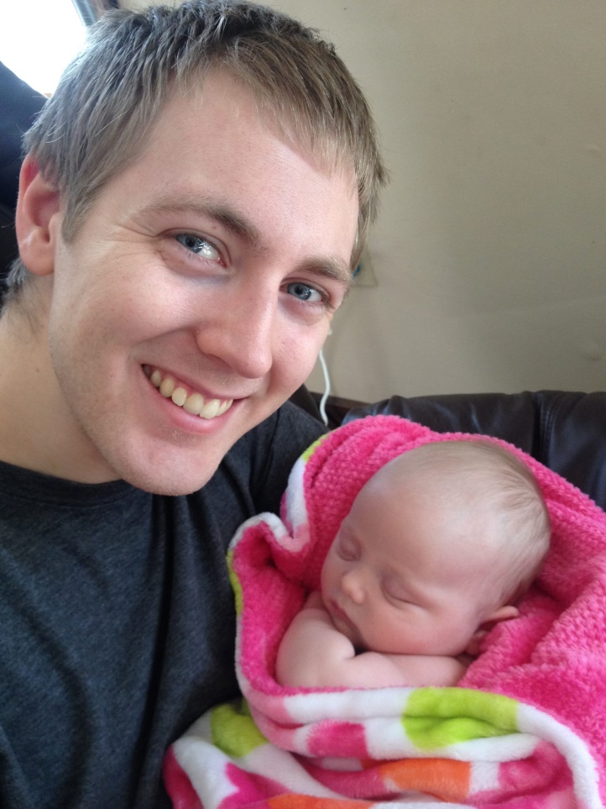
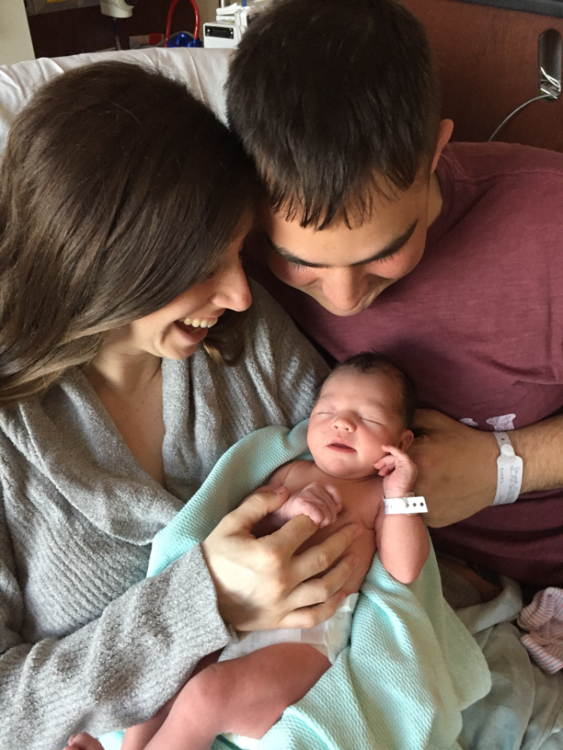
CELEBRATING
LAELYNN ELIZABETH RUBY &
AUDREY CORINNE SHIELDS

Slide 7
LIFETOGETHER
Ephesians 4:11-12 ¹¹ And he gave the apostles, the prophets, the evangelists, the shepherds and teachers, ¹² to equip the saints for the work of ministry, for building up the body of Christ…
Ephesians 4:15-16 ¹⁵ Rather, speaking the truth in love, we are to grow up in every way into him who is the head, into Christ, ¹⁶ from whom the whole body, joined and held together by every joint with which it is equipped, when each part is working properly, makes the body grow so that it builds itself up in love.
1 Corinthians 12:26-27 ²⁶ If one member suffers, all suffer together; if one member is honored, all rejoice together. ²⁷ Now you are the body of Christ and individually members of it.
English Standard Version

Slide 10
EPHESIANS 4:7-10^{ESV}
⁷ But grace was given to each one of us according to the measure of Christ's gift.
⁸ Therefore it says,
“When he ascended on high
he led a host of captives,
and he gave gifts to men.”
⁹ (In saying, “He ascended,” what does it mean but that he had also descended into the lower regions, the earth? ¹⁰ He who descended is the one who also ascended far above all the heavens, that he might fill all things.)

Slide 11
EPHESIANS 4:11-16^{ESV}
¹¹ And he gave the apostles, the prophets, the evangelists, the shepherds and teachers, ¹² to equip the saints for the work of ministry, for building up the body of Christ, ¹³ until we all attain to the unity of the faith and of the knowledge of the Son of God, to mature manhood, to the measure of the stature of the fullness of Christ, ¹⁴ so that we may no longer be children, tossed to and fro by the waves and carried about by every wind of doctrine, by human cunning, by craftiness in deceitful schemes.
¹⁵ Rather, speaking the truth in love, we are to grow up in every way into him who is the head, into Christ, ¹⁶ from whom the whole body, joined and held together by every joint with which it is equipped, when each part is working properly, makes the body grow so that it builds itself up in love.

Slide 12
EPHESIANS 4:7-10^{ESV}
⁷ But grace was given to each one of us according to the measure of Christ's gift.
⁸ Therefore it says,
“When he ascended on high
he led a host of captives,
and he gave gifts to men.”
⁹ (In saying, “He ascended,” what does it mean but that he had also descended into the lower regions, the earth? ¹⁰ He who descended is the one who also ascended far above all the heavens, that he might fill all things.)

Slide 13
EPHESIANS 4:1-6^{ESV}
¹ I therefore, a prisoner for the Lord, urge you to walk in a manner worthy of the calling to which you have been called, ² with all humility and gentleness, with patience, bearing with one another in love, ³ eager to maintain the unity of the Spirit in the bond of peace. ⁴ There is one body and one Spirit—just as you were called to the one hope that belongs to your call— ⁵ one Lord, one faith, one baptism, 6 one God and Father of all, who is over all and through all and in all.

Slide 14
EPHESIANS 4:1-6^{ESV}
¹ I therefore, a prisoner for the Lord, urge you to walk in a manner worthy of the calling to which you have been called, ² with all humility and gentleness, with patience, bearing with one another in love, ³ eager to maintain the unity of the Spirit in the bond of peace. ⁴ There is one body and one Spirit—just as you were called to the one hope that belongs to your call— ⁵ one Lord, one faith, one baptism, 6 one God and Father of all, who is over all and through all and in all.

Slide 15
EPHESIANS 4:1-6^{ESV}
¹ I therefore, a prisoner for the Lord, urge you to walk in a manner worthy of the calling to which you have been called, ² with all humility and gentleness, with patience, bearing with one another in love, ³ eager to maintain the unity of the Spirit in the bond of peace. ⁴ There is one body and one Spirit—just as you were called to the one hope that belongs to your call— ⁵ one Lord, one faith, one baptism, 6 one God and Father of all, who is over all and through all and in all.
⁷ But grace was given to each one of us
according to the measure of Christ's gift.

Slide 16
EPHESIANS 4:7-10^{ESV}
⁷ But grace was given to each one of us according to the measure of Christ's gift.
⁸ Therefore it says,
“When he ascended on high
he led a host of captives,
and he gave gifts to men.”
⁹ (In saying, “He ascended,” what does it mean but that he had also descended into the lower regions, the earth? ¹⁰ He who descended is the one who also ascended far above all the heavens, that he might fill all things.)

Slide 17
EPHESIANS 4:7-10^{ESV}
⁷ But grace was given to each one of us according to the measure of Christ's gift.
⁸ Therefore it says,
“When he ascended on high
he led a host of captives,
and he gave gifts to men.”
⁹ (In saying, “He ascended,” what does it mean but that he had also descended into the lower regions, the earth? ¹⁰ He who descended is the one who also ascended far above all the heavens, that he might fill all things.)
You ascended on high, leading a host of captives in your train and receiving gifts among men… Psalm 68:18a

Slide 18
EPHESIANS 4:7-10^{ESV}
⁷ But grace was given to each one of us according to the measure of Christ's gift.
⁸ Therefore it says,
“When he ascended on high
he led a host of captives,
and he gave gifts to men.”
⁹ (In saying, “He ascended,” what does it mean but that he had also descended into the lower regions, the earth? ¹⁰ He who descended is the one who also ascended far above all the heavens, that he might fill all things.)
You ascended on high, leading a host of captives in your train and receiving gifts among men… Psalm 68:18a

Slide 19
EPHESIANS 4:7-10^{ESV}
⁷ But grace was given to each one of us according to the measure of Christ's gift.
⁸ Therefore it says,
“When he ascended on high
he led a host of captives,
and he gave gifts to men.”
⁹ (In saying, “He ascended,” what does it mean but that he had also descended into the lower regions, the earth? ¹⁰ He who descended is the one who also ascended far above all the heavens, that he might fill all things.)
You ascended on high, leading a host of captives in your train and receiving gifts among men… Psalm 68:18a

Slide 20
EPHESIANS 4:7-10^{ESV}
⁷ But grace was given to each one of us according to the measure of Christ's gift.
⁸ Therefore it says,
“When he ascended on high
he led a host of captives,
and he gave gifts to men.”
⁹ (In saying, “He ascended,” what does it mean but that he had also descended into the lower regions, the earth? ¹⁰ He who descended is the one who also ascended far above all the heavens, that he might fill all things.)
You ascended on high, leading a host of captives in your train and receiving gifts among men… Psalm 68:18a

Slide 21
EPHESIANS 4:7-10^{ESV}
⁷ But grace was given to each one of us according to the measure of Christ's gift.
⁸ Therefore it says,
“When he ascended on high
he led a host of captives,
and he gave gifts to men.”
⁹ (In saying, “He ascended,” what does it mean but that he had also descended into the lower regions, the earth? ¹⁰ He who descended is the one who also ascended far above all the heavens, that he might fill all things.)
You ascended on high, leading a host of captives in your train and receiving gifts among men… Psalm 68:18a

Slide 22
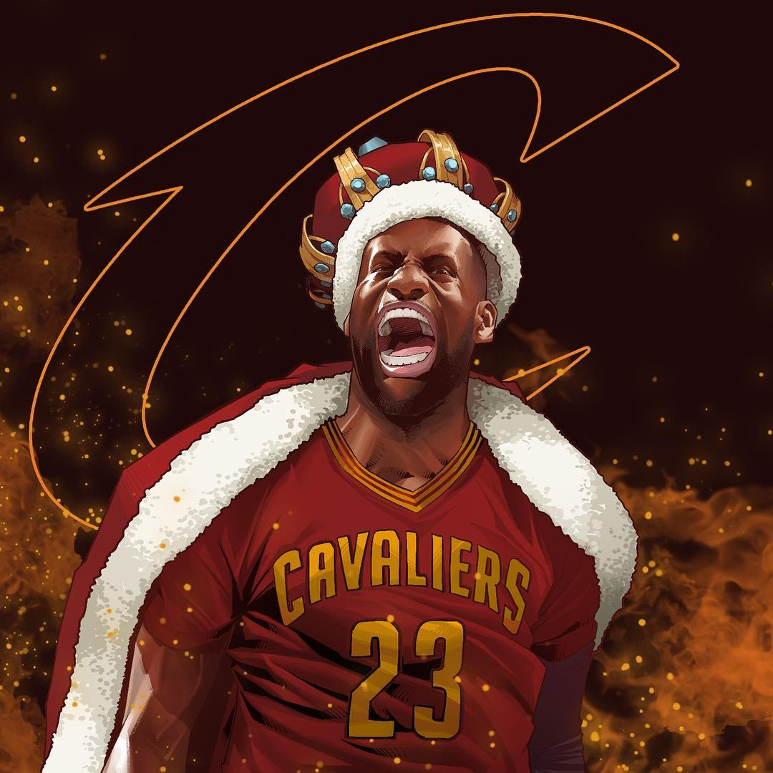

Slide 23
EPHESIANS 4:7-10^{ESV}
⁷ But grace was given to each one of us according to the measure of Christ's gift.
⁸ Therefore it says,
“When he ascended on high
he led a host of captives,
and he gave gifts to men.”
Being therefore exalted at the right hand of God, and having received from the Father the promise of the Holy Spirit, he has poured out this that you yourselves are seeing and hearing. Acts 2:33

Slide 24
EPHESIANS 4:7-10^{ESV}
⁷ But grace was given to each one of us according to the measure of Christ's gift.
⁸ Therefore it says,
“When he ascended on high
he led a host of captives,
and he gave gifts to men.”
⁹ (In saying, “He ascended,” what does it mean but that he had also descended into the lower regions, the earth? ¹⁰ He who descended is the one who also ascended far above all the heavens, that he might fill all things.)
¹¹ And he gave the apostles, the prophets, the evangelists, the shepherds and teachers…

Slide 25
KING JESUS GIVES GIFTS
There’s a diversity of gifts!

Slide 26
KING JESUS GIVES GIFTS
There’s a diversity of gifts!
Ephesians 4:11 And he gave the apostles, the prophets, the evangelists, the shepherds and teachers…

Slide 27
KING JESUS GIVES GIFTS
There’s a diversity of gifts!
Ephesians 4:11 And he gave the apostles, the prophets, the evangelists, the shepherds and teachers…
Romans 12:6-8 ⁶ Having gifts that differ according to the grace given to us, let us use them: if prophecy, in proportion to our faith; ⁷ if service, in our serving; the one who teaches, in his teaching; ⁸ the one who exhorts, in his exhortation; the one who contributes, in generosity; the one who leads, with zeal; the one who does acts of mercy, with cheerfulness.

Slide 28
KING JESUS GIVES GIFTS
There’s a diversity of gifts!
Ephesians 4:11 And he gave the apostles, the prophets, the evangelists, the shepherds and teachers…
Romans 12:6-8 ⁶ Having gifts that differ according to the grace given to us, let us use them: if prophecy, in proportion to our faith; ⁷ if service, in our serving; the one who teaches, in his teaching; ⁸ the one who exhorts, in his exhortation; the one who contributes, in generosity; the one who leads, with zeal; the one who does acts of mercy, with cheerfulness.
1 Peter 4:11a …whoever speaks, as one who speaks oracles of God; whoever serves, as one who serves by the strength that God supplies…

Slide 29
KING JESUS GIVES GIFTS
There’s a diversity of gifts!
1 Corinthians 12:8-10 ⁸ For to one is given through the Spirit the utterance of wisdom, and to another the utterance of knowledge according to the same Spirit, ⁹ to another faith by the same Spirit, to another gifts of healing by the one Spirit, ¹⁰ to another the working of miracles, to another prophecy, to another the ability to distinguish between spirits, to another various kinds of tongues, to another the interpretation of tongues.

Slide 30
KING JESUS GIVES GIFTS
There’s a diversity of gifts!
1 Corinthians 12:8-10 ⁸ For to one is given through the Spirit the utterance of wisdom, and to another the utterance of knowledge according to the same Spirit, ⁹ to another faith by the same Spirit, to another gifts of healing by the one Spirit, ¹⁰ to another the working of miracles, to another prophecy, to another the ability to distinguish between spirits, to another various kinds of tongues, to another the interpretation of tongues.
1 Corinthians 12:28 And God has appointed in the church first apostles, second prophets, third teachers, then miracles, then gifts of healing, helping, administrating, and various kinds of tongues.

Slide 31
KING JESUS GIVES GIFTS
There’s a diversity of gifts!
All gifts are vital.

Slide 32
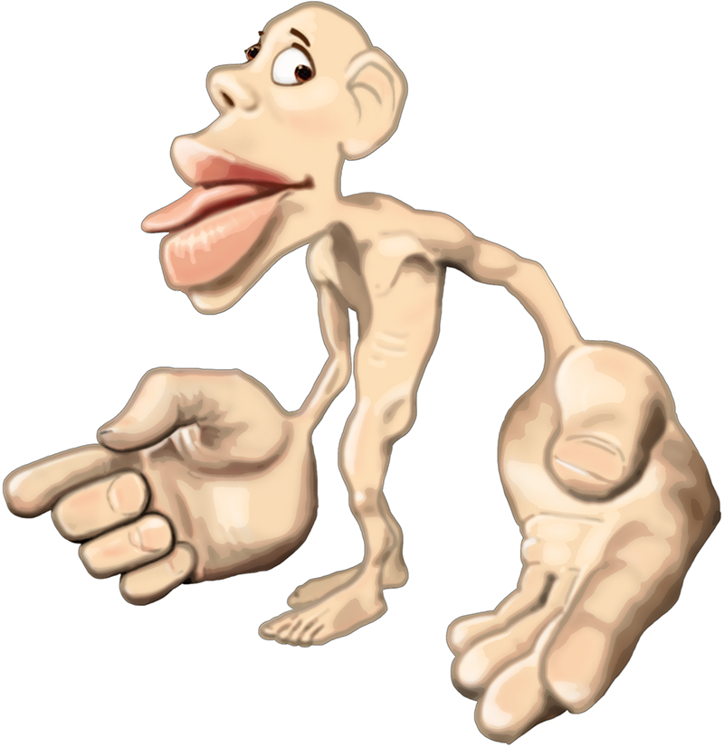

Slide 33
KING JESUS GIVES GIFTS
There’s a diversity of gifts!
All gifts are vital.
Steward all that you’ve been given.

Slide 34
KING JESUS GIVES GIFTS
There’s a diversity of gifts!
All gifts are vital.
Steward all that you’ve been given.
1 Peter 4:10 As each has received a gift, use it to serve one another, as good stewards of God's varied grace…

Slide 35
KING JESUS GIVES GIFTS
There’s a diversity of gifts!
All gifts are vital.
Steward all that you’ve been given.
1 Peter 4:10 As each has received a gift, use it to serve one another, as good stewards of God's varied grace…
Romans 12:4-6a ⁴ For as in one body we have many members, and the members do not all have the same function, ⁵ so we, though many, are one body in Christ, and individually members one of another. ^{6a} Having gifts that differ according to the grace given to us, let us use them…

Slide 36
KING JESUS GIVES GIFTS
There’s a diversity of gifts!
All gifts are vital.
Steward all that you’ve been given.
Spur each other on.

Slide 37
KING JESUS GIVES GIFTS
There’s a diversity of gifts!
All gifts are vital.
Steward all that you’ve been given.
Spur each other on.
Hebrews 10:24a And let us consider how to stir up one another to love and good works…

Slide 38
KING JESUS GIVES GIFTS
There’s a diversity of gifts!
All gifts are vital.
Steward all that you’ve been given.
Spur each other on.
Hebrews 10:24a And let us consider how to stir up one another to love and good works…
Ephesians 4:12 …to equip the saints for the work of ministry, for building up the body of Christ…

Slide 39
KING JESUS GIVES GIFTS
There’s a diversity of gifts!
All gifts are vital.
Steward all that you’ve been given.
Spur each other on.
Discover by serving in community.

Slide 40
KING JESUS GIVES GIFTS
There’s a diversity of gifts!
All gifts are vital.
Steward all that you’ve been given.
Spur each other on.
Discover by serving in community.
Gifts are given to the body of Christ!

Slide 41
KING JESUS GIVES GIFTS
There’s a diversity of gifts!
All gifts are vital.
Steward all that you’ve been given.
Spur each other on.
Discover by serving in community.
Gifts are given to the body of Christ!
Ephesians 4:12b, 16c …for the work of ministry, for building up the body of Christ… so that it builds itself up in love.

Slide 42
KING JESUS GIVES GIFTS
There’s a diversity of gifts!
All gifts are vital.
Steward all that you’ve been given.
Spur each other on.
Discover by serving in community.
Gifts are given to the body of Christ!
Ephesians 4:12b, 16c …for the work of ministry, for building up the body of Christ… so that it builds itself up in love.
Romans 12:4-5 ⁴ For as in one body we have many members, and the members do not all have the same function, ⁵ so we, though many, are one body in Christ, and individually members one of another.

Slide 43
KING JESUS GIVES GIFTS
There’s a diversity of gifts!
All gifts are vital.
Steward all that you’ve been given.
Spur each other on.
Discover by serving in community.
Gifts are given to the body of Christ!
1 Corinthians 12:7, 11 ⁷ To each is given the manifestation of the Spirit for the common good. ¹¹ All these are empowered by one and the same Spirit, who apportions to each one individually as he wills.

Slide 44
KING JESUS GIVES GIFTS
There’s a diversity of gifts!
All gifts are vital.
Steward all that you’ve been given.
Spur each other on.
Discover by serving in community.
Gifts are given to the body of Christ!
1 Corinthians 12:7, 11 ⁷ To each is given the manifestation of the Spirit for the common good. ¹¹ All these are empowered by one and the same Spirit, who apportions to each one individually as he wills.
1 Corinthians 12:27, 31 ²⁷ Now you are the body of Christ and individually members of it. ³¹ But earnestly desire the higher gifts. And I will show you a still more excellent way.

Slide 45
KING JESUS GIVES GIFTS
There’s a diversity of gifts!
All gifts are vital.
Steward all that you’ve been given.
Spur each other on.
Discover by serving in community.
Gifts are given to the body of Christ!
For we are his workmanship, created in Christ Jesus for good works, which God prepared beforehand, that we should walk in them. Ephesians 2:10

Slide 46
KING JESUS GIVES GIFTS
How has King Jesus gifted you to serve His body?
How have you discovered your gifts?
How have you been spurred on to love and good deeds?
How have you seen our body build itself up in love?
What are you learning about how you are uniquely part of God’s masterpiece, the body of Christ?

Slide 48
LIFETOGETHER
Ephesians 4:11-12 ¹¹ And he gave the apostles, the prophets, the evangelists, the shepherds and teachers, ¹² to equip the saints for the work of ministry, for building up the body of Christ…
Ephesians 4:15-16 ¹⁵ Rather, speaking the truth in love, we are to grow up in every way into him who is the head, into Christ, ¹⁶ from whom the whole body, joined and held together by every joint with which it is equipped, when each part is working properly, makes the body grow so that it builds itself up in love.
1 Corinthians 12:26-27 ²⁶ If one member suffers, all suffer together; if one member is honored, all rejoice together. ²⁷ Now you are the body of Christ and individually members of it.
English Standard Version

Slide 50
NO LONGER SLAVES
by Bethel

Slide 51
NO LONGER SLAVES
You unravel me, with a melody
You surround me with a song
Of deliverance, from my enemies
Till all my fears are gone
I’m no longer a slave to fear
I am a child of God (2x)
by Bethel

Slide 52
NO LONGER SLAVES
From my mother’s womb
You have chosen me
Love has called my name
I’ve been born again, into Your family
Your blood flows through my veins
I’m no longer a slave to fear
I am a child of God (4x)
by Bethel

Slide 53
NO LONGER SLAVES
I am surrounded
By the arms of the Father
I am surrounded
By songs of Deliverance
We’ve been liberated
From our bondage
We’re the sons and the daughters
Let us sing our freedom!
by Bethel

Slide 54
NO LONGER SLAVES
You split the sea, so I could walk
right through it
You drowned my fears in perfect love
You rescued me, so I could stand & sing
I am a child of God (2x)
I am a child of God!
by Bethel

Slide 55
NO LONGER SLAVES
I’m no longer a slave to fear
I am a child of God (2x)
by Bethel

Slide 56
TIS SO SWEET TO TRUST IN JESUS
hymn

Slide 57
TIS SO SWEET TO TRUST IN JESUS
‘Tis so sweet to trust in Jesus,
Just to take Him at His word;
Just to rest upon His promise;
Just to know, “Thus saith the Lord.”
hymn

Slide 58
TIS SO SWEET TO TRUST IN JESUS
Jesus, Jesus, how I trust Him,
How I’ve proved Him o’er and o’er,
Jesus, Jesus, Precious Jesus!
O for grace to trust Him more.
hymn

Slide 59
TIS SO SWEET TO TRUST IN JESUS
O how sweet to trust in Jesus,
Just to trust His cleansing blood;
Just in simple faith to plunge me,
’Neath the healing, cleansing flood.
hymn

Slide 60
TIS SO SWEET TO TRUST IN JESUS
Jesus, Jesus, how I trust Him,
How I’ve proved Him o’er and o’er,
Jesus, Jesus, Precious Jesus!
O for grace to trust Him more.
hymn

Slide 61
TIS SO SWEET TO TRUST IN JESUS
Yes, ’tis sweet to trust in Jesus,
Just from sin and self to cease;
Just from Jesus simply taking
life, and rest, and joy, and peace.
hymn

Slide 62
TIS SO SWEET TO TRUST IN JESUS
Jesus, Jesus, how I trust Him,
How I’ve proved Him o’er and o’er,
Jesus, Jesus, Precious Jesus!
O for grace to trust Him more.
hymn

Slide 63
TIS SO SWEET TO TRUST IN JESUS
I’m so glad I learned to trust Thee,
Precious Jesus, Savior, Friend;
And I know that Thou art with me,
Wilt be with me to the end.
hymn

Slide 64
TIS SO SWEET TO TRUST IN JESUS
Jesus, Jesus, how I trust Him,
How I’ve proved Him o’er and o’er,
Jesus, Jesus, Precious Jesus!
O for grace to trust Him more.
hymn

Slide 65
JESUS PAID IT ALL
by Kristian Stanfill

Slide 66
JESUS PAID IT ALL
I hear the Savior say, “Thy strength indeed is small
Child of weakness, watch and pray
Find in me thine all in all”
by Kristian Stanfill

Slide 67
JESUS PAID IT ALL
Jesus paid it all
All to him I owe
Sin had left a crimson stain
He washed it white as snow
by Kristian Stanfill

Slide 68
JESUS PAID IT ALL
Lord, now indeed I find
Thy power and thine alone
can change the leper's spots
and melt the heart of stone
by Kristian Stanfill

Slide 69
JESUS PAID IT ALL
Jesus paid it all
All to him I owe
Sin had left a crimson stain
He washed it white as snow
by Kristian Stanfill

Slide 70
JESUS PAID IT ALL
When from my dying bed my ransomed soul shall rise
“Jesus died my soul to save”
shall rend the vaulted skies
by Kristian Stanfill

Slide 71
JESUS PAID IT ALL
Jesus paid it all
All to him I owe
Sin had left a crimson stain
He washed it white as snow
by Kristian Stanfill

Slide 72
JESUS PAID IT ALL
Oh praise the one who paid my debt
and raised this life up from the dead
by Kristian Stanfill

Slide 73
JESUS PAID IT ALL
And when before the throne
I stand in Him complete I’ll lay my trophies down
All down at Jesus’ feet
by Kristian Stanfill

Slide 74
JESUS PAID IT ALL
Jesus paid it all
All to him I owe
Sin had left a crimson stain
He washed it white as snow
by Kristian Stanfill

Slide 75
HOW DEEP THE FATHER’S LOVE
by Austin Stone Worship

Slide 76
HOW DEEP THE FATHER’S LOVE
How deep the Father’s love for us
How vast beyond all measure
That He should give His only Son
To make a wretch His treasure
How great the pain of searing loss
The Father turns His face away
As wounds which mar the Chosen One
Bring many sons to glory
by Austin Stone Worship

Slide 77
HOW DEEP THE FATHER’S LOVE
Behold the man upon the cross
My sin upon His shoulders
Ashamed I hear my mocking voice
Call out among the scoffers
It was my sin that held Him there
Until it was accomplished
His dying breath has brought me life
I know that it is finished
by Austin Stone Worship

Slide 78
HOW DEEP THE FATHER’S LOVE
I will not boast in anything
No gifts, no power, no wisdom
But I will boast in Jesus Christ
His death and resurrection
by Austin Stone Worship

Slide 79
HOW DEEP THE FATHER’S LOVE
Why should I gain from His reward
I cannot give an answer
But this I know with all my heart
His wounds have paid my ransom
(repeat)
Yes this I know with all my heart
His wounds have paid my ransom
by Austin Stone Worship

Slide 80
TALLGRASS
COMMUNITY CHURCH

