Slide 2
TALLGRASS
COMMUNITY CHURCH

Slide 3
TALLGRASS
COMMUNITY CHURCH
Maris Deaver | Announcements

Slide 4
1
TALLGRASS
COMMUNITY CHURCH
Tallgrass Youth Mtg. TONIGHT!
Fellowship Hall after Central Gathering

Slide 5
TALLGRASS
COMMUNITY CHURCH
Guys After Party TONIGHT!
Deaver’s (1230 Houston)

Slide 6
TALLGRASS
COMMUNITY CHURCH
ManCamp rescheduled!
May 19-20 at University Park

Slide 7
TALLGRASS
COMMUNITY CHURCH
Lord’s Supper AND
Taco Bar NEXT WEEK!

Slide 8
TALLGRASS
COMMUNITY CHURCH
Tallgrass KIDS

Slide 9
TALLGRASS
COMMUNITY CHURCH
Tallgrass KIDS Pickup (Staggered):
6:20pm littles
6:25pm 2s & 3s
6:30pm 4s-1st Grade

Slide 10
TALLGRASS
COMMUNITY CHURCH
Serve at Tallgrass

Slide 11
TALLGRASS
COMMUNITY CHURCH
tallgrass.church

Slide 12
TALLGRASS
COMMUNITY CHURCH
Tell each other about
your neighborhoods.

Slide 13
TALLGRASS
COMMUNITY CHURCH
BEN DEAVER| Lead Pastor

Slide 14
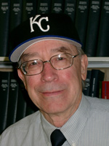
HONORING
Prof. Linder
University Distinguished Professor Robert Linder will be honored for his fifty years of service in the history department at a retirement celebration Friday, May 4 at 3:30 pm. At that time K-State will plant a tree to honor Prof. Linder in the common area behind Eisenhower Hall with a reception following
on the top floor of Calvin Hall. His former graduate
students would like to invite you—especially
Tallgrass folks!—to this unusual event.
For more info, email Liam Atchison at
culfinatan@gmail.com or call 913-952-0756.

Slide 15
RECLAIMING
neighboring

Slide 16
RECLAIMING
neighboring
Because God first loved us,
we exist to love God and
love our neighbors.

Slide 17
INHERITING
eternal life
And behold, a lawyer stood up to put him to the test, saying, “Teacher, what shall I do to inherit eternal life?”
Luke 10:25

Slide 18
INHERITING
eternal life
²⁵ And behold, a lawyer stood up to put him to the test, saying, “Teacher, what shall I do to inherit eternal life?” ²⁶ He said to him, “What is written in the Law? How do you read it?”
Luke 10:25-26

Slide 19
INHERITING
eternal life
²⁵ And behold, a lawyer stood up to put him to the test, saying, “Teacher, what shall I do to inherit eternal life?” ²⁶ He said to him, “What is written in the Law? How do you read it?” ²⁷ And he answered, “You shall love the Lord your God with all your heart and with all your soul and with all your strength and with all your mind, and your neighbor as yourself.”
Luke 10:25-27

Slide 20
INHERITING
eternal life
²⁵ And behold, a lawyer stood up to put him to the test, saying, “Teacher, what shall I do to inherit eternal life?” ²⁶ He said to him, “What is written in the Law? How do you read it?” ²⁷ And he answered, “You shall love the Lord your God with all your heart and with all your soul and with all your strength and with all your mind, and your neighbor as yourself.”
Luke 10:25-27
Deuteronomy 6:4-5
Leviticus 19:18
The Great Commandment

Slide 21
INHERITING
eternal life
²⁵ And behold, a lawyer stood up to put him to the test, saying, “Teacher, what shall I do to inherit eternal life?” ²⁶ He said to him, “What is written in the Law? How do you read it?” ²⁷ And he answered, “You shall love the Lord your God with all your heart and with all your soul and with all your strength and with all your mind, and your neighbor as yourself.”
Luke 10:25-27
Deuteronomy 6:4-5
Leviticus 19:18
The Great Commandment

Slide 22
INHERITING
eternal life
²⁵ And behold, a lawyer stood up to put him to the test, saying, “Teacher, what shall I do to inherit eternal life?” ²⁶ He said to him, “What is written in the Law? How do you read it?” ²⁷ And he answered, “You shall love the Lord your God with all your heart and with all your soul and with all your strength and with all your mind, and your neighbor as yourself.”
Luke 10:25-27
Deuteronomy 6:4-5
Leviticus 19:18
The Great Commandment

Slide 23
INHERITING
eternal life
²⁵ And behold, a lawyer stood up to put him to the test, saying, “Teacher, what shall I do to inherit eternal life?” ²⁶ He said to him, “What is written in the Law? How do you read it?” ²⁷ And he answered, “You shall love the Lord your God with all your heart and with all your soul and with all your strength and with all your mind, and your neighbor as yourself.”
²⁸ And he said to him, “You have answered correctly; do this, and you will live.”
Luke 10:25-28

Slide 24
INHERITING
eternal life
²⁵ And behold, a lawyer stood up to put him to the test, saying, “Teacher, what shall I do to inherit eternal life?” ²⁶ He said to him, “What is written in the Law? How do you read it?” ²⁷ And he answered, “You shall love the Lord your God with all your heart and with all your soul and with all your strength and with all your mind, and your neighbor as yourself.”
²⁸ And he said to him, “You have answered correctly; do this, and you will live.”
Luke 10:25-28

Slide 25
ANY LOOPHOLES?
who is my neighbor?
²⁵ And behold, a lawyer stood up to put him to the test, saying, “Teacher, what shall I do to inherit eternal life?” ²⁶ He said to him, “What is written in the Law? How do you read it?” ²⁷ And he answered, “You shall love the Lord your God with all your heart and with all your soul and with all your strength and with all your mind, and your neighbor as yourself.”
²⁸ And he said to him, “You have answered correctly; do this, and you will live.”
²⁹ But he, desiring to justify himself, said to Jesus, “And who is my neighbor?”
Luke 10:25-29

Slide 26
ANY LOOPHOLES?
who is my neighbor?
¹ When you do a good deed, make sure you know who is benefiting from it; then what you do will not be wasted. ² You will be repaid for any kindness you show to a devout person. If he doesn't repay you, the Most High will. ³ No good ever comes to a person who gives comfort to the wicked; it is not a righteous act. ⁴ Give to religious people, but don't help sinners. ⁵ Do good to humble people, but don't give anything to those who are not devout. Don't give them food, or they will use your kindness against you. Every good thing you do for such people will bring you twice as much trouble in return. ⁶ The Most High himself hates sinners, and he will punish them. ⁷ Give to good people, but do not help sinners.
Wisdom of Sirach 12:1-7

Slide 27
ANY LOOPHOLES?
who is my neighbor?
“love all the sons of light…
hate all the sons of darkness”
Qumran (1QS 1.9-11)

Slide 28
STORYTIME
with Jesus
Jesus replied, “A man was going down from Jerusalem to Jericho…”
Luke 10:30a

Slide 29
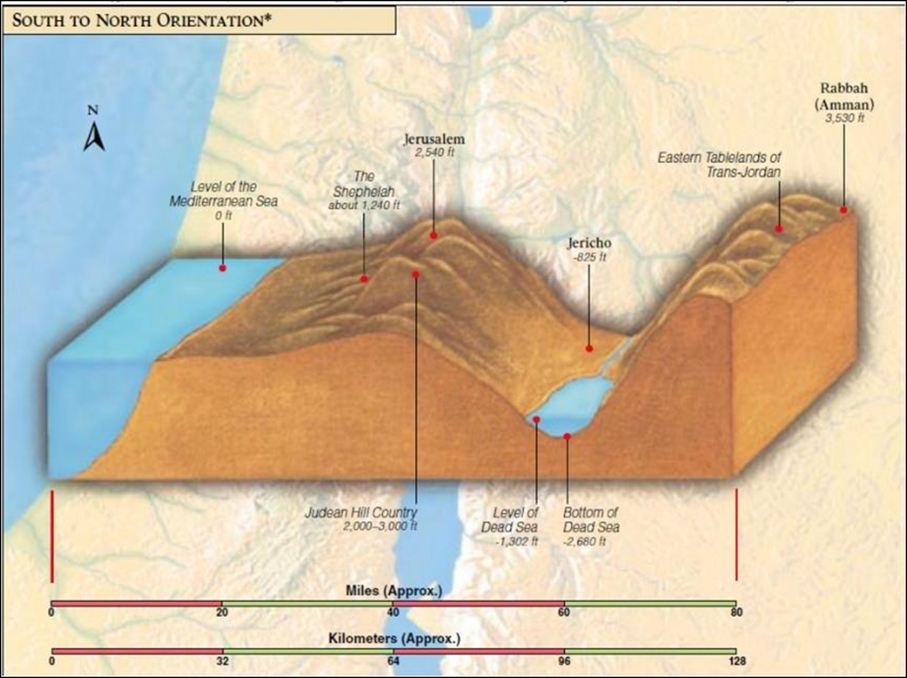

Slide 30
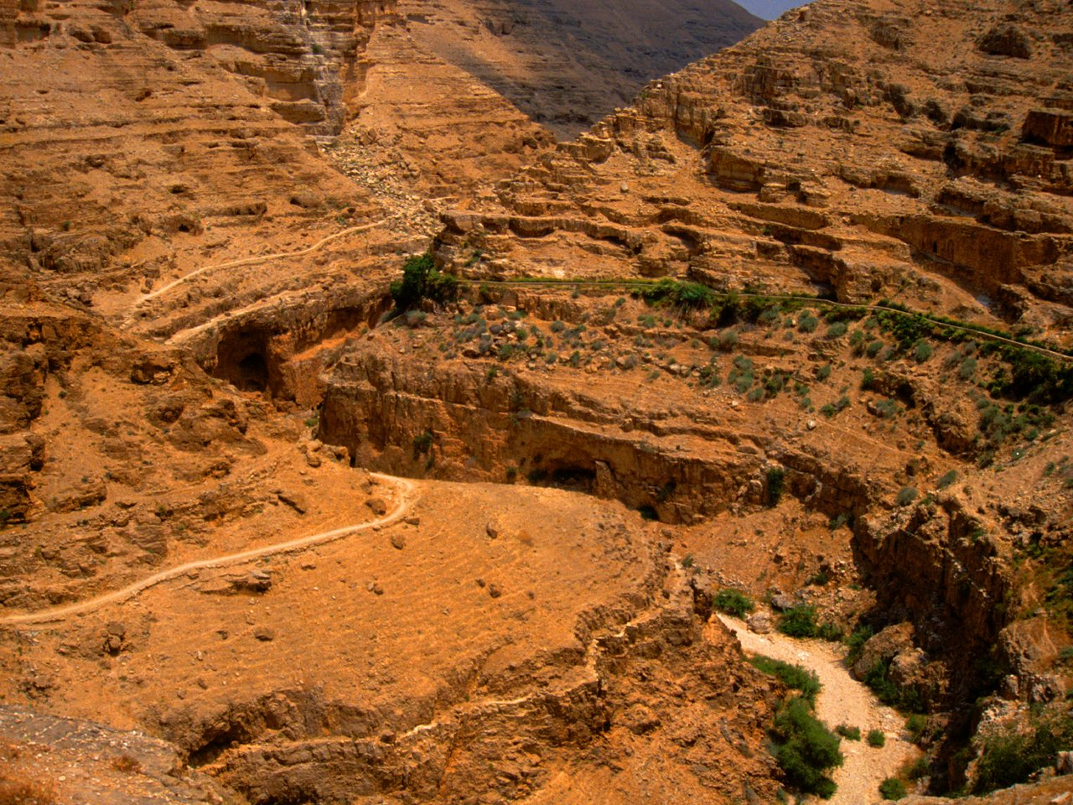

Slide 31
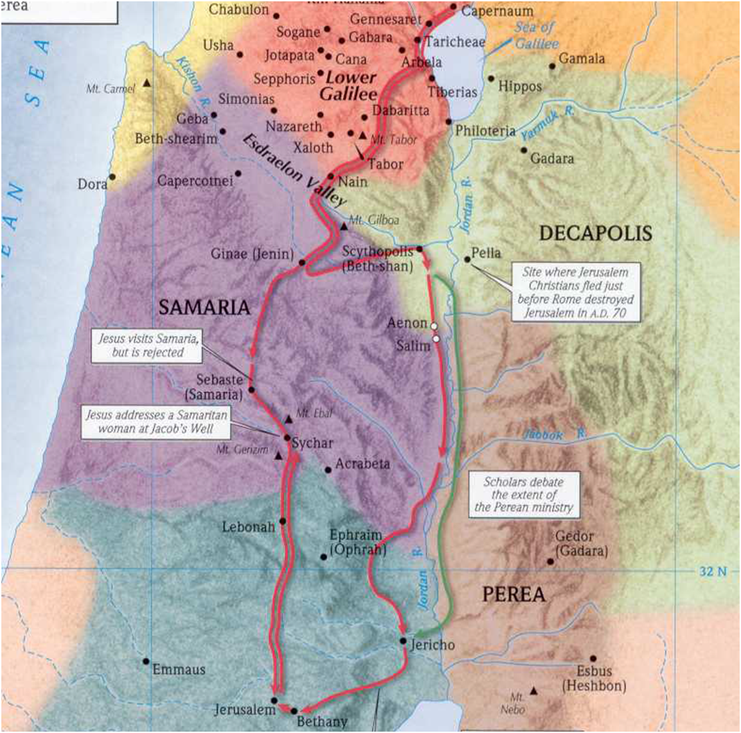

Slide 32
Samaria
Jerusalem
Jericho

Slide 33
Samaria
Woman at the Well (John 4)
Jerusalem
Jericho

Slide 34
Samaria
Jesus rejected by Samaritans (Lk. 9)
Woman at the Well (John 4)
Jerusalem
Jericho

Slide 35
Samaria
Jesus rejected by Samaritans (Lk. 9)
Woman at the Well (John 4)
“He that eats the bread of Samaritans is like to one who eats the flesh of swine” Talmud (m. Seb 8.10 )
Jerusalem
Jericho

Slide 36
STORYTIME
with Jesus
Jesus replied, “A man was going down from Jerusalem to Jericho, and he fell among robbers, who stripped him and beat him and departed, leaving him half dead.”
Luke 10:30

Slide 37
STORYTIME
with Jesus
³⁰ Jesus replied, “A man was going down from Jerusalem to Jericho, and he fell among robbers, who stripped him and beat him and departed, leaving him half dead. ³¹ Now by chance a priest was going down that road, and when he saw him he passed by on the other side.”
Luke 10:30-31

Slide 38
STORYTIME
with Jesus
³⁰ Jesus replied, “A man was going down from Jerusalem to Jericho, and he fell among robbers, who stripped him and beat him and departed, leaving him half dead. ³¹ Now by chance a priest was going down that road, and when he saw him he passed by on the other side.³² So likewise a Levite, when he came to the place and saw him, passed by on the other side.”
Luke 10:30-32

Slide 39
STORYTIME
with Jesus
³⁰ Jesus replied, “A man was going down from Jerusalem to Jericho, and he fell among robbers, who stripped him and beat him and departed, leaving him half dead. ³¹ Now by chance a priest was going down that road, and when he saw him he passed by on the other side.³² So likewise a Levite, when he came to the place and saw him, passed by on the other side.”
Luke 10:30-32

Slide 40
STORYTIME
with Jesus
³⁰ Jesus replied, “A man was going down from Jerusalem to Jericho, and he fell among robbers, who stripped him and beat him and departed, leaving him half dead. ³¹ Now by chance a priest was going down that road, and when he saw him he passed by on the other side.³² So likewise a Levite, when he came to the place and saw him, passed by on the other side.”
Luke 10:30-32
What will happen next?

Slide 41
STORYTIME
with Jesus
“But a Samaritan…”
Luke 10:33a

Slide 42
STORYTIME
with Jesus
“But a Samaritan…”
Luke 10:33a
DUN-DUN-DUUUUUN!!!

Slide 43
STORYTIME
with Jesus
“But a Samaritan , as he journeyed, came to where he was, and when he saw him…”
Luke 10:33a
DUN-DUN-DUUUUUN!!!

Slide 44
STORYTIME
with Jesus
“But a Samaritan , as he journeyed, came to where he was, and when he saw him…”
Luke 10:33a
The suspense is killing me!

Slide 45
STORYTIME
with Jesus
“But a Samaritan , as he journeyed, came to where he was, and when he saw him…”
Luke 10:33a
…he had compassion!

Slide 46
STORYTIME
with Jesus
^{33 “}But a Samaritan, as he journeyed, came to where he was, and when he saw him, he had compassion.
^{34a} He went to him and bound up his wounds, pouring on oil and wine.”
Luke 10:33-34a

Slide 47
STORYTIME
with Jesus
^{33 “}But a Samaritan, as he journeyed, came to where he was, and when he saw him, he had compassion.
³⁴ He went to him and bound up his wounds, pouring on oil and wine.
Then he set him on his own animal and brought him to an inn and took care of him.”
Luke 10:33-34

Slide 48
STORYTIME
with Jesus
^{33 “}But a Samaritan, as he journeyed, came to where he was, and when he saw him, he had compassion.
³⁴ He went to him and bound up his wounds, pouring on oil and wine.
Then he set him on his own animal and brought him to an inn and took care of him.
³⁵ And the next day he took out two denarii and gave them to the innkeeper, saying, ‘Take care of him, and whatever more you spend, I will repay you when I come back.’”
Luke 10:33-35

Slide 49
RECLAIMING
neighboring
“Which of these three, do you think, proved to be a neighbor to the man who fell among the robbers?”
Luke 10:36

Slide 50
RECLAIMING
neighboring
^{36 “}Which of these three, do you think, proved to be a neighbor to the man who fell among the robbers?”
^{37a} He said, “The one who showed him mercy.”
Luke 10:36-37a

Slide 51
RECLAIMING
neighboring
^{36 “}Which of these three, do you think, proved to be a neighbor to the man who fell among the robbers?”
³⁷ He said, “The one who showed him mercy.”
And Jesus said to him, “You go, and do likewise.”
Luke 10:36-37

Slide 52
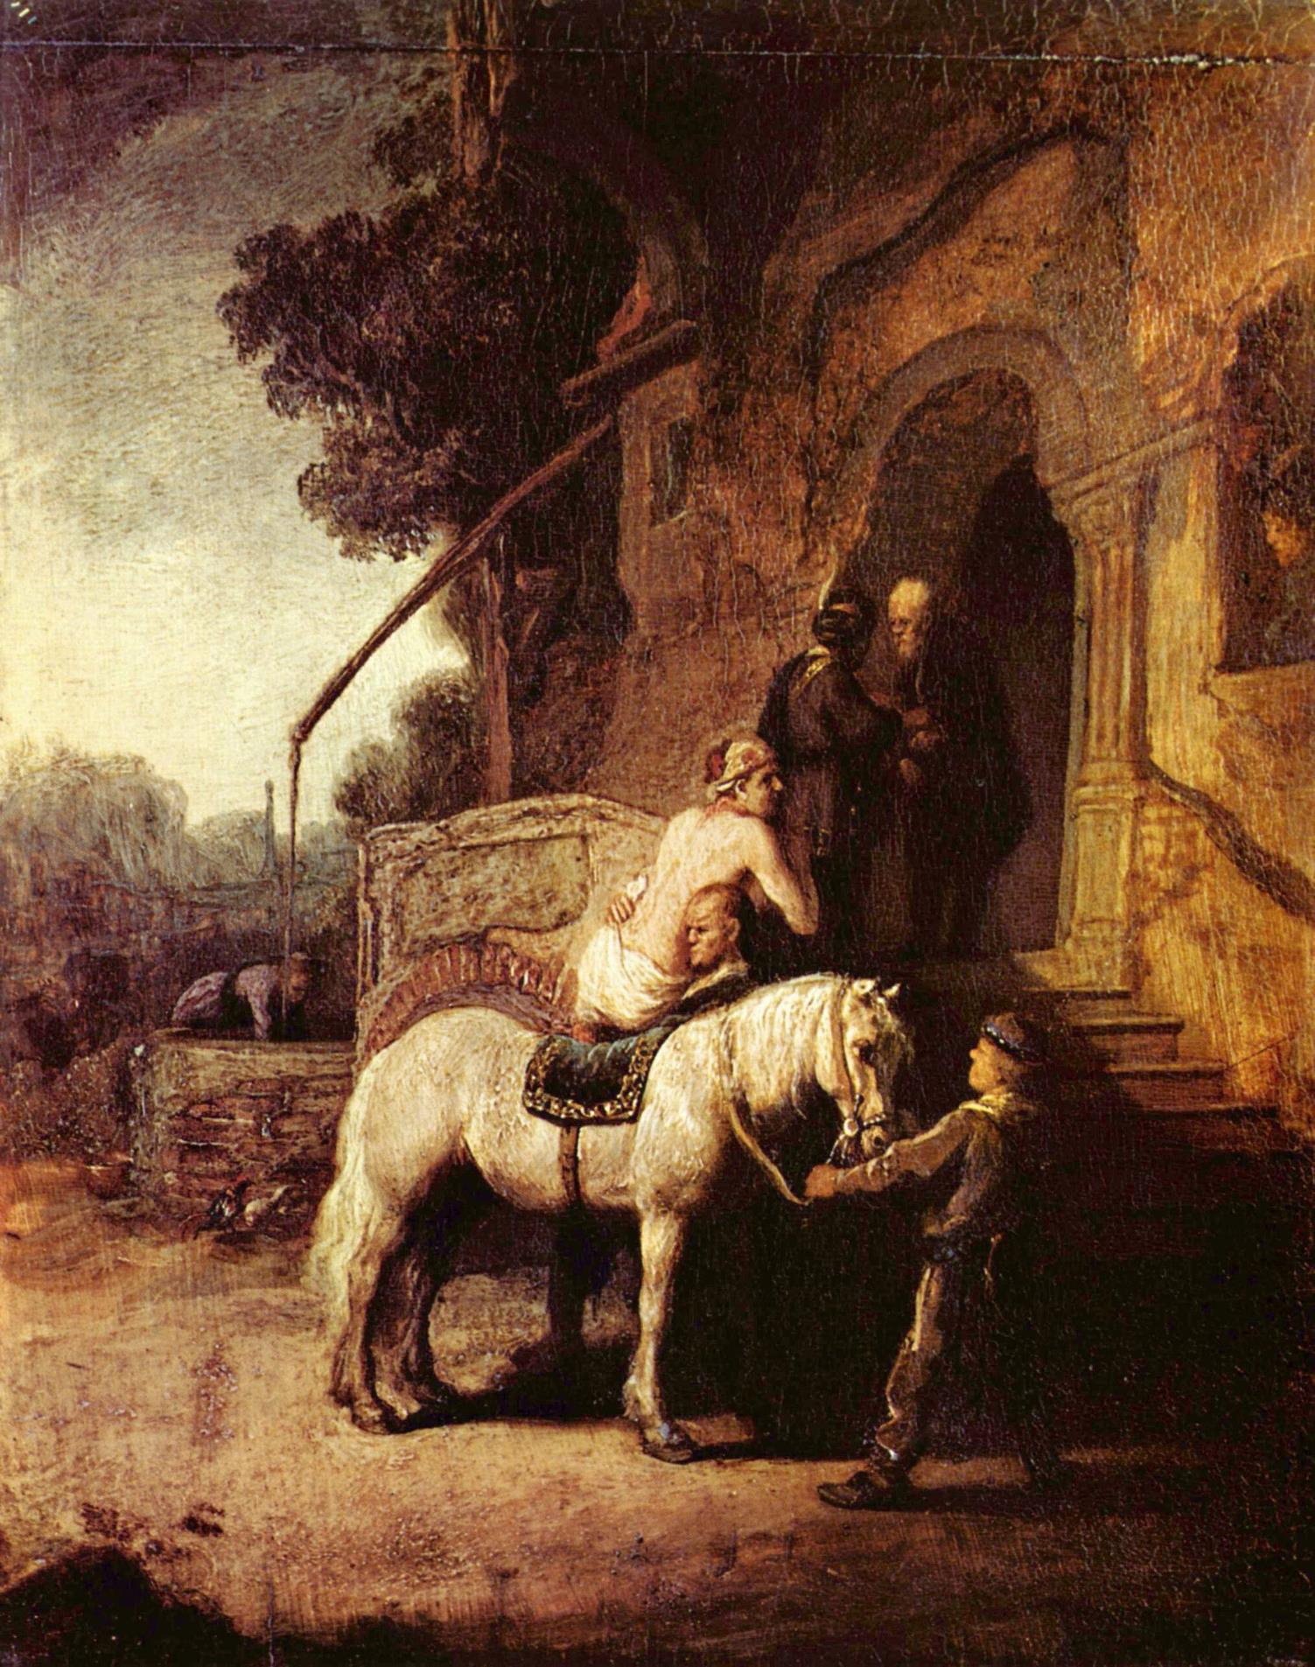

Slide 53
JESUS of NAZARETH
the Great Samaritan

Slide 54
JESUS of NAZARETH
the Great Samaritan
The Word became flesh and blood, and moved into the neighborhood.
John 1:14 (The Message)

Slide 55
JESUS of NAZARETH
the Great Samaritan
The Word became flesh and blood, and moved into the neighborhood.
John 1:14 (The Message)
For if while we were enemies we were reconciled to God by the death of his Son, much more, now that we are reconciled, shall we be saved by his life.
Romans 5:10

Slide 56
RECLAIMING
neighboring
And Jesus says to us, “You go, and do likewise.”

Slide 57
RECLAIMING
neighboring

Slide 58
RECLAIMING
neighboring
Neighboring is an incredibly comprehensive ministry model. In fact, it’s 100% comprehensive.

Slide 59
RECLAIMING
neighboring
Neighboring is an incredibly comprehensive ministry model. In fact, it’s 100% comprehensive.
Not everyone can be a pastor, teacher, elder, singer or musician, but everyone is a neighbor. No one can opt out. Neighboring fits every demographic: young, old, single, married, adults, teenagers, apartment dwellers, soccer moms, CEOs, baristas, bachelors, grandmothers, and retired couples.

Slide 60
RECLAIMING
neighboring
Neighboring is an incredibly comprehensive ministry model. In fact, it’s 100% comprehensive.
Not everyone can be a pastor, teacher, elder, singer or musician, but everyone is a neighbor. No one can opt out. Neighboring fits every demographic: young, old, single, married, adults, teenagers, apartment dwellers, soccer moms, CEOs, baristas, bachelors, grandmothers, and retired couples.
Pastoral care, divorce care, children, youth, women, men, discipleship, prayer, Bible study, sports...everything is encompassed in neighboring.

Slide 61
RECLAIMING
neighboring
“Your home is the number-one place for discipleship, evangelism, and fellowship.” p. 65

Slide 62
RECLAIMING
neighboring
“Your home is the number-one place for discipleship, evangelism, and fellowship.” p. 65
“Jesus came to move us out of a place of religious complexity and into a place of relational simplicity.” p. 71

Slide 63
RECLAIMING
neighboring
“Your home is the number-one place for discipleship, evangelism, and fellowship.” p. 65
“Jesus came to move us out of a place of religious complexity and into a place of relational simplicity.” p. 71
“The goal is to grow. We have been programming people for comfort, not growth. We have done the opposite of what we set out to do.” p. 75

Slide 64
RECLAIMING
neighboring
“Your home is the number-one place for discipleship, evangelism, and fellowship.” p. 65
“Jesus came to move us out of a place of religious complexity and into a place of relational simplicity.” p. 71
“The goal is to grow. We have been programming people for comfort, not growth. We have done the opposite of what we set out to do.” p. 75
“Neighboring is quite possibly the best spiritual formation process a church can initiate.” p. 77

Slide 65
Tallgrass Church
Central Gathering

Slide 66
Deaver LIFE Group
Greeve LIFE Group
Tallgrass Church
Central Gathering

Slide 67
Deaver LIFE Group
Greeve LIFE Group
Wamego
Tallgrass Church
Central Gathering
South of Poyntz

Slide 68
Deaver LIFE Group
Greeve LIFE Group
Wamego
Tallgrass Church
Central Gathering
South of Poyntz
LIFE Group
LIFE Group

Slide 69
Deaver LIFE Group
Greeve LIFE Group
Wamego
Tallgrass Church
Central Gathering
South of Poyntz
LIFE Group
University Park
Timbercreek
LIFE Group

Slide 70
SoPo
Tallgrass
Church
Wamego
City Park West
Jardine
Timbercreek
UP
Tuttle Sandwich

Slide 71
SoPo
Tallgrass
Church
Wamego
City Park West
Jardine
Timbercreek
Amherst
Tuttle Sandwich
Ogden
UP
JC

Slide 72
RECLAIMING
neighboring
Who will you have compassion on?

Slide 73
RECLAIMING
neighboring
Who will you have compassion on?
How will you meet their need(s)?

Slide 74
RECLAIMING
neighboring
Who will you have compassion on?
How will you meet their need(s)?
How will you learn neighboring from Jesus?

Slide 75
RECLAIMING
neighboring
Who will you have compassion on?
How will you meet their need(s)?
How will you learn neighboring from Jesus?
What might God do through
our church if we learned to
neighbor as Jesus neighbored?

Slide 76
QUESTIONS
COMMENTS
TESTIMONIES

Slide 77
JOYS & SORROWS
testimonies

Slide 78
Questions for Testimony
What doubts are robbing you from resting in confidence in the Lord?
What fears are hindering you from doing what God is asking of you?
What is currently stealing or strengthening your joy?
In what ways has God relentlessly pursued you?
How has God assured you of His faithfulness/love?
Songs for Response
Yes and Amen
No Longer Slaves
Take Courage
Joy of the Lord
Joy
Reckless Love
How Deep the Father’s Love
Jesus We Love You
Jesus Paid It All

Slide 79
YES AND AMEN
by Housefires

Slide 80
YES AND AMEN
Father of kindness
You have poured out grace
You brought me out of darkness
You have filled me with peace
Giver of mercy You're my
help in time of need
Lord I can't help but sing:
by Housefires

Slide 81
YES AND AMEN
Faithful You are
Faithful forever You will be
Faithful You are
All Your promises are yes and Amen
All Your promises are yes and Amen
[See 2 Corinthians 1:20]
by Housefires

Slide 82
YES AND AMEN
Beautiful Savior
You have brought me near
You pulled me from the ashes
You have broken every curse
Blessed redeemer
You have set this captive free
Lord I can't help but sing:
by Housefires

Slide 83
YES AND AMEN
Faithful You are
Faithful forever You will be
Faithful You are
All Your promises are yes and Amen
All Your promises are yes and Amen
[See 2 Corinthians 1:20]
by Housefires

Slide 84
YES AND AMEN
I will rest in Your promises
My confidence is Your faithfulness
by Housefires

Slide 85
YES AND AMEN
Faithful You are
Faithful forever You will be
Faithful You are
All Your promises are yes and Amen
All Your promises are yes and Amen
[See 2 Corinthians 1:20]
by Housefires

Slide 86
NO LONGER SLAVES
by Bethel

Slide 87
NO LONGER SLAVES
You unravel me, with a melody
You surround me with a song
Of deliverance, from my enemies
Till all my fears are gone
I’m no longer a slave to fear
I am a child of God (2x)
by Bethel

Slide 88
NO LONGER SLAVES
From my mother’s womb
You have chosen me
Love has called my name
I’ve been born again, into Your family
Your blood flows through my veins
I’m no longer a slave to fear
I am a child of God (4x)
by Bethel

Slide 89
NO LONGER SLAVES
I am surrounded
By the arms of the Father
I am surrounded
By songs of Deliverance
We’ve been liberated
From our bondage
We’re the sons and the daughters
Let us sing our freedom!
by Bethel

Slide 90
NO LONGER SLAVES
You split the sea, so I could walk
right through it
You drowned my fears in perfect love
You rescued me, so I could stand & sing
I am a child of God (2x)
I am a child of God!
by Bethel

Slide 91
NO LONGER SLAVES
I’m no longer a slave to fear
I am a child of God (2x)
by Bethel

Slide 92
TAKE COURAGE
by Bethel

Slide 93
TAKE COURAGE
Slow down, take time
"Breathe in," He said
He'd reveal what's to come
The thoughts in His mind
Always higher than mine
He'll reveal all to come
[See Isaiah 55:8-9]
by Bethel

Slide 94
TAKE COURAGE
So take courage my heart
Stay steadfast my soul
He's in the waiting
He's in the waiting
And hold onto your hope
As your triumph unfolds
He's never failing
He's never failing
by Bethel

Slide 95
TAKE COURAGE
Sing praise my soul
Find strength in joy
Let His words lead you on
Do not forget
His great faithfulness
He'll finish all He's begun
[See Nehemiah 8:10]
by Bethel

Slide 96
TAKE COURAGE
So take courage my heart
Stay steadfast my soul
He's in the waiting
He's in the waiting
And hold onto your hope
As your triumph unfolds
He's never failing
He's never failing
by Bethel

Slide 97
TAKE COURAGE
And You who hold the stars
Who call them each by name
Will surely keep Your promise to me
That I will rise in Your victory!
by Bethel

Slide 98
TAKE COURAGE
So take courage my heart
Stay steadfast my soul
He's in the waiting
He's in the waiting
And hold onto your hope
As your triumph unfolds
He's never failing
He's never failing
by Bethel

Slide 99
CONFIDENT
by Steffany Gretzinger & Bobby Strand

Slide 100
CONFIDENT
You’re always moving in the unseen
The breath You exhale sustaining me
Before I call, You know my need
You’re always going before me
by Steffany Gretzinger & Bobby Strand

Slide 101
CONFIDENT
I’m confident Your faithfulness
will see me through
My soul can rest, my righteousness
is found in You
With every moment left,
in every borrowed breath
Let this be true
That all my heart, for all my life
belongs to You
by Steffany Gretzinger & Bobby Strand

Slide 102
CONFIDENT
Your laughter scatters my enemies
You give me joy for my mourning
You lift my head, so I can see
All of Heaven surrounding me
by Steffany Gretzinger & Bobby Strand

Slide 103
CONFIDENT
I’m confident Your faithfulness
will see me through
My soul can rest, my righteousness
is found in You
With every moment left,
in every borrowed breath
Let this be true
That all my heart, for all my life
belongs to You
by Steffany Gretzinger & Bobby Strand

Slide 104
CONFIDENT
I won’t win this battle with the strength of
my own hands;
You’re the Mountain Mover,
and only You can
I won’t build my life on sinking sand
You’re my hope forever,
the Rock where I stand
(repeat)
by Steffany Gretzinger & Bobby Strand

Slide 105
CONFIDENT
I’m confident Your faithfulness
will see me through
My soul can rest, my righteousness
is found in You
With every moment left,
in every borrowed breath
Let this be true
That all my heart, for all my life
belongs to You
by Steffany Gretzinger & Bobby Strand

Slide 106
JESUS PAID IT ALL
by Kristian Stanfill

Slide 107
JESUS PAID IT ALL
I hear the Savior say, “Thy strength indeed is small
Child of weakness, watch and pray
Find in me thine all in all”
by Kristian Stanfill

Slide 108
JESUS PAID IT ALL
Jesus paid it all
All to him I owe
Sin had left a crimson stain
He washed it white as snow
by Kristian Stanfill

Slide 109
JESUS PAID IT ALL
Lord, now indeed I find
Thy power and thine alone
can change the leper's spots
and melt the heart of stone
by Kristian Stanfill

Slide 110
JESUS PAID IT ALL
Jesus paid it all
All to him I owe
Sin had left a crimson stain
He washed it white as snow
by Kristian Stanfill

Slide 111
JESUS PAID IT ALL
When from my dying bed my ransomed soul shall rise
“Jesus died my soul to save”
shall rend the vaulted skies
by Kristian Stanfill

Slide 112
JESUS PAID IT ALL
Jesus paid it all
All to him I owe
Sin had left a crimson stain
He washed it white as snow
by Kristian Stanfill

Slide 113
JESUS PAID IT ALL
Oh praise the one who paid my debt
and raised this life up from the dead
by Kristian Stanfill

Slide 114
JESUS PAID IT ALL
And when before the throne
I stand in Him complete I’ll lay my trophies down
All down at Jesus’ feet
by Kristian Stanfill

Slide 115
JESUS PAID IT ALL
Jesus paid it all
All to him I owe
Sin had left a crimson stain
He washed it white as snow
by Kristian Stanfill

Slide 116
JOY OF THE LORD
by Rend Collective

Slide 117
JOY OF THE LORD
Though the tears may fall
My song will rise, my song will rise to You
Though my heart may fail
My song will rise, my song will rise to You
While there's breath in my lungs
I will praise You, Lord

Slide 118
JOY OF THE LORD
In the dead of night,
I'll lift my eyes, I'll lift my eyes to You
Though the waters rise,
I'll lift my eyes, I'll lift my eyes to You
While there's hope in this heart
I will praise You, Lord
by Rend Collective

Slide 119
JOY OF THE LORD
The joy of the Lord is my strength!
The joy of the Lord is my strength!
In the darkness I'll dance
In the shadows I'll sing
The joy of the Lord is my strength!
by Rend Collective

Slide 120
JOY OF THE LORD
When I cannot see You with my eyes
Let faith arise to You
When I cannot feel Your hand in mine
Let faith arise to You
God of mercy and love
I will praise You, Lord
by Rend Collective

Slide 121
JOY OF THE LORD
How You shine with glory, Lord of light
I feel alive with You
In Your presence now I come alive
I am alive with You
There is strength when I say:
“I will praise You, Lord”
by Rend Collective

Slide 122
JOY OF THE LORD
The joy of the Lord is my strength!
The joy of the Lord is my strength!
In the darkness I'll dance
In the shadows I'll sing
The joy of the Lord is my strength!
by Rend Collective

Slide 123
JOY OF THE LORD
When sorrow comes my way
You’re the shield around me
Always, You remain
My courage in the fight
I hear You call my name
Jesus, I am coming
Walking on the waves
Reaching for Your light!
by Rend Collective

Slide 124
JOY OF THE LORD
The joy of the Lord is my strength!
The joy of the Lord is my strength!
In the darkness I'll dance
In the shadows I'll sing
The joy of the Lord is my strength!
by Rend Collective

Slide 125
JOY
by Rend Collective

Slide 126
JOY
We're choosing celebration
Breaking into freedom
You're the song,
You're the song of our hearts
We cast aside our shadows
Trust You with our sorrows
You're the song,
You're the song of our hearts
by Rend Collective

Slide 127
JOY
We're dancing to the rhythm of Your heart
We're rising from the ashes to the stars
by Rend Collective

Slide 128
JOY
You're the joy, joy, joy lighting my soul
The joy, joy, joy making me whole
Though I'm broken, I am running
into Your arms of love
by Rend Collective

Slide 129
JOY
The pain will not define us
Joy will reignite us
You're the song,
You're the song of our hearts.
The dark is just a canvas
for Your grace and brightness
You're the song,
You're the song of our hearts
by Rend Collective

Slide 130
JOY
We're dancing to the rhythm of Your heart
We're rising from the ashes to the stars
by Rend Collective

Slide 131
JOY
You're the joy, joy, joy lighting my soul
The joy, joy, joy making me whole
Though I'm broken, I am running
into Your arms of love
by Rend Collective

Slide 132
JOY
In the shadows
In the sorrows
In the desert
When the pain hits
You are constant
Ever-present
You're the song of my heart
by Rend Collective

Slide 133
JOY
You're the joy, joy, joy lighting my soul
The joy, joy, joy making me whole
Though I'm broken, I am running
into Your arms of love
by Rend Collective

Slide 134
RECKLESS LOVE
by Cory Asbury

Slide 135
RECKLESS LOVE
Before I spoke a word,
You were singing over me
You have been so, so good to me
Before I took a breath,
You breathed Your life in me
You have been so, so kind to me
by Cory Asbury

Slide 136
RECKLESS LOVE
O, the overwhelming, never-ending,
reckless love of God
O it chases me down, fights ‘til I’m found
leaves the ninety-nine
I couldn’t earn it, I don’t deserve it,
still You give Yourself away
Oh, the overwhelming, never-ending,
reckless love of God
by Cory Asbury

Slide 137
RECKLESS LOVE
When I was Your foe,
still Your love fought for me
You have been so, so good to me
When I felt no worth, You paid it all for me
You have been so, so kind to me
by Cory Asbury

Slide 138
RECKLESS LOVE
O, the overwhelming, never-ending,
reckless love of God
O it chases me down, fights ‘til I’m found
leaves the ninety-nine
I couldn’t earn it, I don’t deserve it,
still You give Yourself away
Oh, the overwhelming, never-ending,
reckless love of God
by Cory Asbury

Slide 139
RECKLESS LOVE
There’s no shadow You won’t light up
Mountain You won’t climb up
Coming after me
There’s no wall You won’t kick down
Lie You won’t tear down
Coming after me
(repeat)
by Cory Asbury

Slide 140
RECKLESS LOVE
O, the overwhelming, never-ending,
reckless love of God
O it chases me down, fights ‘til I’m found
leaves the ninety-nine
I couldn’t earn it, I don’t deserve it,
still You give Yourself away
Oh, the overwhelming, never-ending,
reckless love of God
(repeat)
by Cory Asbury

Slide 141
HOW DEEP THE FATHER’S LOVE
by Austin Stone Worship

Slide 142
HOW DEEP THE FATHER’S LOVE
How deep the Father’s love for us
How vast beyond all measure
That He should give His only Son
To make a wretch His treasure
How great the pain of searing loss
The Father turns His face away
As wounds which mar the Chosen One
Bring many sons to glory
by Austin Stone Worship

Slide 143
HOW DEEP THE FATHER’S LOVE
Behold the man upon the cross
My sin upon His shoulders
Ashamed I hear my mocking voice
Call out among the scoffers
It was my sin that held Him there
Until it was accomplished
His dying breath has brought me life
I know that it is finished
by Austin Stone Worship

Slide 144
HOW DEEP THE FATHER’S LOVE
I will not boast in anything
No gifts, no power, no wisdom
But I will boast in Jesus Christ
His death and resurrection
by Austin Stone Worship

Slide 145
HOW DEEP THE FATHER’S LOVE
Why should I gain from His reward
I cannot give an answer
But this I know with all my heart
His wounds have paid my ransom
(repeat)
Yes this I know with all my heart
His wounds have paid my ransom
by Austin Stone Worship

Slide 146
JESUS WE LOVE YOU
by Bethel

Slide 147
JESUS WE LOVE YOU
Old things have passed away
Your love has stayed the same
Your constant grace remains the cornerstone
Things that we thought were dead
Are breathing in life again
You cause Your Son to shine on darkest nights
For all that You’ve done we will
pour out our love
This will be our anthem song
by Bethel

Slide 148
JESUS WE LOVE YOU
Jesus we love You
Oh how we love You
You are the one our hearts adore
by Bethel

Slide 149
JESUS WE LOVE YOU
The hopeless have found their hope
The orphans now have a home
All that was lost has found its place in You
You lift our weary head
You make us strong instead
You took these rags and made us beautiful
For all that you’ve done we will
pour out our love
This will be our anthem song
by Bethel

Slide 150
JESUS WE LOVE YOU
Jesus we love You
Oh how we love You
You are the one our hearts adore
by Bethel

Slide 151
JESUS WE LOVE YOU
Our affection, our devotion
poured out on the feet of Jesus
(4x)
by Bethel

Slide 152
JESUS WE LOVE YOU
Jesus we love You
Oh how we love You
You are the one our hearts adore
(3x)
by Bethel

Slide 153
DOXOLOGY
Praise God, from Whom all blessings flow;
Praise Him, all creatures here below;
Praise Him above, ye heav’nly host;
Praise Father, Son, and Holy Ghost.
Amen.
by Bethel

Slide 154
TALLGRASS
COMMUNITY CHURCH

Slide 155
TALLGRASS
COMMUNITY CHURCH
Tallgrass KIDS Pickup (Staggered):
6:20pm littles
6:25pm 2s & 3s
6:30pm 4s-1st Grade

