Slide 2
FINDING YOURSELF IN COMMUNITY
EPHESIANS 4:11-25

Slide 3
¹¹ So Christ himself gave the apostles, the prophets, the evangelists, the pastors and teachers, ¹² to equip his people for the work of ministry, so that the body of Christ may be built up ¹³ until we all reach unity in the faith and in the knowledge of the Son of God and become mature, attaining to the whole measure of the fullness of Christ. ¹⁴ Then we will no longer be infants, tossed back and forth by the waves, and blown here and there by every wind of teaching and by the cunning and craftiness of people in their deceitful scheming. ¹⁵ Instead, speaking the truth in love, we will grow to become in every respect the mature body of him who is the head, that is, Christ. ¹⁶ From him the whole body, joined and held together by every supporting ligament, grows and builds itself up in love, as each part does its work.
EPHESIANS 4:11-16

Slide 4
God
Traditional Model
Institutional Paradigm
Clergy
Laity

Slide 5
New Testament Model
Christ (the head)
Organic Paradigm
Leaders
(elders, pastors, staff)
Everybody
(ministers)

Slide 6
¹¹ So Christ himself gave the apostles, the prophets, the evangelists, the pastors and teachers, ¹² to equip his people for the work of ministry, so that the body of Christ may be built up ¹³ until we all reach unity in the faith and in the knowledge of the Son of God and become mature, attaining to the whole measure of the fullness of Christ. ¹⁴ Then we will no longer be infants, tossed back and forth by the waves, and blown here and there by every wind of teaching and by the cunning and craftiness of people in their deceitful scheming. ¹⁵ Instead, speaking the truth in love, we will grow to become in every respect the mature body of him who is the head, that is, Christ. ¹⁶ From him the whole body, joined and held together by every supporting ligament, grows and builds itself up in love, as each part does its work.
EPHESIANS 4:11-16

Slide 7
¹⁷ So I tell you this, and insist on it in the Lord, that you must no longer live as the Gentiles do, in the futility of their thinking. ¹⁸ They are darkened in their understanding and separated from the life of God because of the ignorance that is in them due to the hardening of their hearts. ¹⁹ Having lost all sensitivity, they have given themselves over to sensuality so as to indulge in every kind of impurity, and they are full of greed.
EPHESIANS 4:17-19

Slide 8
¹⁷ So I tell you this, and insist on it in the Lord, that you must no longer live as the Gentiles do, in the futility of their thinking. ¹⁸ They are darkened in their understanding and separated from the life of God because of the ignorance that is in them due to the hardening of their hearts. ¹⁹ Having lost all sensitivity, they have given themselves over to sensuality so as to indulge in every kind of impurity, and they are full of greed.
My people have committed two sins: They have forsaken me, the spring of living water, and have dug their own cisterns, broken cisterns that cannot hold water. - Jeremiah 2:13
EPHESIANS 4:17-19

Slide 9
²⁰ That, however, is not the way of life you learned ²¹ when you heard about Christ and were taught in him in accordance with the truth that is in Jesus. ²² You were taught, with regard to your former way of life, to put off your old self, which is being corrupted by its deceitful desires; ²³ to be made new in the attitude of your minds; ²⁴ and to put on the new self, created to be like God in true righteousness and holiness. ²⁵ Therefore each of you must put off falsehood and speak truthfully to your neighbor, for we are all members of one body.
EPHESIANS 4:20-25

Slide 10
²⁰ That, however, is not the way of life you learned ²¹ when you heard about Christ and were taught in him in accordance with the truth that is in Jesus. ²² You were taught, with regard to your former way of life, to put off your old self, which is being corrupted by its deceitful desires; ²³ to be made new in the attitude of your minds; ²⁴ and to put on the new self, created to be like God in true righteousness and holiness. ²⁵ Therefore each of you must put off falsehood and speak truthfully to your neighbor, for we are all members of one body.
Therefore, confess your sins to one another and pray for one another, that you may be healed. - James 5:16
EPHESIANS 4:20-25

Slide 11
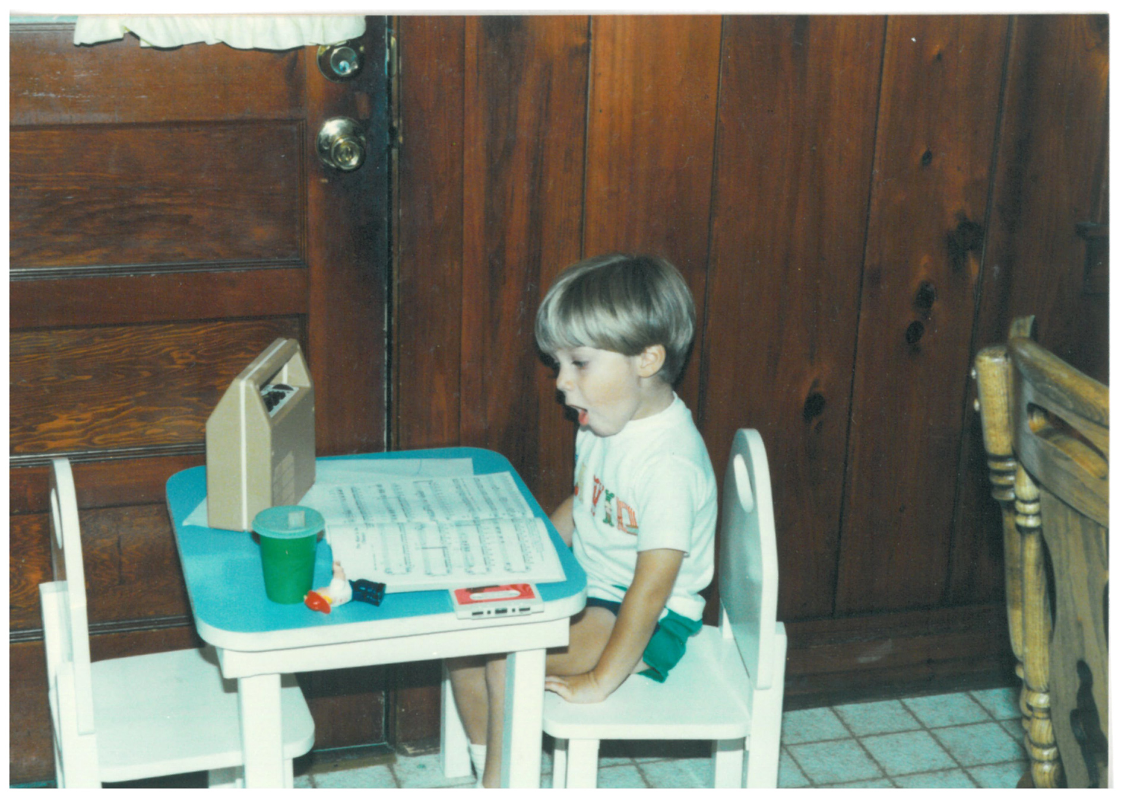

Slide 12
Who knows the real you? Who can speak into your life?
NEXT STEPS

Slide 13
Who knows the real you? Who can speak into your life?
Jump into a small group
NEXT STEPS

Slide 14
Who knows the real you? Who can speak into your life?
Jump into a small group
Pure Desire, Men: davegeldart@tallgrassatthewell.church
Pure Desire, Women: jenn31@gmail.com
NEXT STEPS

Slide 15
Who knows the real you? Who can speak into your life?
Jump into a small group
Pure Desire, Men: davegeldart@tallgrassatthewell.church
Pure Desire, Women: jenn31@gmail.com
Practice ministering in your group
NEXT STEPS

Slide 16
CELEBRATING COMMUNION

