Slide 2
Community Building

Slide 3
Multi-racial and experienced unity across ethnic boundaries
Community of forgiveness and reconciliation
Famous for their hospitality to the poor and the suffering
Community committed to the sanctity of life
Upheld a sexual counterculture
FIVE UNIQUE FEATURES OF THE EARLY CHURCH (TIM KELLER)

Slide 4
⁴¹ Those who accepted his message were baptized, and about 3000 were added to their number that day. ⁴² They devoted themselves to the apostles’ teaching and to fellowship, to the breaking of bread and to prayer. ⁴³ Everyone was filled with awe at the many wonders and signs performed by the apostles. ⁴⁴ All the believers were together and had everything in common. ⁴⁵ They sold property and possessions to give to anyone who had need. ⁴⁶ Every day they continued to meet together in the temple courts. They broke bread in their homes and ate together with glad and sincere hearts, ⁴⁷ praising God and enjoying the favor of all the people. And the Lord added to their number daily those who were being saved.
ACTS 2:41-47, NIV

Slide 5
“The expression ‘continually devoting themselves’ is strong. This was not just something they did once in awhile. This group didn’t trust their leaders to the learning: the whole group felt they needed to know truth at a deep level. Happily, we have this same teaching from the apostles in our New Testament. So while we can’t go down some evenings and listen to Peter or John lecture, we can read and study their books. Understood properly, the church is a community of truth. We don’t come together based mainly on social need or affinity, but based on the great truths of God and especially his work in Jesus Christ.”
Dennis McCallum, Members of One Another

Slide 6
⁹ But you are a chosen people, a royal priesthood, a holy nation, God’s special possession, that you may declare the praises of him who called you out of darkness into his wonderful light. ¹⁰ Once you were not a people, but now you are the people of God; once you had not received mercy, but now you have received mercy.
1 PETER 2:9-11, NIV

Slide 7
⁷ The end of all things is near. Therefore be alert and of sober mind so that you may pray. ⁸ Above all, love each other deeply, because love covers over a multitude of sins. ⁹ Offer hospitality to one another without grumbling. ¹⁰ Each of you should use whatever gift you have received to serve others, as faithful stewards of God’s grace in its various forms.
1 PETER 4:7-10, NIV

Slide 8
“American Christians sense an awful vacuum in western Christianity, but are frankly confused on what to do about it. Spirituality and devotional books fly of the shelves (and many are quite good), but as we read the contemporary literature on how to fix your ailing Christian walk, and compare it with the New Testament, one big difference comes across again and again: The body of Christ. Even when contemporary writers mention the people of God as part of the solution, their discussions often become vague at that point. Many people today frankly wonder what this part means.”
Dennis McCallum, Members of One Another

Slide 9
“In the New Testament, the context and content for every book is the same—the close community of God’s people. These are all communities, rather like the one in Jerusalem we just considered. We never see a version of Christianity in the New Testament that envisions the individual with his or her God. It’s always, always, always the people of God growing together at a deep level. Without this, much of the content of the New Testament simply makes no sense.”
Dennis McCallum, Members of One Another

Slide 10
Love one another—Jn 13:34-35; 15:12, 17; Rom 12:10; 13:8; 14:13; 1 Thess 3:12; 4:9; 2 Thess 1:3; 1 Pet 1:22; 1 Jn 3:11, 23; 4:7, 11-12; 2 Jn 1:5
Serve one another—Gal 5:13, 22; Phil 2:3; 1 Pet 4:9; 5:5
Accept one another—Rom 15:7, 14
Strengthen one another—Rom 14:19
Help one another—Heb 3:13; 10:24
Encourage one another—Rom 14:19; 15:14; Col 3:16; 1 Thess 5:11; Heb 3:13; 10:24-25
Care for one another—Gal 6:2
Forgive one another—Eph 4:32; Col 3:13
Submit to one another—Eph 5:21; 1 Pet 5:5
Commit to one another—1 Jn 3:16
THE “ONE ANOTHERS”

Slide 11
Build trust with one another—1 Jn 1:7
Be devoted to one another—Rom 12:10
Be patient with one another—Eph 4:2; Col 3:13
Be interested in one another—Phil 2:4
Be accountable to one another—Eph 5:21
Confess to one another—Js 5:16
Live in harmony with one another—Rom 12:16
Do not be conceited with one another—Rom 13:10
Do not pass judgment on one another—Rom 14:13; 15:7
Do not slander one another—Js 4:11
THE “ONE ANOTHERS”

Slide 12
Instruct one another—Rom 15:14
Greet one another—Rom 16:16; 2 Cor 13:12
Admonish one another—1 Thess 5:14; Col 3:16
Spur one another toward love and good deeds—Heb 10:24
Meet with one another—Heb 10:25
Agree with one another—1 Cor 1:10
Be concerned for one another—Heb 10:24
Be humble to one another—Eph 4:2
Be compassionate to one another—Eph 4:32
Do not be consumed by one another—Gal 5:14-15
THE “ONE ANOTHERS”

Slide 13
Do not anger one another—Gal 5:26
Do not lie to one another—Col 3:9
Do not grumble against one another—Js 5:9
Give preference to one another—Rom 12:10
Be at peace with one another—Rom 12:18
Sing to one another—Eph 5:19
Be of the same mind with one another—Rom 12:16; 15:5
Comfort one another—1 Thess 4:18; 5:11
Be kind to one another—Eph 4:32
Live in peace with one another—1 Thess 5:13
Carry one another’s burdens—Gal 6:2
THE “ONE ANOTHERS”

Slide 14
⁷ The end of all things is near. Therefore be alert and of sober mind so that you may pray. ⁸ Above all, love each other deeply, because love covers over a multitude of sins. ⁹ Offer hospitality to one another without grumbling. ¹⁰ Each of you should use whatever gift you have received to serve others, as faithful stewards of God’s grace in its various forms.
1 PETER 4:7-10, NIV

Slide 15
“Hospitality, because it was such a fundamental human practice, always included family, friends, and influential contacts. The distinctive Christian contribution was the emphasis on including the poor and neediest, the ones who could not return the favor. The focus did not diminish the value of hospitality to family and friends; rather, it broadened the practice so that the close relations formed by table fellowship and conversation could be extended to the most vulnerable.”
CHRISTINE POHL, MAKING ROOM

Slide 16
“The contemporary church hungers for models of a more authentic Christian life in which glimpses of the Kingdom can be seen and the promise of the Kingdom embodied.
More than words and ideas, the world needs living pictures of what a life of hospitality could look like.”
CHRISTINE POHL, MAKING ROOM

Slide 17
⁷ The end of all things is near. Therefore be alert and of sober mind so that you may pray. ⁸ Above all, love each other deeply, because love covers over a multitude of sins. ⁹ Offer hospitality to one another without grumbling. ¹⁰ Each of you should use whatever gift you have received to serve others, as faithful stewards of God’s grace in its various forms.
1 PETER 4:7-10, NIV

Slide 18
⁷ The end of all things is near. Therefore be alert and of sober mind so that you may pray. ⁸ Above all, love each other deeply, because love covers over a multitude of sins. ⁹ Offer hospitality to one another without grumbling. ¹⁰ Each of you should use whatever gift you have received to serve others, as faithful stewards of God’s grace in its various forms. ¹¹ If anyone speaks, they should do so as one who speaks the very words of God. If anyone serves, they should do so with the strength God provides, so that in all things God may be praised through Jesus Christ. To him be the glory and the power for ever and ever. Amen.
1 PETER 4:7-11, NIV

Slide 19
⁶ We have different gifts, according to the grace given to each of us. If your gift is prophesying, then prophesy in accordance with your faith; ⁷ if it is serving, then serve; if it is teaching, then teach; ⁸ if it is to encourage, then give encouragement; if it is giving, then give generously; if it is to lead, do it diligently; if it is to show mercy, do it cheerfully.
ROMANS 12:6-8, NIV

Slide 20
²⁷ Now you are the body of Christ, and each one of you is a part of it. ²⁸ And God has placed in the church first of all apostles, second prophets, third teachers, then miracles, then gifts of healing, of helping, of guidance, and of different kinds of tongues. ²⁹ Are all apostles? Are all prophets? Are all teachers? Do all work miracles? ³⁰ Do all have gifts of healing? Do all speak in tongues? Do all interpret? ³¹ Now eagerly desire the greater gifts. And yet I will show you the most excellent way.
1 CORINTHIANS 12:27-31, NIV

Slide 21
¹¹ And he gave the apostles, the prophets, the evangelists, the shepherds and teachers, ¹² to equip the saints for the work of ministry, for building up the body of Christ, ^{13a} until we all attain to the unity of the faith and of the knowledge of the Son of God, to mature manhood… ^{15b} …we are to grow up in every way into him who is the head, into Christ, ¹⁶ from whom the whole body, joined and held together by every joint with which it is equipped, when each part is working properly, makes the body grow so that it builds itself up in love.
EPHESIANS 2:11-13a, 15b-16, NIV

Slide 22
God
Traditional Model
Institutional Paradigm
Clergy
Laity

Slide 23
New Testament Model
Christ (The Head)
Organic Paradigm
Leaders
(Elders)
Everybody
(Ministers)

Slide 24
What is your next step into community?
What is your next step to build community?
Who and how are you being called to love sacrificially?
Who are you being invited to offer hospitality to?
What risk can you take to discover and offer your gifts?
RESPONSE & ACTION

Slide 25
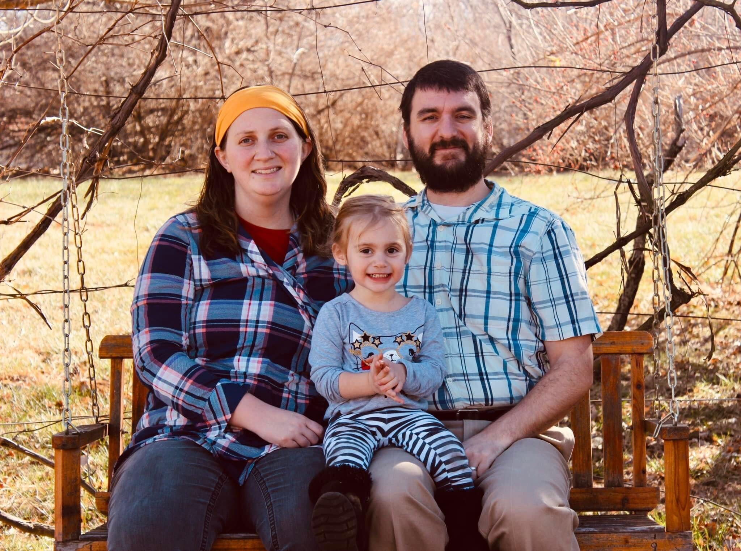
BRIDGET & JOSH MOONEY w/ ALY

Slide 26
What is your next step into community?
What is your next step to build community?
Who and how are you being called to love sacrificially?
Who are you being invited to offer hospitality to?
What risk can you take to discover and offer your gifts?
What is the Spirit saying to you?
How will you respond?
RESPONSE & ACTION & REFLECTION

