Slide 1
FAMILY WORSHIP GATHERING

Slide 10
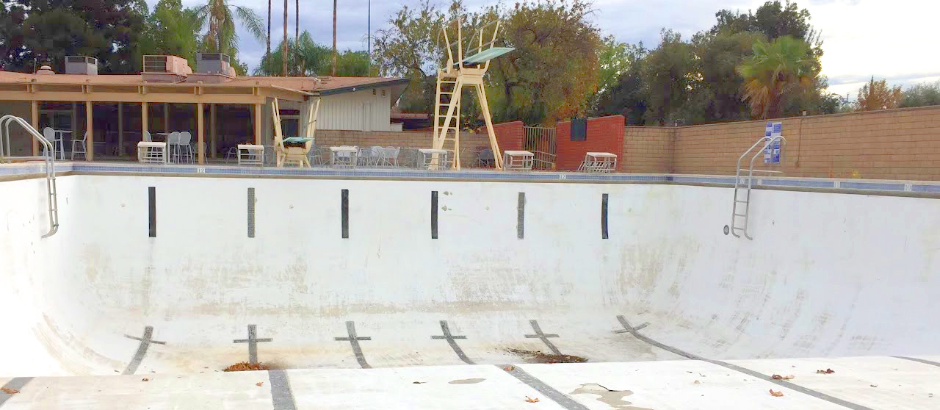

Slide 12
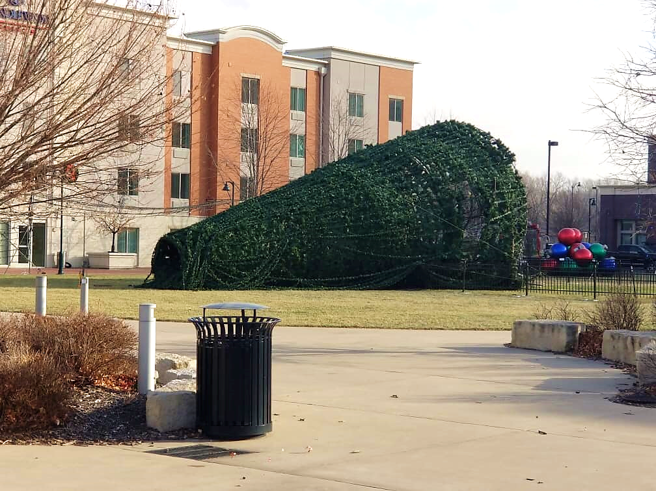

Slide 13
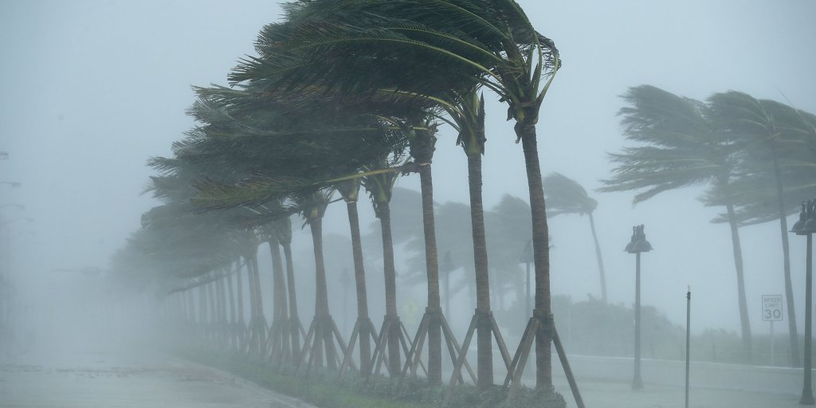

Slide 14
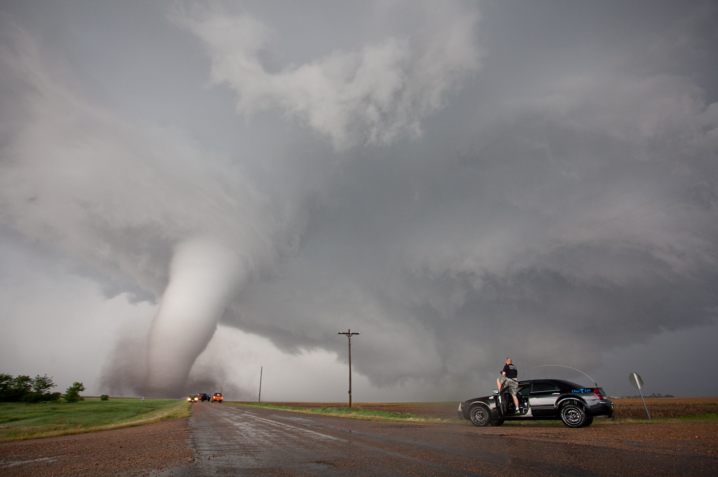

Slide 15
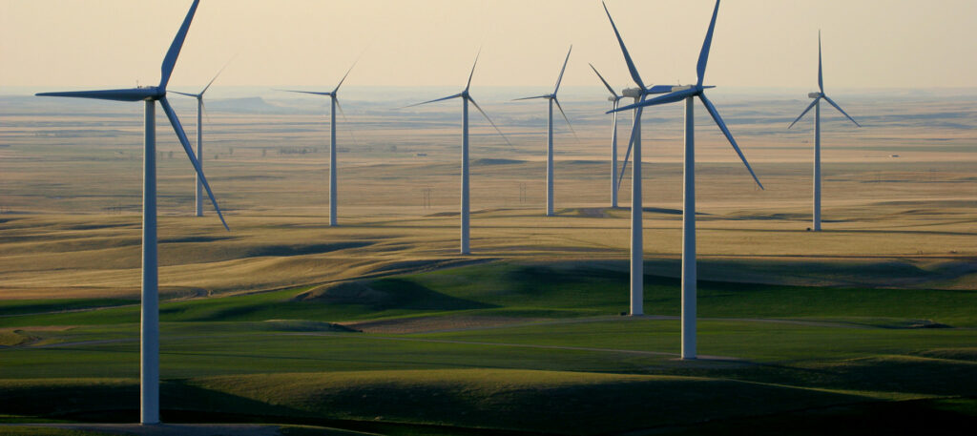

Slide 16
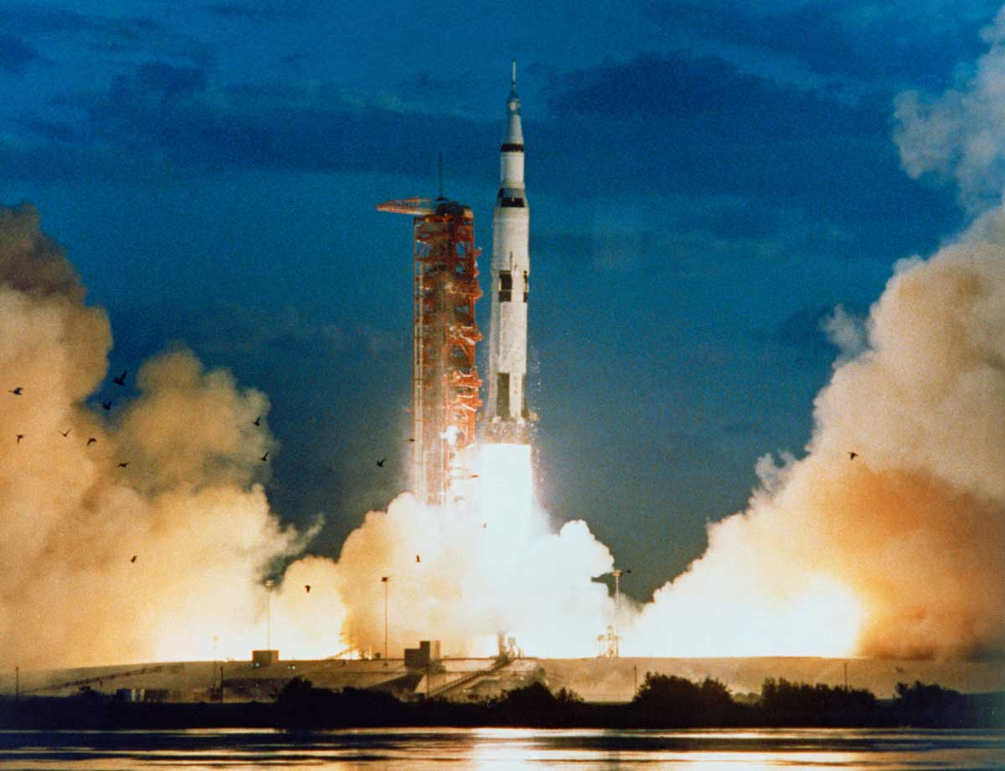

Slide 18
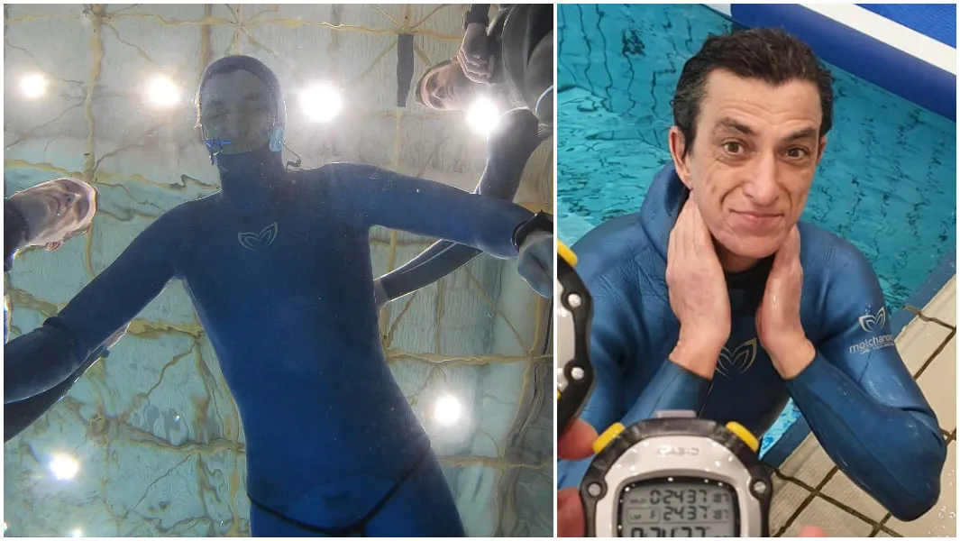

Slide 19
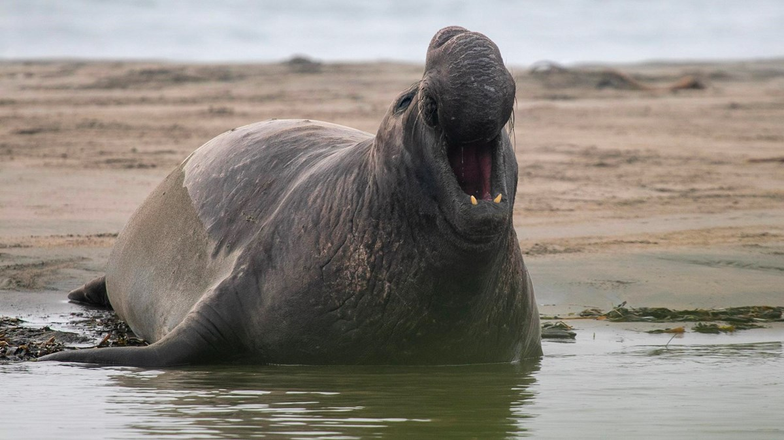

Slide 20
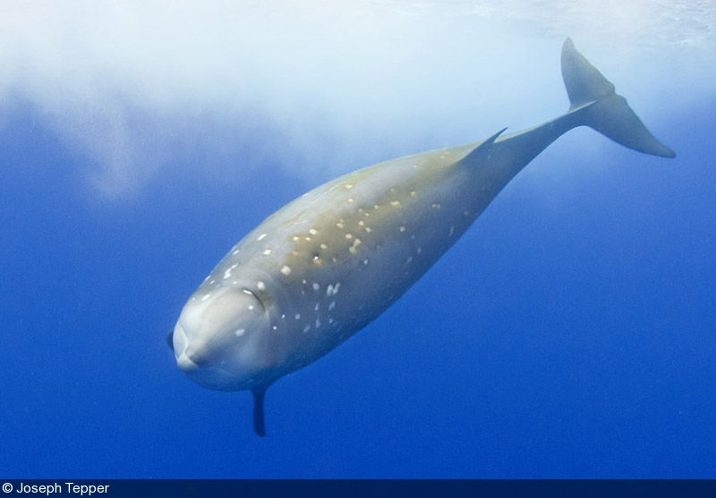

Slide 21
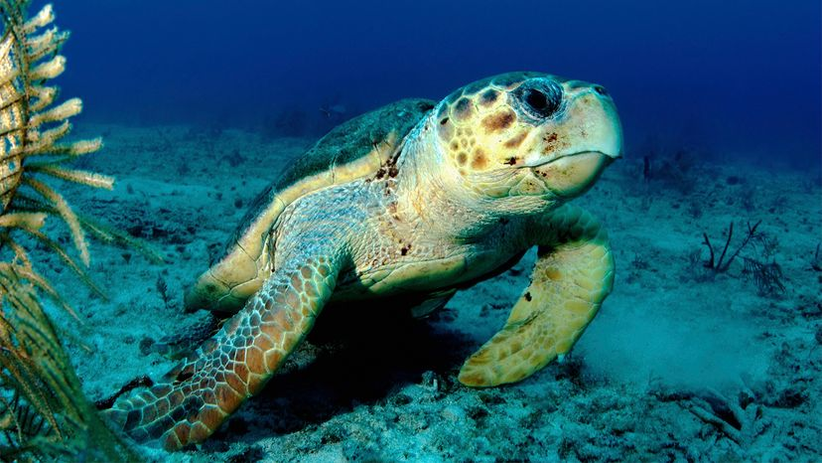

Slide 22
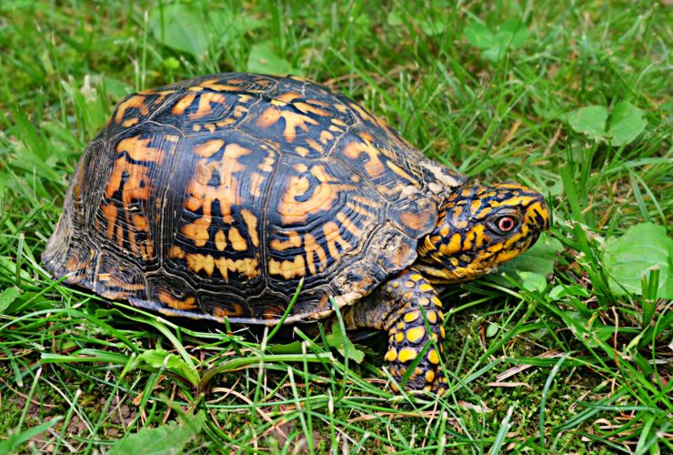

Slide 23
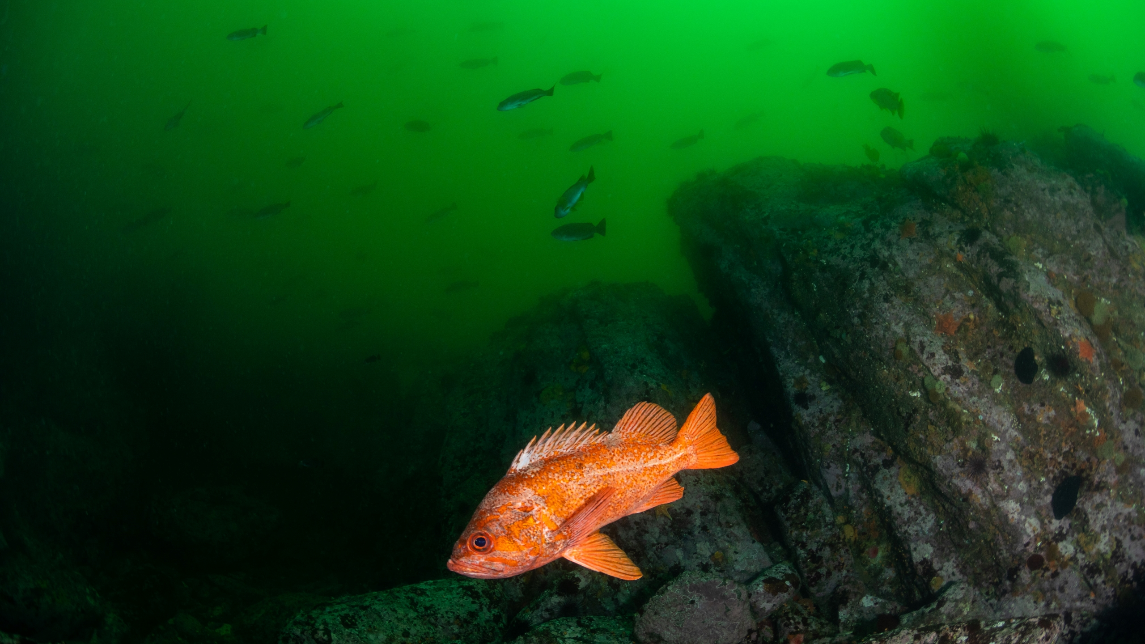

Slide 25
BREATHING IN THE SPIRIT

Slide 26
BREATHING IN THE SPIRIT

Slide 27
¹ In the beginning God created the heavens and the earth. ² Now the earth was formless and empty, darkness was over the surface of the deep, and the Spirit (RUACH) of God was hovering over the waters.
GENESIS 1:1-2 ^{NIV}

Slide 28
Then the Lord God formed a man from the dust of the ground and breathed (RUACH) into his nostrils the breath (RUACH) of life, and the man became a living being.
GENESIS 2:7 ^{NIV}

Slide 29
^{20b} After he said this, he showed them his hands and side. The disciples were overjoyed when they saw the Lord. ²¹ Again Jesus said, “Peace be with you! As the Father has sent me, I am sending you.” ²² And with that he breathed on them and said, “Receive the Holy Spirit.
JOHN 20:20-21 ^{NIV}
PNEUMA

Slide 30
² Suddenly a sound like the blowing of a violent wind came from heaven and filled the whole house where they were sitting. ³ They saw what seemed to be tongues of fire that separated and came to rest on each of them. ⁴ All of them were filled with the Holy Spirit and began to speak in other tongues as the Spirit enabled them.
ACTS 2:2-4 ^{NIV}
PNEUMA

Slide 31
And if the Spirit of him who raised Jesus from the dead is living in you, he who raised Christ from the dead will also give life to your mortal bodies because of his Spirit
who lives in you.
Romans 8:11 ^{NIV}
PNEUMA

Slide 32
The wind blows wherever it pleases. You hear its sound, but you cannot tell where it comes from or where it is going. So it is with everyone born of the Spirit.
John 3:8 ^{NIV}
PNEUMA

Slide 33
Where do you see God working these days?
Where are the pinwheels spinning?

