Slide 1
THERISENLORD

Slide 2
JOHN 20:11-13a ^{NIV}
¹¹ Now Mary stood outside the tomb crying. As she wept, she bent over to look into the tomb ¹² and saw two angels in white, seated where Jesus’ body had been, one at the head and the other at the foot.
^{13a} They asked her,
“Woman, why are you crying?”

Slide 3
JOHN 20:13b-15a ^{NIV}
^{13b} “They have taken my Lord away,” she said, “and I don’t know where they have put him.”
¹⁴ At this, she turned around & saw Jesus standing there, but she did not realize that it was Jesus.
^{15a} He asked her,
“Woman, why are you crying? Who is it you are looking for?”

Slide 4
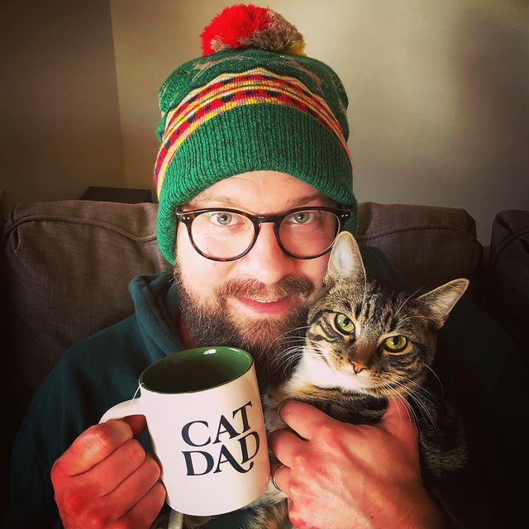

Slide 5
THERISENLORD

Slide 6
JOHN 20:15b-16a ^{NIV}
^{15b} Thinking he was the gardener, she said,
“Sir, if you have carried him away, tell me where you have put him, and I will get him.”
^{16a} Jesus said to her, “Mary.”

Slide 7
JOHN 20:15b-16 ^{NIV}
^{15b} Thinking he was the gardener, she said,
“Sir, if you have carried him away, tell me where you have put him, and I will get him.”
¹⁶ Jesus said to her, “Mary.”
She turned toward him & cried out in Aramaic,
“Rabboni!” (which means “Teacher”).

Slide 9
JOHN 20:17 ^{NIV}
Jesus said, “Do not hold on to me, for I have not yet ascended to the Father. Go instead to my brothers and tell them, ‘I am ascending to my Father and your Father, to my God and your God.’”

Slide 10
FIVE EASTER FACTS

Slide 11
FIVE EASTER FACTS
The Minimal Facts Method:
If this book is divinely inspired, Jesus is raised from the dead.
If this book ISN’T divinely inspired but is reliable, Jesus is raised from the dead.
What if this book ISN’T inspired and ISN’T reliable but is just on the level of something like Homer and Plato, just a book from that time? Jesus is STILL raised from the dead!

Slide 12
FIVE EASTER FACTS
For what I received I passed on to you as of first importance: that Christ died for our sins according to the Scriptures, that he was buried, that he was raised on the third day according to the Scriptures…
1 Corinthians 15:3-4

Slide 13
FIVE EASTER FACTS
Jesus died by crucifixion.
Jesus’ disciples believed that he rose and appeared to them.
The church persecutor Paul was suddenly changed.
The skeptic James, brother of Jesus, was suddenly changed.
The tomb was empty.

Slide 14
#1 JESUS DIED BY CRUCIFIXION

Slide 15
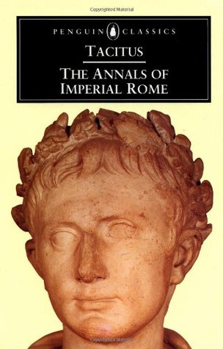
#1 JESUS DIED BY CRUCIFIXION
“Consequently, to get rid of the report, Nero fastened the guilt and inflicted the most exquisite tortures on a class hated for their abominations, called Christians by the populace. Christus, from whom the name had its origin, suffered the extreme penalty during the reign of Tiberius at the hands of one of our procurators,

Slide 16
#1 JESUS DIED BY CRUCIFIXION
Pontius Pilatus, and a most mischievous superstition, thus checked for the moment, again broke out not only in Judæa, the first source of the evil, but even in Rome, where all things hideous and shameful from every part of the world find their centre and become popular.”
Passage 15.44

Slide 17
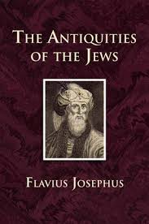
#1 JESUS DIED BY CRUCIFIXION
“About this time there lived Jesus, a wise man, if indeed one ought to call him a man. For he was one who performed surprising deeds and was a teacher of such people as accept the truth gladly. He won over many Jews and many of the Greeks. He was the Christ. And when, upon the accusation of the principal men among us, Pilate had condemned him to a cross, those who had first come to love him did not cease.

Slide 18
#1 JESUS DIED BY CRUCIFIXION
He appeared to them spending a third day restored to life, for the prophets of God had foretold these things and a thousand other marvels about him. And the
tribe of the Christians, so called
after him, has still to this day not disappeared.”
Book 18, Chapter 3, 3

Slide 19
#2 DISCIPLES BELIEVED HE ROSE

Slide 20
#2 DISCIPLES BELIEVED HE ROSE
…and that he appeared to Cephas, and then to the Twelve. After that, he appeared to more than five hundred of the brothers and sisters at the same time, most of whom are still living, though some have fallen asleep. Then he appeared to James, then to all the apostles…
1 Corinthians 15:5-7

Slide 21
#2 DISCIPLES BELIEVED HE ROSE
“Men of Israel, hear these words: Jesus of Nazareth, a man attested to you by God with mighty works and wonders and signs that God did through him in your midst, as you yourselves know—
Acts 2:22-24

Slide 22
#2 DISCIPLES BELIEVED HE ROSE
…this Jesus, delivered up according to the definite plan and foreknowledge of God, you crucified and killed by the hands of lawless men. God raised him up, loosing the pangs of death, because it was not possible for him to be held by it.” Acts 2:22-24

Slide 23
#2 DISCIPLES BELIEVED HE ROSE
For we did not follow cleverly devised myths when we made known to you the power and coming of our Lord Jesus Christ, but we were eyewitnesses of his majesty. 1 Peter 1:16

Slide 24
#3 PAUL WAS SUDDENLY CHANGED

Slide 25
#3 PAUL WAS SUDDENLY CHANGED
…and last of all he appeared to me also, as to one abnormally born. For I am the least of the apostles and do not even deserve to be called an apostle, because I persecuted the church of God.
1 Corinthians 15:8-9

Slide 26
#4 JESUS’ BROTHER WAS CHANGED

Slide 27
#4 JESUS’ BROTHER WAS CHANGED
Then he appeared to James…
1 Corinthians 15:7a

Slide 28
#4 JESUS’ BROTHER WAS CHANGED
For not even his brothers believed in him.
John 7:5
And when his family heard it, they went out to seize him, for they were saying, “He is out of his mind.”
Mark 3:21
James, a servant of God and of the Lord Jesus Christ…
James 1:1a

Slide 29
#5 THE TOMB WAS EMPTY

Slide 30
#5 THE TOMB WAS EMPTY
The Jerusalem Factor
The Principle of Enemy Attestation
The Testimony of Women (The Criterion of Embarrassment)

Slide 31
#5 THE TOMB WAS EMPTY
3. The Testimony of Women
“But let not the testimony of women be admitted, on account of the levity and boldness of their sex. Nor let servants be admitted to give testimony, on account of the ignobility of their soul; since it is probable that they may not speak truth, either out of hope of gain, or fear of punishment.” -Josephus, Antiquities of the Jews

Slide 32
#5 THE TOMB WAS EMPTY
3. The Testimony of Women
“whatever testimony a woman is unfit to give, they—for example, dice rollers and those who lend money on interest—are also unfit to give”
-Mishnah Rosh Hashanah 1:8

Slide 33
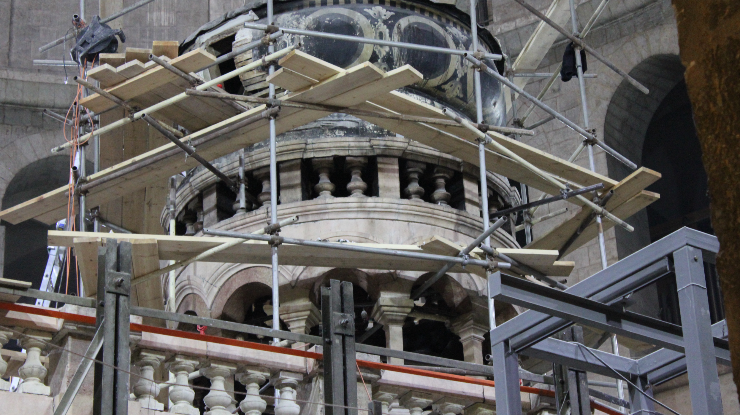

Slide 34
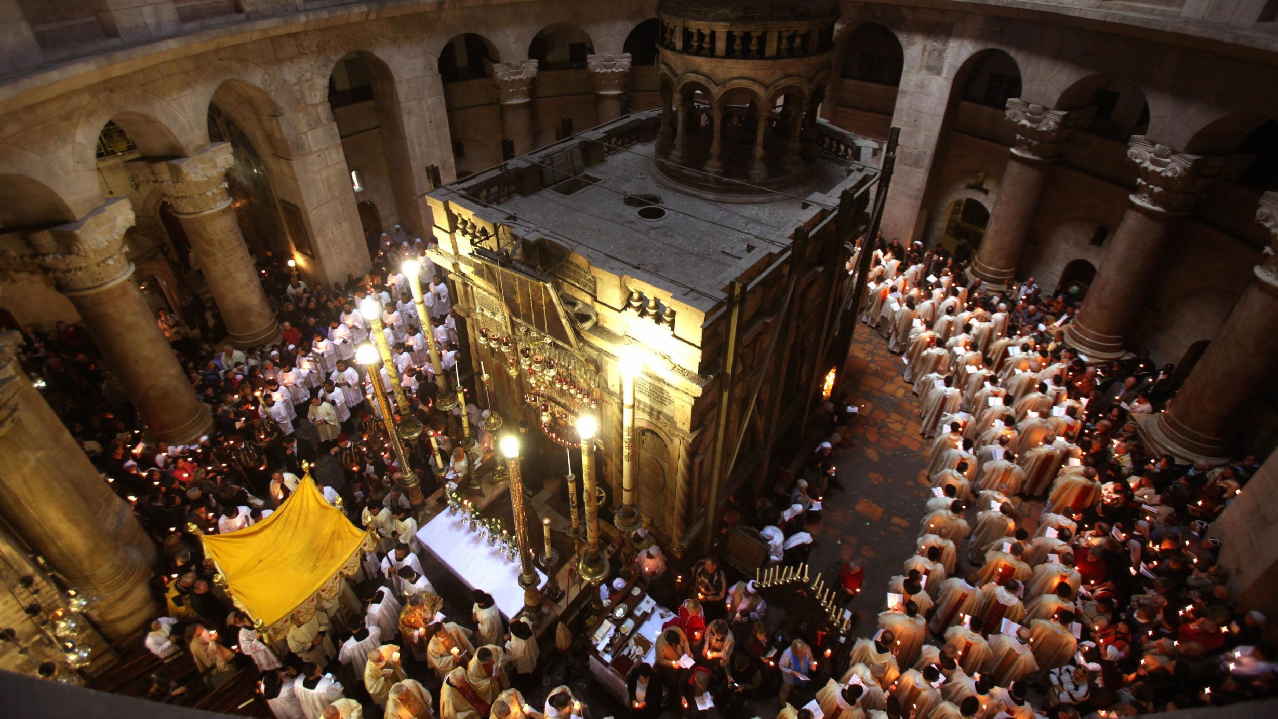

Slide 35
THE RISEN LORD!
And if Christ has not been raised, your faith is futile and you are still in your sins. Then those also who have fallen asleep in Christ have perished. If in Christ we have hope in this life only, we are of all people most to be pitied.
1 Corinthians 15:17-19

Slide 36
THE RISEN LORD!
…concerning his Son, who was descended from David according to the flesh and was declared to be the Son of God in power according to the Spirit of holiness by his resurrection from the dead, Jesus Christ our Lord…
Romans 1:3-4

Slide 37
THE RISEN LORD!
We were buried therefore with him by baptism into death, in order that, just as Christ was raised from the dead by the glory of the Father, we too might walk in newness of life.
Romans 6:4

Slide 38
THE RISEN LORD!
And God raised the Lord and will also raise us up by his power. 1 Corinthians 6:14
But our citizenship is in heaven, and from it we await a Savior, the Lord Jesus Christ, who will transform our lowly body to be like his glorious body, by the power that enables him even to subject all things to himself.
Philippians 3:20-21

Slide 39
JOHN 20:18 ^{NIV}
Mary Magdalene went to the disciples with the news: “I have seen the Lord!” And she told them that he had said these things to her.

Slide 40
JOHN 20:18 ^{NIV}
Mary Magdalene went to the disciples with the news: “I have seen the Lord!” And she told them that he had said these things to her.
“Because you have seen me, you have believed; blessed are those who have not seen and yet have believed.” John 20:29

Slide 41
BOOK OF COMMON PRAYER
Almighty God, who through your Son Jesus Christ overcame death and opened to us the gate of everlasting life: Grant that we, who celebrate with joy the day of the Lord’s resurrection, may be raised from the death of sin by your life-giving Spirit; through Jesus Christ our Lord, who lives and reigns with you and the Holy Spirit, one God, now and forever.
Amen.

Slide 42
THERISENLORD

